Slide 1
SPS RF upgrade for ultimate LHC intensity
E. Shaposhnikova
SPSU meeting, 21.01.2010
Acknowledgements: T. Bohl, E. Ciapala, T. Linnecar, E. Montesinos

Slide 2
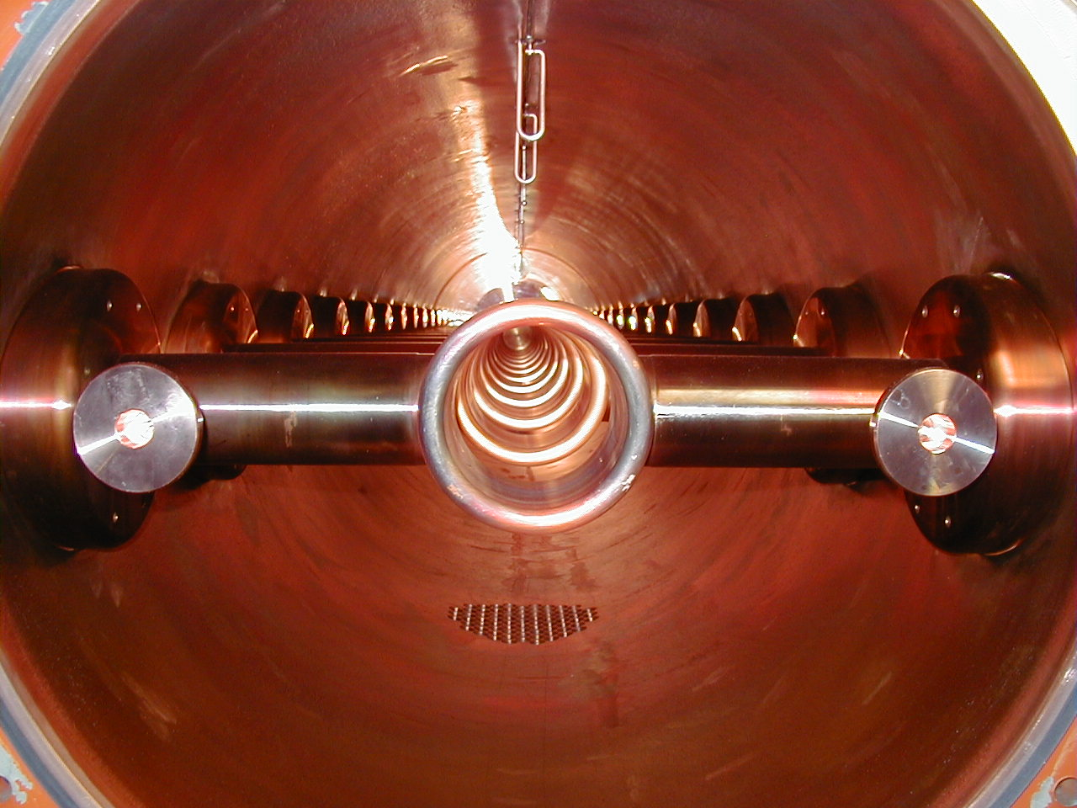
200 MHz RF system in the SPS
4 cavities:
  2 of 5 sections
  2 of 4 sections
  1 section has 11 cells
Power/cavity (Eric M.):
  700 kW for full ring
  1.4 MW for half ring
  (not tested yet)
  limited by couplers and
  feeder lines
Total voltage: 8.0 MV

Slide 3
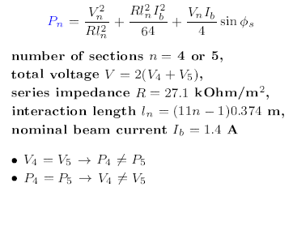
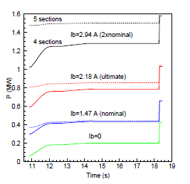
200 MHz RF system in the SPS
Power in one 200 MHz TW cavity
Power/cavity during LHC cycle
for different beam intensities
Ref. G. Dome, 1976

Slide 4
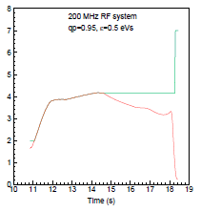
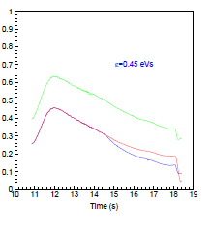
Nominal LHC cycle in the SPS
200 MHz voltage program
Beam stability (Rsh [Mohm]) through the cycle in single and double RF
+ 800 MHz
200 MHz
Voltage for acceleration of the nominal LHC beam is well below limit except FT
Flat top – transfer to 400 MHz LHC RF

Slide 5
Motivation for SPS RF upgrade
Present power limitation is still OK for acceleration of the ultimate LHC beam intensities assuming present voltage programme.
However (and this most probably will be the case) if larger longitudinal emittances are required for beam stability in the SPS or at injection to LHC the most critical area will be beam transfer to the LHC (one can slow down the acceleration in the SPS) since the voltage needed on the flat top could be above the voltage limit of 8 MV.
Two solutions are possible:
  to install the 200 MHz RF system in the LHC
  to rearrange the existing 200 MHz TW RF system in the SPS to obtain more voltage and reduce beam loading

Slide 6
Motivation for SPS RF upgrade
Present status:
  1.7 ns long bunches, long. emittance ε₁ = 0.6 eVs
  For stability at ultimate intensity
  ε₂ = (N_{ult}/N_{nom})^{1/2}
  Since bunch length ~ (ε/V^{1/2})^{1/2}
  to have the same bunch length at SPS extraction
  for ultimate beam as now one needs voltage:
  V₂/V₁ = N_{ult}/N_{nom} =1.48, V₂=1.48 V₁ = 10.3 MV

Slide 7
200 MHz RF system for higher intensities – where?
in LHC
in SPS
8 bare cavities exist plus tuners and HOM damping loops from the SW 200 MHz ; we have already a low power coupler
two identical systems (4 cavities / beam) → cost, maintenance
reduce reliability
no access during operation
partial solution: beam still needs to be transferred to the 400 MHz RF system
increase LHC impedance
significantly (factor 4) reduce beam stability unless used with the 400 MHz RF system as a Landau cavity
need new low-level beam control
rearrange existing 4 cavities into 5 or 6 cavities of shorter length with 1 or 2 extra power plants to
  reduce beam loading per cavity
  increase available voltage
  (good for transfer to LHC)
  reduce beam coupling impedance
  accessible on the surface
necessary first step for further intensity increase in the SPS (with PS2 as injector)

Slide 8
200 MHz RF system for higher intensities – when and how much?
in LHC
in SPS
If work starts after it is proved to be needed -> RF system will be ready in 4-6 years - too late?
if work on prototype starts in 2010, results in 2-3 years -> series ready in 2014-2016
Cost: 8 (450 kW) power plants plus infrastructure
Work can start now – it will be useful in any case
Upgrade is completed in 3-4 years:
  more reliable operation for high intensity beams in the SPS (both LHC and CNGS)
  not required before 2016
  (linac4 – 2014/2015)
Cost: 1 or two power plants
(1 MW) plus feeder lines

Slide 9
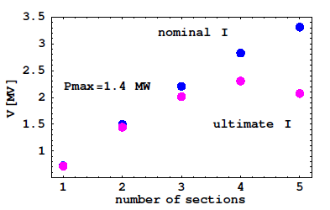
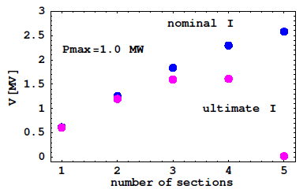
Voltage for given maximum power/cavity as a function of beam intensity
Two 5-section cavities become less efficient at ultimate LHC current for power limit of 1.4 MW/cavity and “useless” for 1 MW/cavity (pulsed mode, not tested)
More voltage can be obtained by rearranging existing 4 cavities with 18 sections into 5 (3x4+2x3 = 18) or 6 (2x4+2x3+2x2) cavities
Total power increased correspondingly by 25% or 50% (5 or 6 cavities)

Slide 10
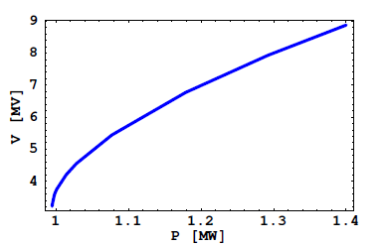
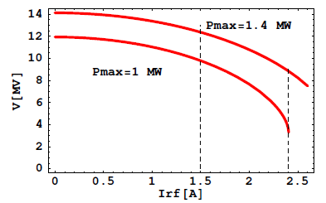
Voltage available on FT now as a function of beam current or power limit

Slide 11
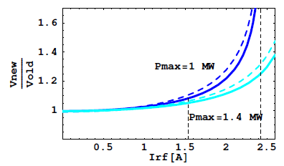
Gain in 200 MHz voltage at 450 GeV/c due to possible RF system modification
LHC beam: 288 bunches at 25 ns
1.5 A - RF current for nominal LHC (+10%)
2.4 A – RF current for ultimate LHC (+10%)
- - - - - - 2x4 & 2x3 & 2x2
3x4 & 2x3

Slide 12
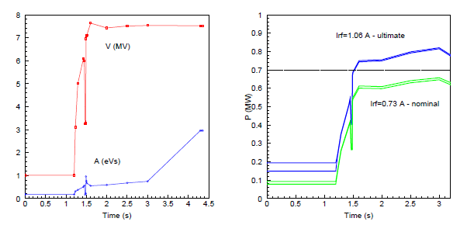
FT/CNGS acceleration cycle (1/2)
Voltage and bucket area
Power/cavity
limit
7x10¹³
limit
4.8x10¹³
High voltage is required for fast acceleration (3 s!) and due to emittance blow-up during transition crossing

Slide 13
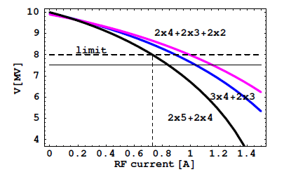
FT/CNGS acceleration cycle (2/2)
Limitation for voltage required for (max) acceleration with Pmax=0.7 MW
4200 bunches spaced by 5 ns
0.73 A - RF current for N = 4.8 10¹³ (nominal CNGS)
Presently 7.5 MV used after transition crossing
Reduction of longitudinal emittance blow-up during transition crossing is expected from improved beam control (beam loading) → more gain in current for lower fixed voltage or in voltage for given (higher) current

Slide 14
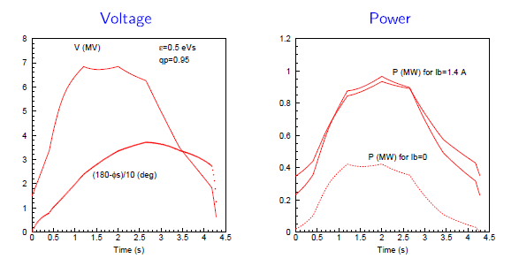
Fast LHC cycle
Used in operation for pilot beam in 2009
17% reduction in LHC filling time for nominal beam
Limited by voltage during acceleration for large (> 0.6eVs) emittances
→ Similar gain as for CNGS/FT cycle

Slide 15
Impedance reduction
Total impedance of the 200 MHz TW RF system
Z= R/8 ∑L_{n}² =RL²/8 ∑ (n-1/11)²
R=27.1 kOhm/m²,
n - number of sections/cavity (2,3,4 or 5), ∑ n =18
L_{n}=L (n-1/11), L=11x0.374 m, RL²/8=57.3 kOhm
2x5 & 2x4: Z = 4.52 MOhm - now
(1) 2x3 & 3x4: Z = 3.6 MOhm – 20% less
(2) 2x2 & 2x3 & 2x4: Z = 3.14 MOhm – 30% less than now
(2) is also the best option for beam control (feedback) with large bandwidth amplifier

Slide 16
Possible solutions in the SPS
Present SPS power systems (32 Philips and 8 Siemens tubes/line) have at least ~10 years more lifetime, we have an important storage
Large (800 kW) Diacrode power amplifiers could be available in 2-3 years (full test stand area)
``Small” (150 kW) Tetrode existed for TV transmission → 8 tubes per transmitter
Space: 1 or 2 cavities in Point 5 in addition to 4 shorter cavities in P3 (now)
2 power plants (2 feeder lines) per cavity for PS2 intensities (1 power plant and feeder line now and for ultimate LHC intensity)

Slide 17
Conclusions
Transfer of the ultimate LHC beam from the SPS 200 MHz RF system to the LHC 400 MHz RF system will be improved by higher voltage at SPS extraction.
This solution has certain advantages over the installation of the capture system in the LHC.
The present 200 MHz TW RF system consists of 5- and 4-section cavities. 5-section cavities become less efficient at ultimate LHC current.
Modification of cavities will allow more voltage for given current or more beam current for fixed voltage. Gain depends on real peak power limitation (to be tested in pulsed mode).
The advantages of the option with 6 cavities as compared to 5 cavities seem to be not sufficient to justify twice higher cost of power needed.

