Slide 1
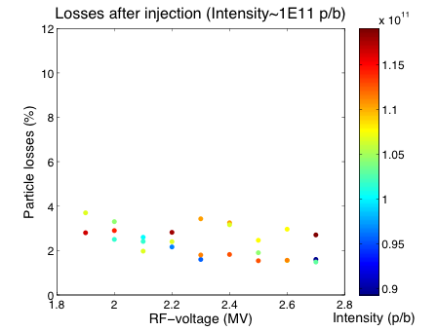
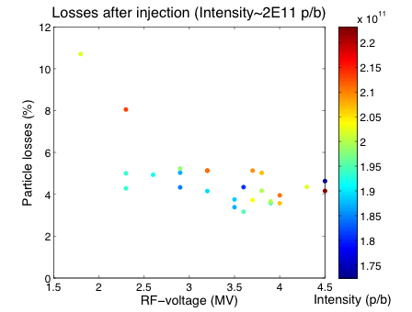
MD on MD1 cycle, 20.Nov
Scan of RF-voltage for different intensities
  Qx=20.13, Qy=20.18, ξ_{x}~0.2, ξ_{y}~0.03 (chromaticities not measured)
Improving losses after injection with increasing RF-voltage
  Small effect for intensity around 1E11 p/b: 2-4% losses
  Losses around 4% for RF-voltage above 2.5 MV for 2E11, but increased loses for lower voltages
  No clear dependence on RF-voltage in both cases – maybe due to longitudinal phase space distribution coming from the PS (optimization for high intensities may be needed)

Slide 2
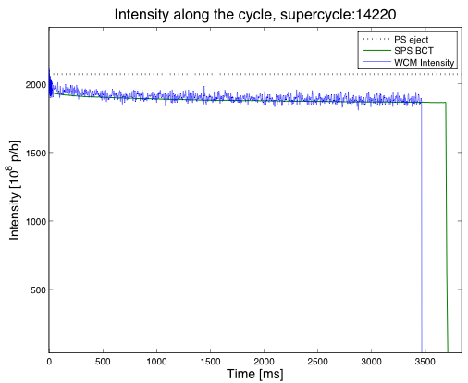
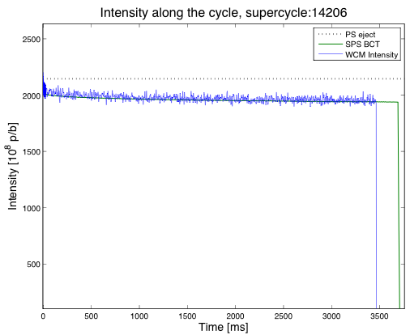
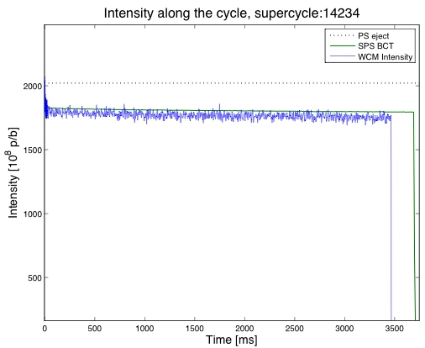
MD1, 20.Nov: 2E11 p/b from PS
RF-voltage: 1.8 MV
RF-voltage: 3.2 MV
RF-voltage: 3.8 MV
Immediate losses with 1.8 MV (~10%)
Reduced losses within first 20 ms after injection for RF-voltage above 2.5 MV (~4%)
  Slow losses within 1.5 s
  Total losses seem to increase again with higher voltage
Why? Maybe crossing of resonances due to increased space charge forces arising from shorter bunch length…

