Slide 1
MDs for 2011
SPSU SG meeting
16 December 2010

Slide 2
Proposed MD studies/requests for 2011
re-establish low-loss nominal 25 ns beam, reference measurements for e-cloud (scrubbing?)
- 1st MD of 16 hours minimum (4h OP + 8h RF + 4h)
- Note, 75 ns and 50 ns nominal beams will be operational before 1st MD
limitations with “above nominal” intensity beams, increase of intensity in steps with time for optimisation
probably 50 ns first and then 25 ns beam
– each MD block, 12 hours minimum
transverse emittance preservation:
accurate and systematic measurements during each MD
minimisation of blow-up
origin if blow-up unavoidable
impedance identification (transverse + HOM longitudinal)
transverse – parallel MDs
longitudinal - with 75 ns, 50 ns and 25 ns beam of variable (low) intensity
TMCI – single bunch - parallel MDs
threshold in a double RF system
multi-bunch stability
double RF system (stability and emittance blow-up) – nominal LHC beam

Slide 3
Proposed MD studies/requests for 2011
Low gamma transition - most urgent studies
optics studies - parallel MDs
acceleration of nominal LHC beams late - long dedicated MD session(s)
study minimum longitudinal emittance/bunch length at 450 GeV/c sufficient for beam stability

Slide 4
RF issues for low γ_{t}
Successful MDs with a single bunch (H. Bartosik, Y. Papaphilippou et al.): γ_{t}=22.8 → 18, η increase 2.86 (26 GeV/c) to 1.6 (450 GeV/c)
Expected increase in beam stability for the same bunch parameters N_{th}~ η for both TMCI (observed!) and longitudinal instabilities
To have the same longitudinal parameters (bucket area) V ~ η → can be a problem for extraction to LHC of the same longitudinal emittance as now (now 4σ bunch length limit is 1.7 ns)
But emittance blow-up for the same stability in the SPS can be reduced: for loss of Landau damping N_{th}~ ε² η τ. Since τ ~ (ε² η/V)^{1/4}
→ ε ~ η^{-1/2} and τ = const for V=const.
If LHC itself needs higher longitudinal emittance at injection (IBS, stability) → 200 MHz RF system in LHC?
Fast cycles are not possible (3 s or 4.2 s acceleration time)
Space charge limit, e-cloud - ?

Slide 5
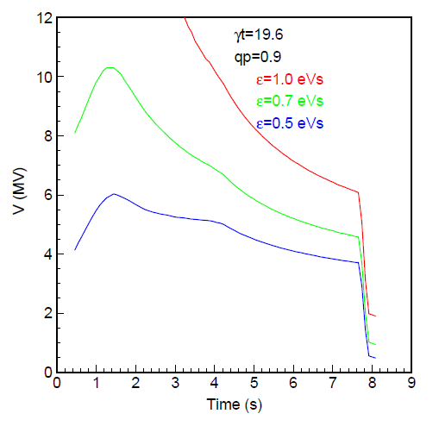
Voltage
γ_{t} = 19.6
γ_{t} = 22.8

Slide 6
Loss of Landau damping single 200 MHZ RF system
γ_{t}=22.8
γ_{t}=19.6

