Slide 1
SPS E-Cloud Transmission Experiment BA5

Slide 2
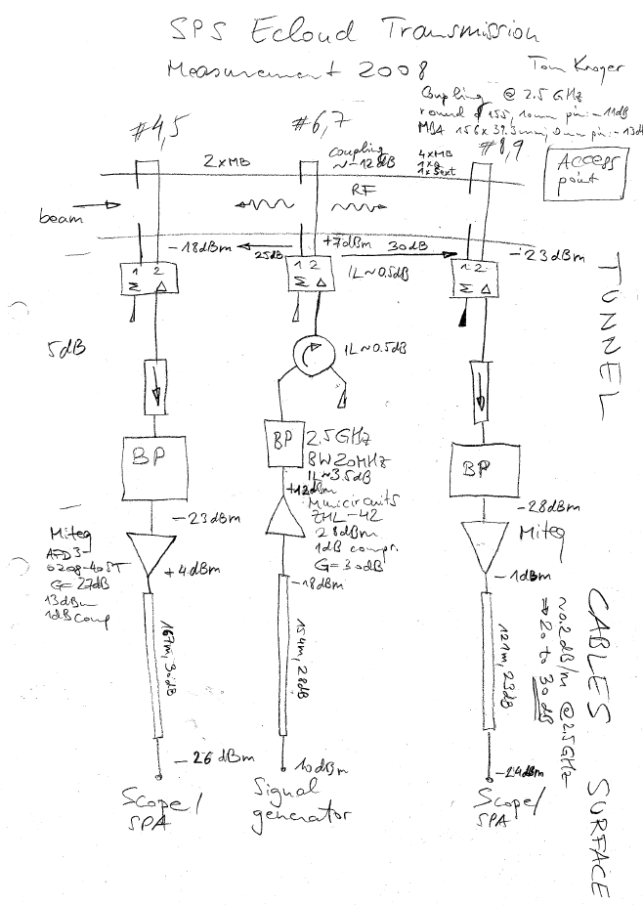
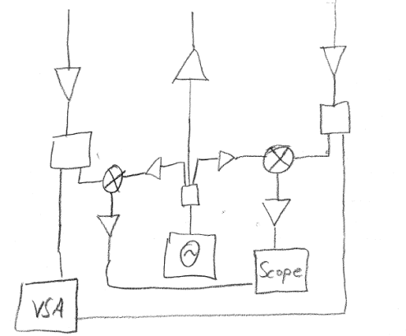
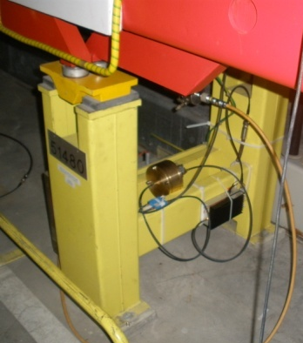
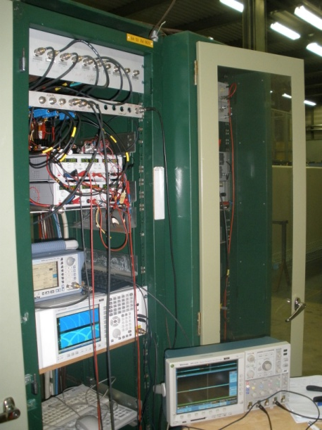
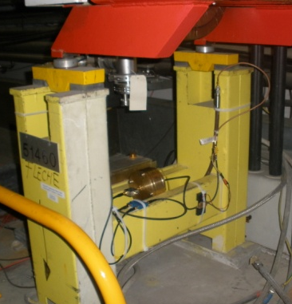
Experimental Setup
Surface Setup
Tunnel

Slide 3
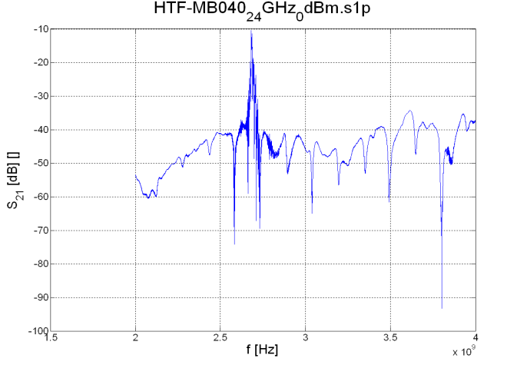
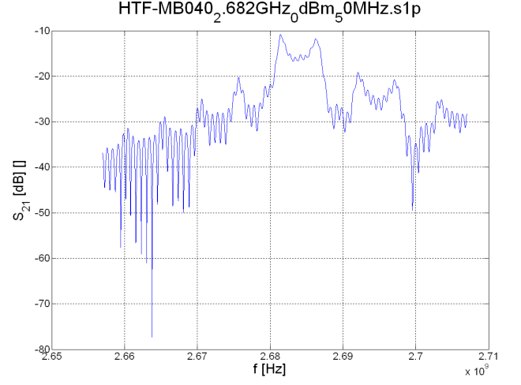
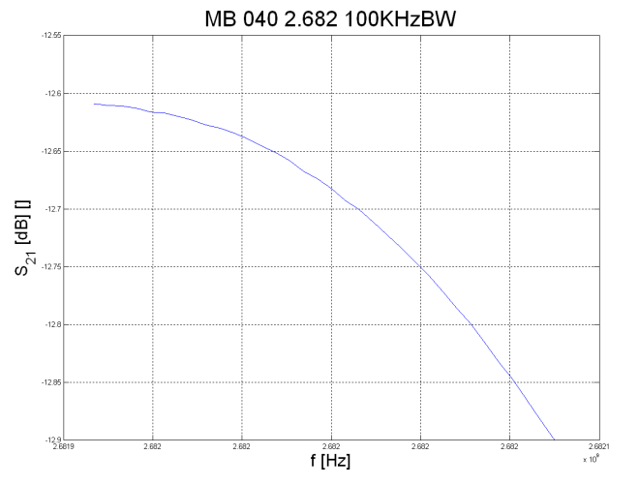
Hardware Transfer Function MB040
Transmission around 2.682 GHz
Slight slope within a span of 100KHz, will probably cause PM-AM conversion

Slide 4
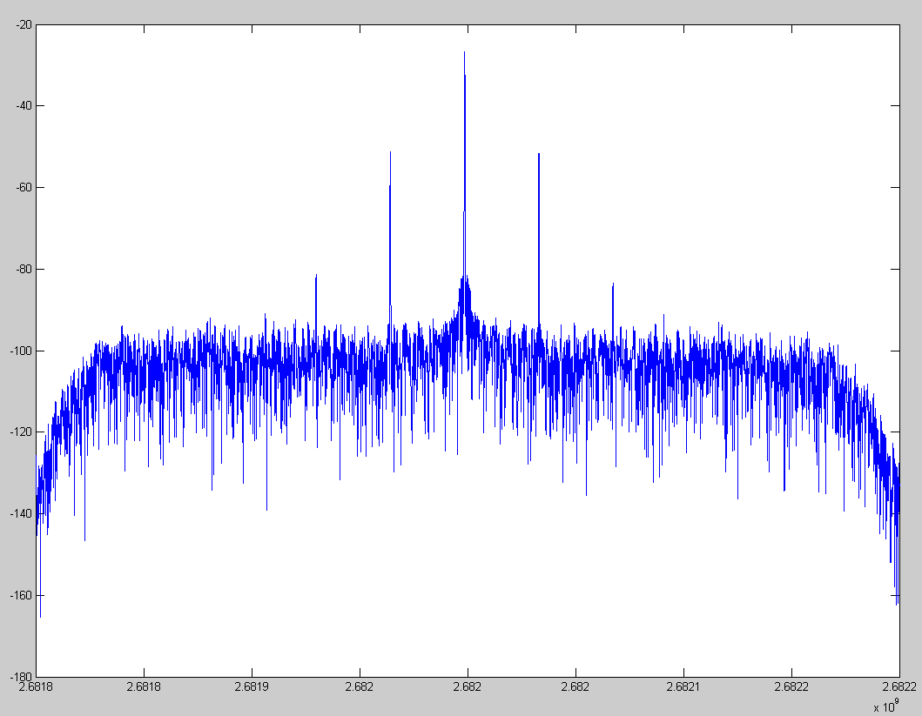
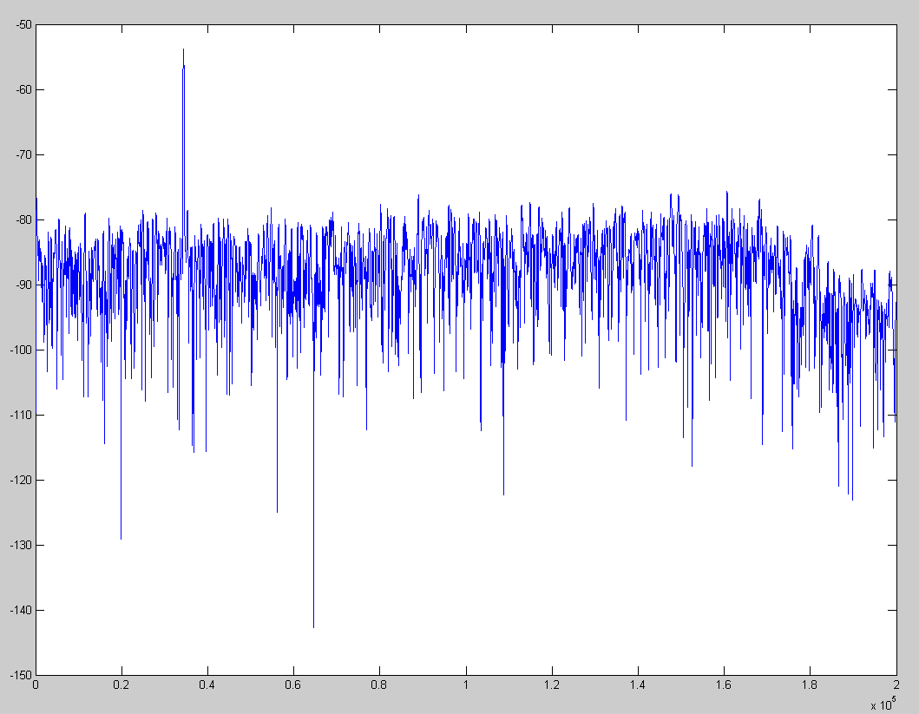
Preliminary Measurement of PM-AM Conversion
Spectrum
Different amplitudes of sidebands
AM demodulation shows AM presence, which is partly to residual AM of the signal generator
-51.31 dB
-51.61dB
AM Demodulation

Slide 5
Output Mixers
The figure shows the output of the mixers digital low-pass filtered with 200Hz to show that we already are able to measure something with the setup

