Slide 1
Progress report on coatings for SPS-U
Status of liner coatings
Testing programme
Proposal for installation
Status of SPS dipoles coating bench
S.Calatroni, P.Chiggiato, P.Costa Pinto, M.Taborelli, I.Wevers,
C.Yin Vallgren, H.Pedroso-Marques, W. Vollenberg

Slide 2
Liner status – lab testing
SPS test with liners:
  Old 2008 liner with carbon coating, exposed to air during shutdown
  Stainless steel liner for reference
  New liner with rough carbon coating (zirconium underlayer)
  A new slot is available. Proposal (to be discussed): carbon coating on getter underlayer
Sample in C-magnet:
  New sample holder being prepared

Slide 3
Work is in progress, we have to understand some issues related to a-C layer uniformity and coating temperature

Slide 4
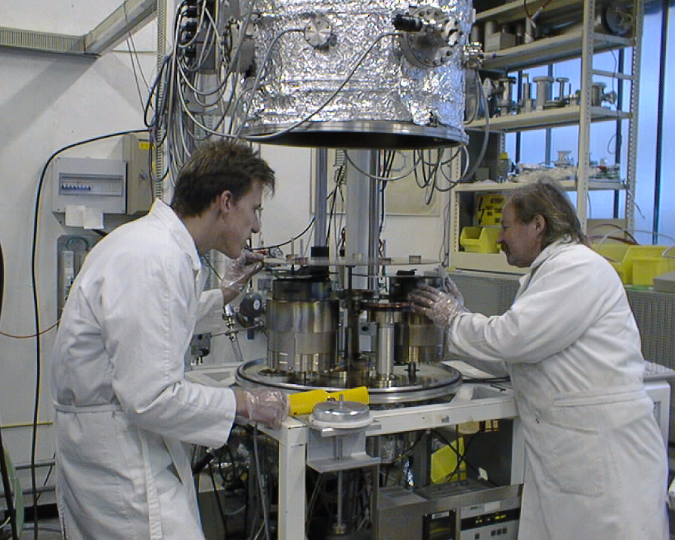
Test on dual magnetron system, bldg 101
samples
C source
Ti source

Slide 5
Ageing with Ti underlayer (getter for H₂)
7 weeks in air
standard
3 weeks in air
4 days in air
Ti underlayer
Continuous Ti underlayer

Slide 6
Proposal for 4th liner
Produce a NEG TiZrV underlayer on a liner
Assemble it in C coating system, activate NEG to pump H₂ and perform standard carbon coating
Test samples in parallel

Slide 7
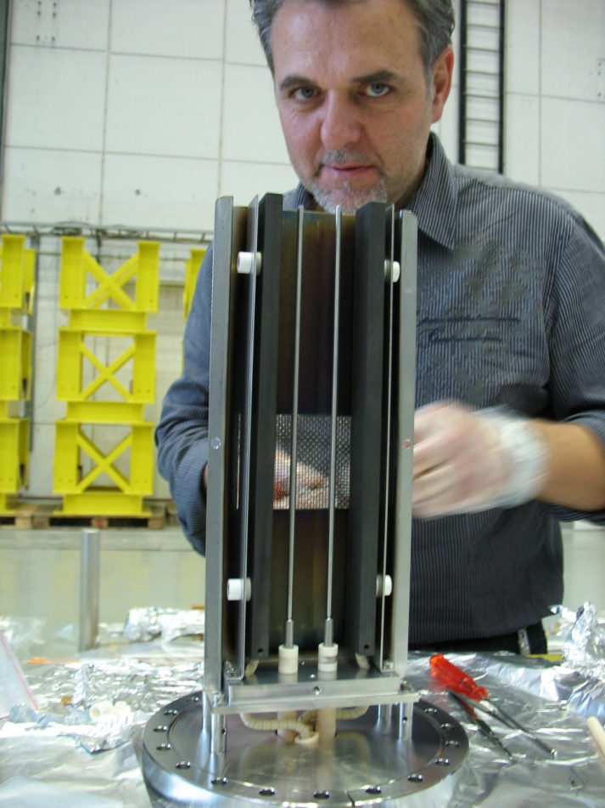
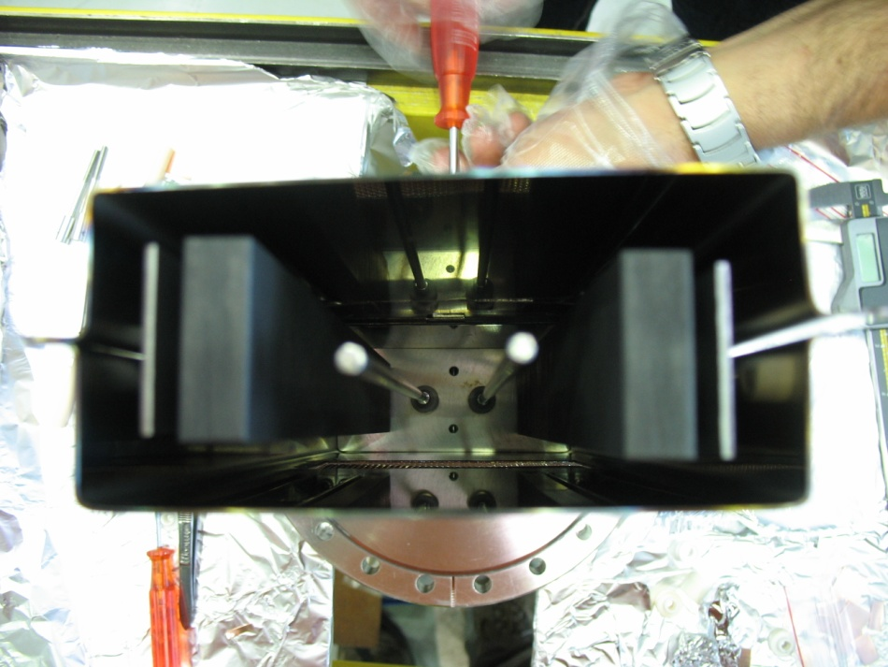
MBB prototype test
MBB cross section;
L=300mm;
2 rectangular carbon cathodes;
Tested in LSS solenoids (B=190 Gauss)
B field

Slide 8
MBB prototype test
MBB cross section; L=300mm;
2 rectangular carbon cathodes;
Tested in LSS solenoids (B=190 Gauss)

Slide 9
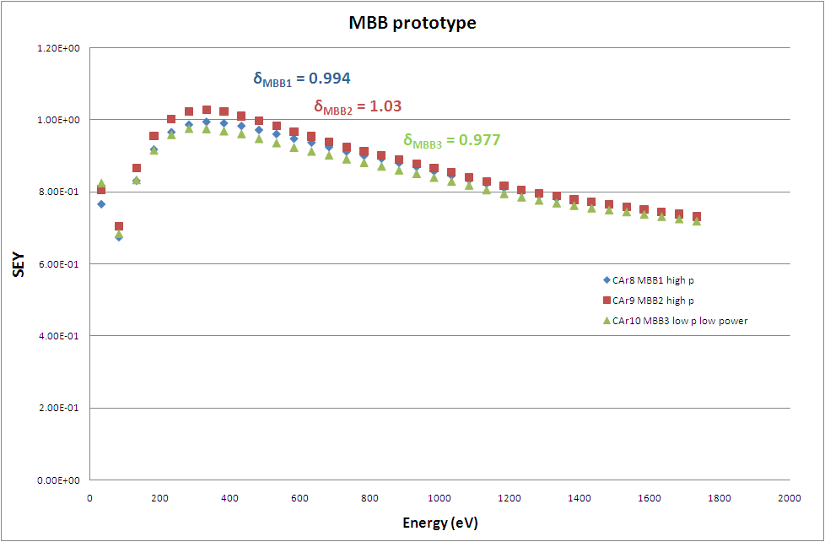

Slide 10
Cross section of the liner
L2
L1
Mid
R1
R2
630 nm
960 nm
Saved for aging
Sent to SEM for thickness measurement
 | δ_{initial} onStSt | L1 | L2 | Mid
CAr9 – MBB2 | 1.03 | 1.03 | 1.03 | 1.06
CAr10 – MBB3 | 0.977 | 0.999 | 0.998 | 0.997
CNe31 – MBB4 | 1.03
After 39 days in air: 1.07

Slide 11
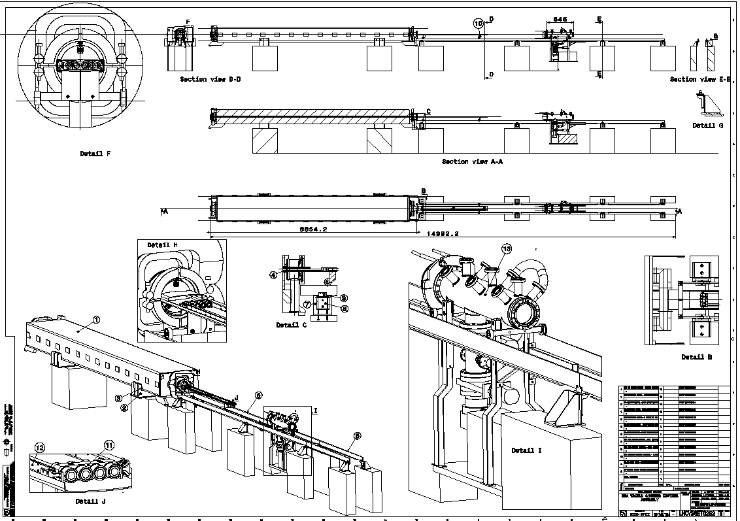
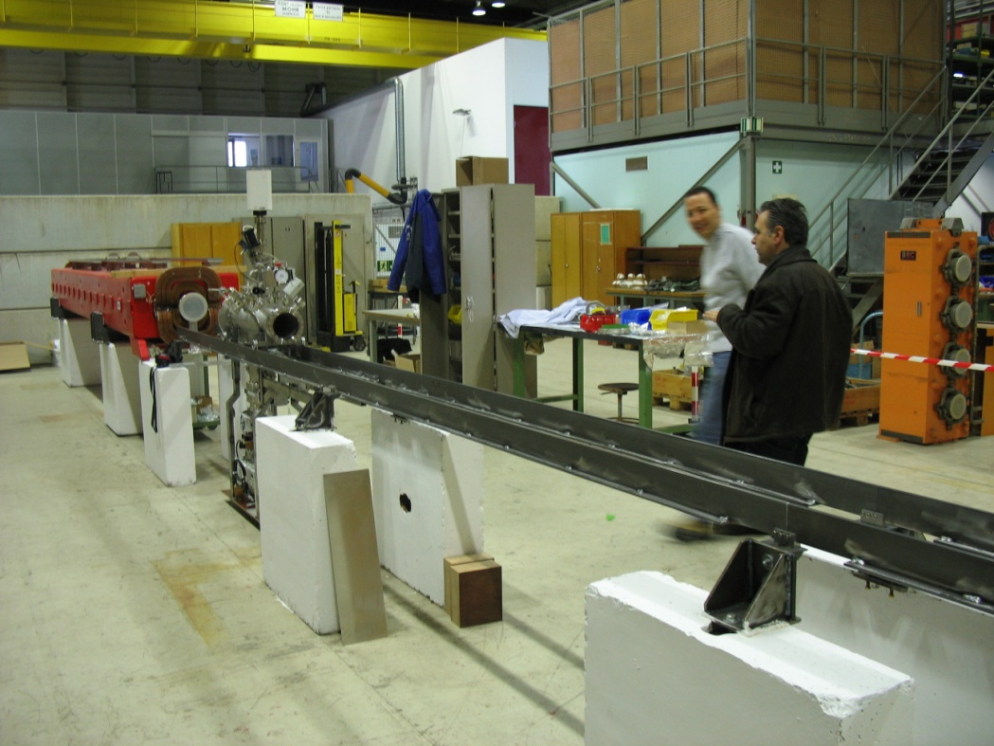

Slide 12
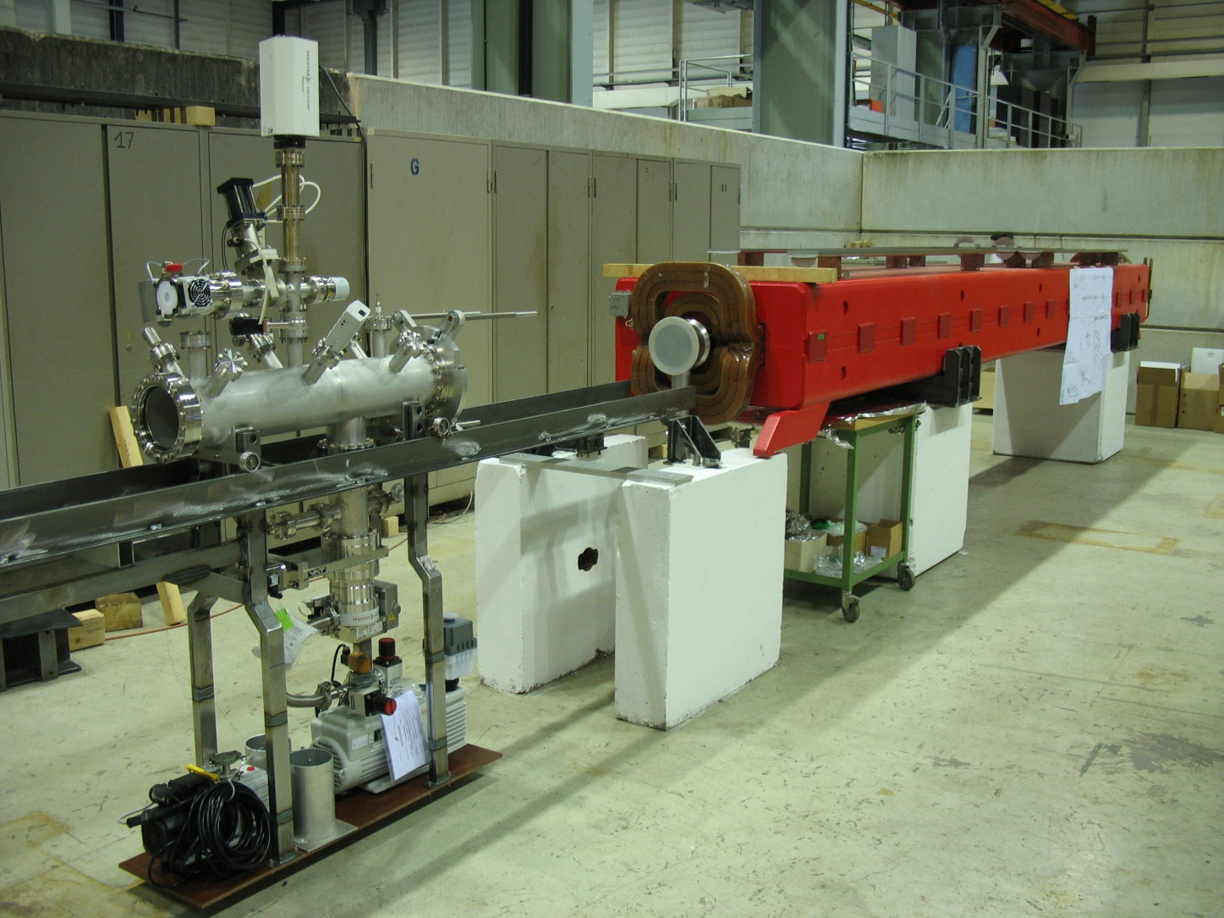
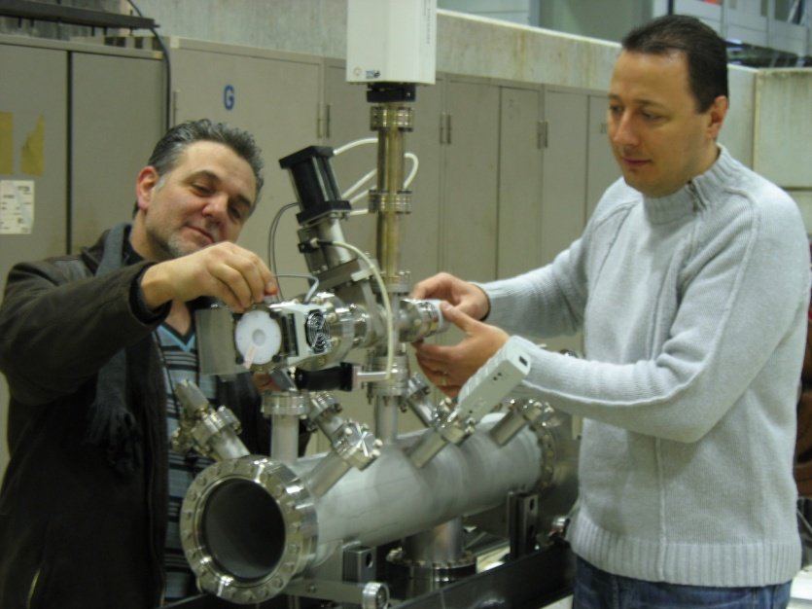
MBB coating bench in bldg. 867

Slide 13
