Slide 1
Coating of the SPS Main Dipoles Vacuum Chambers: Resources Needed for Project
Hypothesis of work
Strategies
Layouts of Underground Workshops
Strategies in 3 or 4 years
Estimates
3 Years Strategy
4 Years Strategy
Conclusion and Next Steps

Slide 2
Hypothesis of Work
Coating process
→ Vacuum chambers: no disassembly of vacuum chambers from the magnets to perform the coating (process would take 100 hours x 3 pers. / magnet, so 223,000 hours @ 60 CHF/hour)
→ Time of coating process: 48 hours, including installation of equipment, vacuum pumping, coating and dismantling of equipment 4 days, including cleaning (1 day), installation of equipment - vacuum pumping (1/2 day), coating (2 days) and dismantling of equipment (1/2 day)
→ Position of magnet during process: horizontal
Magnets treated
→ Only SPS main dipoles ≈ 5 km of vacuum chambers (>70 % of SPS vacuum system length)
Time
→ Duration of shutdown period: 14 weeks of access in the machine, 10 weeks of effective work + start-up and end phases and safety margin
Ressources
→ Equipment: use of existing vehicles for transport (2 Dumont handling machines + trailers), possibly with some adaptations (No new vehicule)
→ Manpower: work done mainly during normal working hours, 5 days/week

Slide 3
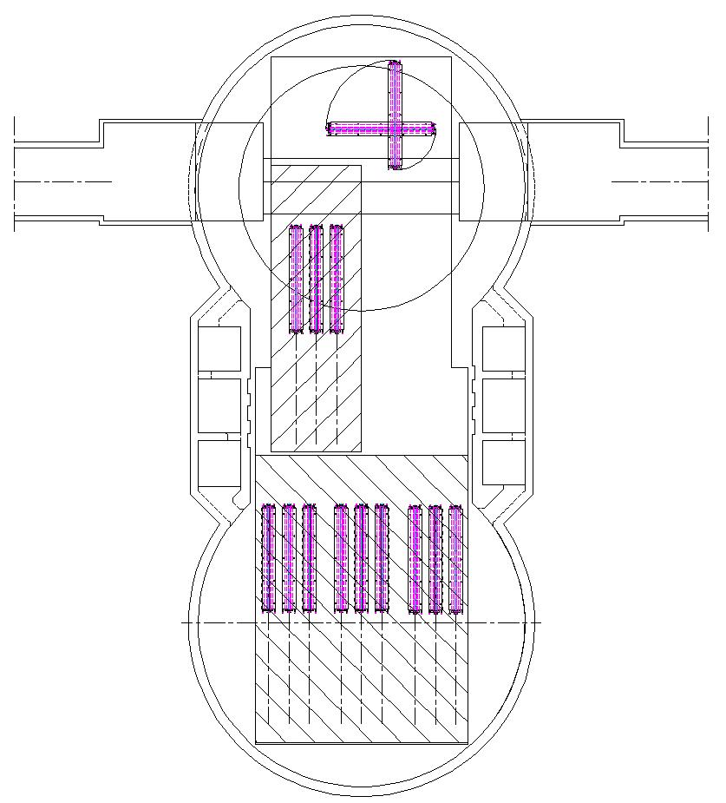
Layouts of Underground Worshop
Underground Workshop ECX5 + 100 m2 floor ECA5
Underground Workshop ECX5 + 300 m2 concrete screed ECA5
Capacity of workshop: 16 magnets
Capacity of workshop: 24 magnets

Slide 4
Strategies
Project in 3 years
→ Cadency: 6 magnets / day (8h / day)
→ Startup phase: preparation of 300 m2 concrete screed and painting in ECA5 ≈ 3 weeks (15 days)
→ Total number of days of work:
744 magnets / cadency = 124 days
124 days + 15 days = 139 days
139 days @ 50 days / shutdown ≈ 3 shutdowns
Project in 4 years
→ Cadency: 4 magnets / day (8h / day)
→ Startup phase: preparation of 100 m2 floor in ECA5 ≈ 1 weeks (5 days)
→ Total number of days of work:
744 magnets / cadency = 186 days
186 days + 5 days = 191 days
139 days @ 50 days / shutdown ≈ 4 shutdowns

Slide 5
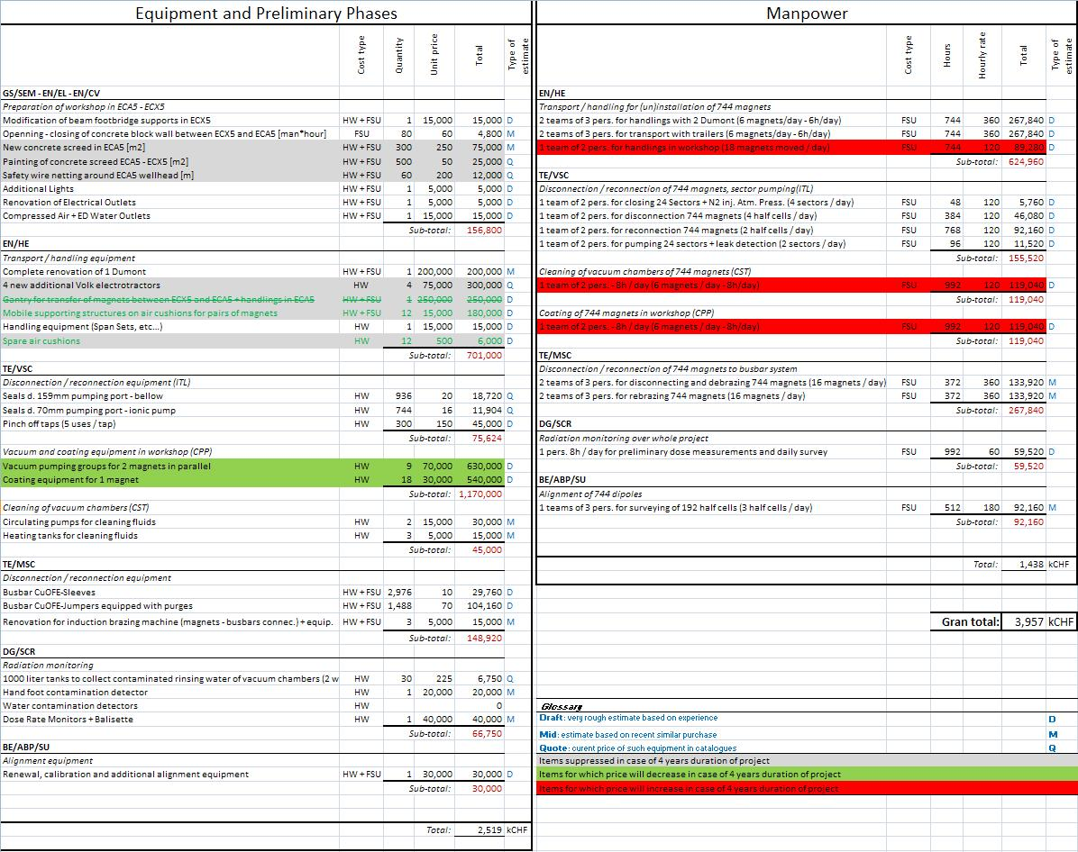
Estimate Project in 3 Years

Slide 6
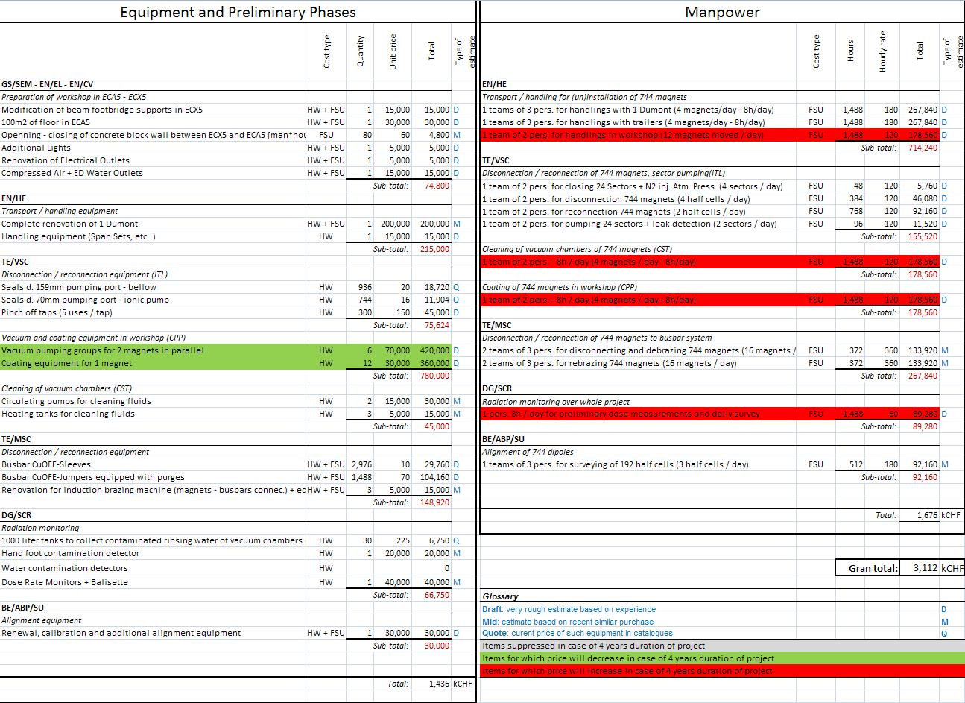
Estimate Project in 4 Years

Slide 7
Optional costs
Optional
 | Cost type | Quantity | Unit price | Total | Type of estimate
TE/VSC
Additionnal sectorisation of SPS arcs vacuum system (ITL-ICM)
New additional vacuum valves + supports | HW | 12 | 14,000 | 168,000 | M
Cabling (metres purchased - installed - connected) - avg. 500m / VV | HW + FSU | 6,000 | 10 | 60,000 | D
Control systems linked to additional VV (Pe Pi gauges, elec. Cards, TPG…) | HW | 1 | 30,000 | 30,000 | D
Vacuum chambers modification - installation VV | HW + FSU | 12 | 3,000 | 36,000 | D
 |  |  | Sub-total: | 294,000
EN/HE
Transport / handling equipment
1 new additional transport vehicle | HW | 1 | 700,000 | 700,000 | D
 |  |  | Sub-total: | 700,000
 |  |  | Total: | 994 | kCHF

Slide 8
Conclusions and Next Steps
Strategy to choose ?
→ 4 years:
- cheaper, but less space in workshop (ergonomics and safety aspects)
- Dumont vehicle more sollicitated, but second Dumont as spare in case of breakdown
→ 3 years:
- more expensive but with more space in workshop
- 2 Dumont used simultaneously with reasonable cadencies, but could require building a new vehicle (paid by this project ?)
- requires to occupy a large part of the machine → interference with other activities during shutdowns
Next steps
→ Define more precisely the process: to help defining more precisely the time, cadencies… and price of the project
→ Try to improve cleaning and coating process: improve the tooling to require less space in workshop, decrease time of coating process, comply with radiation protection safety aspects for cleaning (big quantities of contaminated rinsing water)

