Slide 1
Measurement of Electromagnetic properties of NEG coating in the microwave range
David Seebacher
Status current experience
Potential explanation of causes and effects observed
Could NEG be a very high ε dielectric in the microwave range
Microwave bench measurements done so far
Description and justification of the proposed measurement method
Expected results

Slide 2
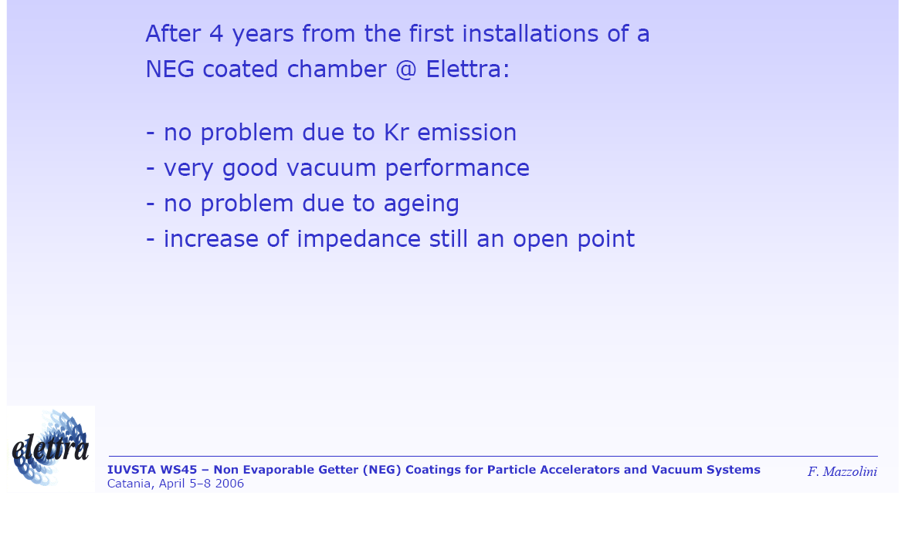
NEG Coating @ ELETTRA:
4 Years Of Experience

Slide 3
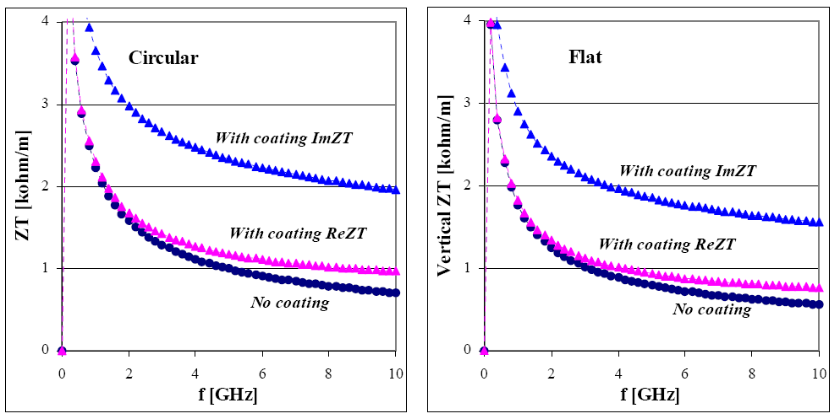
Impact of NEG Coating on the Impedance
Considerable impact on imaginary part of transverse impedance due to NEG
Impact of NEG Coating on the Impedance 11th ESLS Workshop, 17 ~ 18 November 2003,
ESRF, Grenoble
By Ryutaro Nagaoka, Synchrotron SOLEIL

Slide 4
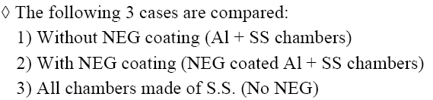
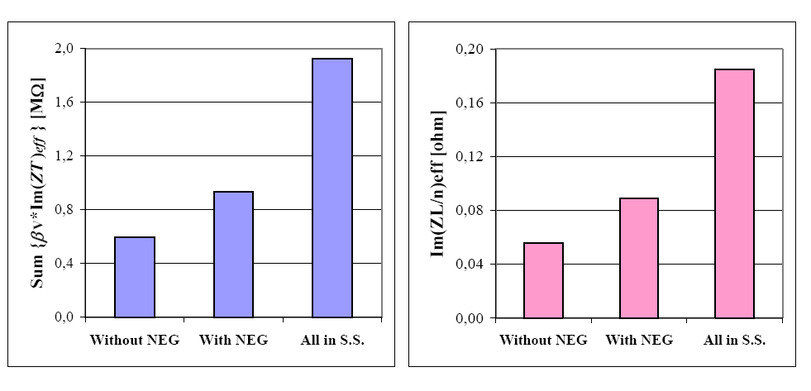
Comparison of different vacuum chambers
This reference claims a serious impact on the imaginary part of the transverse impedance due to NEG coating
Surface impedance is proportional (1+j), real part is not considered here
Impact of NEG Coating on the Impedance 11th ESLS Workshop, 17 ~ 18 November 2003,
ESRF, Grenoble
By Ryutaro Nagaoka, Synchrotron SOLEIL

Slide 5
NEG-COATED VACUUM CHAMBERS AT THE ESRF
No adverse effect on the impedance of the machine
caused by the electric conductivity of the NEG
coatings has been noticed [4]. One of our colleagues,
--E. Plouviez of the Diagnostic Group, Machine
Division-- has measured the surface resistance of
sample kapton foils which had been coated by us
(thicknesses measured: 0.6 and 2 μm). At the chosen
frequency of 14 GHz a resistivity of 5.0E-6 Ω/m has
been measured. This means that the skin-depth at 14
GHz is greater than the NEG-coating thickness [7].
This reference: no adverse effects
NEG-COATED VACUUM CHAMBERS AT THE ESRF: PRESENT STATUS
AND FUTURE PLANS
R. Kersevan, ESRF, Grenoble

Slide 6
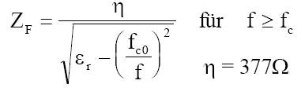
Bench measurement method (1)
MEASUREMENT OF THE RESISTIVITY OF THE NEG COATING AT 14 GHz
Diagnostics 02-03
E. Plouviez
21/04/2002
----------------------------------------------------------------------------------------------------------------
NEG resistivity measurement
We have measured the surface resistance at 14 GHz of samples of kapton coated with NEG. The coating process is the same as the one that will be used for the ESRF low gap straight section vacuum vessel. The thickness of the coating of the samples was about .6 mm and 2 mm; the coating of the vacuum vessel will be 2 mm thick.
Measurement method
We have inserted the samples between the flanges of two X band wave guide to N type connectors transitions. The cross section of the wave guide is 22.5 X 10.5mm. We have measured the reflection and transmission coefficient of the films, called s₁₁ and s₂₁ using the usual RF measurement notation, For this measurement , we have used a HP8510 vector network analyzer; in this way we can obtain the value of the complex impedance of the NEG coated kapton films normalized by the wave guide impedance Z₀= 330Ω.
Open questions:
Z₀=waveguide impedance =330Ω? Waveguide impedance for TE₁₀ Mode always bigger then 377Ω
Measurement at 14GHz? Frequency range of X-Band is 8.2 to 12.4 GHz, at 14GHz the TE₂₀ mode can already propagate

Slide 7
Bench measurement method (2)
s₁₁ =Z- Z₀/Z+ Z₀ => Z/ Z₀=1+ s₁₁/1- s₁₁
In our case Z is real since the film impedance is purely resistive, so s₁₁ and s₂₁ are real. When s₁₁ is close to 1 this Z derivation can be inaccurate; in this case it is better to use the s₂₁ measurement of the transmitted signal through the film. When a transmission line is terminated by a an impedance much lower than Z₀ the current flowing in this termination will be equal to the sum of the current corresponding to the incident signal and the reflected signal.
For an incident signal power P_{i} we can we write:
P _{i}= ½ V_{i}²/ Z₀
or P_{i}= ½ Z₀ I_{i}²
and for the reflected signal power we have:
P_{r}= ½ Z₀ I_{r}²
Since in the case of a very low impedance termination such as our NEG film, the reflected signal amplitude is nearly equal to the incident signal amplitude, the current (I_{i} +I_{r}) flowing in the termination is about twice the incident signal current, the voltage across this impedance Z is:
V= Z.(I_{i} +I_{r}).

Slide 8
Bench measurement method (3)
Then the transmitted power P_{t} is equal to:
P_{t}= ½V²/ Z₀
P_{t}= ½ (( I_{i} +I_{r})Z)²/ Z_{0 =1/2} ( 2.I_{i} .Z)²/ Z ₀ for s₁₁ close to 1
The ratio P_{t} / P_{i} is equal to s₂₁² and we will have Z/ Z₀ = s₂₁/2
Measurement results
For the first .6mm thick sample we measured s₁₁ = -.97 and s₂₁ = .1 and for the second 2mm thick sample we measured s₁₁ = -.98 and s₂₁ = .03
Z₀= 330 Ω so the .6mm thick sample resistance is 16.5 Ω and the 2 mm thick sample resistance is 5 Ω at 14GHz. The current is flowing between the large sides of the waveguide; so the surface resistances of the films are about 33 Ω /square and 10 Ω /square
So the resistivity of the coating seems to be about 2.5 10⁻⁵Ω.m and the coating is still much thinner than the skin depth at 14 GHz: good news!

Slide 9
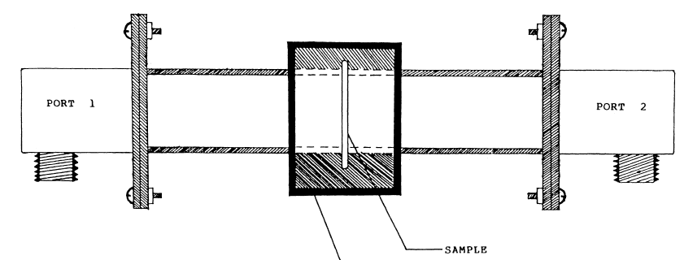
Bench measurement Setup
The sample foil is placed in the middle and the reflection due to the properties of the sample are measured
Method is not able to determine whether the sample is a conductor or has a very high ε, which show both the same effect
strong coupling on both ports, sample foil placed in the middle
David Seebacher , NEG properties in the microwave range, SPSU Meeting, 17th February, CERN

Slide 10
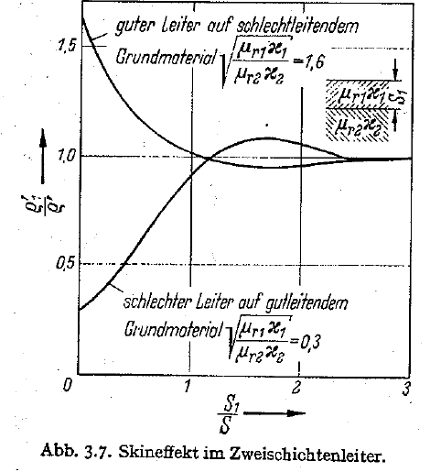
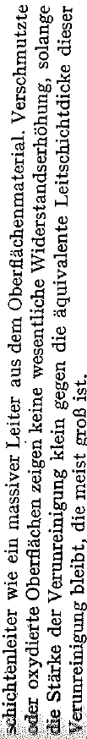
2 Layer conductor
A thin layer with high resistance on a good conducting material has little influence on the overall impedance
As long as the skindepth is large with respect to the layer thickness
Skindepth @3GHz for NEG ~20 µm (ρ=500e-8 Ωm)
H. Meinke and F.W. Gundlach, Taschenbuch der Hochfrequenztechnik, Springerverlag Berlin 1968

Slide 11
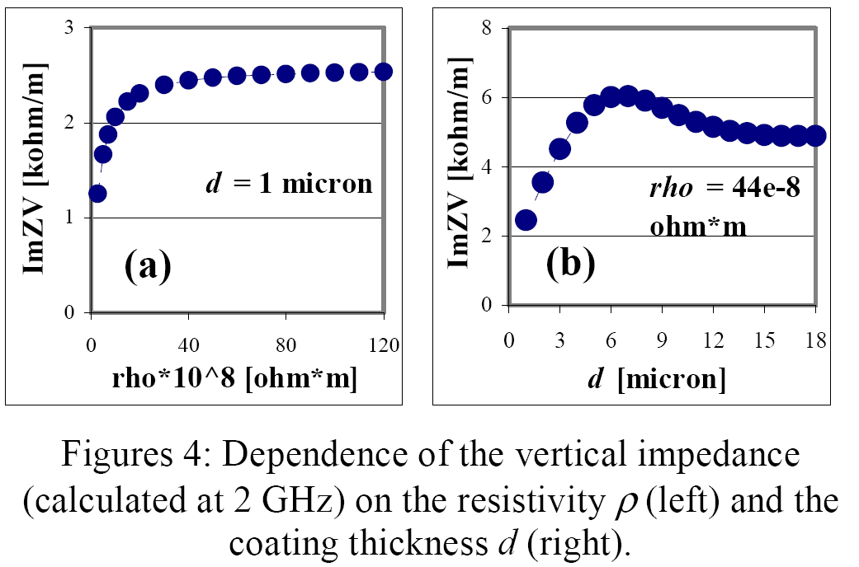
Study of resistive wall effects on SOLEIL
Calculations correspond with theory of slide before
As the resistivity of the surface layer is increased the impact is limited(saturation)
As the thickness is increased the NEG-layer gets the main conductor and impedance increases to that of NEG
Study of Resistive-Wall effects on SOLEIL, EPAC 2004
By Ryutaro Nagaoka, Synchrotron SOLEIL

Slide 12
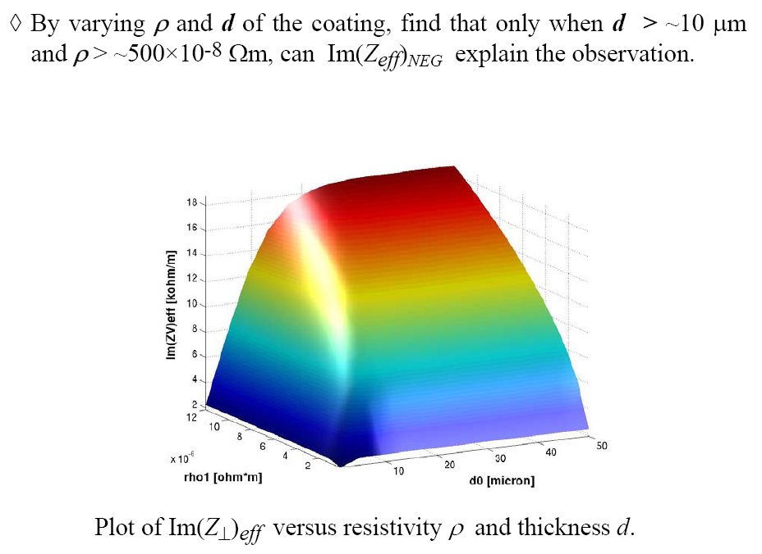
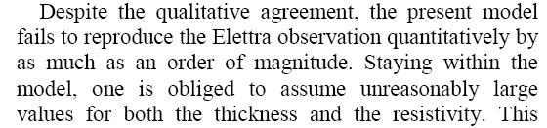
Study of resistive wall effects on SOLEIL
To explain the observations at ELETTRA ρ has to be bigger than 500E-8 and the coating has to be thicker than 10µm (calculations done at 2GHz)
The studies can’t explain the high increase observed at ELETTRA
Study of Resistive-Wall effects on SOLEIL, EPAC 2004
By Ryutaro Nagaoka, Synchrotron SOLEIL

Slide 13
Summary of statements
E. Karanzoulis, ELETTRA | Increase of impedance still an open point
R. Kersevan, ESRF | No adverse effect on the impedance of the machine 5.0E-6 Ω/m @14GHz
R. Nagaoka, Synchroton SOLEIL | Simulation of the influence of NEG conductivity and layer thickness on the impedance can’t explain the high rise at ELETTRA

Slide 14
Possible reasons
A possibility is that higher spectral frequencies (~100 GHz) can’t be neglected and cause a major part of the impedance increase (skindepth isn’t anymore larger than the layer thickness)
The increase of the imaginary part could be related a very high dielectric constant of NEG at microwave frequencies, which we want to test with the following experiment, in other words we want to test the hypothesis that NEG appears as a very high dielectric beyond say one GHz
For SPS only we are interested only in frequencies up to about 3GHz, however measurements in electron machines are done with short bunches with spectral components well beyond 100GHz

Slide 15
Cavity transmission resonator
The resonator is measured in transmission S21
For our measurement a rectangular S-Band (2-4GHz) TE103 resonator will be used
weakly coupled at input- and output- port, thus the measured Q is approximately equal to the unloaded Q

Slide 16
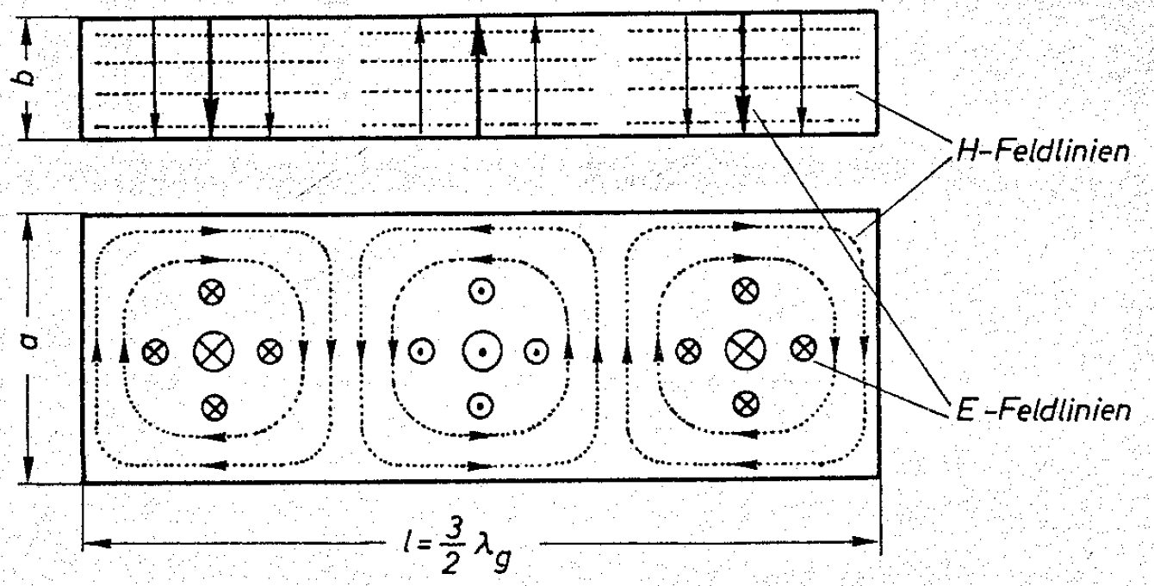
Field in the resonator
The sample is inserted at the maximum of the electric field in the middle of the resonator
As long as the sample is small we can assume that the field isn’t disturbed it will just detune the resonator
The measurement on metal is difficult, therefore we use a glass rod for this purpose
Sample
(4mm diameter glass rod), reference measurement uncoated

Slide 17
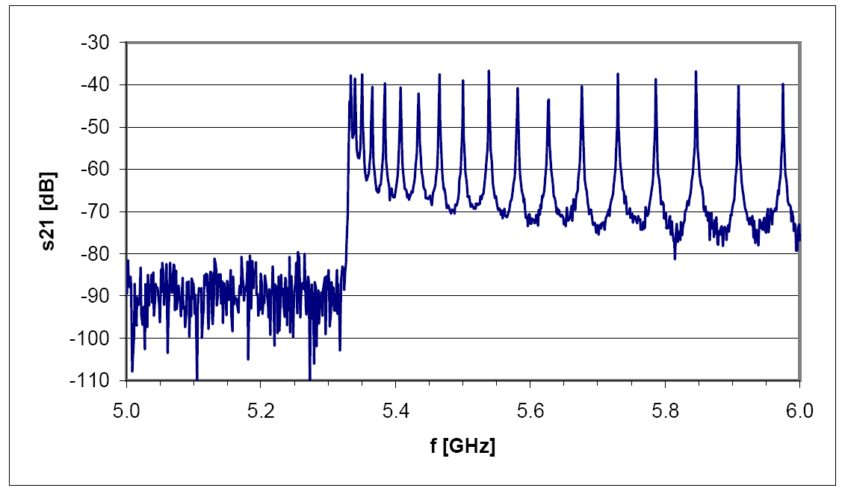
Resonance peaks
There are resonances whenever half of the guided wavelength is a multiple of the length of the resonator
Only the odd peaks (TE103, TE105…)will be detuned because for the even ones there is no electric field at the sample so it has is no influence
Resonance peaks
below cut-off

Slide 18
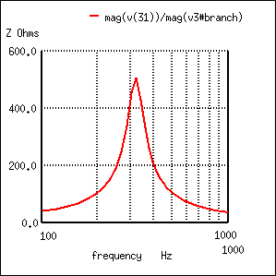
Determination of resonance frequency
The resonant frequency f0 is the center frequency of the peak
The -3db bandwidth is the difference between the two points where the -3db line intersects the
0db
Fo =
-3db
f1
f2
f0

Slide 19

Q-factor
,
.
The Quality factor is defined as the center frequency over the Bandwidth
The bandwidth is measured at -3db (0.707) and refers to the point where only half of the power is transferred
The narrower the f1 and f2 are the higher the Q-factor is
The dielectric loss in the sample will change the Q-factor

Slide 20
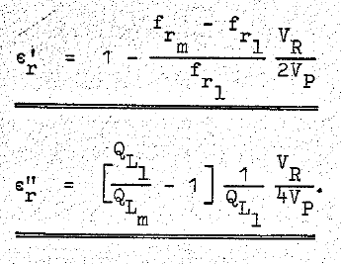
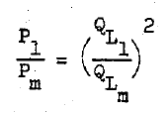
Determination of the permittivity
To determine the permittivity two measurements are required
One with the empty resonator as reference (In our case with uncoated glass rods)
One with the perturbation resonator (coated glass rods)
From the frequency shift and the change of the Q factor or the change of power loss we can determine the complex permittivity

Slide 21
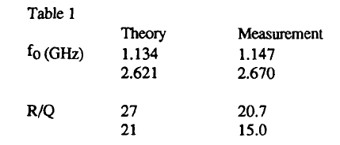
Change of Resonant Frequency
For a dielectric sample the resonant frequency will decrease
For a conducting sample the resonant frequency will increase
dielectric
conductor
Increase of resonant frequency due to the inserted wire

Slide 22
Preliminary conclusion
Different partly contradictory statements about the Impedance of NEG
With the resonator measurement we can determine whether NEG is a bad conductor or a bad dielectric
We expect to measure a high ε in order to explain the effects observed

