Slide 1
Effect of the holes in the e-cloud strip monitor G. Rumolo, for the SPS-U Study Team (08/09/2009)
Motivation of the simulation study
ECLOUD simulations:
How much does the presence of the holes affect the electron cloud build up?
What do we actually measure?
Effect of the magnetic field
Results of several simulation scans and comparisons between unperturbed and perturbed geometries
⇒ Many people involved in the discussions: S. Cettour-Cave, K. Cornelis, E. Métral, E. Shaposhnikova, M. Taborelli, C. Yin Valgren, et al.

Slide 2
Motivations of the study
During the last SPS long MD (week 32), it was decided to carry out a systematic study of the behavior of the measured electron cloud in the StSt liner as a function of the magnetic field.
Surprisingly enough, the measured signal seemed to indicate the presence of a denser electron cloud for low values of magnetic field.
This behavior had been observed before and was qualitatively ascribed to a local electron cloud suppression at the hole locations. When the magnetic field is strong enough that the Larmor radius of the electron motion becomes smaller than the hole radius, multipacting is locally suppressed because the electrons are swallowed by the holes and not multiplied in the chamber (G. Arduini et al., PAC’01)
However, in absence of quantitative analysis, this observation led to the belief that there could be really more electron cloud in regions with low magnetic field, e.g. in the fringe field regions of the bending magnets, where the magnetic field rapidly varies from the nominal dipole value to zero (or vice versa)
The idea appeared to find a strong confirmation in that most of the SPS vacuum chambers exhibit a clear central black mark, possibly attributed to e-cloud heating, over a region extending for only about 0.5m at the entrance and at the exit of the magnets (see Karel’s talk)
ECLOUD could be used to simulate the effect of the hole in the pipe wall….

Slide 3
E-cloud simulations with hole
The ECLOUD code had to be modified to take into account the presence of holes in the vacuum chamber walls:
The charges of the macroelectrons that hit the chamber wall at some predefined hole location(s) are set to zero
At the same time, their original charges are added into a general accumulator variable that counts the total charge going through the hole (proportional to the signal measured by an e-cloud strip monitor)
The ‘clean’ routine, called at the end of each bunch passage or inter-bunch gap, eliminates then all the macroelectrons having zero charge, making sure that those that went into the hole(s) are not tracked anymore
Using the modified version of the code, we simulated the electron cloud build up for MBB dipole chamber geometries with and without holes (exploring a few locations and sizes of the holes) and for a wide range of magnetic field values, compatible with the variation range of the magnetic field in the liners.
The beam energy is 26 GeV/c and the passage of 4 batches was simulated for each case. The value of the maximum SEY was always set to 1.6 (as expected for StSt after some scrubbing)

Slide 4
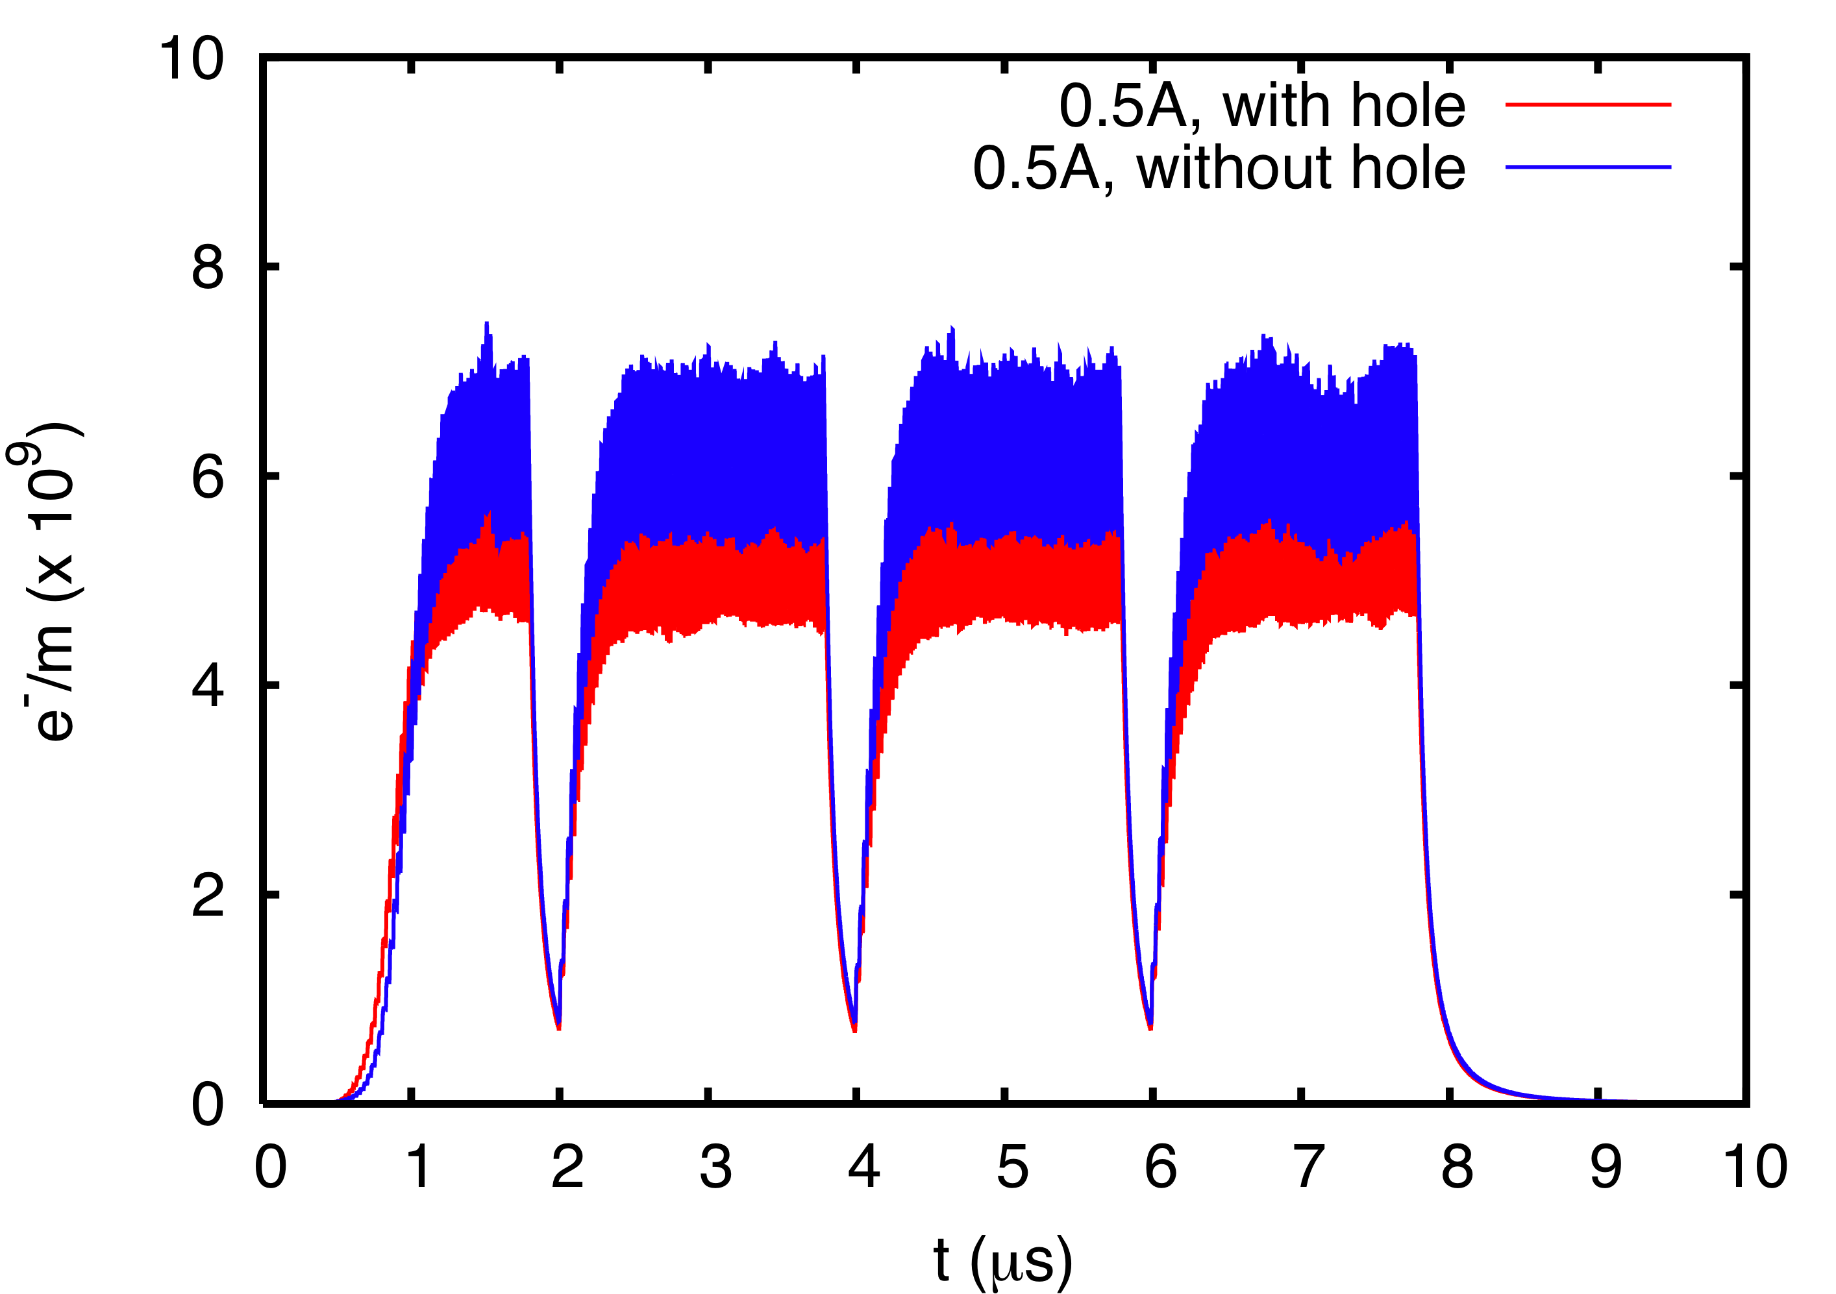
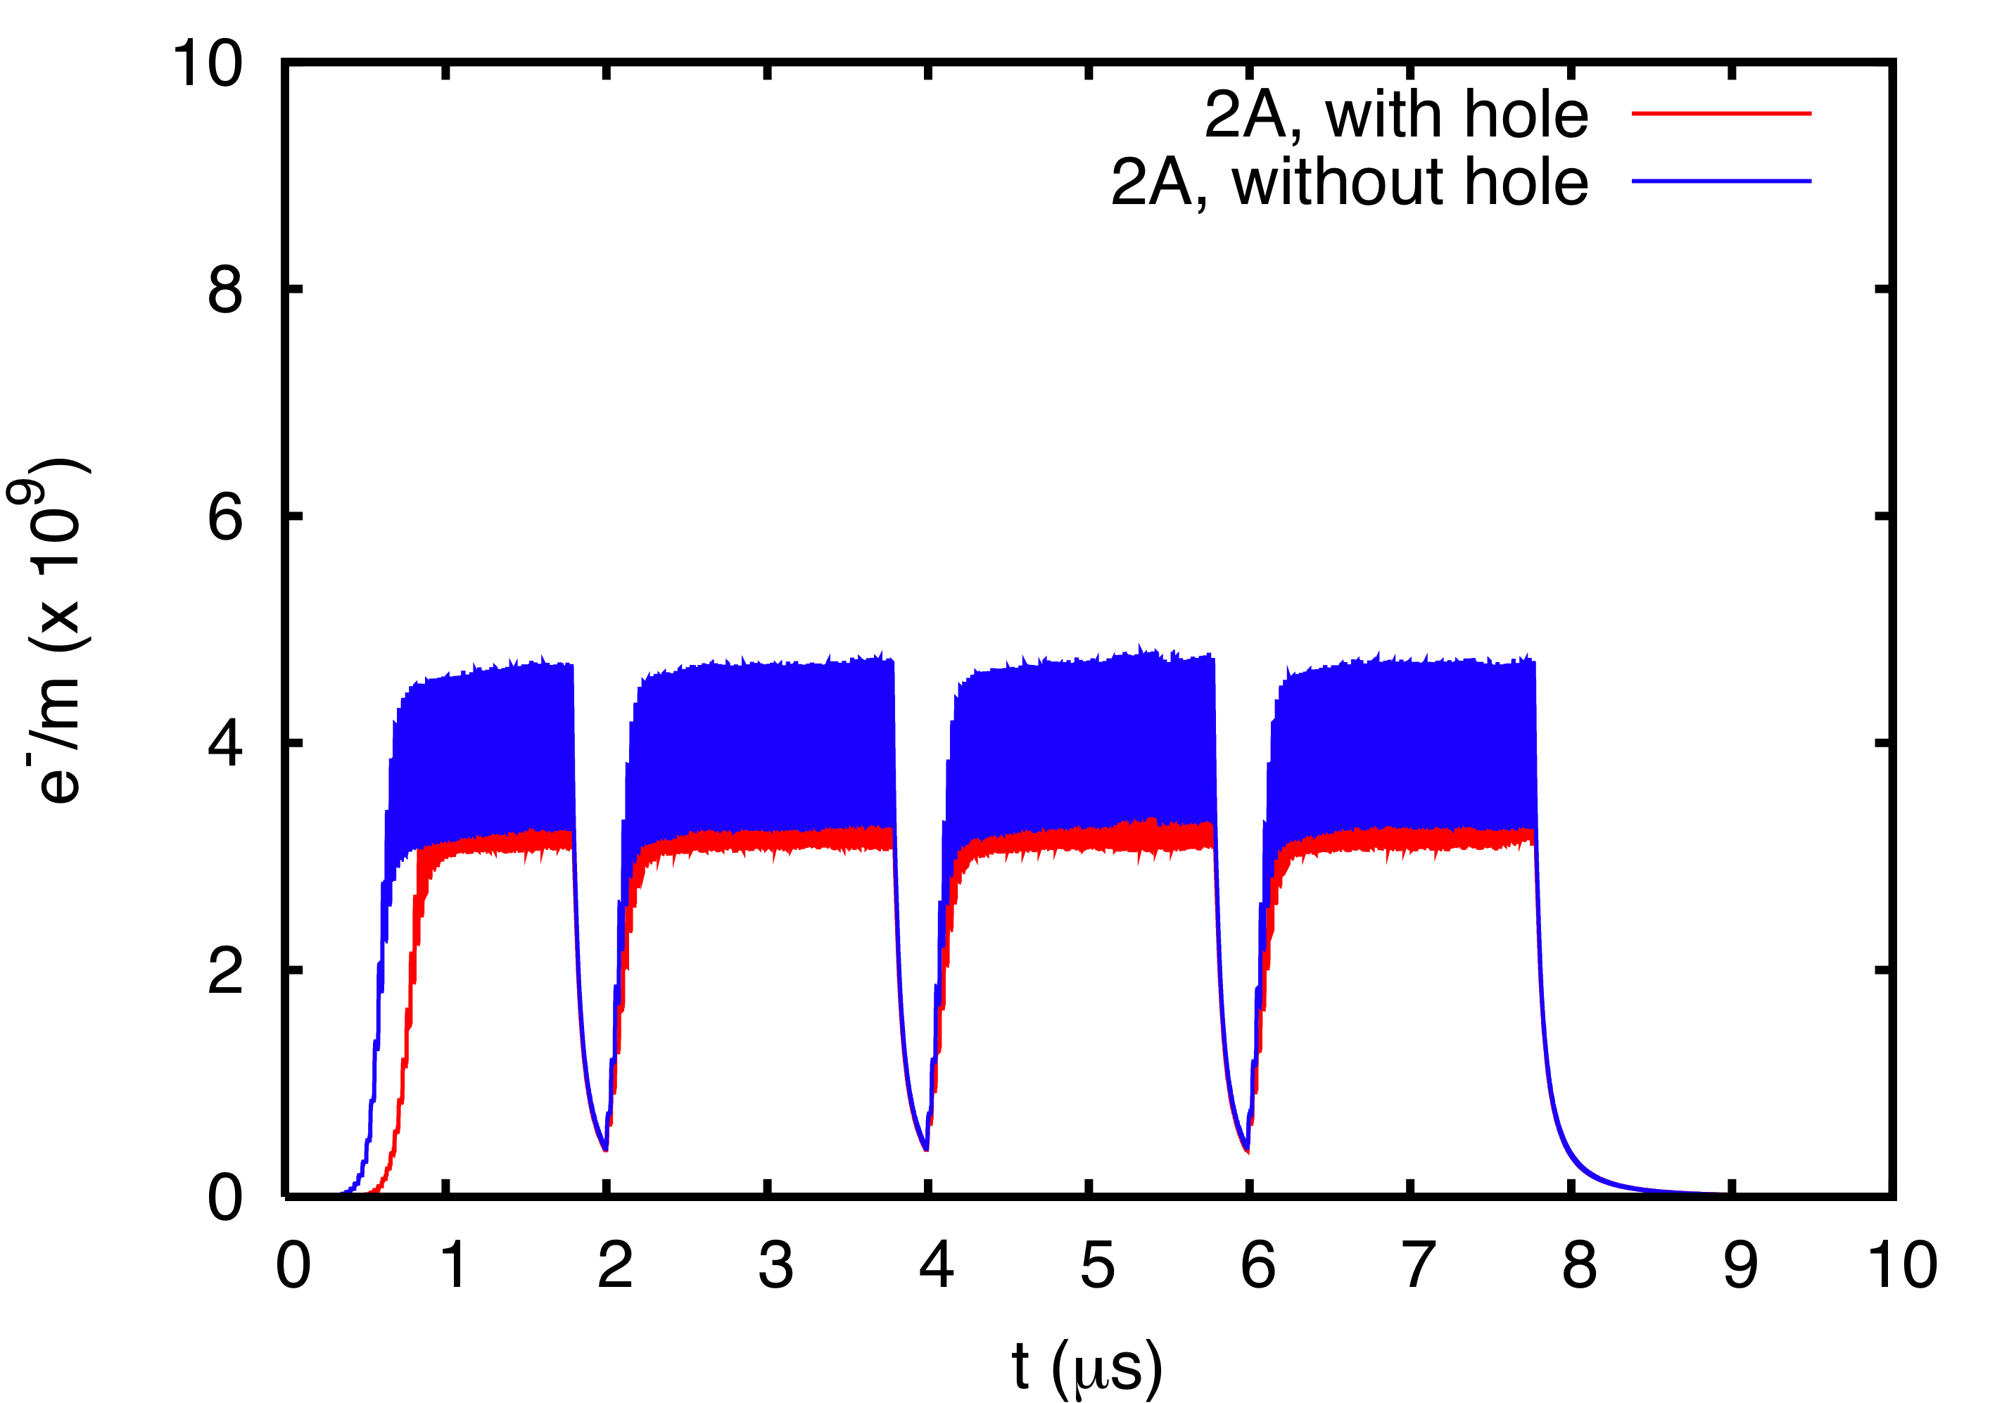
E-cloud simulations with hole: one hole in the center of the chamber (1mm)
In terms of average electron cloud density over the chamber cross section, the electron cloud build up seems to be only moderately affected by the presence of the hole in the chamber wall

Slide 5
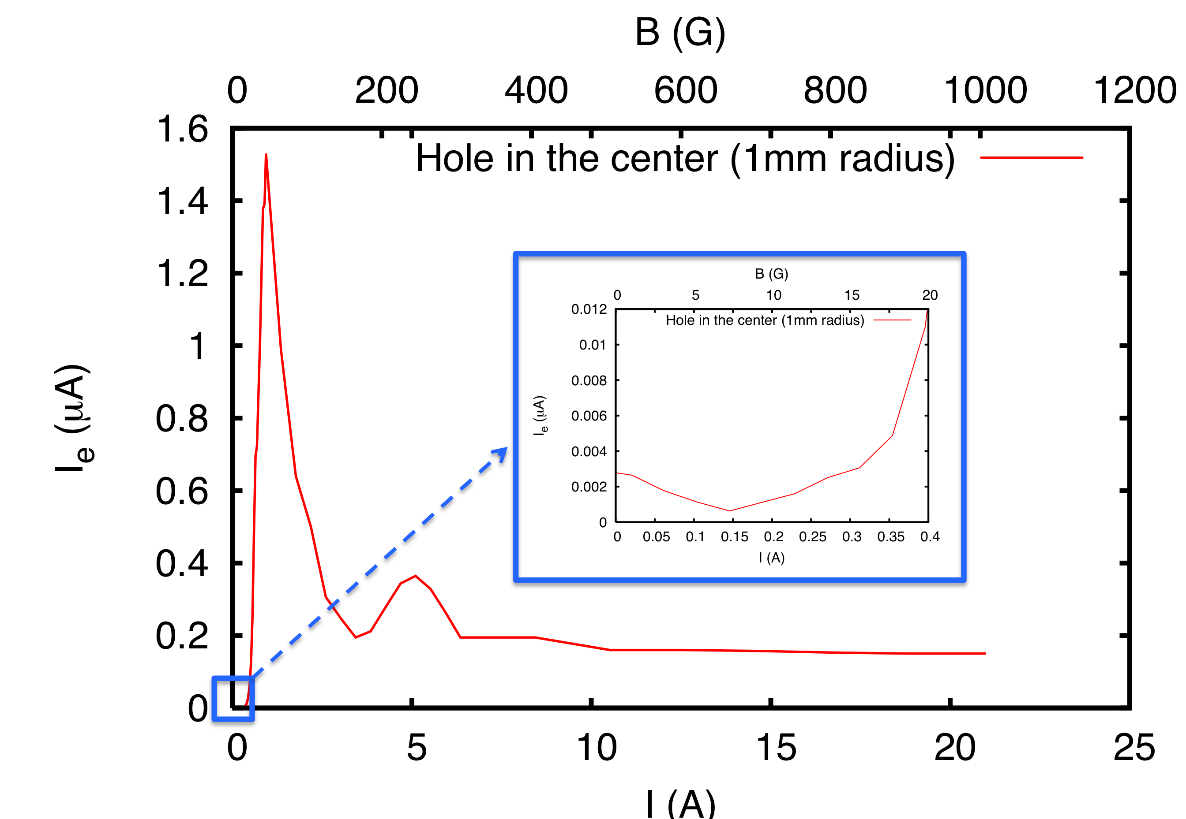
E-cloud simulations with hole: one hole in the center of the chamber (1mm radius)
The measured electron cloud signal, i.e. the total charge into the hole, is a strong function of the magnetic field (on the lower x-axis we have used the current feeding the liner magnet)
Since the total charge is calculated for 4 batches, the total electron current through the hole, I_{e}, is obtained by dividing the total charge from the simulation by the revolution period of the SPS.
2mm

Slide 6
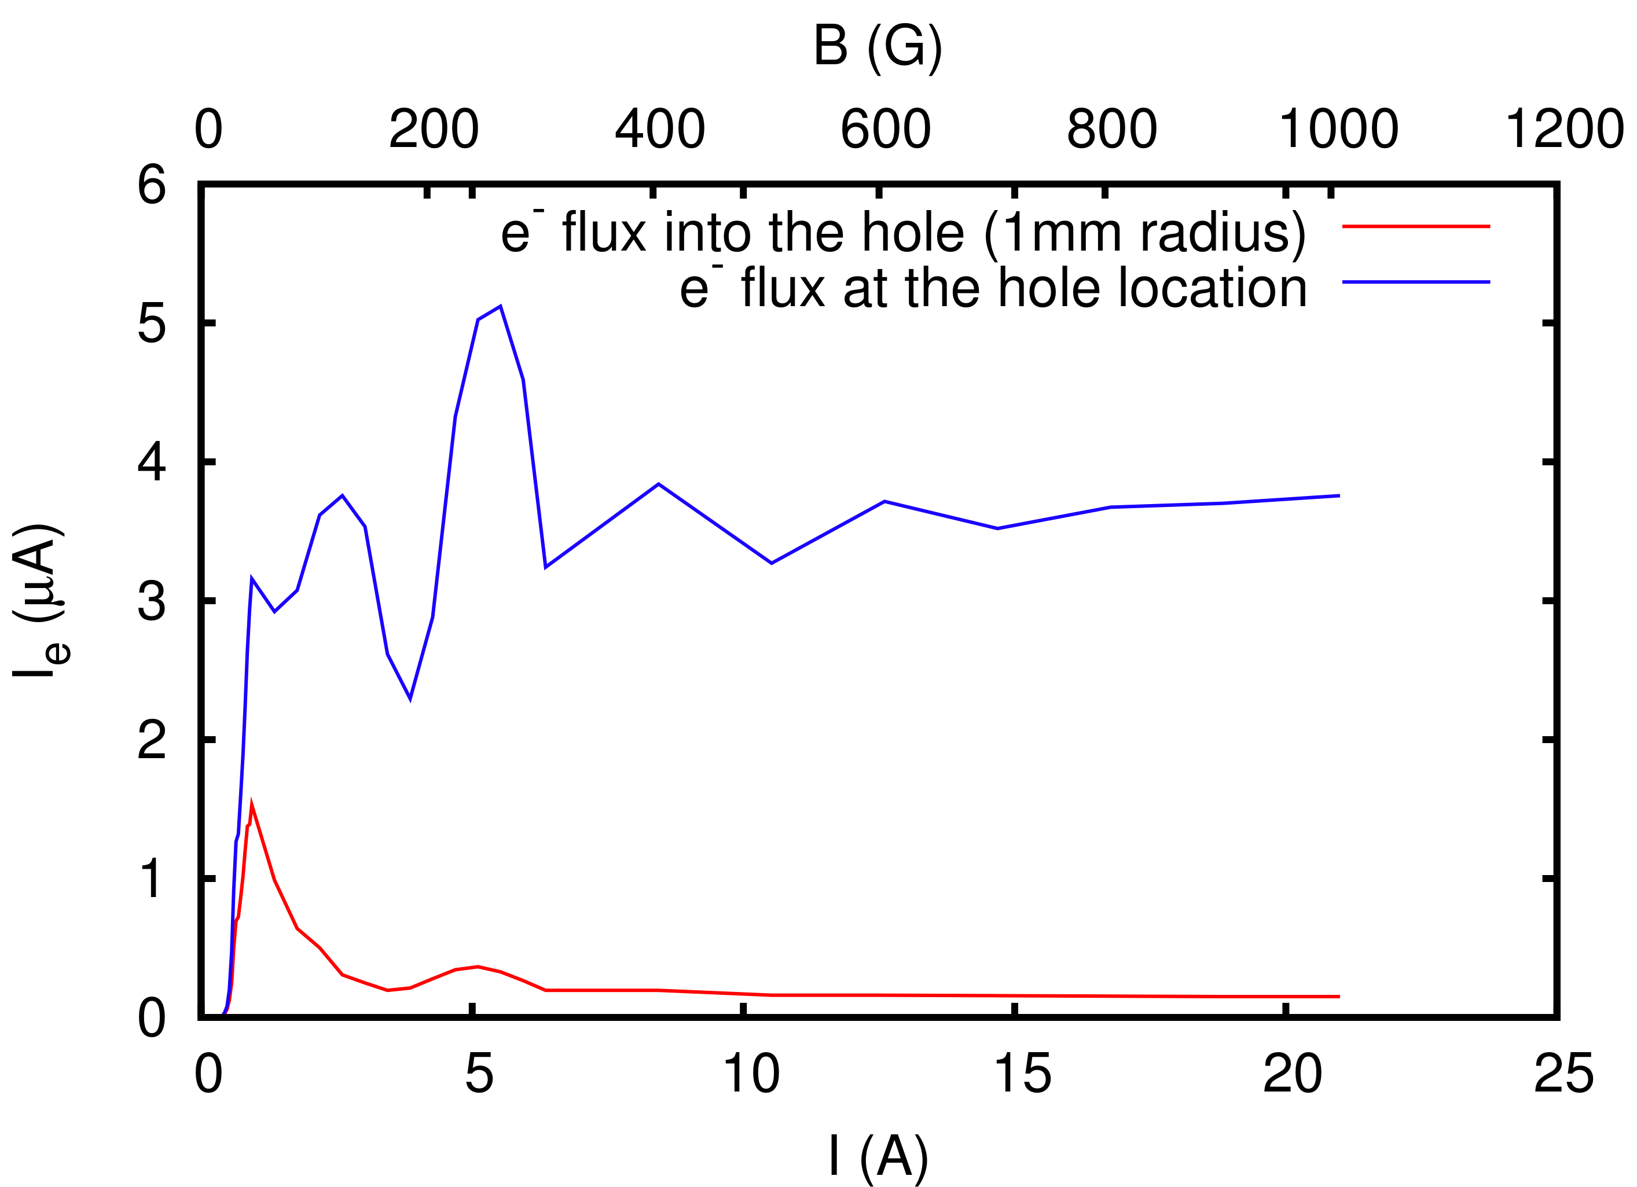
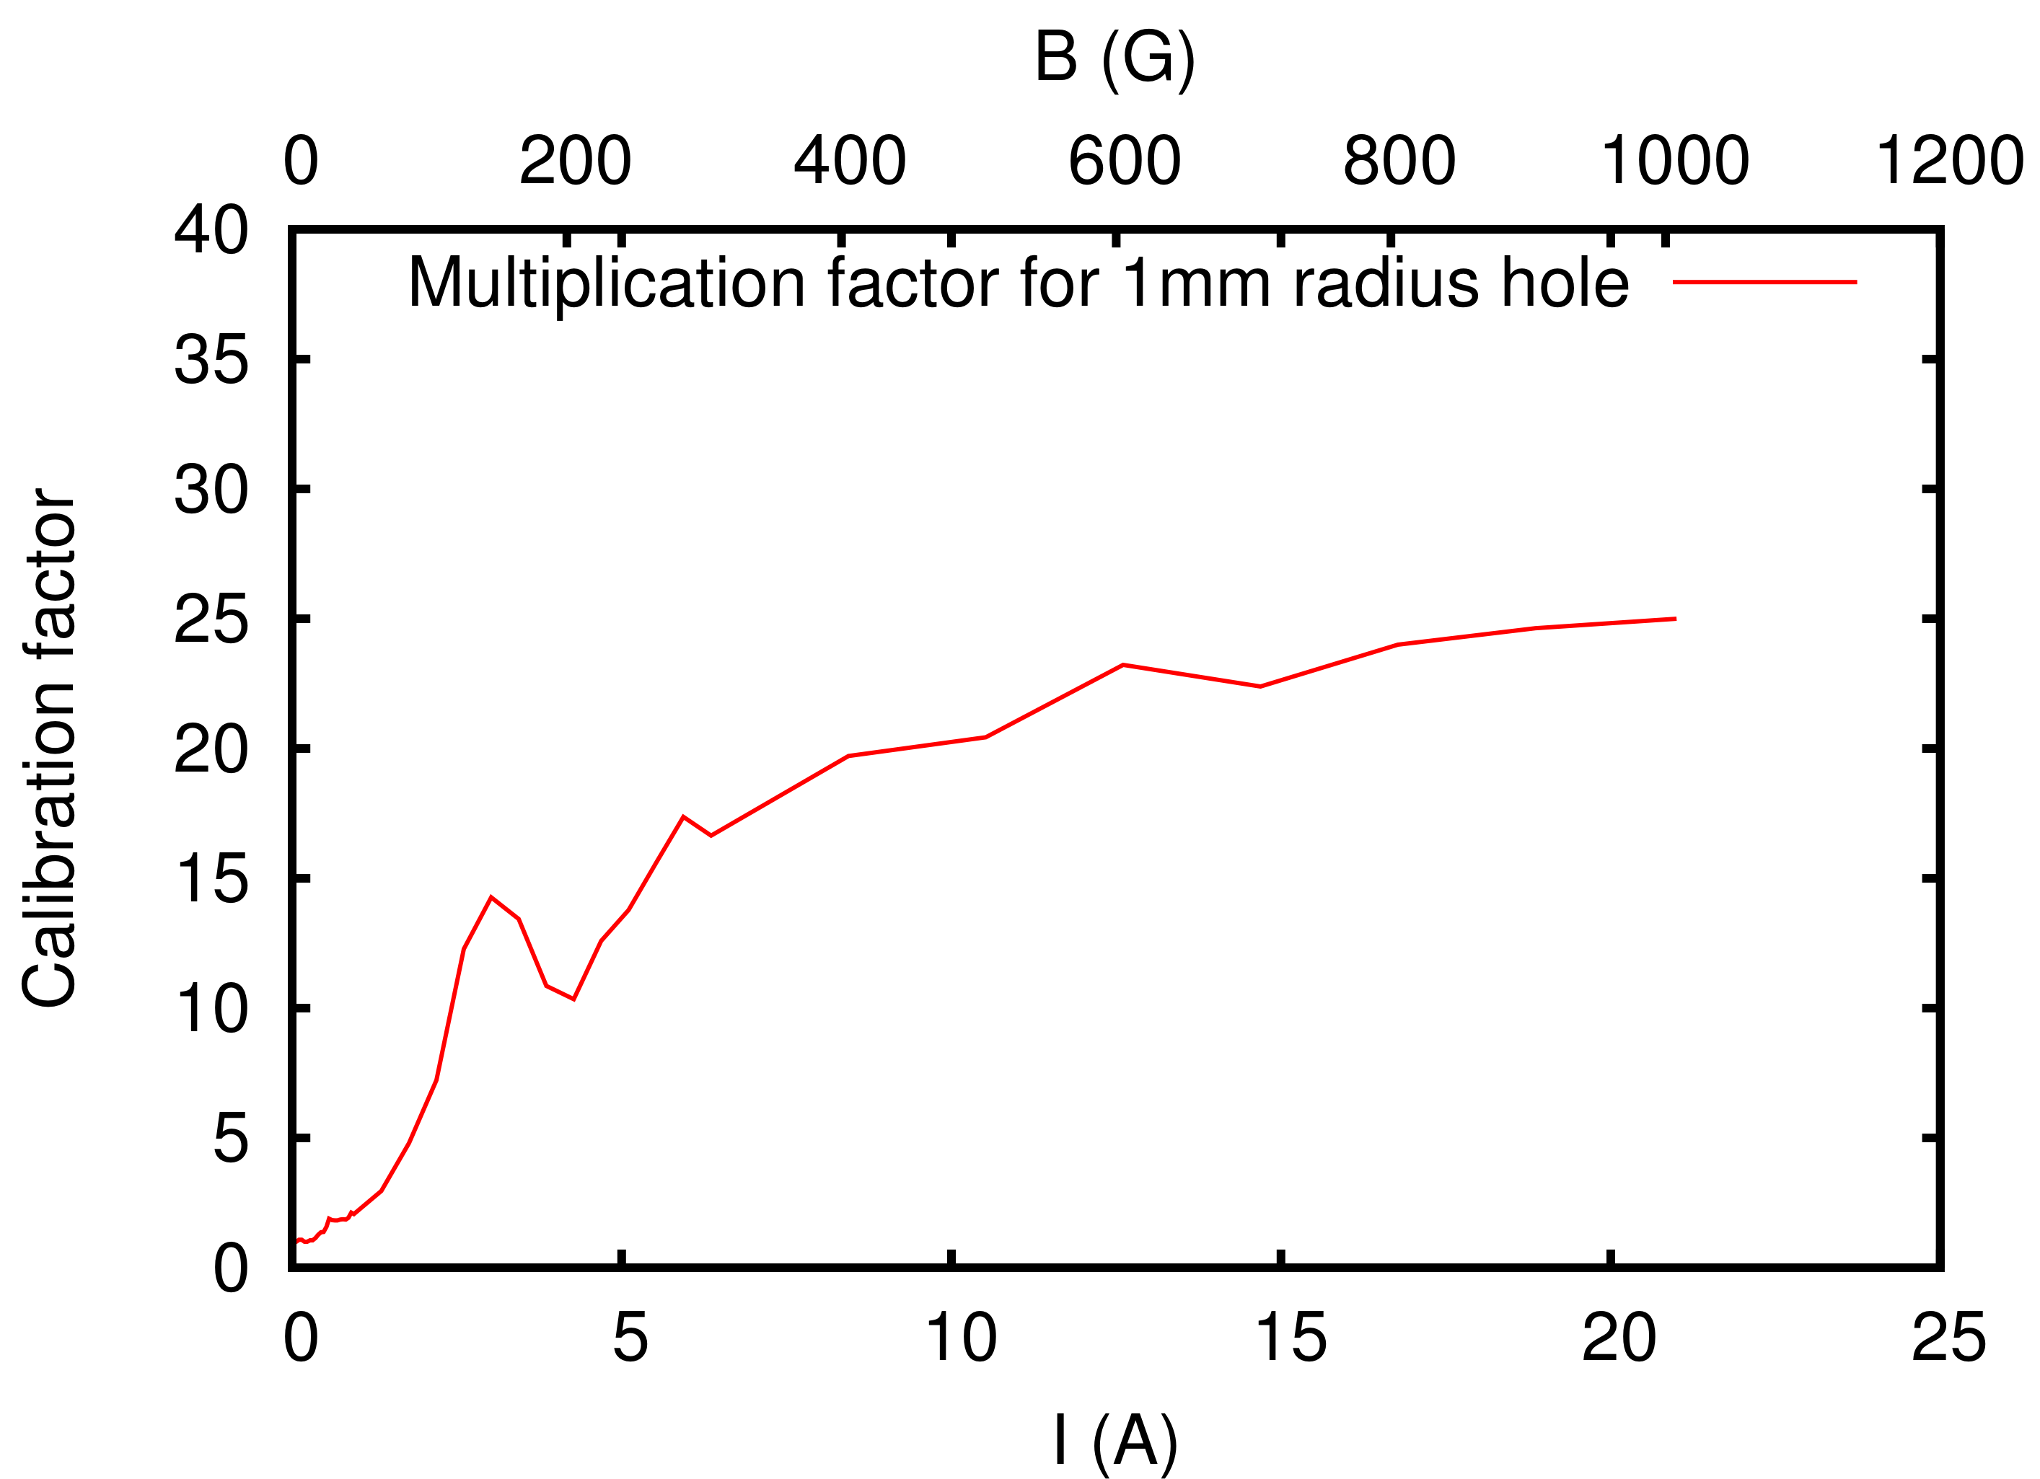
E-cloud simulations with hole: one hole in the center of the chamber (1mm radius)
The fact that the electron current decreases at high values of B is mainly due to local suppression of the e-cloud at the hole location.
Simulations done without the hole, but counting the total charge hitting the chamber wall at the “virtual” hole location, clearly show this effect (blue curve, plot on the left)
On the right, we also plot the dependence on energy of the ratio between the unperturbed electron flux at the hole location and the real electron flux into the hole

Slide 7
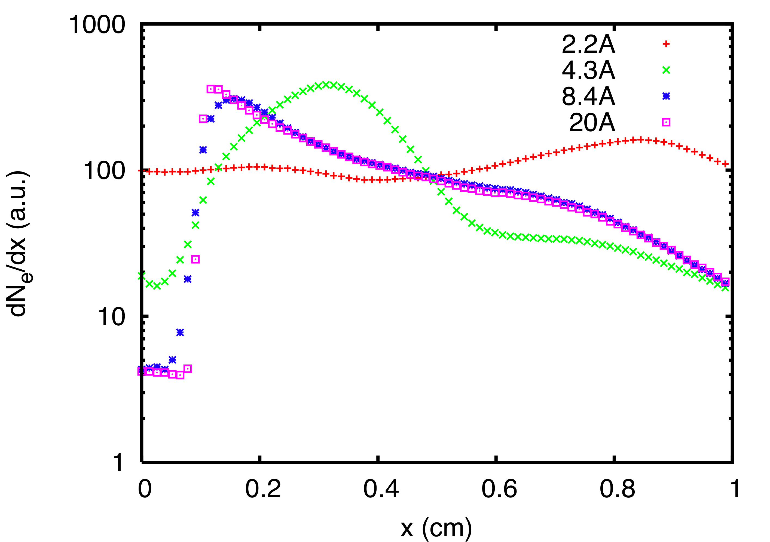
E-cloud simulations with hole: one hole in the center of the chamber (1mm radius)
The simulated distribution of electrons along the horizontal coordinate is plotted for 4 different values of magnetic field. It also shows the suppression effect at the hole location, which occurs for values of the current in the liner magnetic higher than ~6A.

Slide 8
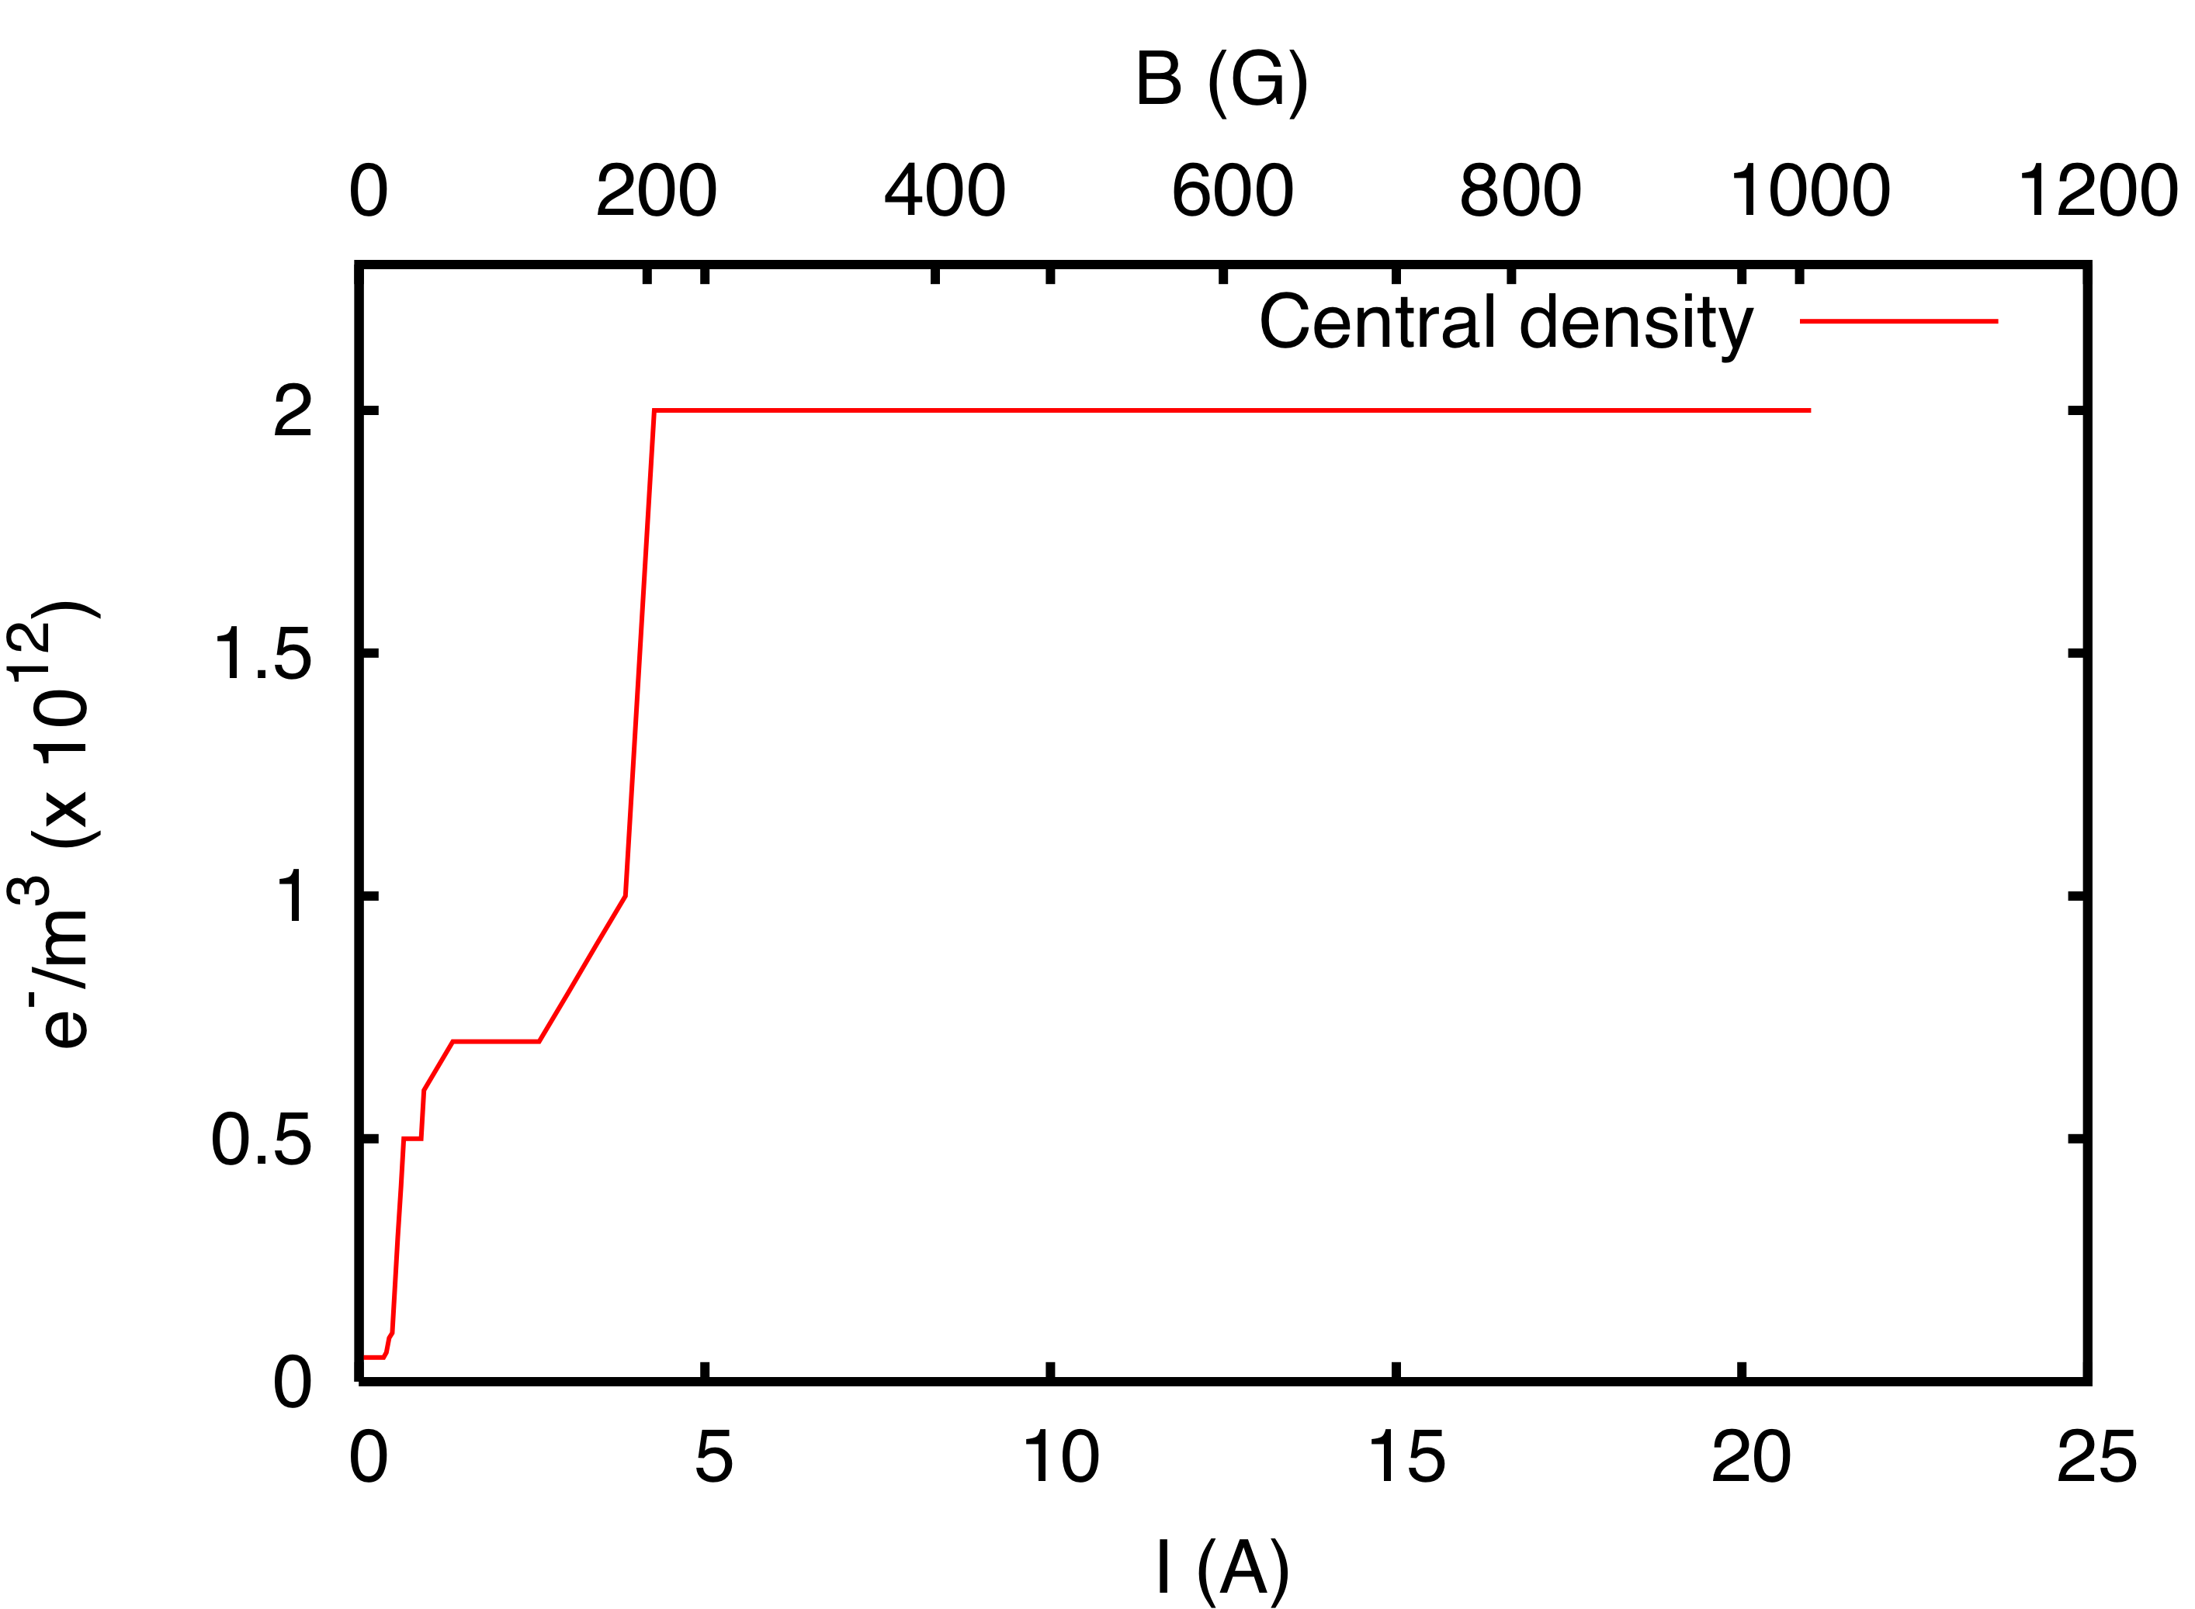
E-cloud simulations with hole: one hole in the center of the chamber (1mm radius)
In spite of the shape of the curve of the measured electron flux into the hole as a function of the magnetic field, the central electron density (which determines the beam stability) becomes higher for strong dipole fields and levels off for B>200G

Slide 9
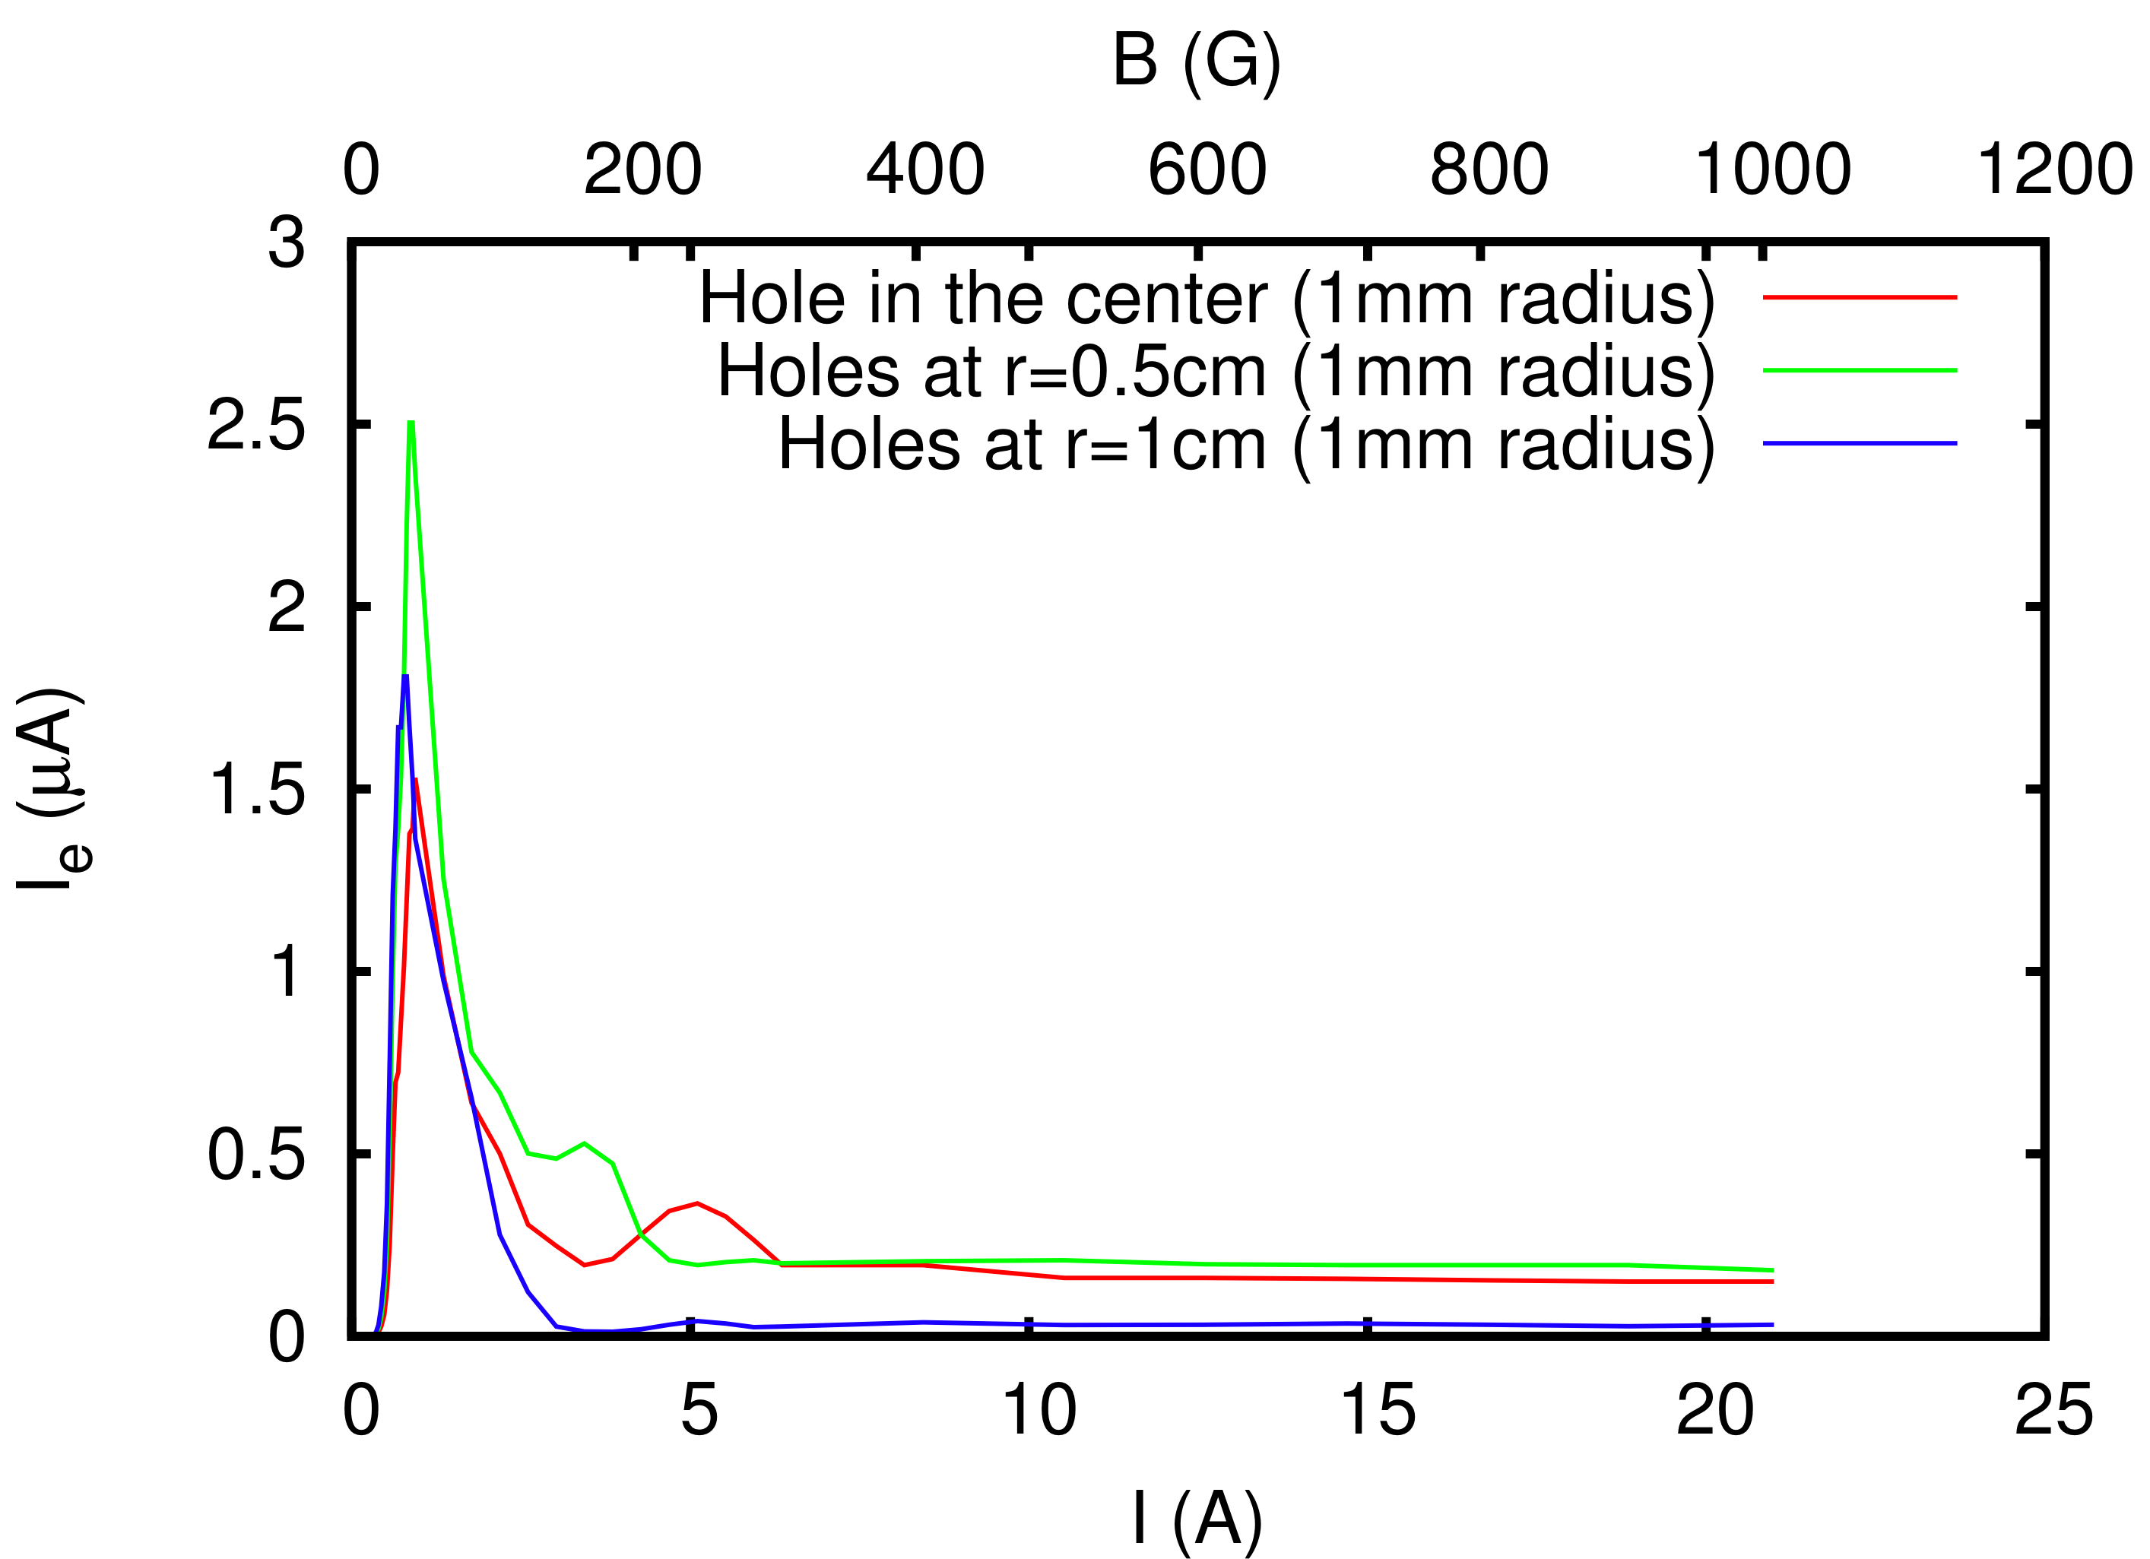
E-cloud simulations with hole: comparing one hole in the center of the chamber (1mm) with two holes at ±0.5cm and ±1cm
The average current into the hole has been simulated for the case of central hole (1mm) and for two symmetric holes with respect to the chamber center, located at r=±0.5cm and r=±1cm.
While the peak at very low magnetic field (~1A) does not change much, the location of the second peak decreases for r=±0.5cm and eventually the second peak disappears for r=±1cm
The signal for high B values vanishes when the holes are located at r=±1cm
r
2mm
2mm

Slide 10
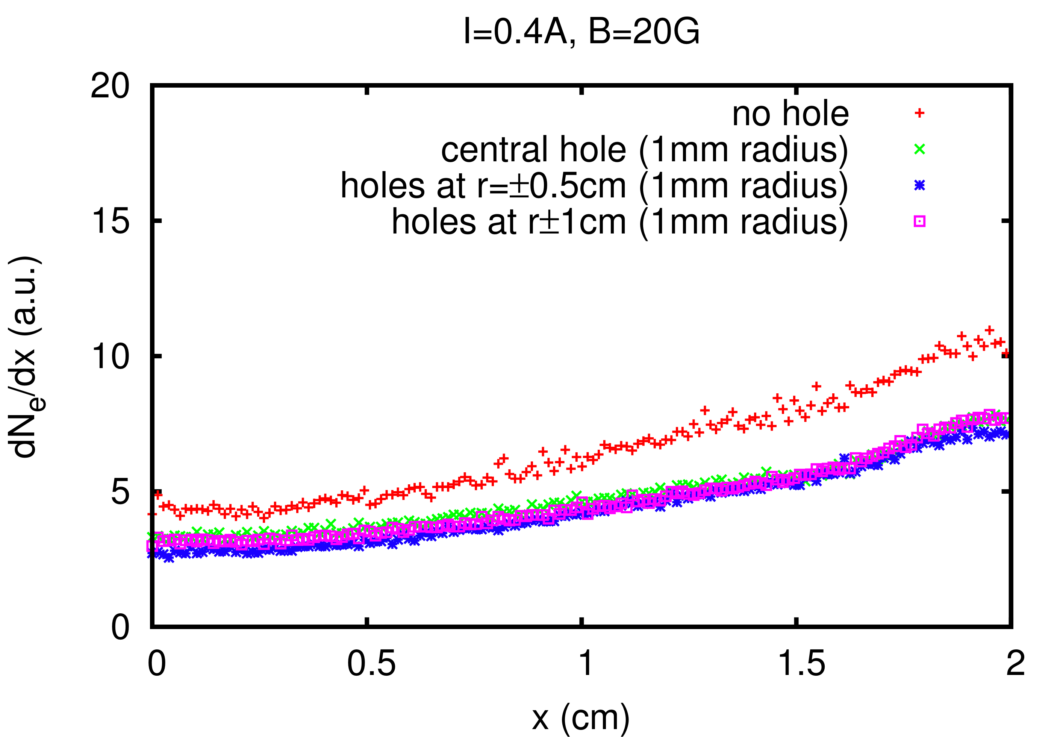
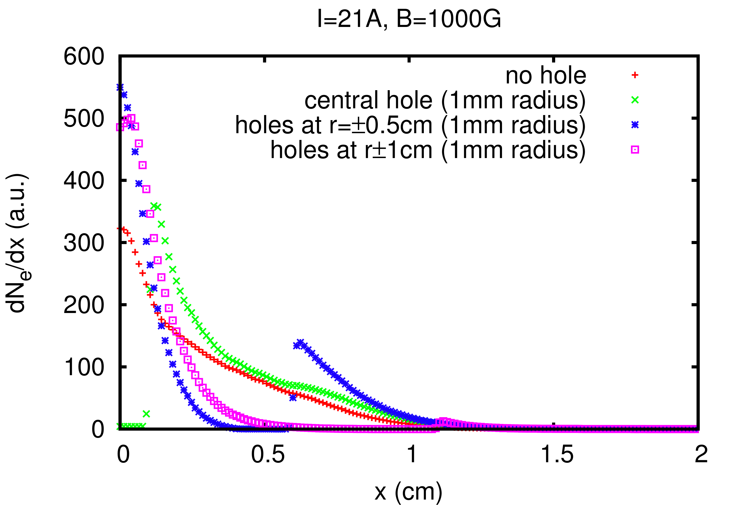
E-cloud simulations with hole: comparing one hole in the center of the chamber (1mm) with two holes at ±0.5cm and ±1cm
The signal suppression at the hole location(s) which occurs for high magnetic field values is evident from the horizontal distribution of the electron hitting the chamber in the different configurations…

Slide 11
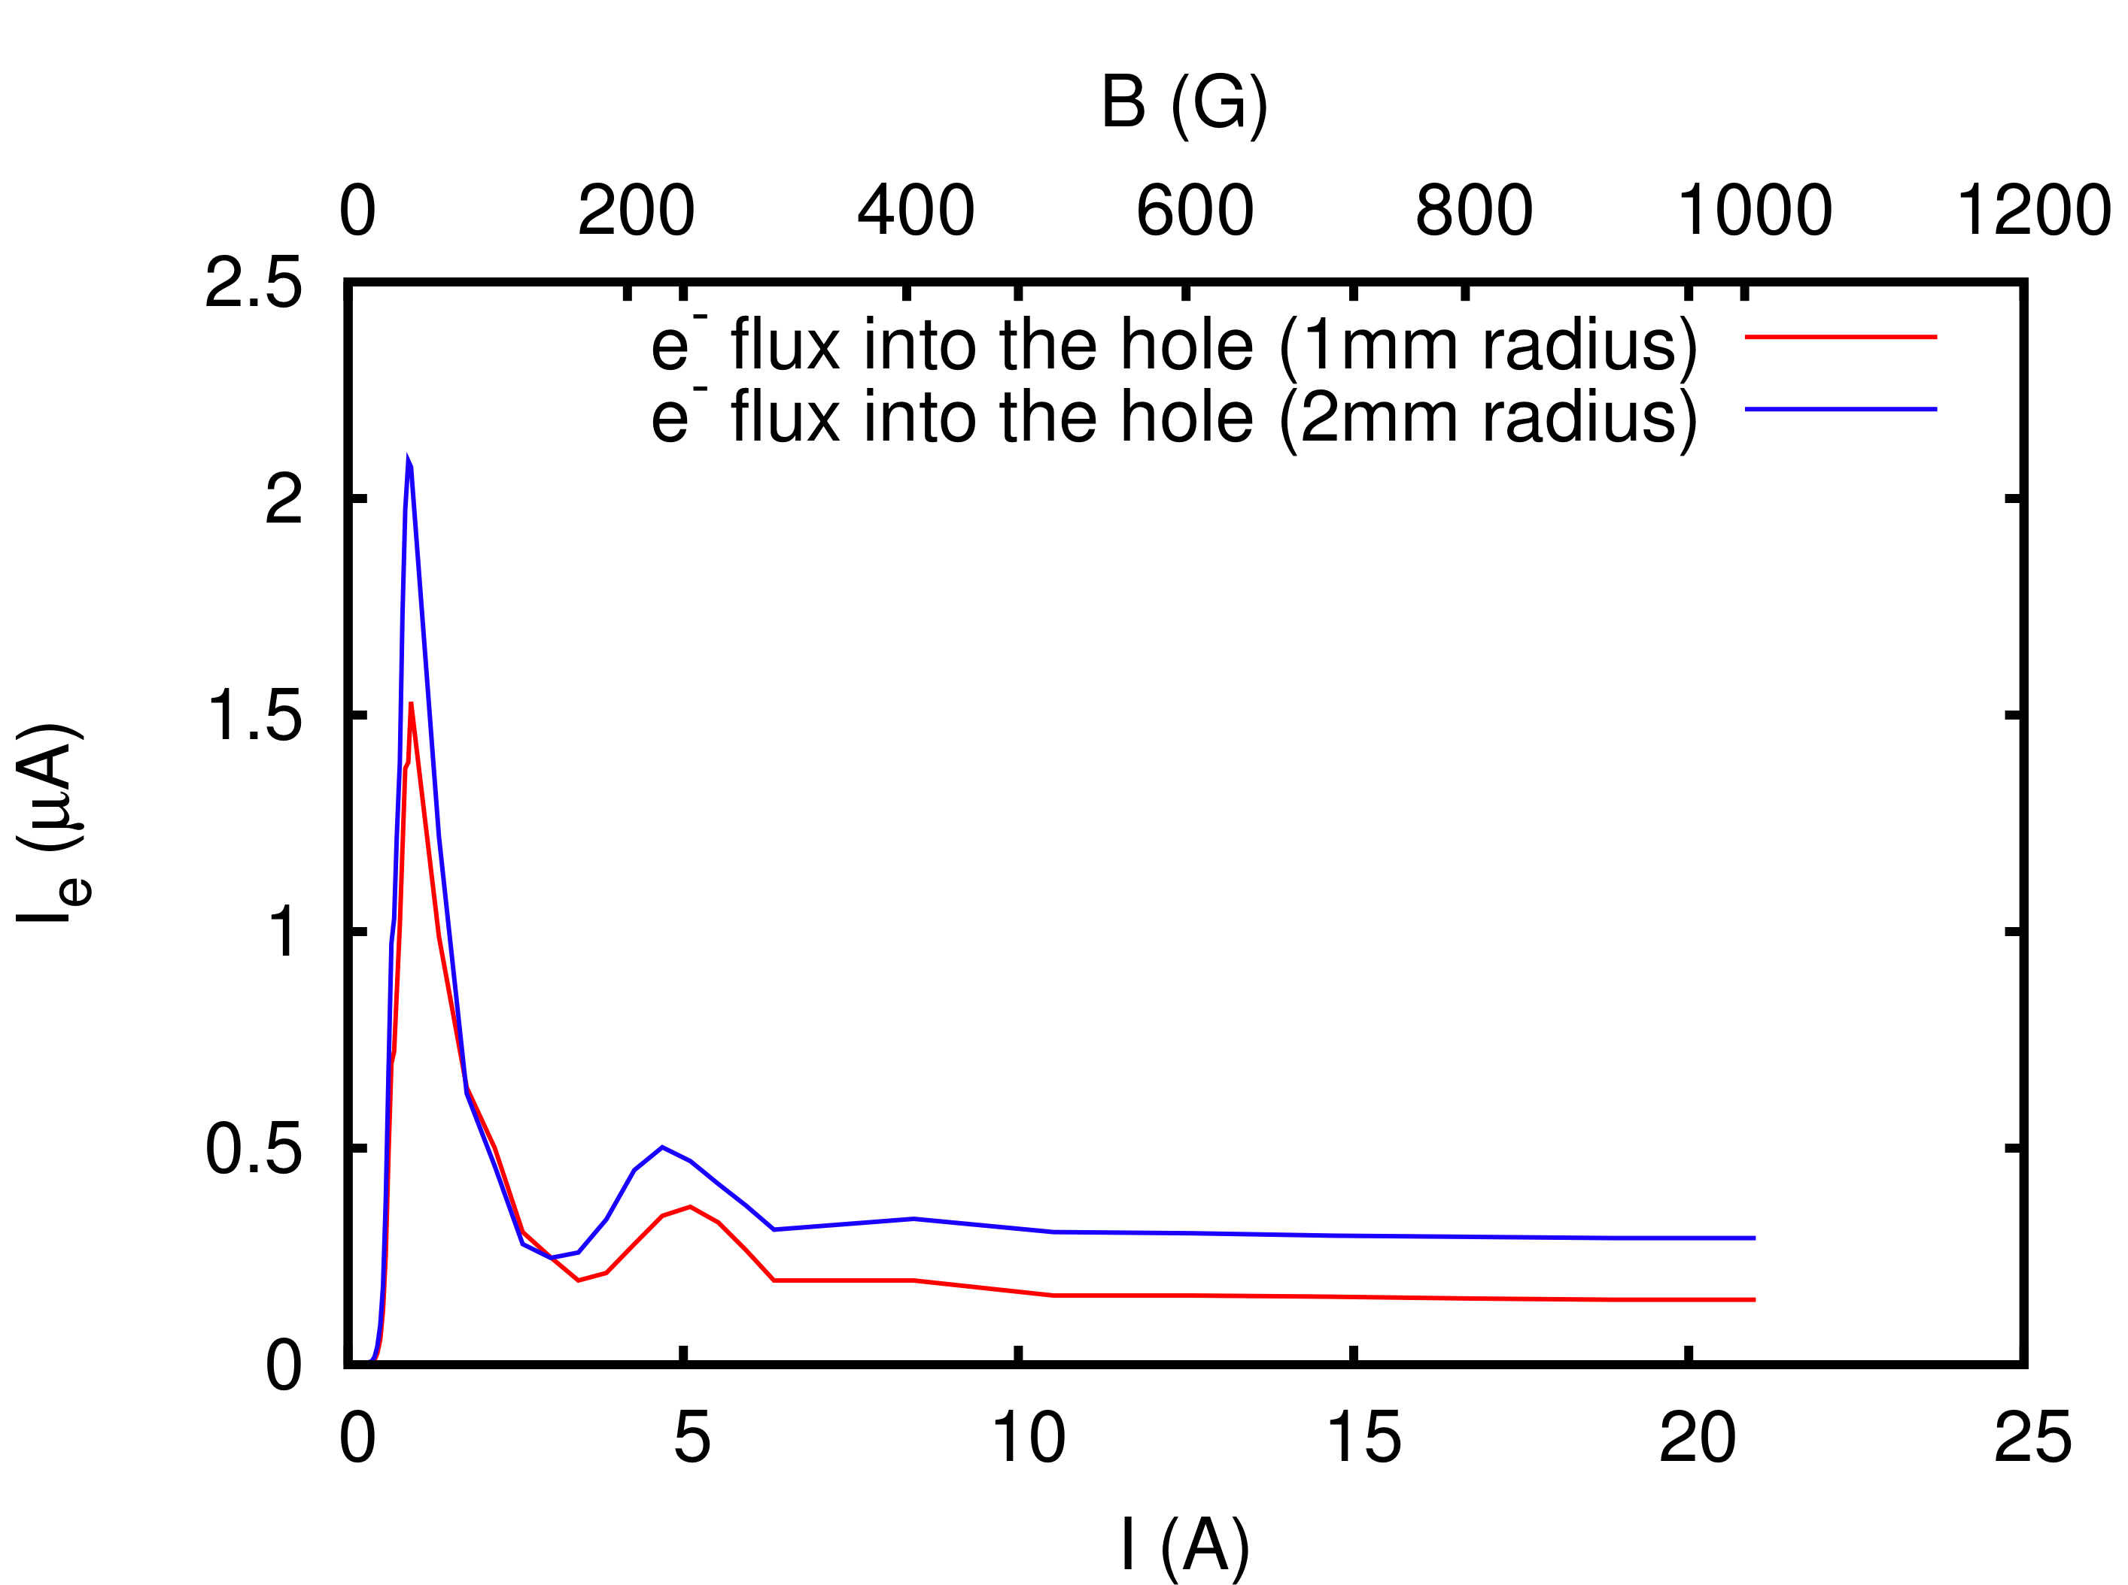
E-cloud simulations with hole: comparing two different sizes of the hole in the center of the chamber (1mm and 2mm)
The size of the hole does not seem to significantly affect the dependence of the electron cloud signal on the intensity of the magnetic field. This is probably due to the fact that we are considering hole sizes in the same order of the beam transverse sizes. Maybe simulations at 450 GeV/c could highlight a difference between these two cases
2mm
4mm

Slide 12
Conclusions
The presence of holes in the pipe wall can locally affect the electron cloud build up, especially for strong magnetic field perpendicular to the holes

