Slide 1
Coating of the SPS main dipoles vacuum chambers: alternative scenarios, logistics

Slide 2
Coating of the SPS main dipoles vacuum chambers: alternative scenarios, logistics
Introduction
Coating project: hypothesis of work
Strategy 1: coating in the tunnel
  Previous experiences
  Implementation of the method in the coating project
  Pros & cons
  Rythm, bottlenecks
Strategy 2: coating in an underground workshop
  Previous experience
  Workshop
  Transport
  Pros & cons
  Rythm, bottlenecks
Strategy 3: coating in a surface workshop
  Previous experience
  Transport
  Pros & cons
  Rythm, bottlenecks
Conclusion

Slide 3
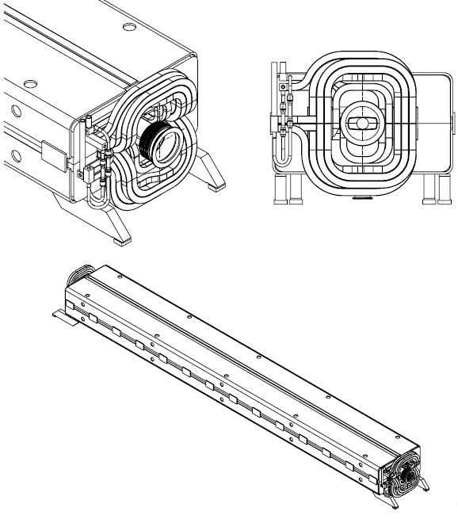
Introduction
General overview of the SPS main dipoles
→ 744 MBA/MBB dipoles form the main bending magnet system of the SPS.
→ MBA and MBB dipole magnets have similar outside dimensions, but different apertures. Each magnet is about 6 meter long, 18 tons and consists of two identical laminated half-cores, a coil assembly composed of inner and outer coils and a captive stainless steel vacuum chamber.
→ The assembly is welded into a rigid self-supporting unit.
→ The 744 dipoles are powered and cooled via a copper bus-bar system

Slide 4
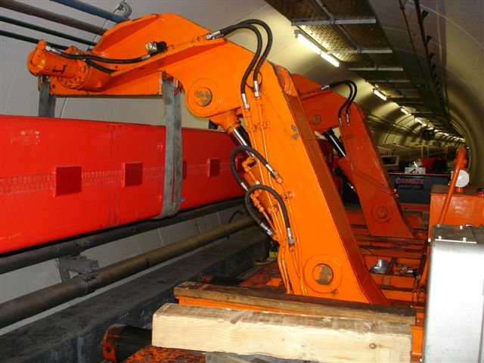
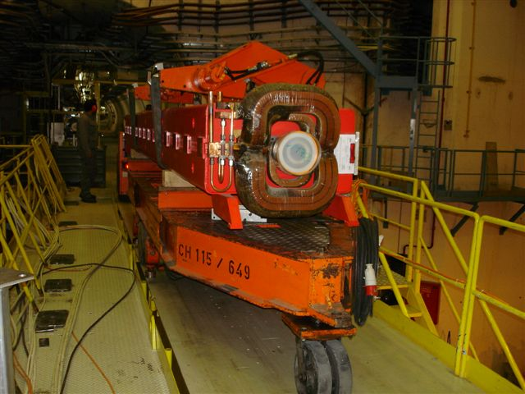
Introduction
Handling and transport of SPS main magnets
➔ done with the ‘Dumont’ machines:
- Trailers equipped with 2 handling manipulators, not motorized
- Hydraulic system, not automated
- Tare: 12 tons
Installation of main dipole in the SPS
Transport of dipole

Slide 5
Coating project: hypothesis of work
Coating process
→ Vacuum chambers: no disassembly of vacuum chambers from the magnets to perform the coating (process would take 3 weeks / magnet)
→ Time of coating process: 48 hours, including installation of equipment, vacuum pumping, coating and dismantling of equipment
→ Position of magnet during process: horizontal
Magnets treated
→ Only SPS main dipoles ≈ 5 km of vacuum chambers (>70 % of SPS vacuum system length)
Time
→ Duration of shutdown period: 14 weeks of access in the machine
Ressources
→ Equipment: use of existing vehicles for transport (2 Dumont handling machines + trailers), possibly with some adaptations (No new vehicules.)
→ Manpower: work done mainly during normal working hours, 5 days/week

Slide 6
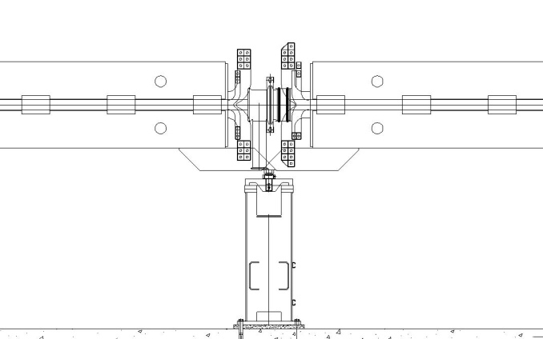
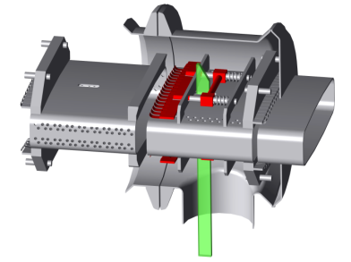
Strategy 1: coating in the tunnel
Previous experiences
  Installation of synchrotronic shieldings in some SPS magnet vacuum chambers in the 80’s
  Installation of RF shieldings in the pumping port cavities of the magnet vacuum chambers between 1999 and 2001
  → Method used: 1 over 2 magnets removed from its position and put in the passageway on the Dumont handling machines to allow accessing interconnections on all the magnets
  → Figures (RF shieldings):
    1200 bellows equipped during 2 long shutdowns
    370 main dipoles and a hundred of auxiliary magnets removed from their position
    Rate of treatment: 3 magnets / day removed and reinstalled to their position
    Time of process / magnet: a few hours, including handlings
RF shielding model

Slide 7

Strategy 1: coating in the tunnel
Implementation of the method to the coating project
  Idea to take out of its position 1 over 2 magnet to allow access to all vacuum chambers ➔ OK
  BUT with a coating process time ≈ 2 days, doing it in the same way means to let 370 magnets, 2 days each one, on the Dumont in the passageway. Since only 2 Dumont are available → project would be realised in about 370 days… more than 5 shutdowns !
Alternative: lifting the magnets about 500 mm above their position instead of bringing them in the passageway + stabilizing them with supports in order to free the Dumont + removal of SSS girders
Access for cathode Insertion
SPS typical half-cell

Slide 8
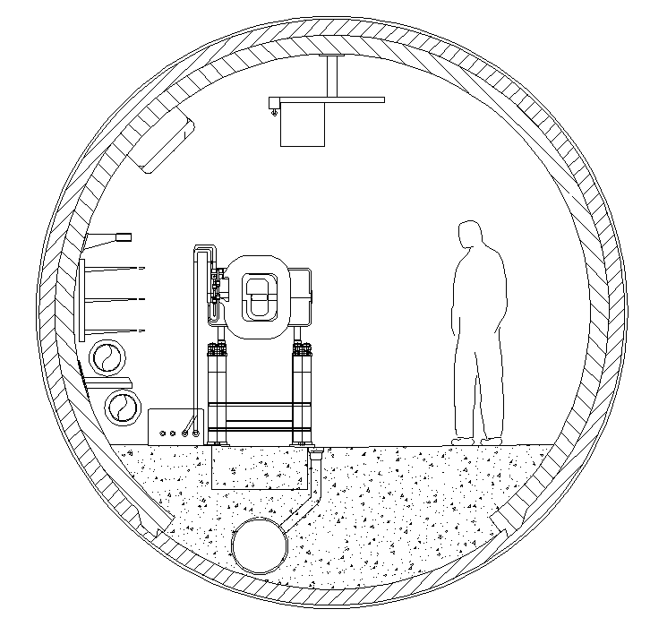
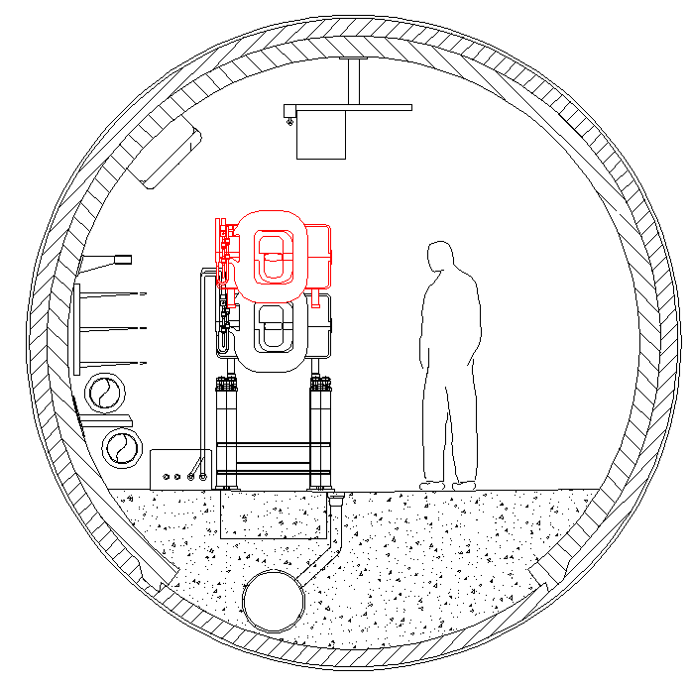
Strategy 1: coating in the tunnel
  BUT space available above the magnet is too small to realize that with the Dumonts
  ➔ need to purchase or manufacture a lifting device that pushes instead of pulling (like a lifting table)
SPS tunnel cross-sections @ dipole position

Slide 9


Strategy 1: coating in the tunnel
Pros
  Minimize handling to the very minimum
  No transport
  The method gives access to both side of each quadrupole that could so be treated too (≈10% of SPS ring vacuum length)
  Quadrupoles stay in place → survey reference kept, time won for alignment
Cons
  Radioactive environment
  Space available is small
  External conditions more difficult than dedicated workshop
  Bulky equipment to move around
  Interference with other activities
  Requires numerous specific supporting structures

Slide 10

Strategy 1: coating in the tunnel
Bottlenecks
  Number of coating equipment available
  Number of supporting structures available
Rhythm
  Assuming in 2 days:
    1 team disconnect-reconnect 6 dipoles from the busbars;
    1 team lift and put back in place 6 dipoles ;
    1 team remove-reinstall 3 SSS girders;
    1 team clean 12 dipole vacuum chambers;
    1 team align 3 half-cells
  Assuming
    12 supporting units are available
    12 coating equipments are available
  Rhythm = 6 magnets / day
  Project completed in 120 jours ≈ 2 shutdowns

Slide 11
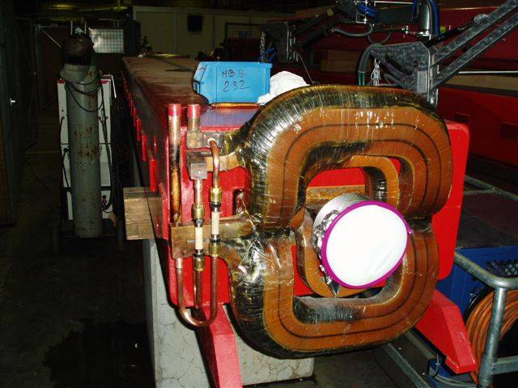
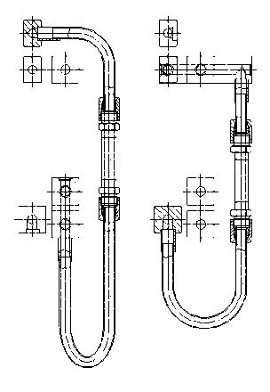
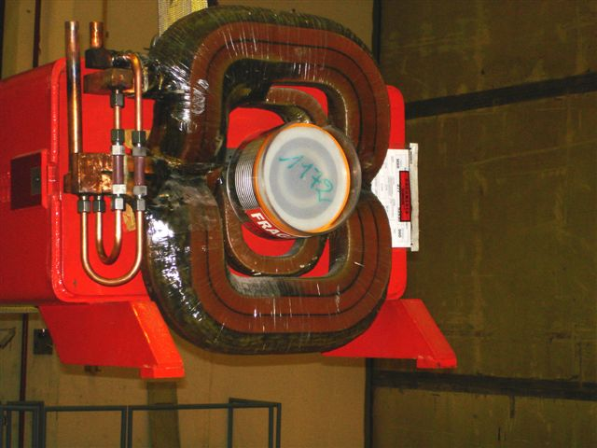
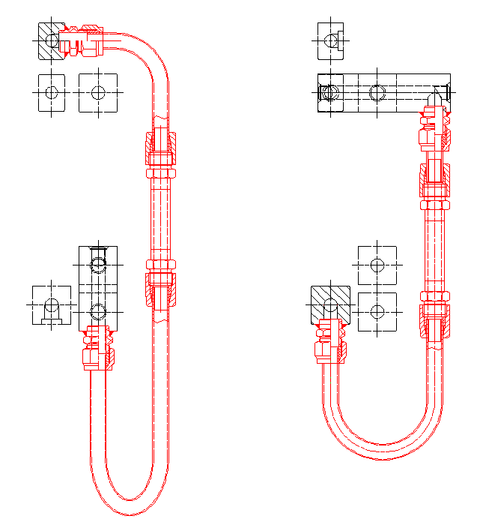
Strategy 2: coating in an underground workshop
Previous (and current) experience
MBB manifold consolidation program: complete refurbishment of all the manifolds on the MBB magnets equipped with Lintott coils in operation in the SPS
  → Method used: magnets removed from their positions and transported with the Dumonts and trailers to ECX5 cavern converted in radioactive workshop
  → Figures :
    255 magnets treated over 3 years (shutdowns 2007, 2008 & 2009)
    Refurbishment rate: 4 magnets / day
    Time of process / magnet (machining, welding, assembly and tests): ≈ 2 hours
Before
After

Slide 12
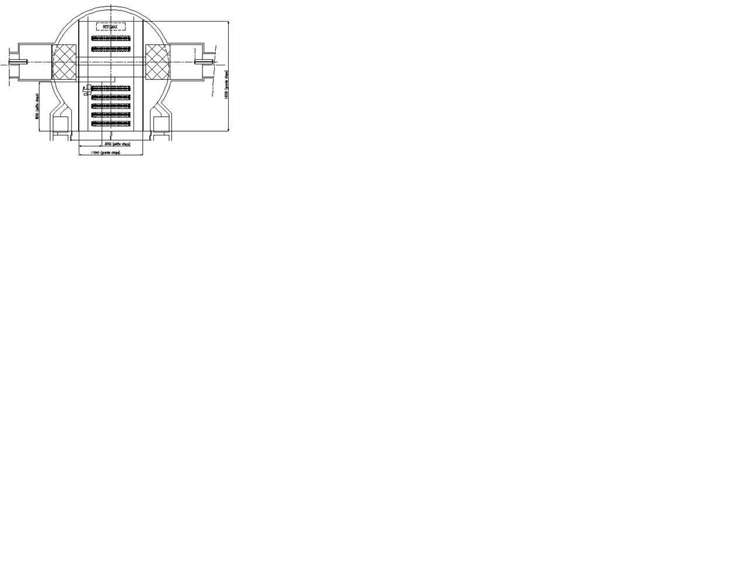
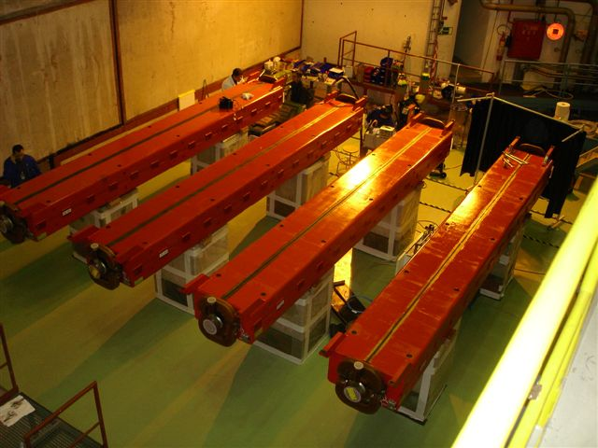
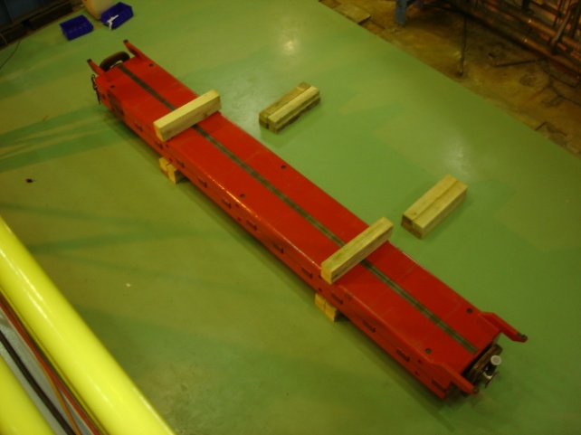
Strategy 2: coating in an underground workshop
Workshop
→ Radioactive workshop in ECX5 cavern
- Underground instead of surface: to limit the risks of transport and handlings and to win time
- In the ECX5 cavern:
→ polar 40 tons crane available (refurbished in 2007)
→ enough space to refurbish 4 magnets / day
→ low radiation level
ECX5 worshop for MBB manifold consolidation (top view)
ECX5, workshop side
ECX5, storage side

Slide 13
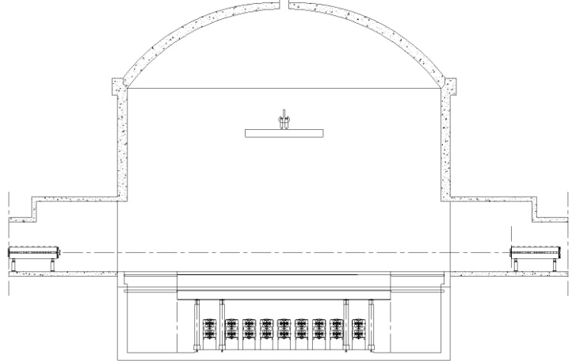
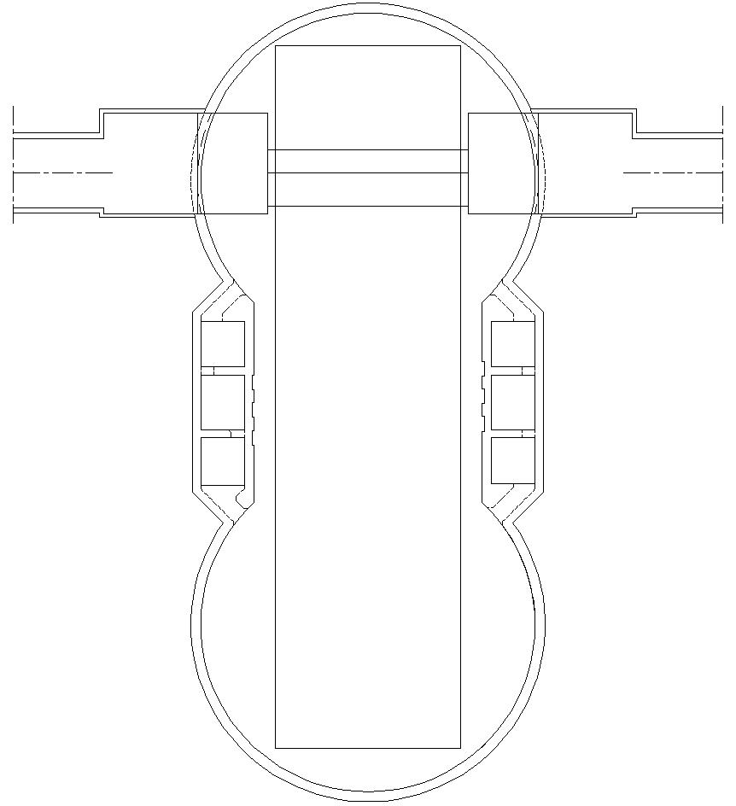


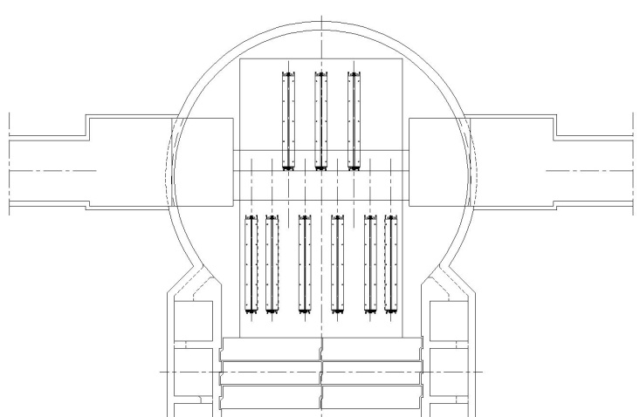
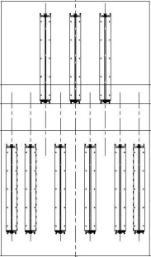
Strategy 2: coating in an underground workshop
→ Layout of ECX5 workshop with 18 magnets in 2 layers
ECX5 coating workshop (front view)
460 m²
210 m²
ECA5 & ECX5, concrete separation wall removed (top view)
ECX5 coating workshop (top view)

Slide 14
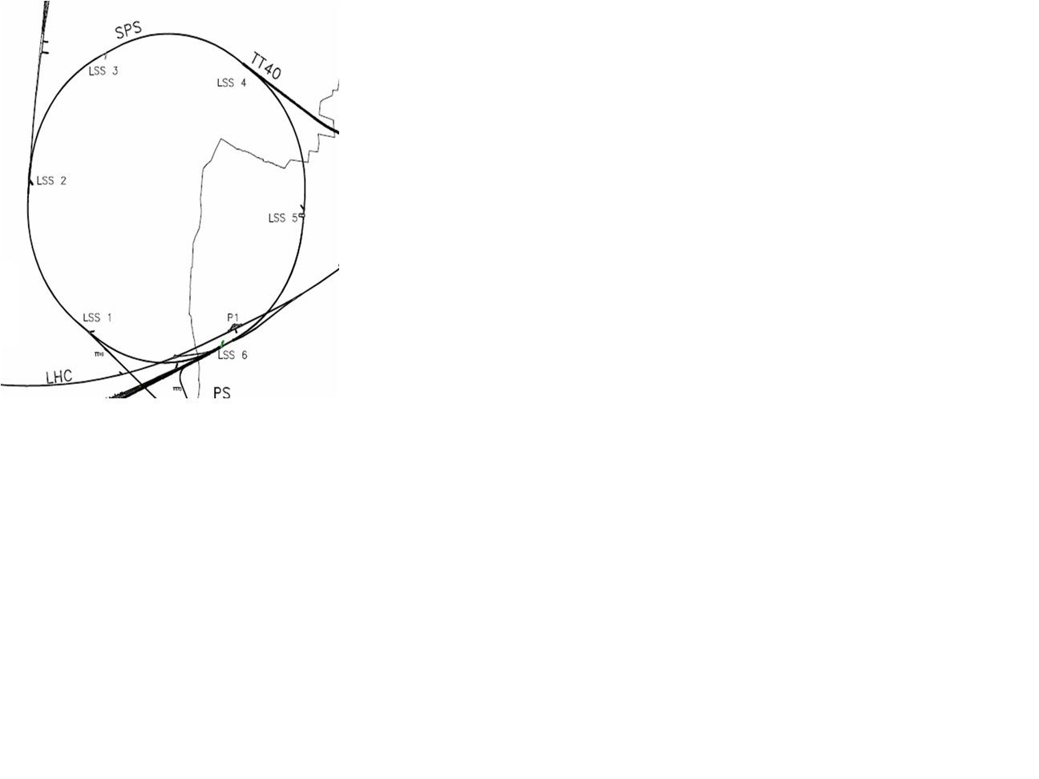

Strategy 2: coating in an underground workshop
Transport
Transfer Dumonts ↔ trailers
- Possible in LSS2-TT20, LSS4-ECX4 and LSS6-TT60
- T_{transfer} ≈ 20 min
Journey with Dumont machines
- Average speed ≈ 2 km/h
- T_{1 sextant} = 36 min
Sectors type 3
Sectors type 2
Sectors type 1
Journey with trailers
- Average speed ≈ 5 km/h
- T_{1 sextant} = 14 min
Half-cells 131 and 304:
positions from which going through journey of
sector types 2 or of type 3 takes the same time

Slide 15
Strategy 2: coating in an underground workshop
Transport time estimate, based on MBB consolidation experience:
Sectors | Sector type | Average time install or remove magnet [min] | Dumont journey |  |  | Average time Dumont-trailer transfer [min] | Trailer journey |  |  | Average time loading or unloading in ECX5 [min] | Total time go and return [min] | Quantity of magnets per sector type | Total time for transport per sector [h]
 |  |  | Average distance [sextants] | Time / sextant [min] | Average time of journey [min] |  | Distance [sextants] | Time / sextant [min] | Average time of journey [min]
418-518 / 518-618 | 1 | 20 | 0,5 | 36 | 18 | 0 | 0 | 14 | 0 | 15 | 106 | 248 | 438
304-418 / 618-131 | 2 | 20 | 0,7 | 36 | 25,2 | 10 | 1 | 14 | 14 | 10 | 158 | 344 | 908
218-304 / 131-218 | 3 | 20 | 0,3 | 36 | 10,8 | 10 | 3 | 14 | 42 | 10 | 186 | 152 | 470
 |  |  |  |  |  |  | Total transport time (all magnets) [h] |  |  |  |  |  | 1816
 |  |  |  |  |  |  | Average time of transport / magnet [h] |  |  |  |  |  | 2,44
 |  |  |  |  |  |  | Working time / day for each Dumont (6 magnets / day) [h] |  |  |  |  |  | 7,3
 |  |  |  |  |  |  | Total transport time (all magnets) with 2 Dumont [jours] |  |  |  |  |  | 124

Slide 16
Strategy 2: coating in an underground workshop
Pros
  Workshop environment with lower radiation level than in the tunnel
  Much space available, possibility to pile up magnets
  Equipment regrouped in a dedicated workshop
  Equipment and supporting structures to perform the coating stay in place
  No special supporting structure required, can use concrete blocks
Cons
  Interference between transport and other activities
  Risks inherent to handling and transport increased
  Time lost with transport

Slide 17
Strategy 2: coating in an underground workshop
Bottlenecks
  Only 2 Dumont vehicles are available
  Number of coating equipment available
  Space available in ECX5 (→ could extend in ECA5)
Rhythm
  Assuming same rhythm for connection to busbars, alignment and vacuum than strategy 1
  Assuming transport teams work a bit in overtime or in 2 shifts with 2 Dumont + trailers
  Rhythm = 6 magnets / day
  Project completed in 120 jours ≈ 2 shutdowns

Slide 18
Strategy 3: coating in a surface workshop
Previous experiences
None in big projects, only preventive and corrective annual magnet exchanges (5 to 10 / year)
  → Method used: magnet removed from its positions and transported with the Dumont to BA3 lift and pulled by electro tractor to magnet workshop in bdg. 867, replaced by a spare
Transport
Need to implement an important logistic in surface in addition to the one underground
Choice of the hoist(s) could be linked to the choice of workshop(s), many possibilities
Hoists need to be refurbished ?
BAs equipped with hoist:
BA2, BA3 & BA6
- T_{lift} ≈ 15-20 min

Slide 19
Strategy 3: coating in a surface workshop
Candidate workshops
  867 or another workshop in Prevessin site to allow coming out of the machine through BA3 hoist →no need for lorries for the surface transport
  Workshop in Meyrin site, with same advantages if we come out from BA6 hoist
  Workshop in BHA5 → if we open the concrete block wall between ECA5 and ECX5, we can lift the magnets with the BHA5 crane (no more need for hoists)

Slide 20
Strategy 3: coating in a surface workshop
Pros
  Work in a non radioactive environment, and not underground
Cons
  Heavy logistics, more difficult to manage and time consuming
  Increase of risks inherent to handlings and transport compared to strategy 1 and 2
  More costly than strategy 1 and 2

Slide 21
Strategy 3: coating in a surface workshop
Bottlenecks
  Only 2 Dumont vehicles are available
  Number of coating equipment available
  Transport teams and vehicles available
Rhythm
  Should not be better than strategy 1 and 2, probably worse
  Rhythm = 6 magnets / day ?
  Project completed in 120 jours ≈ 2 shutdowns ?

Slide 22
Conclusion
Which strategy ?
  Depending on evolution of studies of coating process (operating mode, process duration, conditions needed…)
  Depending on deadline
  Depending on ressources allocated to the project (budgets, manpower)
  Depending on shutdown durations
  ➔ Impossible to choose before having fixed these parameters
Next milestone ?
  Definitely define the process of coating
  Tests on several magnets in the machine ?

Slide 23
Aknowledgments
Special thanks to David Smekens and Marc Ainoux for their help

Slide 24
References
Reducing the sps machine impedance, P.Collier, M. Ainoux, R. Guinand, J-M Jimenez, A. Rizzo, A. Spinks, K. Weiss
New Strategy for the Repair of SPS Dipole Water Manifolds, J.Bauche, W.Kalbreier, D.Smekens (EDMS Doc. No.: 783313)
Projet de Consolidation des Dipôles Principaux du SPS. Remplacements des manifolds de refroidissement des bobines dipôles, David Smekens (EDMS Doc. No.: 782003)

Slide 25
Annex
Rhythms of processes for the groups involved in the MBB manifold consolidation program
(not including workshop)
- TS/HE: average of 4 to 5 magnets / day (whole process of (un)installation, transports go and return, multiple handlings in the workshop) following the vicinity of the position with only one Dumont crane (2 available) + trailers
- AT/VAC: average of 8 vacuum sectors opened and closed + 85 magnets disconnected – reconnected in a few weeks / shutdown
- TS/SU: 6 to 8 dipoles / day realigned
- AT/MCS: 6 to 8 magnets / day disconnected or reconnected to busbar system with only one induction brazing machine (2 available)
- TS/MME: 4 magnets / day fitted with 4 TIG-brazed bronze sleeves

