Slide 1
RF-Measurements of SPS pumping ports without shielding inserts
S. Federmann, F. Caspers

Slide 2
Overview
Motivation
Simplified Theoretical Model
Measurement setup
Simplified mechanical model of shielding insert with coupling loop
Pumping port model without shielding
Results
Preliminary conclusions

Slide 3
Motivation
We have to eliminate the amplifiers in the SPS tunnel (radiation damage)-> the improvement of the coupling is therefore necessary
The problem so far was that most of the energy coupled into the structure went into the space between the shielding and the pumping port wall
We deduced this
because the losses
over the measurement
section (waveguide +
coupling ports) were
around 50 dB. The typical
attenuation of waveguide
modes in the SPS beam pipe
between 2 and 3 GHz is about 0.1 dB/m.

Slide 4
Simplified theoretical model
Theoretical model:
We lose half of the signal (-3 dB) at injection, since the signal power splits equally to the left and to the right (in the frame of this model) assuming no directivity of the coupling structure
For the pickup we have the same characteristic (reciprocity)
Pick up
Injection
-3 dB
-3 dB
-3 dB
-3 dB

Slide 5
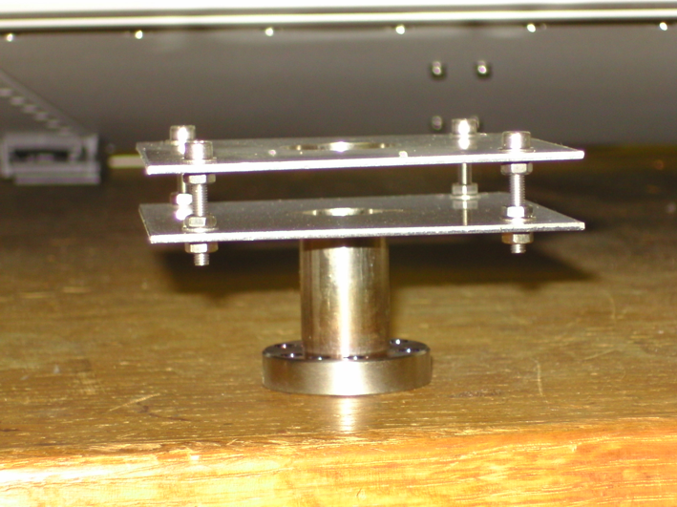
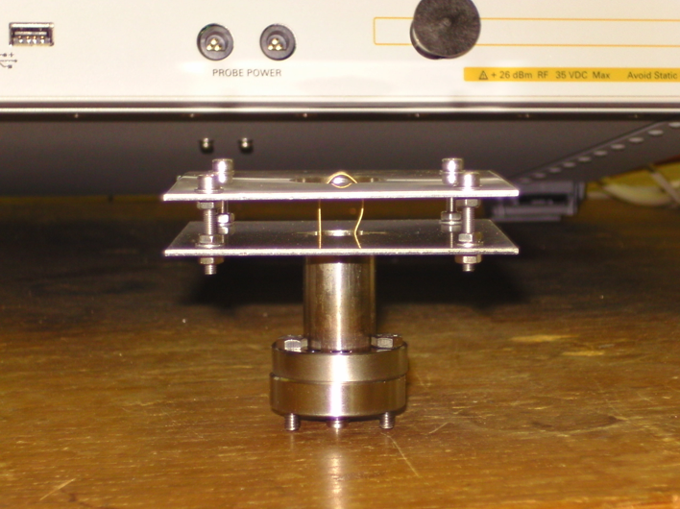
Measurement setup (1)
The coupling loop was measured in free space as well as in a mock up of the pumping ports to check its radiation and coupling properties for its given geometry limited by aperture constraints
12mm
12mm
12mm

Slide 6
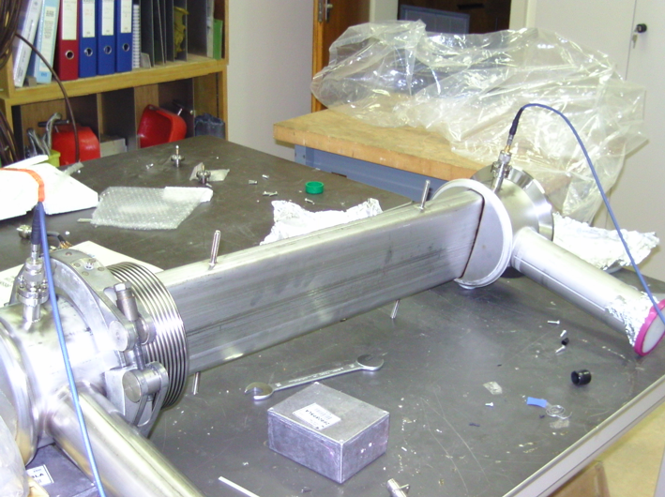
Measurement setup (2)
Furthermore, we measured in a mock up the reflection at each port and the transmission between two SPS pumping ports:

Slide 7
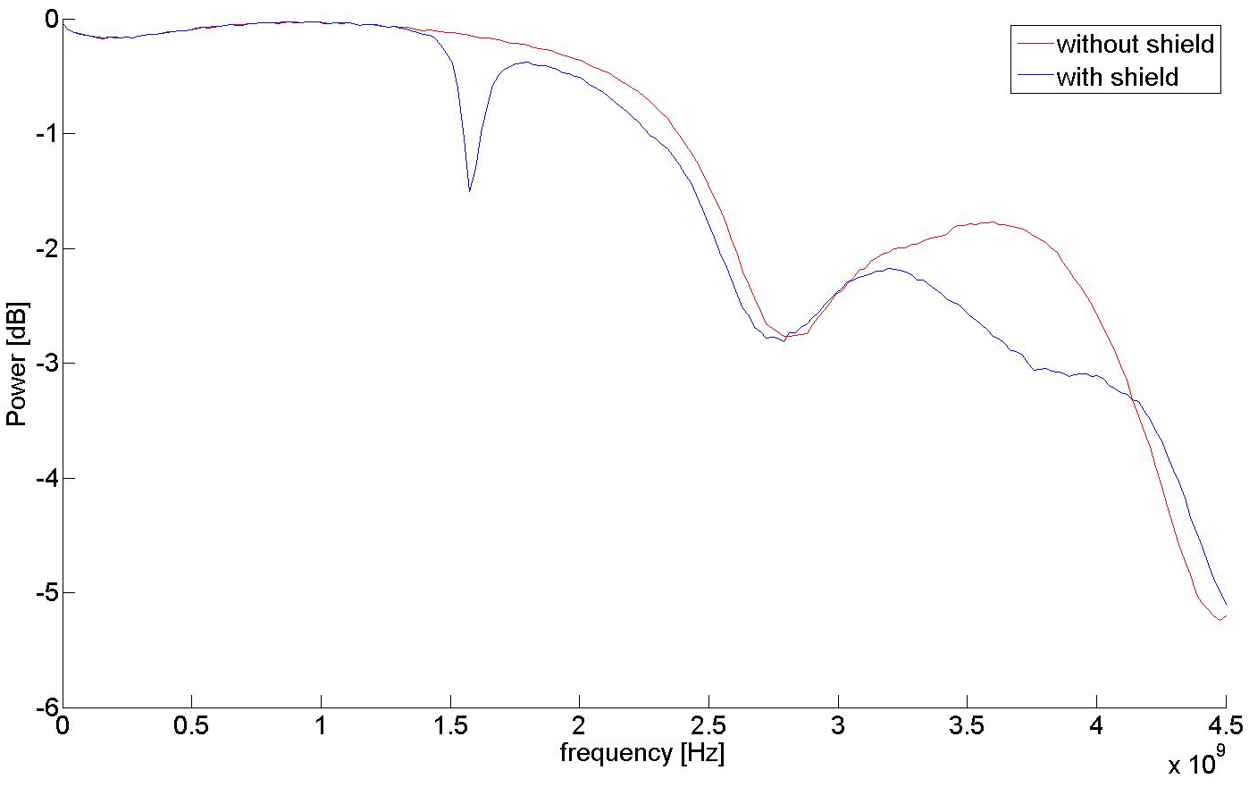
Results for setup #1
The coupling loop itself radiates satisfactory in free space:

Slide 8
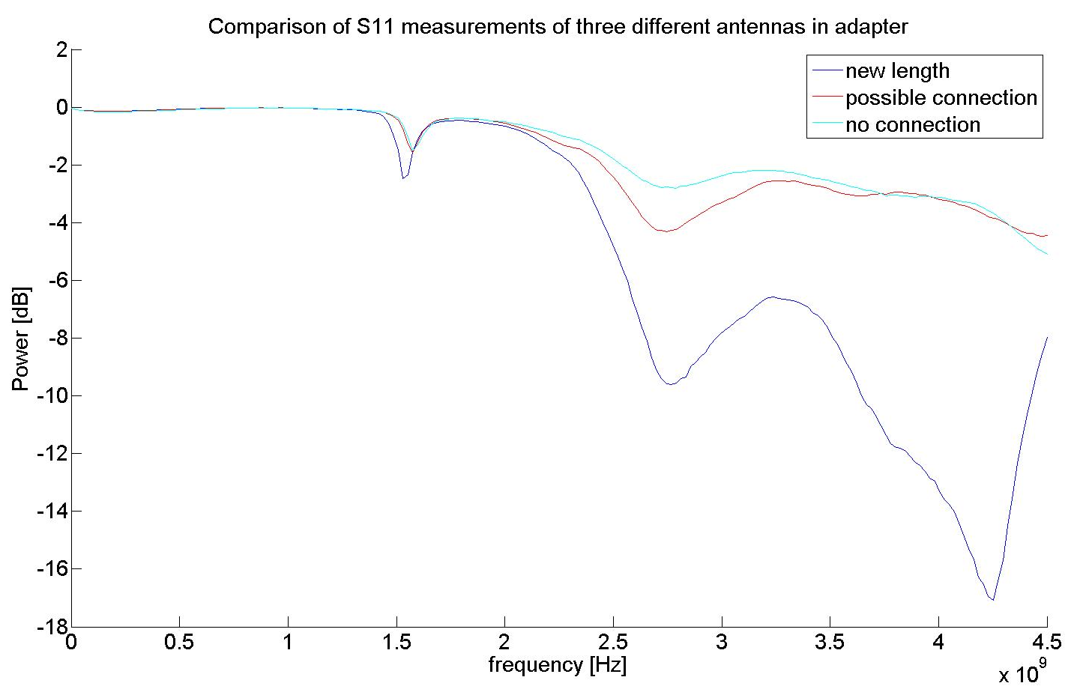
Results
Using coupling loops of different length did not change/improve significantly the radiation properties:

Slide 9
Results for Setup #2
We could find excellent transmission properties for the pumping ports without the shielding, coupling to the H₂₀ mode (identification of the mode via perturbation measurements using a resistive foil)
We noticed that coupling to this cavity mode made the orientation of the loops rather uncritical.
Since we are coupling to a cavity mode the usage of 2 coupling loops is obsolete -> only one coupling loop for excitation and pick up respectively is sufficient
An optimal working frequency was determined around 2.5 GHz

Slide 10
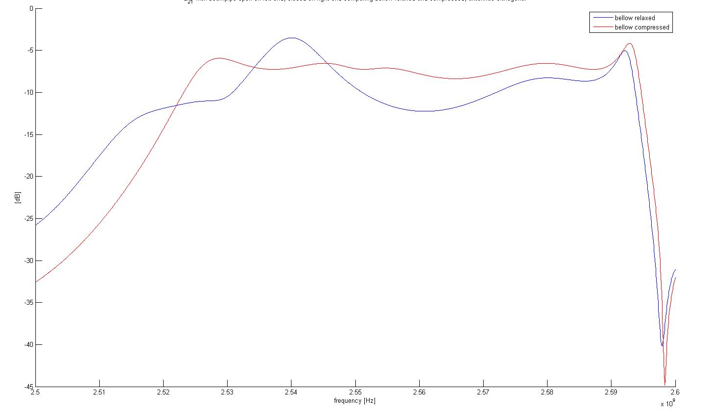
results
We have also investigated differences in transmission for a relaxed and a compressed bellow:

Slide 11
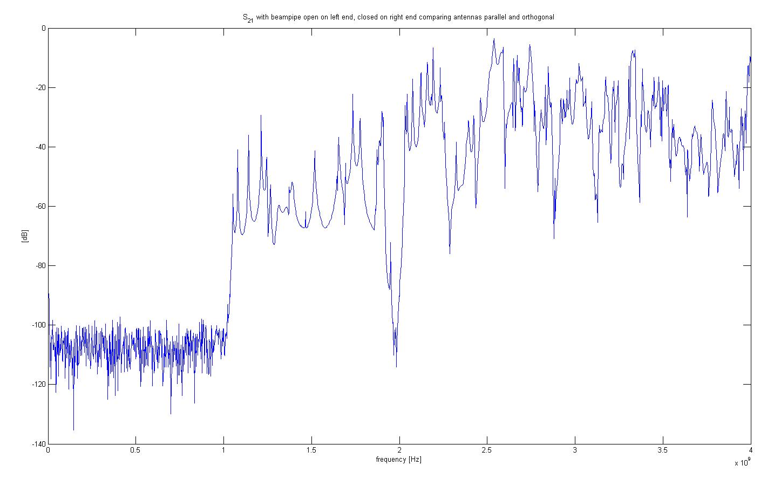
Results
An optimal operating frequency was determined around 2.5 GHz:
Cutoff frequency for the TE₁₀ mode

Slide 12
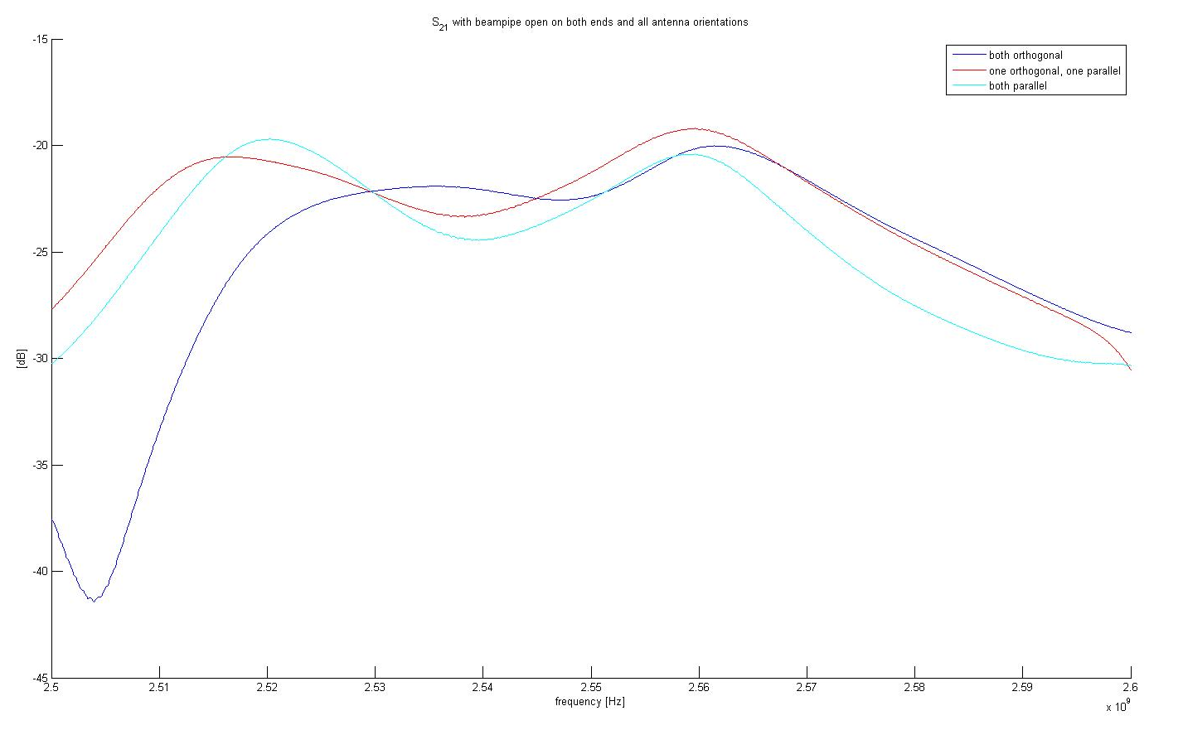
results
A transmission loss of 14 dB was measured with open receiver ‘cavity’ = pumping port structure:

Slide 13
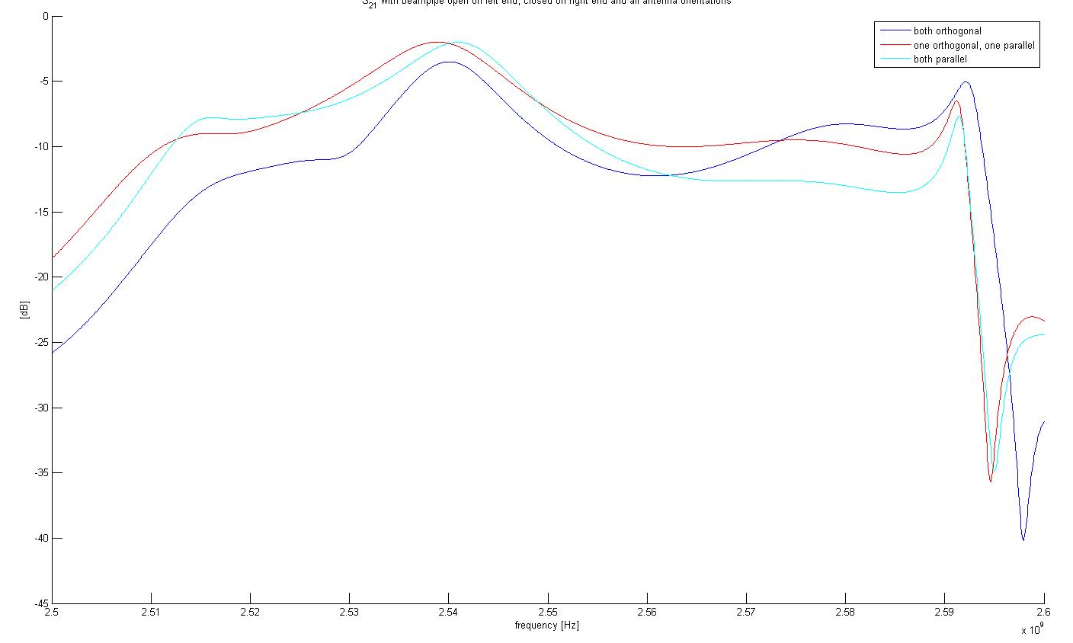
Results
Peculiarity: Closing the receiver cavity on the right end delivered a higher transmission value than predicted by the simplified theoretical model (symmetric excitation to left and right), i.e. 2 dB including 0.1dB waveguide losses:

Slide 14
Results
This points to a directivity (asymmetry) of the cavity mode field pattern, since the theoretical value is based on the assumption of a symmetric pumping port cavity
However, the cavity has already a mechanical asymmetry (which was neglected beforehand) due to the presence
of the bellows
This result should be cross
checked with numerical
simulations

Slide 15
Preliminary conclusions
We need only a single coupling loop to couple to the desired cavity mode
The orientation of the loop turned out to be not very critical
Transmission using the TE₂₀ cavity mode is sufficiently good to operate without amplifiers in the tunnel (but of course we will use them on the surface)
The cavity mode is very likely asymmetrical which leads to a slight asymmetry (1 – 2 dB) in coupling to the left and right. This is not critical for data evaluation, since we normalize to the carrier wave anyway.

Slide 16
Multipactor Measurements on a Stand Alone MBB Magnet
F. Caspers, P. Costa-Pinto,
S. Federmann, M. Taborelli

Slide 17
Overview
Motivation
Measurement setup
Results

Slide 18
Motivation
We wanted to have a setup for testing the multipactoring properties of an SPS vacuum chamber in an MBB magnet that does not depend on the machine planning
With this we are able to study the coating properties independent of MD time in the SPS
We may also be able to install antennas for the microwave transmission method to be used in addition to vacuum diagnostics and reflected RF power as an indicator for multipactoring

Slide 19
Measurement Setup
We were using a stand alone MBB magnet and streched a tungsten wire through the middle of the beam pipe
A vector network analyzer (VNA) followed by a 50 Watt power amplifier was connected to the wire and we programmed a power sweep with 1 minute ramp time on the VNA in the CW mode
A particular matching network was not required for the mode where we operated (225 MHz) as we were reasonably close to critical coupling anyway
We conducted measurements with and without magnetic field

Slide 20
Simultions using ESA multipactor code
In order to get an estimate for the required power to be fed into the resonator, we did a simple multipactor simulation
As a result, the required travelling wave power for provoking multipactoring turned out to be in the order of 1000 Watt for 225 MHz (no matching network required for this frequency)
The loaded Q factor was around 100, thus the power requirement for the resonator mode is about 10 Watt which can be supplied from the available amplifier

Slide 21
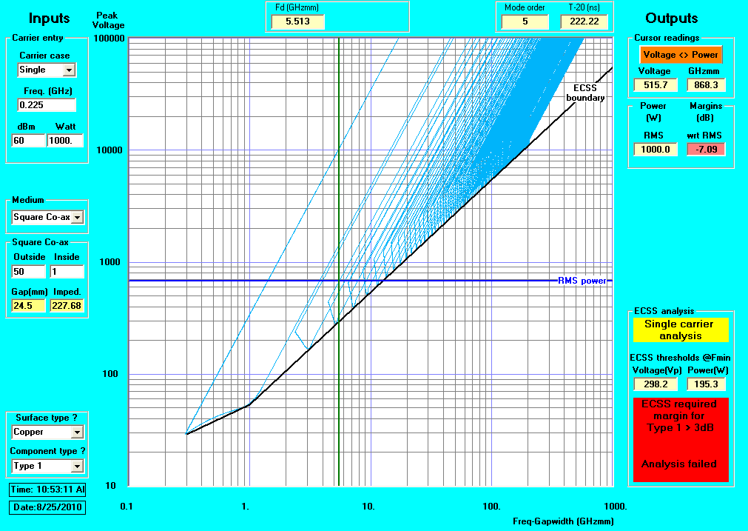
Simulation Results

Slide 22
Results
We could see very nice multipactoring evidence even at relatively small power levels (in the order of 30 Watt)
The presence of the magnetic field lowered the multipactoring threshold considerably
A conditioning effect was observed for all measurement settings

Slide 23
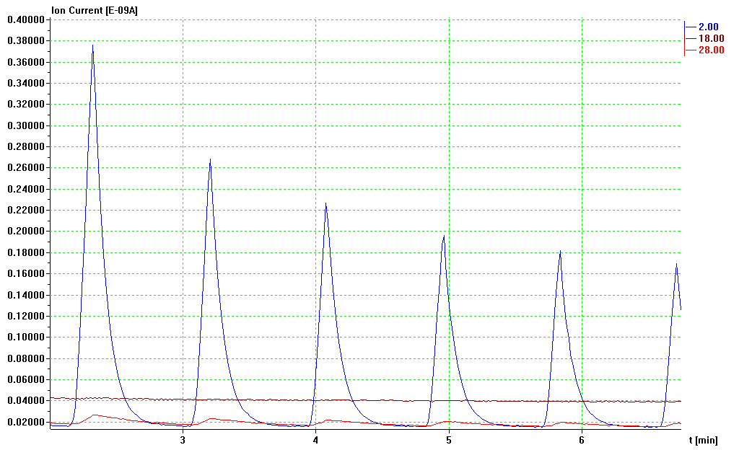
Multipacting test #2 225 MHz, 1min period from -25 to -5 dB on VNA without MAGNETIC FIELD
Period 1min
Conditioning

Slide 24
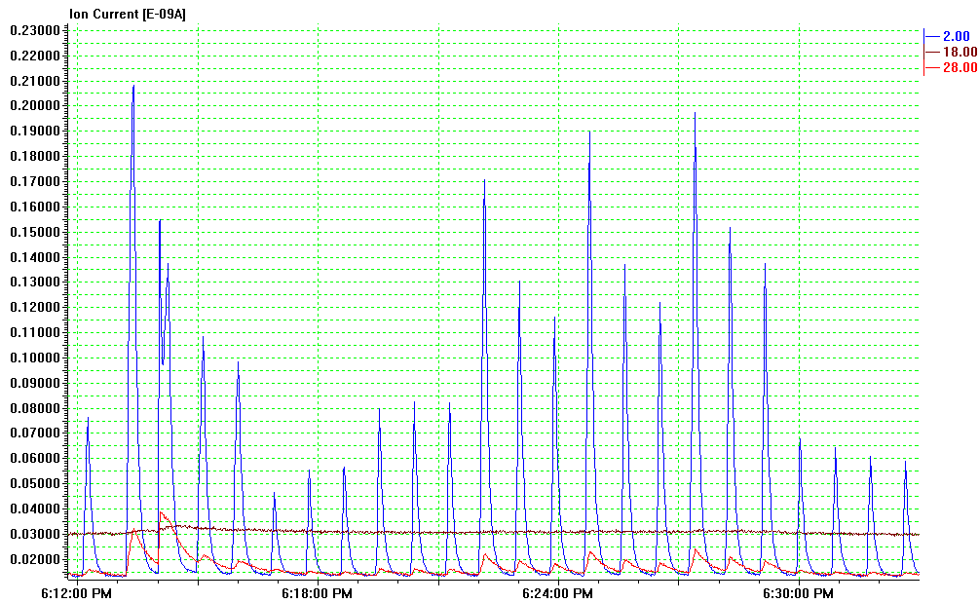
Multipacting test #4: test influence of magnetic field 225 MHz, 1min period from -25 to -3 dB on VNA I_{MBB} -> current in the MBB coil
I_{MBB}
50A
I_{MBB}
0A
I_{MBB}
50A
I_{MBB}
100A
I_{MBB}
150A
I_{MBB}
200A
I_{MBB}
0A
I_{MBB}=0A

Slide 25
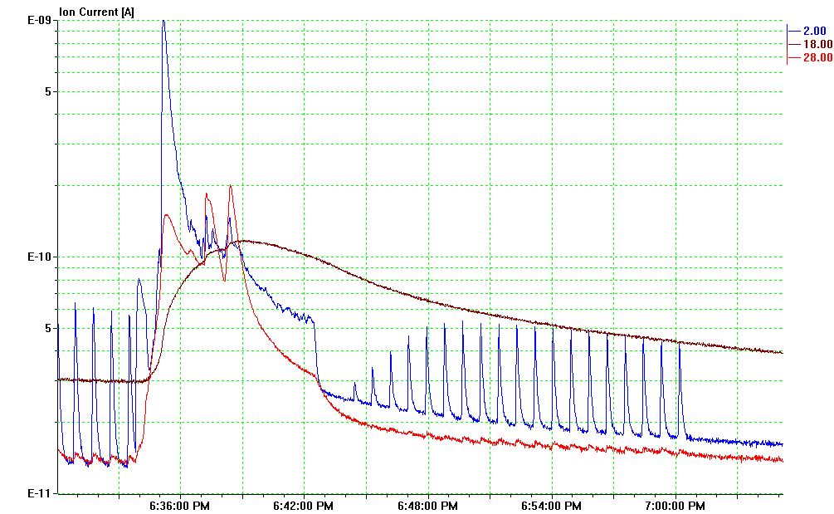
Multipacting test #4: test constant power 225 MHz, constant power -3 dB on VNA (25W)
Pulsed
Constant
Pulsed
Stop

