Slide 1
Observations and measurements on the ZS during the SPS MD 27-29 April 2010
Collaborative effort of many people:
B. Balhan, R. Barlow, J. Borburgh, K. Cornelis, B. Goddard, V. Mertens, B. Pinget, OP crew, RF team …………….

Slide 2
ZS incident 2002
During 2002 scrubbing run: Vacuum interlock provoked ZS main voltage off and ion traps off.
When restarting extraction ZS 5 did not hold voltage anymore (high spark rate), and needed to be replaced.
Therefore, since 2003, during LHC beams, scrubbing runs, etc…. :
ZS ‘retracted’
High Voltage ‘ON’ at 0 kV (not off, to be sure that the voltage is well defined)
ZS 1-5 Ion traps ‘ON’:
-3 kV
-6kV
Software interlock added that verifies Ion trap state: only if Ion trap=on beam is allowed in machine.

Slide 3
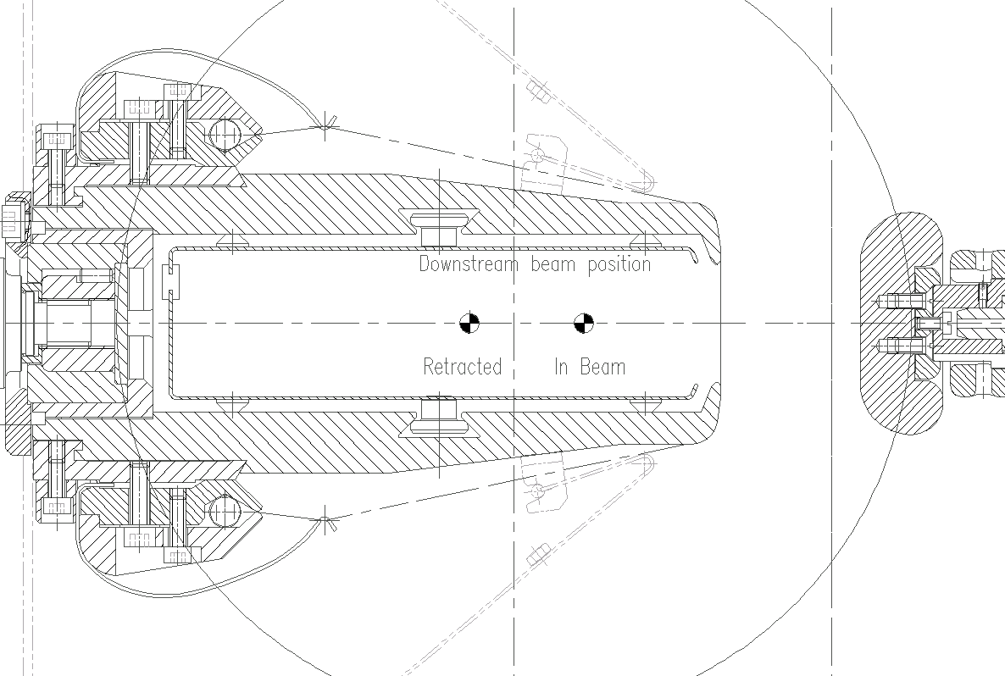
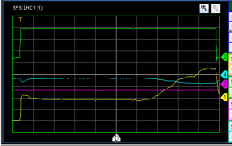
ZS geometry
-3 kV
R 1MΩ
R 500MΩ
R 500MΩ
-220 kV
R 1MΩ
R 100KΩ
I ANODE
-6 kV

Slide 4
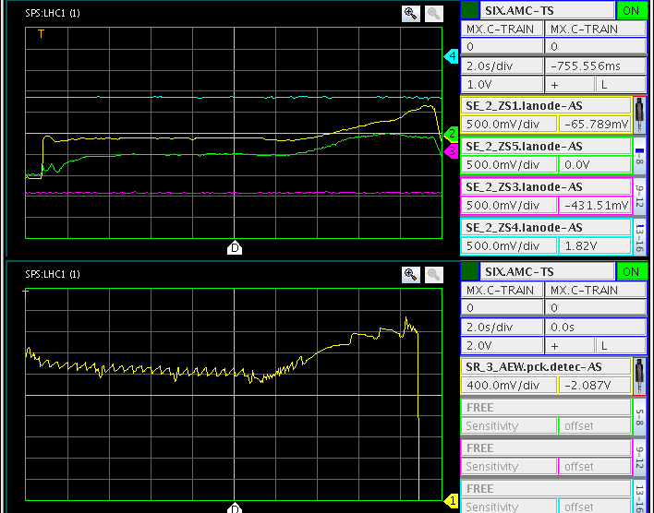
I_{anode} / RF pick-up
ZS Anode current seems to behave like RF pick-up
When beam is injected into SPS, the I_{anode} appears to drops.
If this would be due to protons hitting the anode we would lose 10¹⁴ particles per second!!!
However, no current is observed in generators→ electrons emitted from anode ????

Slide 5
Vacuum activity as a function of beam position
‘In beam’
‘Retracted’
Little conditioning effect observed
NB: LHC25 beam wasn’t at the nominal settings as yet (1 batch, 60 bunches, RF not nominal).

Slide 6
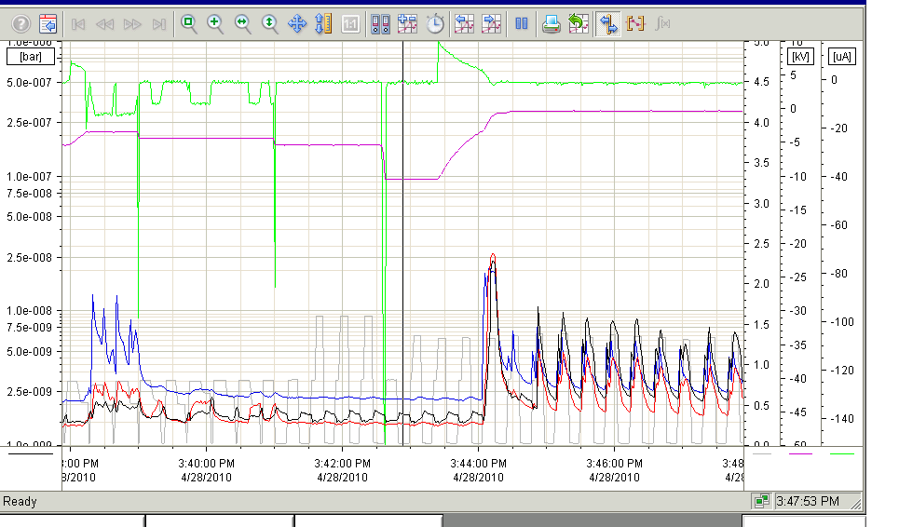
Effect of main gap voltage
LHC25 beam parameters not yet nominal!!! Effect less significant with nominal beam parameters.
By applying main gap field the vacuum activity can be reduced.
U Main ≤ -3kV for Itrap settings -3, -6kV
U Main ≤ -1.5kV for Itrap settings -1.5, -4.5kV
Setting the Itrap settings to 0, -3 kV, tripped the vacuum interlock.
But more time & stable conditions are needed to perform accurate measurement…

Slide 7
Anode support equi-potential lines
Ion traps on(-3, -6 kV)
Main Voltage 0 kV
Ion traps on(-3, -6 kV)
Main Voltage -7 kV

Slide 8
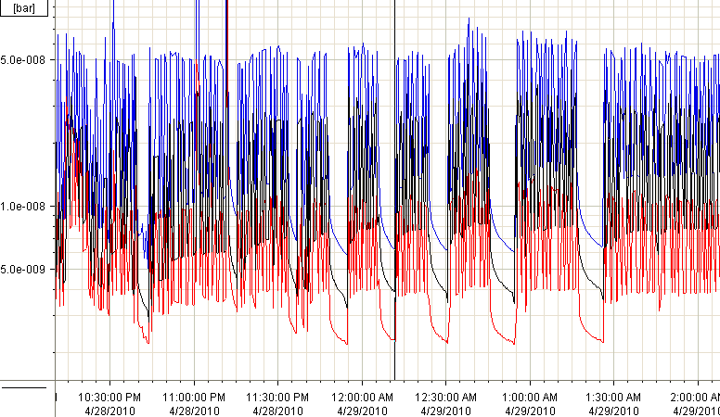
Repeated high intensity cycles
RF voltage increased to 7MV as from here
The night of 29/4/2010 4 batches of 72 bunches were taken with nominal beam parameters (from 12:40 am onwards) .
The main voltage was kept at -7 kV, Itrap voltage at -3, -6 kV.
Nominal beam parameters were more difficult to sustain the beam setting used before. The vacuum levels degraded a factor 10.
Running several hours does not show any further degradation of vacuum in ZS.
Applying a higher voltage to the main gap did not yield a further reduction of the vacuum levels.

Slide 9
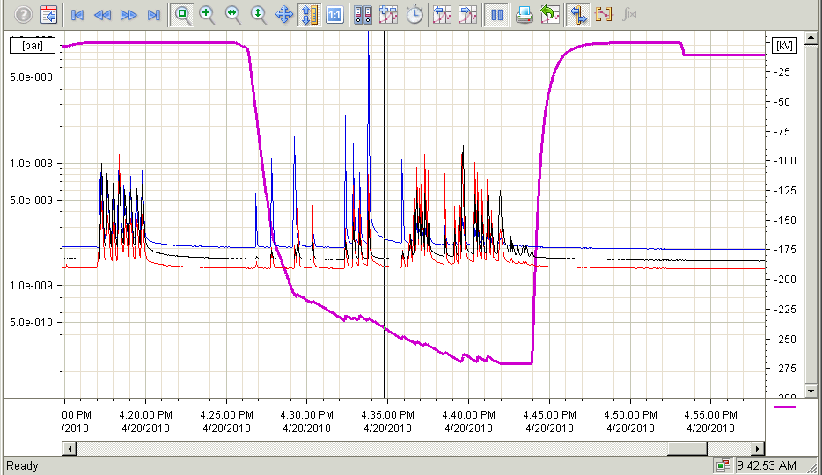
ZS de-conditioning
Main voltage
Vacua
De-conditioning was observed. However, only 10 sparks suffice to retrieve the initial conditioning level.

Slide 10
Conclusions
ZS outgassing depends strongly on beam parameters, in particular the bunch length.
It was found that the main circuit needs to be powered to reduce the vacuum activity.
Most effective setting for reduction of the vacuum activity appear:
ZS ‘retracted’
High Voltage ‘ON’, main gap voltage ≈ - 7 kV; this limits the vacuum activity and still seems a save value not to risk damage to the ZS.
Ion traps ‘ON’: -3kV /-6kV
Simulations of e-cloud with the main field and ion trap field voltages would be nice, but may be very difficult to model.

Slide 11
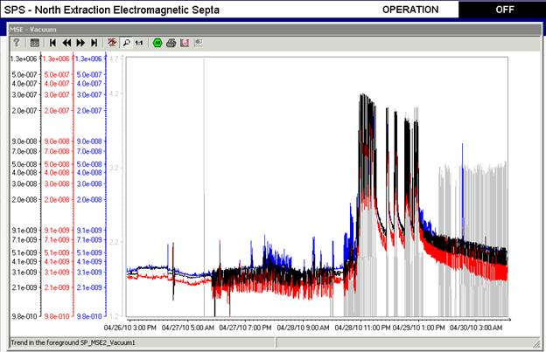
Outgassing observed on MST/MSE
Interlock Level
The MS tripped during these tests. However it is acceptable to increase the vacuum interlock threshold to 10⁻⁶ mbar from the equipment point of view.

Slide 12
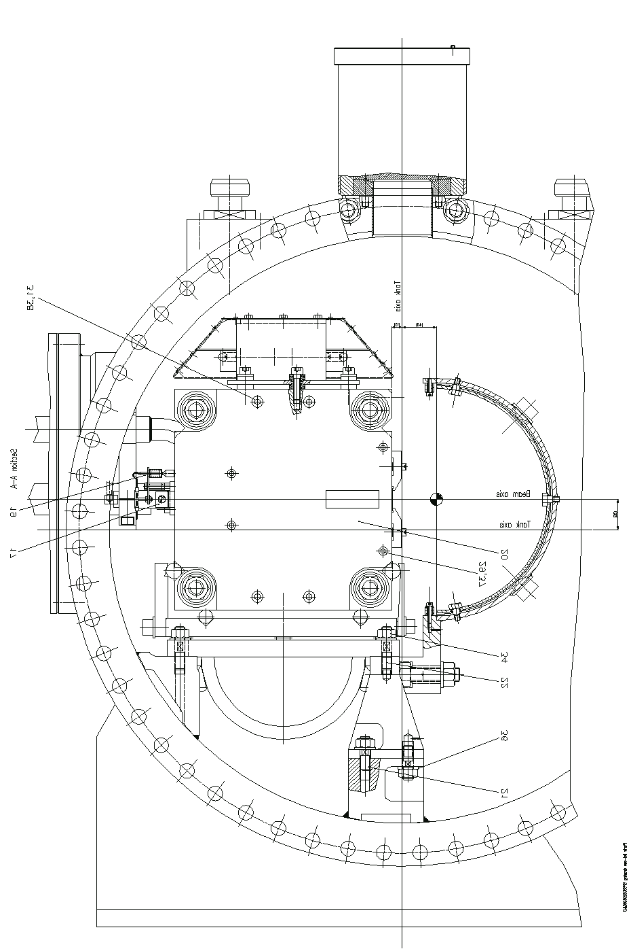
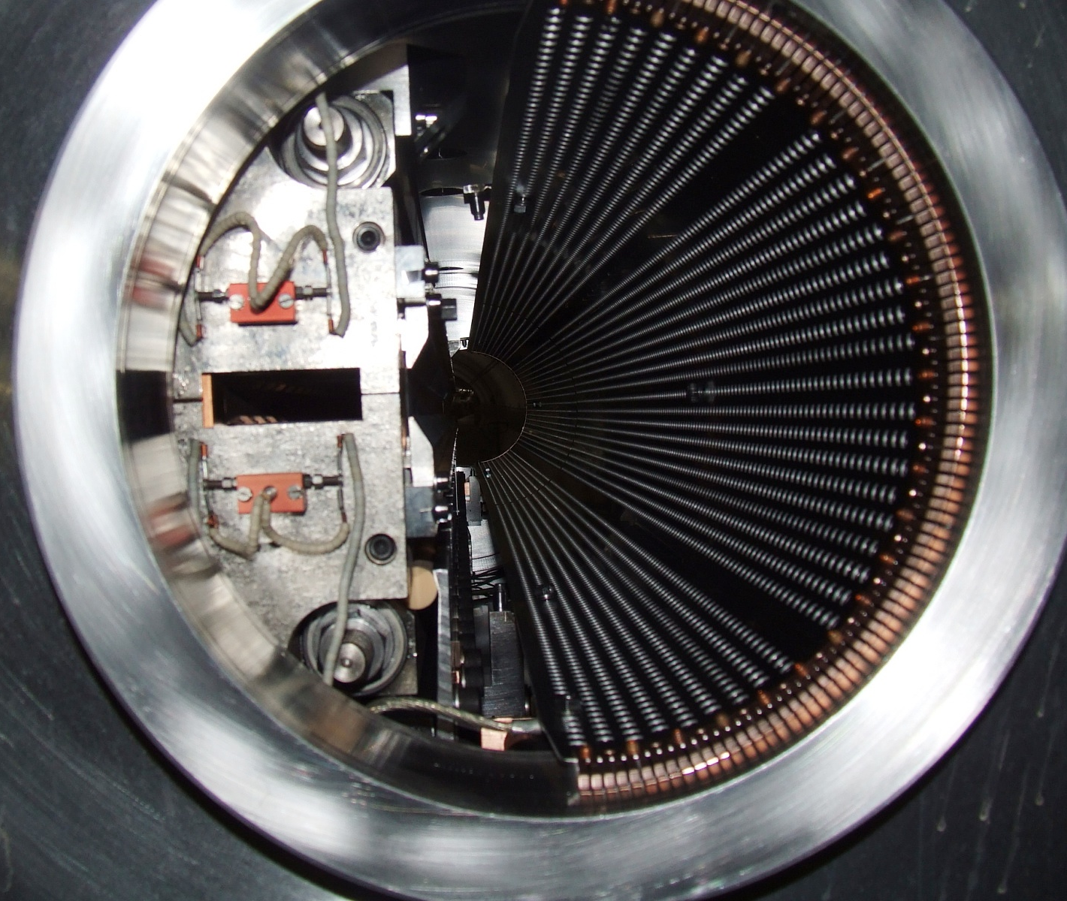
MS geometry
Beam screen

Slide 13
Ideas for the next MD
Test ZS behaviour but make sure to keep ZS alive…
Scan girder position ZS5 (retracted -> in beam) to determine main voltage required vs. girder position.
Set girder parallel to the beam and compare outgassing ZS1-ZS5.
Observe individual ZS behaviour by varying the gap widths,
→ vary the fields individually to see if one of them is more sensitive
Measure precisely the threshold levels for vacuum activity reduction as a function of the Ion trap voltage and Main gap voltage with nominal beam parameters.
Verify outgassing as well as de-conditioning during higher than nominal intensity runs

Slide 14
Ideas for a test facility in LSS6 (ZSTF6)
LSS2 actual layout
LSS6 proposed layout with one Zs
Install 1 ZS (100 µm, wires, stainless steel anode) in LSS6 (cabling to a large extend still available from former West Area extraction).
Install a bipolar Ion Trap Power supply to verify origin of I_{anode} decrease.
Improve Ion trap box, i.e. direct voltage measurement on Ion Trap. plates, as well as lower impedance towards power supply?
Vacuum gauges installed on individual ZS tanks and pumping modules.
Improved image current paths (beam impedance reduction?).
Resources needed: ~0.6 MY + ~100 kCHF (hardware+electronics)
Work may be started in SD 2010/2011?
Launch now??

