Slide 1
MD results from Nov. 20 on low transition energy in the SPS and studies for 2011
H. Bartosik, Y. Papaphilippou, B. Salvant, T. Argyropoulos

Slide 2
Motivation for lower transition energy
Instability thresholds for TMCI and longitudinal instabilities increase linearly with slippage factor η
Higher slippage factor means more mixing in longitudinal plane and faster damping
Higher instability thresholds is thus expected for lower transition energies γ_{t} (=higher slippage factor)
Lower γ_{t} can be achieved in SPS easily by reducing the horizontal betatron tune
Nominal working point for LHC beams (Q26): Q_{x}=26.13, Q_{y}=26.18, y_{t}=22.8, η(@26GeV)=0.63E-3, maximal horizontal dispersion~4.8m
New working point for LHC beams (Q20): Q_{x}=20.13, Q_{y}=20.18, y_{t}=18, η(@26GeV)=1.8E-3, maximal horizontal dispersion~8m
Increase of η by a factor of 2.8 @injection and 1.6 @extraction!
Possible limitation: for achieving same longitudinal parameters (bucket area) RF-voltage needs to be increased according to V~η
However, smaller longitudinal emittance blow-up for same stability

Slide 3
Previous results
2 cycles with lower γ_{t} (Q20) prepared in the SPS database
MD1 for flat bottom studies (3.7s)
LHCfast3 with acceleration up to 450GeV
Transfer lines TT2/TT10 not matched to new optics yet
Optics function in the new cycles confirmed by measurements
Experimentally confirmed increase of slippage factor by measurement of synchrotron frequencies for nominal and new optics
Up to now studies with single bunches only
Successfully injected up to 3.3E11 p/b with MD1 cycle
Successfully accelerated up to 2.5E11 p/b up to 450GeV
No significant blow-up of transverse emittances observed
Higher thresholds for Transverse Mode Coupling (TMC) instabilities qualitatively confirmed
Particle losses (~10%) within the first 10ms after injection of about 3E11 p/b for RF-voltage of 1.8MV (measured with the integrated bunch intensity from the wall current monitor)

Slide 4
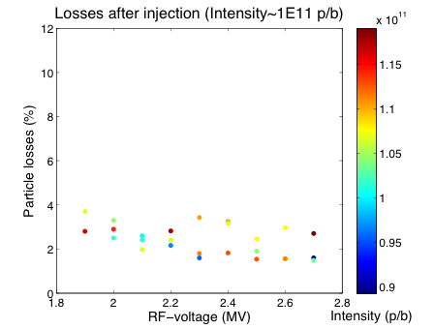
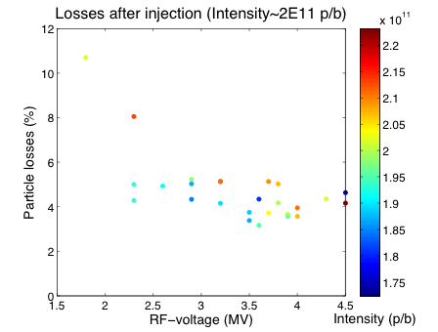
Losses at injection for different RF-voltages
Scan of RF-voltage for different intensities
Qx=20.13, Qy=20.18, ξ_{x}~0.2, ξ_{y}~0.03 (chromaticities not measured)
Improving losses within 10 ms after injection by increasing RF-voltage
Small effect for intensity around 1E11 p/b: 2-4% losses
Losses of around 4% for RF-voltage above 2.5 MV for 2E11, but increased loses for lower voltages
No clear dependence on RF-voltage in both cases (for RF voltage above 2.5MV) → maybe due to longitudinal phase space distribution coming from the PS or space charge effects (optimization for high intensities needed)

Slide 5
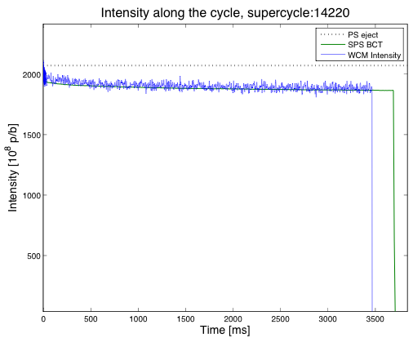
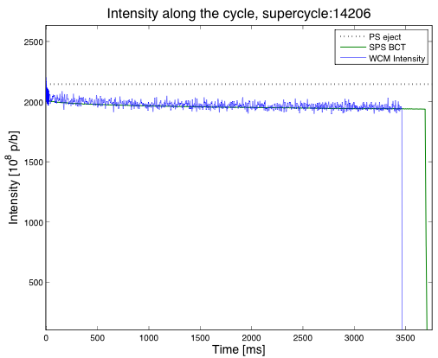
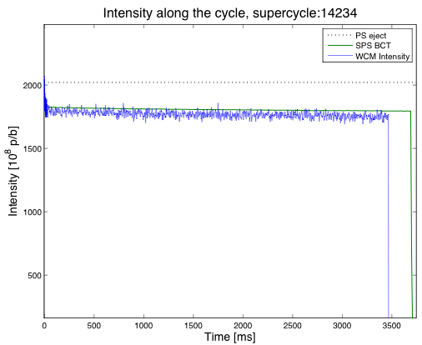
Intensity along flat bottom of MD1
RF-voltage: 1.8 MV
RF-voltage: 3.2 MV
RF-voltage: 3.8 MV
Immediate losses with 1.8 MV (~10%)
Reduced losses within first 20 ms after injection for RF-voltage above 2.5 MV (~4%)
Slow losses within 1.5 s
Total losses seem to increase again with higher voltage – Crossing of resonances due to increased space charge forces arising from shorter bunch length?
Comparison with nominal Q26 MD1 cycle and further studies needed

Slide 6
To be addressed next year
Correct chromaticity along the acceleration cycle for providing comparable set of machine parameters
Optimize RF parameters at flat bottom and along the cycle
Study longitudinal parameters at 450 GeV for different intensities – compatible with LHC requirements and available RF-voltage?
Investigate loss mechanisms at injection – optimize working point and further studies on the nonlinear machine model (space charge, resonances, …)
Inject LHC bunch trains with high intensity for studying impact on electron cloud and other multi-bunch instabilities with all different bunch spacings
Investigate the possibility of injecting high intensity (CNGS) beams above transition (Q15)
Q20 cycles could be very useful to study the localization of impedance sources of the machine
Match transferline TT2/TT10

Slide 7
Possible simulation studies
Study space charge effects and find improved nonlinear model for optimizing working pointfor new optics with different emittances: Hannes
Study electron cloud instability with new optics with different bunch spacings: Kevin
“Headtail” simulations on Transverse Mode Coupling instabilities for estimating thresholds for nominal and new optics (injection/extraction): Benoit
Study of the impedance localization through intensity dependent multi-BPM response (cross check with one-turn transfer matrix): Nicolo
Study coupled bunch instabilities (transverse, injection/extraction): Nicolas
Studies in longitudinal plane: Elena S./Theodoros/Chandra
Coupled bunch instabilities (injection-extraction)
Double RF – use of 800MHz cavity and longitudinal emittance blow-up
Matching of transfer line TT2/TT10: Elena B./Hannes

