Slide 1
Single Bunch Instability at Flat Top
Ivan Karpov
Acknowledgements:
Alexandre Lasheen, Theodoros Argyropoulos,
Markus Schwarz, Elena Shaposhnikova
LIU-SPS BD WG meeting, 16 Jan. 2020

Slide 2
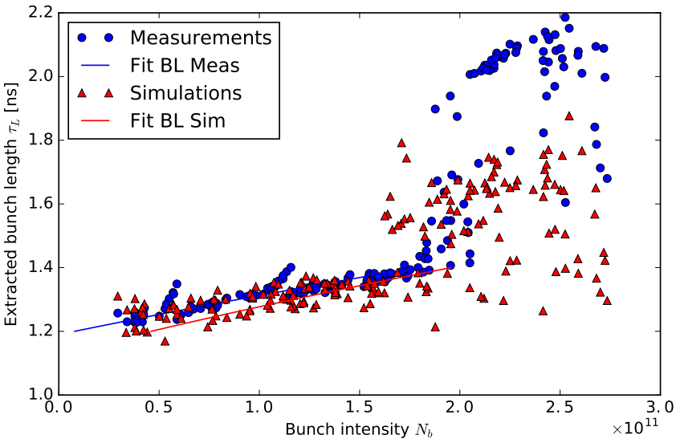
Reference measurements with single bunch
Potential use single bunch instability threshold as validation of post-LS2 SPS impedance model
Flat top (FT), single rf, $V_{200} = 7.2$ MV, Q20
Single bunch measurements in 2015 (A. Lasheen, LIU-SPS BD WG 06/08/2015):
Emittance and intensity adjusted in the PSB
Emittance ($ε_{l}\sim 0.24$ eVs, calculated from $τ$)
Scanning intensity ($N_{ppb}=0.5×{10}^{11}$ to $2.8×{10}^{11}$)
(A. Lasheen, PhD thesis, 2017)

Slide 3
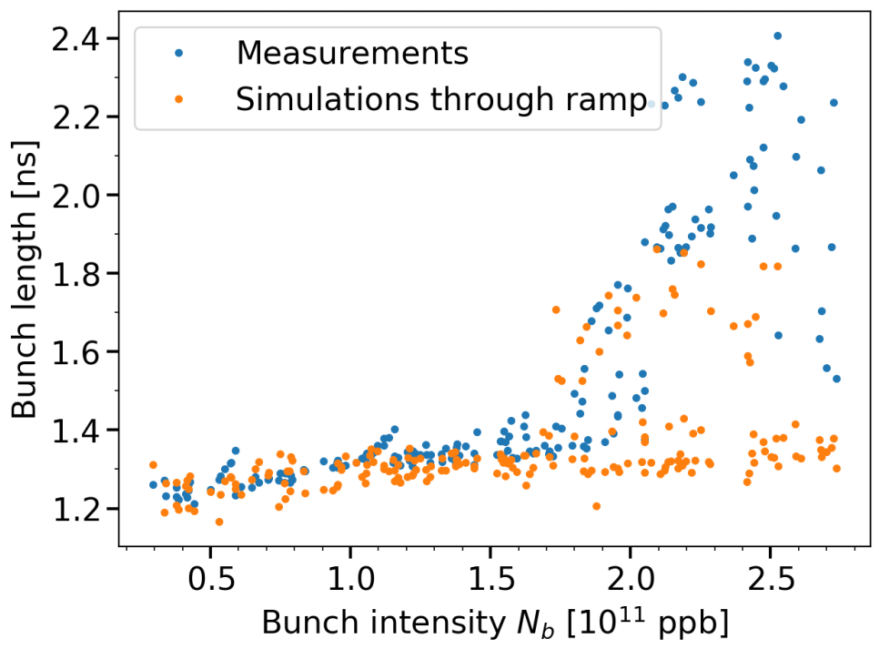
Reference measurements with single bunch
Potential use single bunch instability threshold as validation of post-LS2 SPS impedance model
Flat top (FT), single rf, $V_{200} = 7.2$ MV, Q20
Single bunch measurements in 2015 (A. Lasheen, LIU-SPS BD WG 06/08/2015):
Emittance and intensity adjusted in the PSB
Emittance ($ε_{l}\sim 0.24$ eVs, calculated from $τ$)
Scanning intensity ($N_{ppb}=0.5×{10}^{11}$ to $2.8×{10}^{11}$)
Better agreement with simulations using the latest impedance model
Comparison of simulations and measurements in double rf are more difficult due to unknown $φ_{800}$
(J. Repond, PhD thesis, 2019)

Slide 4
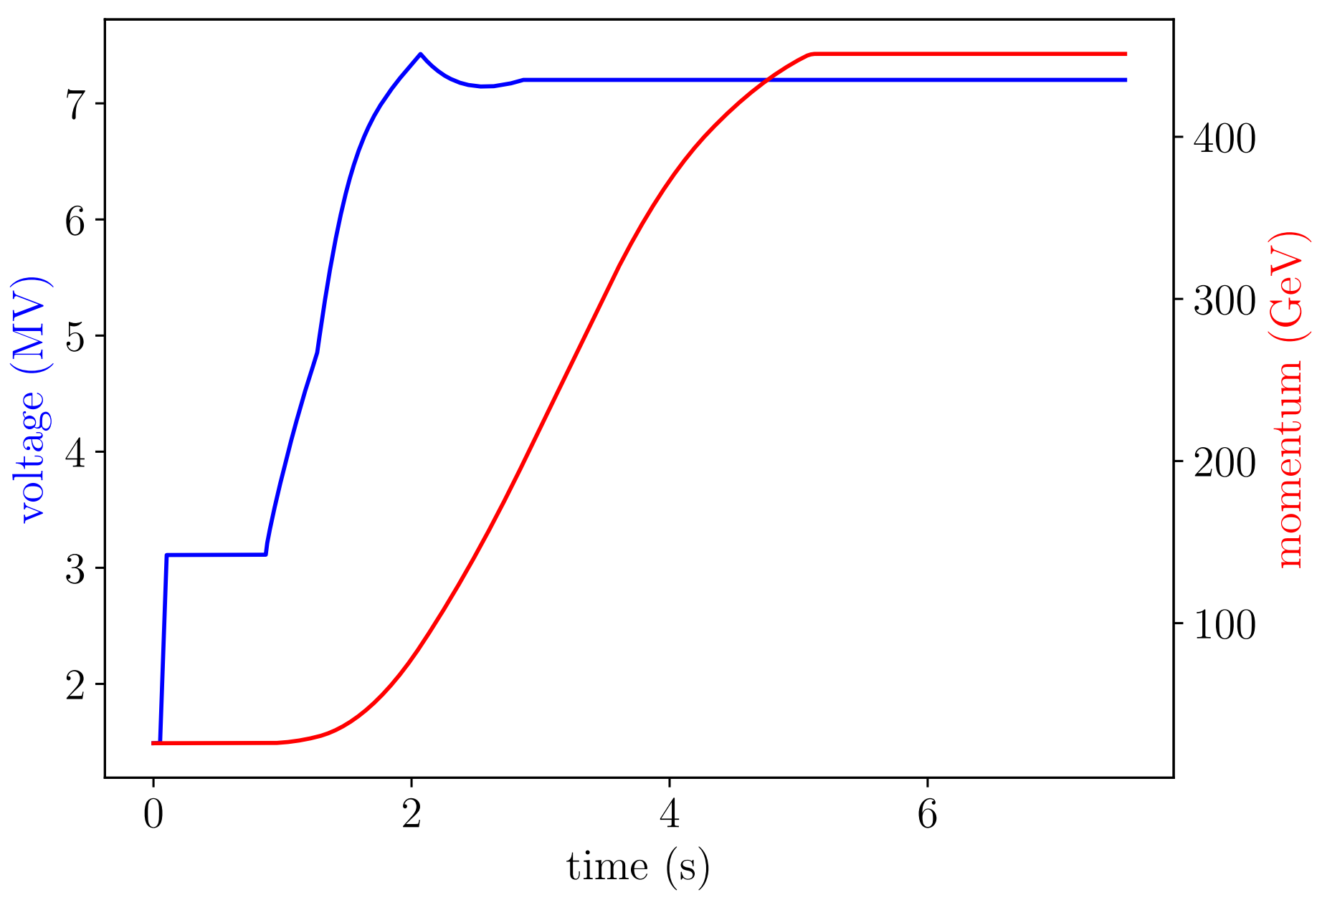
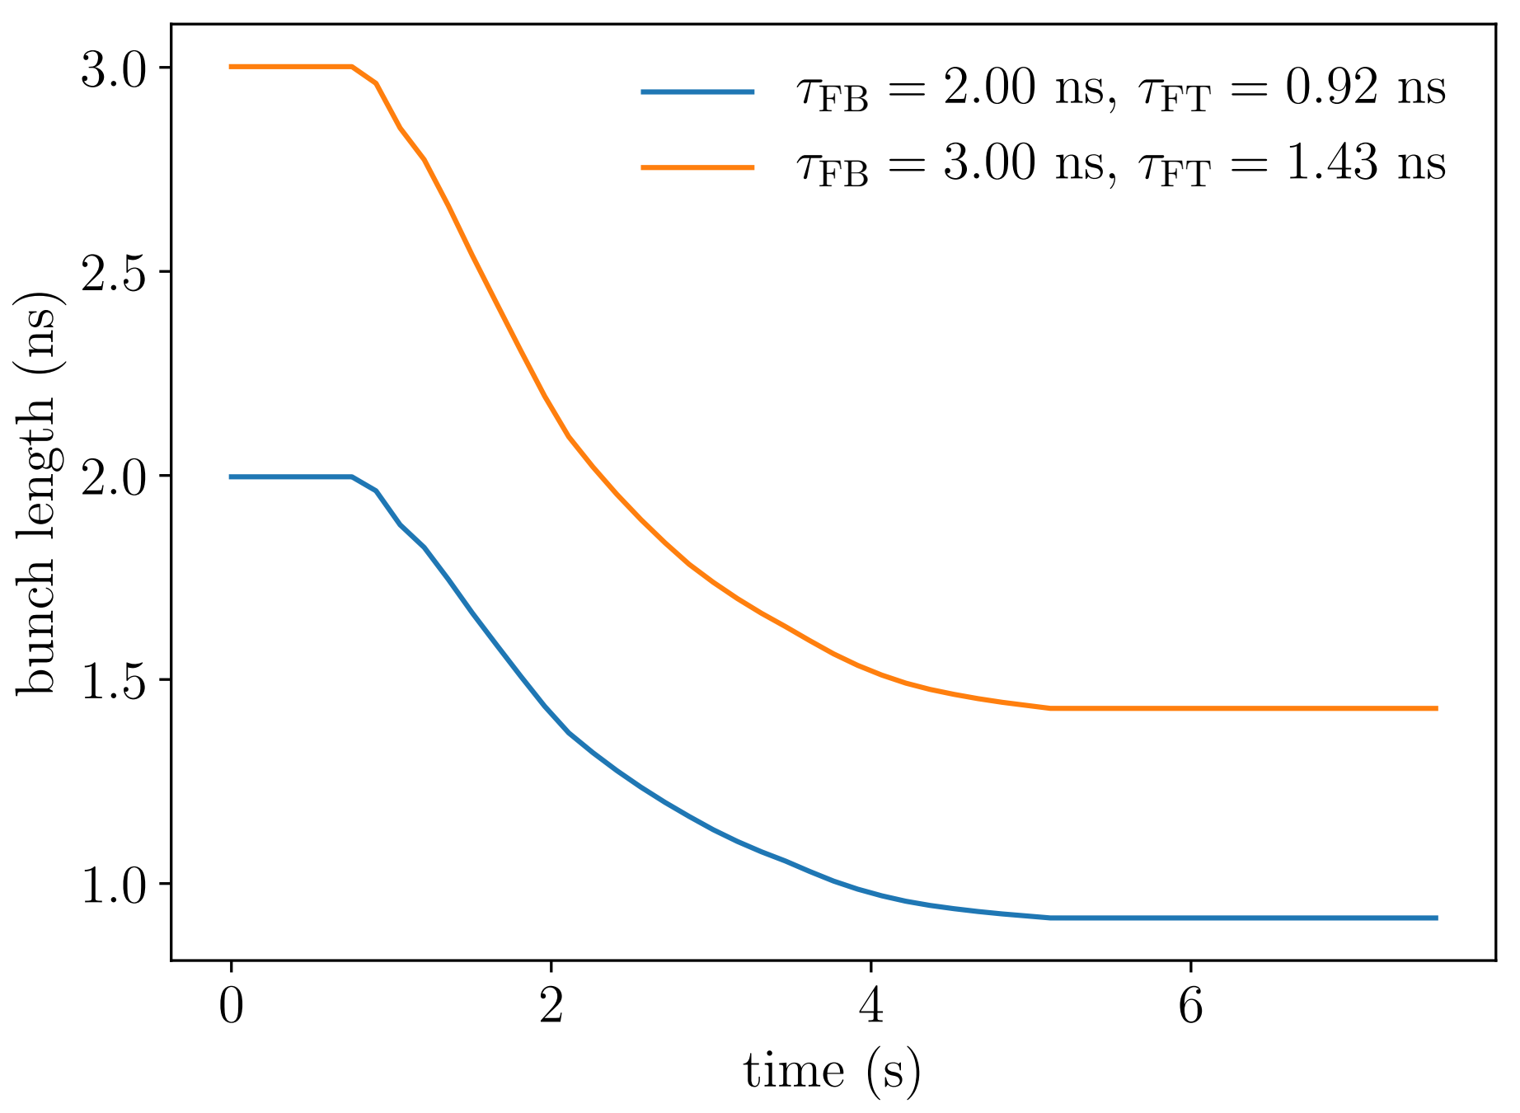
Simulations parameters
Bunch length evolution during the ramp
Extended flattop to compare with “flattop” simulations
Two set of simulations with different impedance model (pre-LS2 & post-LS2)
bunches are matched at flat bottom (bunch length 2-3 ns, intensity 0.5e11 - 3e11 ppb)
Number of macro-particles 1e6, slicing 256 bins per bucket

Slide 5
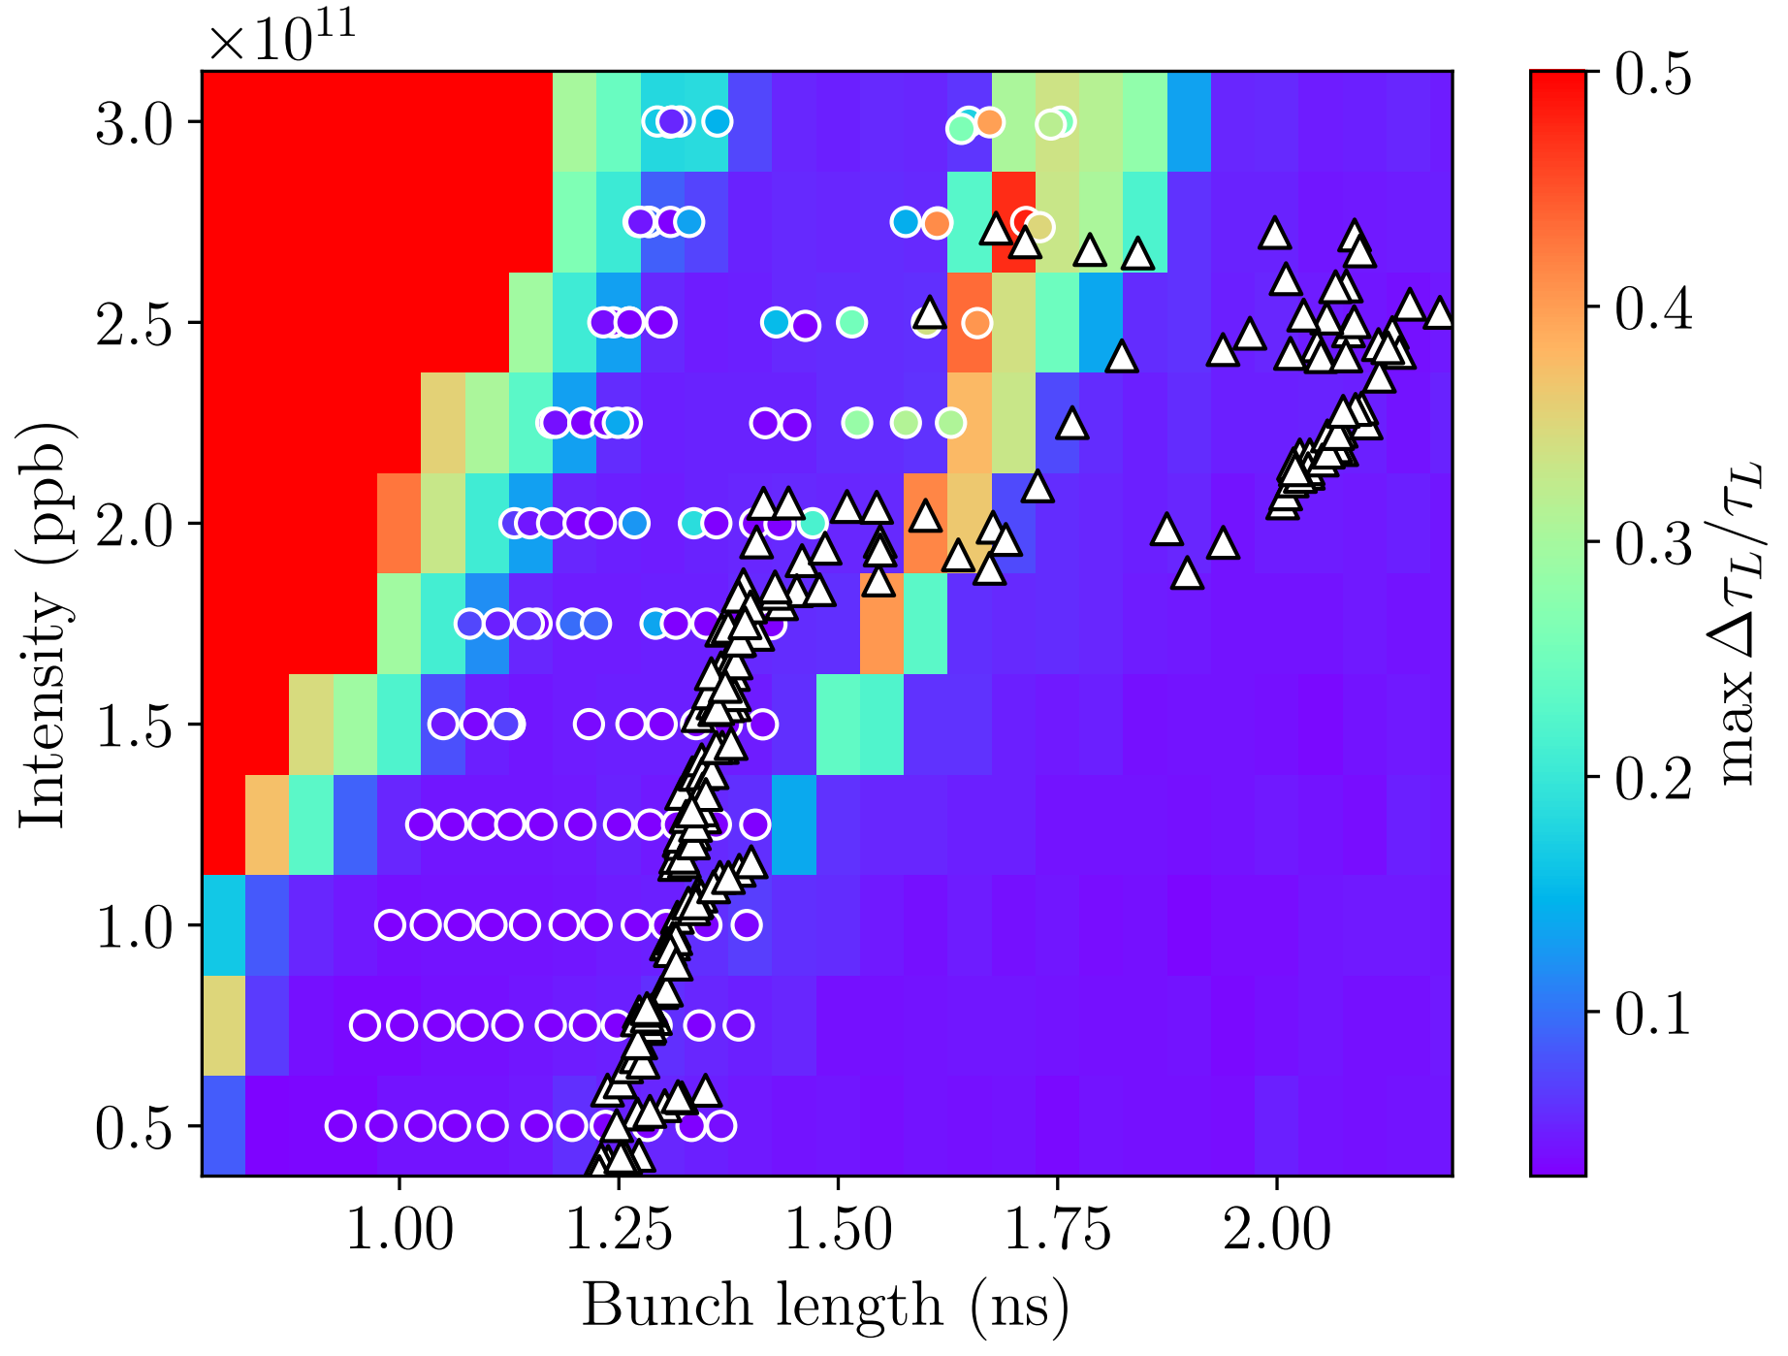
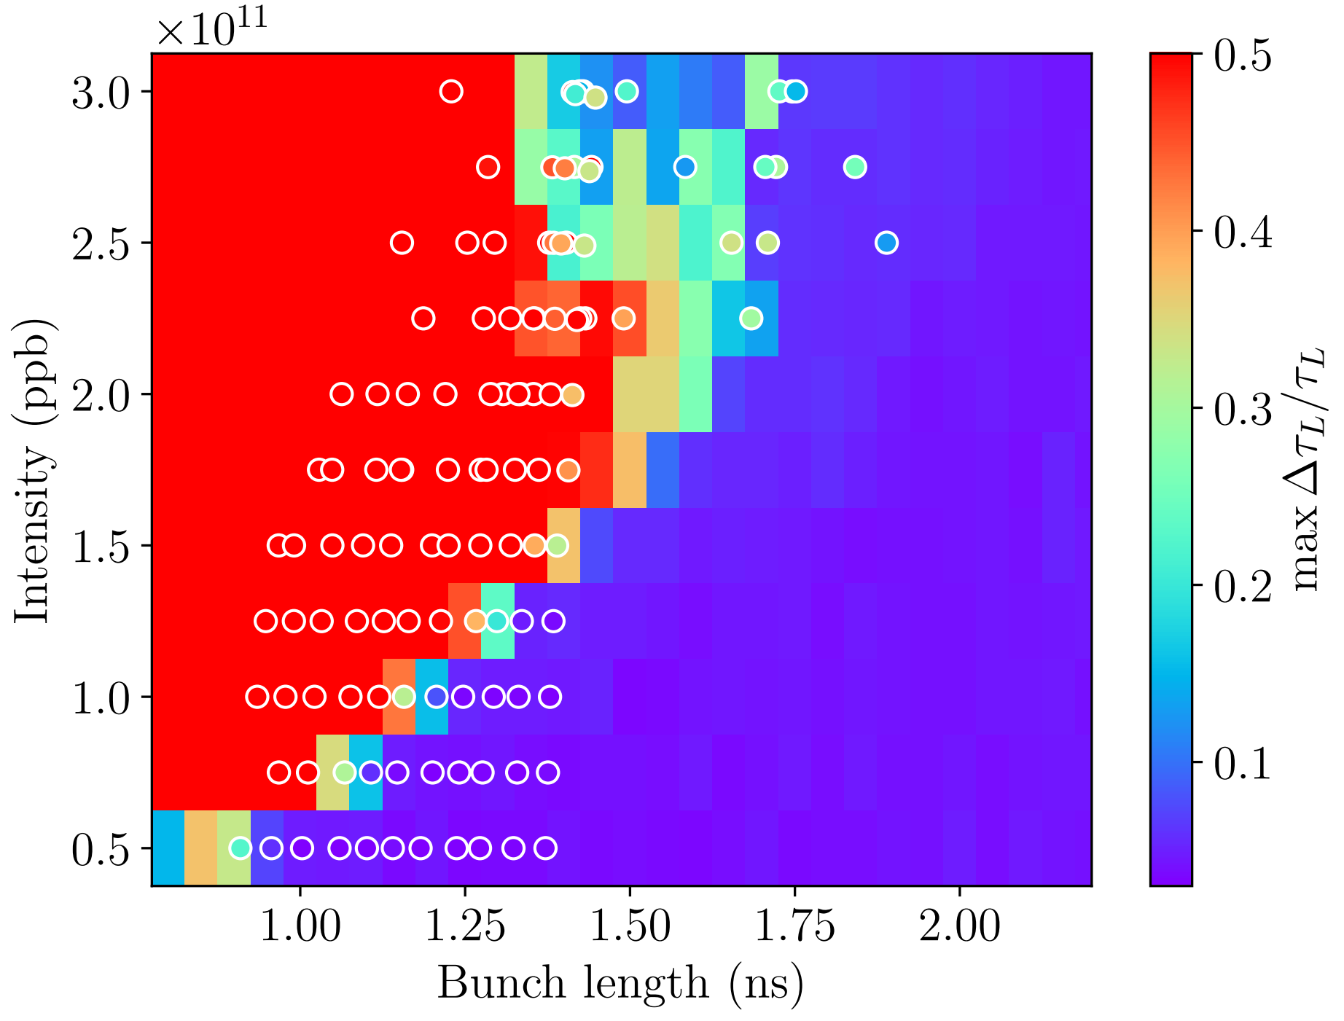
Simulations at FT vs ramp in single rf
Pre-LS2
Post-LS2
“Degradation” of stability in single rf (was also observed in simulations done by A. Lasheen and E. Radvilas)
Overall agreement between simulation results during the ramp and flat top only
There is an offset in bunch length in comparison to measurements

Slide 6
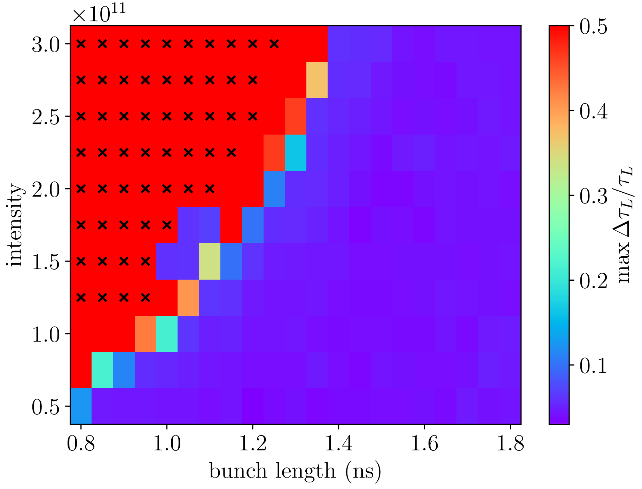
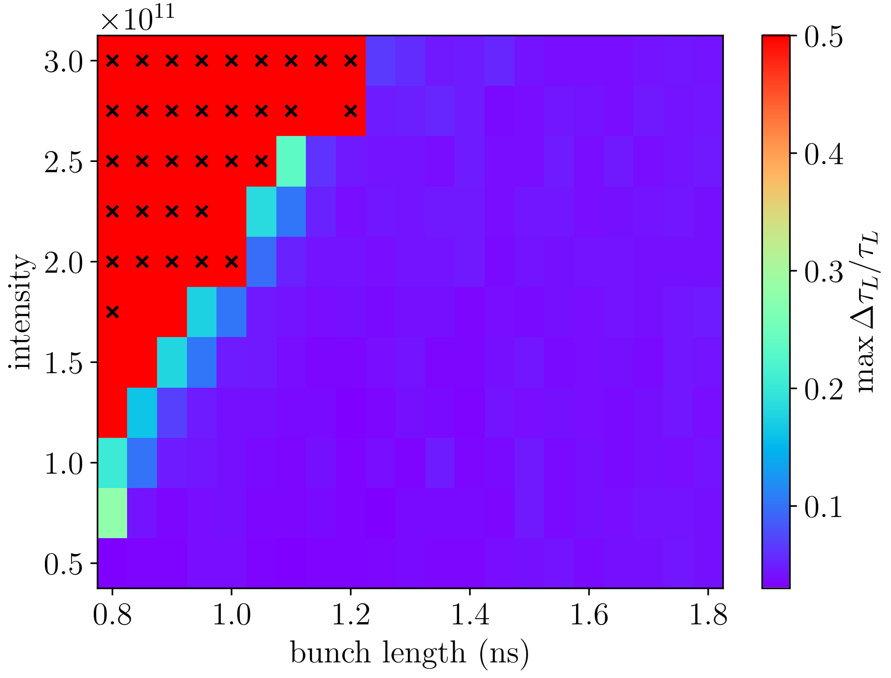
Stability at flat top in double rf
$$V_{800}/V_{200} = 0.1, V_{200} = 7.2 MV$$
Pre-LS2
Post-LS2
Crosses are simulations where matched distribution was not found
After LS2 bunch is more stable in double rf (was also observed in simulations done by A. Lasheen and E. Radvilas)

Slide 7
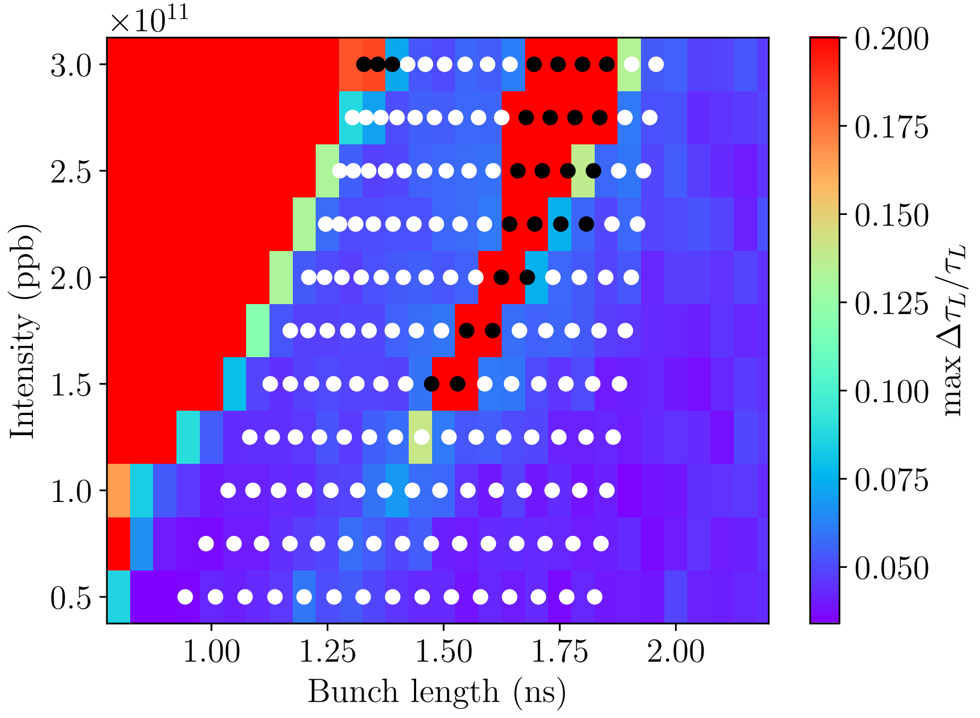
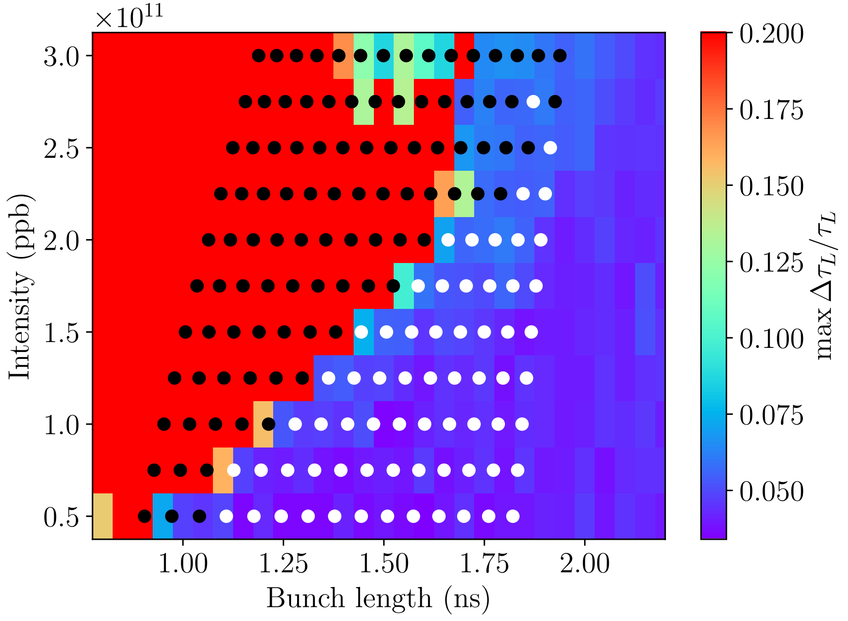
BLonD vs MELODY at FT in single rf
Pre-LS2
Post-LS2
Overall good agreement (preliminary)
Discrepancy potentially due to not sufficient number of azimuthal modes

Slide 8
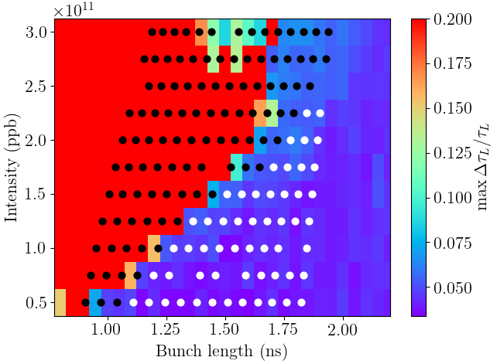
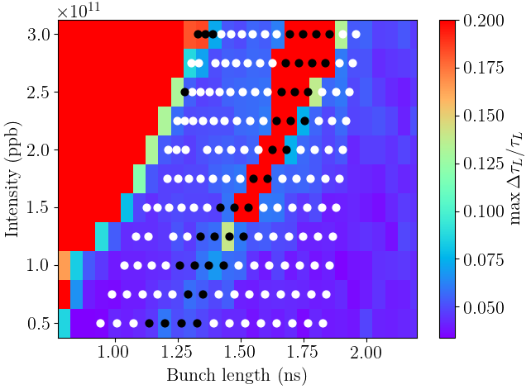
BLonD vs MELODY at FT in single rf m=1,2
Pre-LS2
Post-LS2
Overall good agreement (preliminary)
Discrepancy potentially due to not sufficient number of azimuthal modes

Slide 9
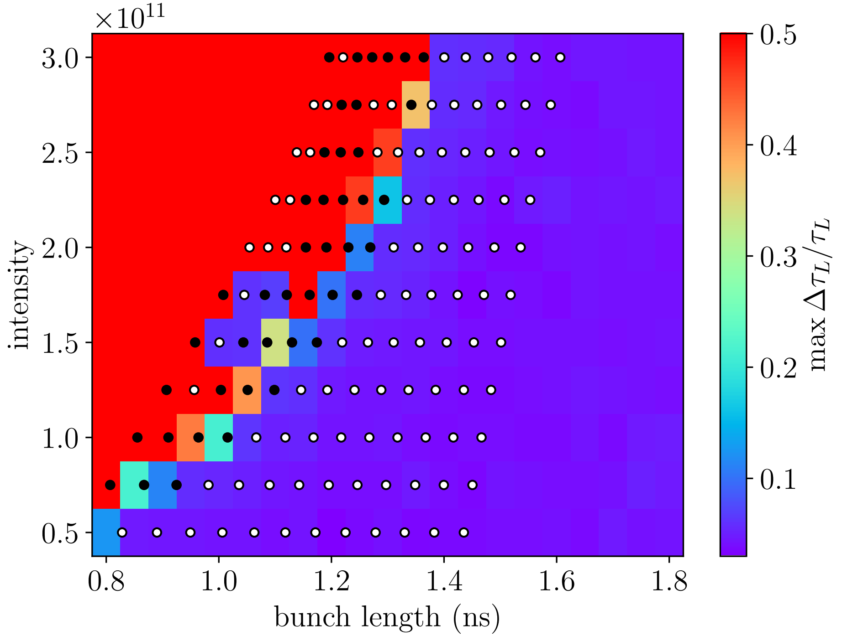
BLonD vs MELODY at FT in double rf
$$V_{800}/V_{200} = 0.1, V_{200} = 7.2 MV$$
Pre-LS2
Post-LS2
Results from MELODY*: white dots – stable, black dots – unstable
*Matrix Equations for LOngitudinal beam DYnamics calculations – Vlasov solver

Slide 10
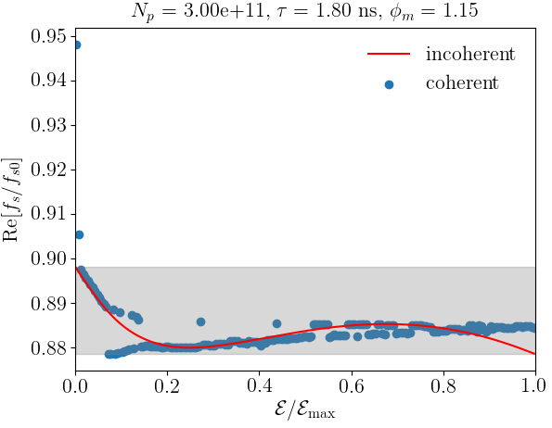
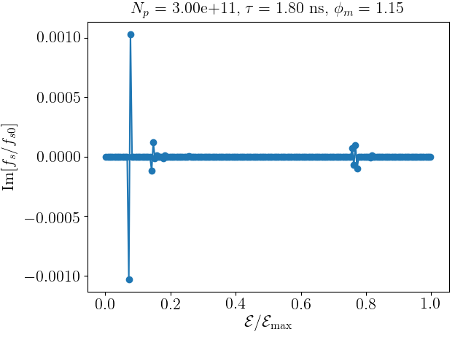
Example of unstable solution

Slide 11
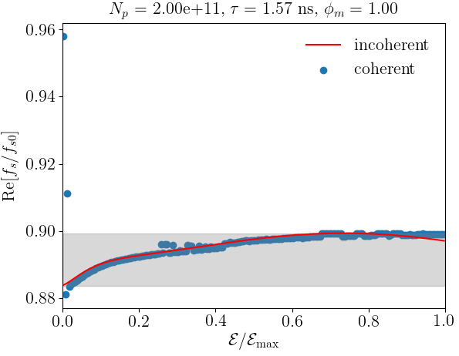
Example of stable solution

Slide 12
Summary
Single bunch simulations are difficult to use as reference measurements
Initial comparison of macroparticle simulations and analytical calculations looks promising. More detailed convergence study is required.
Next steps:
Impact of phase loop
Injection of PS bunches

Slide 13
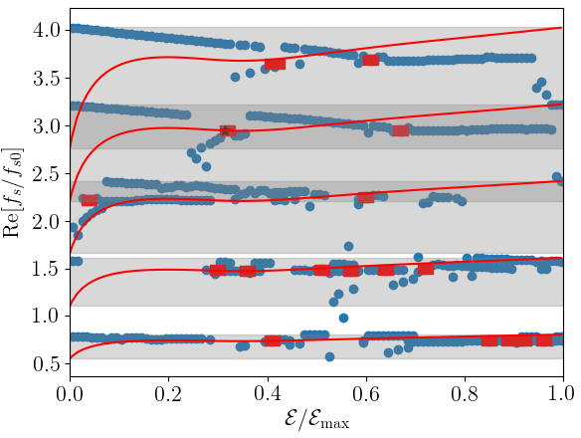
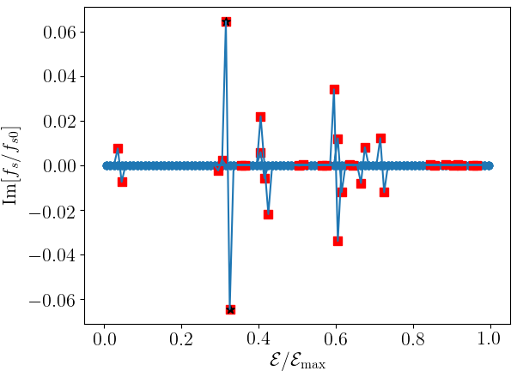
3e11, bunch length 1.2 ns, post LS2

Slide 14
