Slide 1
Update on the CERN-SPS horizontal instability studies
C. Zannini, S. Antipov, H. Bartosik, M. Beck, M. Carla’,
L.R. Carver, E. Métral, N. Mounet, G. Rumolo, B. Salvant, M. Schenk,
Thanks to: T. Bohl, H. Damerau, V. Kain, G. Kotzian, A. Lasheen,
K. Li, G. Papotti, J. Repond, M. Schwarz, E. Shaposhnikova
SPS & PS operators

Slide 2
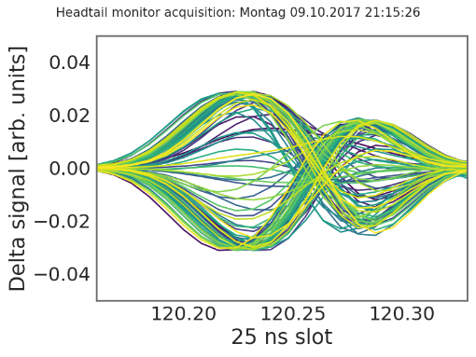
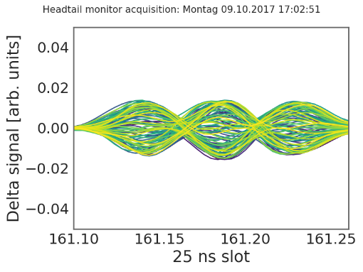
Multi-bunch horizontal instability
ξ_{H}~0.1–0.2
2018 MDs observations
Stable with 1 batch at 2e11
Unstable with 4 batches at 2e11 with BS = 200ns
Mode1 or Mode2 instability depending on chroma
Stabilization at chromax about 0.6
Stabilization with batch spacing >500 ns
Some stabilization with octupoles
Instability threshold at about 1.8e11
ξ_{H}~0.3–0.5
Development of a dedicated model for multi-bunch simulations
Important to use analytical models to minimize numerical artefacts
Stabilization above 2.1e11 ppb not evident during 2018 MDs

Slide 3
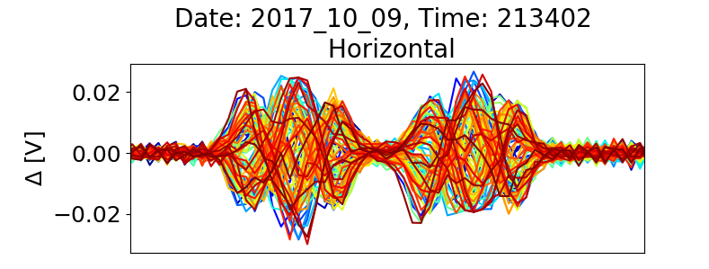
SPS horizontal instability: observations
In 2017 the 4 x 48 bunches suffered from single bunch instabilities (some bunches in 3rd and 4th batch)
Mode 1
Summary of instability observations
Chromaticity | Beam Stability
ξ=0.17 | Unstable mode1
ξ=0.27 | Unstable mode1
ξ=0.37 | Unstable mode1
ξ=0.47 | Unstable mode2
ξ=0.57 | Stable
ξ=0.67 | Stable
Mode 2
L. R. Carver, Horizontal Instability During High Intensity Run
https://docs.google.com/presentation/d/1o2NMNl-Up7lwaYoNW3rgwHuA_-kosCByWSxxZ7C-6c0/edit#slide=id.g36dac49bd4_0_104
H. Bartosik et al., Summary from high intensity run (transverse), LIU-SPS-BD meeting, 19.10.2017

Slide 4
Understanding of the SPS horizontal instability: Sacherer theory
Impedance source: combination of wall and kicker impedance
Summary of instability observations
Chromaticity | Beam Stability
ξ=0.17 | Unstable mode1
ξ=0.27 | Unstable mode1
ξ=0.37 | Unstable mode1
ξ=0.47 | Unstable mode2
ξ=0.57 | Stable
ξ=0.67 | Stable

Slide 5
Example of the CERN-SPS: DELPHI simulations
DELPHI Vlasov solver confirms the results obtained with Sacherer theory

Slide 6
Understanding of the SPS horizontal instability: Sacherer theory
Everything understood?
Analytical studies do not take into account
Actual filling scheme
Stability dependence on number of batches and batch spacing
Effect of damper
Effect of detuning impedance
Nonlinearities

Slide 7
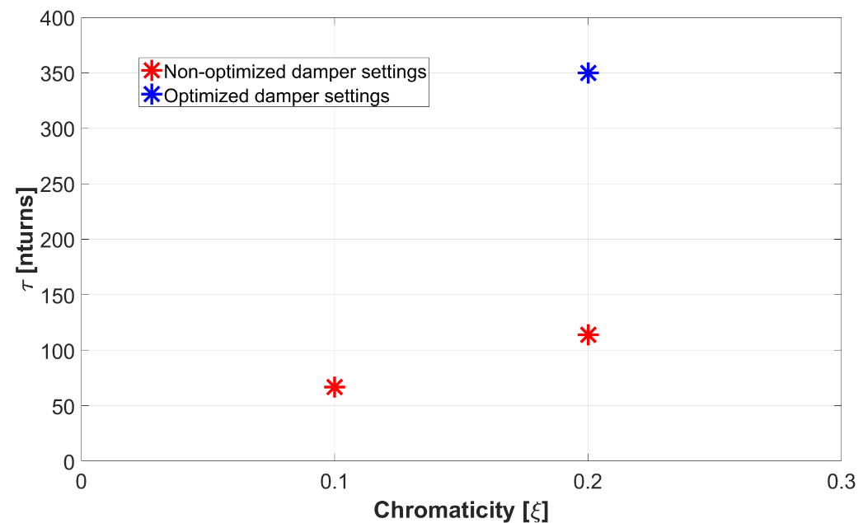
Understanding of the SPS horizontal instability: 2018 measurement campaign
2018 MDs observations
Stable with 1 batch at 2e11
Unstable with 4 batches at 2e11 with BS = 200ns
Mode1 or Mode2 instability depending on chroma
Stabilization at chromax about 0.6
Stabilization with batch spacing >500 ns
Some stabilization with octupoles
Instability threshold at about 1.8e11
ξ_{H}~0.1–0.2
From headtail monitor measurements data
ξ_{H}~0.3–0.5
4x48 bunches, BS=200 ns
N=2e11 ppb

Slide 8
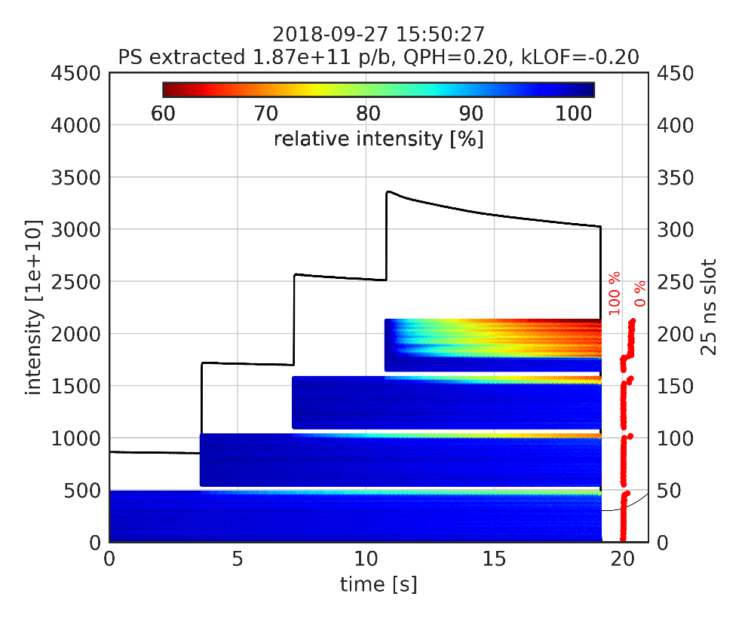
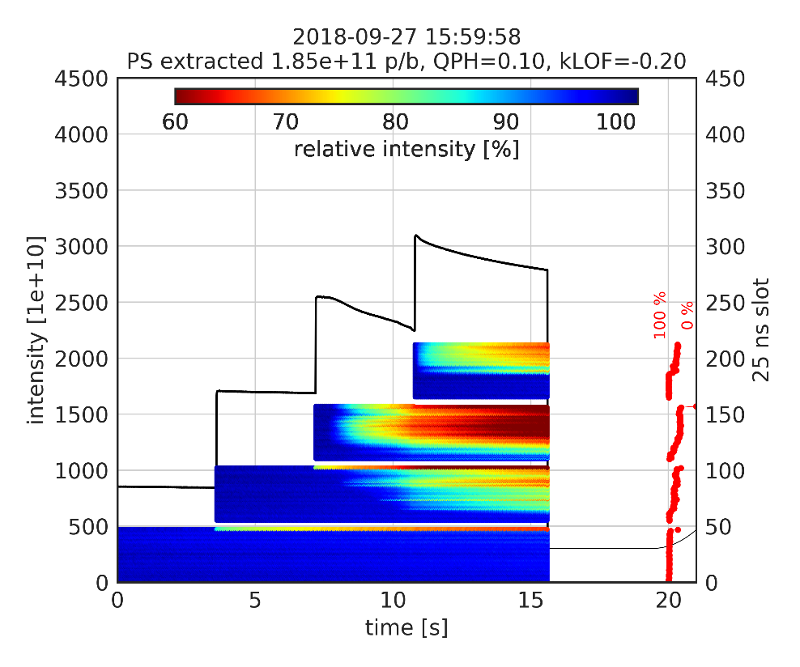
Understanding of the SPS horizontal instability: 2018 measurement campaign
Instability starts from the last batch and extend to the other batches for more critical settings

Slide 9
Understanding of the SPS horizontal instability: PyHEADTAIL simulations
Impedance model: wall and kickers
Kicker model fitted with resonators
MD observations | Multibunch PyHEADTAIL simulations
Stable with 1 batch at 2e11 | ok
Unstable with 4 batches at 2e11 with BS = 200ns | ok
Instability behaviour along the batches | ok
Stabilization with batch spacing >500 ns | ok
Instability threshold at about 1.8e11 | Within 10% (ok)
Stabilization at chromax about 0.6 | ongoing
Behaviour with chroma and octupoles | To be studied

Slide 10
Understanding of the SPS horizontal instability: PyHEADTAIL simulations
Impedance model: wall and kickers
Kicker model fitted with resonators
MD observations | Multibunch PyHEADTAIL simulations
Stable with 1 batch at 2e11 | ok
Unstable with 4 batches at 2e11 with BS = 200ns | ok
Instability behaviour along the batches | ok
Stabilization with batch spacing >500 ns | ok
Instability threshold at about 1.8e11 | Within 10% (ok)
Stabilization at chromax about 0.6 | ok
Behaviour with chroma and octupoles | ok
Improved kicker wake for multi-bunch range

Slide 11
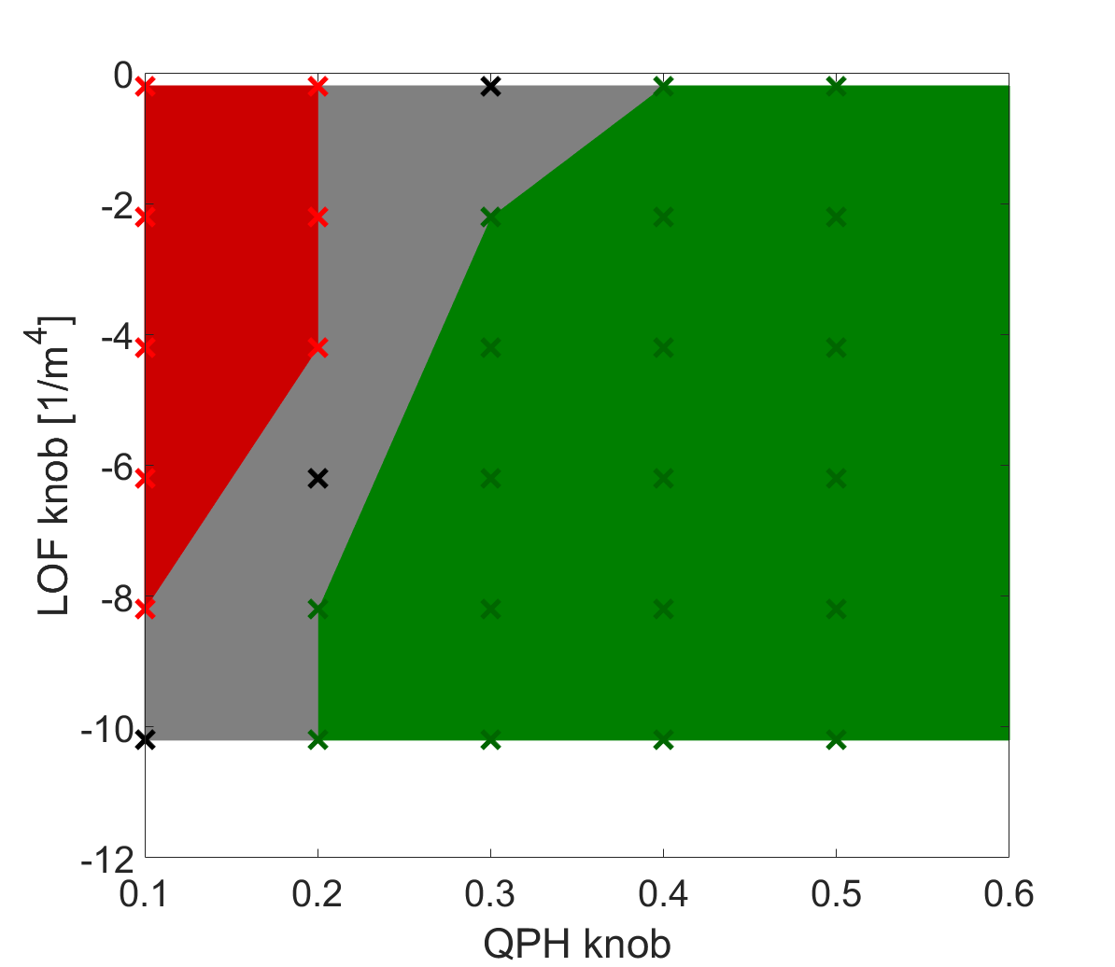
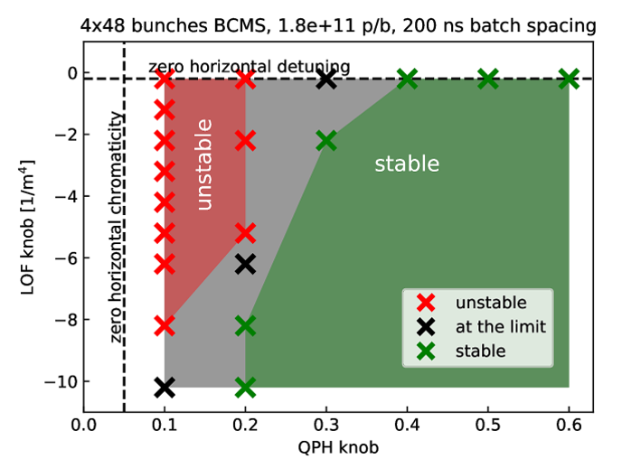
Instability versus chroma and octupoles: comparing measurements and simulations
N=1.8e11 ppb
Measurements
PyHEADTAIL simulations
Simulation can reproduce behaviour of the instability with chromaticity and octupoles

Slide 12
Simulations at higher intensity
N=2.3e11 ppb
4 x 48 bunches
Stable in measurements up to N=2.2e11 ppb
Preliminary
Stabilization is expected to be possible for reasonable settings of chromaticity and octupoles

Slide 13
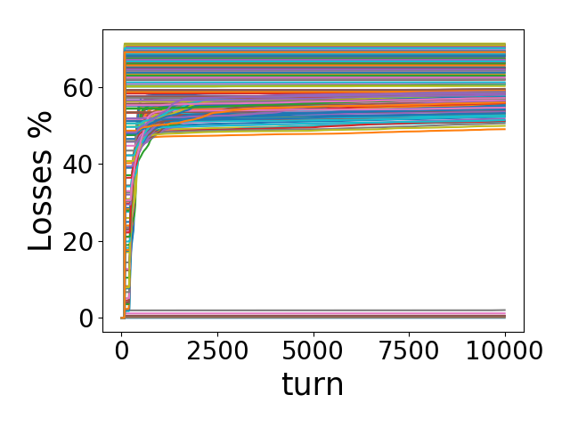
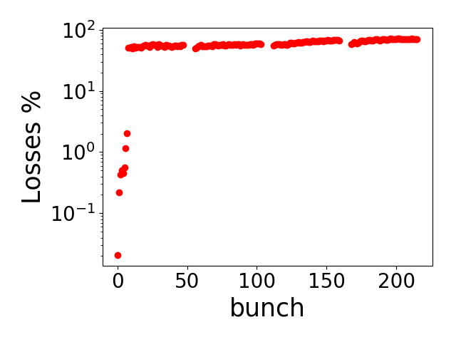
Simulations at LIU intensity
At 2.6e11 for BCMS (4 x 48) a violent vertical instability is observed
With nominal beam the instability is observed already at 2.3e11
Preliminary

Slide 14
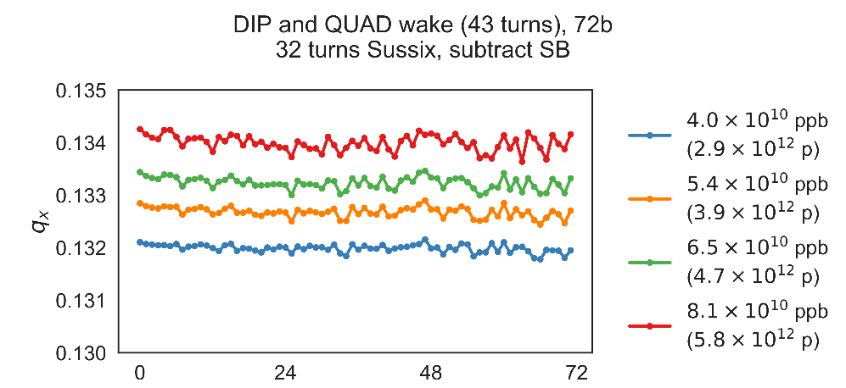
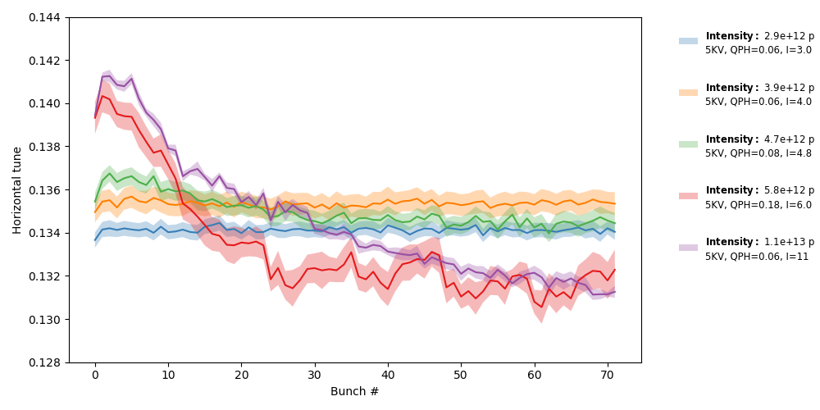
Understanding of the SPS horizontal instability: PyHEADTAIL simulations
Vertical
Impedance model: wall
Good agreement in the vertical plane
Threshold effect in measurements not observed in simulations
Electron cloud effect?
Horizontal
Measurement
PyHEADTAIL

Slide 15
Summary
SPS horizontal instability could be a serious limitation for LIU
A possible explanation of the impedance mechanism driving the instability has been presented by using Sacherer theory
More involved model including actual filling scheme, damper, detuning impedance and nonlinearities shows
Behaviour versus octupoles and chromaticity of the instability successfully reproduced for BCMS 1.8e11 ppb
Stabilization with octupoles, chroma and damper checked up to 2.3e11 ppb for BCMS beam (ξ_{x}=0.4, klof=-6.2)
Issues to be further investigated
In simulations with high intensity (close to the LIU intensity) a violent vertical instability is observed
Transverse emittance blow-up for stable points when using octupoles
Beam lifetime and quality for the explored operational settings

Slide 16
Thank you for your attention

Slide 17
Appendix

Slide 18
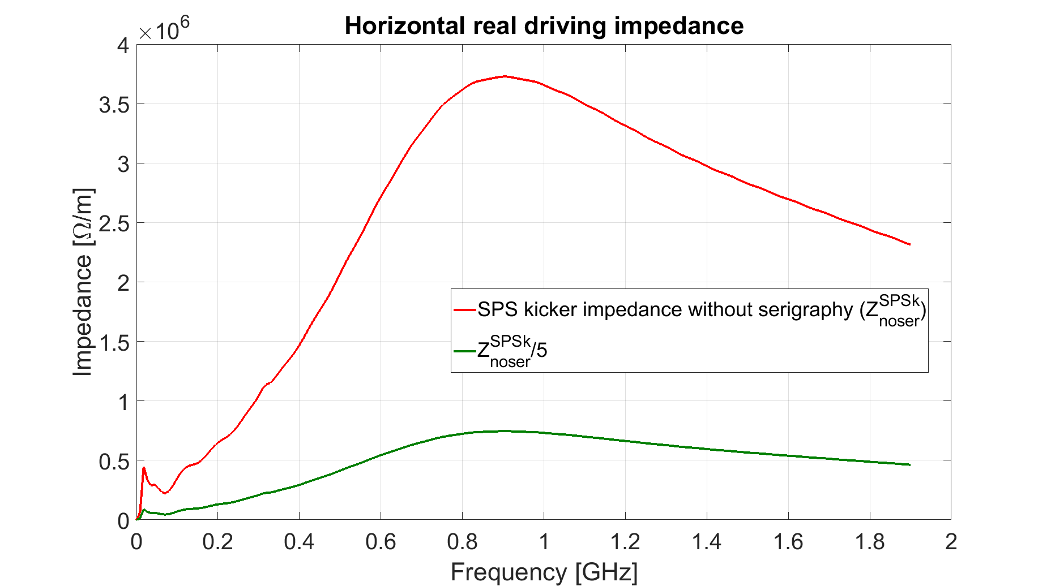
Impedance reduction is not always beneficial
Effect on the stability of the Headtail mode 1

Slide 19
Headtail mode 0
$$Z_{⊥}^{∗}\left(ω\right)=−Z_{⊥}\left(−ω\right)$$
SPS wall impedance model
ξ=0.2
$$\left\{\begin{aligned}Re\left[{\left(Z_{dip}\right)}_{eff}\right]<0 ξ<0 Unstable \\ Re\left[{\left(Z_{dip}\right)}_{eff}\right]>0 ξ>0 Stable\end{aligned}\right.$$
$$Re[Z_{dip}(ω>0)]>0$$

Slide 20
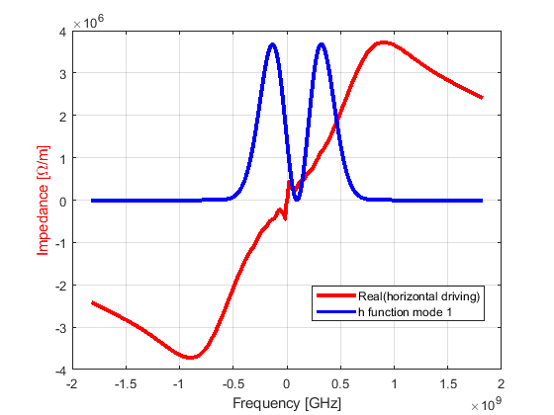
Headtail mode 1
SPS wall impedance model
SPS kicker impedance model without serigraphy
ξ=0.2
ξ=0.2
For a given chromatic shift the sign of the effective impedance depends on the impedance type
No general rule for stability criteria can be given for mode 1

Slide 21
Wall Impedance
ξ_{max}
$$ξ<\left|ξ_{max}\right|$$
Headtail mode 1 above transition is unstable for positive chromaticity and stable for negative chromaticity

Slide 22
Ferrite loaded kickers impedance
Headtail mode 1 above transition is stable for positive chromaticity and unstable for negative chromaticity

Slide 23
Interplay of impedances
Destabilizing
Stabilizing
The overall effect of different impedance contributions depends on the weight of stabilizing and destabilizing effects

Slide 24
Interplay of impedances
The overall effect of different impedance contributions depends on the weight of stabilizing and destabilizing effects

Slide 25
Interplay of impedances
The overall effect of different impedance contributions depends on the weight of stabilizing and destabilizing effects
An inductive impedance has a stabilizing effect for mode 1 and ξ>0.
Reducing this kind of impedance makes the situation worst

Slide 26
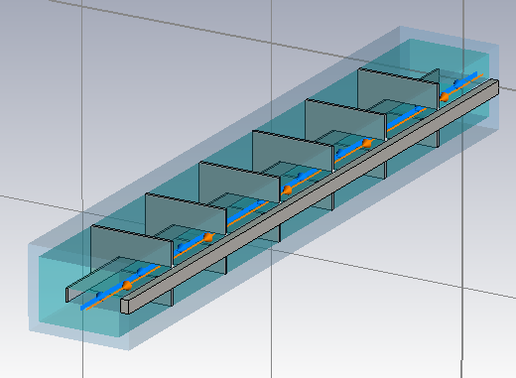
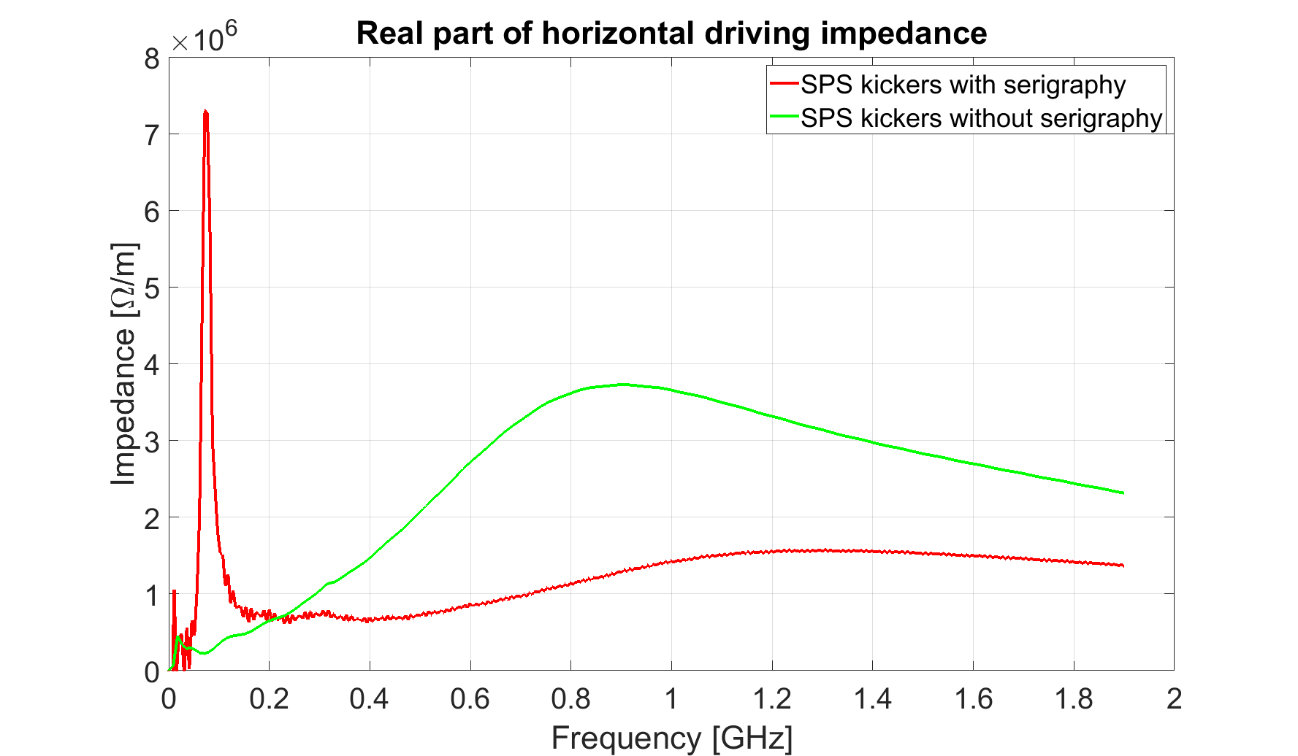
Example of the CERN-SPS
MKE with serigraphy
MKE without serigraphy

Slide 27
Example of the CERN-SPS
Mode 1
Instability at positive chromaticity stabilized by kickers

Slide 28
Example of the CERN-SPS
Mode 1
Instability at positive chromaticity enhanced by kickers with serigraphy
80 MHz serigraphy resonance
lower broadband stabilizing impedance

Slide 29
Example of the CERN-SPS
Mode 1
A deep understanding of all the impedance induced effects is needed to make the best choice in terms of impedance optimization looking at both local (direct effect on the device) and global effects (interplay between the different impedances)

Slide 30
Effect of wall and kicker impedance with and without detuning impedance
Impedance+Damper
Horizontal
Vertical

