Slide 1
Update on 915 MHz HOM
M. Schwarz
Acknowledgements:
A. Farricker, I. Karpov, P. Kramer, E. Shaposhnikova, BLonD dev team
LIU-SPS BD WG meeting, 19/12/19

Slide 2
Motivation 915 MHz HOM
The 915 MHz HOMs have high Q and large R/Q → long range wake field couples batches
Exact values for 915 MHz HOM are not known at present (R_{sh}, f_{r}, Q) and are difficult to measure and simulate
CST simulations of 915 MHz HOM assuming open boundary conditions (P. Kramer, 19/10/24 LIU-SPS BD WG meeting) give twice larger R_{sh} than what is in present longitudinal impedance model
What is the impact of this ‘higher R_{sh} case’ on multi-batch stability?
How does the threshold change when HOM resonance frequency is at exact multiples of the revolution frequency?

Slide 3
Simulation Parameters
Flat top, double RF V₂₀₀=10MV, Q20
4x72 bunches with 1 Million macro-particles per bunch
V₈₀₀/V₂₀₀=0.16, including voltage limitation due to beam loading (relevant above 2.5e11 p/b)
Multi-batch simulation possible thanks to BLonD-MPI (K. Iliakis, LIU-SPS BD WG meeting, 21/02/2019)
Bunch spacing 5 RF buckets (25ns), batch spacing 40 RF buckets (200ns)
Using full SPS impedance model, in particular
200 & 800 MHz TWC feedbacks modeled by reducing R_{sh} by 26dB
different models for 915 MHz HOM (see next slide)
no phase loop
BLonD simulation parameters: frequency resolution exactly f_{rev}
Initial bunches were matched including intensity effects!
Simulate 100 000k turns of flat top (2.3s)
Beam considered unstable if maximum relative bunch length spread exceeds 0.07: $\frac{\max{∆τ}}{τ_{av,inj}}>0.07$

Slide 4
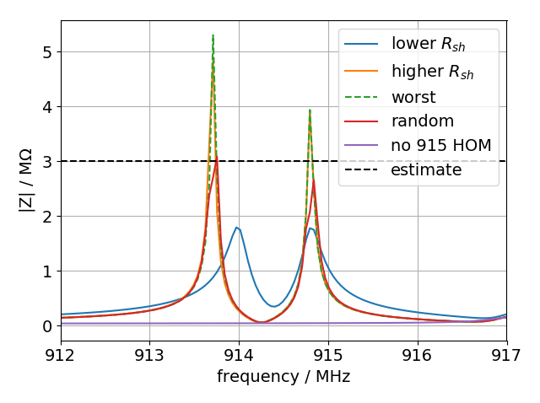
Models for 915MHz HOMs
lower R_{sh}: R_{sh}~2MΩ, Q~5k (in current longitudinal SPS impedance model)
higher R_{sh} (open boundary conditions): R_{sh}~5MΩ, Q~18k (see appendix for exact values)
worst case: higher R_{sh} model, where f_{r} of the two modes at (nearly) integer multiples of f_{rev} (next slide)
random: each cavity HOM (4 3-sections, 2 4-sections) has f_{r} randomly shifted by ±50kHz
‘higher R_{sh} model’ has larger R_{sh}, but reduced R/Q compared to ‘lower R_{sh}’ model
3MΩ estimate from fixed target beam (I. Karpov, LIU-SPS BD WG meeting)

Slide 5
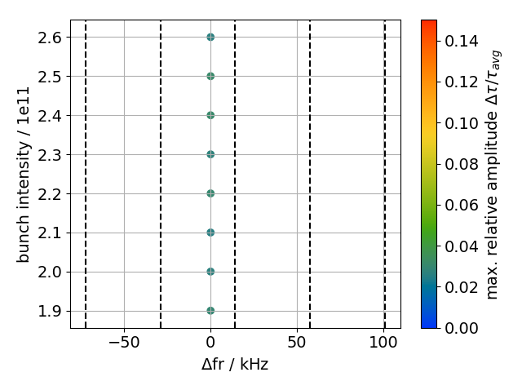
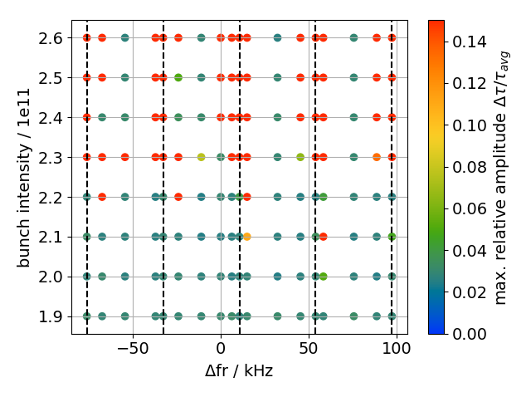
Effect of 915 MHz HOM frequency shift (V₈₀₀/V₂₀₀ = 0.10)
915 HOMs at $f_{r}=\left(n_{0}+n+df\right)f_{rev}$; nominal resonance frequency $f_{r0}$
$n_{0}$ closest integer such that $f_{r0}≃n_{0}f_{rev}$; $n=−2,…,2$; $df=0, 0.1 ,0.5, 0.8$
$Δf=f_{r}−f_{r0}$; dashed lines are at multiples of $f_{rev}$
Shifting by $Δf$~ 15kHz (n=0, df=0.1) yields ‘worst case’ model with lowest threshold
lower R_{sh} model: R_{sh}~2MΩ, Q~5k
higher R_{sh} model: R_{sh}~5MΩ, Q~18k
worst case

Slide 6
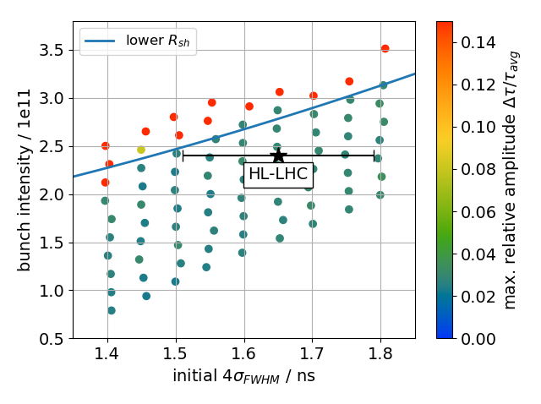
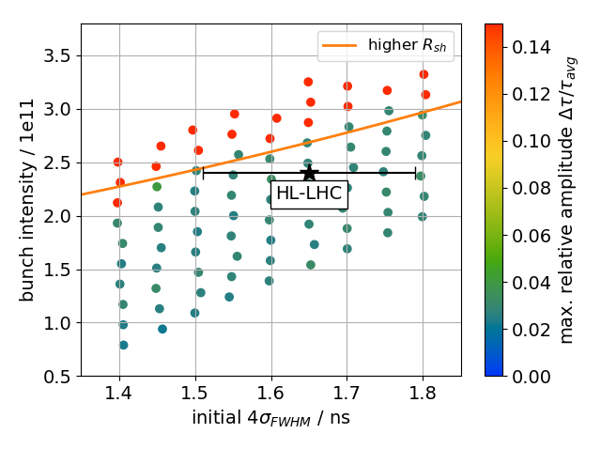
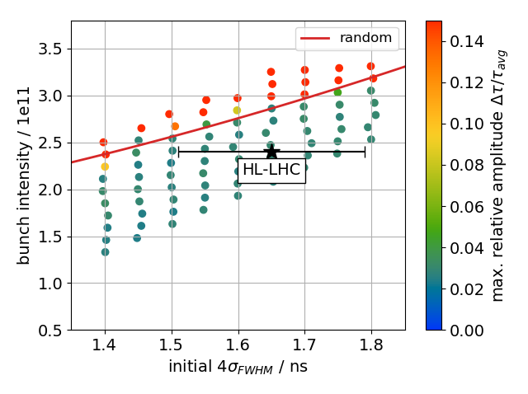
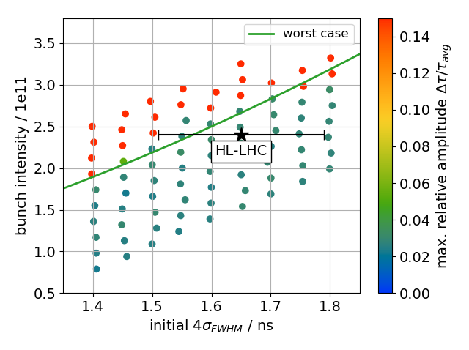
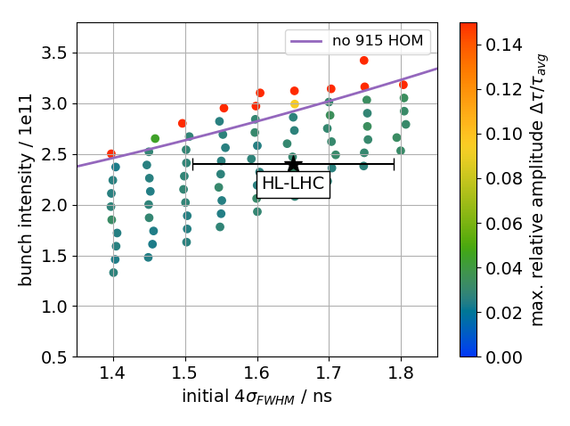
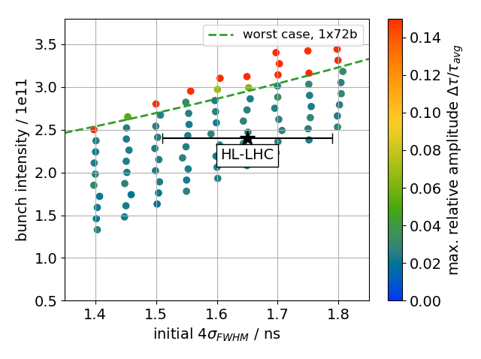
Thresholds, different 915 MHz HOM models

Slide 7
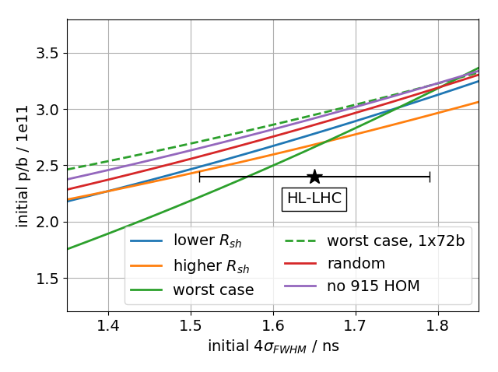
Thresholds
4x72 bunches; V₈₀₀/V₂₀₀=0.16, including voltage limitation due to beam loading

Slide 8
Summary
Different models of 915 MHz HOM yield similar multi-batch threshold
Beam HL-LHC design values (2.4e11 p/b and 1.65 ns bunch length) is stable, but no margin for shorter bunches
Power limitation mainly due to 200 MHz TWC, and V₈₀₀/V₂₀₀ was kept at 16% → ratio V₈₀₀/V₂₀₀ could be increased to gain larger stability margin
Next steps
On-going CST simulations of 200 MHz TWCs including terminations (load and Y-chamber) and correct lengths of feeder lines → simulate threshold once new ‘realistic’(?) model of 915 MHz HOM becomes available
Thank you for your attention!

Slide 9
Appendix

Slide 10
Values for 915MHz HOMs
4 section* | higher R_{sh} | lower R_{sh}
fr / GHz | 913.7; 914.8 | 914.0; 914.8
R / kΩ | 1064; 791 | 385.0, 386.0
Q | 18586; 15290 | 5000; 5000
R/Q / Ω | 57; 52 | 77
τ / μs | 6.5; 5.3 | 1.7; 1.7
BW / kHz | 155; 192 | 574; 575
3 section | higher R_{sh} | lower R_{sh}
fr / GHz | 913.7; 914.8 | 914.0; 914.8
R / kΩ | 798; 593 | 231.0, 231.6
Q | 18586; 15290 | 3000; 3000
R/Q / Ω | 43; 39 | 77
τ / μs | 6.5; 5.3 | 1.0; 1.0
BW / kHz | 155; 192 | 957; 958
*scaled

Slide 11
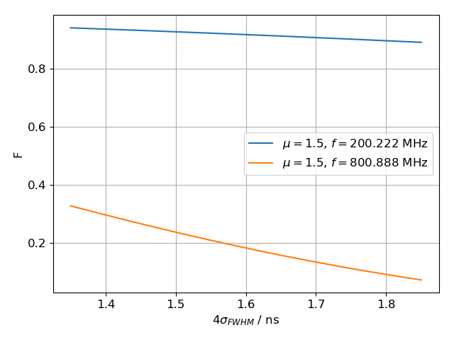
Power limitation
Total voltage $V$ in a TWC (interaction length $L$, series impedance $R_{2}$, zero phase slip) for given power $P$ and beam current $I$: ${V(n_{b},σ)}^{2}=\left(P−\frac{R_{2}L^{2}}{64}I^{2}−\frac{\left|V\right|I}{4}\sin{φ_{s}}\right)R_{2}L^{2}$ [G. Dôme, CERN-SPS/ARF/77-11, 1977]
Beam current at frequency $f$: $I=2I_{0}F(f)$, $I_{0}=n_{b}e/τ_{bb}$, $n_{b}$: p/b, bunch spacing $τ_{bb}=25$ns
Use binomial-μ distribution with bunch length $τ_{L}$ and bunch spectrum $F\left(f\right)$
Spectrum close to 1 at 200MHz and only mild dependence on bunch length
Strong bunch length-dependence at 800MHz
Available power:
4-section cavity: 1.6MW
3-section cavity: 1.05MW
800MHz TWC: 216kW (peak), 144kW (average)

Slide 12
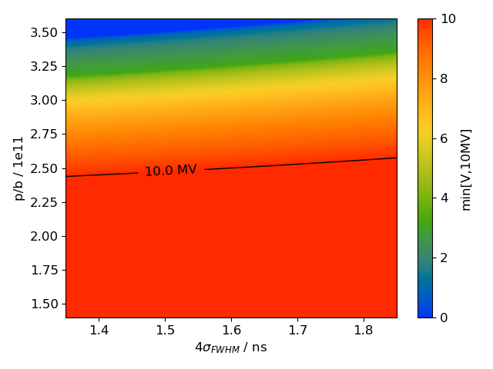
Power limitation, 200 MHz TWC
Total voltage $V$ (plot capped at 10MV)
Mild dependence on bunch length
10 MV can be obtained below 2.5e11 p/b
Voltage drops quickly above 2.5e11 p/b

Slide 13
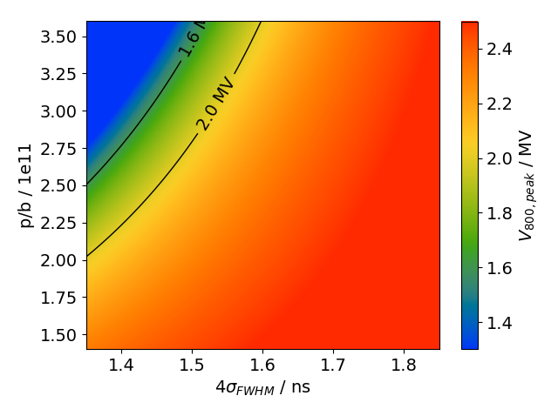
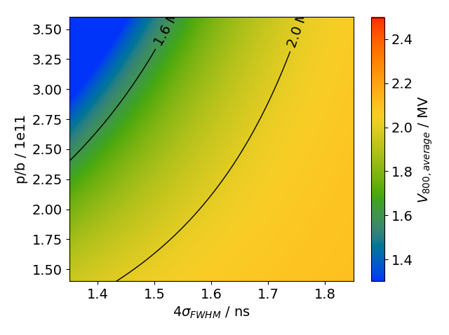
Power limitation, 800 MHz TWC
Total voltage $V$ for peak power (left) and average power (right)
Use $I→I/{\sqrt{2}}$ when computing voltage from average power
Voltage primarily limited by limited average power

Slide 14
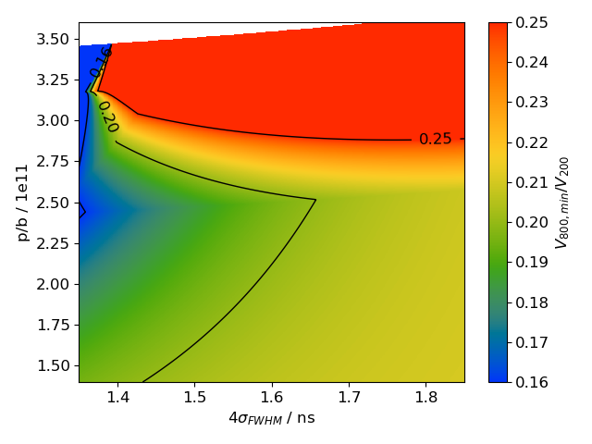
Power limitation, voltage ratio
Plot ratio: min(V₈₀₀) / min(10MV, V₂₀₀)
Voltage ratio ${V_{800}}/{V_{200}}≥0.16$ can be satisfied everywhere
${V_{800}}/{V_{200}}≥0.2$ cannot be fulfilled for small bunch length and intensities between 1.5 and 2.7e11 p/b
A ratio ${V_{800}}/{V_{200}}≥0.25$ can only be fulfilled above 3.0e11 p/b, where $V_{200}$ is power-limited

