Slide 1
End-of-Year summary
LIU-SPS BD WG meeting 19.12.2019

Slide 2
Meetings in 2019
10 meetings
Main topics:
Transverse and longitudinal beam instabilities
200 MHz RF upgrade
Ions
Fixed target beam
This year winners
(9 talks) Markus Schwarz
(3 talks) Carlo Zannini, Patrick Kramer, …
Minutes: thanks a lot to Markus
Many thanks to all participants and speakers!

Slide 3
Challenges for 2019 (from last year talk)
HOM damping and tuning of the 200 MHz TWC during LS2
Quality control of impedance reduction (VF shielding) in the tunnel
Beam losses at the beginning of ramp (full bucket due to PS bunch distribution), feasibility of smaller injected bunches
Longitudinal beam stability on flat bottom and during ramp
Stabilisation of ion beam and slip-stacking
Controlled emittance blow-up for protons and especially ions (intensity effects and bunch-by-bunch difference)

Slide 4
Challenges for 2019 (from last year talk)
Horizontal stability with LIU intensity - source to be identified to prepare mitigation strategy and future actions
Bunch-by-bunch coherent tune shifts with LIU intensity and impact on damper operation (wide tune acceptance, Laslett corrections, …)
Emittance preservation: operation with -0.21 space charge tune shift (LIU BCMS) on top of bunch-by-bunch tune shifts from impedance
Preparation for re-start

Slide 5
Achievements (1/2)
Baseline HOM damping in 3- and 4-section cavities achieved
Instability thresholds on flat top simulated with 4 LHC batches
Identification and studies of the 915 MHz HOM
Single bunch thresholds - agreement of simulations with measurements using updated SPS impedance model
Impedance reduction due to layout optimisation
Longitudinal instability at the injection plateau due to 200 MHz impedance
Study of effect of fundamental frequency shift in 200 MHz RF system
Study of the impact of installing 200 MHz cavities for eSPS

Slide 6
Achievements (2/2)
Development and validation of SPS multi-bunch impedance model and PyHeadTail simulation model
Reproduced horizontal multi-bunch instability – limits as function of chromaticity and octupole settings in good agreement with measurements
Defined required 915 MHz HOM damping for transverse stability
Refined studies of emittance growth due to quadrupole power converter ripple
Preparation of SPS optics model with LIU upgrades including layout checks in preparation for post-LS2 operation

Slide 7
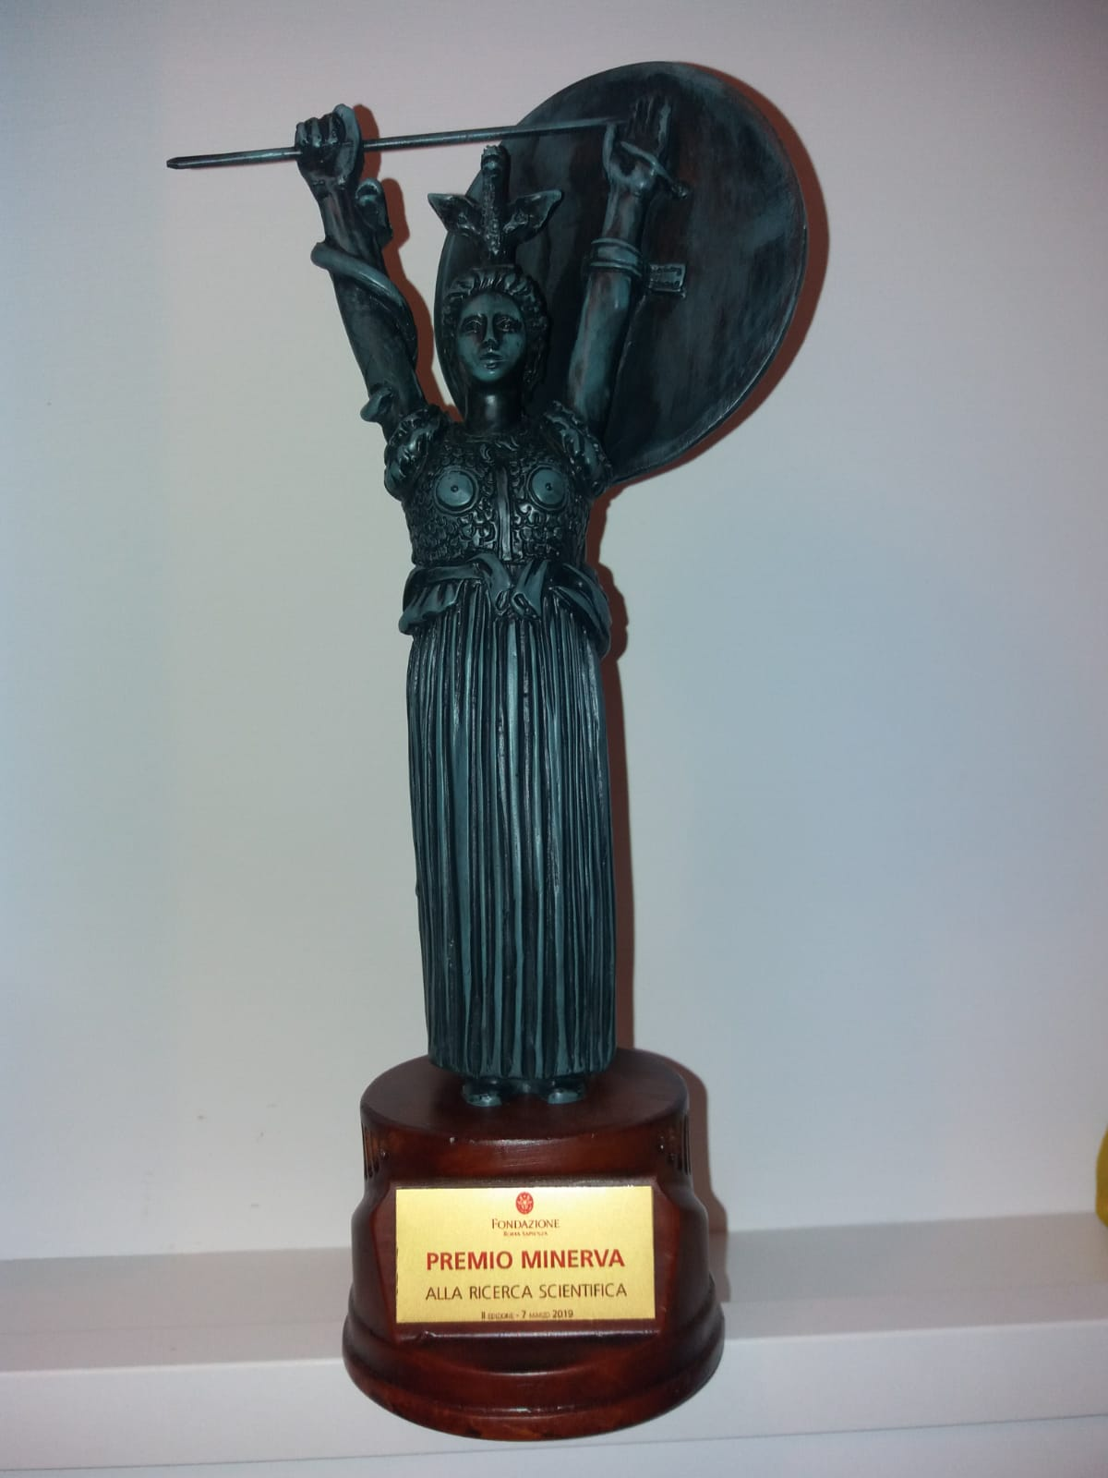
PhD thesis defended in 2019
Danilo Quartullo - Jan 2019 at Sapienza Universiy, Rome - award to the best PhD student in scientific departments (physics, mathematics, chemistry, …)
Joel Repond – Aug 2019 at EPFL, Lausanne
Jaimie Mitchell – Sep 2019 at Lancaster University, UK

Slide 8
Challenges for 2020 (1/2)
Operational algorithms for
Optimum 800 MHz voltage & phase program
Controlled emittance blow-up
Simulations of 4(x72) LHC batches:
Losses with FB included
Stability during ramp
Emittance BUP with phase loop & new noise generation (as in PSB)
Simulations of LHC ions during the whole SPS cycle
Realistic model of 915 MHz HOM and damping scheme
Measurements of the 200 MHz cavities in the tunnel

Slide 9
Challenges for 2020 (2/2)
Bunch-by-bunch coherent tune shifts with LIU intensity
Impact on damper operation (wide tune acceptance, Laslett corrections, …)
Optimum working point
Emittance preservation: operation with -0.21 space charge tune shift (LIU BCMS) on top of bunch-by-bunch tune shifts from impedance
Preparation for beam commissioning and intensity ramp-up after LS2, including reference measurements

Slide 10
Happy New Year!
Successful completion of LS2!

