Slide 2
SPS scrubbing with high intensity: Experience from past scrubbing runs (2012, 2014, 2015)
E-cloud team:
H. Bartosik, M. Carla, G. Iadarola, K. Li, L. Mether, G. Rumolo, C. Zannini

Slide 3
Before 2012
Dedicated scrubbing runs from 2002 to 2009
  At 26 GeV/c (~40 s cycle length)
  Observed beam instabilities, emittance growth, pressure rise all around the SPS
  Efficiency typically limited by heating/outgassing of specific element
MDs with LHC beams in 2010-11 showed for the first time that 4 batches of 25 ns beam with 1.2e11 p/b could be accelerated in the SPS with ε_{x,y} < 3 μm
2002
(14d)
2003
(8d)
2004
(10d)
2006
(5d)
2007
(7d)
2008
(2.5d)
2009
(1.5d)
2012
(5d)
Shutdown
~1 month before 2005 long shutdown
16 days in 2006 – 2009

Slide 4
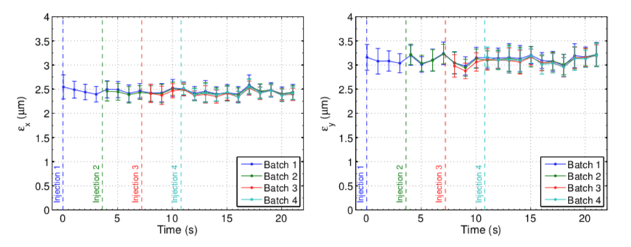
Scrubbing 2012
One week dedicated scrubbing (studies) in the SPS
Scrubbing ‘status’ of the SPS was confirmed for nominal intensity
  No measurable emittance growth over 4 batches and long flat bottom

Slide 5
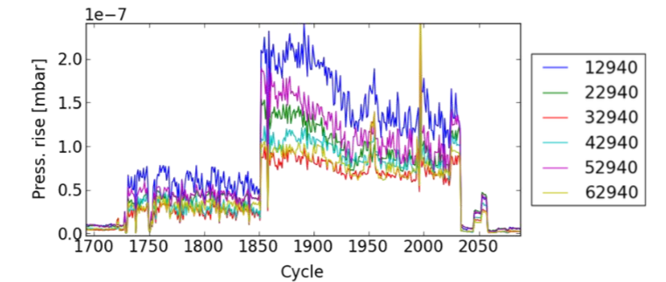
Scrubbing 2012
One week dedicated scrubbing (studies) in the SPS
High intensity tests up to ‘ultimate’ (1.8e11 p/b)
  Disclaimer: Quality probably not optimal from PS, bunches longer than 4 ns at injection
  Sharp increase of pressure rise (arcs, LSS5) when making intensity steps – however, signs of conditioning over few hours
‘nominal’ intensity
‘ultimate’ intensity

Slide 6
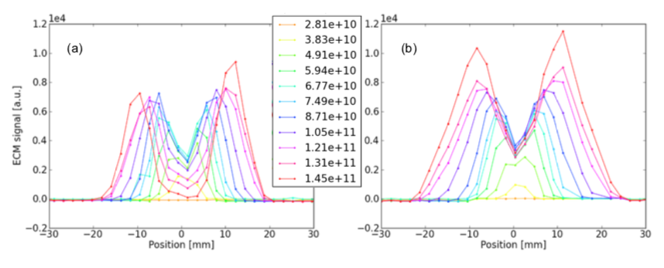
Scrubbing 2012
One week dedicated scrubbing (studies) in the SPS
High intensity tests up to ‘ultimate’ (1.8e11 p/b)
  Electron cloud distribution measured in the strip monitors
  Stripes moving outwards and occupying larger regions, however depleting the center
MBA
MBB

Slide 7
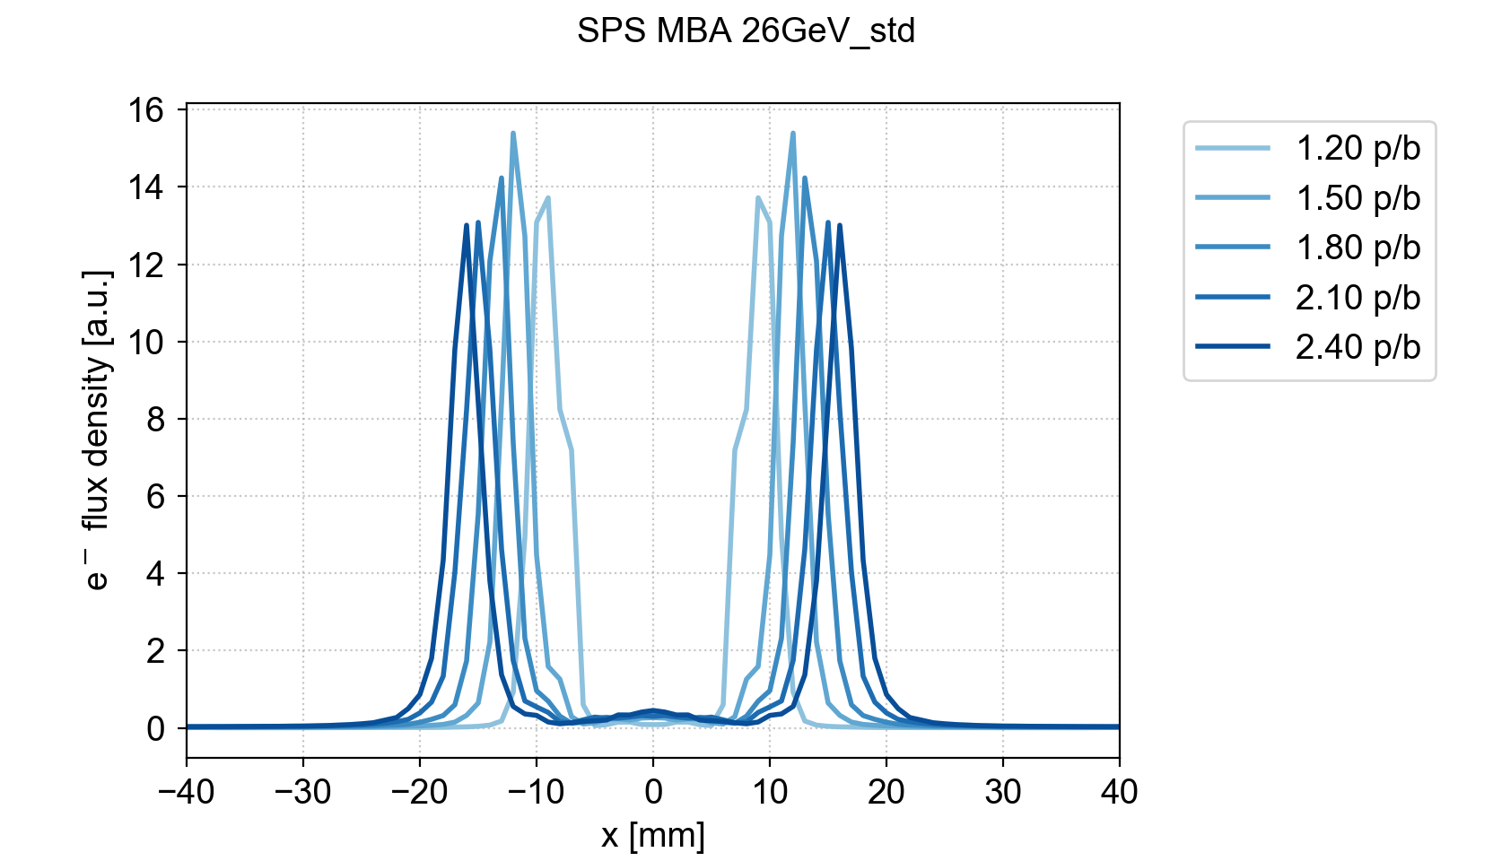
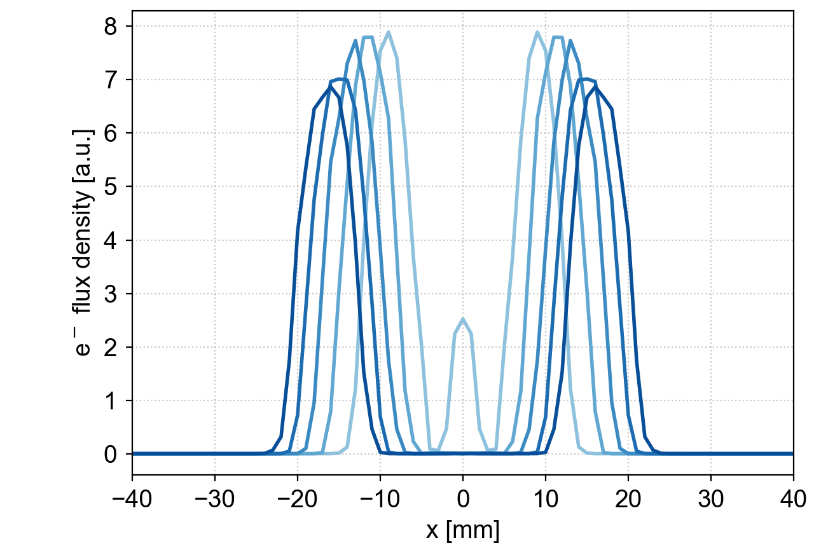
Scrubbing 2012
One week dedicated scrubbing (studies) in the SPS
High intensity tests up to ‘ultimate’ (1.8e11 p/b)
  Electron cloud distribution measured in the strip monitors
  Stripes moving outwards and occupying larger regions, however depleting the center
MBA
MBB
19/12/19
already known from simulations

Slide 8
Scrubbing 2012
One week dedicated scrubbing (studies) in the SPS
High intensity tests up to ‘ultimate’ (1.8e11 p/b)
A stronger flux is observed in the outer regions of the liners which were not reached by the scrubbing performed with the nominal bunch intensity.
The bunch intensity used for the scrubbing run defines the maximum intensity for which an ”EC free” operation can be guaranteed afterwards.
Radial steering can be employed to condition a wider region, but this comes at the expense of the overall scrubbing time and the effectiveness is modulated around the machine according to the dispersion function.

Slide 9
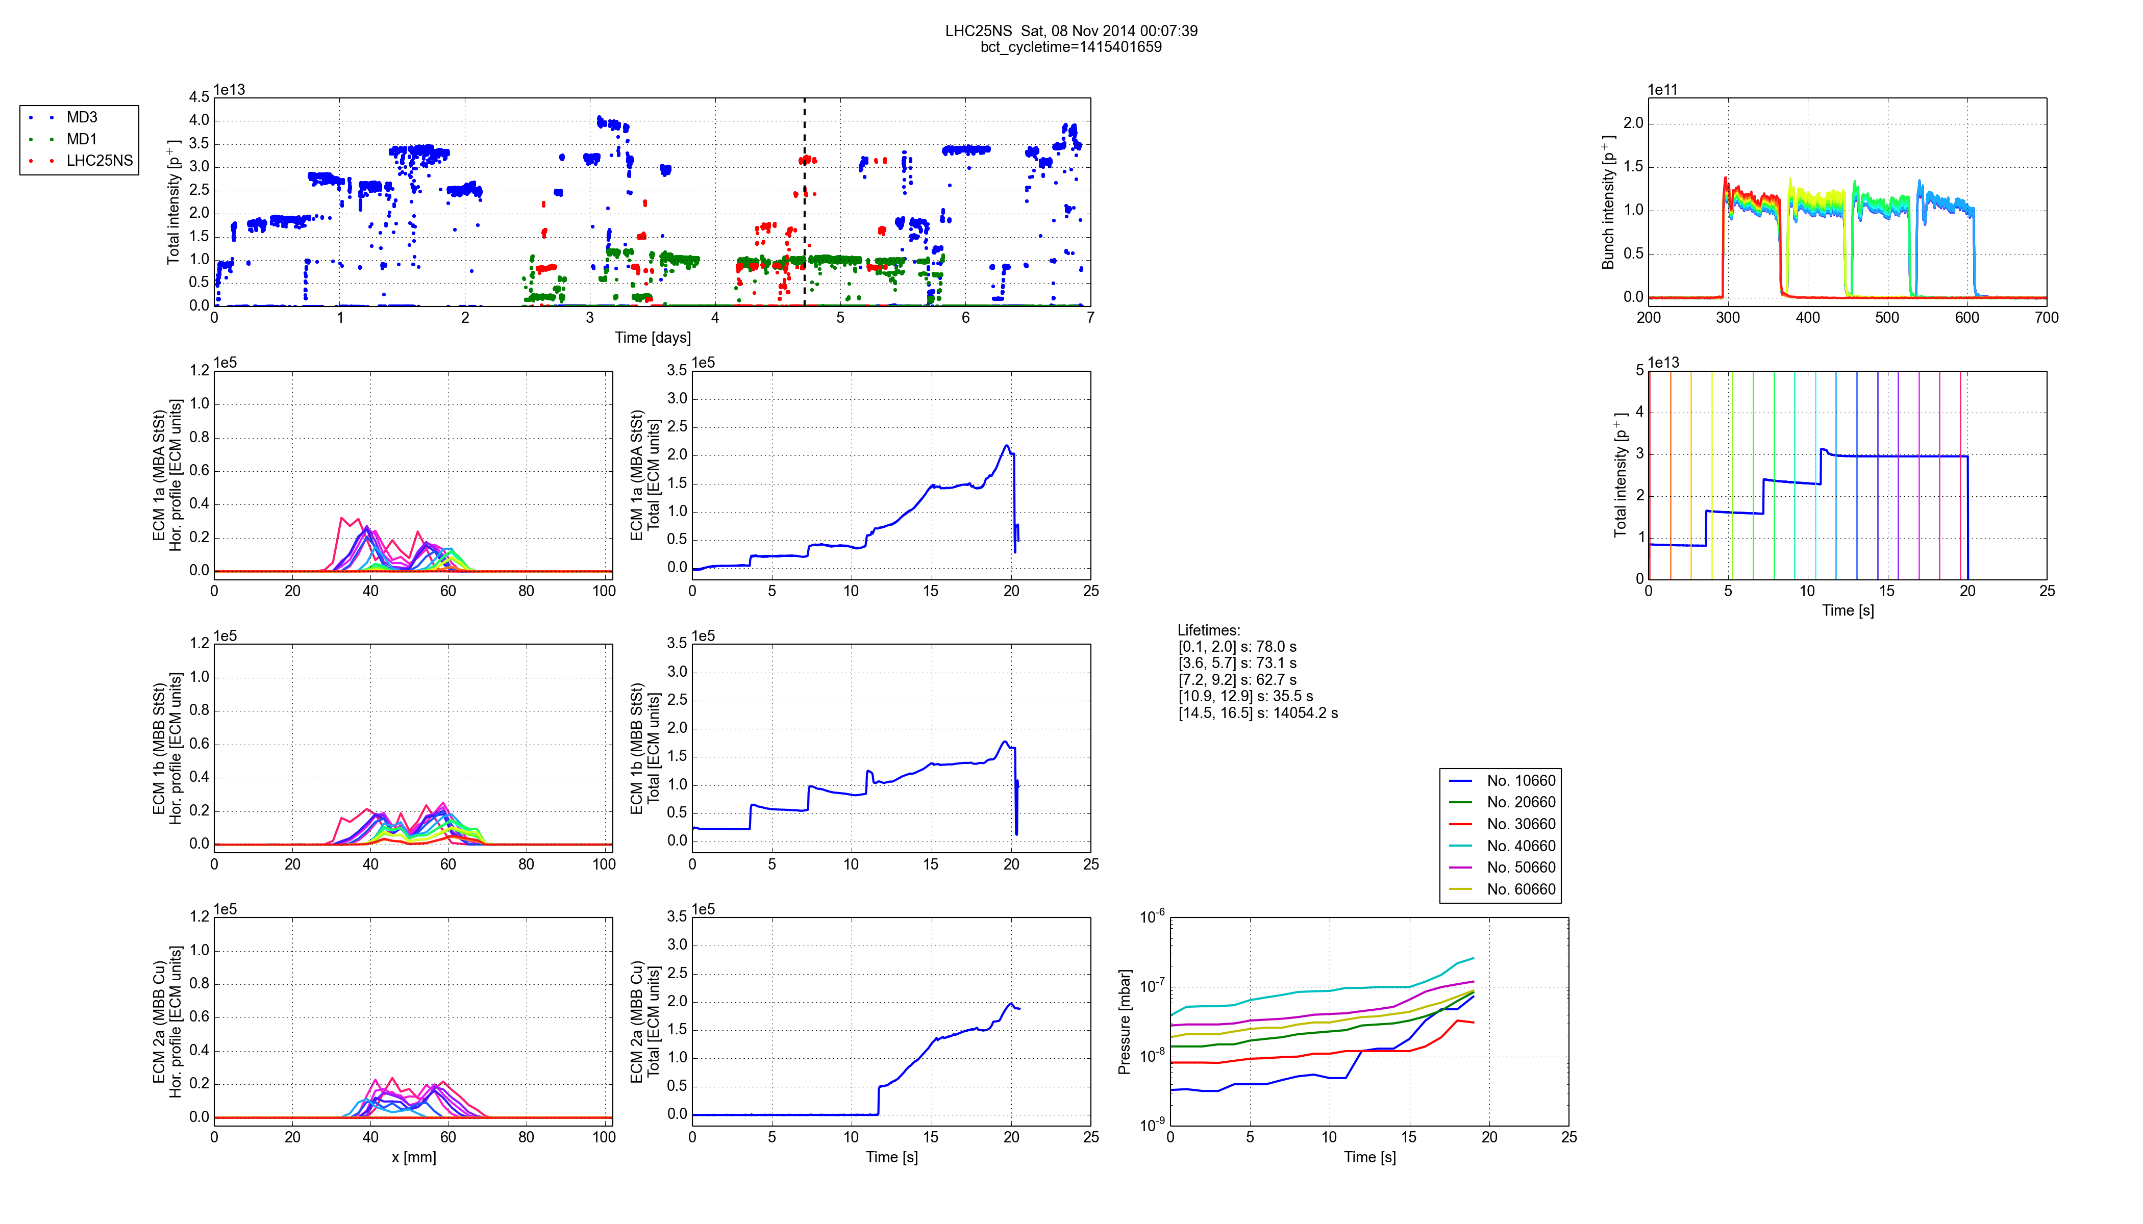
Scrubbing 2014
One week (October ) + 3 days (December) dedicated scrubbing in the SPS
First week in 2014 was used to recover SPS performance post-LS1
  One week found indeed to be sufficient to recover a ‘scrubbing status’ of the SPS to allow for LHC beam production within target parameters
Beam type | Bunch intensity (injected) | Number of bunches | Transverse emittances (at 26 GeV) | Beam lifetime after each injection
25 ns Standard | ~1.25 x 10¹¹ p/b | 288 (4 x 72) | ε_{H,V} ≈ ~2.6 μm | ~200 s, ~210 s, ~180 s

Slide 10
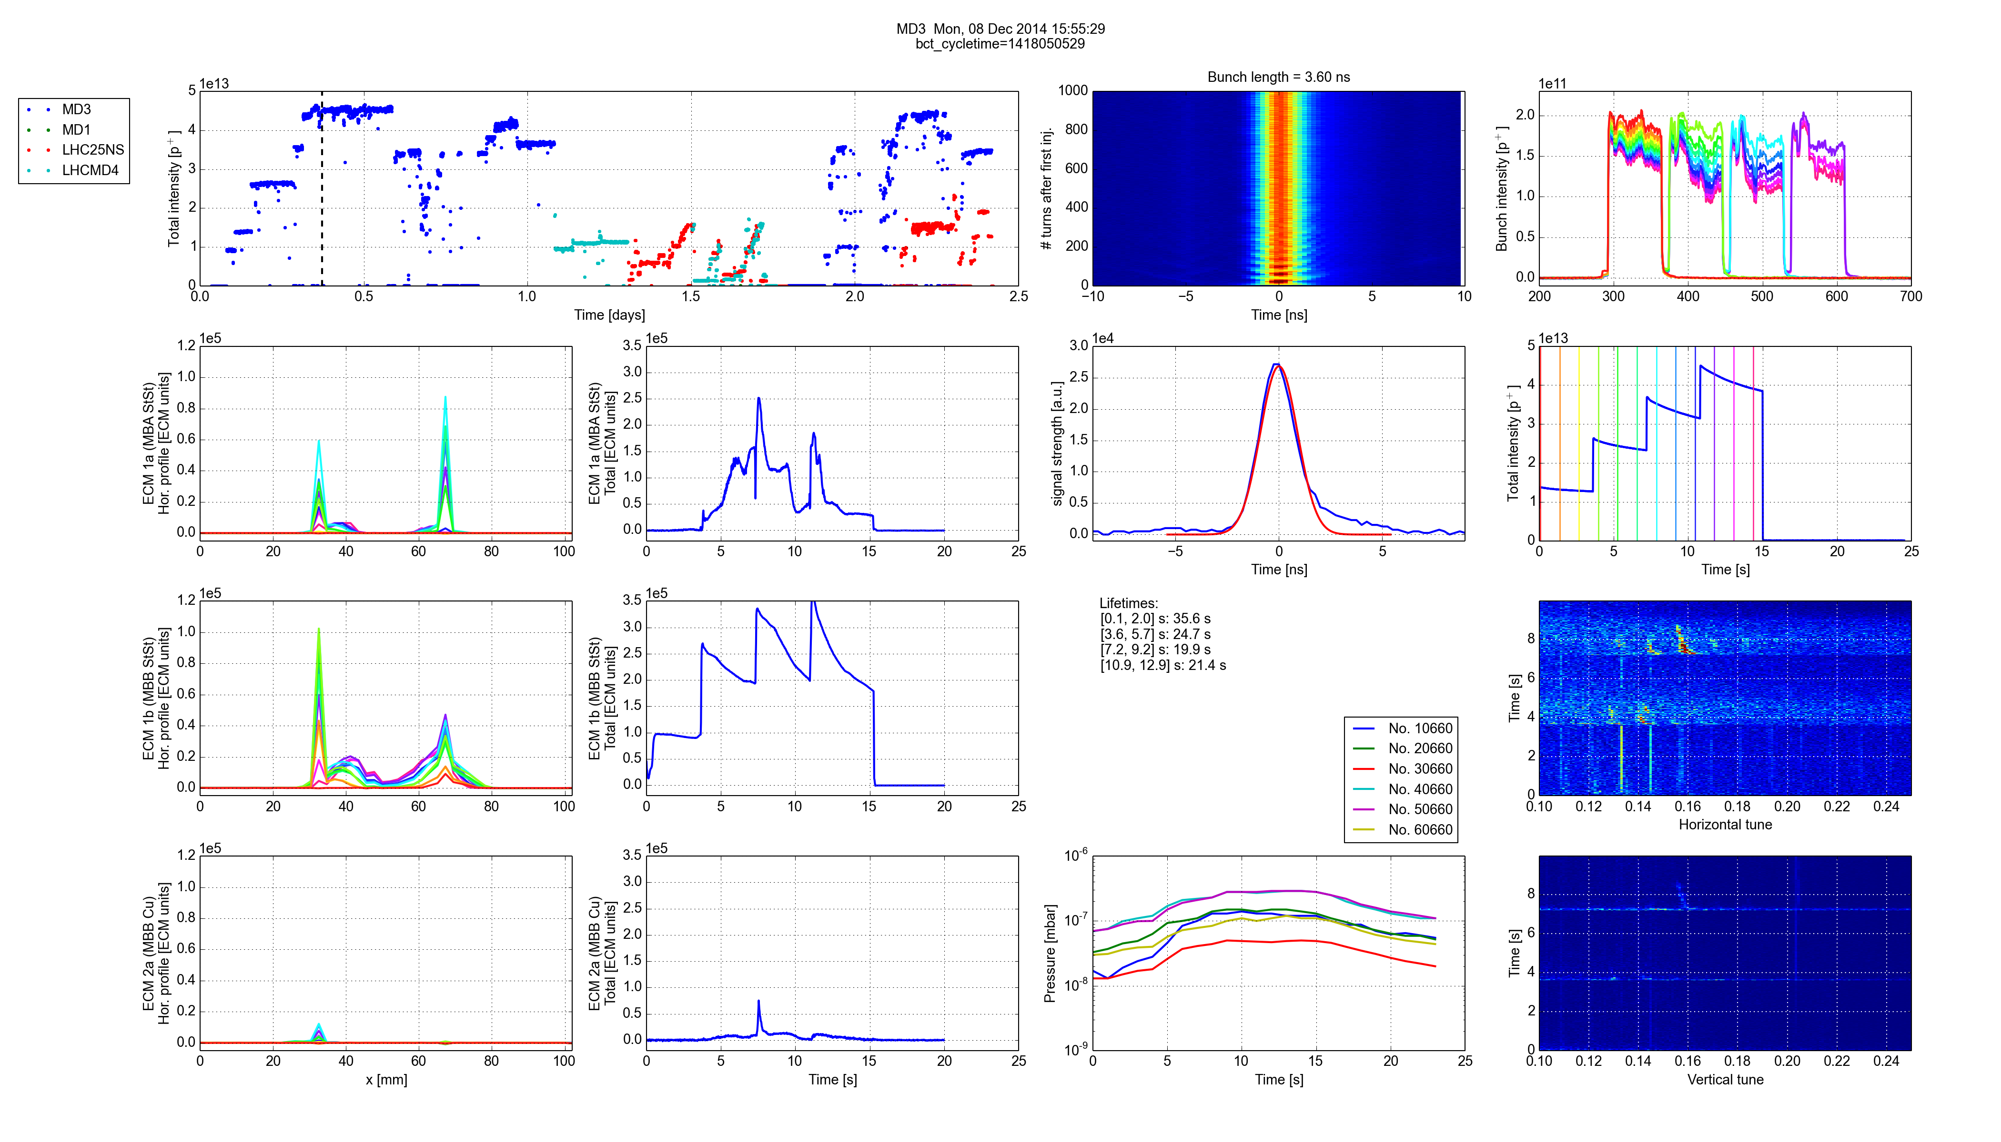
Scrubbing 2014
One week (October ) + 3 days (December) dedicated scrubbing in the SPS
High intensity test (2e11 p/b)
Beam type | Bunch intensity (injected) | Number of bunches | Transverse emittances (at 26 GeV) | Beam lifetime after each injection
25 ns Standard | ~1.25 x 10¹¹ p/b | 288 (4 x 72) | ε_{H,V} ≈ ~2.6 μm | ~200 s, ~210 s, ~180 s
25 ns – High intensity | ~2.0 x 10¹¹ p/b | 288 (4 x 72) | ε_{H,V} > 5.0 μm | ~40 s, ~30 s, ~20 s

Slide 11
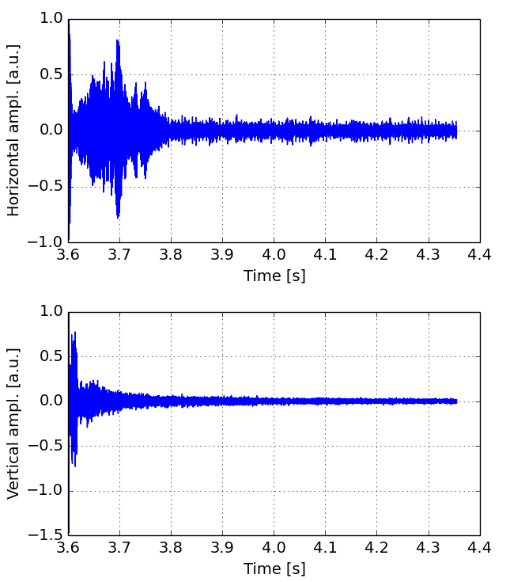
Scrubbing 2014
One week (October ) + 3 days (December) dedicated scrubbing in the SPS
High intensity test (2e11 p/b)
  Horizontal instabilities

Slide 12
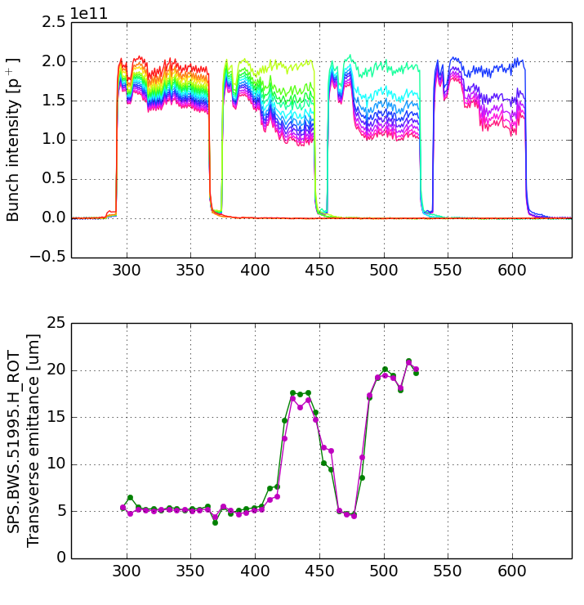
Scrubbing 2014
One week (October ) + 3 days (December) dedicated scrubbing in the SPS
High intensity test (2e11 p/b)
  Horizontal instabilities
  Emittance growth

Slide 13
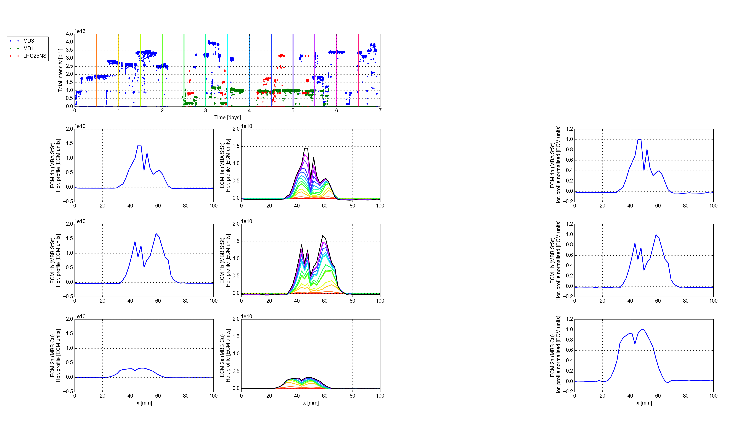
Scrubbing 2014
One week (October ) + 3 days (December) dedicated scrubbing in the SPS
High intensity test (2e11 p/b)
MBA dipole
MBB dipole
Accumulated during Scrubbing Run 1 (October)
Signals measured with ~2.0 x 10¹¹ p/b

Slide 14
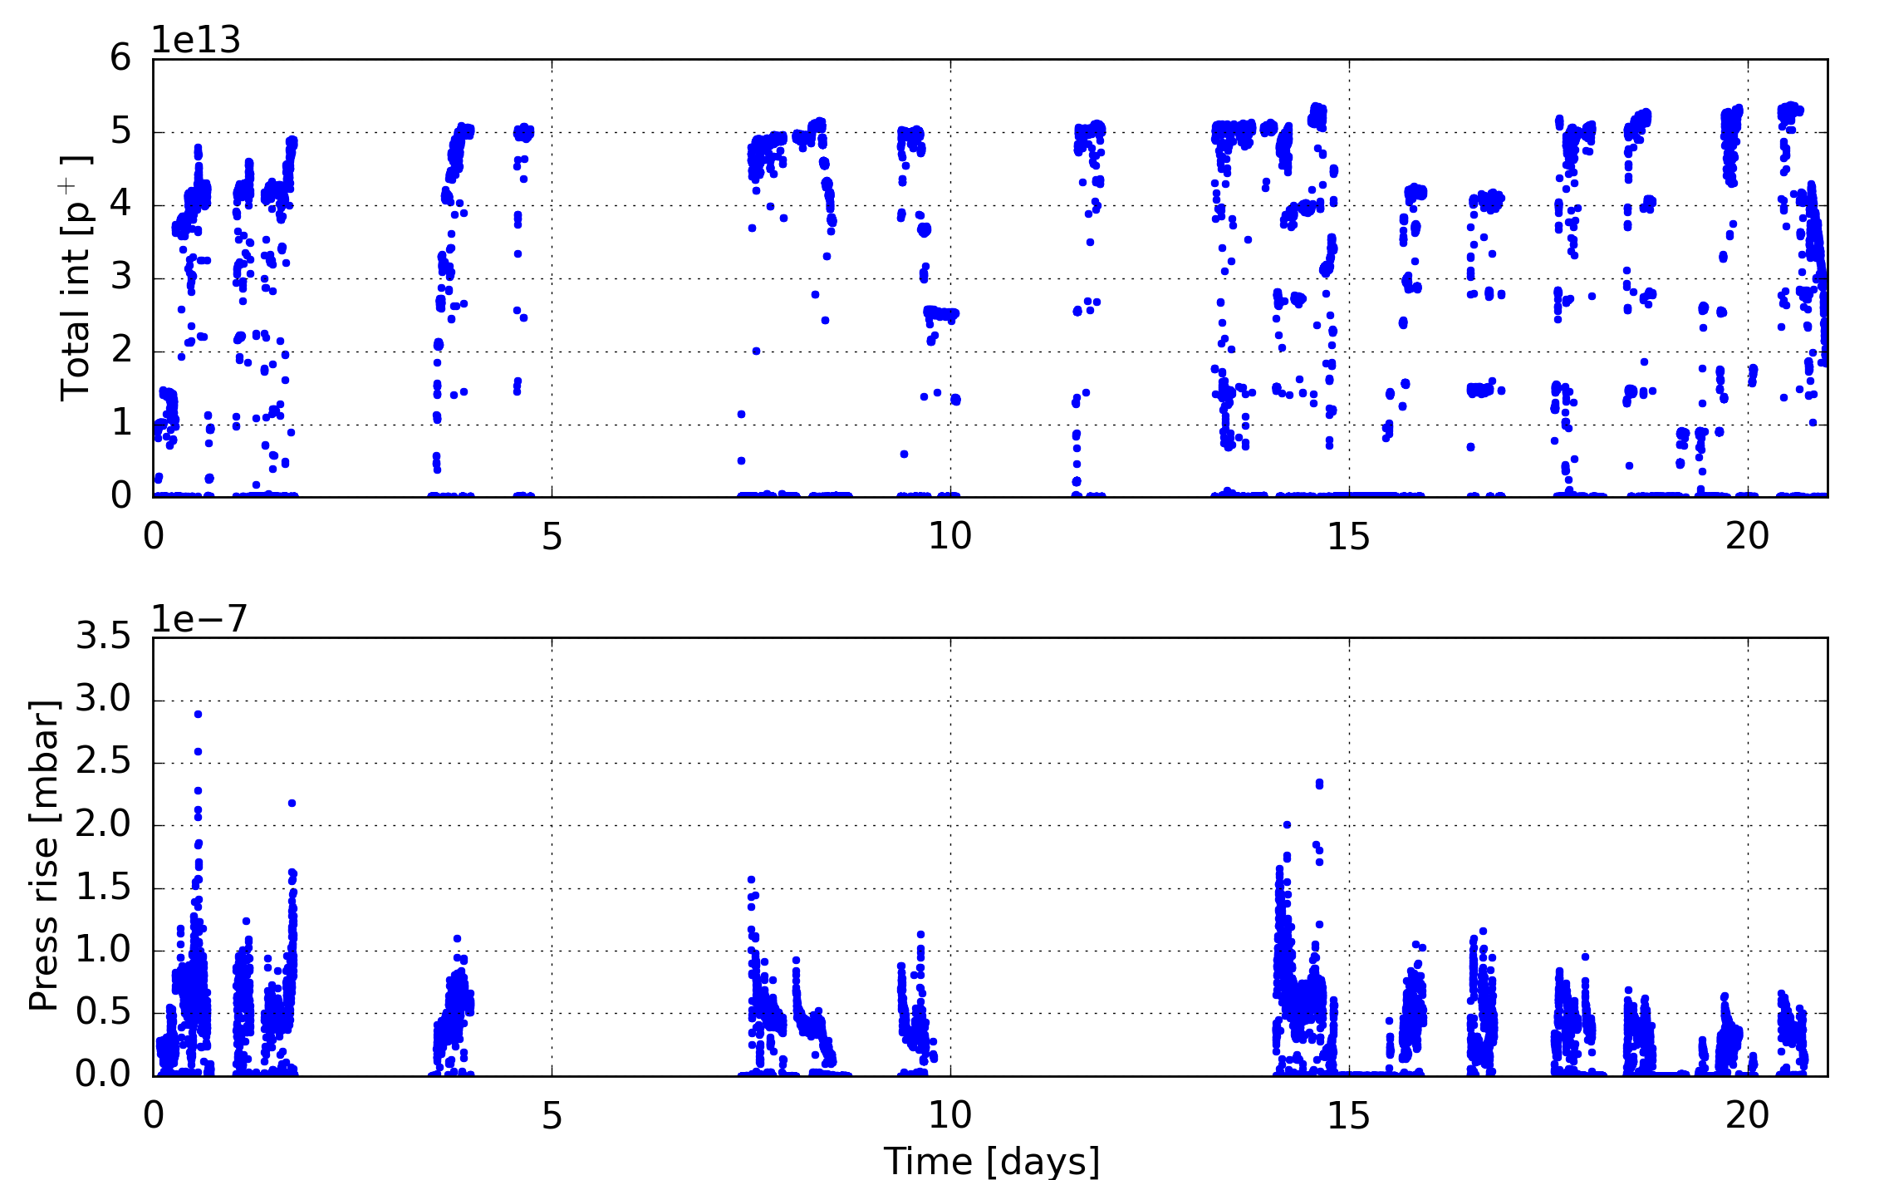
Scrubbing 2015
Two full weeks dedicated scrubbing in the SPS split in four blocks of 3.5 days
arc gauge 40660

Slide 15
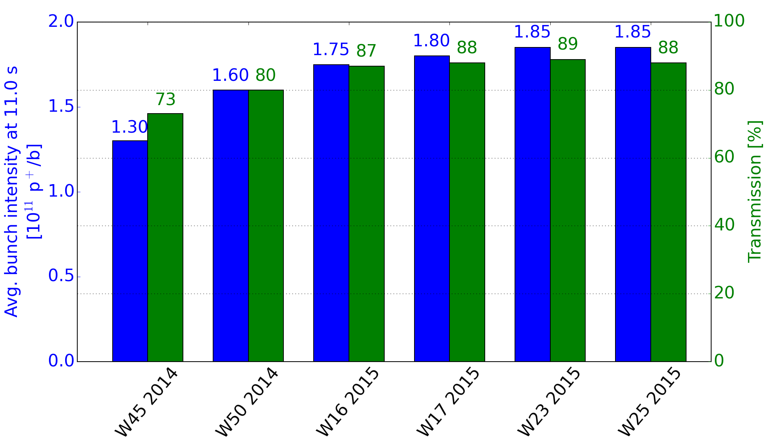
Scrubbing 2015
Two full weeks dedicated scrubbing in the SPS split in four blocks of 3.5 days
  Significant improvement of flat bottom transmission when injecting about 1.9e11 p/b – a combination of improved machine settings and scrubbing
  Remaining losses hopefully from beam loading
injected about 1.9e11 p/b

Slide 16
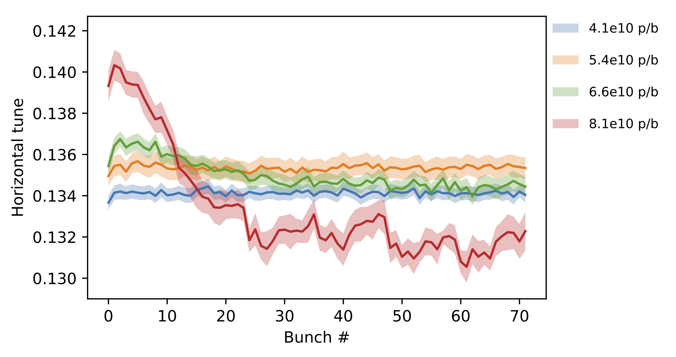
High intensity studies in 2017
Horizontal tune shift along the batch observed for intensities >6e10 p/b
  Most likely due to electron cloud (to be confirmed in simulations)

Slide 17
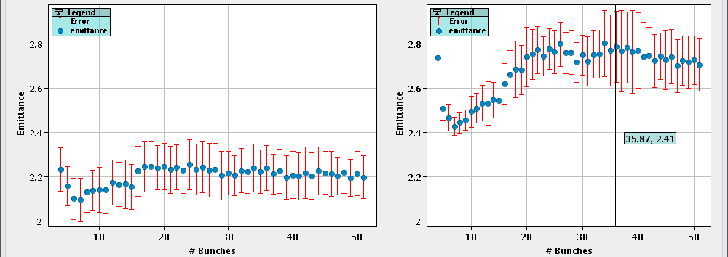
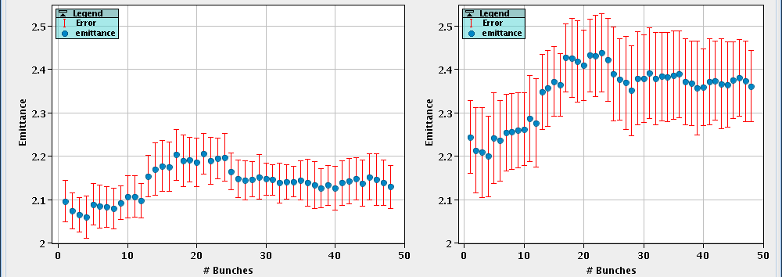
High intensity studies in 2018
48 bunches of BCMS with 1.9e11 p/b injected show blow-up from e-cloud
Horizontal:
injection
after 18 s (EFB)
Vertical:
injection
after 18 s (EFB)

Slide 18
High intensity studies in 2018
Continuous emittance growth with 2e11 p/b measured with BGI

Slide 19
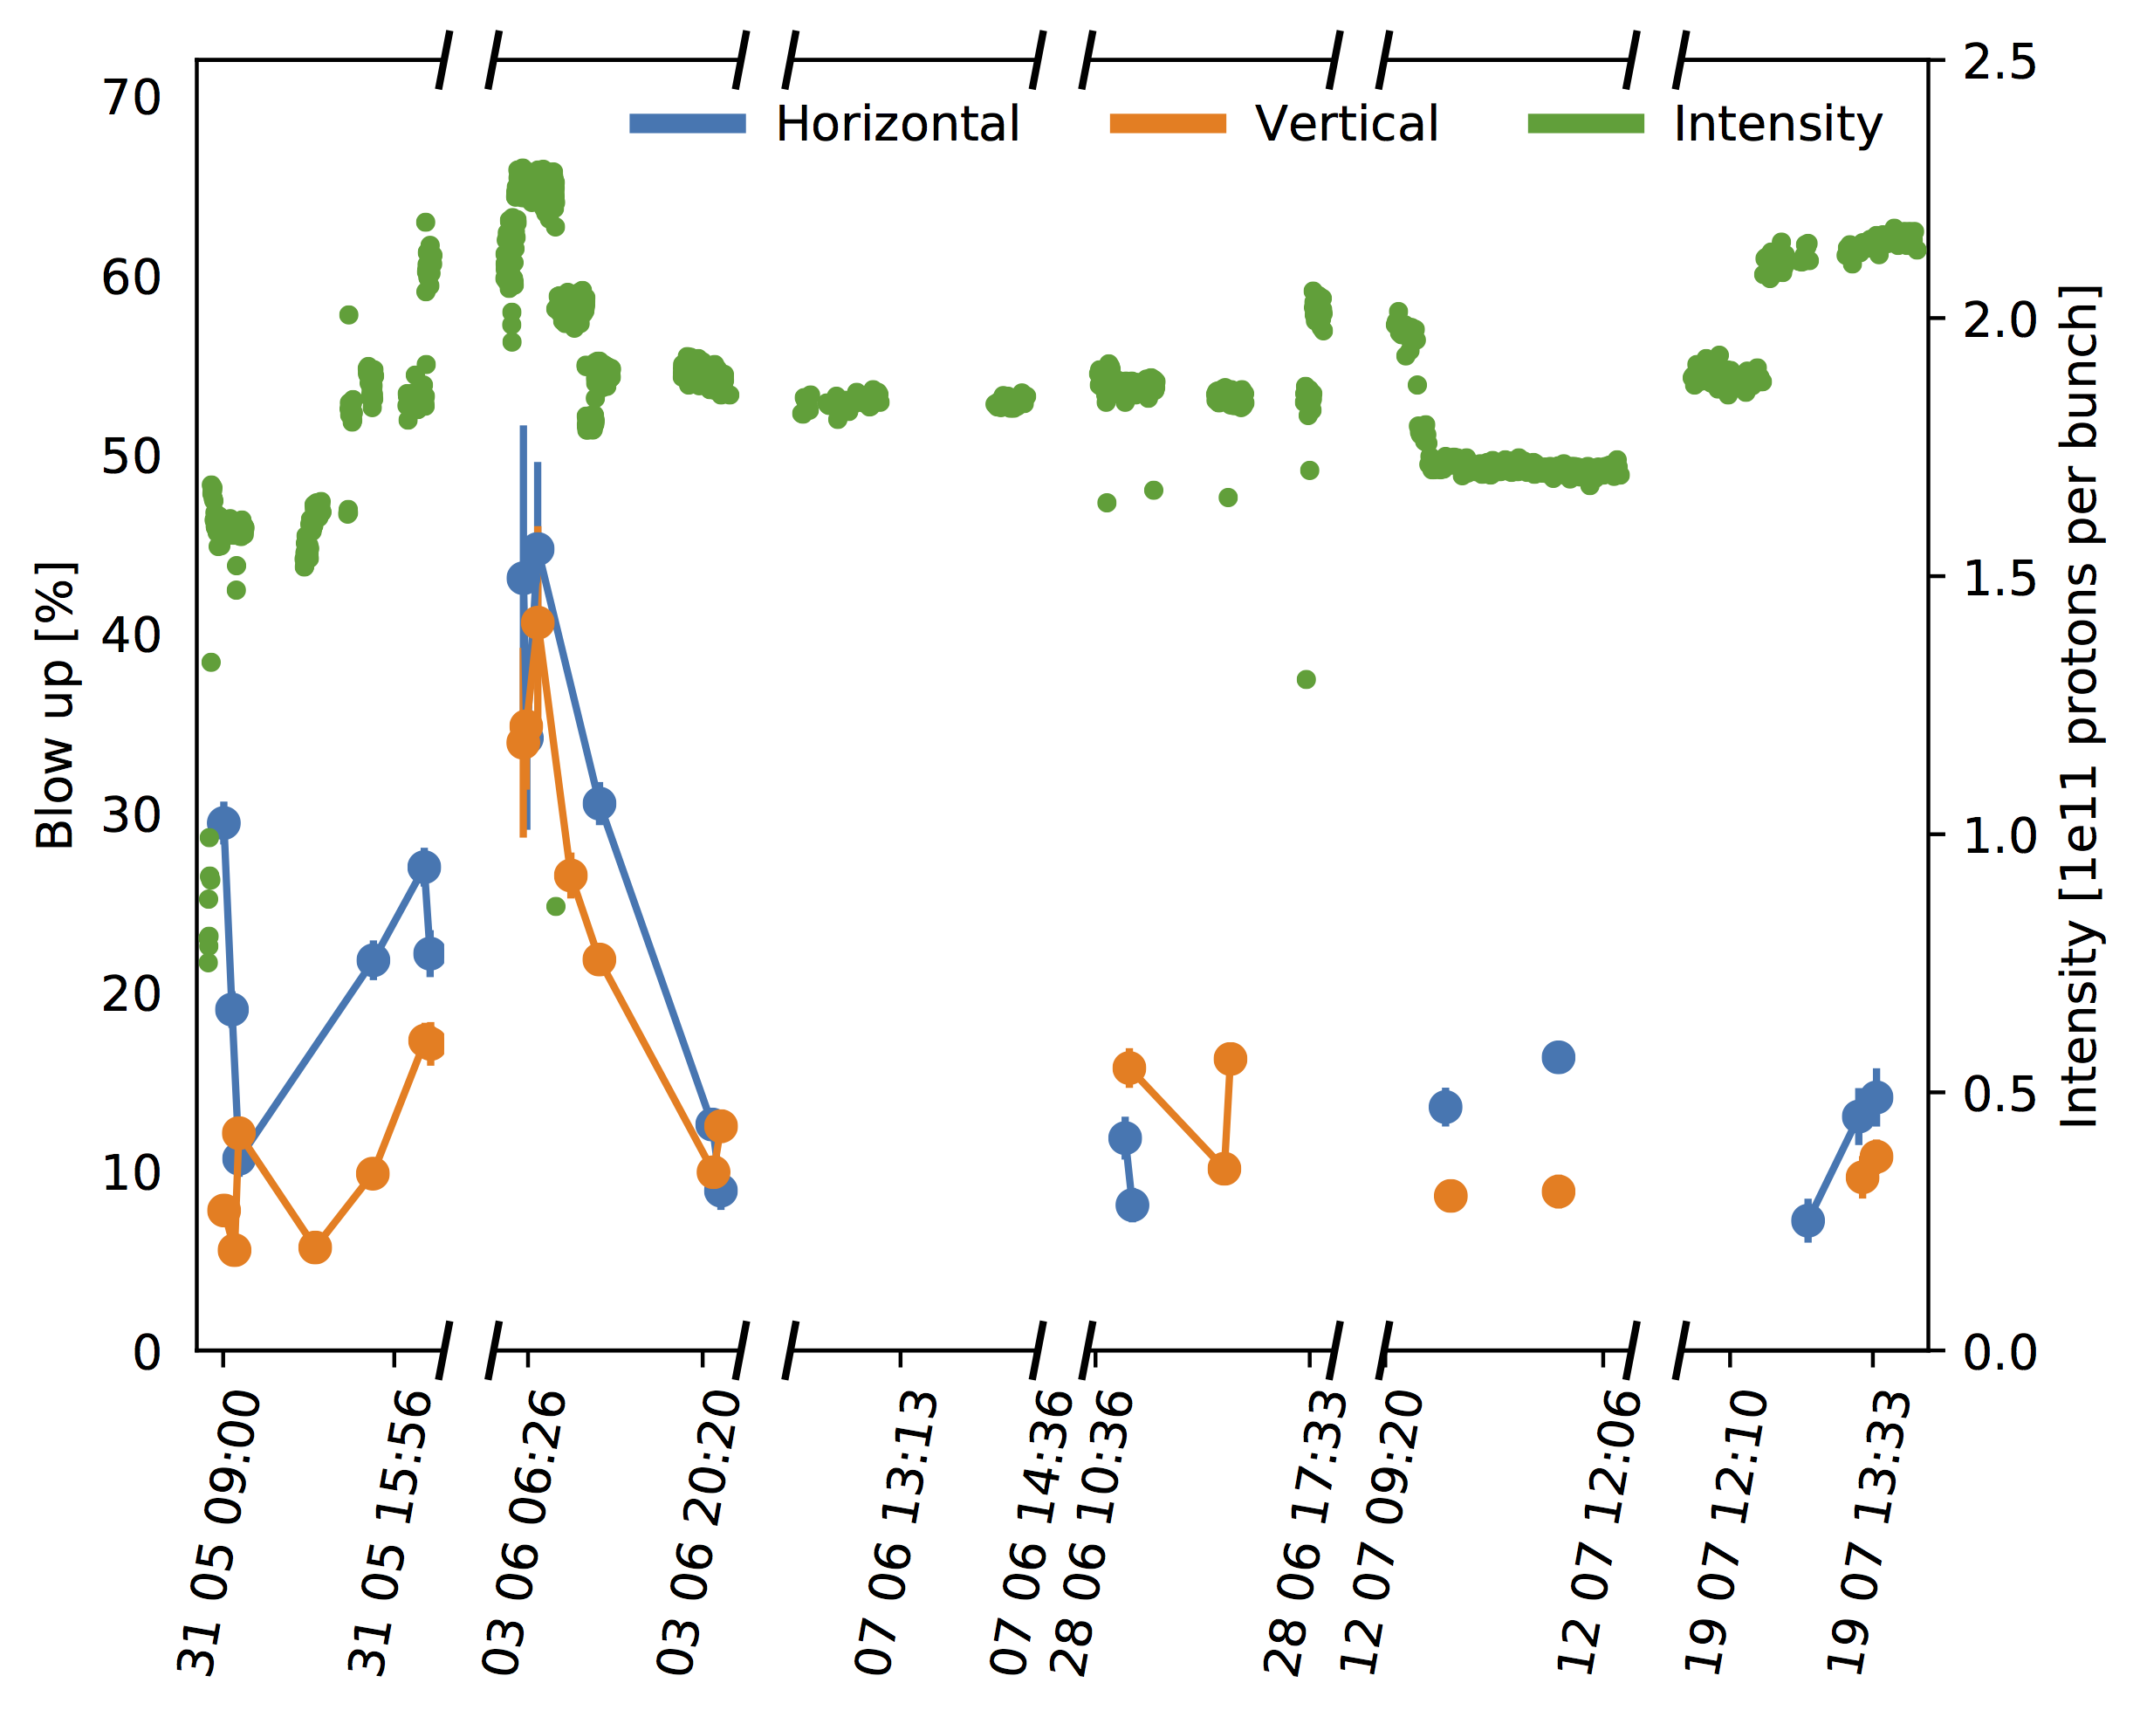
High intensity studies in 2018
emittance blow-up of first batch over ~ 20 s reduced to about 15% after a few days of high intensity scrubbing
mini scrubbing run

Slide 20
SPS machine configuration for scrubbing
Fast vacuum valves blocked open (by vacuum piquet)
Concentrate losses on the momentum scraper by horizontal bump
Extraction elements off, ZSs at -30 kV
  ZS sparking is expected to be less severe after LS2 due to ZS upgrade
MKPL interlock levels to 6e-7 mbar (SW) and 7e-7 mbar (HW)
  Heating (and related outgassing) will be a limitation after LS2 (see next slides)

Slide 21
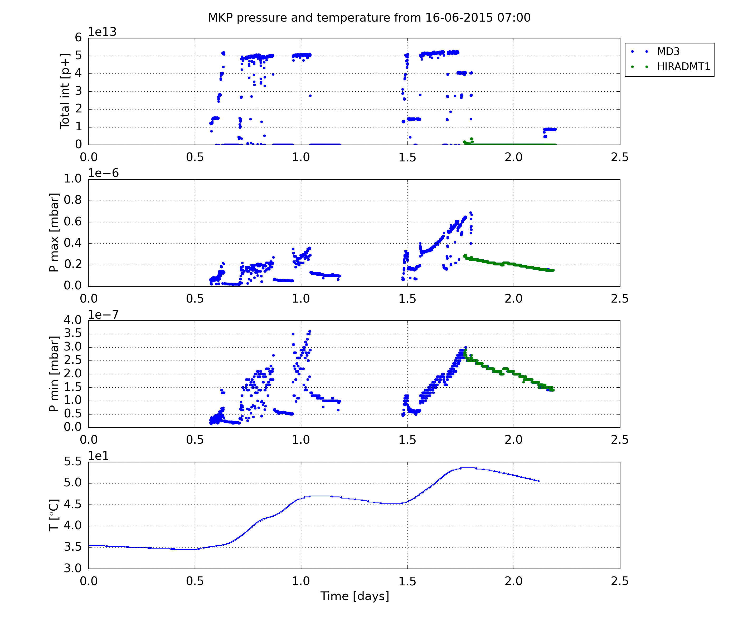
Operational limitations from MKPL in 2015
Reached close to 55° after 2 days of high intensity scrubbing in 2015

Slide 22
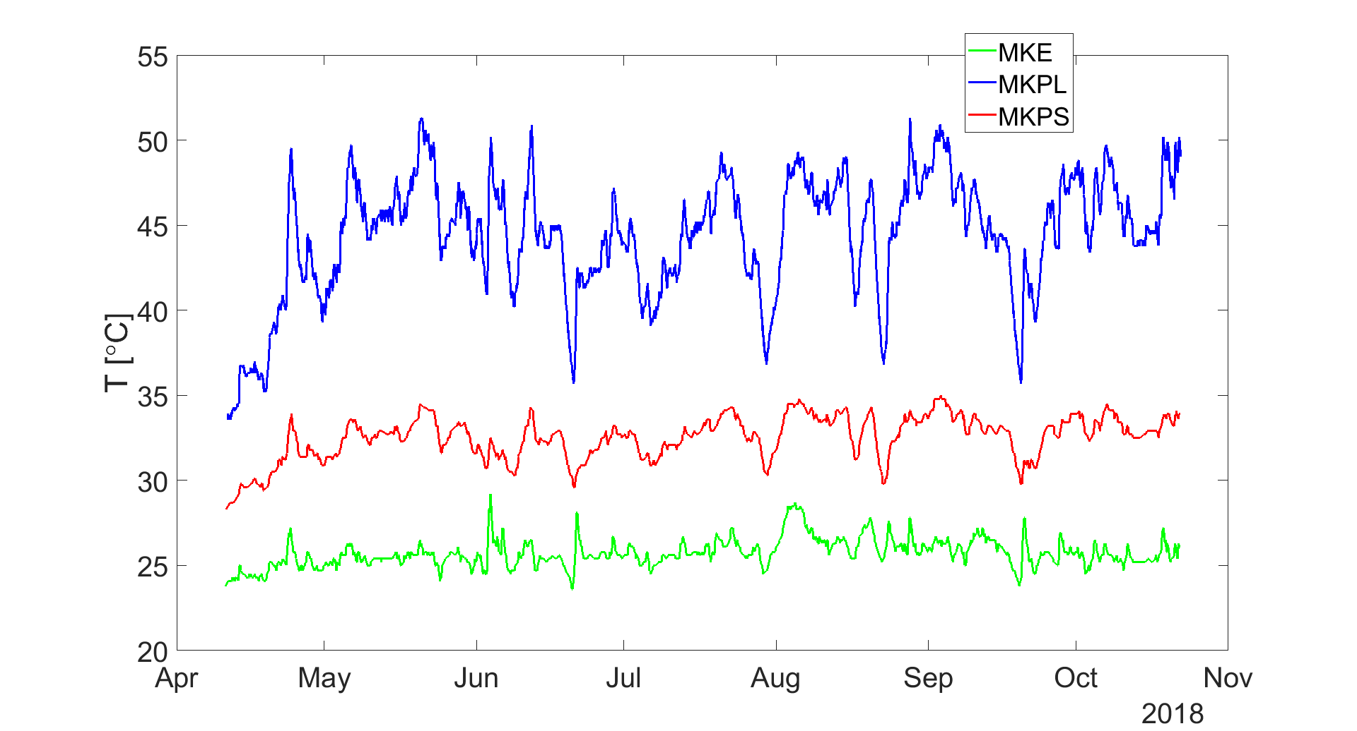
Operational limitations from MKPL in 2018
Reached high temperatures even without dedicated scrubbing, just from nominal operation and high intensity studies on Thursdays

Slide 23
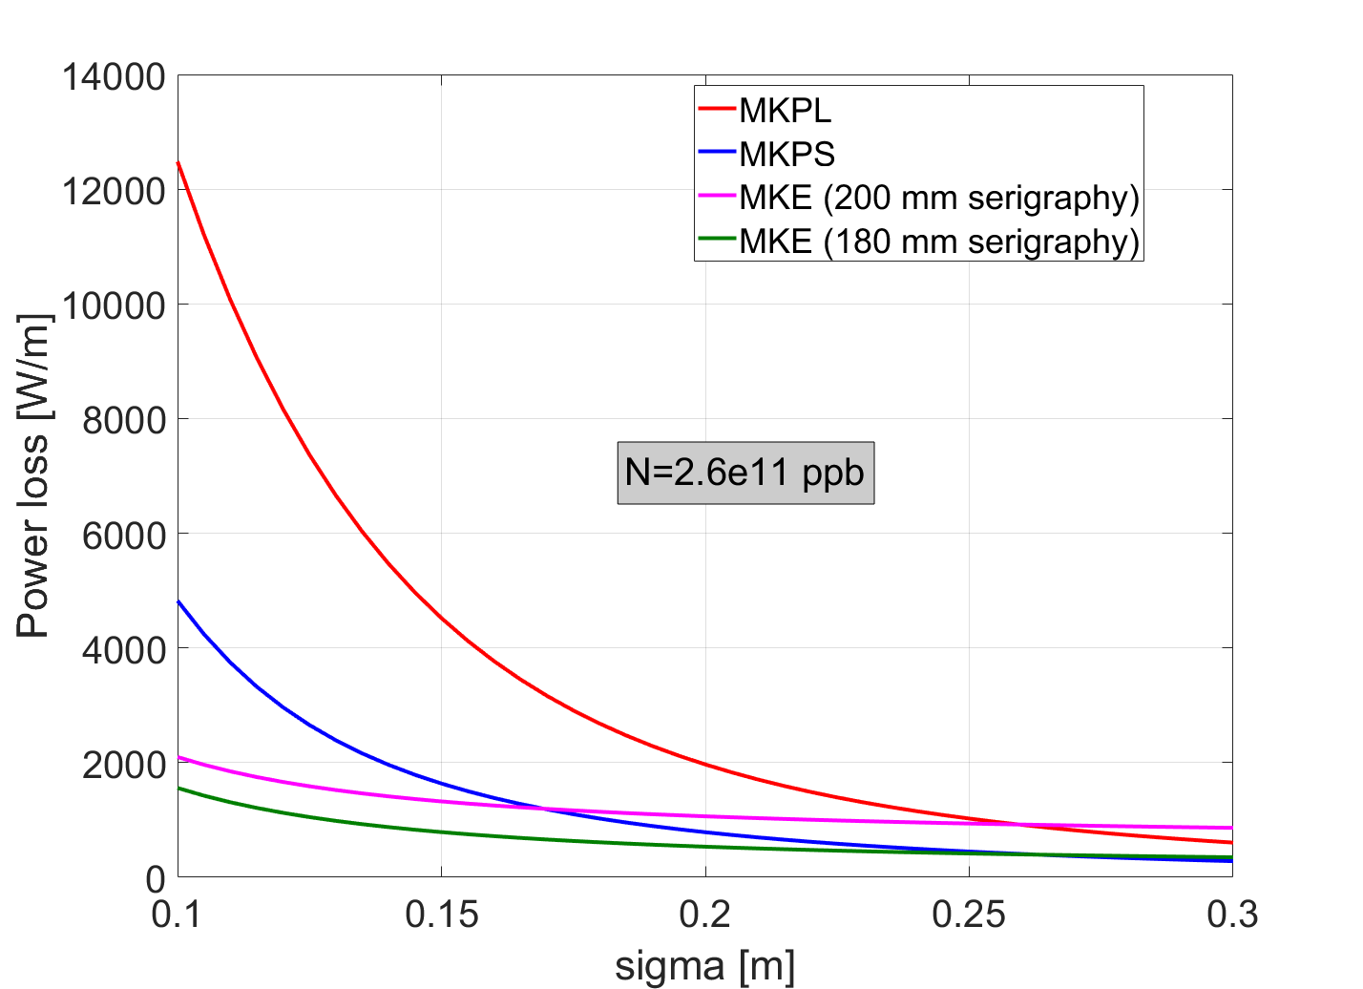
Power loss in kickers as function of bunch length

Slide 24
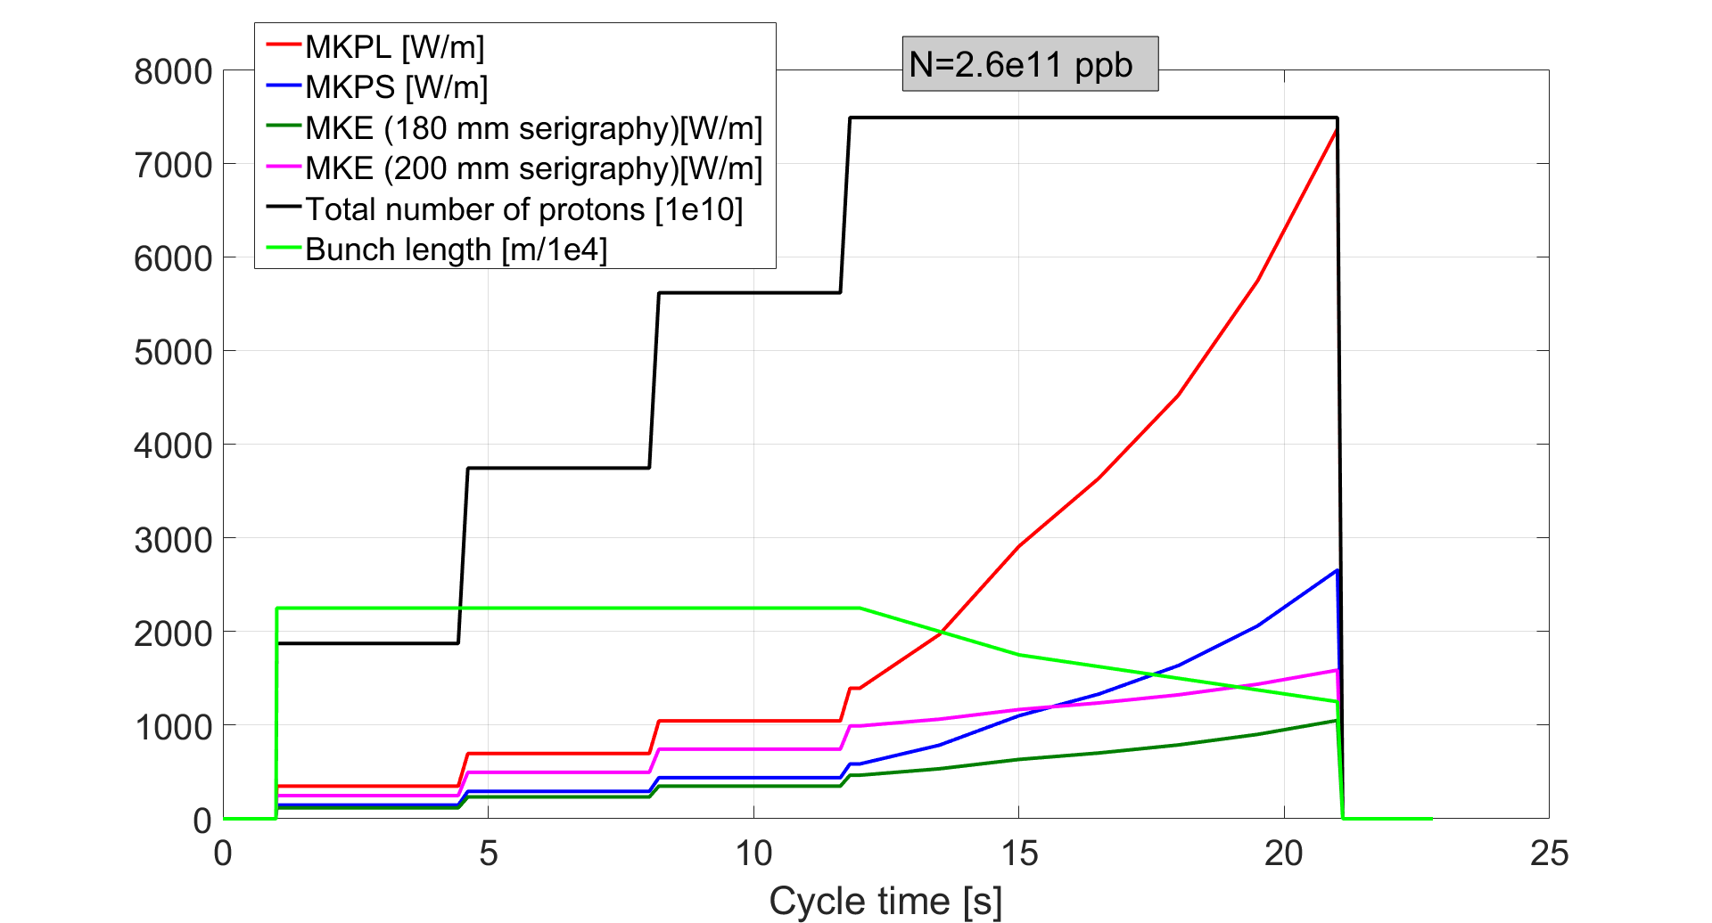
Power loss in kickers along cycle
Strong heating of MKPL expected at high beam energy (short bunches)

Slide 25
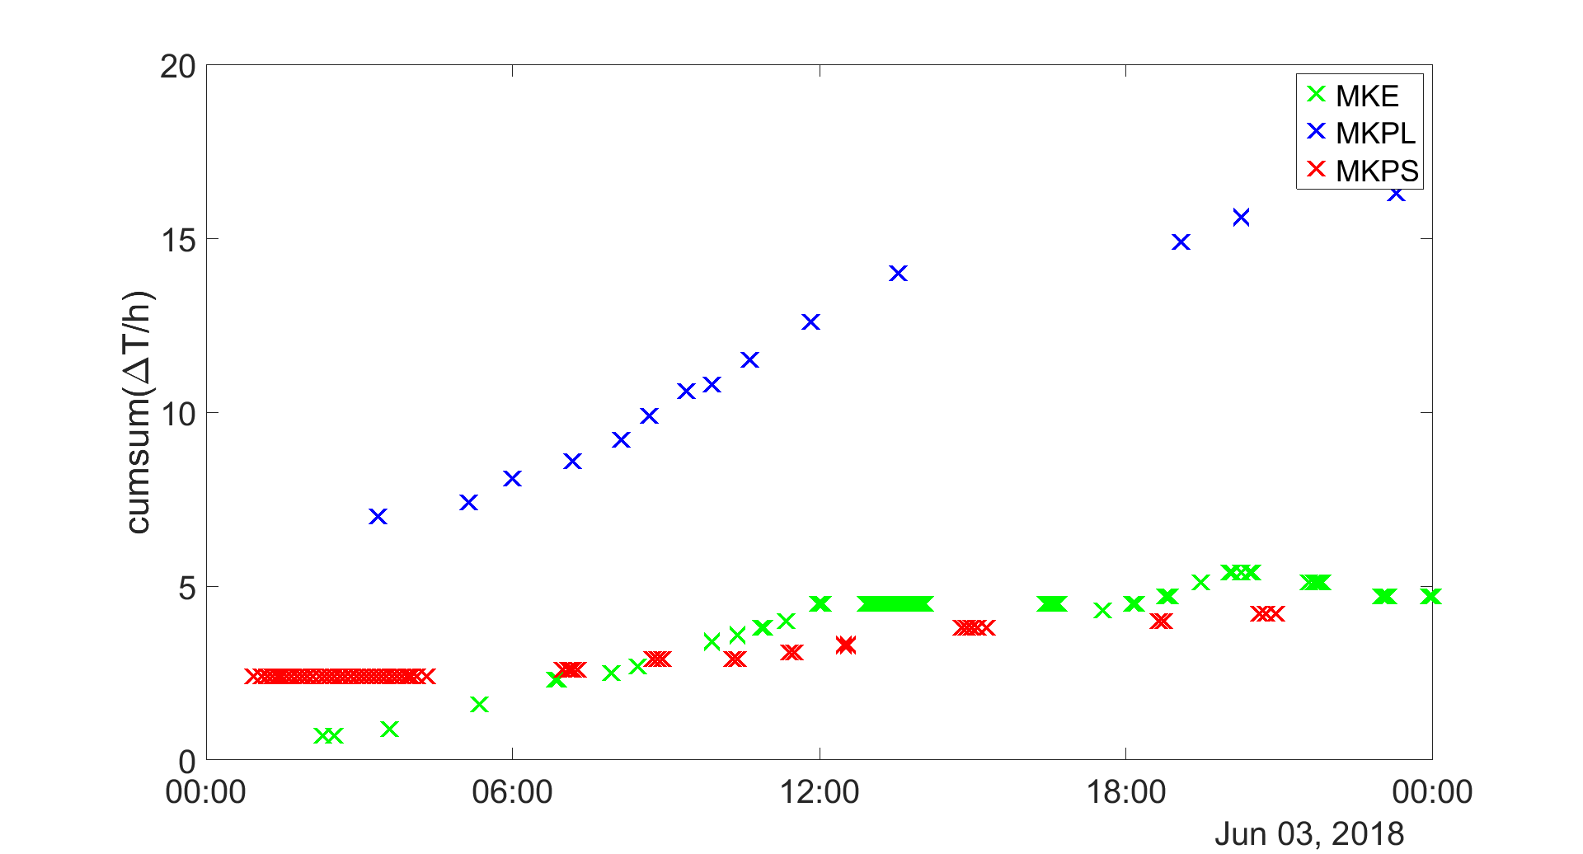
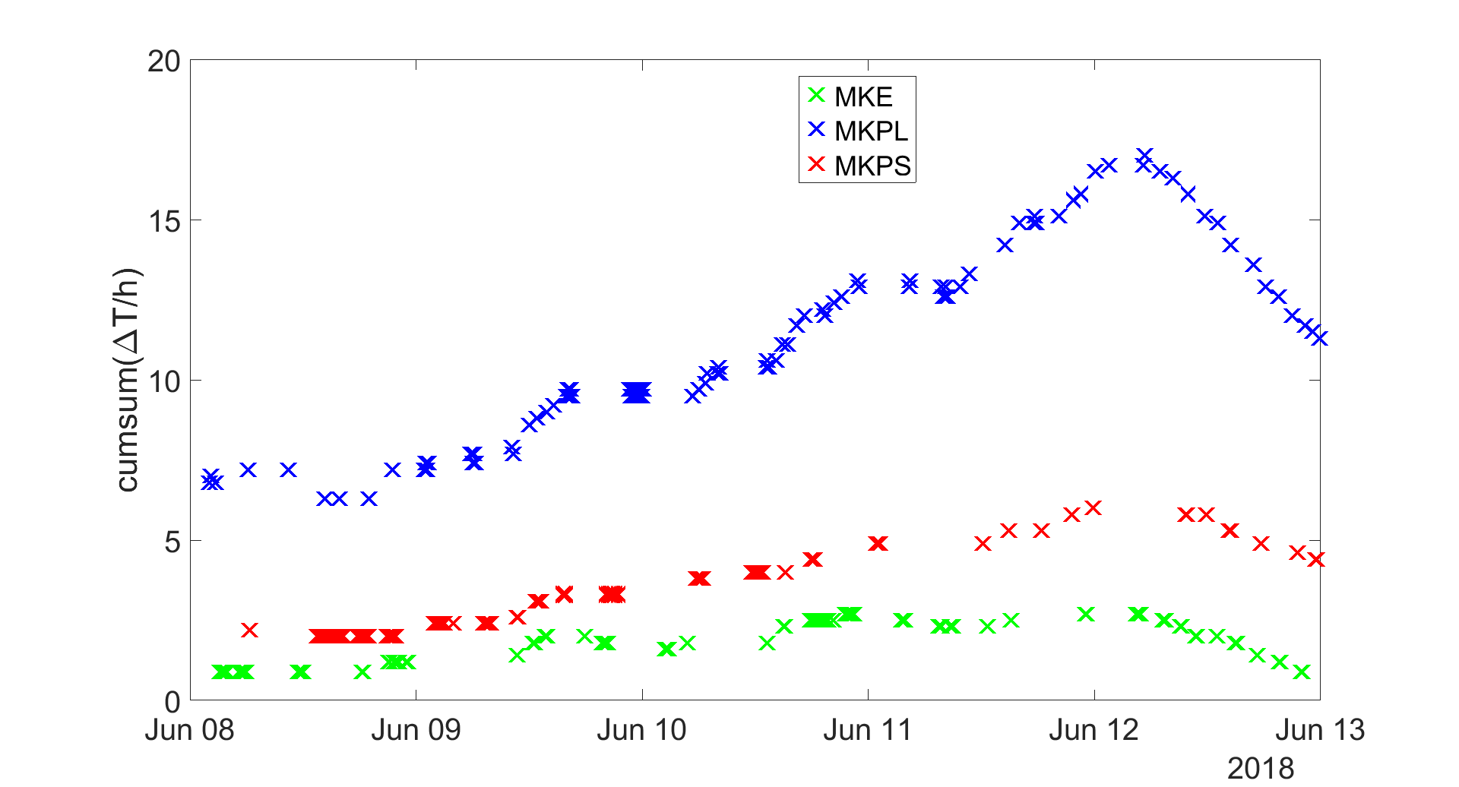
Kicker heating flat bottom vs. ramp
Scrubbing at flat bottom (2018)
MD at flat top and LHC filling (2018)
… confirms expected behavior (MKE on flat bottom more critical than MKPS while opposite on the ramp)

Slide 26
Conclusions
Beam degradation from e-cloud as well as improvement due to scrubbing clearly observed in SPS
  After LS1 it took 1 week to recover acceptable performance of nominal 25 ns beam
When ramping up intensity, the stripes in dipole magnets move outside
  Recrudescence of instabilities (both horizontal and vertical) and pressure rise
  Scrubbing needed to condition these regions of the dipole chambers and therefore scrubbing time needs to be allocated for every “intensity step”
  Scrubbing could be combined with beam setup and performance optimization of the high intensity LHC beams
Dedicated scrubbing runs are affected by operational limitations
  Kicker heating (in particular for MKPL) becoming much more severe for LIU intensities will prohibit scrubbing in long blocks and potentially makes scrubbing very inefficient
  Scrubbing in parallel to North Area physics should become feasible thanks to ZS upgrade

Slide 27
THANK YOU FOR YOUR ATTENTION

