Slide 1
Update on effect of 915 MHz HOM on LHC beam
M. Schwarz
Acknowledgements:
R. Calaga, A. Farricker, P. Krämer, E. Shaposhnikova, BLonD dev team
LIU-SPS BD WG meeting, 19/11/21

Slide 2
Motivation
The 915 MHz HOMs have high Q and large R/Q → long range wake field couples batches
Exact values for 915 MHz HOM are not known at present (R_{shunt}, f_{r}, Q) and are difficult to measure and simulate
CST simulations of 915 MHz HOM assuming open boundary conditions (P. Kramer, 19/10/24 LIU-SPS BD WG meeting) give twice larger R_{shunt} than what is in present longitudinal impedance model
What is the impact of this ‘worst case’ on multi-batch stability?
Outline
Simulation of ‘worst case scenario’
Effect of shifting resonant frequency
Simulations with single-resonator model

Slide 3
Setup for full impedance model simulations
Flat top, double RF V₂₀₀=10MV (V₈₀₀/V₂₀₀=0.1), Q20
1x72 or 4x72 bunches with 1 Million macro-particles per bunch
Multi-batch simulation possible thanks to BLonD-MPI (K. Iliakis, LIU-SPS BD WG meeting, 21/02/2019)
Bunch spacing 5 RF buckets (25ns), batch spacing 40 RF buckets (200ns)
Using full SPS impedance model
200 MHz feedback modeled by reducing R_{shunt} by 26dB
800 MHz feedback modeled by reducing R_{shunt} by 26dB
915 MHz HOM:
as is in current BLonD model
open boundary conditions (worst case)
No phase loop
BLonD simulation parameters: Δf=44kHz, 64bins/RF bucket
Initial bunches were matched including intensity effects!
Simulate 100 000k turns of flat top (2.3s)
Beam considered unstable if maximum relative bunch length spread exceeds 0.07: $\frac{\max{∆τ}}{τ_{av,inj}}>0.07$

Slide 4
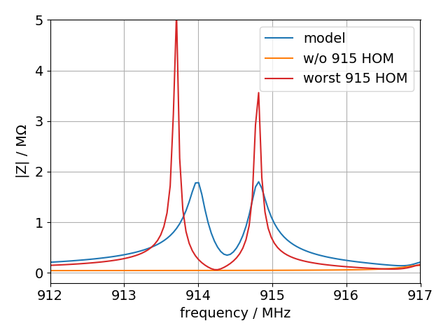
Values for 915MHz HOMs
3 section
 | open | model
fr / GHz | 913.7; 914.8 | 914.0; 914.8
R / kOhm | 798; 593 | 231.0, 231.6
Q | 18586; 15290 | 3000; 3000
R/Q | 43; 39 | 77
τ / μs | 6.5; 5.3 | 1.0; 1.0
4 section (scaled)
 | open | model
fr / GHz | 913.7; 914.8 | 914.0; 914.8
R / kOhm | 1064; 791 | 385.0, 386.0
Q | 18586; 15290 | 5000; 5000
R/Q | 57; 52 | 77
τ / μs | 6.5; 5.3 | 1.7; 1.7
‘worst case’ has larger R but reduced R/Q

Slide 5
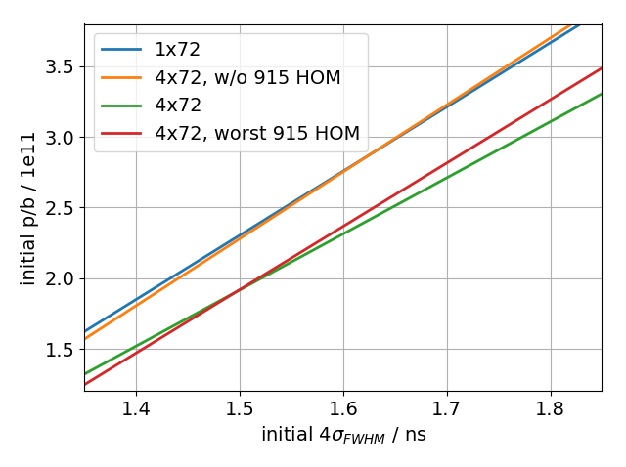
Thresholds
Single batch threshold is recovered without 915MHz HOM
Same multi-batch threshold for 915 MHz with open boundary condition (‘worst’ case)

Slide 6
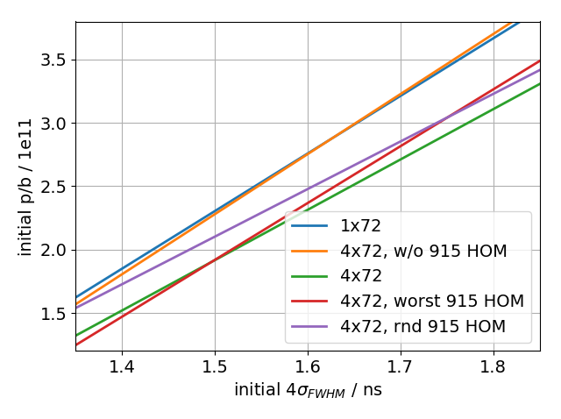
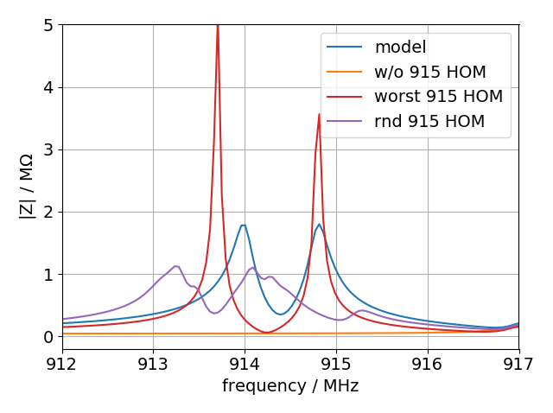
Thresholds for random frequency shift
Resonance frequency may vary from cavity to cavity
Use full impedance model with ‘worst case’ 915 MHz HOM and change f_{r} randomly (rnd) for each of the four 3-section and two 4-section cavities (assume (-1,0.5) MHz)
→ Multi-batch threshold similar for bunch lengths larger than 1.65 ns

Slide 7
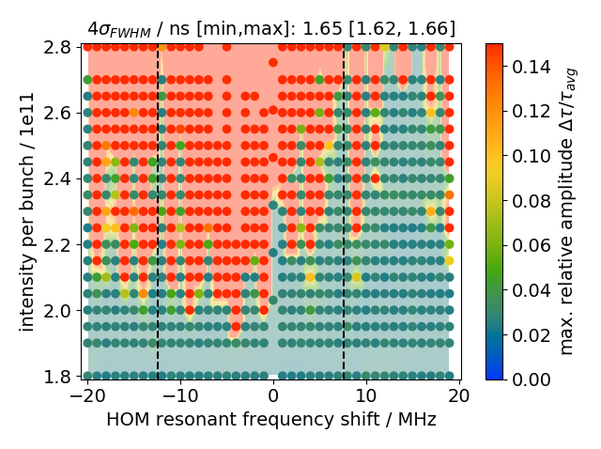
Effect of 915 MHz HOM frequency shift
Simulate with full impedance model, but shift $f_{r}$ of 915 MHz HOM (two resonators at $f_{r}=913.7$ and $f_{r2}=f_{r}+δf_{r}=914.8$ MHz) → huge impact on threshold
Wake fields from bunches cancel if $f_{r}=\frac{n−1/{πQ}}{τ_{bb}\sqrt{4−1/Q^{2}}}−\frac{δf}{2}$; dashed lines in figure (J. Repond, E. Shaposhnikova, CERN-2018-003-CP)

Slide 8
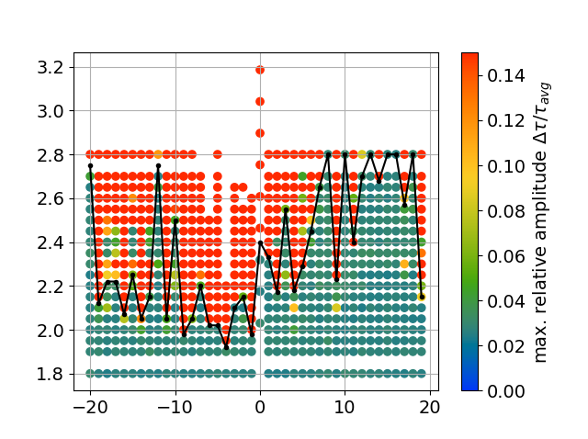
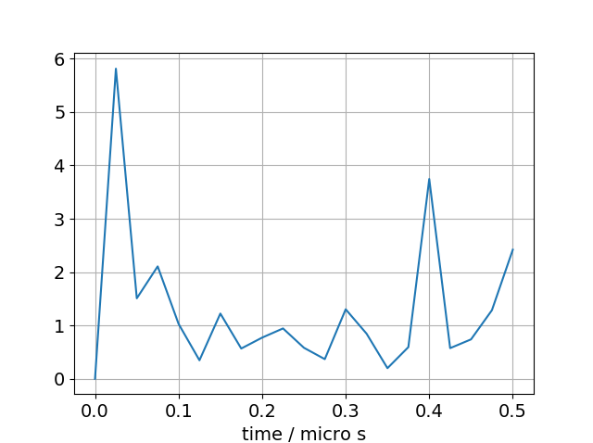
Effect of 915 MHz HOM frequency shift
Fourier Transform of threshold curve (obtained by hand) reveals additional 2.5 MHz (0.4 micro s) modulation:
16 bunches (16x25ns)
Twice batch spacing (2x200ns)
25ns

Slide 9
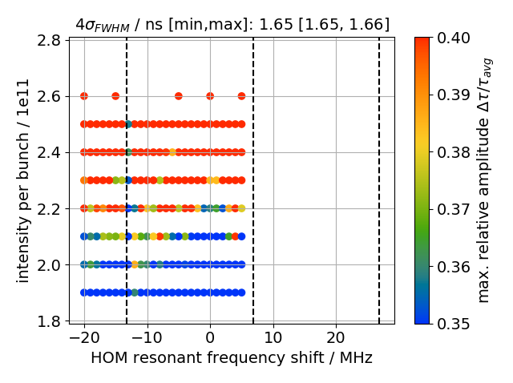
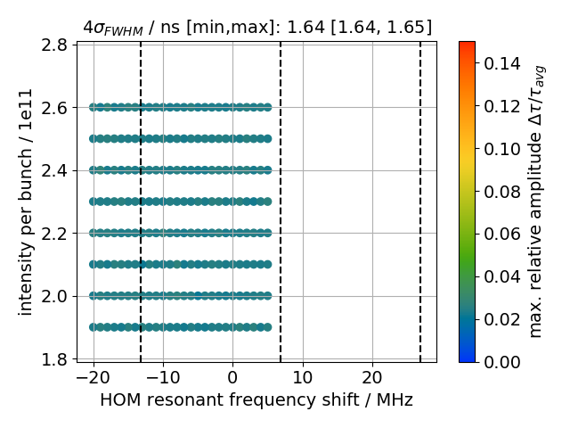
4x72 bunches, single-resonator model
Single resonator (R=1.7MOhm, $f_{r}=915$MHz, $Q=5000$) and shift $f_{r}$
No threshold for ${V_{800}}/{V_{200}}=0.1$
Without 800 MHz, beam is always unstable (${\max{∆τ}}/{τ_{av,inj}}>0.07$) → adjust color range to identify ‘threshold’
800 off
800 at 10%

Slide 10
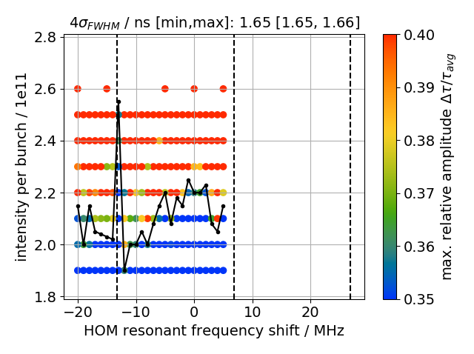
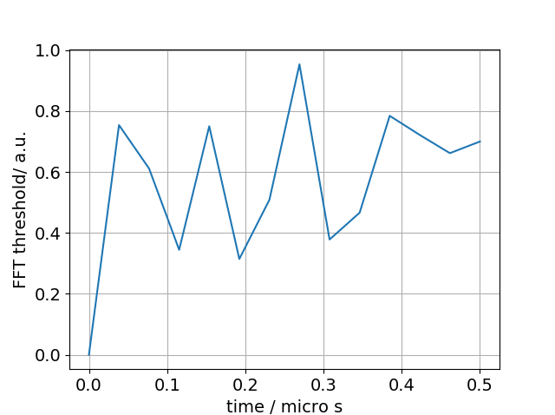
4x72 bunches, single-resonator model
Fourier Transform of threshold curve (obtained by hand) reveals no peak in spectrum

Slide 11
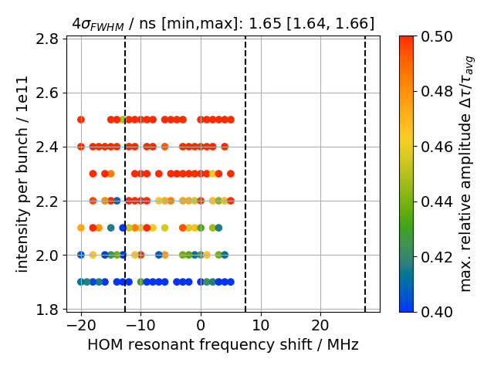
4x72 bunches, two-resonators model
Two resonators (R=1.7MOhm, $Q=5000$, $f_{r}=914$ MHz and 914.8 MHz) and shift $f_{r}$
Without 800 MHz, beam is always unstable (${\max{∆τ}}/{τ_{av,inj}}>0.07$) → adjust color range to identify ‘threshold’
Simulations ongoing!
800 off

Slide 12
Summary
What is the impact of this ‘worst case’ on multi-batch stability? → same multi-batch threshold
Randomly changing the resonant frequency of each cavity yields same multi-batch threshold
Changing resonant frequency by constant $Δf_{r}$ has large impact on multi-batch threshold
Large thresholds at $Δf_{r}=$ +8 MHz and -12 MHz reproduced by analytic formula
Additional $Δf_{r}=2.5$ MHz modulation due to batch spacing?
Single-resonator model
Is stable with 800 MHz TWC at 10%, and unstable without 800 MHz TWC
Raising threshold condition did not show any modulation
Next step
2.5 Modulation due to batch spacing?
Simulate full impedance model with different batch spacings
Thank you for your attention!

