Slide 1
eSPS Impedance Considerations Aaron Farricker Acknowledgements: T. Bohl, R. Calaga, I. Karpov, J. Repond & E. Shaposhnikova

Slide 2
SPS Beam Parameters
LIU LHC Proton Beam
Beam Parameter | Value | Units
Number of Bunches | 4 x 72
Protons per bunch | 2.4 x 10¹¹ | ppb
Irf | 3 | A
E | 26—450 | GeV
eSPS Beam
Beam Parameter | Value | Units
Number of Bunches | 40 x 77
Electrons per bunch | 1.0 x 10⁸ | epb
Irf | 0.006 | A
E | 3.5—16 | GeV

Slide 3
Important Considerations
Instability directly caused by additional impedance
Loss of Landau damping due to broadband impedance sources
Coping with strong beam loading for LHC and fixed target beams

Slide 4
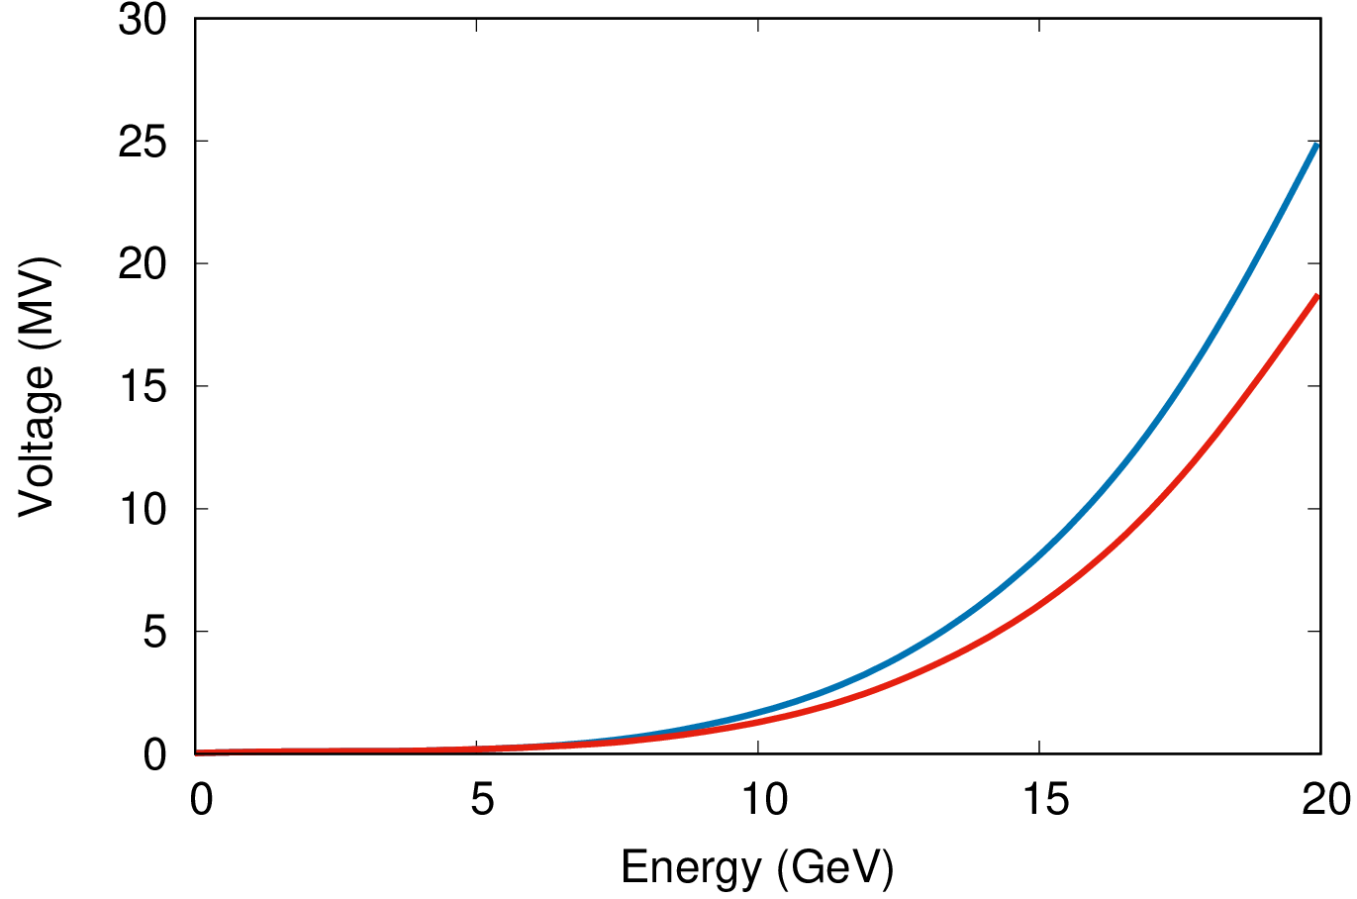
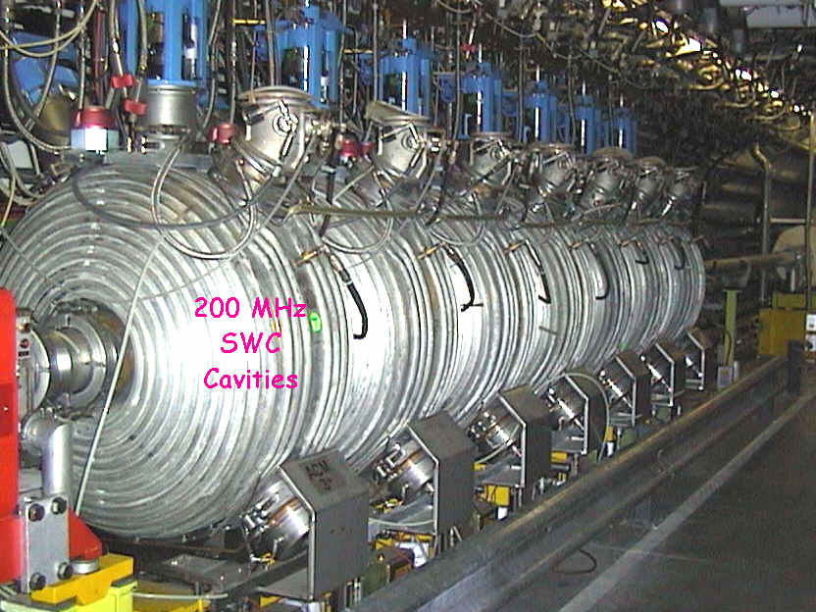
Choice of Cavities – LEP Era
Requirement: 10 MV of accelerating field for 16 GeV electrons
10 normal conducting, 200 MHz cavities
Powered independently by 60 kW power supplies
HOM couplers damp the HOMs well
A damping loop is used to de-Q the accelerating mode during proton operation
Do the HOMs cause instability for the HL-LHC and FT beams?
Can the cavities take the induced power?
What effect does the loss of power have on the proton beams?

Slide 5
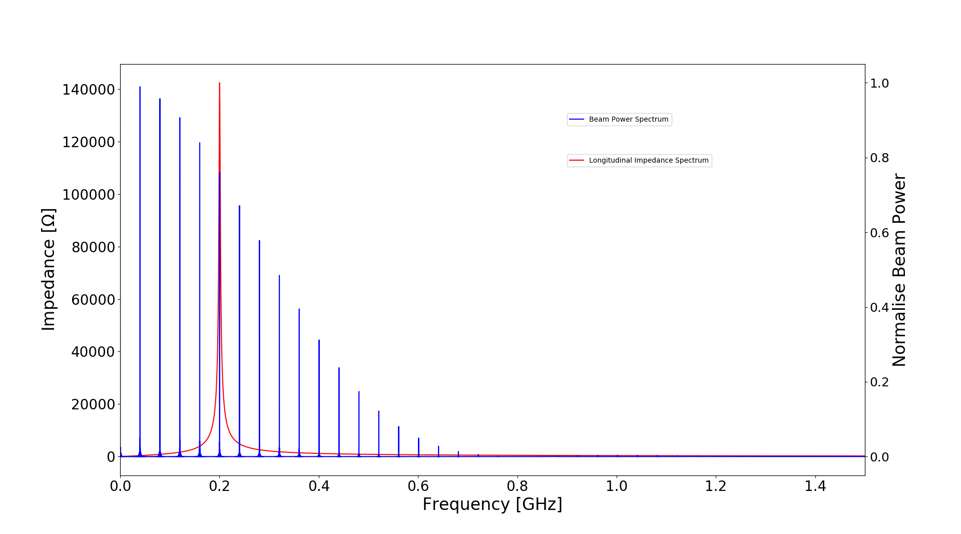
Choice of Cavities – LEP Era
Requirement: 10 MV of accelerating field for 16 GeV electrons
Initial simulations indicate that the HOMs suggest little effect on the stability of the proton beams (Single Batch Only)
The power induced in the HOMs is also not a major concern
However the damping loop for the accelerating mode in the LEP era was designed for 3 kW
With LIU beam it could be 15 kW average per cavity (LEP era it was 3 kW) inducing 400 kV in total – Can the damping system handle this?
Also vacuum leaks were caused in the past by the bellows on the damping loop. Mechanical integrity for parallel operation is challenging
The beam induced voltage is about 4% of the available voltage for protons
Adds 40% to the impedance at 200 MHz (Instability source)
No feedback possible at the cavity due to damping
Without the damping loop Q is is approximately 50k implying MW’s of power

Slide 6
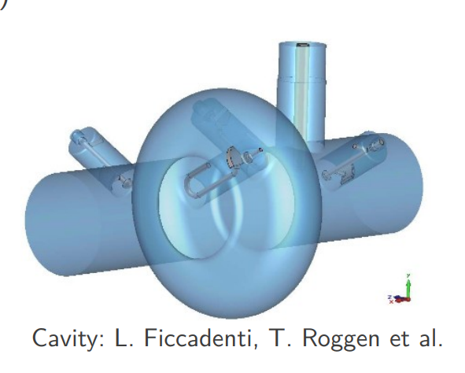
Choice of Cavities – SRF
Requirement: 10 MV of accelerating field for 16 GeV electrons (6.7 mA average)
In-line system
Approximately five single cell 800 MHz SRF cavities (LHC Landau Cavity?) beam loading is less challenging than at 200 MHz
Heavily damped HOMs
Seen by the SPS proton beam
How can the impedance of the cavity be compensated through the SPS cycles using feedback?
Do we need to be concerned about stability of proton beams? (This would be a significant study)

Slide 7
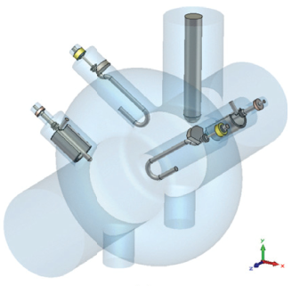
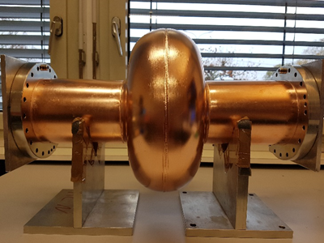
Option 1: 800 MHz, 1-Cell
Possible in-beam option, impedance of 800 MHz mode (~few $MΩ$) requires strong RF feedback
Strong HOM damping using 4 LHC-type HOM couplers to cope with LIU proton beam
Input RF power quoted for protons (in-beam) – very approximate
per cavity | unit | value
Frequency | [MHz] | 801.58
Voltage | [MV] | 2.5 (for e⁻)**
R/Q | [$Ω]$ | 45
Epk, Hpk | [$m^{−1}, mT/MV]$ | 29, 56
RF Power* | [kW] | $$\sim 300$$
Sample Configuration ($10 MV$ for $e^{−}$)
FCC-800 MHz prototype
Four 1-cell in a CM ~ $5m$
* First approximation – requires detailed study for SPS operation **More cavities may be required for proton operation (needs study)

Slide 8
Choice of Cavities – Parasitic Operation
Requirement: 10 MV of accelerating field for 16 GeV electrons (6.7 mA average)
Crab cavity style bypass
N x 100 MHz… cavities
Multi-cell (synergy FCC studies) or single cell
Moderate damping only for electron beams
Not seen by the SPS proton beam
This requires a dedicated cycle which limits its availability
Experience form the crab cavity bypass in LSS6 is that moving in and out of the beamline is feasible within 10 min and compatible with LHC filling

Slide 9
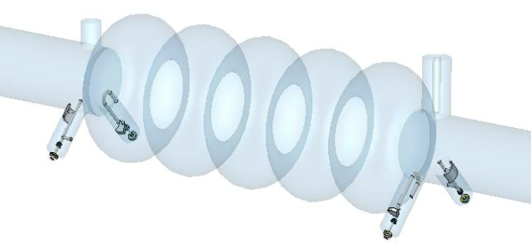
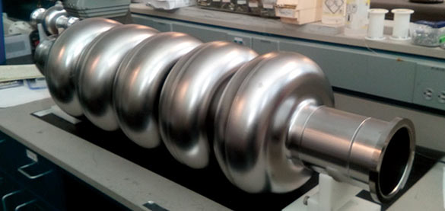
Option 2: 800 MHz, 5-Cell
In mechanical bypass, moved in/out of beam in ~10 min. No proton constraints for beam loading/impedance
Moderate HOM damping using 4 LHC-type HOM couplers for electron beam
per cavity | unit | value
Frequency | [MHz] | 801.58
Voltage | [MV] | 5.0
R/Q | [$Ω]$ | 196
Epk, Hpk | [$m^{−1}, mT/MV]$ | 30, 60
RF Power | [kW] | $$\sim 50$$
Sample Configuration ($10 MV$ for $e^{−}$)
FCC-800 MHz prototype
Two 5-cells in a CM ~ $5m$
* First approximation – requires detailed study to optimize RF system

Slide 10
High Power Considerations
Single Cell
300 kW/cavity is challenging (1.2 MW in most cycles)
It requires the use of WR1150 waveguide from the surface (Long Feeder Lines)
Additional infrastructure may need to be put in place (cryogenics, power plant, etc.)
Current cryo plant may require a significant upgrade
50 kW/cavity is challenging (Out in proton cycles)
It may be possible to use coaxial lines (including the two current lines)
Preferred location of the power plant is on the surface
May be possible to install in the tunnel if enough appropriate space is available
Cryo plant may be able to operate as is
Multi Cell

Slide 11
Injection & Extraction
Injection scheme will require kickers (1 or 2?), these need to be low impedance as broadband impedance results in a loss of Landau damping (Instabilities)
Impedance optimization of kickers and BI required
Extraction via septa (electric or magnetic?) Impedance needs to be minimized
Any BI equipment needs optimization for impedance
Additional Considerations
Additional sector valves around cavities, kickers and septa will require shielding (if they are installed)
Bellows connecting the new equipment will require impedance optimization
Any cross-sectional changes will require tapering to minimize the impedance contribution

