Slide 1
Different FB methods and effect on instability threshold
Work in progress!
M. Schwarz
Acknowledgements:
E. Shaposhnikova, BLonD dev team
LIU-SPS BD WG meeting, 19/09/19

Slide 2
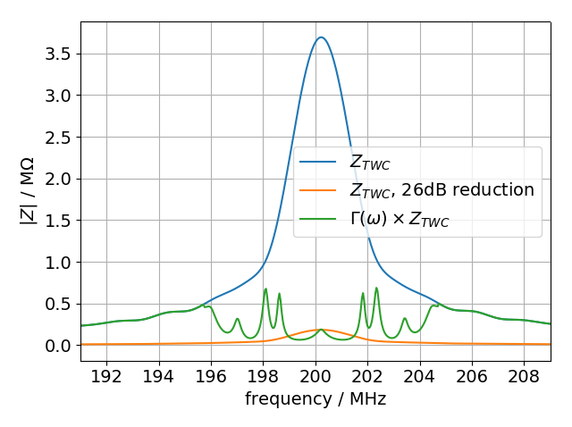
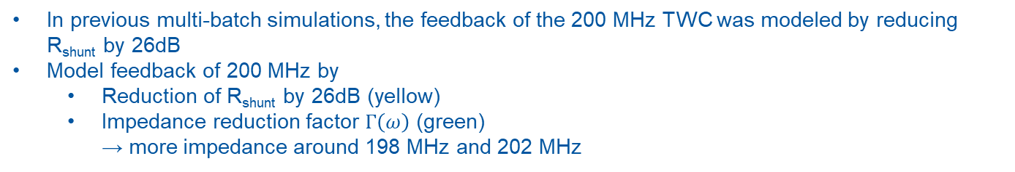
Different feedback models
In previous multi-batch simulations, the feedback of the 200 MHz TWC was modeled by reducing R_{shunt} by 26dB
Model feedback of 200 MHz by
  Reduction of R_{shunt} by 26dB (yellow)
  Impedance reduction factor $Γ\left(ω\right)$ (green)
  → more impedance around 198 MHz and 202 MHz

Slide 3
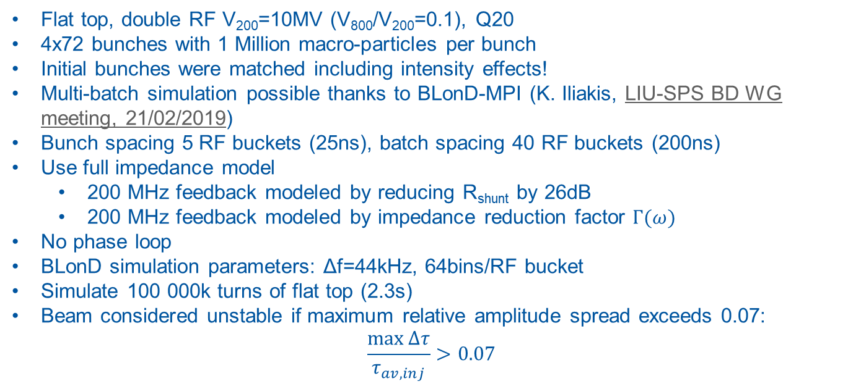
Setup for full impedance model simulations
Flat top, double RF V₂₀₀=10MV (V₈₀₀/V₂₀₀=0.1), Q20
4x72 bunches with 1 Million macro-particles per bunch
Initial bunches were matched including intensity effects!
Multi-batch simulation possible thanks to BLonD-MPI (K. Iliakis, LIU-SPS BD WG meeting, 21/02/2019)
Bunch spacing 5 RF buckets (25ns), batch spacing 40 RF buckets (200ns)
Use full impedance model
  200 MHz feedback modeled by reducing R_{shunt} by 26dB
  200 MHz feedback modeled by impedance reduction factor $Γ(ω)$
No phase loop
BLonD simulation parameters: Δf=44kHz, 64bins/RF bucket
Simulate 100 000k turns of flat top (2.3s)
Beam considered unstable if maximum relative amplitude spread exceeds 0.07:
$\frac{\max{∆τ}}{τ_{av,inj}}>0.07$

Slide 4
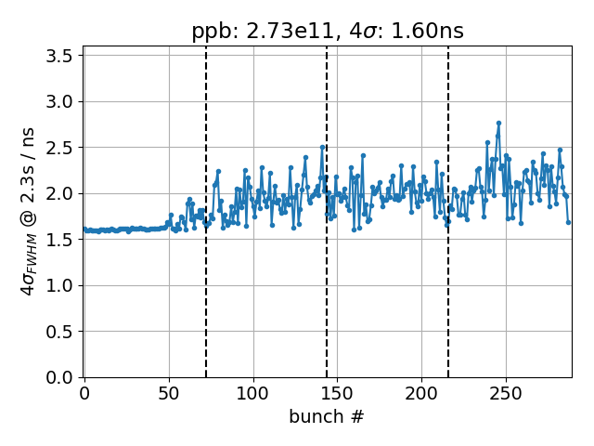
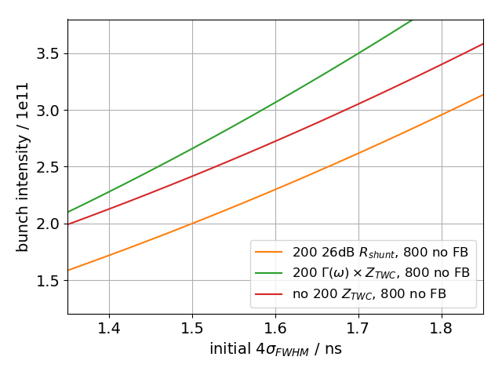
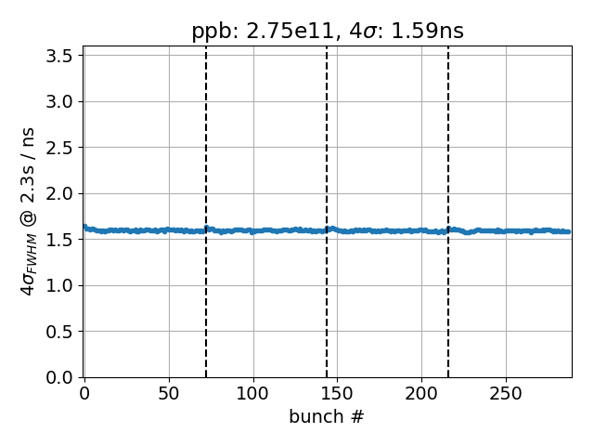

Thresholds for different feedback models
-26dB x R_{shunt}
With $Γ\left(ω\right)$
With impedance reduction factor,
threshold is significantly higher, even though we have more impedance! (also observed by J. Repond)
Possible reason: Different voltage modulation due to different FB models leads to different bunch-by-bunch synchrotron frequency spread and changes Landau
damping

Slide 5
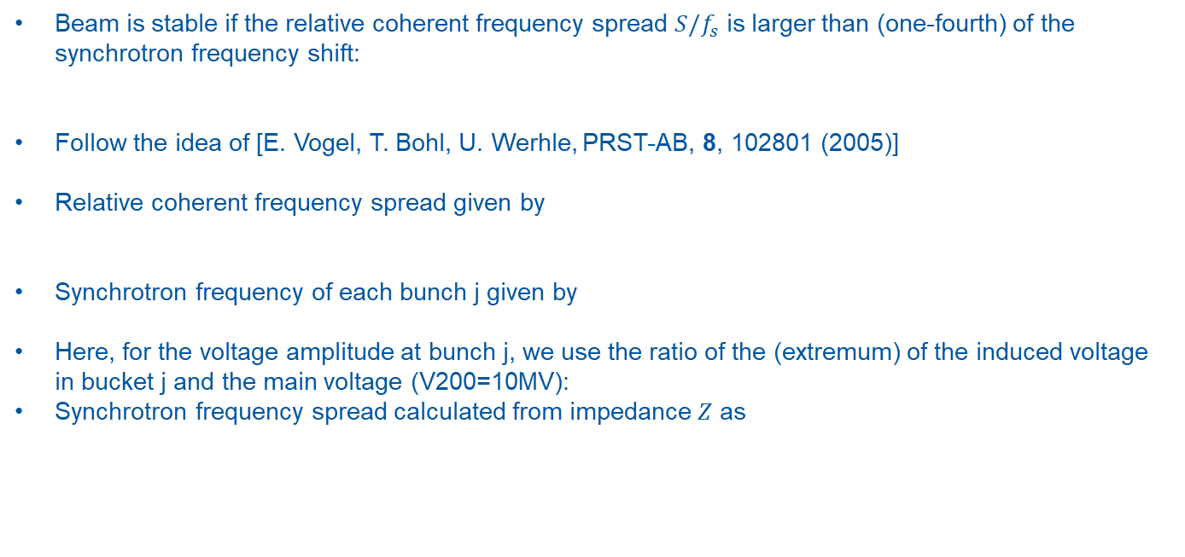
Estimate of frequency spread
Beam is stable if the relative coherent frequency spread $S/f_{s}$ is larger than (one-fourth) of the synchrotron frequency shift:
Follow the idea of [E. Vogel, T. Bohl, U. Werhle, PRST-AB, 8, 102801 (2005)]
Relative coherent frequency spread given by
Synchrotron frequency of each bunch j given by
Here, for the voltage amplitude at bunch j, we use the ratio of the (extremum) of the induced voltage in bucket j and the main voltage (V200=10MV):
Synchrotron frequency spread calculated from impedance $Z$ as

Slide 6
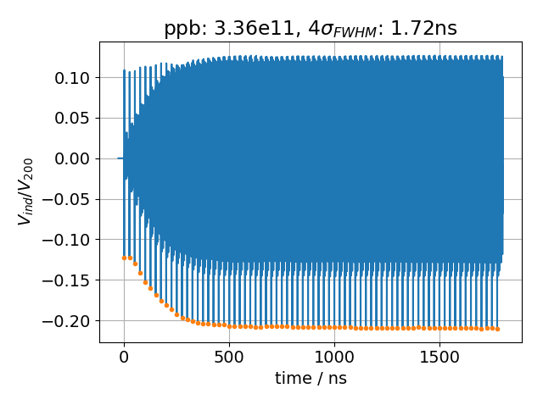
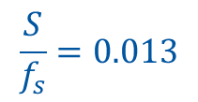
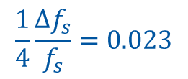
Threshold for different FB models
v_{j} with R_{shunt} reduced by 26dB
Unstable
in simulation
$$\frac{1}{4}\frac{Δf_{s}}{f_{s}}=0.023$$
Unstable
by criterion
$$\frac{S}{f_{s}}=0.013$$

Slide 7
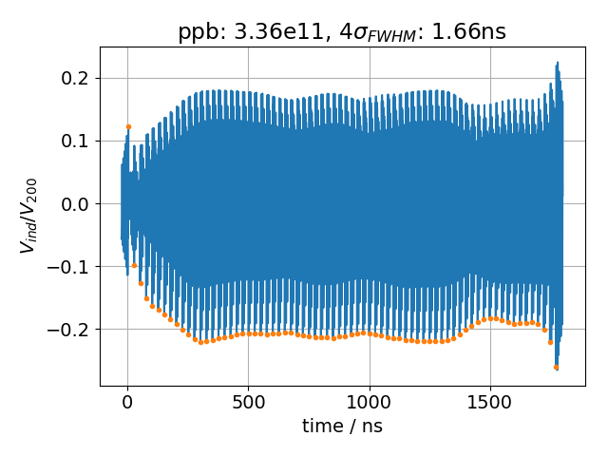
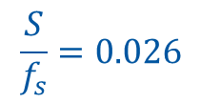

Threshold for different FB models
v_{j} with R_{shunt} reduced by 26dB
v_{j} for impedance reduction factor
Unstable
in simulation
Stable
in simulation
$$\frac{1}{4}\frac{Δf_{s}}{f_{s}}=0.023$$
$$\frac{1}{4}\frac{Δf_{s}}{f_{s}}=0.04$$
Unstable
by criterion
Unstable
by criterion
$$\frac{S}{f_{s}}=0.026$$
$$\frac{S}{f_{s}}=0.013$$
Frequency shift doubles when using impedance reduction factor, but so does coherent frequency spread → no conclusions can be drawn yet

Slide 8
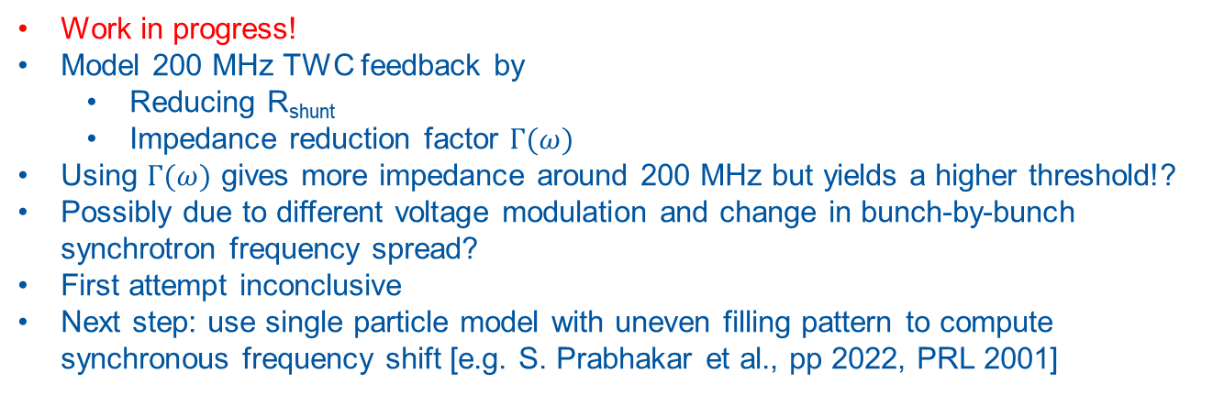
Summary
Work in progress!
Model 200 MHz TWC feedback by
  Reducing R_{shunt}
  Impedance reduction factor $Γ(ω)$
Using $Γ(ω)$ gives more impedance around 200 MHz but yields a higher threshold!?
Possibly due to different voltage modulation and change in bunch-by-bunch synchrotron frequency spread?
First attempt inconclusive
Next step: use single particle model with uneven filling pattern to compute synchronous frequency shift [e.g. S. Prabhakar et al., pp 2022, PRL 2001]
Thank you for your attention!

