Slide 1
Effect of the 915MHz HOM on multi-batch stability
M. Schwarz
Acknowledgements:
A. Farricker, K. Iliakis, P. Krämer, A. Lasheen, N. Nasresfahani, J. Repond, E. Shaposhnikova, BLonD dev team
LIU-SPS BD WG meeting, 19/08/08

Slide 2
Motivation
All simulated thresholds were obtained for a single batch (up to 72 bunches)
The 915 MHz HOMs have Q=5000 and R_{shunt}=1.7MΩ → long range wake field couples batches
How does the 915 MHz HOM affect instability thresholds for multiple batches?
Outline
Effect of 915 MHz HOM on multi-batch stability
Effect of power limitation

Slide 3
Setup for full impedance model simulations
Flat top, double RF V₂₀₀=10MV (V₈₀₀/V₂₀₀=0.1), Q20
1x72 or 4x72 bunches with 1 Million macro-particles per bunch
Multi-batch simulation possible thanks to BLonD-MPI (K. Iliakis, LIU-SPS BD WG meeting, 21/02/2019)
Bunch spacing 5 RF buckets (25ns), batch spacing 40 RF buckets (200ns)
Using full SPS impedance model
200 MHz feedback modeled by reducing R_{shunt} by 26dB
No 800 MHz feedback
915 MHz HOMs: two resonators at $f_{r}=914 MHz$ and $f_{r}=914.8 MHz$ with
3-section cavity: $R=231kΩ$, $Q=3000$ 4-section cavity: $R=385kΩ$, $Q=5000$
No phase loop
BLonD simulation parameters: Δf=44kHz, 64bins/RF bucket
Initial bunches were matched including intensity effects!
Simulate 100 000k turns of flat top (2.3s)
Beam considered unstable if maximum relative bunch length spread exceeds 0.07: $\frac{\max{∆τ}}{τ_{av,inj}}>0.07$

Slide 4
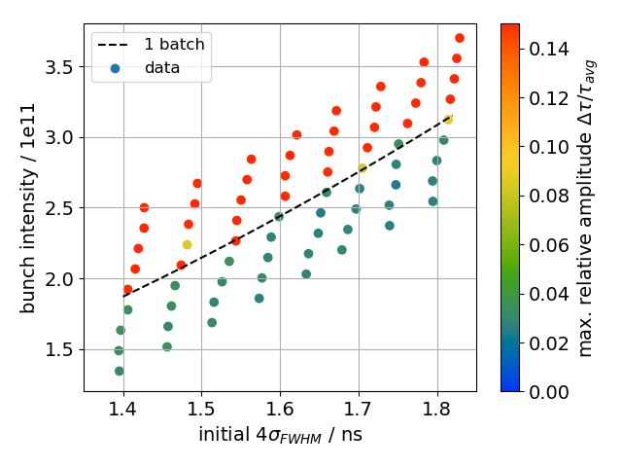
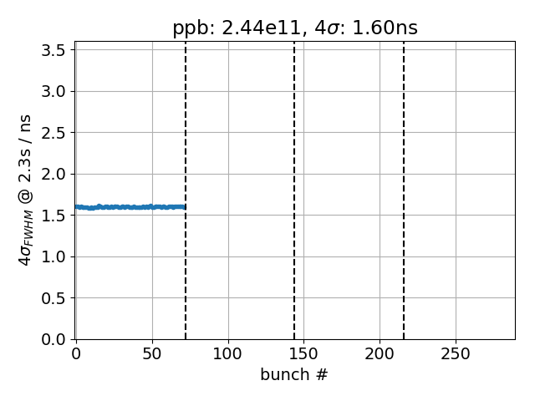
Single batch
Single batch threshold as benchmark

Slide 5
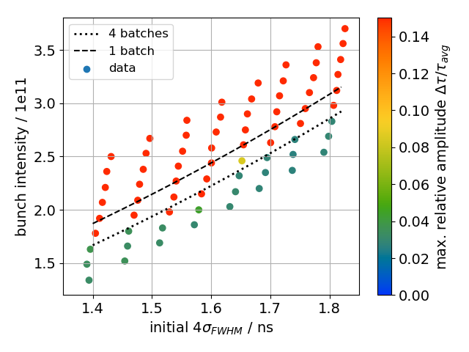
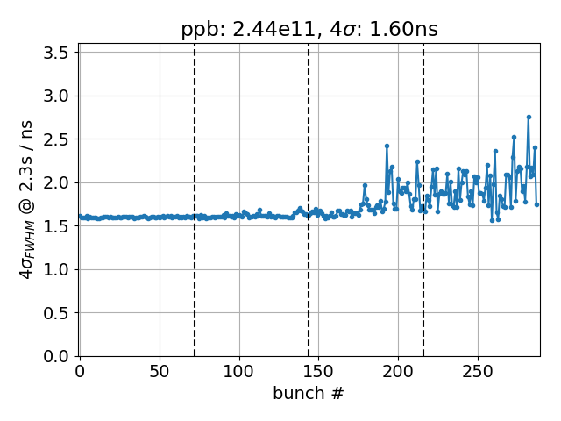
Four batches
Thresholds for four batches is reduced by 9% because last batches become unstable

Slide 6
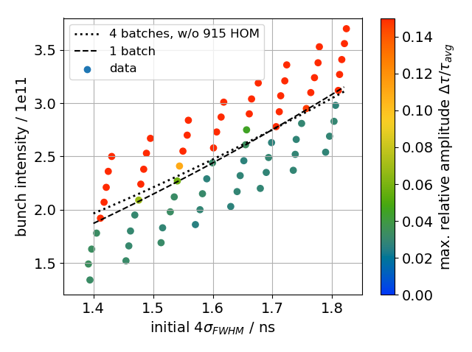
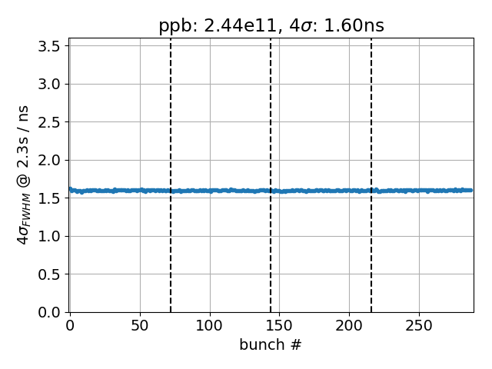
Four batches without 915 MHz HOM
Without 915MHz HOM, same threshold as for single batch → 915MHz HOMs are the dominant source of multi-batch instability

Slide 7
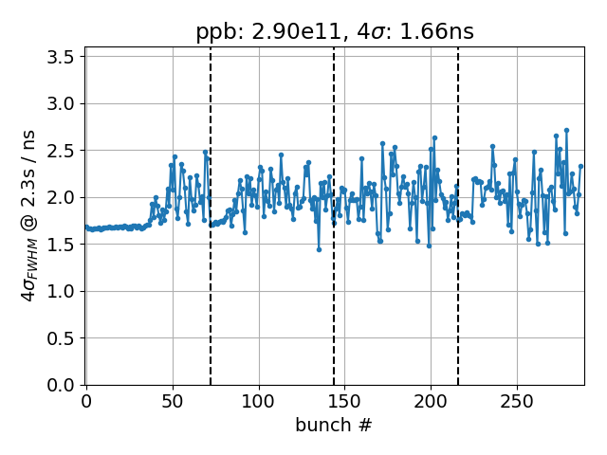
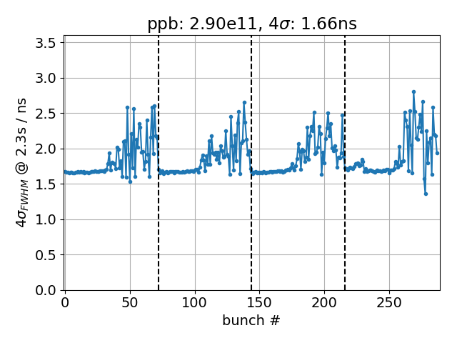
Four batches w/ and w/o 915 MHz HOM
Same intensity (2.9e11 p/b), same bunch length (1.66ns)
With 915MHz HOM (left), batches are coupled (in particular batches 3 and 4)
Without 915MHz HOM (right), all four batches are decoupled
W/ 915MHz HOM
w/o 915MHz HOM

Slide 8
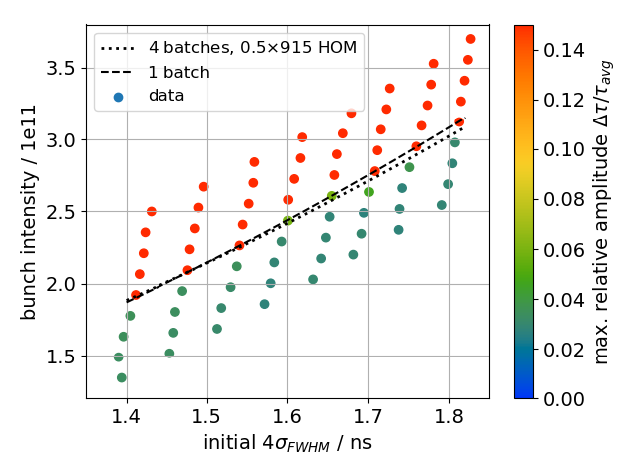
Four batches with damped 915 MHz HOM
Reduce R and Q by factor 2, R/Q=const → nearly same threshold as for single batch

Slide 9
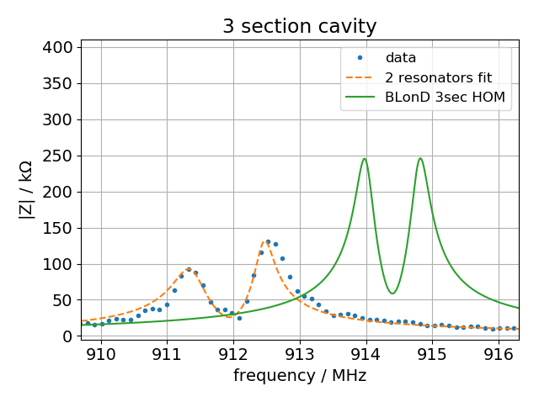
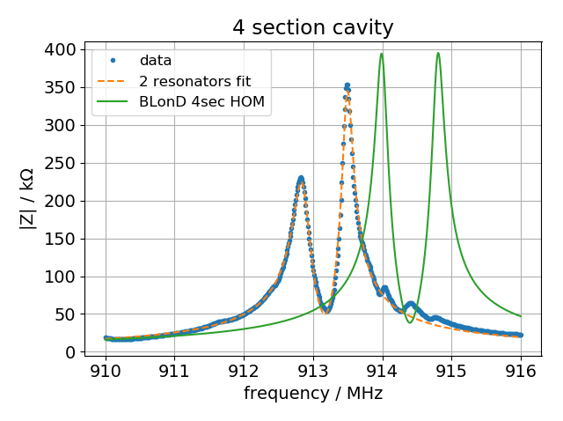
New values for 915MHz HOM
New electromagnetic CST simulations for 3-section cavities (P. Krämer, LIU-SPS BD WG meeting 19/07/04) and 4-section cavities (N. Nasresfahani, LIU-SPS BD WG meeting 19/07/04)
Correct values for 915MHz HOM critically depend on boundary conditions due to FPCs → very difficult to obtain and simulate!
R/Q reduced from 77Ω to 50Ω (3-section) and 60Ω (4-section) (for exact values, see appendix)

Slide 10
Four batches with new 915 MHz HOM
With new 915MHz HOM values, threshold is the same as for single bunch
Stable at ‘target values’ of 4σ_{FWHM}=1.6ns and 2.4e11 p/b , but not much margin…

Slide 11
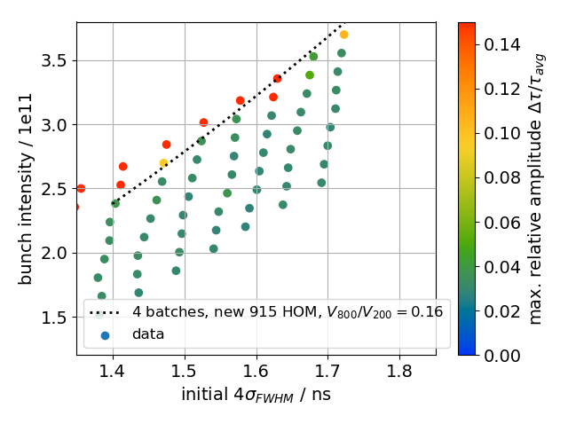
Four batches, new 915 MHz HOM, V₈₀₀ at 16%
V₈₀₀/V₂₀₀=0.16 (was 10% previously) greatly increases threshold…
… but power limitation due to beam loading is not included!

Slide 12
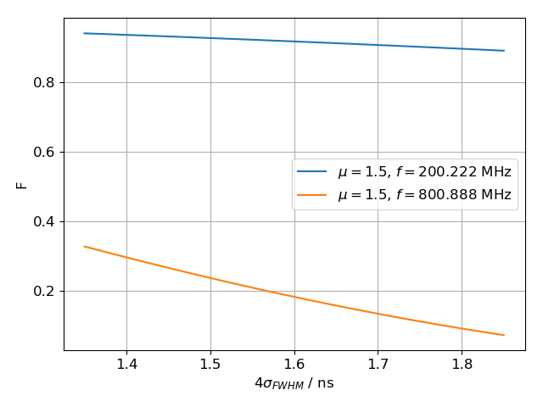
Power limitation
Total voltage $V$ in a TWC (interaction length $L$, series impedance $R_{2}$, zero phase slip) for given power $P$ and beam current $I$: ${V(n_{b},σ)}^{2}=\left(P−\frac{R_{2}L^{2}}{64}I^{2}−\frac{\left|V\right|I}{4}\sin{φ_{s}}\right)R_{2}L^{2}$ [G. Dôme, CERN-SPS/ARF/77-11, 1977]
Beam current at frequency $f$: $I=2I_{0}F(f)$, $I_{0}=n_{b}e/τ_{bb}$, $n_{b}$: p/b, bunch spacing $τ_{bb}=25$ns
Use binomial-μ distribution with bunch length $τ_{L}$ and bunch spectrum $F\left(f\right)$
Spectrum close to 1 at 200MHz and only mild dependence on bunch length
Strong bunch length-dependence at 800MHz
Available power:
4-section cavity: 1.6MW
3-section cavity: 1.05MW
800MHz TWC: 216kW (peak), 144kW (average)

Slide 13
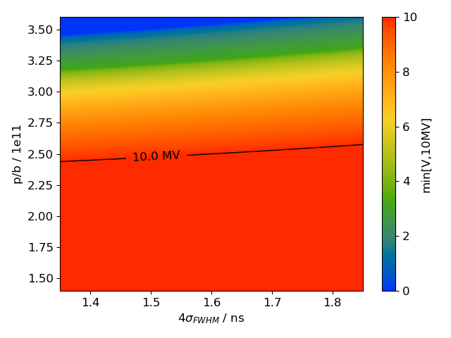
Power limitation, 200 MHz TWC
Total voltage $V$ (plot capped at 10MV)
Mild dependence on bunch length
10 MV can be obtained below 2.5e11 p/b
Voltage drops quickly above 2.5e11 p/b

Slide 14
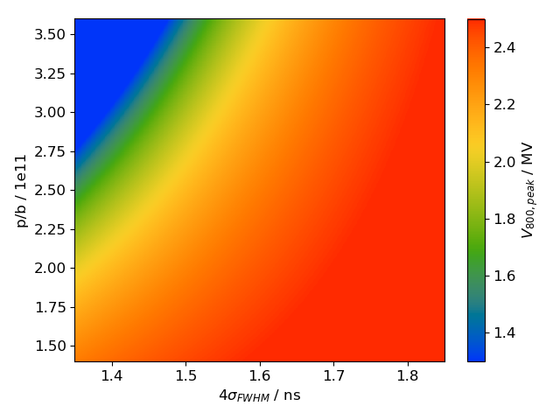
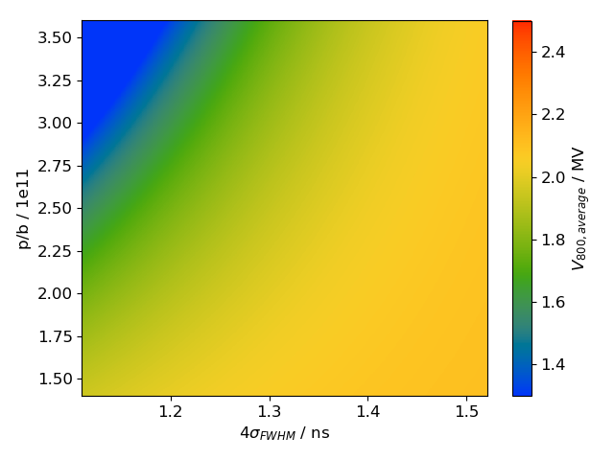
Power limitation, 800 MHz TWC
Total voltage $V$ for peak power (left) and average power (right)
Use $I→I/{\sqrt{2}}$ when computing voltage from average power
Voltage primarily limited by limited average power

Slide 15
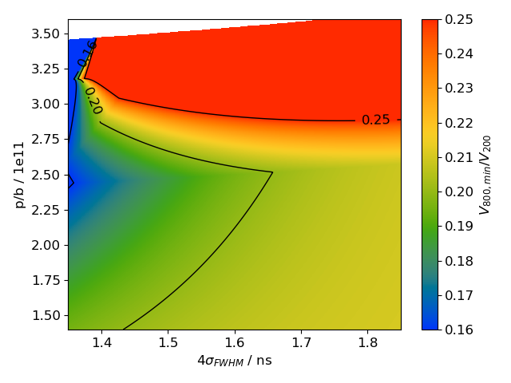
Power limitation, voltage ratio
Plot ratio: min(V₈₀₀) / min(10MV, V₂₀₀)
Voltage ratio ${V_{800}}/{V_{200}}≥0.16$ can be satisfied everywhere
${V_{800}}/{V_{200}}≥0.2$ cannot be fulfilled for small bunch length and intensities between 1.5 and 2.7e11 p/b
A ratio ${V_{800}}/{V_{200}}≥0.25$ can only be fulfilled above 3.0e11 p/b, where $V_{200}$ is power-limited

Slide 16
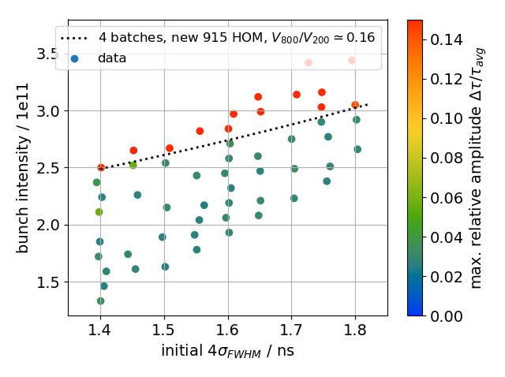
Four batches, new 915 MHz HOM, power limitation
V₈₀₀/V₂₀₀=0.16, but power limitation included
Reduced threshold, but still some margin
Simulations are still running…

Slide 17
Summary
915MHz HOMs are the dominant source of multi-batch instabilities
Present impedance model for 915MHz HOMs likely too pessimistic
With new 915MHz HOM model beam is stable at 2.4e11 and 4σ_{FWHM}=1.6ns …
but very small margin with V₂₀₀/V₈₀₀=0.1
large margin with V₂₀₀/V₈₀₀=0.16 when not including power limitation
some margin with V₂₀₀/V₈₀₀=0.16 and power limitation included
Next steps
Include non-zero phase slip factor in power limitation due to TWC detuning
Use of complex impedance reduction factor instead of simple reduction of R_{shunt} yields much higher threshold, in spite of larger impedance (already observed by Joël) → different RF amplitude modulation and coherent frequency spread?
Simulation of 4x72 bunches along the entire SPS cycle feasible… (but would need simulation of blow-up during ramp)
Thank you for your attention!

Slide 18
New values for 915MHz HOMs
 | new | old
fr / GHz | 911.4; 912.5 | 914.0; 914.8
R / kOhm | 87.3; 124.0 | 231.0, 231.6
Q | 1742; 2872 | 3000; 3000
R/Q | 50; 43 | 77
 | new | old
fr / GHz | 912.9; 913.5 | 914.0; 914.8
R / kOhm | 212.6; 332.7 | 385.0, 386.0
Q | 3563; 5640 | 5000; 5000
R/Q | 60; 59 | 77
Pre-LS2 630MHz damping scheme + four 938 couplers
Pre-LS2 630MHz damping scheme + six 938 couplers

Slide 19
TWCs parameters used for power limitation
 | 3 sec 200MHz TWC | 4 sec 200MHz TWC | 800MHz TWC
Number | 4 | 2 | 2
Active cells | 32 | 43 | 37
Cell length / mm | 374 | 374 | 93.5
R_2 / kΩ/m² | 27.1 | 27.1 | 647
Power / MW | 1.05 | 1.6 | 0.216 (peak) 0.144 (avg.)

Slide 20
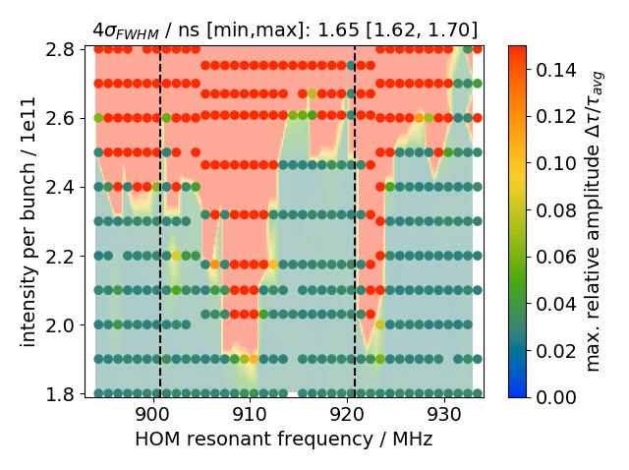
Effect of 915 MHz HOM frequency shift
Take ‘old’ 915MHz HOM model (two resonators at $f_{r}=914.0$ and $f_{r2}=f_{r}+δf_{r}=914.8$ MHz) and shift $f_{r}$
Wake fields cancel if $f_{r}=\frac{n−1/{πQ}}{τ_{bb}\sqrt{4−1/Q^{2}}}−\frac{δf}{2}$; dashed lines in figure (J. Repond, E. Shaposhnikova, CERN-2018-003-CP)

Slide 21
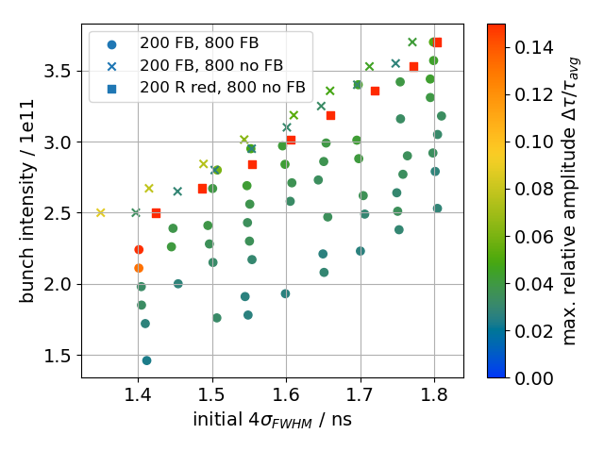
Threshold for different FB models
Using impedance reduction gives larger impedance around 200 MHz, compared to when R_{shunt} is simply reduced by 26dB
But threshold practically absent when using impedance reduction factor!? (was also observed by Joël)
Possible reason: different voltage modulation due to different FB models leads to different bunch-by-bunch synchrotron frequency spread and changes Landau damping [E. Vogel, T. Bohl, U. Werhle, EPAC 2004]

Slide 22
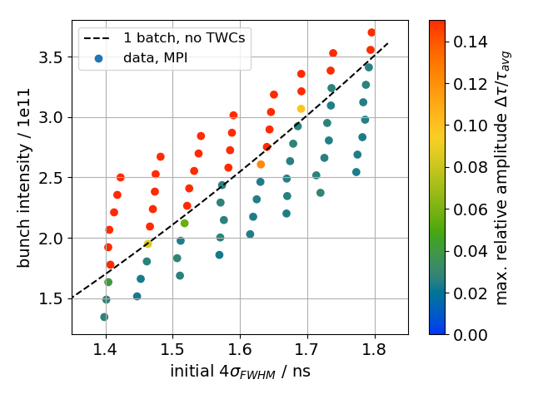
Threshold for different FB models
Smaller threshold even when removing TWC completely for short bunches
Larger threshold even when removing TWC completely for long bunches
full impedance model;
FB: reduce R_{shunt}
full impedance model;
No TWC impedance

