Slide 1
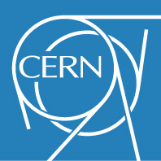
Effect of the 940 MHz resonance from the RF200 MHz cavities on the SPS horizontal instability
C. Zannini
S. Antipov, H. Bartosik, A. Farricker, P. Kramer, E. Mètral, N. Nasresfahani, G. Rumolo, B. Salvant, C. Vollinger

Slide 2
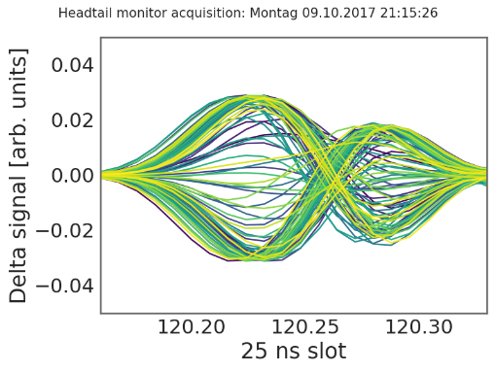
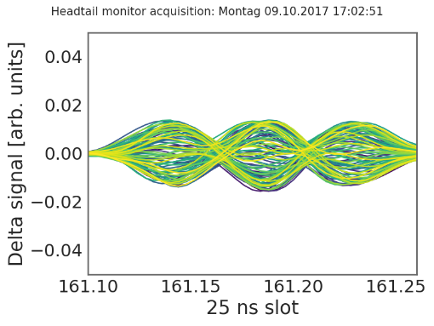
Multi-bunch horizontal instability observed during run II
ξ_{H}~0.1–0.2
2018 MDs observations
Stable with 1 batch at 2e11
Unstable with 4 batches at 2e11 with BS = 200ns
Mode1 or Mode2 instability depending on chroma
Stabilization at chromax about 0.6
Stabilization with batch spacing >500 ns
Some stabilization with octupoles
Instability threshold at about 1.8e11
ξ_{H}~0.3–0.5
Development of a dedicated model for multi-bunch simulations
Important to use analytical models to minimize numerical artefacts
Stabilization above 2.1e11 ppb not evident during 2018 MDs

Slide 3
Understanding of the SPS horizontal instability: PyHEADTAIL simulations
Impedance model: wall and kickers
Kicker model fitted with resonators
MD observations | Multibunch PyHEADTAIL simulations
Stable with 1 batch at 2e11 | ok
Unstable with 4 batches at 2e11 with BS = 200ns | ok
Mode1 or Mode2 instability depending on chroma | ongoing
Stabilization at chromax about 0.6 | ongoing
Stabilization with batch spacing >500 ns | ok
Some stabilization with octupoles | ongoing
Instability threshold at about 1.8e11 | Within 10% (ok)
Studies still ongoing
It looks we are on the good way

Slide 4
Simulation of the multi-bunch instability with and without HOM at 939.45 MHz
Simulation without HOM
SPS impedance (wall and kickers fitted from resonators)
Damper
Chromaticity of 0.2 units
Simulation with HOM
SPS impedance (wall and kickers fitted from resonators)
Damper
Chromaticity of 0.2 units
Resonator at 939.45 MHz. Scan of Q and R to investigate different scenarios

Slide 5
R/Q threshold as function of R
$τ_{0}$ growth time without HOM
$τ_{1}$ growth time with HOM
$\frac{τ_{0}}{τ_{1}}<1.01$ (1% threshold)
$\frac{τ_{0}}{τ_{1}}<1.1$ (10% threshold)
Several simulations have been performed
R swept from 19 MΩ/m to 158 MΩ/m
For each R several Q values have been simulated to estimate the threshold

Slide 6
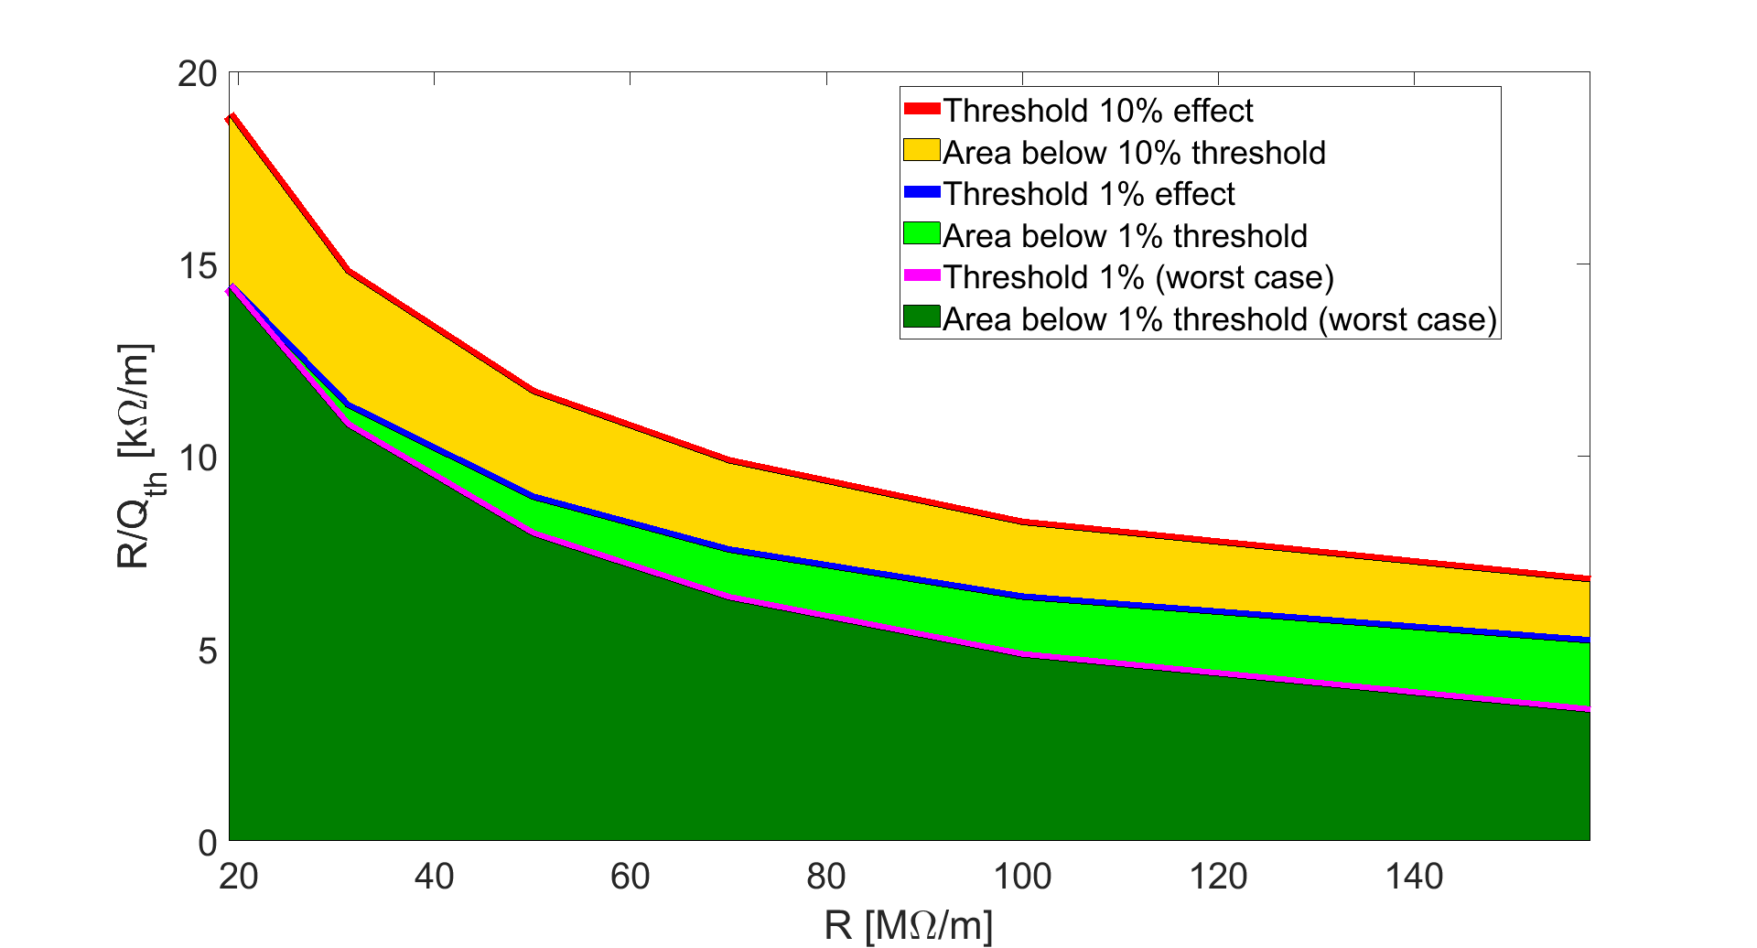
R/Q threshold as function of R
Worst case
f=n f_{rev} (1-Q_{x})

Slide 7
Similar results have been obtained with Nested Head-Tail Vlasov solver
Simulation without HOM
SPS impedance model and wall wake model
Damper
Chromaticity of 0.2 units
Simulation with HOM
SPS impedance model and wall wake model
Damper
Chromaticity of 0.2 units
Resonator at 939.45 MHz. Scan of R with R/Q fixed to the undamped case.

Slide 8
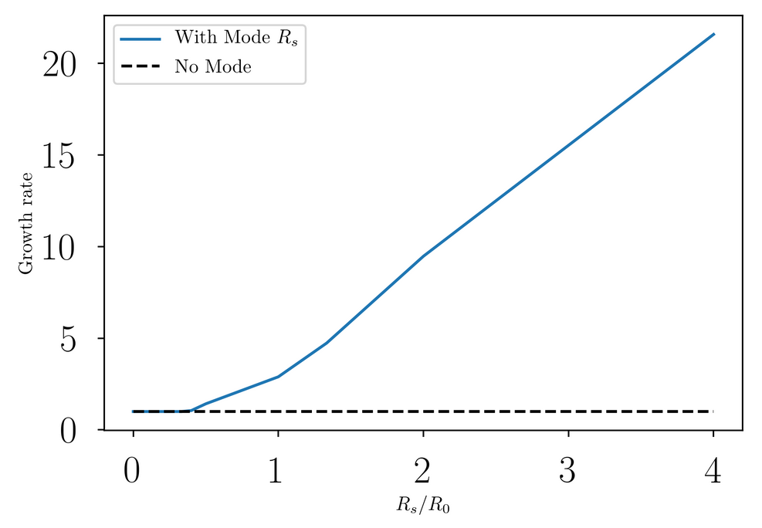
No impact if the mode is damped by at least x3-4
Assuming R/Q = const
Growth rate matches that without the mode at 10⁻² level
S. Antipov

Slide 9
Summary and next step
Two independent studies point to the fact that the HOM from the RF 200 MHz cavity could play a role in the SPS horizontal instability
A threshold plot has been produced to guide the choice of the damping scheme
Check the effect of the HOM with fixed target beam (studies on going very preliminary results with Nested Head-Tail Vlasov solver (S. Antipov) show a significant effect of the HOM)

Slide 10
Thank you for your attention

Slide 11
Appendix

Slide 12
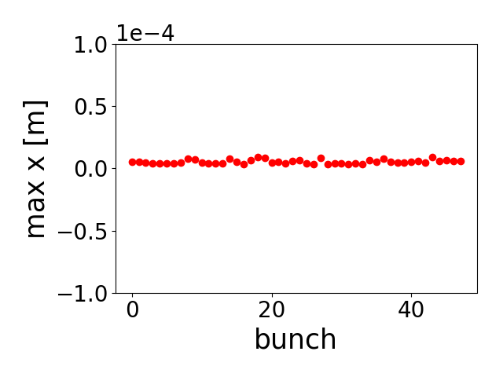
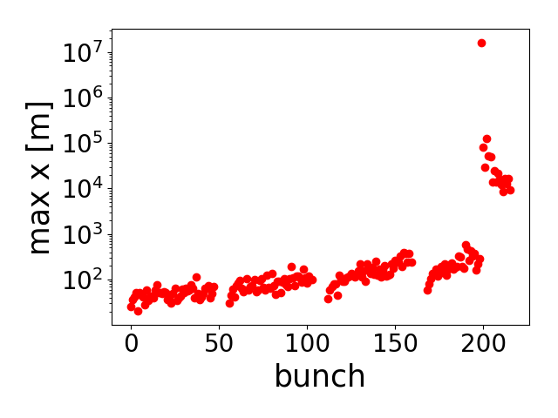
Understanding of the SPS horizontal instability: PyHEADTAIL simulations
Impedance model: wall and kickers
Kicker model fitted with resonators
Stable with 1 batch unstable with 4 batches at 2e11, Stabilization with batch spacing,
Instability threshold around 1.8e11
N=2.2e11 ppb
ξ=0.2
One batch
4 batches

Slide 13
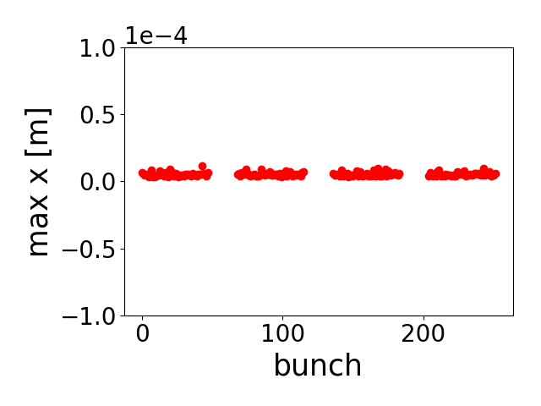
Understanding of the SPS horizontal instability: PyHEADTAIL simulations
Impedance model: wall and kickers
Kicker model fitted with resonators
Stable with 1 batch unstable with 4 batches at 2e11, Stabilization with batch spacing,
Instability threshold around 1.8e11
N=2.2e11 ppb
ξ=0.2
200ns spacing
500ns spacing

Slide 14
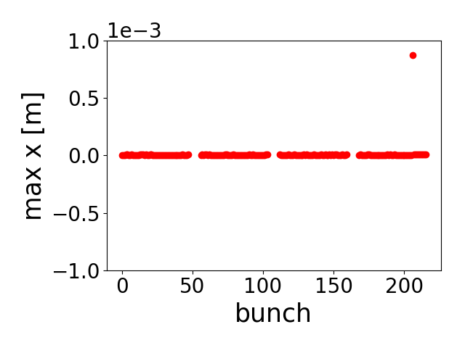
Understanding of the SPS horizontal instability: PyHEADTAIL simulations
Impedance model: wall and kickers
Kicker model fitted with resonators
Stable with 1 batch unstable with 4 batches at 2e11, Stabilization with batch spacing,
Instability threshold around 1.8e11
N=2.0e11 ppb
ξ=0.2
N=2.2e11 ppb

Slide 15
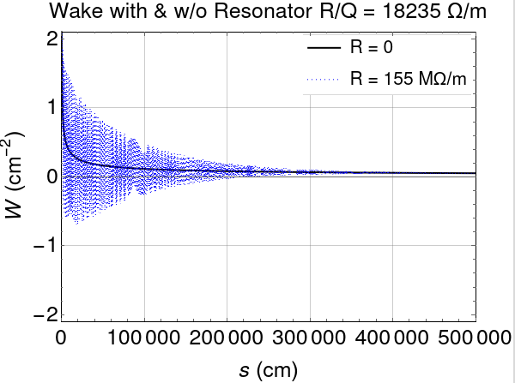
Adding a high frequency mode
Large impact on the coupled-bunch wake
S. Antipov

