Slide 1
Multi-batch flat-top simulations
M. Schwarz
Acknowledgements:
K. Iliakis, A. Lasheen, J. Repond, E. Shaposhnikova, BLonD dev team
LIU-SPS BD WG meeting, 19/07/04

Slide 2
Motivation
All simulated thresholds were obtained for a single batch (mostly 48 bunches)
The 915 MHz HOMs have Q=5000 and R_{shunt}=1.7MΩ → long range wake field couples batches
How does the 915 MHz HOM affect instability thresholds for multiple batches?
Outline
Multi-batch benchmark simulations with a single resonator
Single-batch benchmark MPI simulations with full impedance model

Slide 3
Simulation setup for BLonD-MPI
Flat top, single RF V₂₀₀=10MV, Q20
4x72 bunches with 2 Million macro-particles per bunch → 0.576 Billion macro-particles
Simulations only feasible (both in time and memory) with MPI version of BLonD (see presentation by K. Iliakis, LIU-SPS BD WG meeting, 21/02/2019)
Bunch spacing 5 RF buckets (25ns), batch spacing 50 RF buckets (250ns)
Only include a single resonator impedance
$R=570kΩ$, $f_{r}=630 MHz$, $Q=200$ → wake decay time 20 RF buckets (101ns) $R=1.7MΩ$, $f_{r}=915 MHz$, $Q=5000$ → wake decay time 348 RF buckets (1740ns)
No other impedances!
Initial bunches were matched including intensity effects
Scan intensity between 1.0e11 and 2.6e11 ppb; $4σ_{FWHM}$ between 1.4 and 1.9 ns
Simulate 1s of flat top (44k turns)

Slide 4
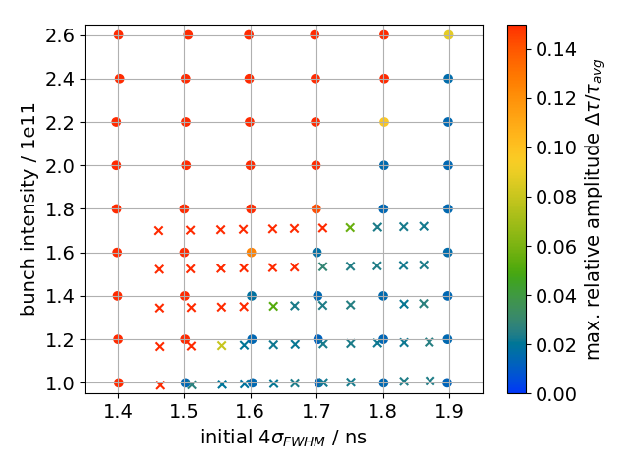
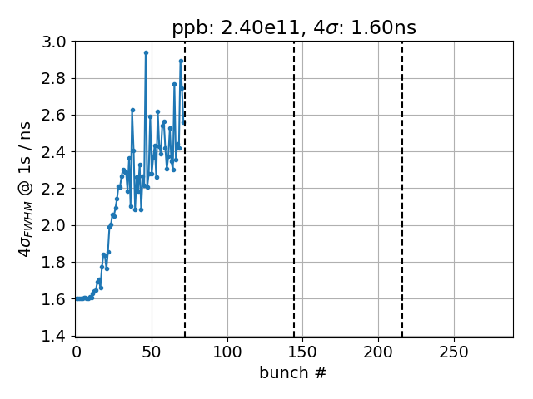
Result $f_{r}=630 MHz$, $Q=200$
1x72 bunches
Color: maximum relative bunch length spread (capped at 0.15)
‘x’: 2.3s simulations by Alexandre

Slide 5
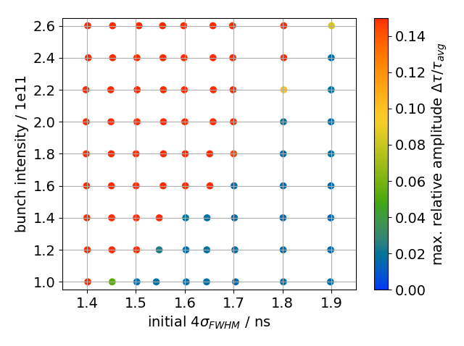
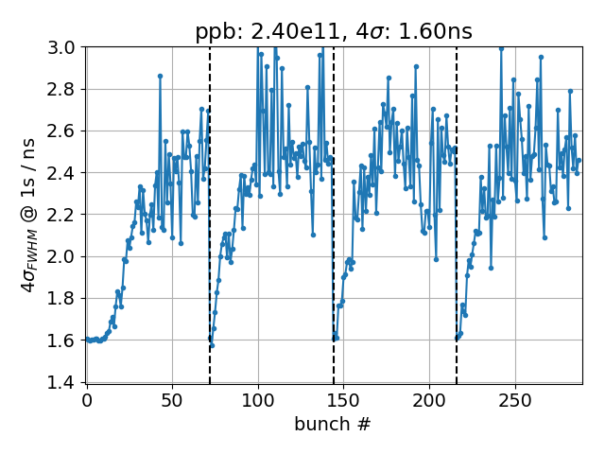
Result $f_{r}=630 MHz$, $Q=200$
4x72 bunches
Color: maximum relative bunch length spread (capped at 0.15)
Same threshold as for single batch
Barely any coupling between batches

Slide 6
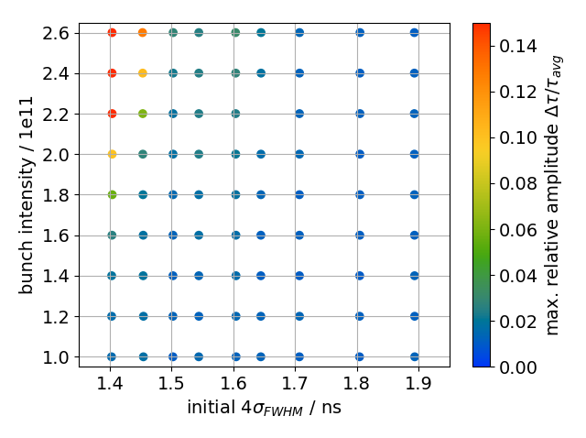
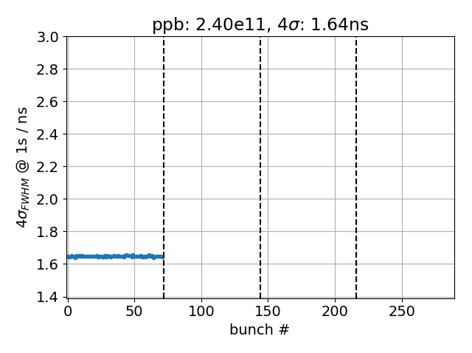
Result $f_{r}=915 MHz$, $Q=5000$
1x72 bunches
Color: maximum relative bunch length spread (capped at 0.15)
Single batch stable

Slide 7
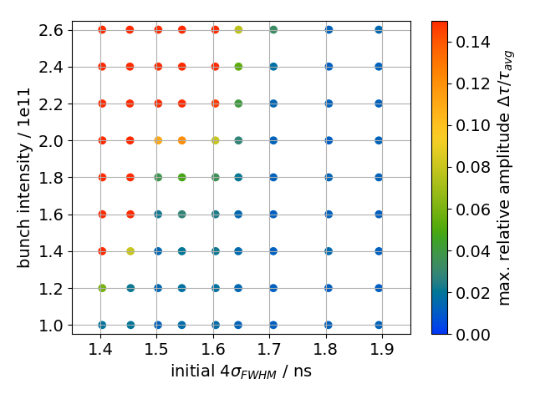
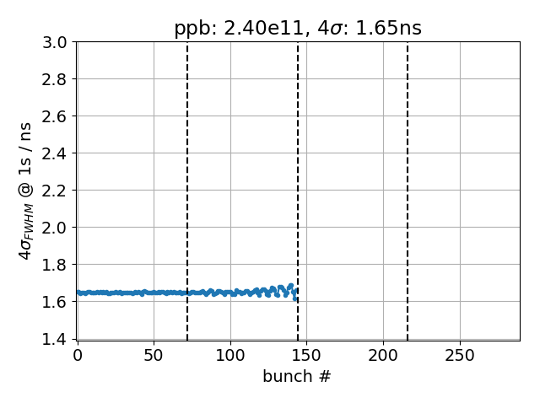
Result $f_{r}=915 MHz$, $Q=5000$
2x72 bunches
Color: maximum relative bunch length spread (capped at 0.15)
Instability threshold reduces as bunches in second half of second batch becomes unstable

Slide 8
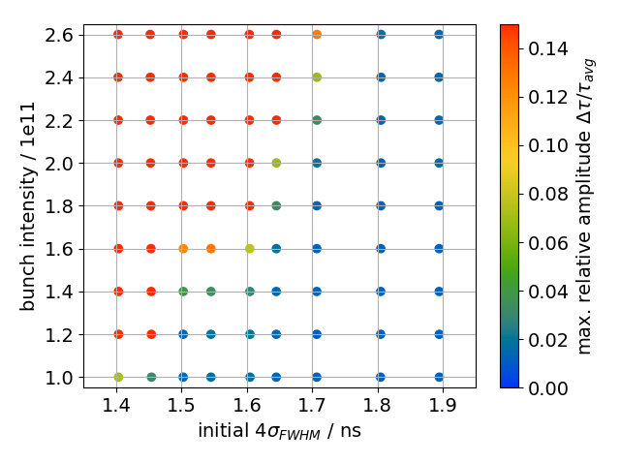
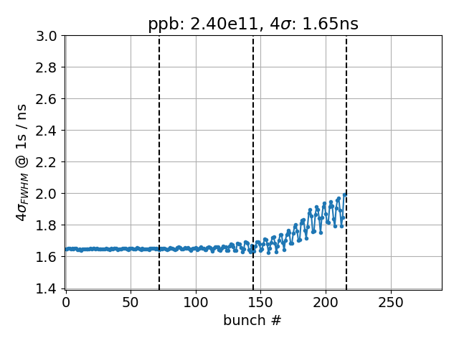
Result $f_{r}=915 MHz$, $Q=5000$
3x72 bunches
Color: maximum relative bunch length spread (capped at 0.15)
Coupling between batches → threshold reduces because the third batch becomes unstable

Slide 9
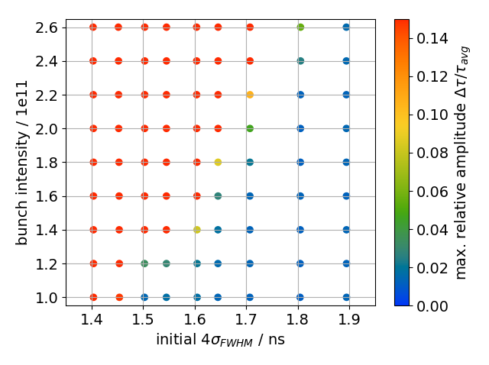
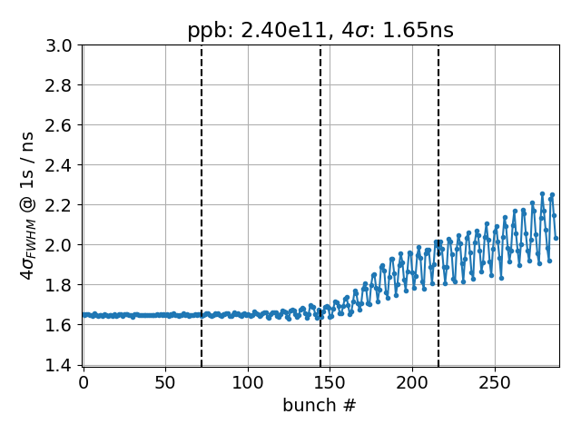
Result $f_{r}=915 MHz$, $Q=5000$
4x72 bunches
Color: maximum relative bunch length spread (capped at 0.15)
Threshold reduces further with fourth batch

Slide 10
Setup for full impedance model simulations
Flat top, double RF V₂₀₀=10MV (V₈₀₀/V₂₀₀=0.1), Q20
1x72 or 4x72 bunches with 1 Million macro-particles per bunch
Bunch spacing 5 RF buckets (25ns), batch spacing 40 RF buckets (200ns)
Use same impedance model as Joël
200 MHz feedback modeled by reducing R_{shunt} by 26dB
No 800 MHz feedback
915 MHz HOMs: two resonators at $f_{r}=914 MHz$ and $f_{r}=914.8 MHz$ with
3 section cavity: $R=231kΩ$, $Q=3000$ (likely too pessimistic) 4 section cavity: $R=385kΩ$, $Q=5000$
No phase loop
Initial bunches were matched including intensity effects
Simulate 100 000k turns of flat top (2.3s)
Beam considered unstable if maximum relative amplitude spread exceeds 0.07: $\frac{\max{∆τ}}{τ_{av,inj}}>0.07$

Slide 11
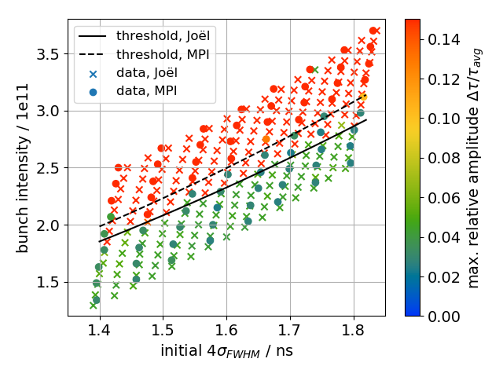
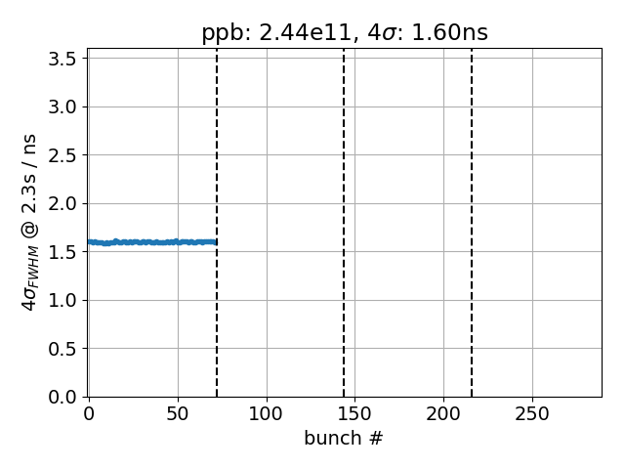
Single batch
Single batch threshold is larger by 7% compared to Joël (likely due to different initial bunch distributions; to be studied…)
single batch

Slide 12
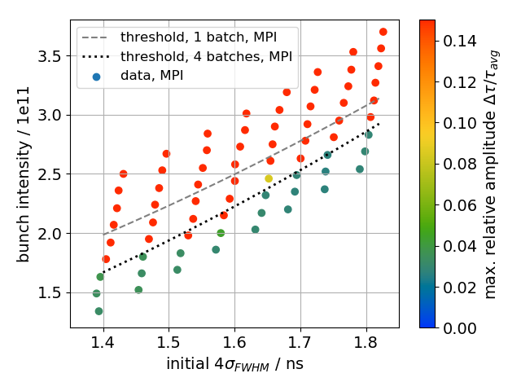
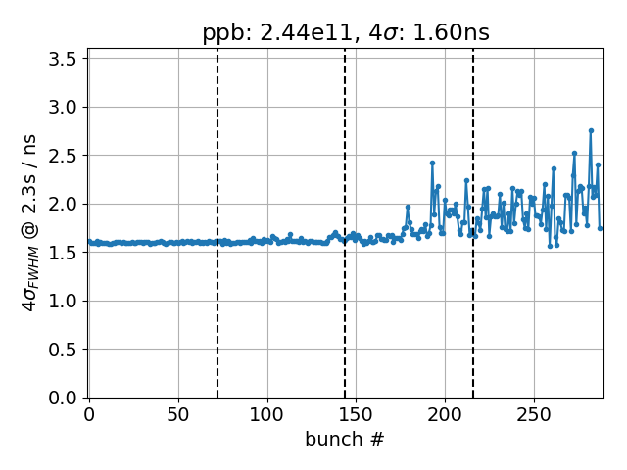
Four batches
Thresholds for four batches is reduced by 11% because last batches become unstable

Slide 13
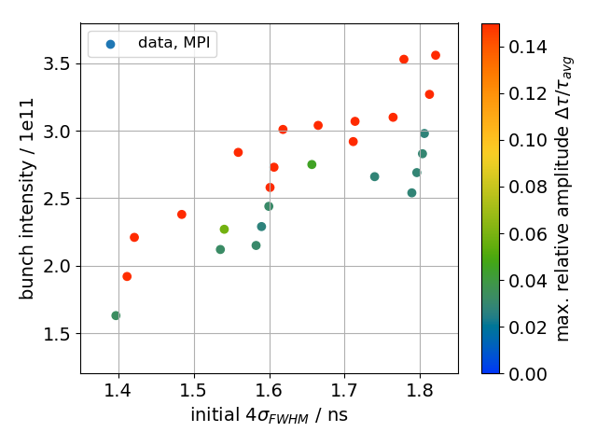
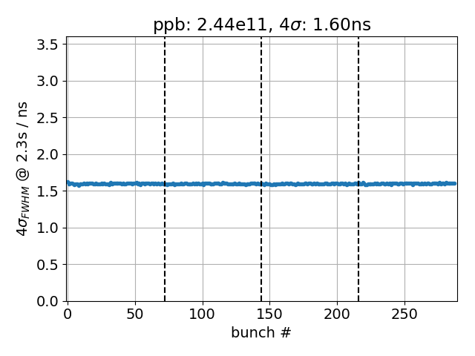
Four batches without 915 MHz HOM
PRELIMINARY!

Slide 14
Testing bunch-matching methods
Flat top, double RF V₂₀₀=10MV (V₈₀₀/V₂₀₀=0.1), Q20
1x72 or 4x72 bunches (5 RF bucket spacing), 40 RF bucket batch spacing
Use same impedance model as Joël
No phase loop
Simulate 100 000k turns of flat top (2.3s)
Simulate with BLonD-MPI and on batch cluster without MPI
Match bunches to SPS flat top with 2.24e11 p/b; emittance 0.65eVs (4σ_{FWHM}=1.48 ns)
Matching method A: match_beam_from_distribution (mbdf); used for full-impedance model simulations
Matching method B: matched_from_distribution_density_multibunch (mfddm); used for single-resonator simulations
Profile resolution 64bins/RF bucket; frequency resolution 1f_{rev}

Slide 15
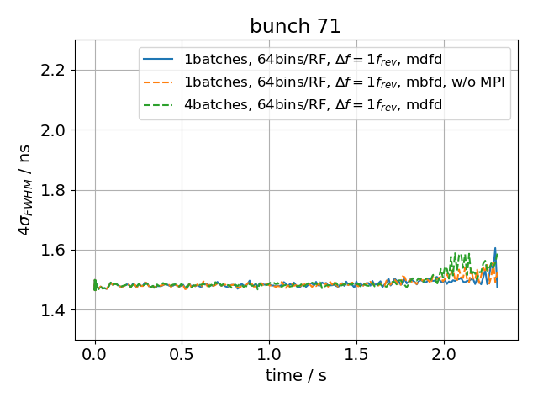
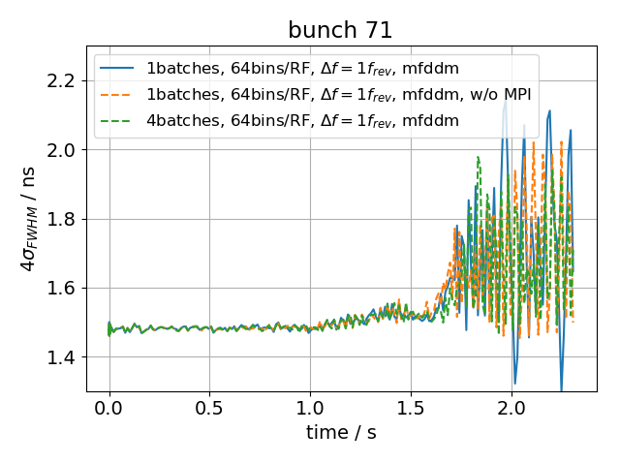
Testing bunch-matching methods
Different bunch length evolution when using different matching methods
For same matching method, late-time behavior differs
Cause under investigation; likely due to differences in induced voltage computations
Notice that beam becomes unstable in all cases.
method ‘A’
method ‘B’

Slide 16
Summary
Multi-batch simulations possible with BLonD-MPI
Simulations with single high-Q resonator show batch-by-batch coupling
BLonD-MPI simulations with full impedance model show slightly higher thresholds compared to Joël’s result
For four batches, thresholds are reduced because last batches become unstable
Next steps
Systematically investigate effect of different 915 MHz HOM damping
Investigate why different bunch-matching algorithms yield different long-term behavior
Simulation of 4x72 bunches along the entire SPS cycle feasible…
Thank you for your attention!

