Slide 1
HOMs around 915 MHz in 200 MHz TWCs of SPS
Nasrin Esfahani, Rama Calaga

Slide 2
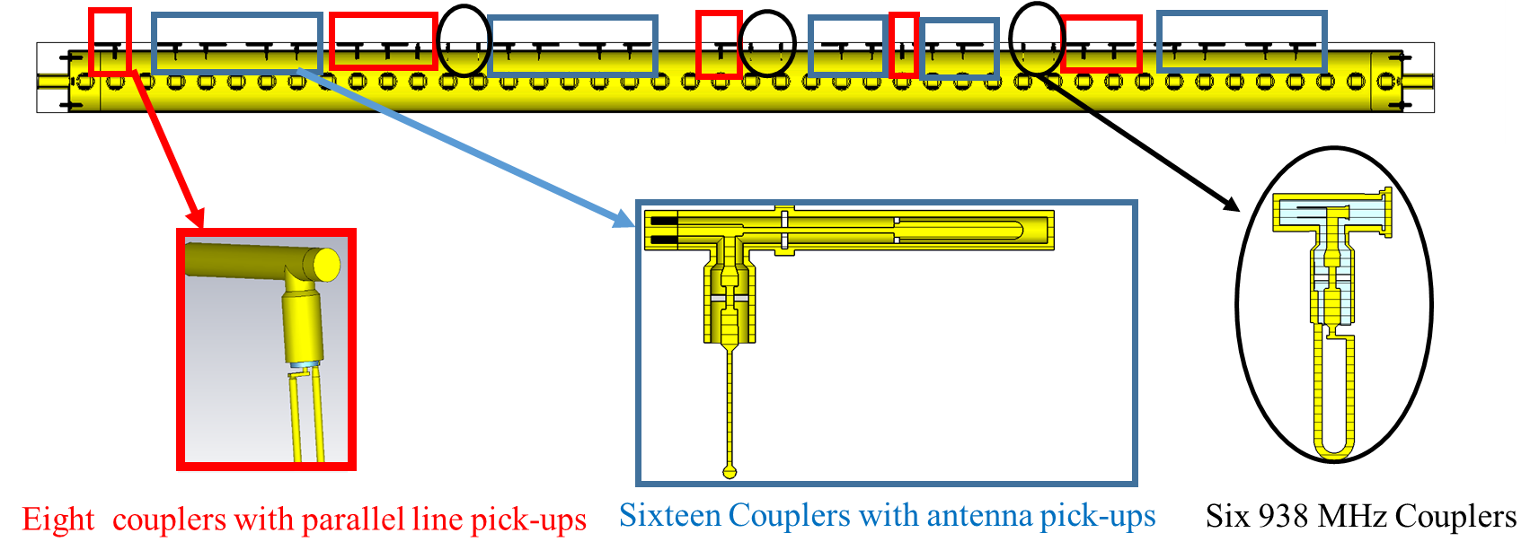
Overview
High long. impedance around 915 is coming from “at least” two high R/Q modes
They have the potential of being coupled to the elbows of the FPCs
Terminations are important for evaluating the quality factor
Pessimistic assumption of not having any damping through FPCs have been considered

Slide 3
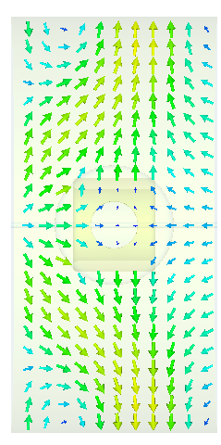

Overview of important modes on a single cell
 | phase | f | Q | R
Unit cell | 83 | 913.36 | 80000 | 1e5
 | 30 | 914.1 | 80000 | 9100
Unit cell +628 MHz HOM coupler | 83 | 912 | 20000 | 4500
 | 30 | 914.4 | 1500 | 2200
Unit cell +938 MHz HOM coupler | 83 | 912.3 | 70000 | 12000
 |  | 915 | 25000 | 4000
 | 30 | 915.9 | 1000 | 1000
Unit cell +fork HOM coupler | 83 | 912.2 | 26500 | 3500
 | 30 | 915.02 | 4500 | 7372
Magnetic
field
Electric field
Mode with the phase advance of 83

Slide 4
Simulations on CAV2
As expected two modes with high R/Qs
Both f these modes survive when we add 628 and 938 MHz couplers
Adding fork couplers reduces R/Q of one of the modes by a factor of 2

Slide 5
Simulations on CAV2
With 628 MHz many modes manage to preserve their high Q
Adding 938MHz, only two modes preserve their high Q
Fork couplers reduce the quality factors by almost a factor of four

Slide 6
Simulations on CAV2-
Results from circuit model

Slide 7
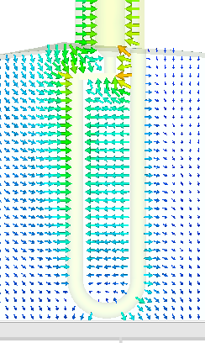
938 MHz coupler and its potential damping effect
Although we know that peculiarities of the transverse mode damping resulted in a design for the 938 MHz HOM
With relatively large reactive part
Without a rejection filter for the accelerating mode
However loop of the 938 MHz mode can capture the undesired mode in the 915 MHz range effectively (“interestingly” through its electric field)
An approach which can pave the way towards a design is:
Modifying the resonant loop

Slide 8
938 MHz HOM coupler for damping the 915 MHz mode
 | phase | f | Q | R
Unit cell +938 MHz coupler | 83 | 915 | 25000 | 4000
 |  | 912.3 | 70000 | 12000
 | 30 | 915.9 | 1000 | 1000
Unit cell +938 MHz coupler+load | 83 | 912.26 | 12000 | 3000
 | 30 | 916 | 600 | 1000
Unit cell +938 MHz coupler +load and modified resonant part | 83 | 912.91 | 2736 | 4000
 |  | 912.99 | 589 | 350
 | 30 | 914.2 | 1000 | 700
Unit cell +938 MHz coupler
f | 939.8 MHz
Q | 55000
Unit cell +938 MHz coupler + load +modified resonant part
f | 939.1 MHz
Q | 7500
Considerable reduction in Q
On a single cell expected frequency shift from 938 MHz is 328 kHz and from the proposed solution is 320 kHz.

Slide 9
Outlook
Effect on the acc. mode will be examined
  Detailed analysis on the four section including frequency shift
  Integration of 200 MHz rejection filters with the design: required or not?
The proposed solution and the damping scheme will be examined on the four section.
Terminations on both the input of the FPC and the 938 loops will be examined on the three section cavity in BAF3.
Measurements in BAF3 will be very useful, requires existing loops and modified resonant matching
Difference between CAV1 and CAV2 (eight versus six 938 MHz couplers) will be examined.

