Slide 1
CERN-SPS horizontal instability
C. Zannini, H. Bartosik, M. Beck, T. Bohl, M. Carla’,
L.R. Carver, H. Damerau, V. Kain, G. Kotzian, A. Lasheen,
K. Li, E. Métral, G. Papotti, J. Repond, G. Rumolo, B. Salvant, M. Schenk, M. Schwarz, E. Shaposhnikova
SPS & PS operators

Slide 2
Overview
What the transverse impedance model can explain in the SPS
Horizontal instability with multiple bunches
Understanding of the SPS horizontal instability
Sacherer theory
PyHEADTAIL simulations
Summary

Slide 3
Impedance as input of beam dynamics simulations
Machine Impedance model
Beam Dynamics Simulations
Analytical equation (e.g. Sacherer theory)
Vlasov Solver (e.g. DELPHI)
Macroparticle simulations (e.g. PyHEADTAIL)
Driving Impedance
Driving and Detuning wake
Determine effect on the beam
Needed wake/impedance range depends on the specific beam dynamics under investigation

Slide 4
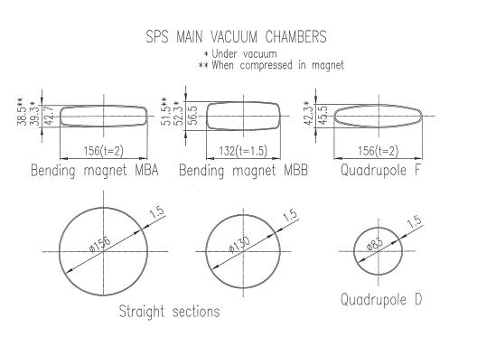
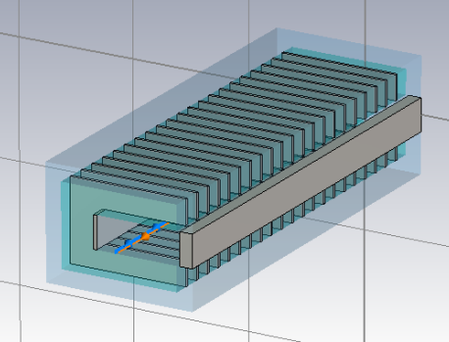
SPS transverse impedance model
Elements included in the database:
Wall impedance that takes into account the different SPS vacuum chambers (analytical calculations)
Kickers (CST 3D simulations)
RF cavities (200 MHZ and 800 MHz) without couplers (CST 3D simulations)
Broadband impedance of step transitions (CST 3D simulations)
Horizontal (BPH) and vertical (BPV) beam position monitors (CST 3D simulations)
Step-transitions and flanges (CST 3D simulations)
Beam pipe
Kickers
RF cavities
Step transitions
BPH
BPV

Slide 5
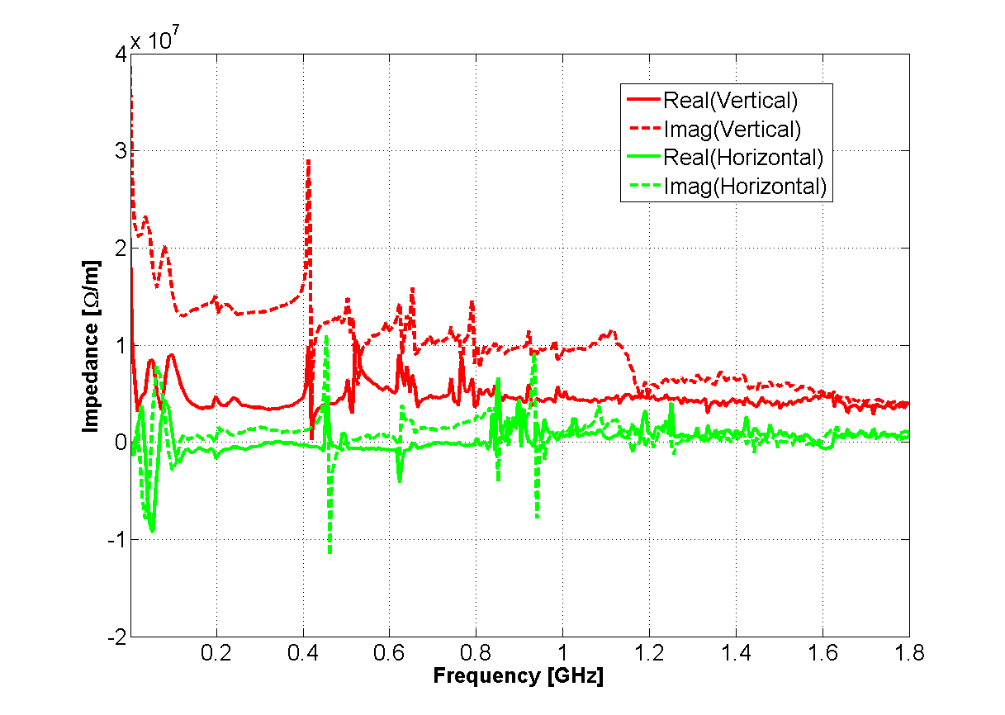
SPS transverse impedance model

Slide 6
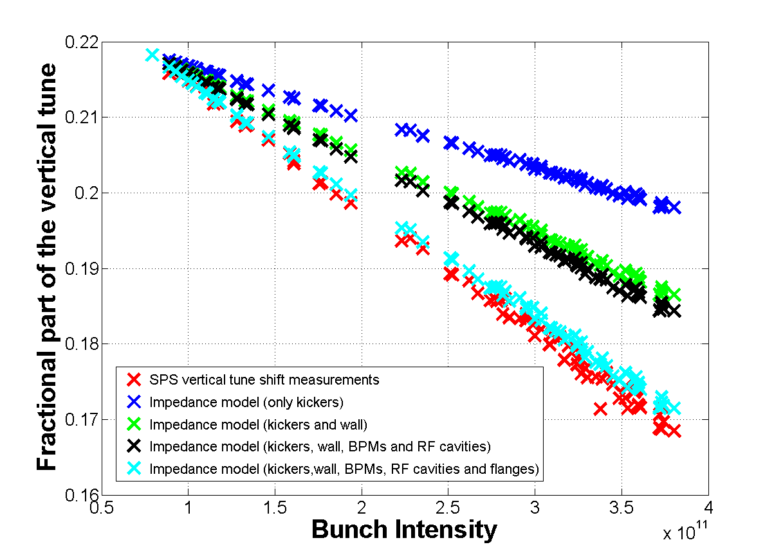
SPS transverse impedance model
Benchmark with beam measurements (coherent tune shifts, head-tail instability growth rates mode 0, TMCI thresholds and intra-bunch motion)
20 %
40 %
60 %
80 %
100 %

Slide 7
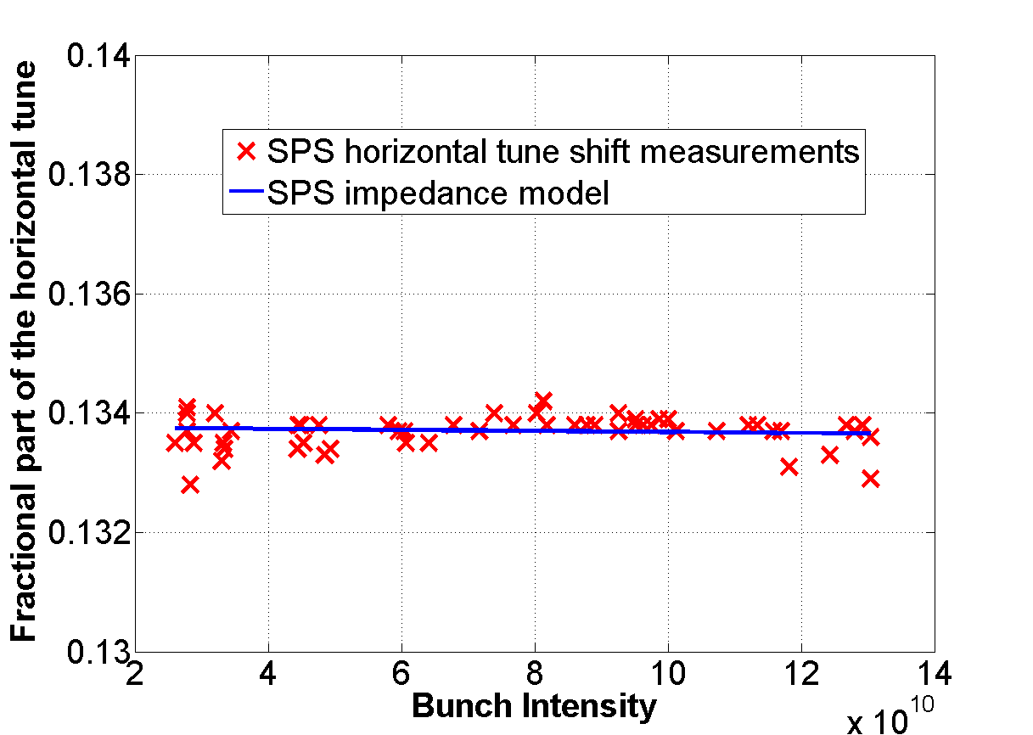
SPS transverse impedance model
Benchmark with beam measurements (coherent tune shifts, head-tail instability growth rates mode 0, TMCI thresholds and intra-bunch motion)

Slide 8
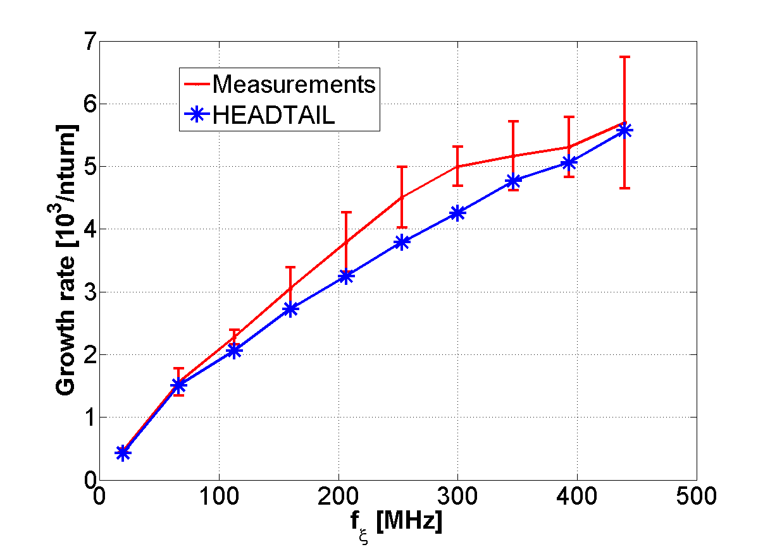
SPS transverse impedance model
Benchmark with beam measurements (coherent tune shifts, head-tail instability growth rates mode 0, TMCI thresholds and intra-bunch motion)
Mode 0
Vertical
Q20 optics

Slide 9
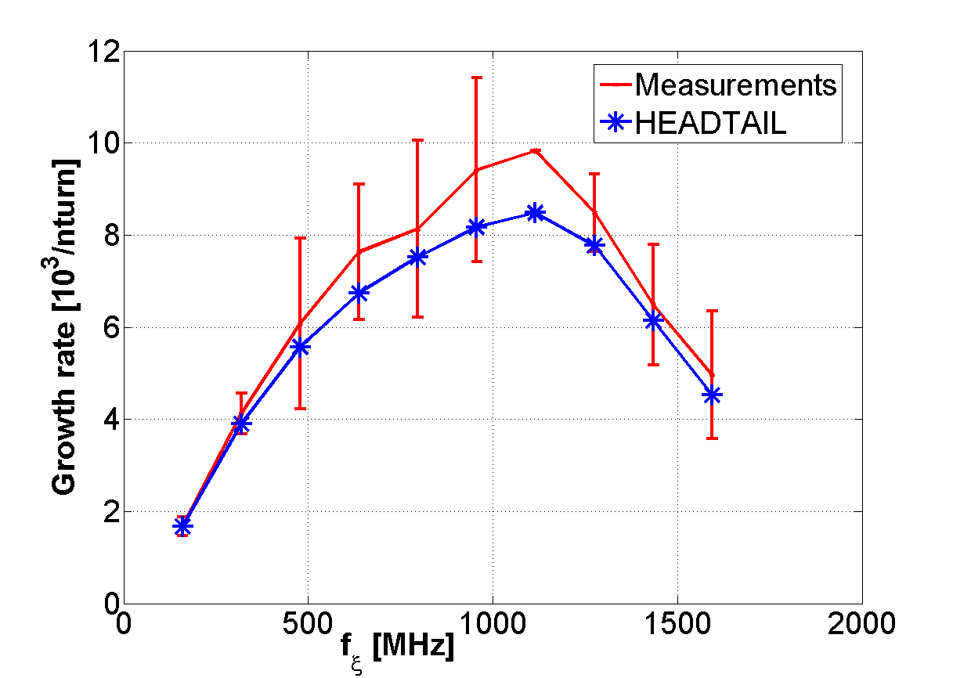
SPS transverse impedance model
Benchmark with beam measurements (coherent tune shifts, head-tail instability growth rates mode 0, TMCI thresholds and intra-bunch motion)
Mode 0
Vertical
Q26 optics

Slide 10
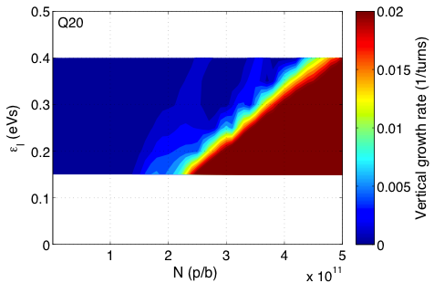
SPS transverse impedance model
Benchmark with beam measurements (coherent tune shifts, head-tail instability growth rates mode 0, TMCI thresholds and intra-bunch motion)
measurements
HEADTAIL simulations
nominal
Island of slow instability
4.5x10¹¹ p/b
@ 0.35 eVs
10

Slide 11
SPS transverse impedance model
Benchmark with beam measurements (coherent tune shifts, head-tail instability growth rates mode 0, TMCI thresholds and intra-bunch motion)
measurements
HEADTAIL simulations
nominal
Island of slow instability
4.5x10¹¹ p/b
@ 0.35 eVs
11

Slide 12
Overview
What the transverse impedance model can explain in the SPS
Horizontal instability with multiple bunches
Understanding of the SPS horizontal instability
Sacherer theory
PyHEADTAIL simulations
Summary

Slide 13
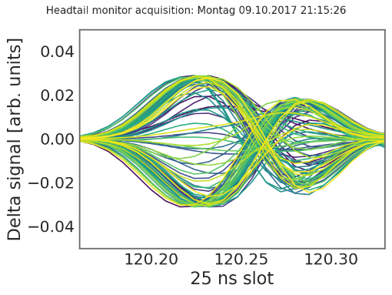
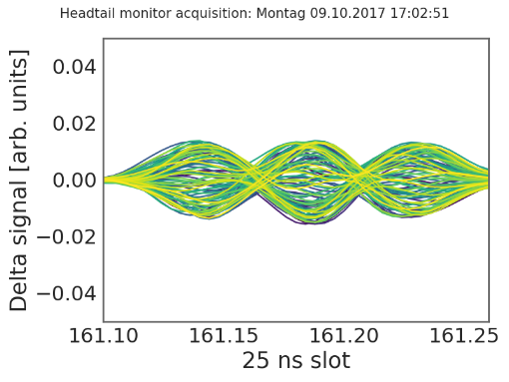
Next challenge for the SPS impedance model: multi-bunch horizontal instability
ξ_{H}~0.1–0.2
2018 MDs observations
Stable with 1 batch at 2e11
Unstable with 4 batches at 2e11 with BS = 200ns
Mode1 or Mode2 instability depending on chroma
Stabilization at chromax about 0.6
Stabilization with batch spacing >500 ns
Some stabilization with octupoles
Instability threshold at about 1.8e11
ξ_{H}~0.3–0.5
Development of a dedicated model for multi-bunch simulations
Important to use analytical models to minimize numerical artefacts
Stabilization above 2.1e11 ppb not evident during 2018 MDs

Slide 14
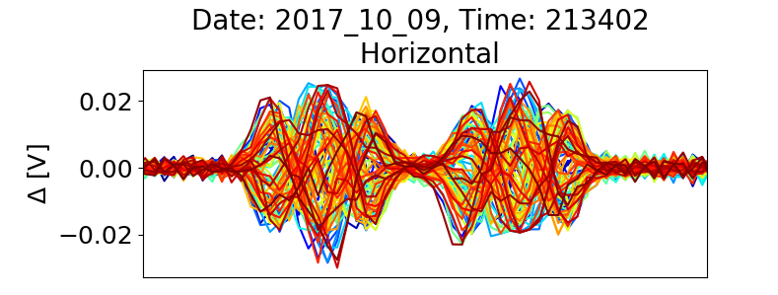
SPS horizontal instability: observations
In 2017 the 4 x 48 bunches suffered from single bunch instabilities (some bunches in 3rd and 4th batch)
Mode 1
Summary of instability observations
Chromaticity | Beam Stability
ξ=0.17 | Unstable mode1
ξ=0.27 | Unstable mode1
ξ=0.37 | Unstable mode1
ξ=0.47 | Unstable mode2
ξ=0.57 | Stable
ξ=0.67 | Stable
Mode 2
L. R. Carver, Horizontal Instability During High Intensity Run
https://docs.google.com/presentation/d/1o2NMNl-Up7lwaYoNW3rgwHuA_-kosCByWSxxZ7C-6c0/edit#slide=id.g36dac49bd4_0_104
H. Bartosik et al., Summary from high intensity run (transverse), LIU-SPS-BD meeting, 19.10.2017

Slide 15
Overview
What the transverse impedance model can explain in the SPS
Horizontal instability with multiple bunches
Understanding of the SPS horizontal instability
Sacherer theory
PyHEADTAIL simulations
Summary

Slide 16
SPS impedance model expectations
The MKE kicker model has been updated to consider the shortening of the serigraphy and the update of sector 4 (removal of one MKE-L)
year | MKE (incl. MKEser) | 200 mm serigraphy | 180 mm serigraphy
2006 | 9 | 0.5 | 0
2012 | 8 | 7 | 0
2015 | 8 | 8 | 0
2016 | 7 | 6 | 1
2017 | 7 | 3 | 4
2018 | 7 | 0 | 7

Slide 17
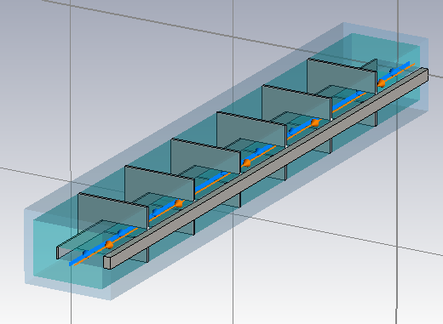
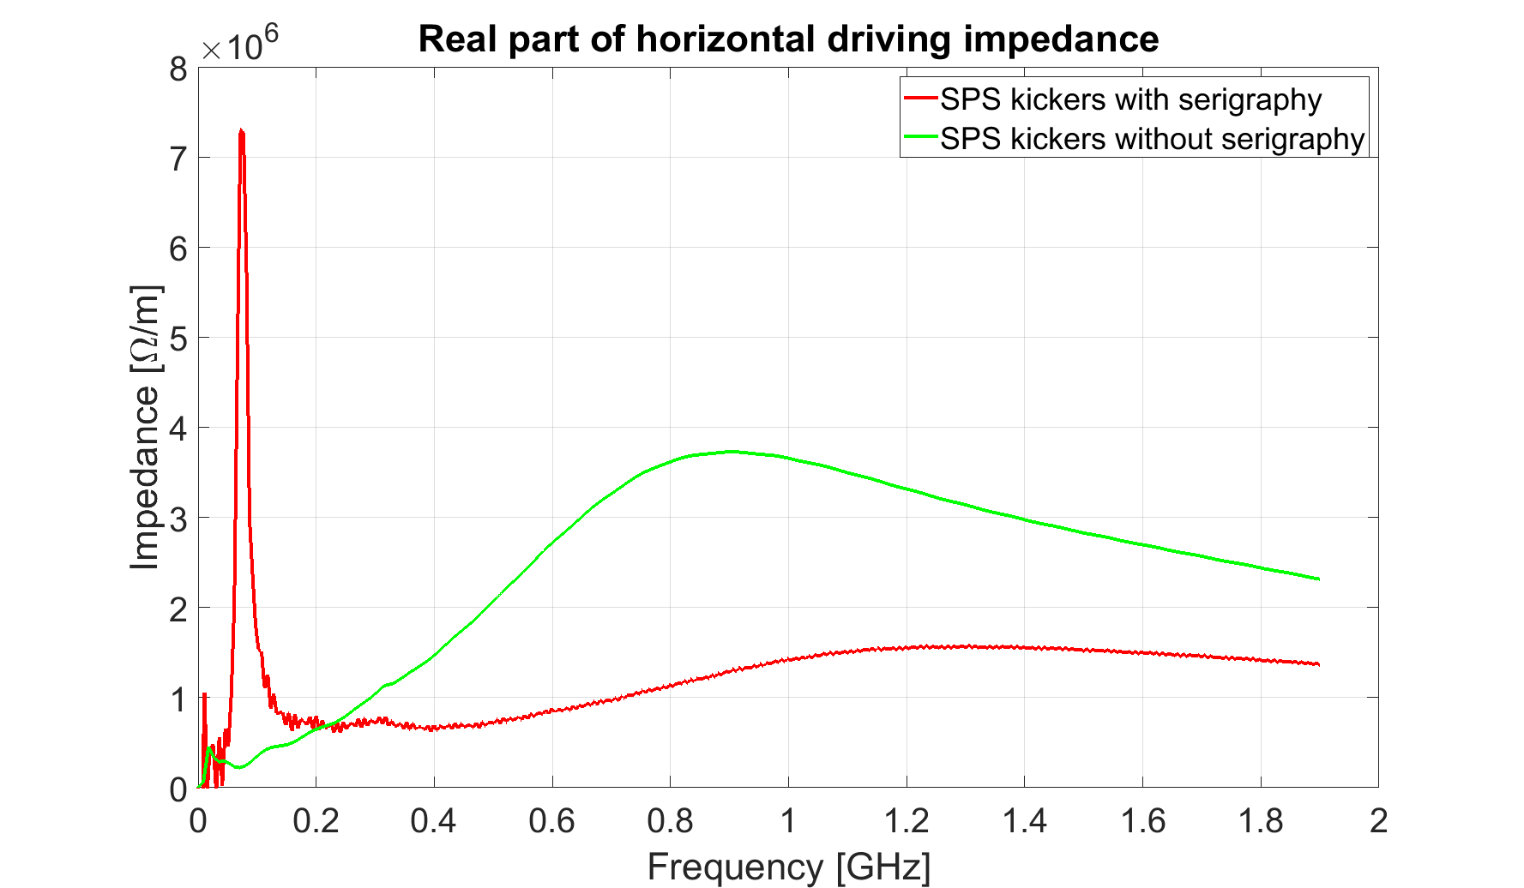
Which is the driving term of the instability?
MKE with serigraphy
MKE without serigraphy
Effect of the serigraphy peak was first studied in 2007 by E. Métral and B. Salvant https://impedance.web.cern.ch/impedance/documents/UpdateOfSPSKickers_APC_27-04-07.pdf
The serigraphy peak was fitted with a resonator and it was concluded that the growth rate due to the resonance would have been significantly smaller than the one expected from wall impedance.

Slide 18
Which is the driving term of the instability?
MKE with serigraphy
MKE without serigraphy
Impedance source: combination of wall and kicker impedance

Slide 19
Only Wall Impedance
Mode 1
Vertical plane more unstable than horizontal
vertical driving impedance is larger than horizontal driving impedance

Slide 20
Wall and kicker without serigraphy
Mode 1
Instability at positive chromaticity stabilized by kickers
Horizontal plane more unstable for negative chromaticity and more stable for positive chromaticity
higher horizontal dipolar kicker impedance

Slide 21
Wall and kickers with serigraphy
Mode 1
Instability at positive chromaticity enhanced by kickers with serigraphy
80 MHz resonance
lower broadband stabilizing impedance
horizontal plane get more unstable than vertical plane
higher 80 MHz peak
lower broadband stabilizing impedance

Slide 22
Full SPS model
BPMs, step-transitions, flanges and RF cavities seems to play a minor role in the headtail instability behaviour

Slide 23
Understanding of the SPS horizontal instability: Sacherer theory
Mode l>0 and ξ>0
Impedance model | Beam Stability
Wall | UnstableY
Wall+kickers without serigraphy | Stable
Wall+kickers with serigraphy | UnstableX
Full model | UnstableX
The kicker broadband impedance has a stabilizing effect for modes l>0 and ξ>0.
The serigraphy enhances the wall instability
80 MHz resonance
The serigraphy reduces the stabilizing effect of the kicker broadband impedance
lower broadband impedance

Slide 24
Understanding of the SPS horizontal instability: Sacherer theory
Impedance source: combination of wall and kicker impedance
Summary of instability observations
Chromaticity | Beam Stability
ξ=0.17 | Unstable mode1
ξ=0.27 | Unstable mode1
ξ=0.37 | Unstable mode1
ξ=0.47 | Unstable mode2
ξ=0.57 | Stable
ξ=0.67 | Stable

Slide 25
Understanding of the SPS horizontal instability: Sacherer theory
The growth rates from impedance are expected to be almost unaffected by the serigraphy change

Slide 26
Understanding of the SPS horizontal instability: Sacherer theory
Everything understood?
Analytical studies do not take into account
Arbitrary filling scheme
Stability dependence on number of batches and batch spacing
Effect of damper
Effect of detuning impedance
Nonlinearities

Slide 27
Overview
What the transverse impedance model can explain in the SPS
Horizontal instability with multiple bunches
Understanding of the SPS horizontal instability
Sacherer theory
PyHEADTAIL simulations
Summary

Slide 28
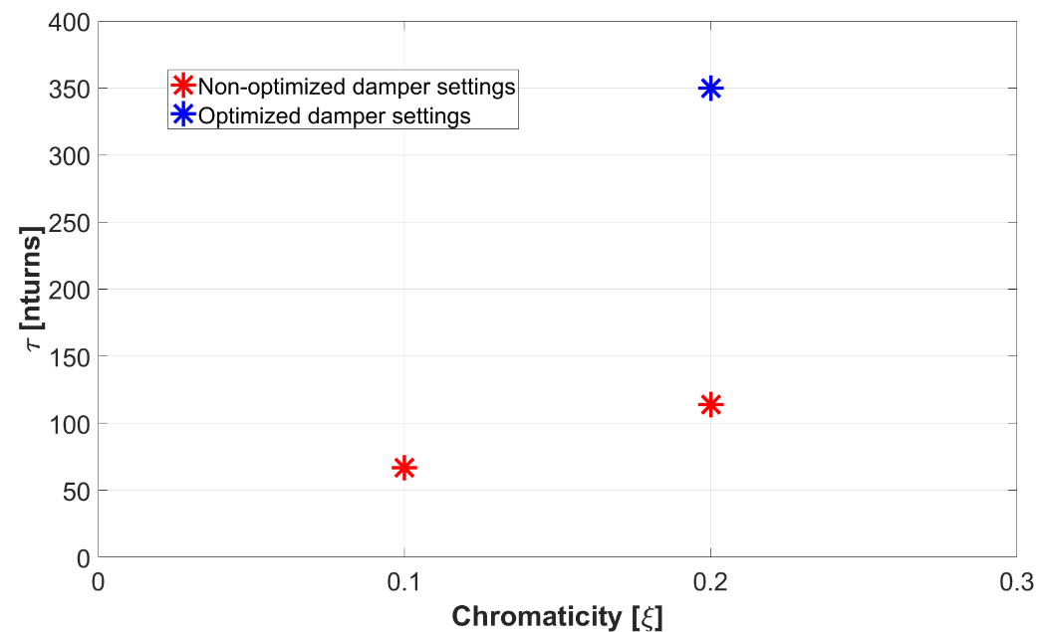
Understanding of the SPS horizontal instability: 2018 measurement campaign
2018 MDs observations
Stable with 1 batch at 2e11
Unstable with 4 batches at 2e11 with BS = 200ns
Mode1 or Mode2 instability depending on chroma
Stabilization at chromax about 0.6
Stabilization with batch spacing >500 ns
Some stabilization with octupoles
Instability threshold at about 1.8e11
ξ_{H}~0.1–0.2
From headtail monitor measurements data
ξ_{H}~0.3–0.5
4x48 bunches, BS=200 ns
N=2e11 ppb

Slide 29
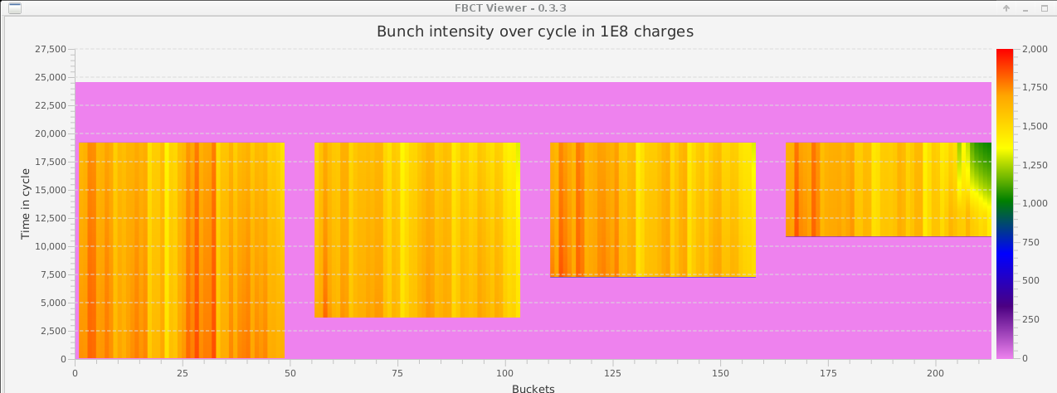
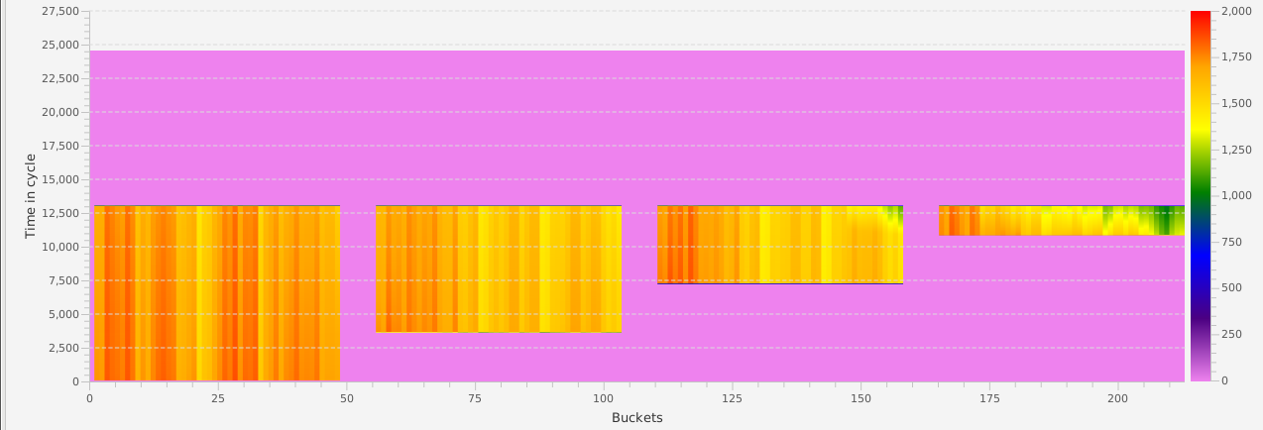
Understanding of the SPS horizontal instability: 2018 measurement campaign

Slide 30
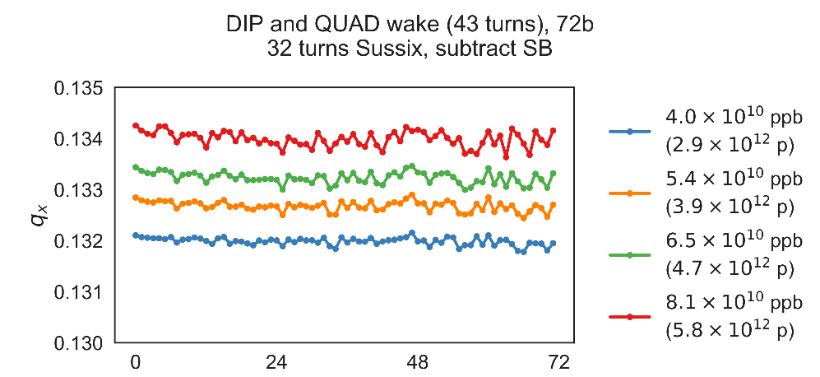
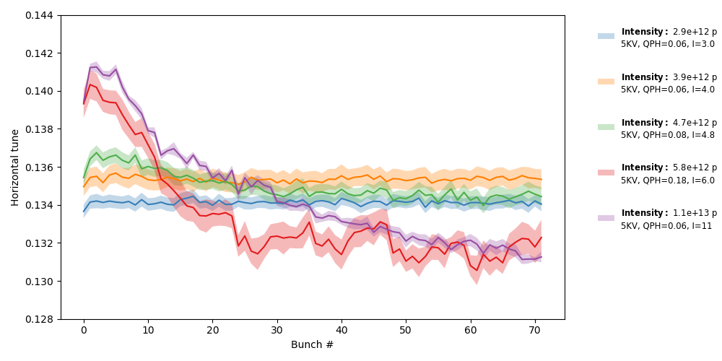
Understanding of the SPS horizontal instability: PyHEADTAIL simulations
Vertical
Impedance model: wall
Good agreement in the vertical plane
Threshold effect in measurements not observed in simulations
Electron cloud effect?
Horizontal
Measurement
PyHEADTAIL

Slide 31
Understanding of the SPS horizontal instability: PyHEADTAIL simulations
Impedance model: wall and kickers
Kicker model fitted with resonators
Stable with 1 batch unstable with 4 batches at 2e11, Stabilization with batch spacing,
Instability threshold around 1.8e11
N=2.0e11 ppb
ξ=0.2
One batch
4 batches

Slide 32
Understanding of the SPS horizontal instability: PyHEADTAIL simulations
Impedance model: wall and kickers
Kicker model fitted with resonators
Stable with 1 batch unstable with 4 batches at 2e11, Stabilization with batch spacing,
Instability threshold around 1.8e11
N=2.2e11 ppb
ξ=0.2
One batch
4 batches

Slide 33
Understanding of the SPS horizontal instability: PyHEADTAIL simulations
Impedance model: wall and kickers
Kicker model fitted with resonators
Stable with 1 batch unstable with 4 batches at 2e11, Stabilization with batch spacing,
Instability threshold around 1.8e11
N=2.2e11 ppb
ξ=0.2
200ns spacing
500ns spacing

Slide 34
Understanding of the SPS horizontal instability: PyHEADTAIL simulations
Impedance model: wall and kickers
Kicker model fitted with resonators
Stable with 1 batch unstable with 4 batches at 2e11, Stabilization with batch spacing,
Instability threshold around 1.8e11
N=2.2e11 ppb
ξ=0.2
200ns spacing
1000ns spacing

Slide 35
Understanding of the SPS horizontal instability: PyHEADTAIL simulations
Impedance model: wall and kickers
Kicker model fitted with resonators
Stable with 1 batch unstable with 4 batches at 2e11, Stabilization with batch spacing,
Instability threshold around 1.8e11
ξ=0.2
N=1.6e11 ppb

Slide 36
Understanding of the SPS horizontal instability: PyHEADTAIL simulations
Impedance model: wall and kickers
Kicker model fitted with resonators
Stable with 1 batch unstable with 4 batches at 2e11, Stabilization with batch spacing,
Instability threshold around 1.8e11
N=2.0e11 ppb
ξ=0.2
N=2.2e11 ppb

Slide 37
Understanding of the SPS horizontal instability: PyHEADTAIL simulations
Impedance model: wall and kickers
Kicker model fitted with resonators
MD observations | Multibunch PyHEADTAIL simulations
Stable with 1 batch at 2e11 | ok
Unstable with 4 batches at 2e11 with BS = 200ns | ok
Mode1 or Mode2 instability depending on chroma | ongoing
Stabilization at chromax about 0.6 | ongoing
Stabilization with batch spacing >500 ns | ok
Some stabilization with octupoles | To be studied
Instability threshold at about 1.8e11 | Within 10% (ok)
Studies still ongoing
It looks we are on the good way

Slide 38
Some potential mitigation
Stabilization with octupoles, chroma and damper
not obvious above 2.1e11 during the 2018 MDs
Impedance mitigation
Modifying once again MKE serigraphy
MKE serigraphy design is optimized to reduce beam induced heating whatever change will likely worsen the situation
Crazy solution: putting a stabilizing device
MKE like structure
The impedance will have a destabilizing effect for TMCI and longitudinal plane (equivalent to an increase of the kicker broadband impedance)
Once simulation model is fully benchmarked we could be more quantitative on the impedance needed
Implement WBFS

Slide 39
Summary
SPS horizontal instability could be a serious limitation for LIU
A possible explanation of the impedance mechanism driving the instability has been presented by using Sacherer theory
More involved model including arbitrary filling scheme, damper, detuning impedance and nonlinearities goes in the same direction
To be continued
Finalize the benchmarking studies
Using the simulation model to study possible mitigation measures

Slide 40
Thank you for your attention

Slide 41
Appendix

Slide 42
Headtail transverse instability
Mode 0 above transition is stable for positive chromaticity and unstable for negative chromaticity
general rule for $Re[Z_{dip}(ω>0)]>0$
Mode l>0 above transition are unstable for positive chromaticity and stable for negative chromaticity
depends on the impedance

Slide 43
Headtail mode 0
$$Z_{⊥}^{∗}\left(ω\right)=−Z_{⊥}\left(−ω\right)$$
SPS wall impedance model
ξ=0.2
$$\left\{\begin{aligned}Re\left[{\left(Z_{dip}\right)}_{eff}\right]<0 ξ<0 Unstable \\ Re\left[{\left(Z_{dip}\right)}_{eff}\right]>0 ξ>0 Stable\end{aligned}\right.$$
$$Re[Z_{dip}(ω>0)]>0$$

Slide 44
Headtail mode l>0
$$Z_{⊥}^{∗}\left(ω\right)=−Z_{⊥}\left(−ω\right)$$
SPS wall impedance model
ξ=0.2
No general rule for stability criteria can be given for mode 1

Slide 45
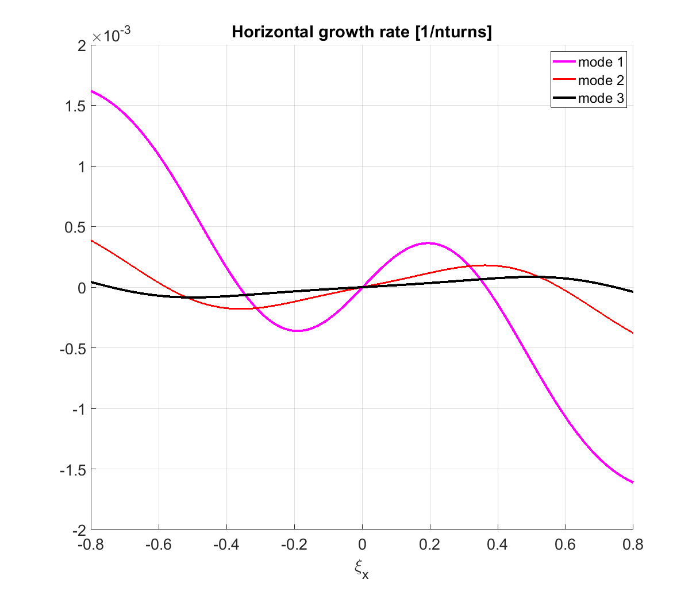
Headtail mode l>0
SPS wall impedance model
No general rule for stability criteria can be given for mode 1

Slide 46
Headtail mode l>0
$$Z_{⊥}^{∗}\left(ω\right)=−Z_{⊥}\left(−ω\right)$$
SPS kicker impedance model without serigraphy
ξ=0.2
No general rule for stability criteria can be given for mode 1

Slide 47
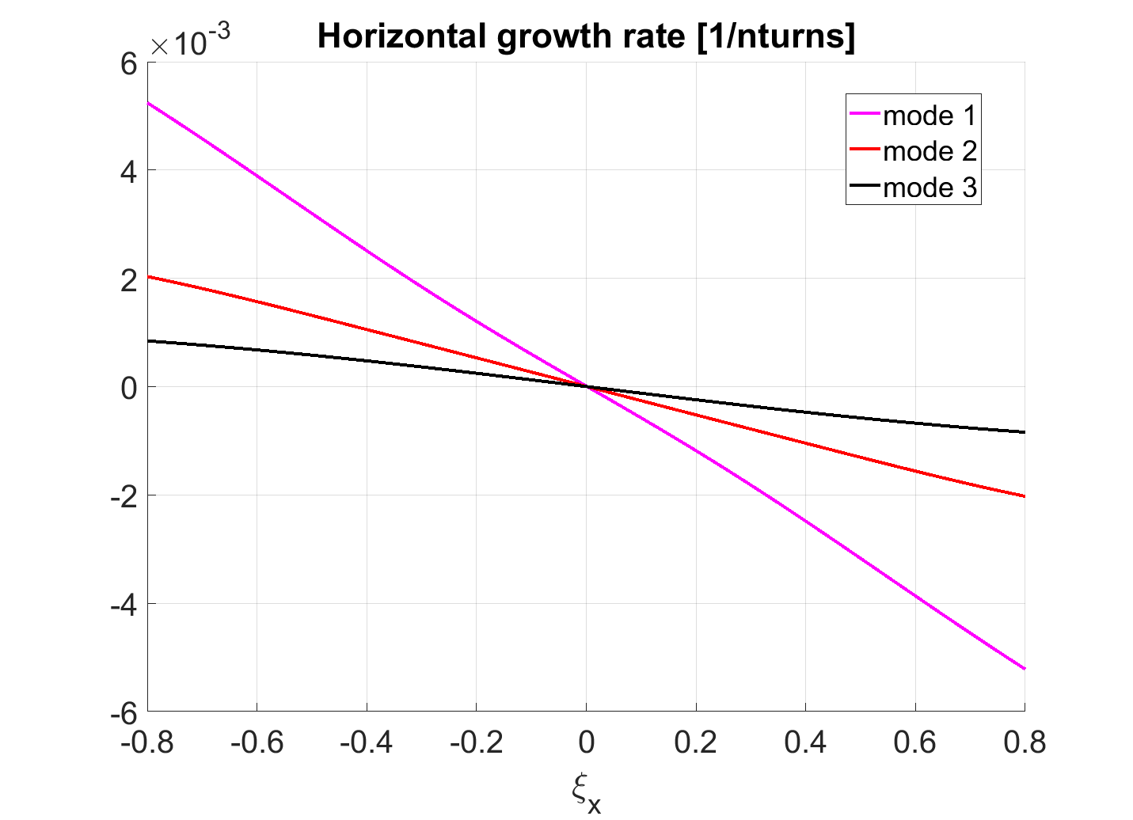
Headtail mode l>0
SPS kicker impedance model without serigraphy
No general rule for stability criteria can be given for mode 1

Slide 48
Summary plot of the headtail growth rates with SPS model without serigraphy
Sacherer theory

Slide 49
SPS growth rates with SPS impedance model from Sacherer theory
Mode 1
M=1
Mode 1
M=48
SPS impedance model (Sacherer theory)
SPS impedance model (Sacherer theory)
The instability could be enhanced with multiple bunches

Slide 50
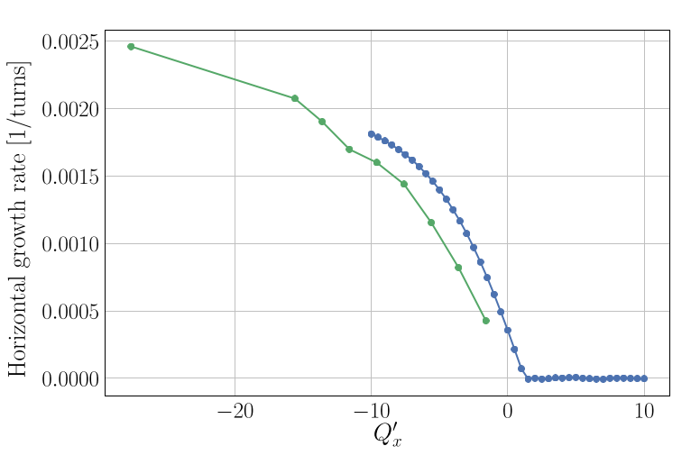
SPS transverse impedance model
Benchmark with beam measurements (coherent tune shifts, head-tail instability growth rates mode 0, TMCI thresholds and intra-bunch motion)
Mode 0
Horizontal
Q20 optics
M. Beck et al., STUDIES OF HORIZONTAL INSTABILITIES IN THE CERN SPS, IPAC2018

Slide 51
SPS headtail instability growth rates
Mode 1
SPS impedance model (Sacherer theory)
$$N=2×{10}^{11}$$
M=1
Summary of instability observations
Chromaticity | Beam Stability
ξ=0.17 | Unstable mode1
ξ=0.27 | Unstable mode1
ξ=0.37 | Unstable mode1
ξ=0.47 | Unstable mode2
ξ=0.57 | Stable
ξ=0.67 | Stable

Slide 52
SPS headtail instability growth rates
Mode 2
SPS impedance model (Sacherer theory)
$$N=2×{10}^{11}$$
M=1
Summary of instability observations
Chromaticity | Beam Stability
ξ=0.17 | Unstable mode1
ξ=0.27 | Unstable mode1
ξ=0.37 | Unstable mode1
ξ=0.47 | Unstable mode2
ξ=0.57 | Stable
ξ=0.67 | Stable

Slide 53
SPS headtail instability growth rates
Mode 3
SPS impedance model (Sacherer theory)
$$N=2×{10}^{11}$$
M=1
Summary of instability observations
Chromaticity | Beam Stability
ξ=0.17 | Unstable mode1
ξ=0.27 | Unstable mode1
ξ=0.37 | Unstable mode1
ξ=0.47 | Unstable mode2
ξ=0.57 | Stable
ξ=0.67 | Stable

Slide 54
SPS headtail instability growth rates
Mode 1
M=1
Mode 1
M=1
SPS impedance model (Sacherer theory)
SPS impedance model (Sacherer theory)
Expectations from the SPS impedance model with Sacherer theory are consistent with instability observations

Slide 55
Effect of wall and kicker impedance with and without detuning impedance
Impedance+Damper
Horizontal
Vertical

Slide 56
SPS horizontal instability
G. Rumolo
YETS
EYETS
YETS
2020-21
2022
2023
2024
LS3
Gradually commission LIU beams
Beams can be produced up to SPS extraction within budgets
Need for Q22 or e-cloud limits high intensity operation
Horizontal instability for high intensity cannot be suppressed
If c), build and implement WBFS in H plane (>2 MCHF)
If b), operational deployment of existing (V) system

