Slide 1
Longitudinal stability of the ions after slip-stacking
T. Argyropoulos, A. Lasheen, D. Quartullo, E. Shaposhnikova
LIU-SPS BD WG 09/05/2019

Slide 2
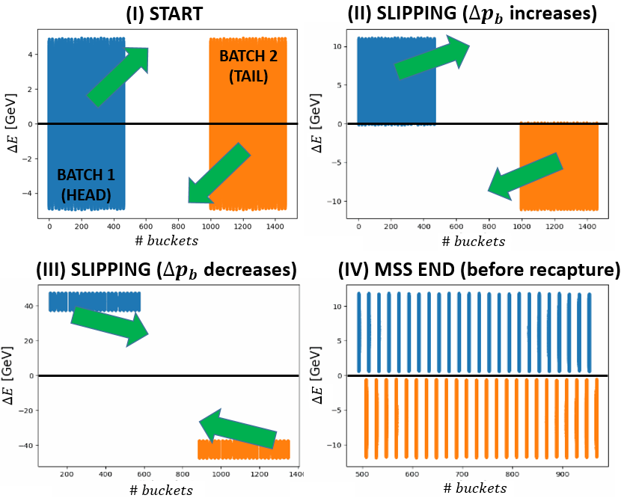
Introduction
Momentum slip-stacking in the SPS is planned to be used in the SPS after LS2
Two SPS batches of 100 ns bunch spacing will be interleaved at an intermediate energy plateau (300 ZGeV, well above transition crossing) reducing the bunch spacing to 50 ns.
Slip-stacking was designed based on realistic macro-particle simulations.
More details can be found in Danilo’s talks at this meeting (06/06 and 03/07 2018)
In this talk we focus on the loss of Landau damping that was observed in simulations after recapture, for the shortest bunches inside the batch

Slide 3
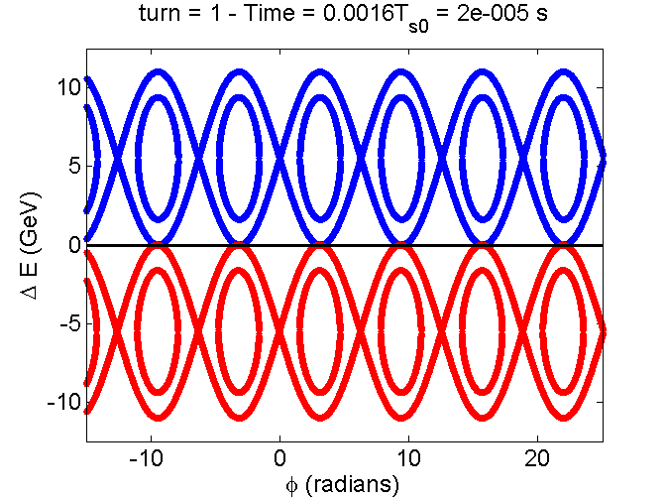

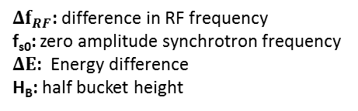
RF perturbation
During slip-stacking each batch will be captured by a different group of RF cavities.
The group of cavities that is not synchronised with the batch will perturb its motion.
The perturbation is described by the slip-stacking parameter
When α=4 the two buckets are tangent to each other → lower limit for stable motion (F. E. Mills)
For α<4 motion becomes chaotic, causing very fast losses → beams should remain separated in energy at the moment of recapture
Particle motion in the longitudinal phase-space
with α=4 (no intensity effects)
$α≝\frac{{Δf}_{RF}}{f_{s0}}$ $=2\frac{ΔE}{H_{B}}$
${Δf}_{RF}$: difference in RF frequency
f_{s0}: zero amplitude synchrotron frequency
$ΔΕ$: Energy difference
H_{B}: half bucket height

Slide 4
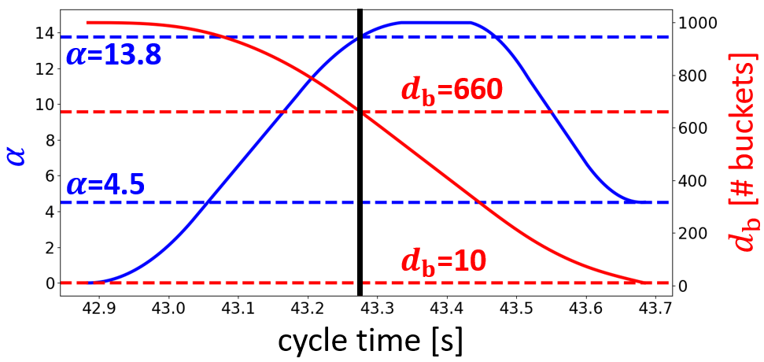
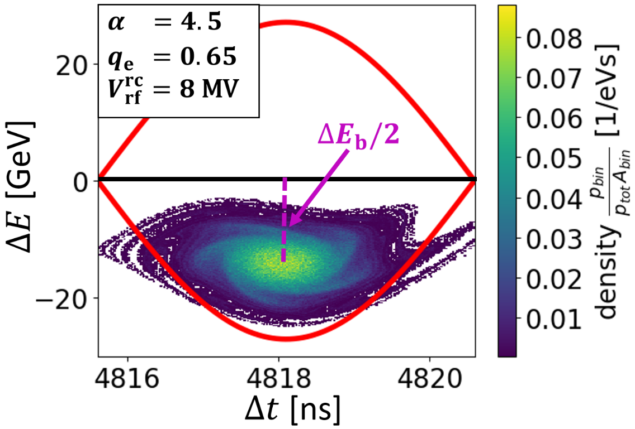
RF perturbation
Example of the α-parameter evolution during an optimised slip-stacking process in Q20 optics
Phase-space distribution at the moment of recapture
End of
Slip-stacking
Recapture
Start of
Slip-stacking
Very distorted particle trajectories, even though α>4.
High RF voltage is needed at recapture → a large emittance blow-up.

Slide 5
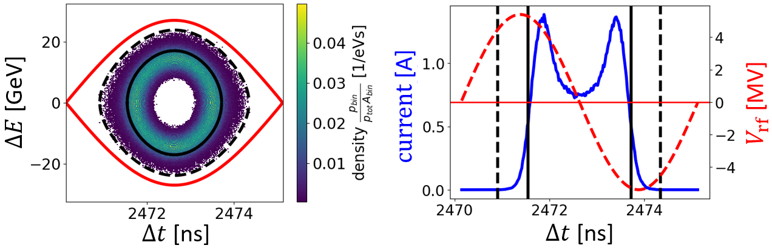
Hollow bunch distribution
Large energy offset at the moment of recapture → hollow bunch is formed after filamentation and this distribution is preserved until the end of the cycle
Example of a simulation without intensity effects

Slide 6
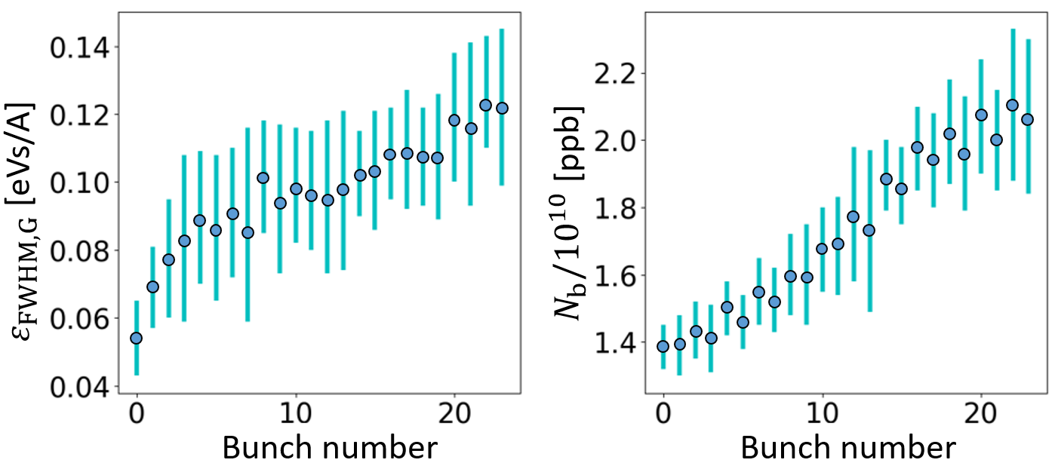
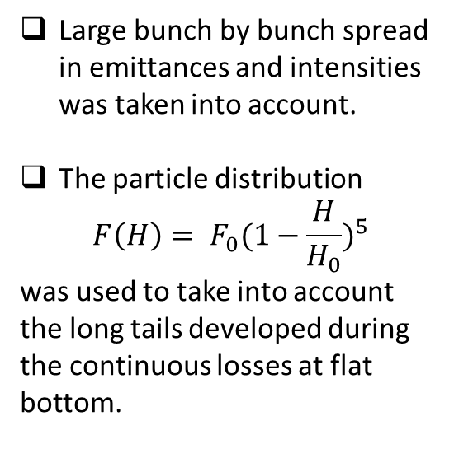
Beam parameters in simulations
Example beam measurements in 2015
Large bunch by bunch spread in emittances and intensities was taken into account.
The particle distribution
$$F\left(H\right)= F_{0}(1−\frac{H}{H_{0}})^{5}$$
was used to take into account the long tails developed during the continuous losses at flat bottom.
A. Lasheen thesis

Slide 7
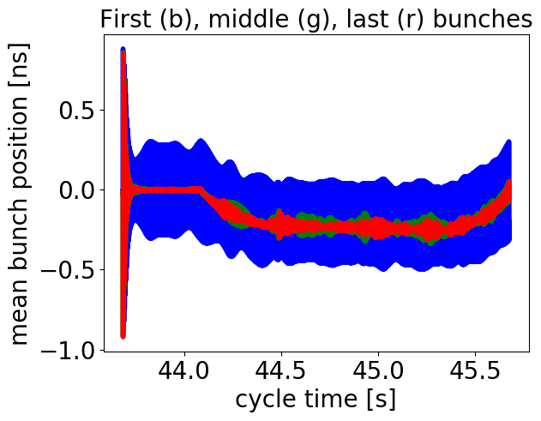
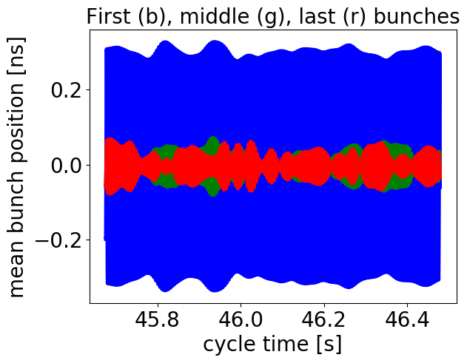
Loss of Landau damping
When intensity effects (SPS impedance model) included in the simulations, loss of Landau damping was observed for the smallest and least intense bunches.
Dipole oscillations are not damped until the end of the cycle.
Recapture and ramp to top energy
Flat-top
First bunch
Middle bunch
Last bunch

Slide 8
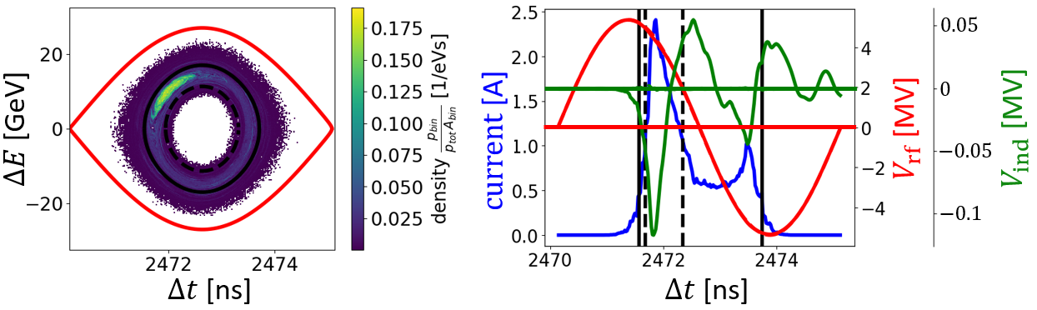
Loss of Landau damping
When intensity effects (SPS impedance model) included in the simulations, loss of Landau damping was observed for the smallest and least intense bunches.
Dipole oscillations are not damped until the end of the cycle.
High density island in phase-space that keeps oscillating around the bucket centre
Example of a simulation with intensity effects at the SPS flat-top

Slide 9
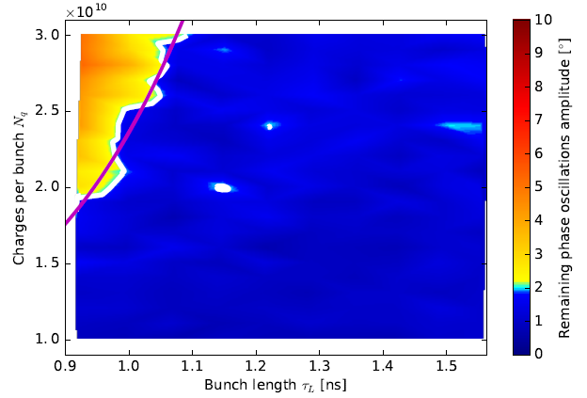
Increase loss of Landau damping threshold
The obvious and easiest way to implement in the machine is to activate the 800 MHz RF system at flat-top
Large increase in threshold expected and shown in previous simulations (A. Lasheen)
Simulations at SPS flat-top in single RF
Simulations at SPS flat-top in BSM with V_{r} = 0.1
A. Lasheen thesis

Slide 10
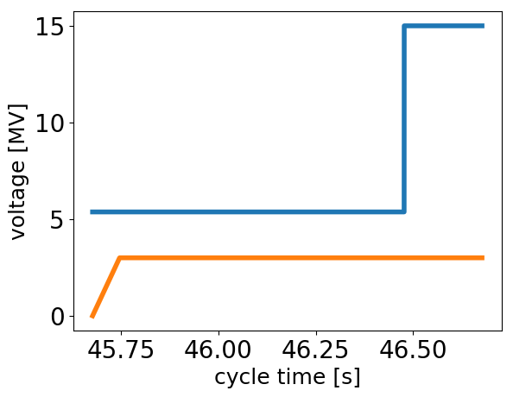


Increase loss of Landau damping threshold
Switching on the 800 MHz RF system at flat-top didn’t damp the oscillations
Only for very high values of V₈₀₀=3.5 MV gave enough damping in BSM.
Beginning of flat-top
$$V_{rf}^{200 MHz}$$
Dipole oscillations at SPS flat-top in double RF system
$$V_{rf}^{800 MHz}$$
First bunch
Middle bunch
Last bunch

Slide 11
Increase loss of Landau damping threshold
Inspecting the synchrotron frequency distribution shows:
  Very small increase in the spread with V₈₀₀ = 0.5 MV in BSM
  Regions with zero derivative generated in BLM but also in BSM for higher 800 MHz RF voltage
  for which the threshold reduces to
Synchrotron frequency distributions at the SPS flat-top without intensity effects
The magenta coloured region shows the region occupied by the bunch

Slide 12
Increase loss of Landau damping threshold
By activating the 800 MHz RF system at the moment of recapture in BSM was possible to damp the oscillations.
  For higher values of V₈₀₀ more than 10% of the V₂₀₀ all bunches loose landau damping
Dipole oscillations at the moment of recapture and during filamentation in double RF system
V₂₀₀ = 8 MV
First bunch
Middle bunch
Last bunch

Slide 13
Increase loss of Landau damping threshold
By activating the 800 MHz RF system at the moment of recapture in BSM was possible to damp the oscillations.
  For higher values of V₈₀₀ more than 10% of the V₂₀₀ all bunches loose landau damping
  Regions with zero derivative generated
Synchrotron frequency distributions at the moment of recapture
The magenta coloured region shows the region occupied by the bunch

Slide 14
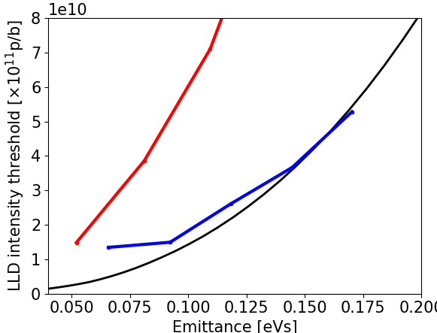
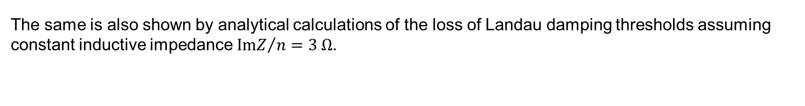
Increase loss of Landau damping threshold
The same is also shown by analytical calculations of the loss of Landau damping thresholds assuming constant inductive impedance ${ImZ}/n=3 Ω$.
Calculations of LLD with the formula shown in black:
The red and blue curves are thresholds calculated by finding the Van Kampen modes.
Loss of Landau damping thresholds at the moment of recapture with V₂₀₀ = 8 MV and V₈₀₀ = V₂₀₀ /10
Regions where the bunches are
The 800 MHz RF system essential for stability from recapture until the end of the cycle.

Slide 15
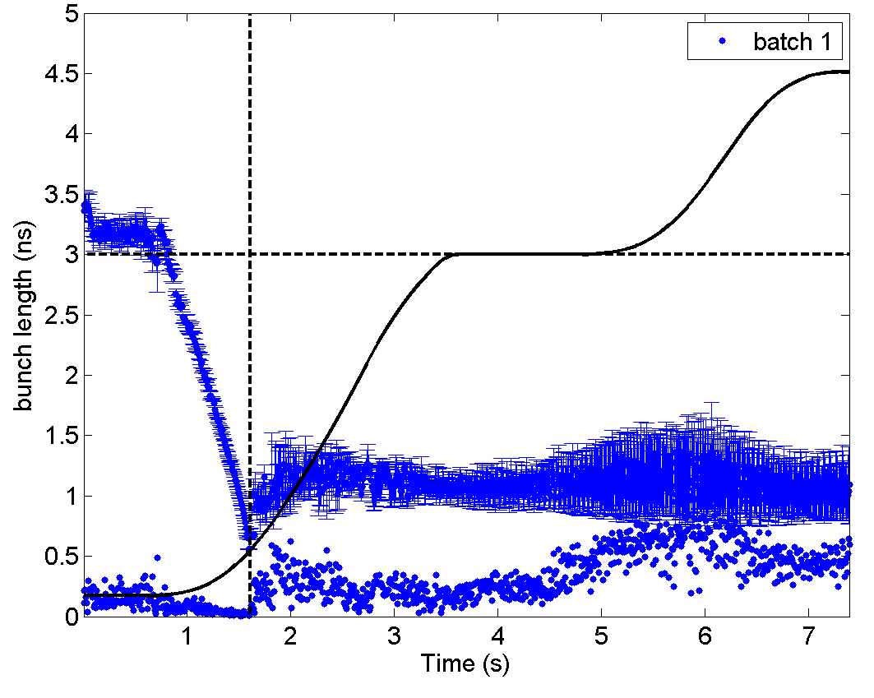
Instability in measurements in slip-stacking MDs
In order to apply the slip-stacking manipulation, the beam needs to be stable and reproducible at the 300 ZGeV/c.
After adjusting the transition crossing timing, bunches were less blown-up but instabilities occurred later in the cycle.
This can be improved if the 800 MHz RF system can be used right after transition crossing
This means that 800 MHz will be needed also during the slip-stacking → separate control of each cavity (following the 200 MHz)

Slide 16
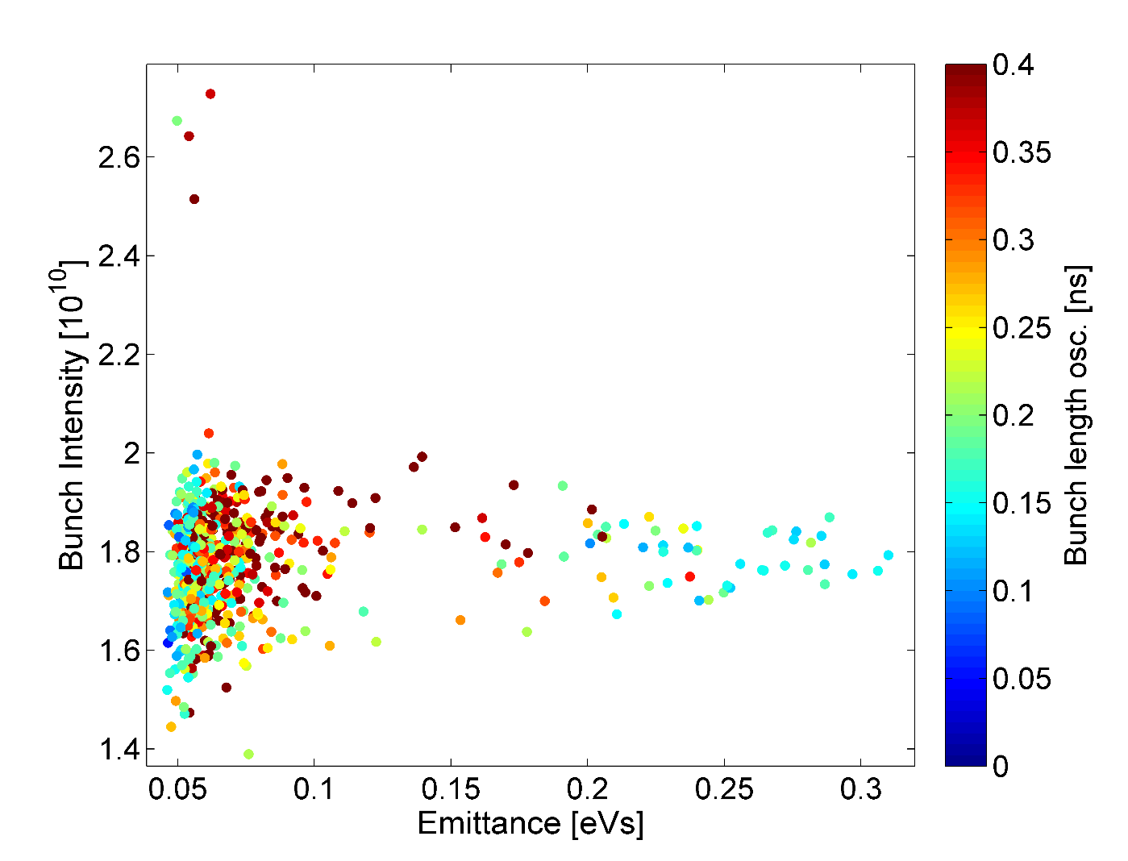
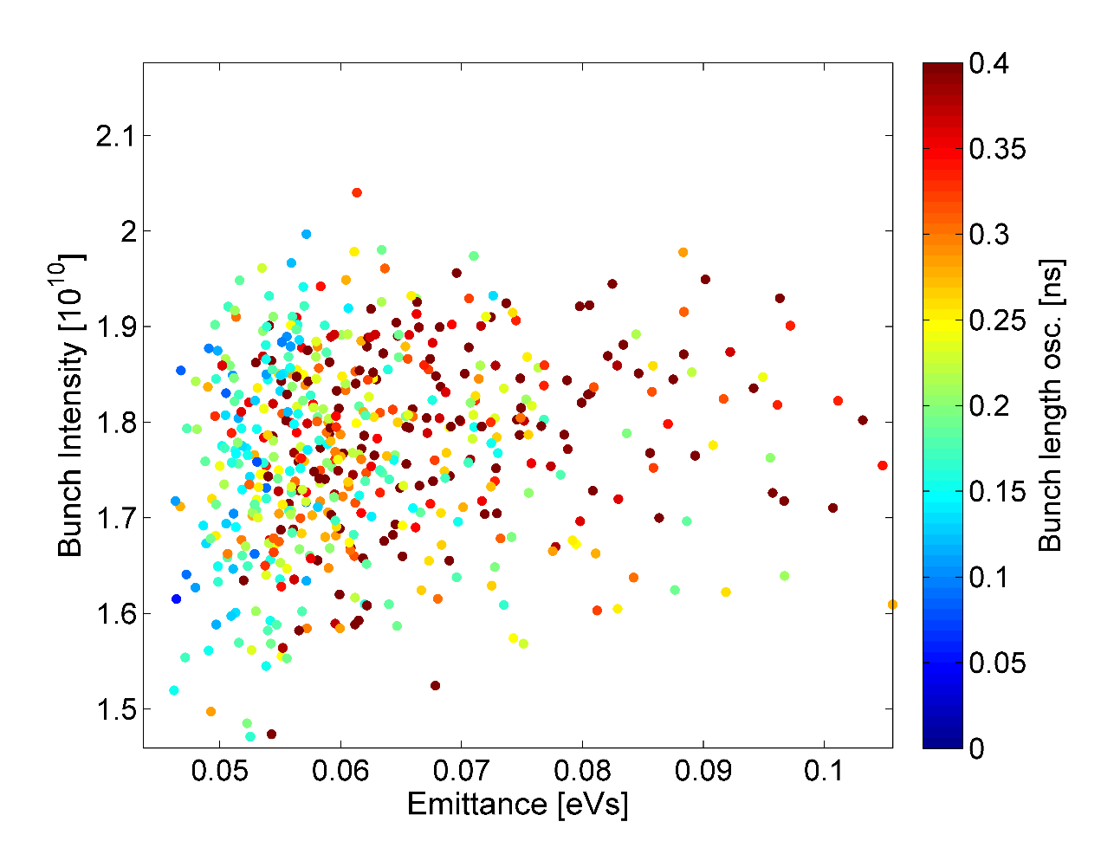
Instability in measurements in slip-stacking MDs
Bunch length oscillations during the 300 ZGeV/c momentum plateau
zoom

