Slide 1
LLRF specifications for slip-stacking
T. Argyropoulos, T. Bohl, G. Papotti, D. Quartullo, E. Shaposhnikova
LIU-SPS Beam Dynamics WG, 28/03/2019

Slide 2
Introduction
Momentum slip-stacking (MSS) is planned to be used in the SPS after LS2 to increase number of bunches in the LHC → increase Luminosity in the LHC experiments.
Cycle overview:
Injected beams: 2 SPS super-batches spaced by T_{b} (T_{b} is defined by the AM of the RF cavities)
SPS super-batch: 6 PS batches of 4 bunches spaced (ideally) by 100 ns (24 bunches spaced by 100 ns)
Accelerate the beam until an intermediate energy plateau (300 GeV Z) around 1 s long.
FFA, transition crossing, stability issues, controlled long. emittance blow-up, 800 MHz RF system
MSS to interleave the two SPS super-bunches → 1 batch of 48 bunches spaced by 50 ns
Losses and longitudinal emittance blow-up
Accelerate the beam to the top energy and extract to the LHC.
Fit bunches to the LHC buckets → bunch rotation might be needed

Slide 3
Introduction
Momentum slip-stacking (MSS) is planned to be used in the SPS after LS2 to increase number of bunches in the LHC → increase Luminosity in the LHC experiments.
Cycle overview:
Injected beams: 2 SPS super-batches spaced by T_{b} (T_{b} is defined by the AM of the RF cavities)
SPS super-batch: 6 PS batches of 4 bunches spaced (ideally) by 100 ns (24 bunches spaced by 100 ns)
Accelerate the beam until an intermediate energy plateau (300 GeV Z) around 1 s long.
FFA, transition crossing, stability issues, controlled long. emittance blow-up, 800 MHz RF system
MSS to interleave the two SPS super-bunches → 1 batch of 48 bunches spaced by 50 ns
Losses and longitudinal emittance blow-up
Accelerate the beam to the top energy and extract to the LHC.
Fit bunches to the LHC buckets → bunch rotation might be needed
Specifications for the LLRF only on MSS

Slide 4
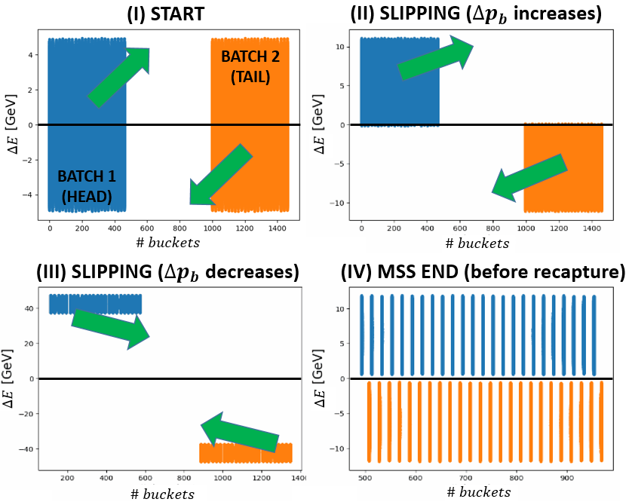
Momentum slip-stacking (MSS) in the SPS
Procedure:
Two groups of 200 MHz RF cavities, one for each batch. f_{RF} variation to accelerate the first batch and decelerate the second → antisymmetric frequency programs.
Batches separated in frequency (energy) slip with respect to each other.
Start bringing the batch close.
Recapture all bunches with all RF cavities at the average frequency (black line at ΔE=0).

Slide 5
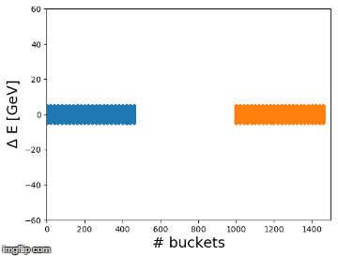
Momentum slip-stacking (MSS) in the SPS
Procedure:
Two groups of 200 MHz RF cavities, one for each batch. f_{RF} variation to accelerate the first batch and decelerate the second → antisymmetric frequency programs.
Batches separated in frequency (energy) slip with respect to each other.
Start bringing the batch close.
Recapture all bunches with all RF cavities at the average frequency (black line at ΔE=0).
Simulation example with 48 bunches

Slide 6
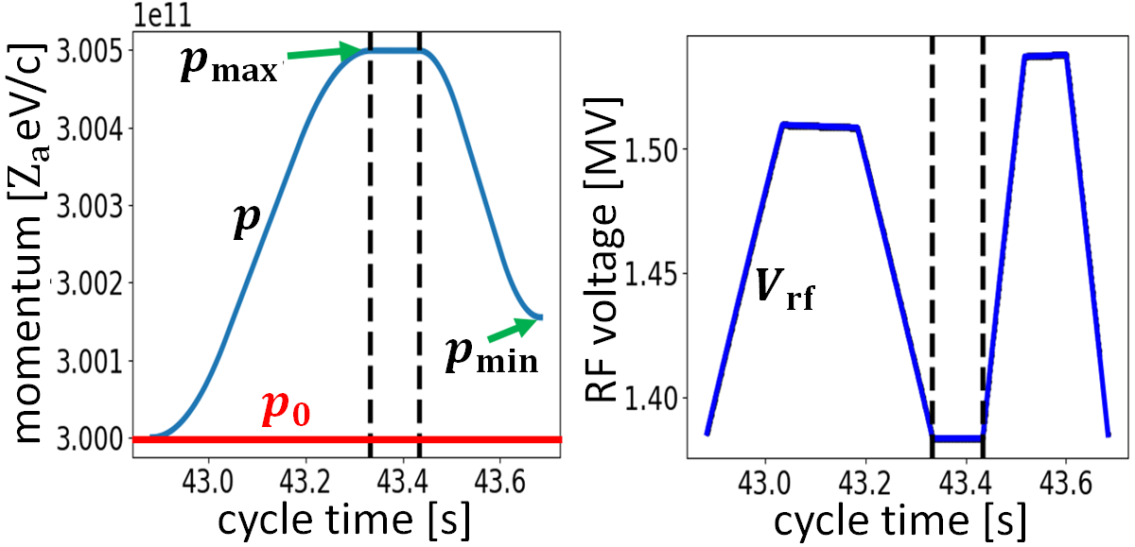
Momentum (frequency) program
Momentum programs should be anti-symmetric for the two batches
Higher $p_{max}$, faster the SS process is. Defined by:
The bandwidth of the RF cavities
The aperture of the machine
Note that faster changes on $p$ will require higher RF Voltage
Full MSS procedure will last of around 0.5 – 1 s with ${∆f}_{rf}\sim 1.2 kHz$ and $∆R\sim 5−10 mm$ (18 mm tried in measurements without losses)
During the MSS the RF phase can be tracked
$$\frac{{∆f}_{rf}}{f_{rf,0}}=−η_{0}\frac{∆p}{p_{0}}$$
$$\frac{∆p}{p_{0}}=γ_{tr}^{2}\frac{∆R}{R_{0}}$$
$p_{0}$: designed momentum
$p_{min}$: depends on beam stability issues and
affects the final beam parameters
$${∆φ}_{rf}=\frac{2 π h{ ∆f}_{rf}}{f_{rf,0}}$$

Slide 7
RF voltage program
Calculated for constant filling factor ($q_{e}$) in momentum based on the size of the largest bunch measured
ε_{l} ~ 0.125 eVs and $q_{e}\sim$0.65 to have some margin for losses.
Same duration as the momentum program (0.5 – 1 s)
$V_{rf}^{max}$, $V_{rf}^{min}$ depend on $ε_{l}^{max}$, $q_{e}$and the duration of the MSS process.
Expected values from each group: $0.3{<V}_{rf}<2$ MV
Same for both groups of RF cavities but AM is needed (at least in the beginning of the process).

Slide 8
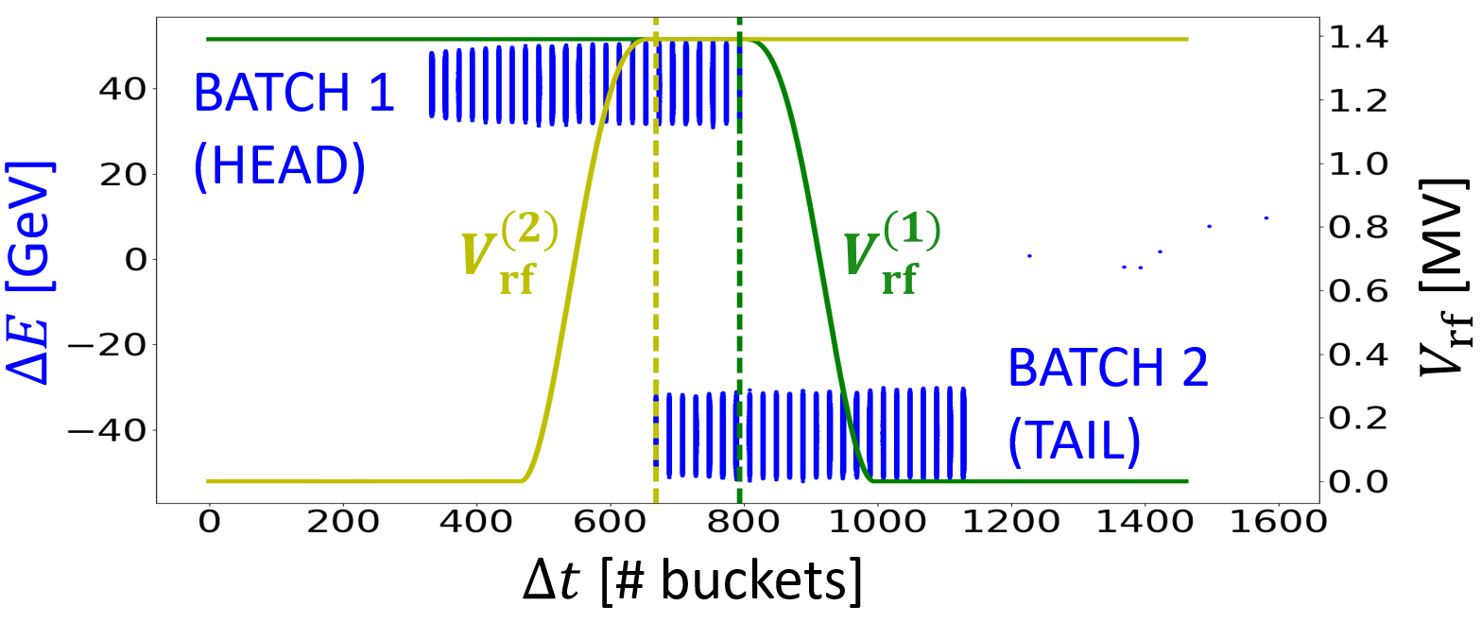
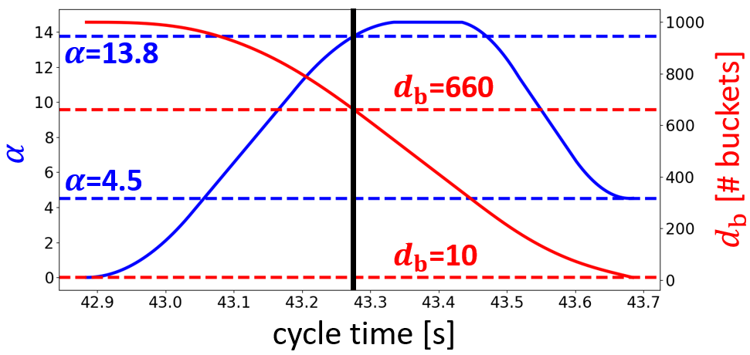
RF voltage amplitude modulation
Measurements of RF voltage during batch passage (T. Bohl)
AM is needed: very crucial in the beginning of the process.
This defines the batch distance T_{b}
1 μs was used in simulations (might even be smaller in the future with the 3-section cavities)
Each group of cavities should be switched off when the corresponding batch has passed through
4 sections
5 sections
Slip-stacking parameter α:
Larger for better stability
$α≝\frac{{Δf}_{RF}}{f_{s0}}$ $=2\frac{ΔE}{H_{B}}$

Slide 9
Recapture
At the end of MSS process the two batches have to be recaptured by all RF systems in the average (designed) frequency.
This has to be done (ideally) within 1 turn.
Margin of a few turns is acceptable.
The maximum available RF voltage is needed

Slide 10
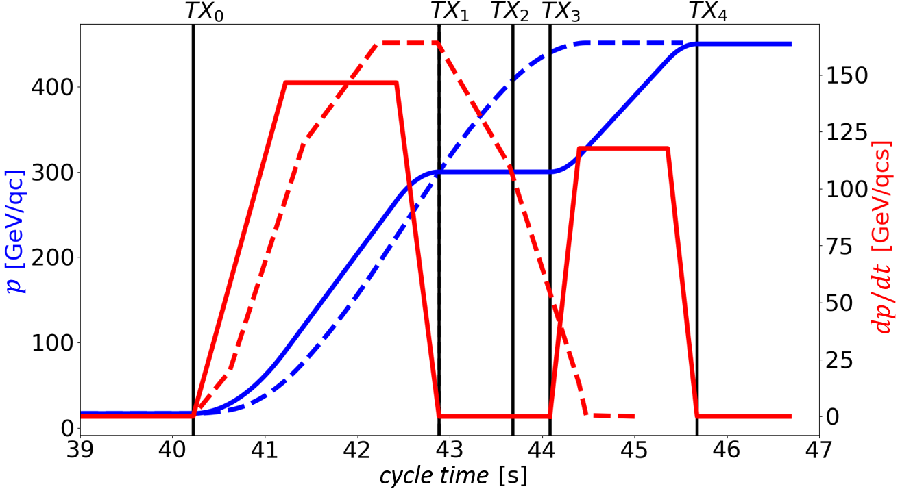
Timings and high level parameters
TX1: Start of the MSS process.
Separate the (some) cavities into two group.
Trigger the voltage and frequency programs (should be provided (designed) beforehand).
TX2: End of MSS process.
Recombine all cavities at the designed frequency
Continue acceleration to flat top of the one batch.
Possibility of more flexibility in triggers is very welcome
Importance of an easy way to group and regroup the RF cavities (counter phasing might also be needed)
Important to have an easy way to input frequency and voltage programs into the two groups of cavities.
LSA parameters for each group e.g. SLST_TOTAL_VOLTAGE_G1

Slide 11
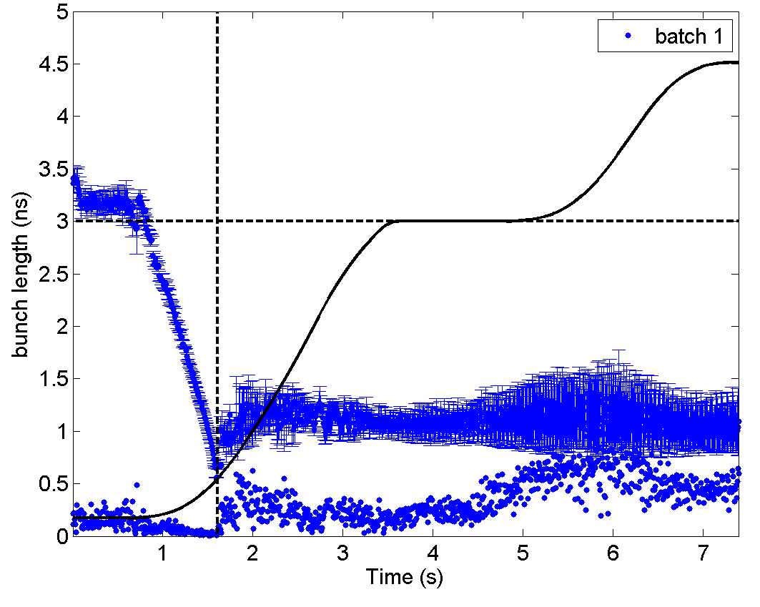
Comments on the ion beams
Stability issues of the LHC ion beams found from measurements in 2018 when the transition crossing was adjusted.
Important for the future operation:
Operate with the 800 MHz on (after transition)
Apply controlled emittance blow-up
Unstable at 300 GeV Z

