Slide 1
Update on Work on Impedance Reduction and 200 MHz TWCs
R. Calaga, A. Farricker ,P. Kramer, E. Montesinos, N. Nasresfahani, B. Popovic & C.Vollinger

Slide 2
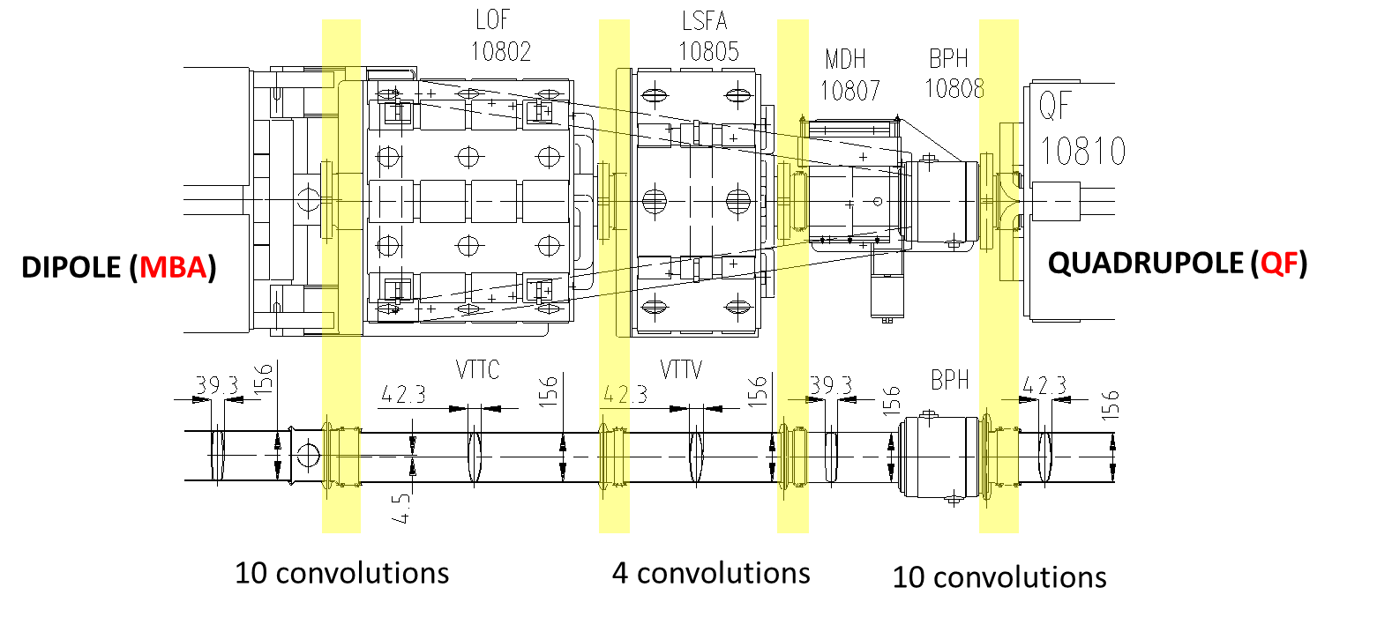
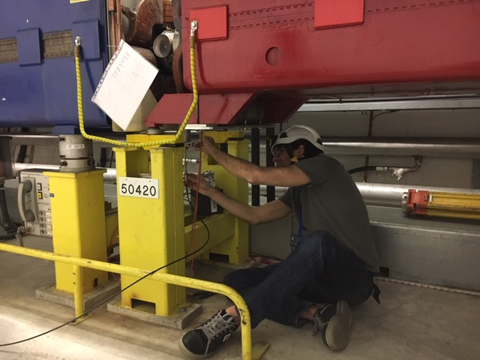
Quality Assurance
Plans for QA measurements on the shielding of the SSS were presented in LIU-SPS BD WG 23/10/18
Measurements have since been performed in areas: 4-, 5- and 3+
So far on the new installations no issues have been found
However we also had the opportunity to measure the pumping ports downstream of the QF
In 5- we observed a mode which we were not expecting
Measuring the pumping ports in 3+ prior to the aC coating we do not observe this resonance
This requires further investigation as to its origin

Slide 3
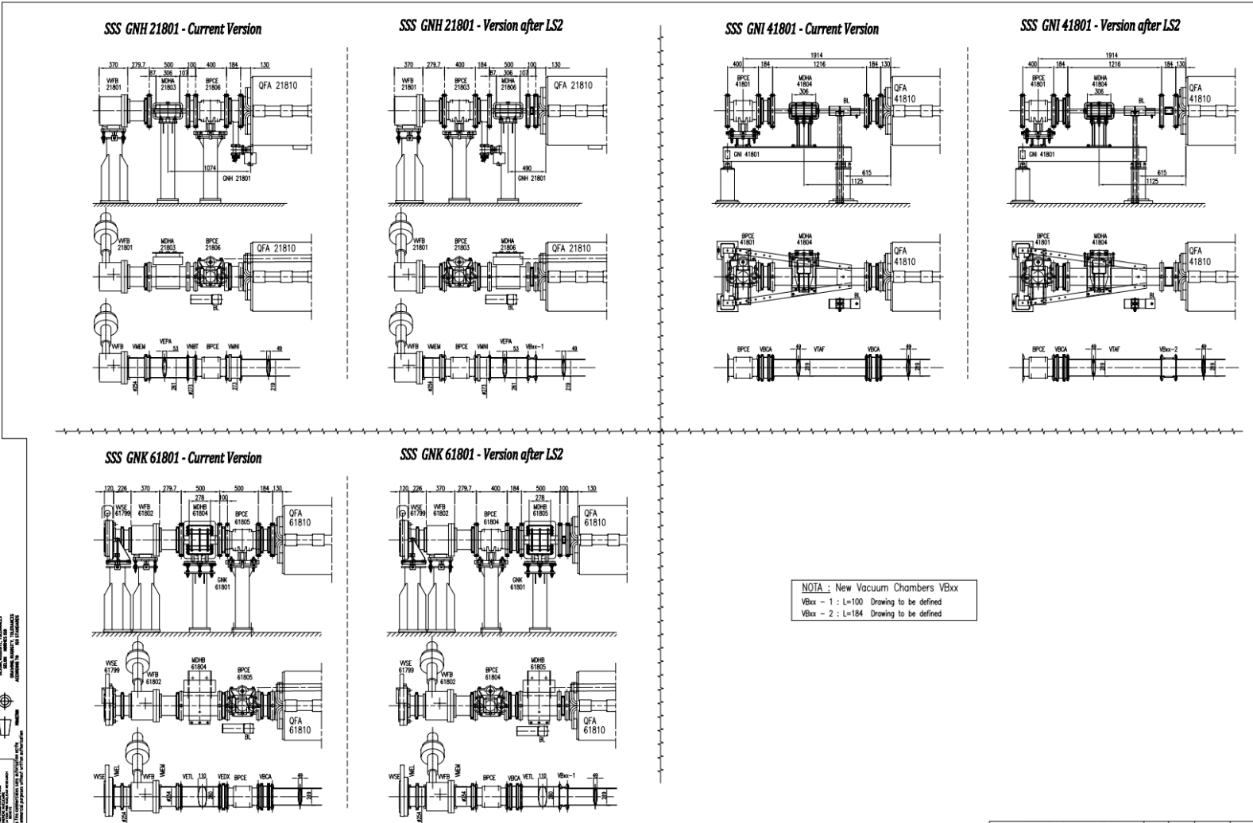
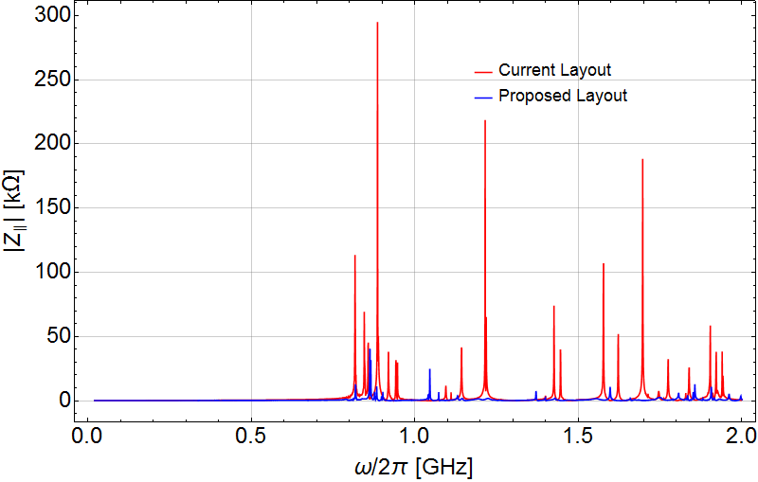
Impedance Reduction in QFA Sections
The optimization of the layouts in the areas QFA.216, QFA.218, QFA.418 & QFA.618 is planned to reduce the impedance
This involves removing undesired cavities by swapping elements and replacing the large circular bellows
QFA.216 is covered in a separate ECR which is being circulated
ECR#2026752

Slide 4
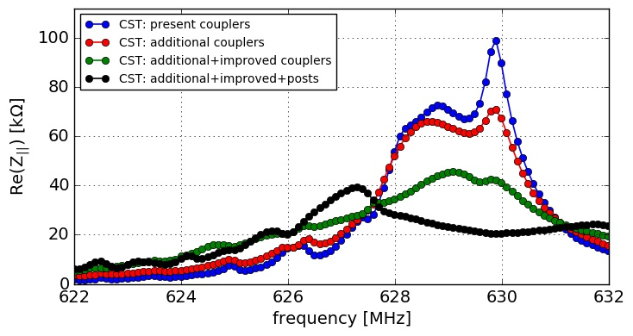
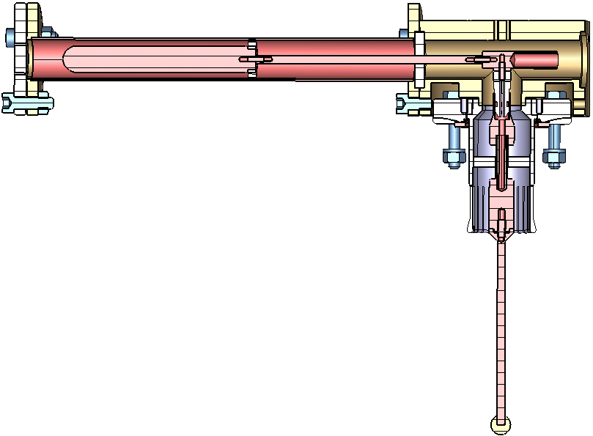
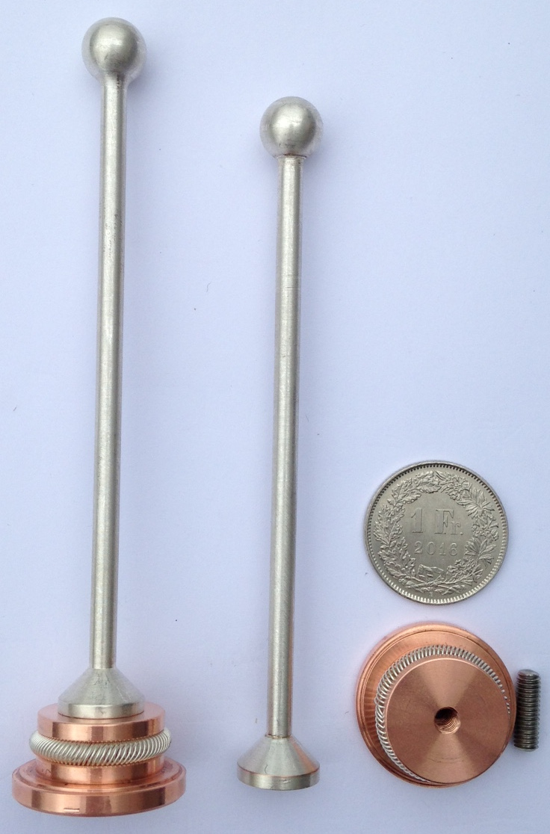
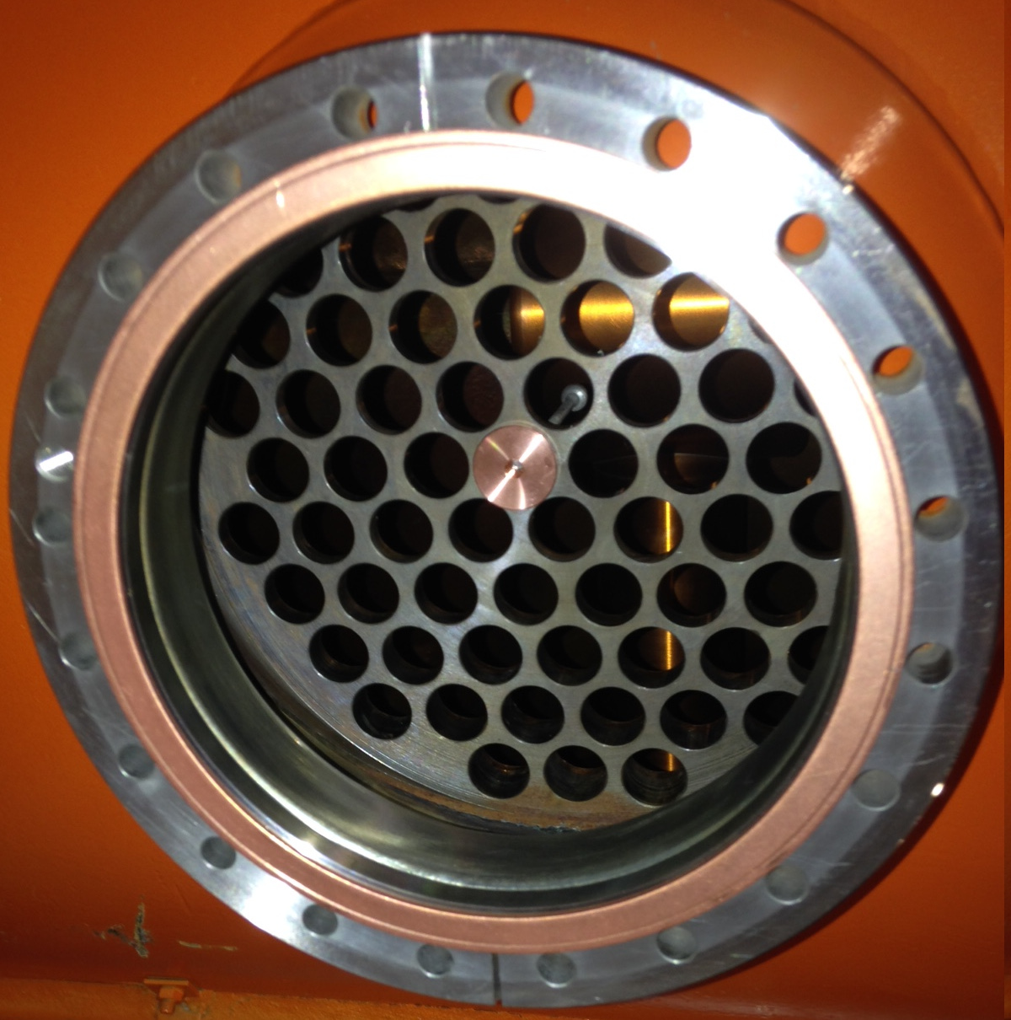
HOM Damping Scheme for 3-Section
Additional couplers in cells with strong electric field
Improved couplers with 23Ω-impedance (critical coupling)
Resonant posts in vacuum pumping ports
  Performance confirmed in lab measurements
  Possible heating issue is being investigated

Slide 5
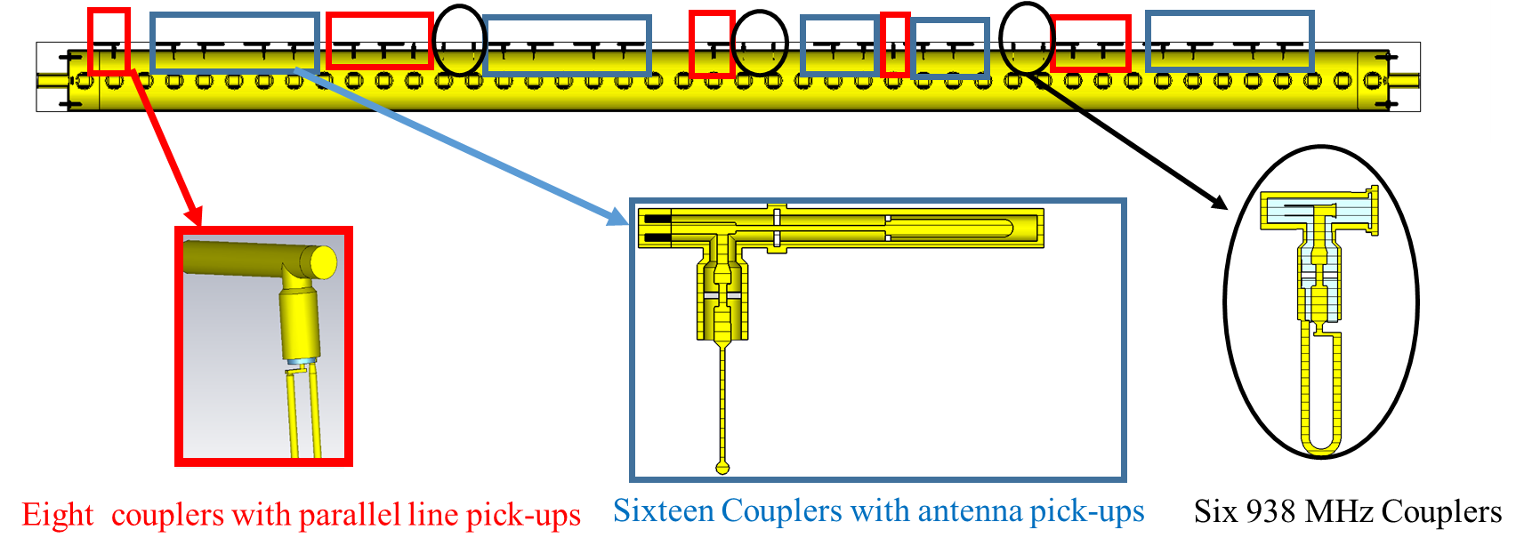
HOM Damping Scheme for 4-Section
Implemented in cavity 2 in 2018-run
Spectral power measurements in the 630 MHz range for different SPS cycles consistently show a reduction in measured power

Slide 6
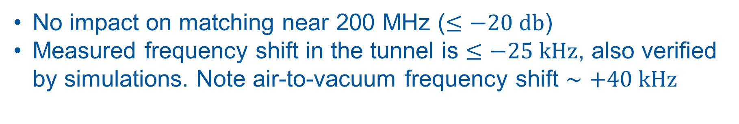
Effect of New HOM Couplers on the Fundamental (1/2)
No impact on matching near 200 MHz ($≤−20 db$)
Measured frequency shift in the tunnel is $≤−25 kHz$, also verified by simulations. Note air-to-vacuum frequency shift $∼+40 kHz$
Note: Measurement performed in standing wave by shorting the FPC lines
Performed by R. Calaga & N. Nasresfahani

Slide 7
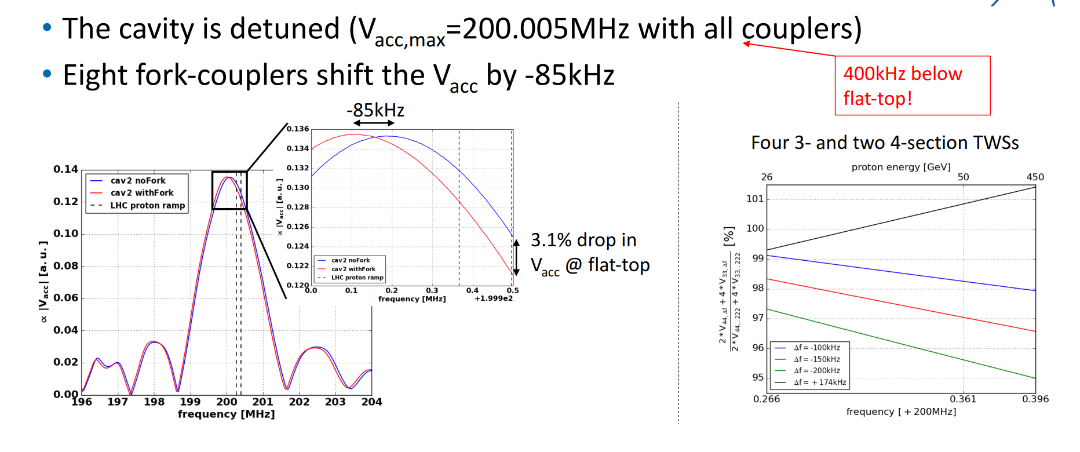
Effect of New HOM Couplers on the Fundamental (2/2)
Note: Shift from Air to Vacuum already included
Note: Measurement performed in travelling wave using the LLRF pickups
Measurements performed by P. Kramer & C. Vollinger

Slide 8
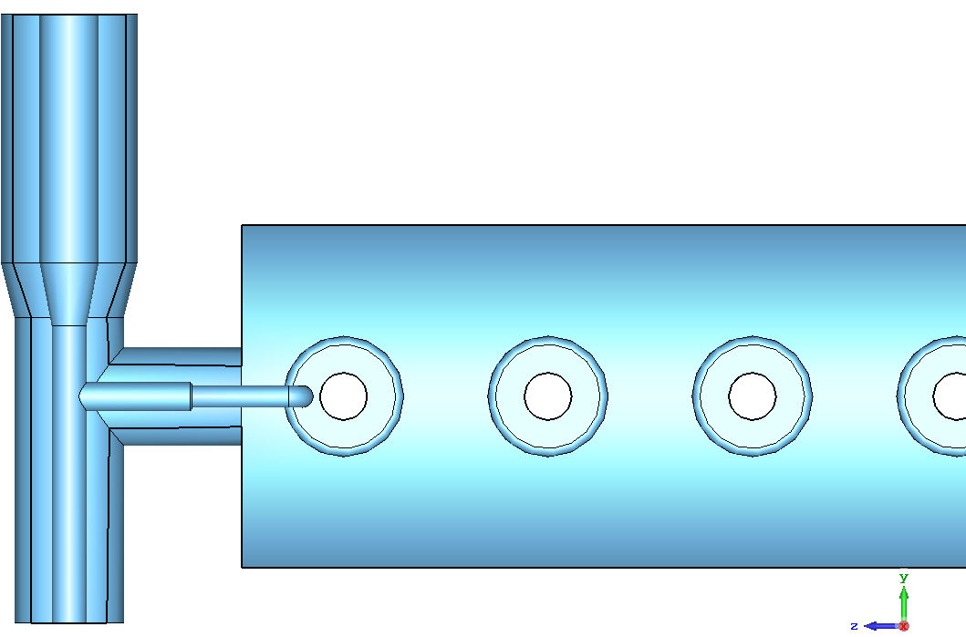
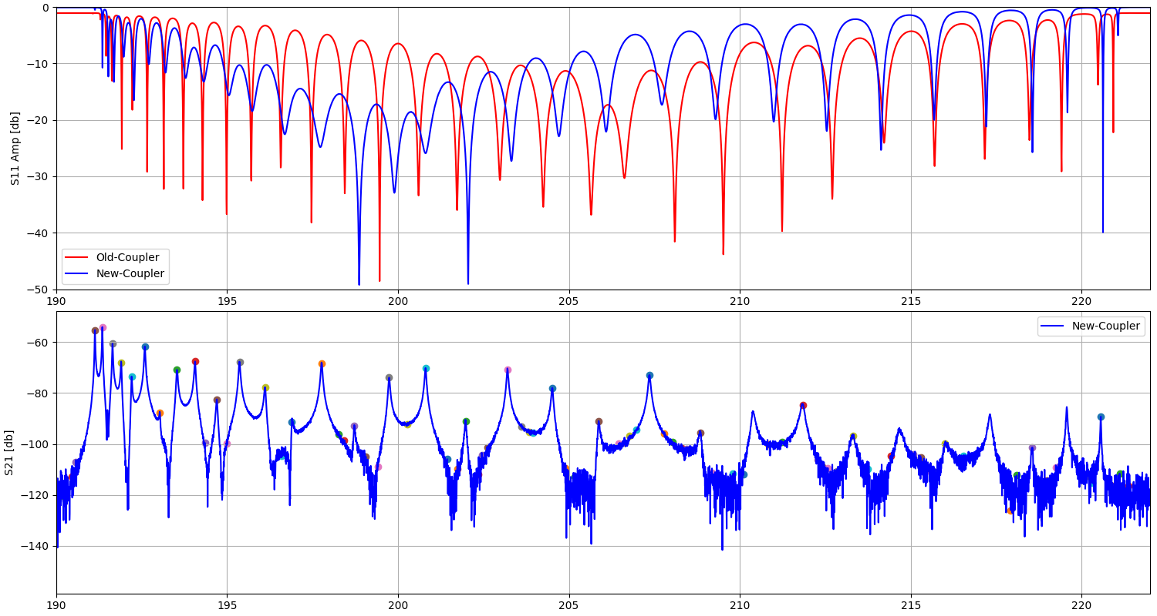
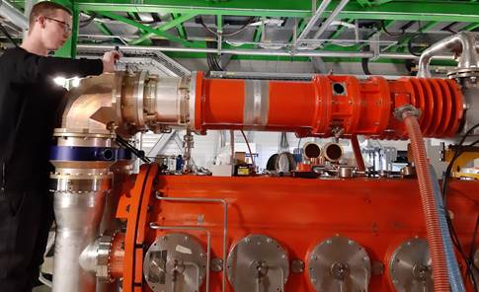
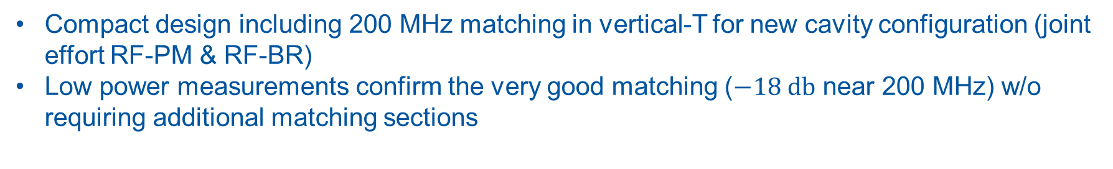
New Fundamental Power Coupler
3-section, BAF3
Compact design including 200 MHz matching in vertical-T for new cavity configuration (joint effort RF-PM & RF-BR)
Low power measurements confirm the very good matching ($−18 db$ near 200 MHz) w/o requiring additional matching sections

Slide 9
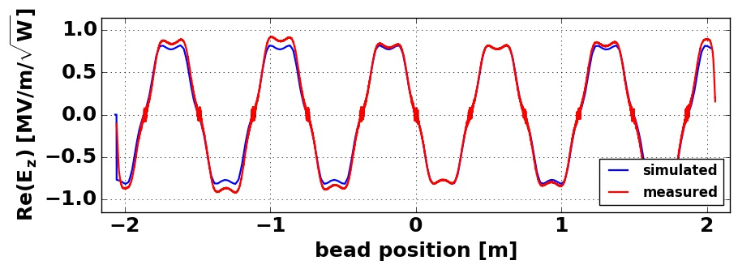
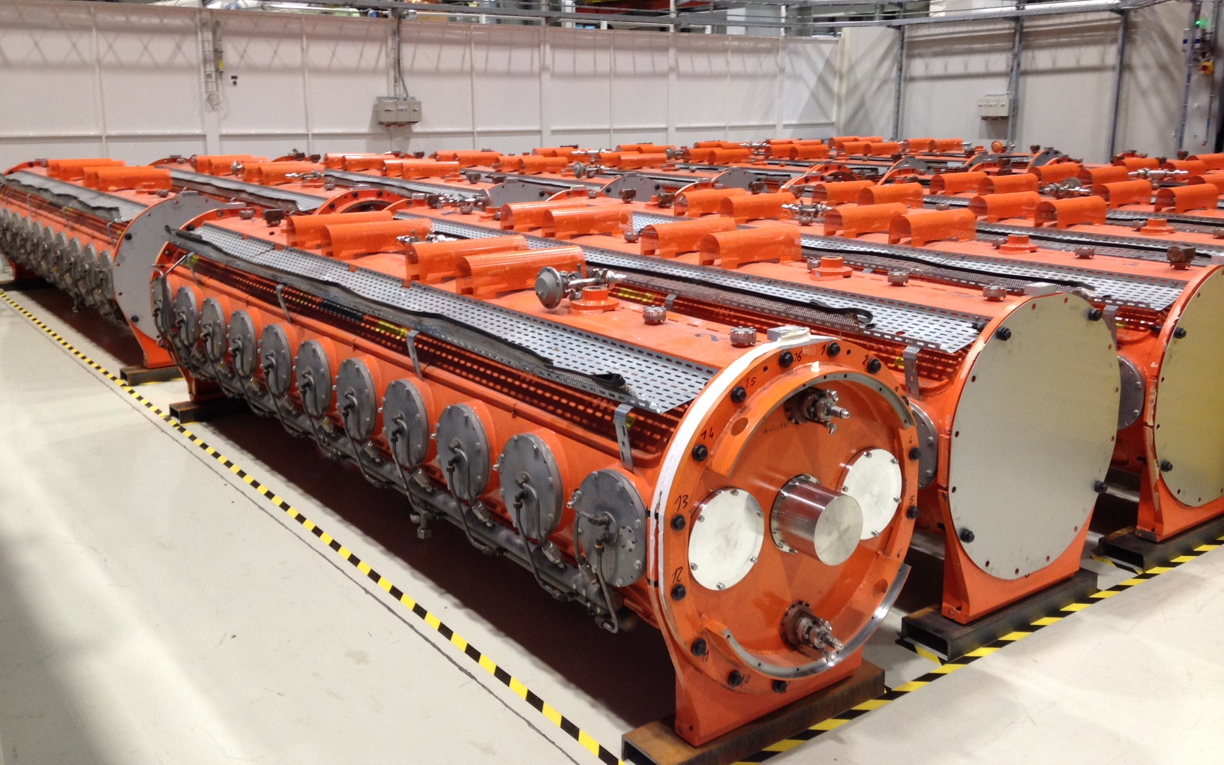
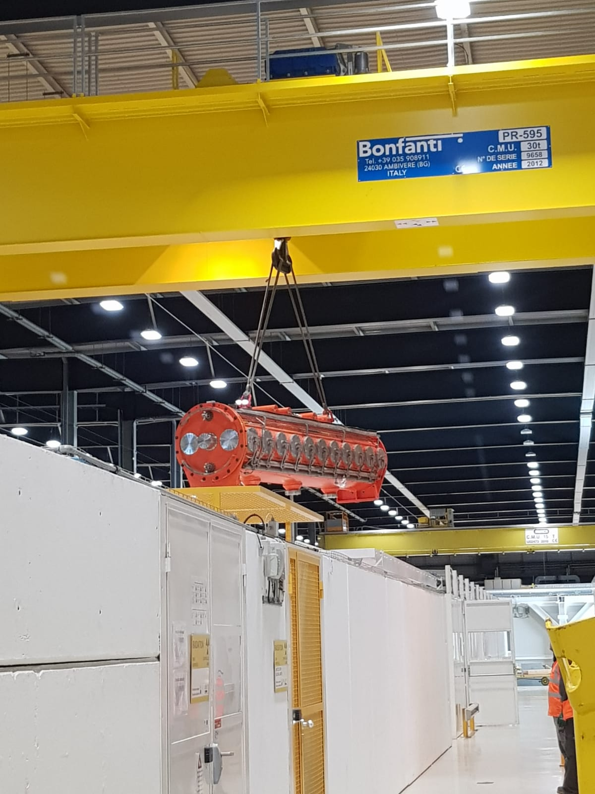
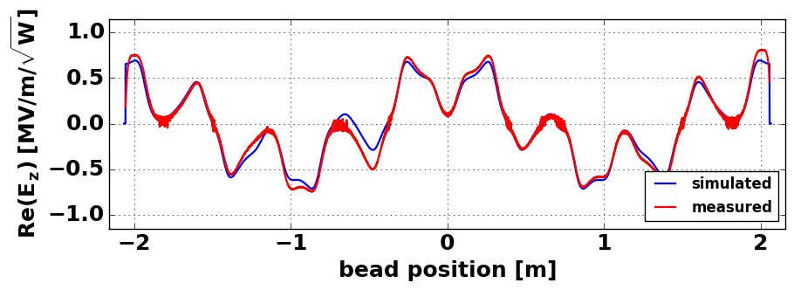
200 MHz Cavities - Future Measurements
Measurement of field flatness of the accelerating band using a bead-pull setup
Tuning test of all single sections (One in BAF3 is detuned)
Confirmation of improved HOM damping using complex loads and resonant posts
200 MHz Band Bead-pull
630 MHz Band Bead-pull

