Slide 1
SPS RF manipulations
LIU-SPS Beam Dynamics Working Group, 2019-03-28
G. Papotti
acks: T. Bohl, E. Shaposhnikova

Slide 2
outline
introduce 3 manipulations:
RF gymnastics by phase jump
bunch rotation by non-adiabatic voltage step
long/short debunching, recapture
focus on motivation & pre-LS2 implementation
(specs for LIU-SPS RF LL under discussion)

Slide 3
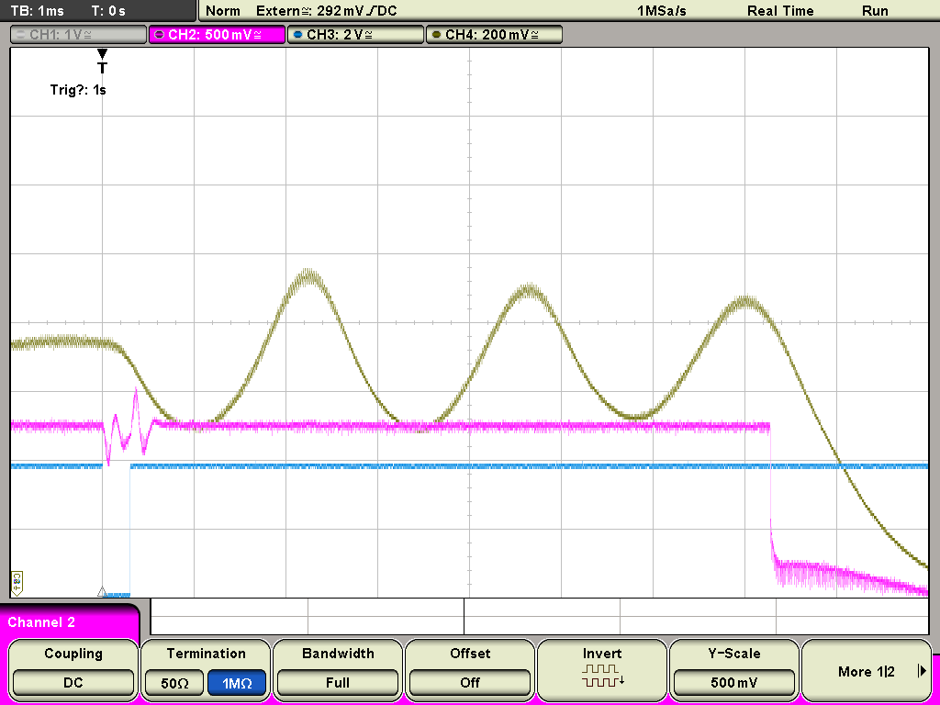
phase jump for Fixed Target
motivation: slow extraction for pFT, iFT
NA experiments need constant spill (during and across cycles)
increase dp/p, flatten dp/p distribution, and debunch
manipulation sequence:
phase jump to unstable phase
jump back to standard, stable phase, after t₁
1. and 2. to increase and flatten dp/p
turn RF off (after t₂) for debunching
setting up
optimize t₁ for max peak (typ ~20 turns)
adjust t₂ to turn RF off at peak (typ ~2.3 ms)
hw: 360 deg phase discriminator + inverting ampli.
peak det
Vtot
inv ampli pol
RF off
t₂
t₁

Slide 4
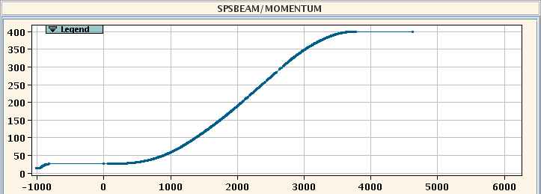
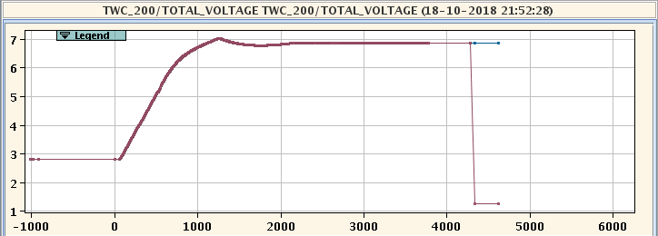
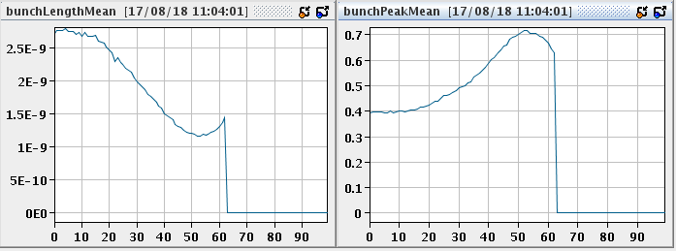
non-adiab voltage step for pAWK
motivation: short bunch at extraction for AWK
hw did not allow for phase jump
manipulation: non-adiabatic voltage step
use pulse generator
synchronized with extraction, thus AWAKE
synch to f_{rep}, precision better than one turn
risetime ~1 ms, amplitude V_{tot} = 7.8 MV
lower voltage adiabatically first
800 MHz needs to follow
OP needs to toggle back and forth
trim voltage program & enable voltage pulse
could see total voltage on Oasis, not in LSA
extract

Slide 5
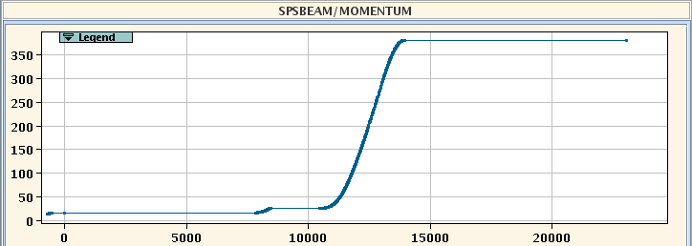
debunching, recapture
motivation: want a constant spill for iFT
4 equidistant bunches, to uniformly distributed in buckets
manipulation sequence (at interm. flat top)
turn RF off to allow debunching
then RF on to recapture
OP to toggle 3 timings for debunching
b-pulses off
all RF off
(ions prepare debunching, due to RFLL hw)
recapture is fixed and untouched by OP
2 pairs of cavities at a time, 1 ms apart

Slide 6
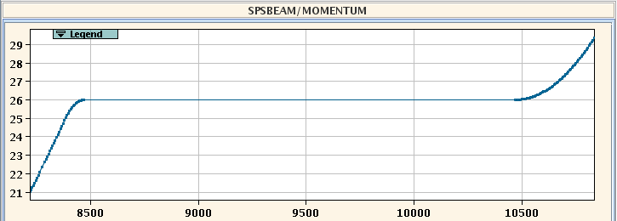
long vs short debunching
motivation:
long debunching (ld): standard for physics operation
short debunching (sd): for OP to setup the rest of the cycle (orbit, tune, …)
implementation
change the same 3 timings, to different delays
minimum differences in setup
post LS2: is “no debunching” an option?
RF off (ld)
RF off (sd)
RF on

