Slide 1
Post-LS2 flat-bottom simulations in Q20 and Q22 optics
M. Schwarz
Acknowledgements:
A. Farricker, K. Iliakis, A. Lasheen, J. Repond, E. Shaposhnikova, H. Timko, BLonD dev team
LIU-SPS BD WG meeting 19/02/21

Slide 2
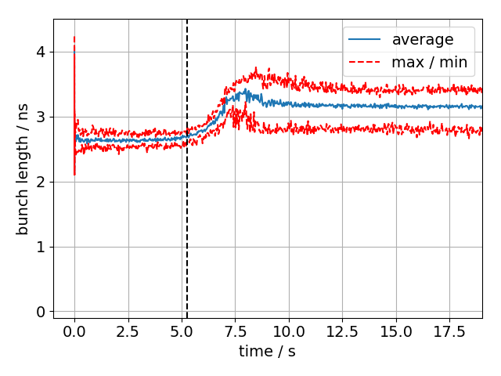
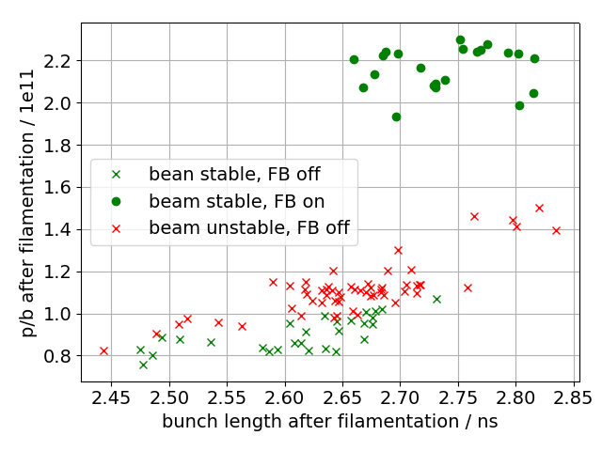
Motivation:
Instability observed on SPS flat bottom
Main driving impedance are the 200 MHz TWCs
Will bunches be stable on flat bottom post-LS2?
Simulations needed
start of instability
Outline:
Benchmarking with measurements of 12 bunches
Post-LS2 simulations of 48 bunches in Q20 and Q22
Summary
LIU-SPS BD WG meeting

Slide 3
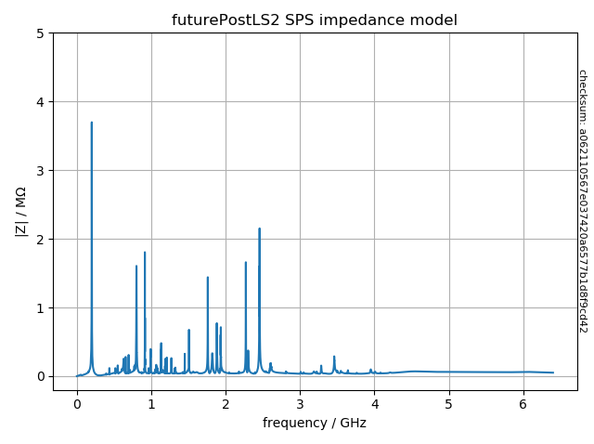
Simulation setup for BLonD
Initial bunches are obtained by simulating bunch rotation in the PS (no intensity effects)
2 million macro-particles per bunch
Simulating 432000 turns (10s cycle)
Use full SPS impedance model
Model 200MHz TWC feedback by ‘impedance reduction’
Phase loop (averages over all bunches)
post-LS2 impedance
Computation time:
Lxplus: ~1day (… but can run ~1000 jobs in parallel)
BLonD MPI version: 1hour (see presentation by Konstantinos) (… but cluster can only run ~30 jobs in parallel) (… small differences due to different FFT algorithms used)

Slide 4
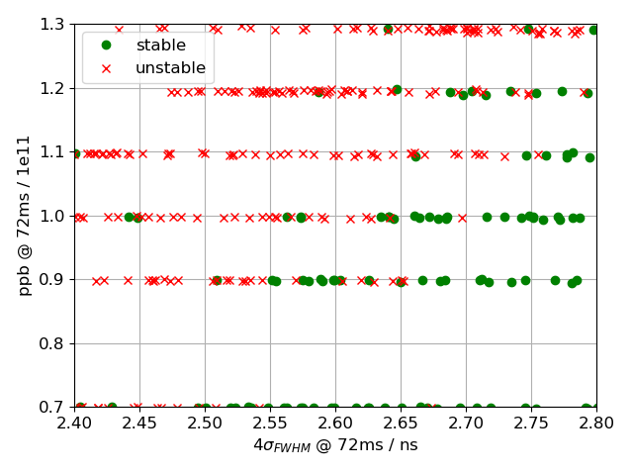
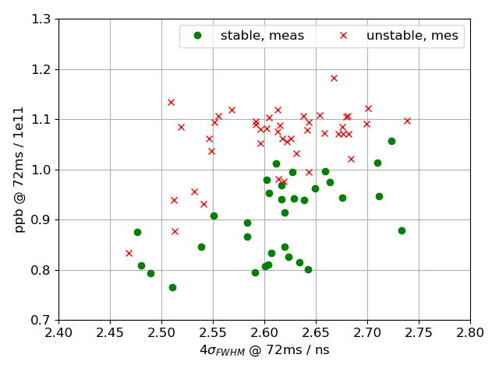
Comparison with measurements after filamentation
12 bunches, Q20
V₂₀₀ = 4.5MV, V₈₀₀ off; FB off, FF off, LD off, PL on
Previous simulations had incorrect 630 MHz HOM damping due to bug
Reasonable agreement with measurements, but simulations give larger threshold

Slide 5
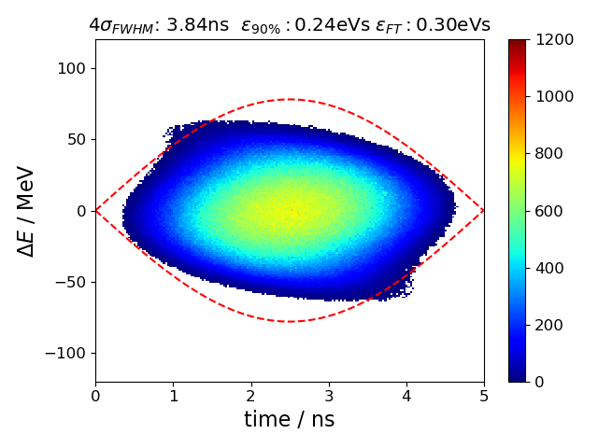
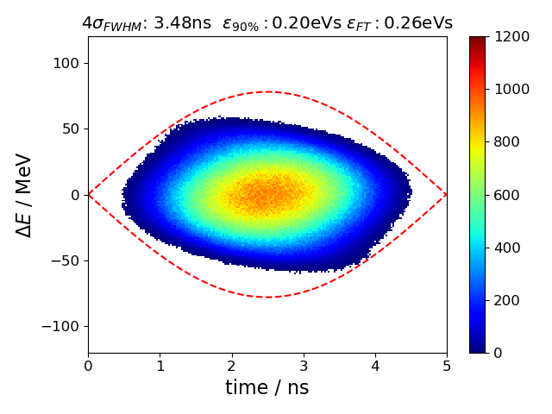
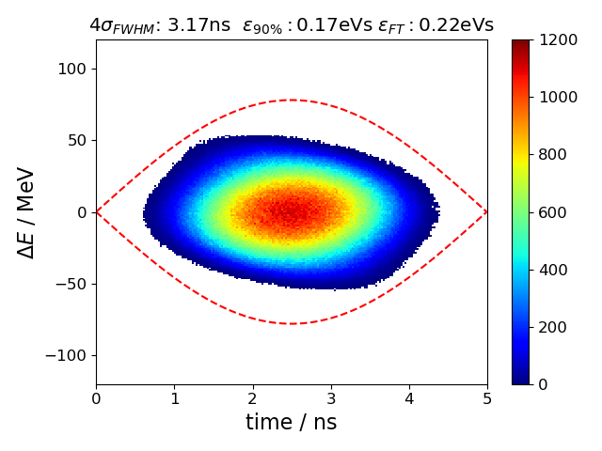
Parameters for post-LS2 SPS simulations
Nominal emittance
15% reduced emittance
30% reduced emittance
48 bunches, 2.6e11 ppb, 25ns spacing, 10s of flat bottom
Q20 or Q22 with V₈₀₀/V₂₀₀ = 0 or 10%
New 200 MHz TWCs configuration (two 4-section, four 3-section)
SPS impedance model after impedance reduction (HOM, vacuum flanges)
Increased feedback strength (-26dB compared to -15.5dB)
Improved phase loop (averaging over all bunches, not only first 12 as now)

Slide 6
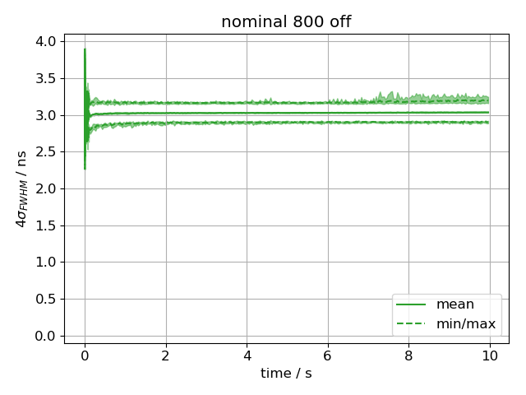
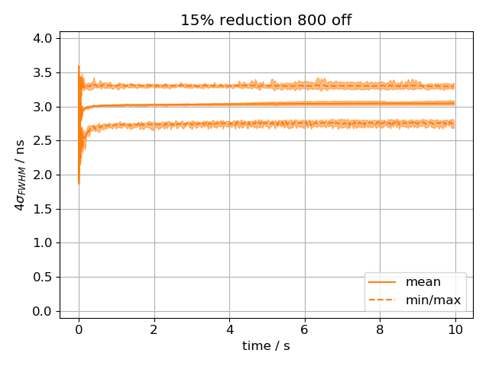
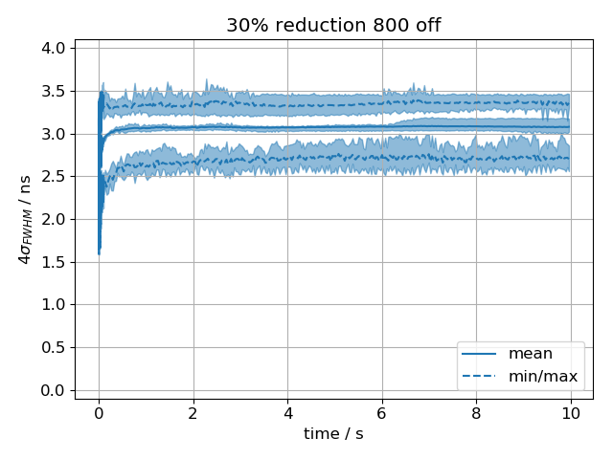
Simulated bunch lengths in post-LS2 SPS; Q20
Nominal emittance
~15% reduced emittance
~30% reduced emittance
shaded region indicate range for different seeds
Beams show no strong instability (no increase in mean bunch length)
Individual bunches become unstable (increase in maximum bunch length); especially for very low emittance
Final mean bunch length is 3ns in all cases

Slide 7
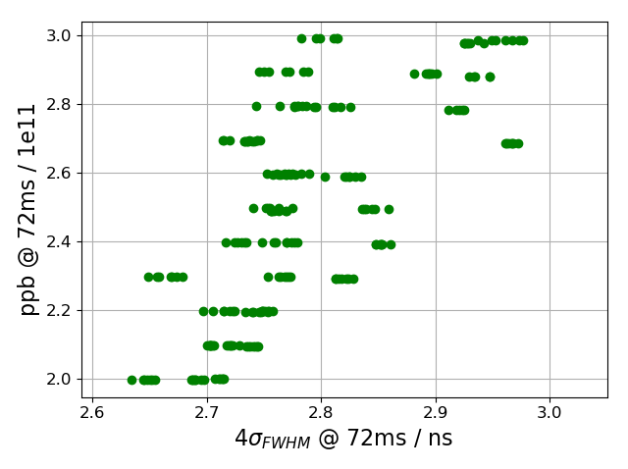
Simulated instability threshold in post-LS2 SPS; Q20
48 bunches, 25ns spacing, Q20, vary bunch intensity
No strong instability found up to 3.0e11 ppb, even for very low emittance bunch!

Slide 8
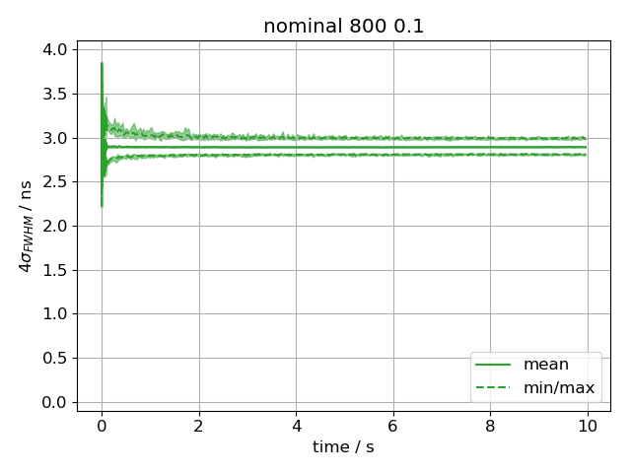
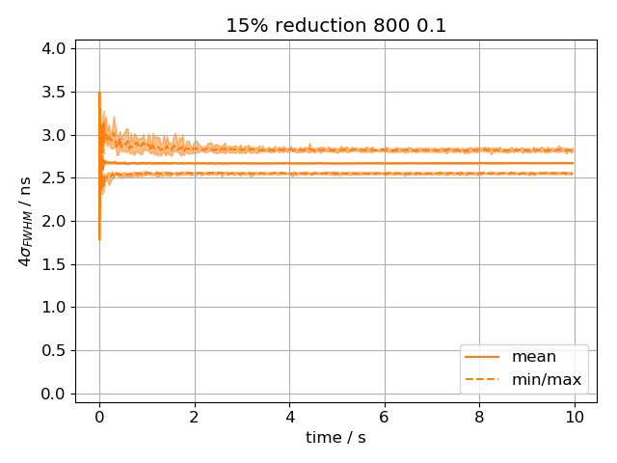
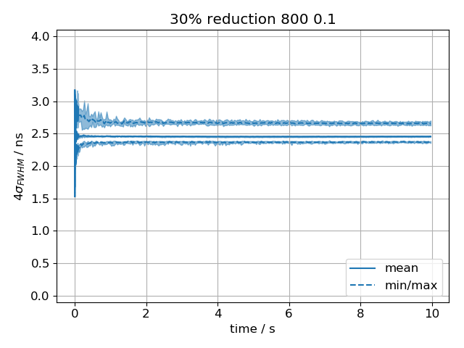
Simulated bunch lengths in post-LS2 SPS; Q20; V₈₀₀ at 10%
Nominal emittance
~15% reduced emittance
~30% reduced emittance
With V₈₀₀ at 10%, all bunches are stable
Smaller mean bunch length for smaller emittances

Slide 9
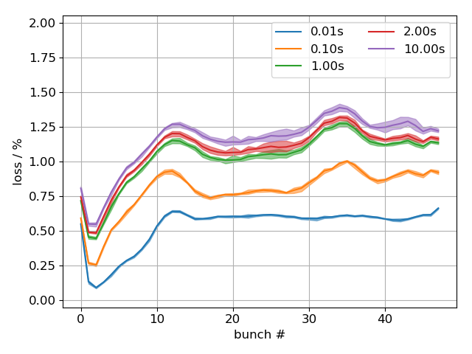
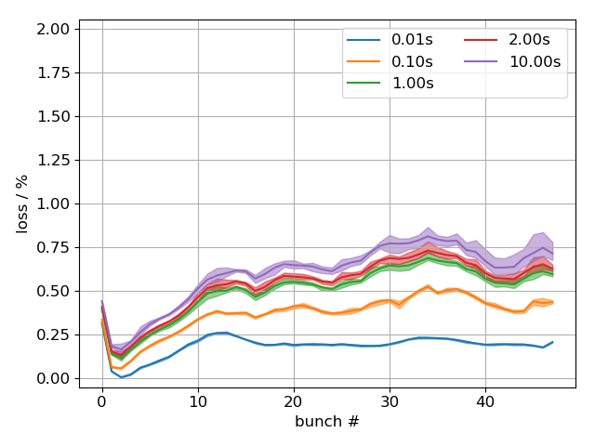
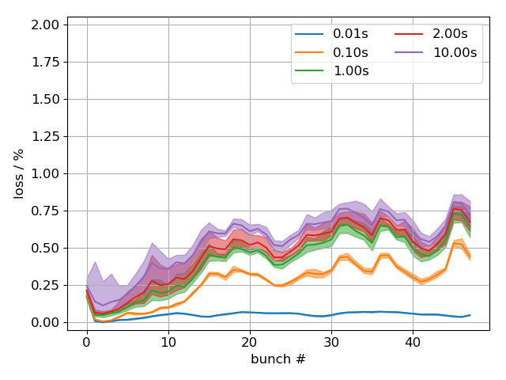
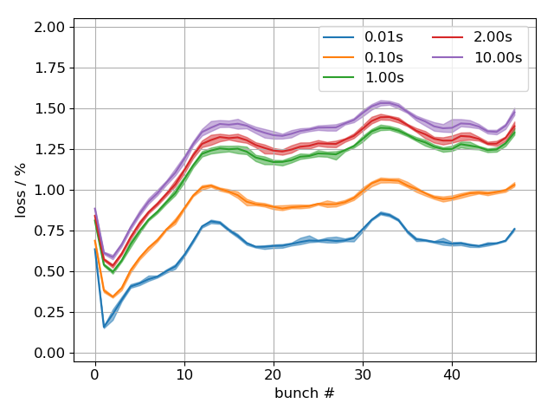
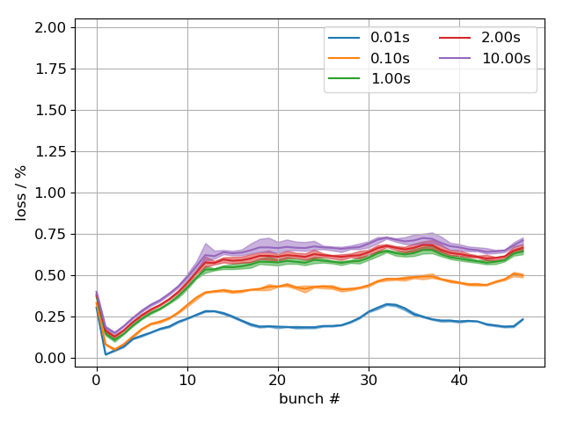
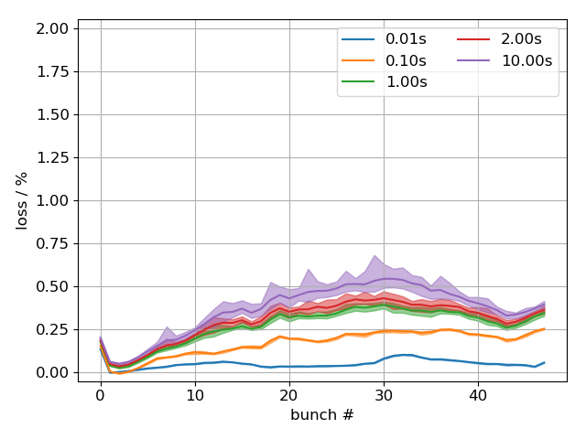
Bunch-by-bunch losses in post-LS2 SPS; Q20
nom ε, 800 off
15% red ε, 800 off
30% red ε, 800 off
nom ε, 800 at 10%
15% red ε, 800 at 10%
30% red ε, 800 at 10%

Slide 10
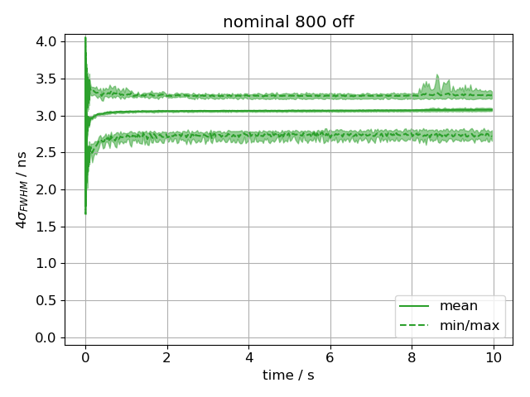
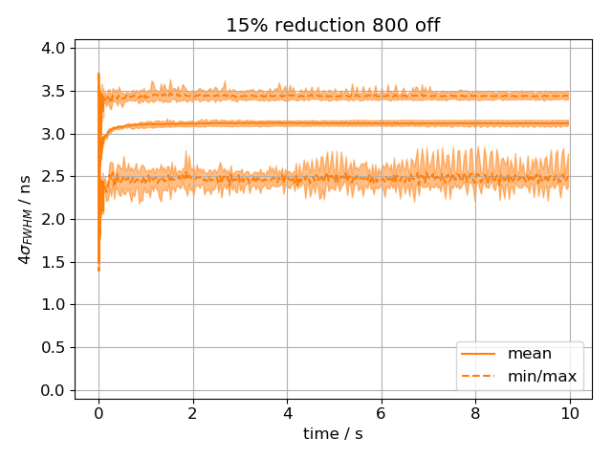
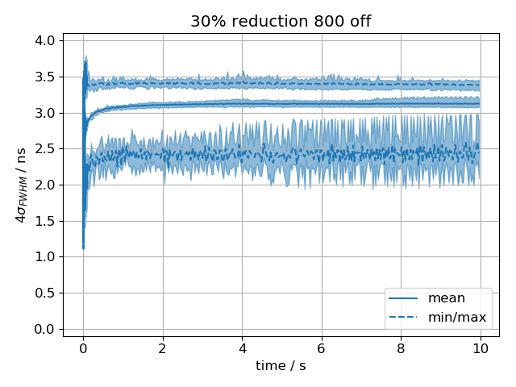
Bunch lengths in post-LS2 SPS; Q22
Nominal emittance
~15% reduced emittance
~30% reduced emittance
Simulated with V₂₀₀ = 3.6MV
In Q22, individual bunches are unstable for all three emittances…

Slide 11
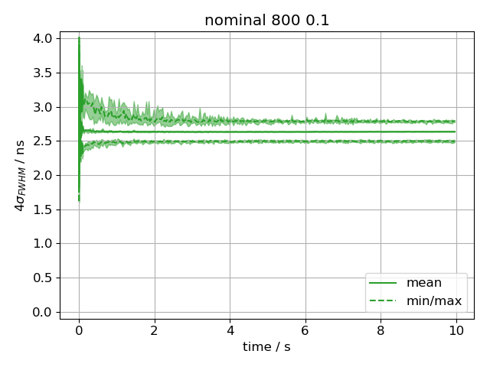
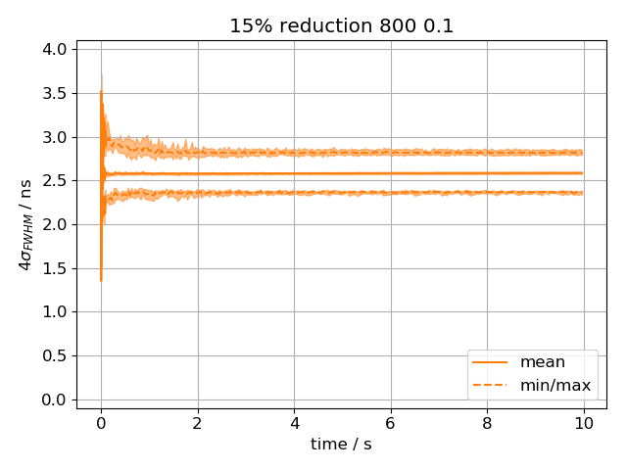
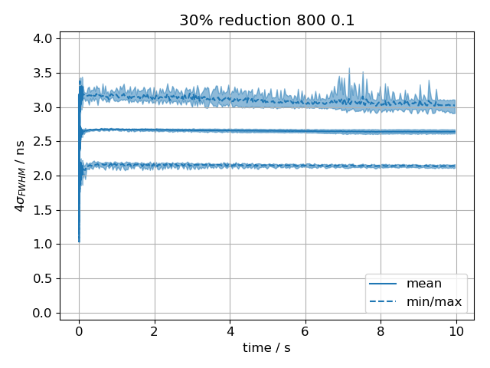
Simulated bunch lengths in post-LS2 SPS; Q22; V₈₀₀ at 10%
nom ε, 800 at 10%
15% red ε, 800 at 10%
30% red ε, 800 at 10%
… with V₈₀₀ at 10% helps for nominal and 15% reduced emittance, but not for very low emittance

Slide 12
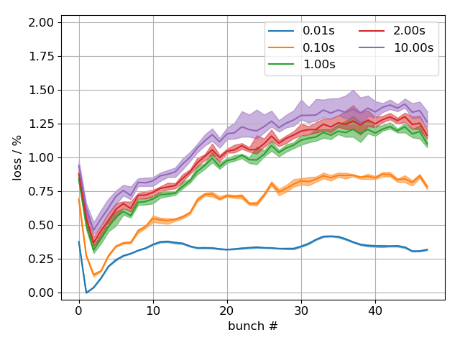
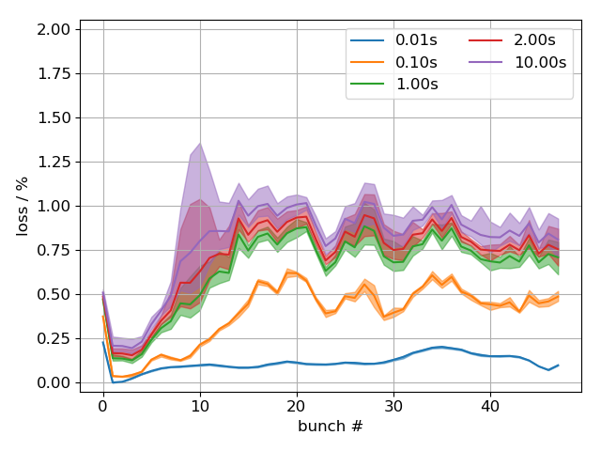
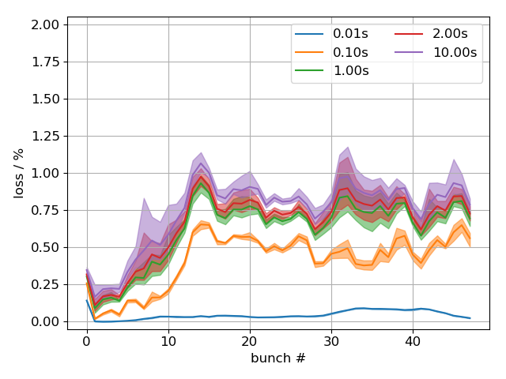
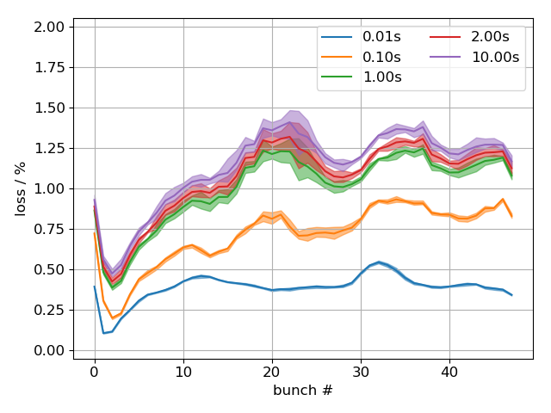
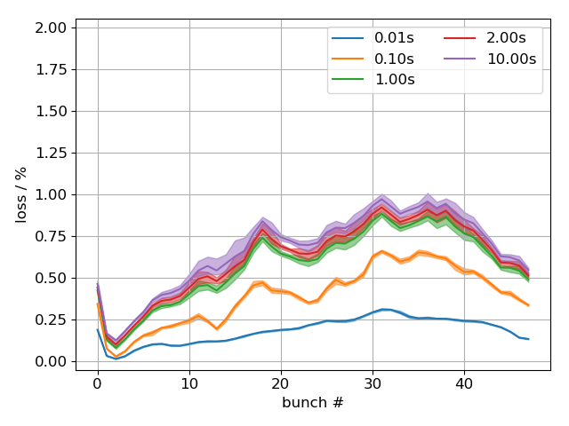
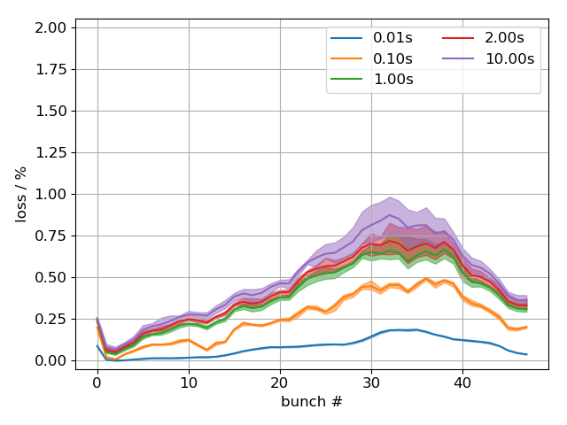
Bunch-by-bunch losses in post-LS2 SPS; Q22
nom ε, 800 off
15% red ε, 800 off
30% red ε, 800 off
nom ε, 800 at 10%
15% red ε, 800 at 10%
30% red ε, 800 at 10%

Slide 13
Summary
Simulated instability threshold for 12 bunches and no FB shows reasonable agreement with measurements, but simulations give larger threshold
For post-LS2 parameters, simulations of 48 bunches show no strong instability threshold in Q20 (i.e. no increase in mean bunch length)
Instability of individual bunches can be cured by using V₈₀₀ at 10% for Q20 for all three emittances
In Q22, bunches remain unstable (for lowest emittance) even when using V₈₀₀ at 10%
Next steps
For 200 MHz TWCs, include frequency shift of fundamental frequency due to HOM couplers
For comparison with measurements, use simulated distributions that match measured injected bunch profiles on a bunch-by-bunch basis
Revisit of synchronous phase shift measurements and simulations…
Thank you for your attention!

Slide 14
Appendix

Slide 15
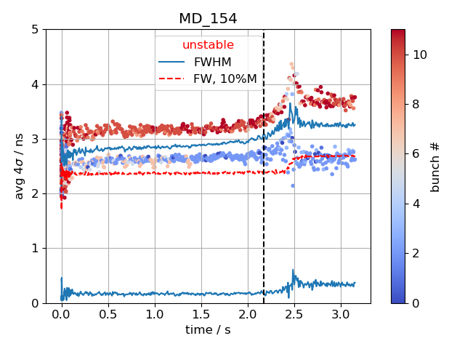
Criterion for (strong) instability
Beam unstable: Average bunch length exceeds threshold bunch length ${\left\langle 4σ\right\rangle }_{bunches}>τ_{th}$
Threshold bunch length is maximum bunch length after filamentation $τ_{th}={\left\langle \max{4σ}\right\rangle }_{40ms…100ms}$
Same criterion used for measured and simulated data
$$τ_{th}\sim 3ns$$

Slide 16
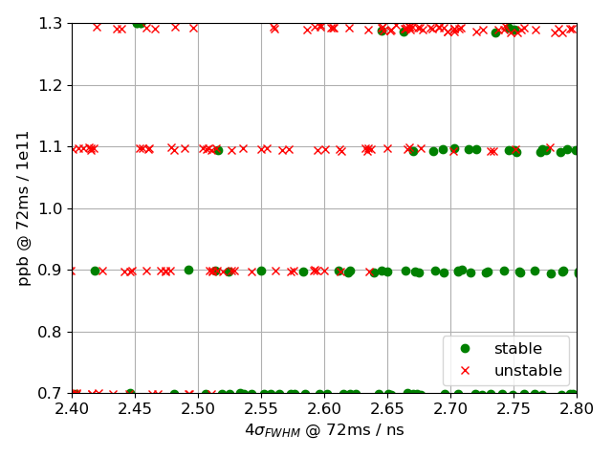
Comparison with measurements
12 bunches, Q20; V₂₀₀ = 4.5MV, V800 off; FB off, FF off, LD off, PL on
Correct (or at least present model)
too much 630 MHz HOM damping
Correcting the 630 MHz HOM damping seems to lower threshold (simulations still ongoing)

