Slide 1
First results on 10s long flat-bottom simulations in the SPS
M. Schwarz
Acknowledgements:
K. Iliakis, A. Lasheen, E. Shaposhnikova BLonD development team
LIU-SPS BD WG meeting 19/01/17

Slide 2
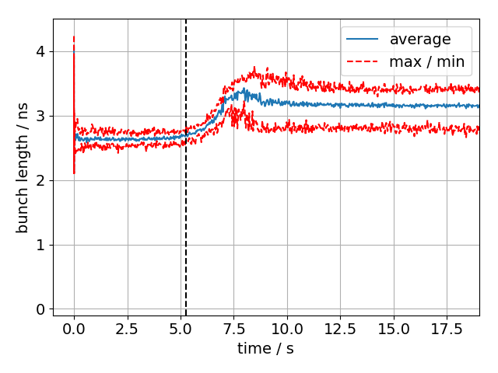
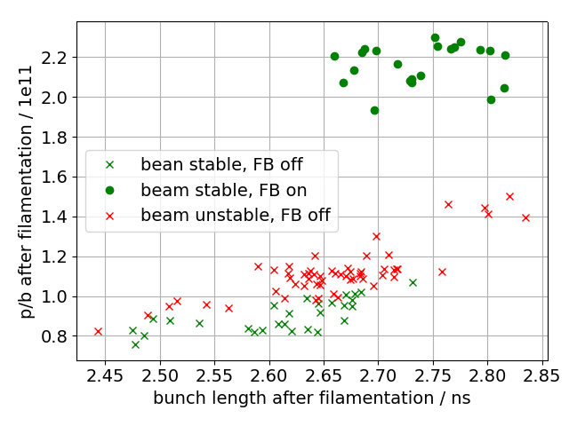
Motivation:
Instability observed on SPS flat bottom
Main driving impedance are the 200 MHz TWCs
Will bunches with LIU-like parameters be stable on flat bottom?
Simulations needed
start of instability
LIU-SPS BD WG meeting

Slide 3
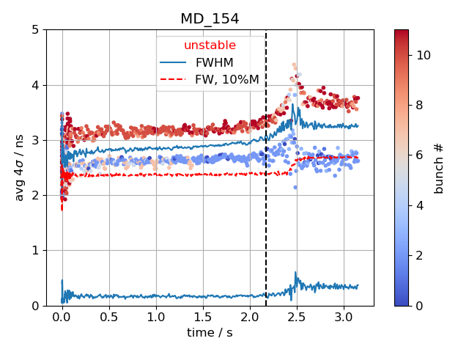
Criterion for instability
Beam unstable: Average bunch length exceeds threshold bunch length ${\left\langle 4σ\right\rangle }_{bunches}>τ_{th}$
Threshold bunch length is maximum bunch length after filamentation $τ_{th}={\left\langle \max{4σ}\right\rangle }_{40ms…100ms}$
Same criterion used for measured and simulated data
$$τ_{th}\sim 3ns$$

Slide 4
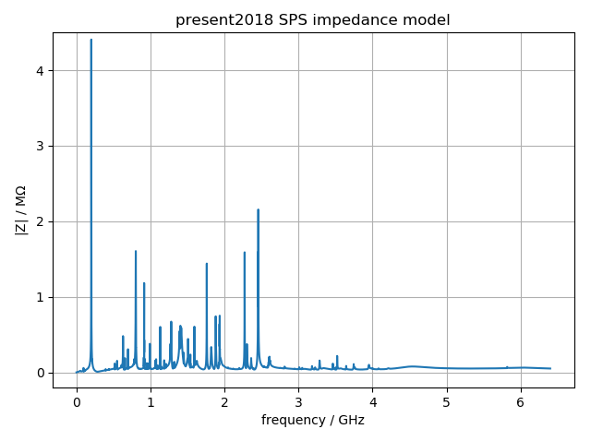
Simulation setup for BLonD
12 bunches (for now)
Initial bunches are obtained by simulating bunch rotation in the PS (no intensity effects)
2 million macro-particles per bunch
Simulating 432000 turns (10s cycle)
Use full SPS impedance model
Model 200MHz TWC feedback by ‘impedance reduction’
Phase loop averages over first 12 bunches
commit 18/12/21
Computation time:
Lxplus: ~1day (… but can run ~1000 jobs in parallel)
BLonD MPI version: 1hour (big ‘thanks’ to Konstantinos!) (… but cluster can only run ~30 jobs in parallel) (… small differences due to different FFT algorithms used)

Slide 5
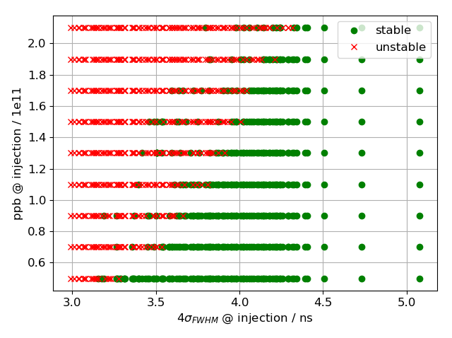
Simulated threshold
12 bunches, Q20
V200 = 4.5MV, V800 off
FB off, FF off, LD off, PL on
116 initial distributions with different bunch profiles
Use these distributions with different intensities
Threshold observed in both bunch length and intensity
‘Transition region’ where some bunches are stable while others are stable

Slide 6
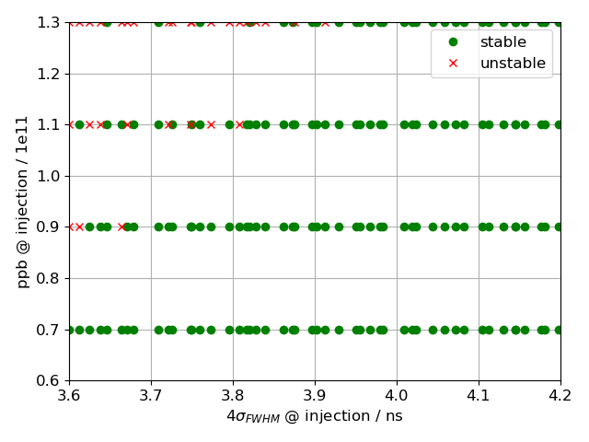
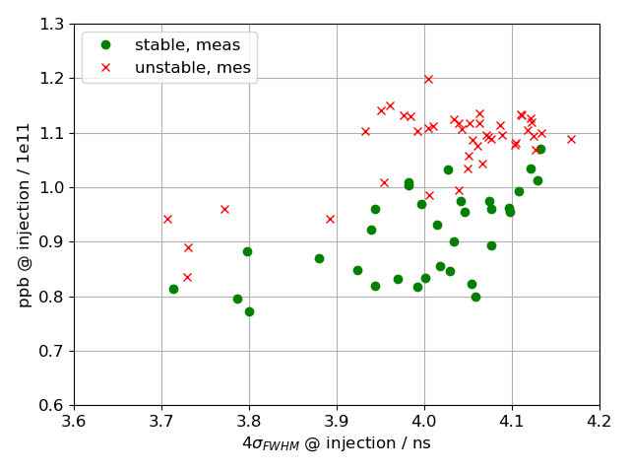
Comparison with measurements
12 bunches, Q20
V200 = 4.5MV, V800 off
FB off, FF off, LD off, PL on
Simulated bunches are more stable

Slide 7
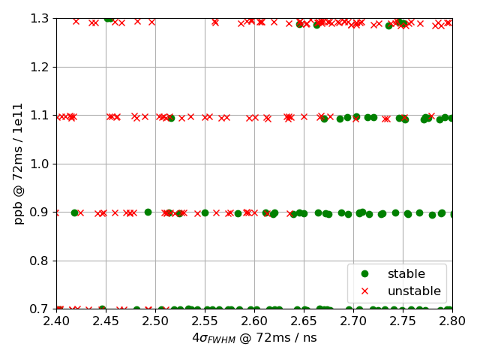
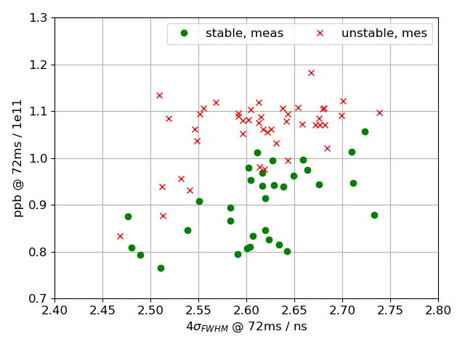
Comparison with measurements after filamentation
12 bunches, Q20
V200 = 4.5MV, V800 off
FB off, FF off, LD off, PL on
Better agreement when comparing bunches after filamentation

Slide 8
Summary
Using the MPI version of BLonD allows computation time to be reduced from approx. day to one hour!
Simulations show instability threshold, but more simulations are needed to better compare with measured threshold
Next steps
For comparison with measurements, use simulated distributions that match measured injected bunch profiles on a bunch-by-bunch basis
Simulate with feedback -> bunches should be stable
Simulate for post LS2 parameters
Thank you for your attention!

