Slide 1
Effect on beam stability of 200 MHz voltage reduction s a 17th of January 2019
LIU-SPS Beam Dynamics Working Group
J. Repond, E. Shaposhnikova

Slide 2
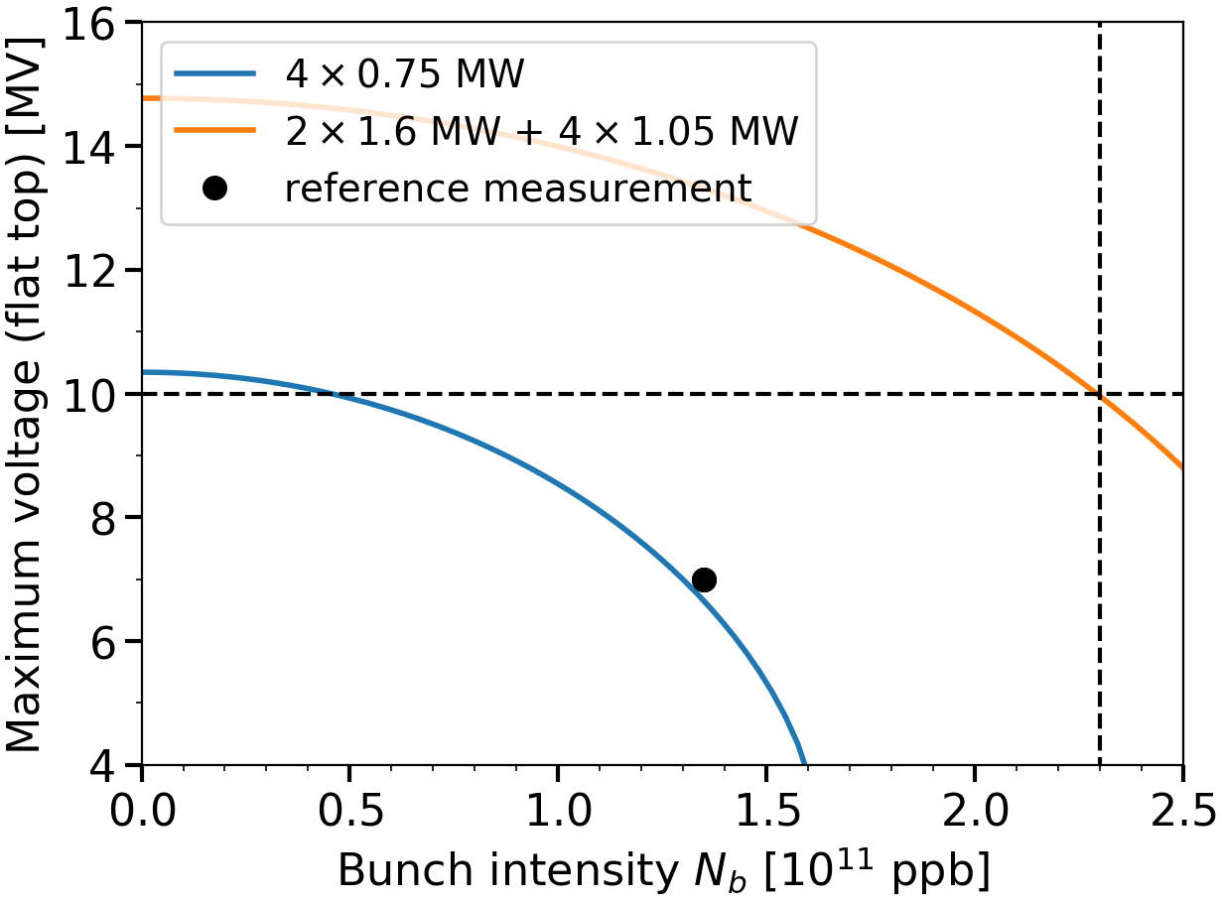
Maximum 200 MHz voltage before/after RF upgrade at SPS flat top (short bunches)
$V_{max}^{200}$ for present and future RF configurations
$V_{max}^{200}$ available defined by beam loading and RF power
Present: 4 x 0.75 MW
Future: 2 x 1.6 MW + 4 x 1.05 MW
$V_{max}^{200}=10$ MV assumed in stability threshold simulations
Beam loading at HL-LHC intensity ($N_{b}=2.4×{10}^{11}$ ppb) reduces this value
Some 630 MHz HOM damping schemes could reduce it too
Available voltage (10 MV) at${ N}_{b}=2.3×{10}^{11}$ ppb
$$2.3×{10}^{11}$$
The effect of a smaller $V_{max}^{200}$ on beam stability studied for the case when the new HOM damping scheme reduces the available 200 MHz voltage to 9 MV (min)

Slide 3
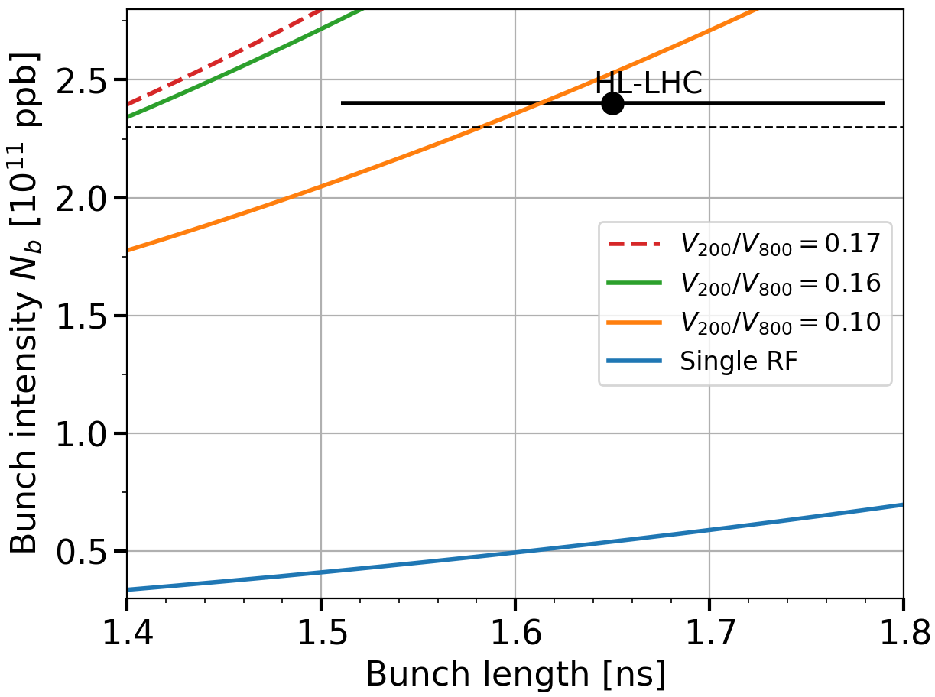
Stability threshold after LIU upgrades (RF, impedance) Effect of double RF operation with $V_{200}=10$ MV
Intensity thresholds of 72b. at SPS flat top
after RF upgrade and impedance reduction
Simulations of stability threshold with
72 bunches spaced by 25 ns
Single and double RF (BSM), $V_{200}=10$ MV
$V_{800}^{max}=1.6$ MV (1.7 MV if pulsed mode)
Impedance model with
-26 dB reduction by feedback (200 MHz)
QF flanges shielded (1.4 GHz)
Latest MKE model
630 MHz HOM damped by a factor of 3
The intensity threshold needs sufficient margins due to bunch length spread
Operational bunch length spread
In single RF the threshold is below the present nominal intensity ($1.15×{10}^{11}$ppb)
With nominal $V_{800}/V_{200}$ ratio r=0.1, no margins at HL-LHC intensity
The voltage ratio can be increased to gain sufficient margins
→ What is the effect of a lower 200 MHz voltage or less 630 MHz HOM damping?

Slide 4
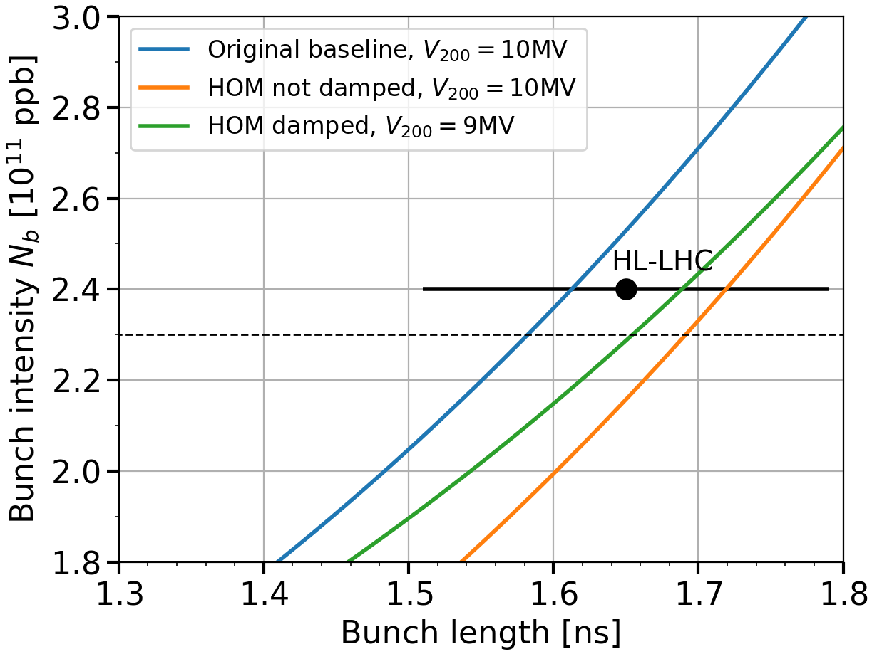
Effect of 630 MHz HOM impedance reduction on intensity threshold at flat top with $V_{800}/V_{200}$ $=0.1$
Intensity threshold at flat top
after RF upgrades, in double RF ($r=0.1$)
Two cases studied and compared to the initial model (impedance reduction, $V_{200}=10$ MV and r=0.1)
$V_{200}=10$ MV but the 630 MHz HOM is not damped
$V_{200}=9$ MV and the 630 MHz HOM is damped (factor 3)
For $V_{200}=10$ MV, the HOM damped by 3 increases the stability threshold by 20% (bunch length = 1.65 ns)
For 9 MV with HOM damping (factor 3), the gain in stability is around 10%
+20%
Full imp. reduction
+9%
With nominal voltage ratio (r=0.1), the intensity threshold is higher with the HOM damped ($V_{200}=9$ MV) than without HOM damping and $V_{200}=10$ MV

Slide 5
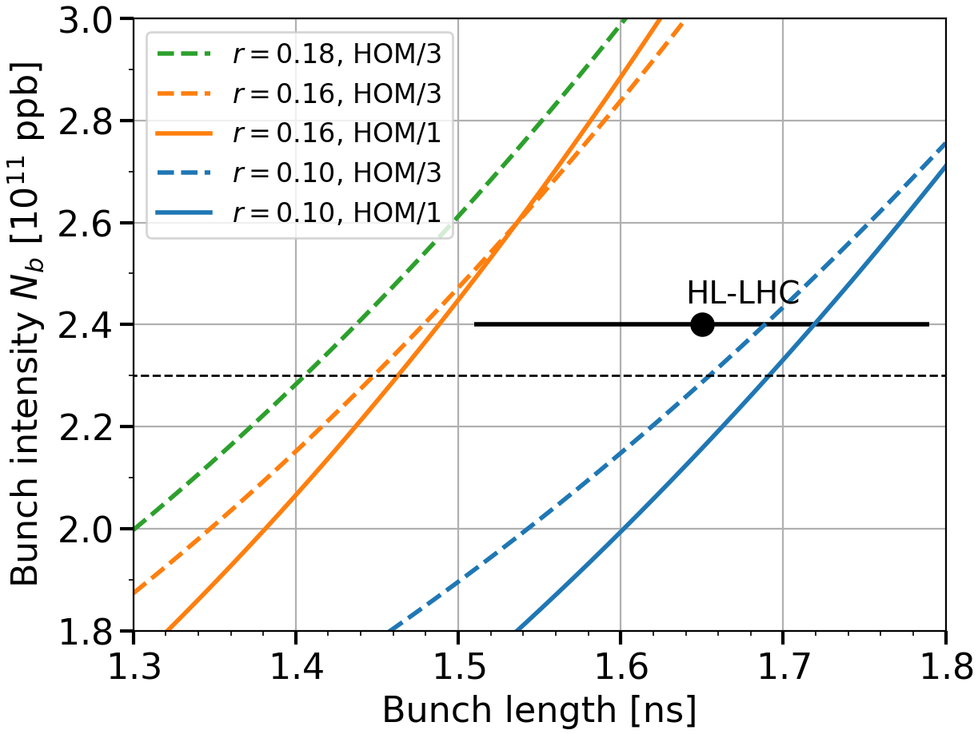
Effect of voltage ratio on stability threshold with/without HOM damping
Intensity threshold at SPS flat top in double RF,
effect of voltage ratio and HOM damping
At operational ratio (r=0.1), better beam stability with HOM damping but reduced $V_{200}$ (9 MV)
At larger voltage ratio (r=0.16), no significant difference between both configurations
A smaller $V_{200}$ for a fixed $V_{800}$ allows to increase the voltage ratio $r=V_{800}/V_{200}$
→ beam stability improved
HOM/1→ 10 MV
HOM/3 → 9 MV
→ At flat top, the HOM damping with a lower 200 MHz voltage (9 MV) gives more margins to the stability threshold. This result still has to be confirmed for the full acceleration cycle.

Slide 6
THANK YOU FOR YOUR ATTENTION!

Slide 7
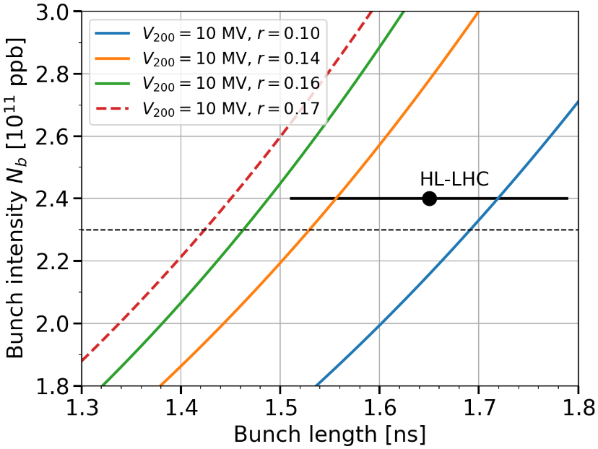
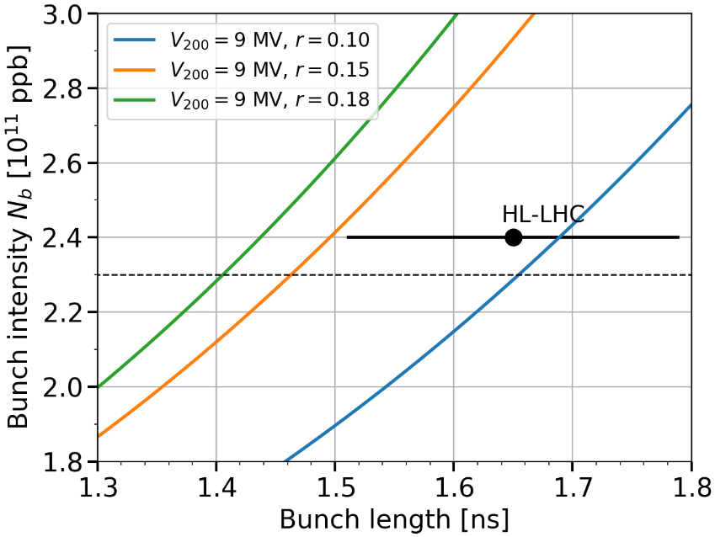
Intensity threshold at SPS flat top in double RF,
$V_{200}=10$ MV and HOM not damped
Intensity threshold at SPS flat top in double RF,
$V_{200}=9$ MV and HOM damped by 3

