Slide 1
Beam dynamics requirements after LS2
E. Shaposhnikova
LIU-SPS BD WG meeting
17.01.2019
With input from T. Argyropoulos, T. Bohl, G. Papotti and J. Repond

Slide 2
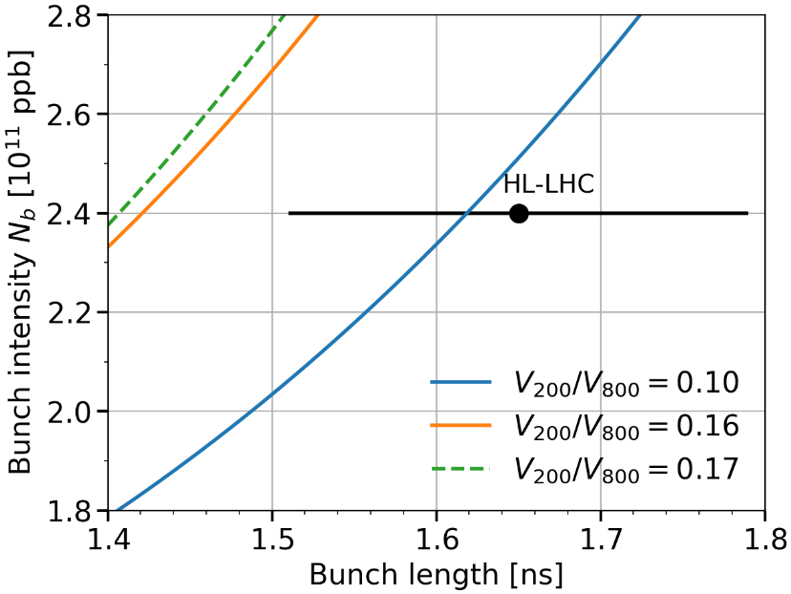
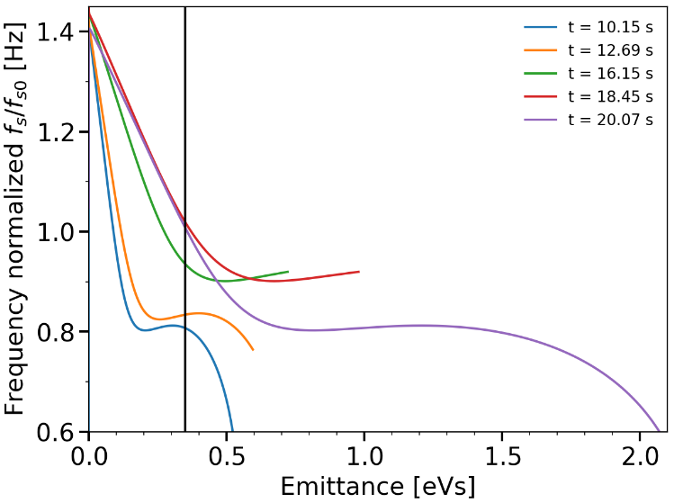
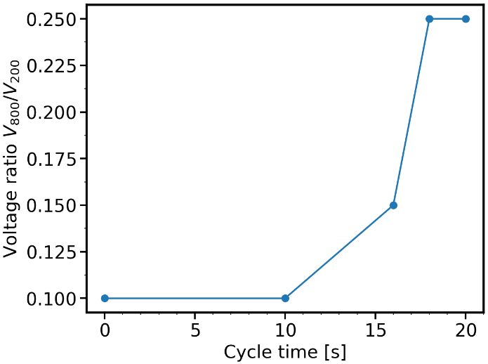
LHC protons
800 MHz RF power (-10% @cavity input): peak 240 (216) kW, average 160 (144) kW
→ pulsing at f_{rev} (< 80 kW w/o beam) helps to have max 800 MHz voltage
V₈₀₀ = 0.25 V₂₀₀
Optimum V₈₀₀/V₂₀₀
ratio during ramp
confirmed in MDs
Increasing V₈₀₀ helps to improve beam stability thresholds, …
but only towards the end of the ramp,
where the threshold is minimum
→ V₈₀₀/V₂₀₀ = 0.1 was used in operation till the end of 2018

Slide 3
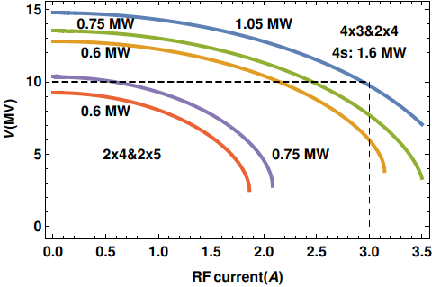
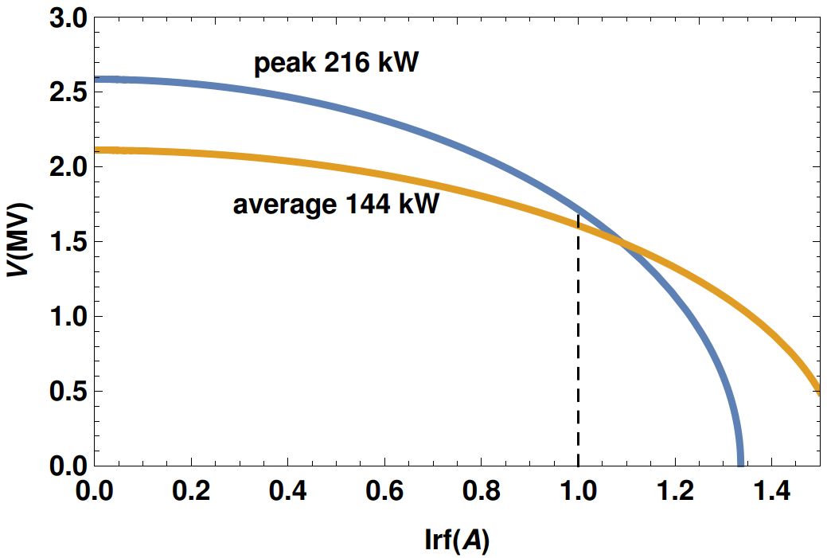
200 MHz and 800 MHz voltage available on the SPS flat top for different values of RF power
Total 200 MHz voltage for P₄=1.6 MW
Maximum total 800 MHz voltage (2 cav)
- For P₃ = 1.05 MW (with pulsing) V₂₀₀ = 10 MV → For voltage ratio of 0.25, max required V₈₀₀ = 2.5 MV
- For P₃ = 0.75 MW limitation is 2.2E11 ppb
For 2.4x10¹¹ ppb Irf = 1.0 A (g = 0.35) and Pb=120 kW → max V₈₀₀ = 1.7 MV for 216 kW and 1.6 MV for average 144 kW (at cavity input) without pulsing
→ ~ 30% missing to follow V₂₀₀ available after upgrade

Slide 4
LHC protons
LLRF loops
Phase and synchro-loops (& LD) adaptive for wide f_{s} ranges (Q20-Q26)
FS: switching from radial loop to synchro loop (or frequency loop) at start flat top for stabilizing the radial position before RF off (p FT, ions FT). Add “or before fast extraction for synchronization (e.g. LHC or AWAKE)”.
Optimum partition of RF voltage between 3- and 4-section cavities is a function of intensity and should be automatic in operation (ions, FT beam, HL-LHC beam)
Procedure for accurate 800 MHz phase calibration during whole cycle → additional increase of instability threshold in simulations for positive phase shifts. Needs to be done at each start-up and be repeated later during run.
Significant RF noise reduction for both 200 MHz and 800 MHz, especially on flat bottom, is required for particle loss reduction (already in FS)

Slide 5
Some remarks
No batch-by-batch voltage modulation at each injection of the PS proton batches is used anymore for LHC beam: was applied in the past in Q26 optics with too low matched injection voltage
- higher injection voltage for Q20 optics (and Q22)
- satellite bunches in LHC
Minimum proton batch spacing 200 ns achieved (not 225 ns), for LHC ions – 100 ns

Slide 6
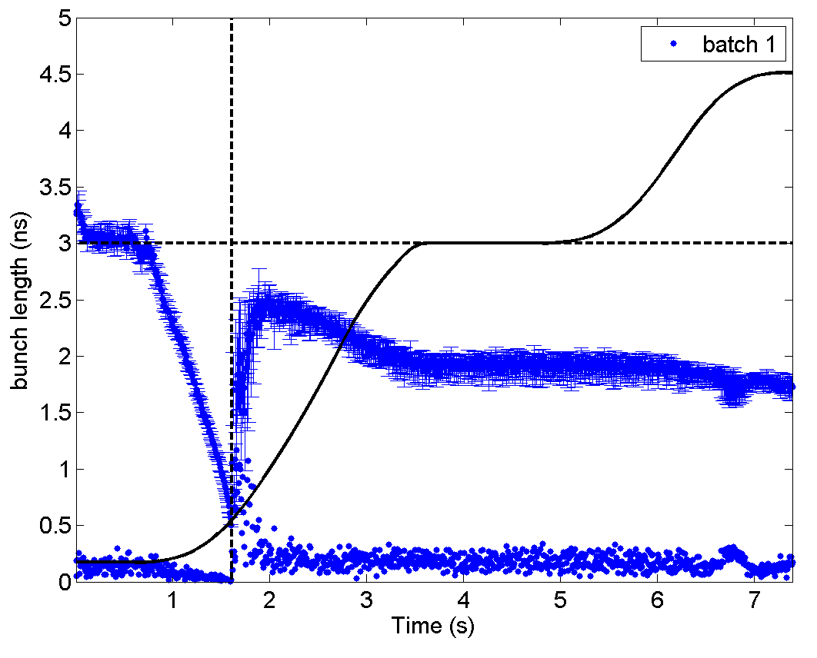
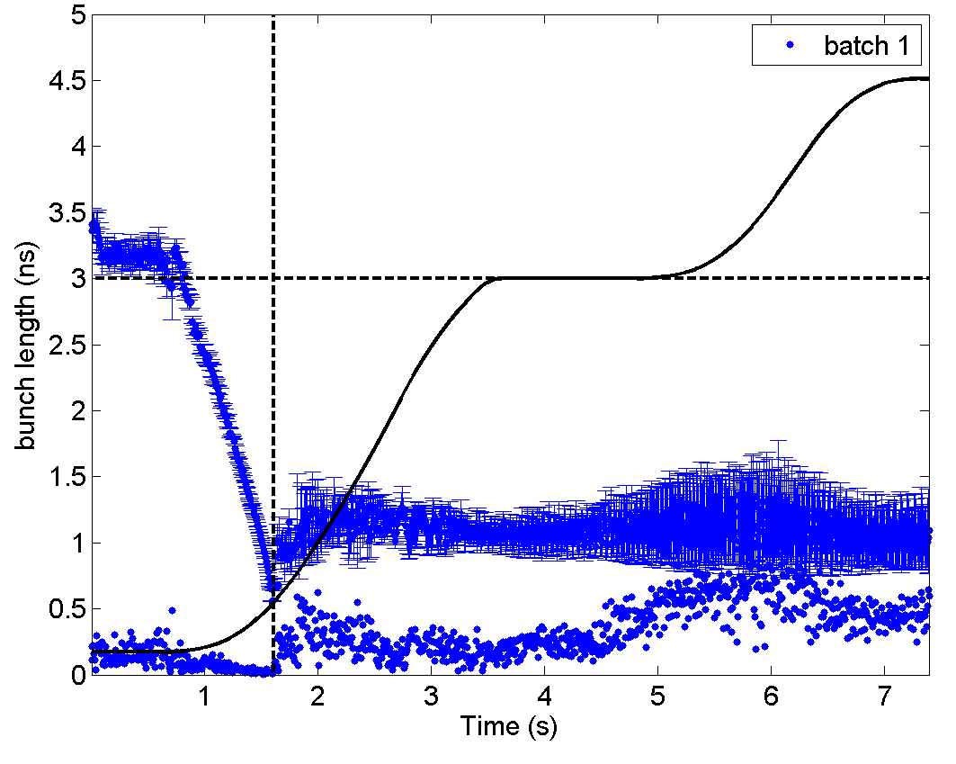
LHC ions
Improving transition crossing leads to smaller blow-up but beam becomes unstable later: instability is often starting at the 300 GeVZ/c (slip-stacking) plateau
Adjusted
transition
crossing
Bad transition,
not reproducible
More reproducible,
but unstable
MD Dec 2018 : one batch of 4 nominal bunches (~2.8E10 charges/bunch)

Slide 7
LHC ions
One-turn delay feedback for the 200 MHz RF: after slip-stacking beam intensity becomes comparable to the (low intensity) FT proton beam
Controlled emittance blow-up before transition crossing (in a single RF) using 200 MHz phase modulation. Large bunch-to bunch variation in intensity and bunch length – feasibility?
Use of the 800 MHz RF (above transition) - tested end 2018 (no effect). Separate control of two cavities (?) during slip stacking
RF noise reduction on flat bottom with fixed h (4653) avoiding FM&AM
Phase loop per beam (signal from “edge” bunches) during slip stacking
Fast voltage reduction between batches during slip stacking
Fast (~ T_{rev}) voltage step for bunch rotation at extraction

Slide 8
FT-type proton beam
FT beam is unstable during ramp, maximum available 200 MHz voltage is used during acceleration due to uncontrolled emittance blow-up and losses
Use of the 800 MHz RF (already in the functional specifications) can help to stabilise the beam
Controlled emittance blow-up may also be needed for beam stabilisation
Variable gain of 1-turn-delay feedback (from high intensity CNGS studies in 2005)
Individual capture of two PS batches (reduced injection voltage), also for FT-ions
Synchro- loop adaptive to f_{s} (like now for LHC beams)
The option to switch from synchro- to radial loop is also required before the start of the ramp, if the ramp is performed on the radial loop (as in case of transition crossing)
Keep an « extraction frequency loop » (as at present) that makes f_{RF} and f_{rev} available also after the RF is switched off, during slow extraction. Useful for exp. and beam observation
Use of longitudinal damper?

Slide 9
Controlled emittance blow-up
Remarks:
Controlled emittance blow-up was not practically used in operation during run2, after switching to the Q20 optics in the SPS
Attempts to apply controlled emittance in a single RF system (ions) were not successful and very difficult in a double RF with Q22 (protons)
Possible solutions:
Feedforward on bunch intensity and length (+ info from injected emittance and voltage program)?
Feedback on bunch length during BUP?
Use of 800 MHz (phase modulation)?

