Slide 1
Update on the SPS 80 MHz RF system evaluation s 6th of June 2018
LIU-SPS Beam Dynamics Working Group
J. Repond, E. Shaposhnikova
Acknowledgements: A. Lasheen, H. Damerau, G. Papotti, BLonD dev. team.

Slide 2
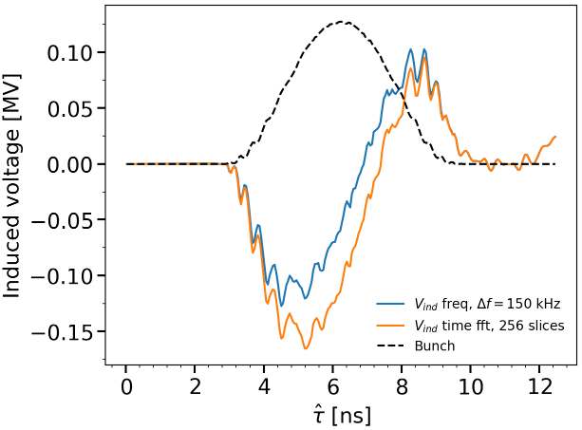
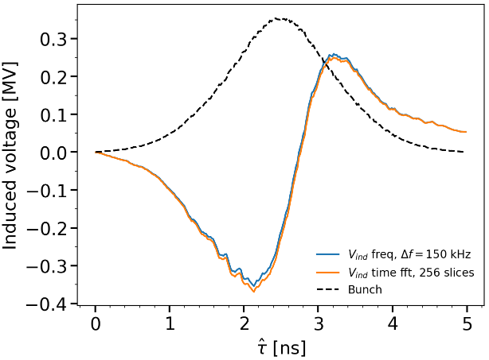
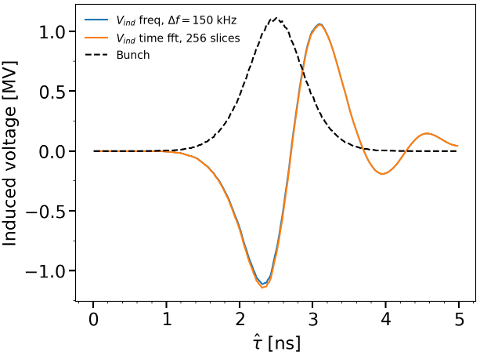
Problem in previous simulations (last meeting) – Lack of accuracy in $V_{ind}$ calculation
Induced voltage computed in general (in SPS) in time domain with 256 bins per RF bucket
→ Finally not optimal for the 80 MHz RF system
Blue : Induced voltage computed in frequency domain with $Δf=150$ kHz
Orange : Induced voltage computed in time domain with 256 slices per RF bucket
Induced voltage time vs frequency
80 MHz RF system flat bottom
Induced voltage time vs frequency
200 MHz RF system flat bottom
Induced voltage time vs frequency
200 MHz RF system flat top
After investigation, due mainly to lake of resolution at high frequency for broad-band impedance (kickers)
→ Direct solution: Solve everything in frequency domain with enough accuracy for the narrow-band peaks (150 kHz)

Slide 3
Potential issues with the 80 MHz
Acceleration of larger emittance bunches in 200 MHz (needed for beam stability in PS if no Landau system installed in PS)
SPS acceptance limited by available power and beam-loading
Lower beam stability due to lower harmonic number
→ 200 MHz as a Landau cavity, but
Residual $V_{200}$ difficult to control to a low level → 6 ns bunch length from the PS but not guaranteed
Instabilities recently observed on flat bottom not fully understood and the 800 MHz RF was not very helpful
Re-bucketing in the 200 MHz RF system
Potential reduction of losses only if related to bunch shape due to PS bunch rotation
Large 80 MHz voltage for re-bucketing in 200 MHz
Creation of satellite bunches if PS bunch has large tails → harmful for LHC
Impedance and beam-loading in the new RF system
Effect on beam stability during the rest of the cycle
Not treated here, requires a dedicated study

Slide 4
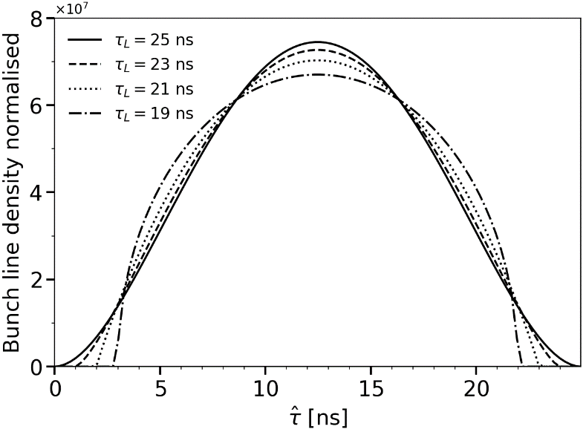
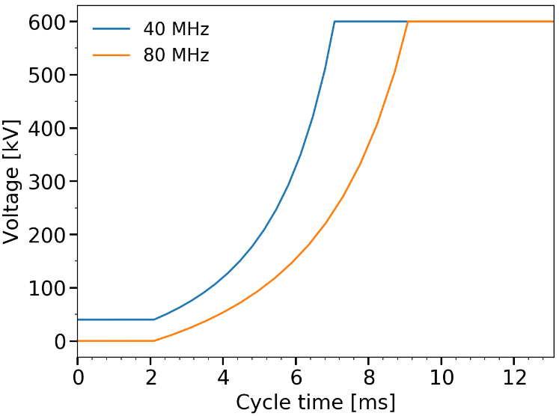
Bunch distribution in PS and RF program
Bunches are generated
At PS flat top with $V_{40}=50$ kV, $V_{80}=0$ kV
According to their line density (binomial) using the Abbel transform for phase space generation
With different tails for a given emittance
Bunches are simulated
At PS flat top (26 GeV)
Without intensity effects
With an RF program for adiabatic bunch length reduction
Binomial line density
$$λ\left(τ\right)=λ_{0}{\left[1−4{\left(\frac{τ}{τ_{L}}\right)}^{2}\right]}^{μ}$$
$$λ\left(\left|τ\right|>\frac{τ_{L}}{2}\right)=0$$
Normalised bunch line density for 0.5 eVs emittance
and different extension of bunch tail ($τ_{L}$)
RF Program
adiabatic bunch length reduction at PS flat top

Slide 5
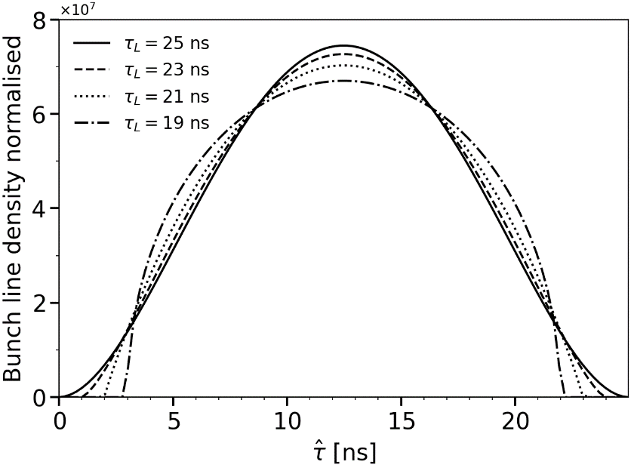
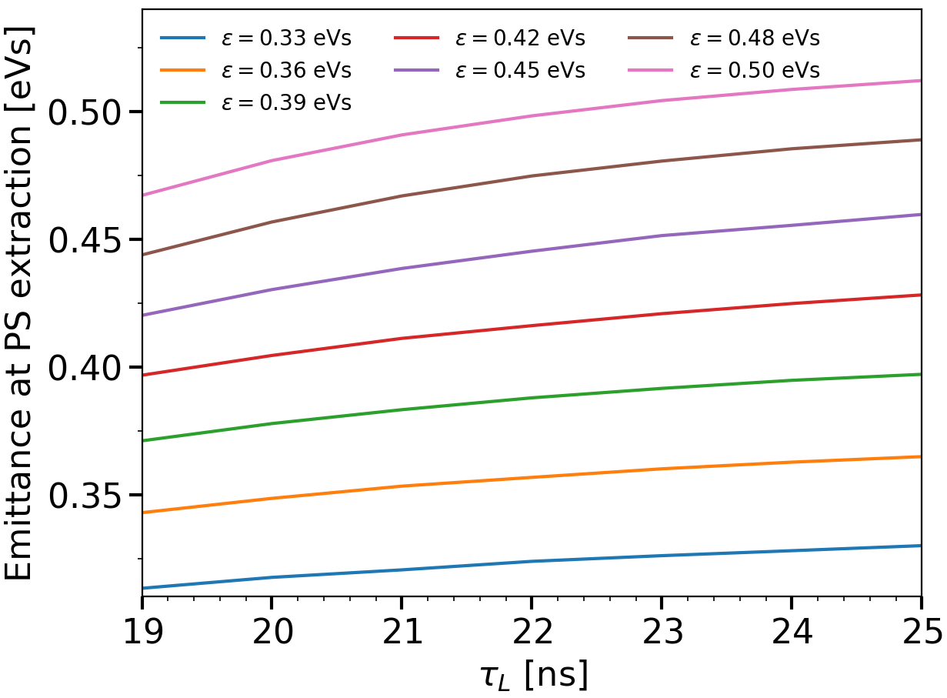
Bunch emittance at extraction to the SPS
Emittance computed for an unperturbed hamiltonian, containing 95% of particles
Normalised bunch line density for 0.5 eVs emittance
Different bunch tail assumptions
Emittance at extraction for different bunch tails ($τ_{L}$)
Emittance at extraction weakly dependent on bunch tail assumptions
Bunches labelled by average emittance over all $τ_{L}$
Emittance between 0.33 eVs and 0.5 eVs

Slide 6
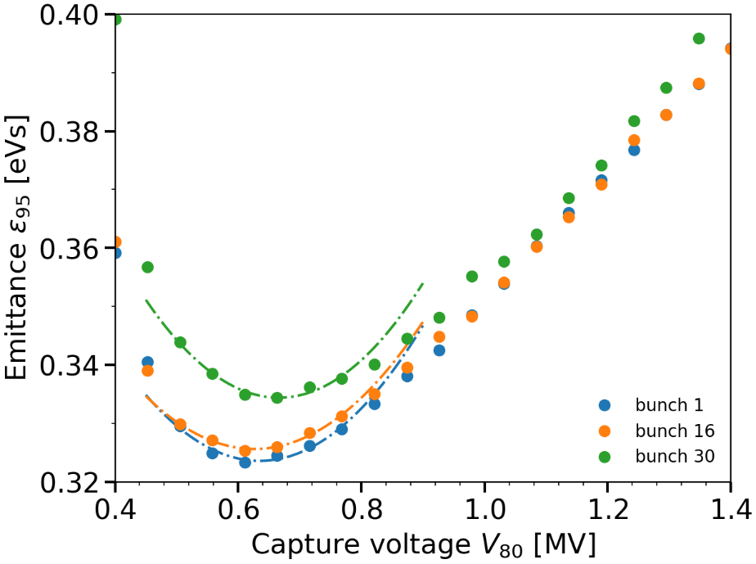
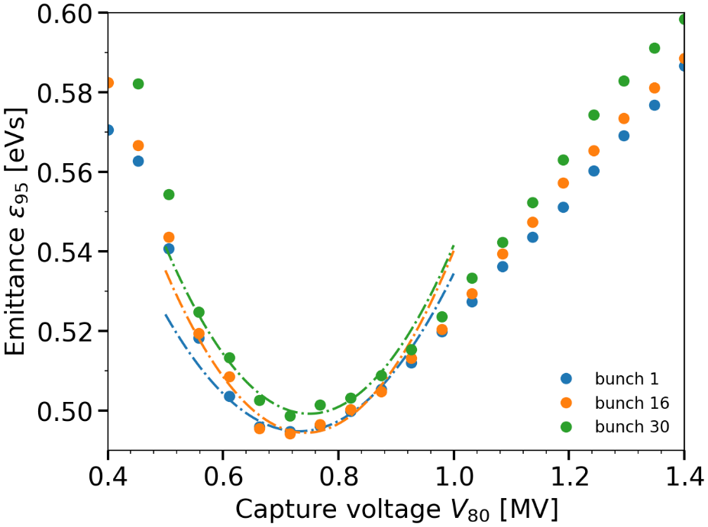
Minimisation of uncontrolled emittance blow-up in SPS – PS bunch distributions
Intensity: $N_{b}=2.4×{10}^{11}$ ppb
RF systems: 80 MHz + 200 MHz in bunch-shortening mode
Emittance after filamentation in SPS in function of $V_{80}$ at capture
$$ε_{PS}=0.33 eVs, τ_{L}=20 ns$$
Emittance after filamentation in SPS in function of $V_{80}$ at capture
$$ε_{PS}=0.5 eVs, τ_{L}=20 ns$$
Due to beam-loading (200 MHz), the last bunch have a larger emittance after filamentation
→ $V_{80}∈\left(0.7,0.8\right)$ MV to minimise the uncontrolled emittance blow-up of the last bunch

Slide 7
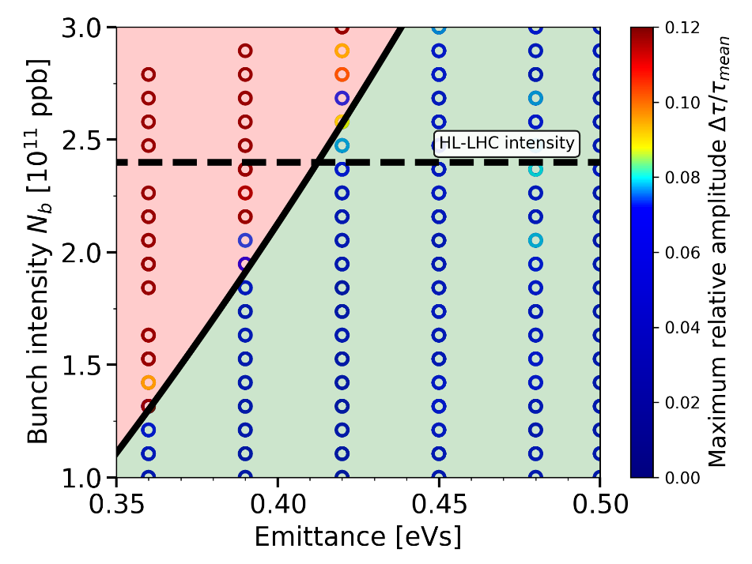
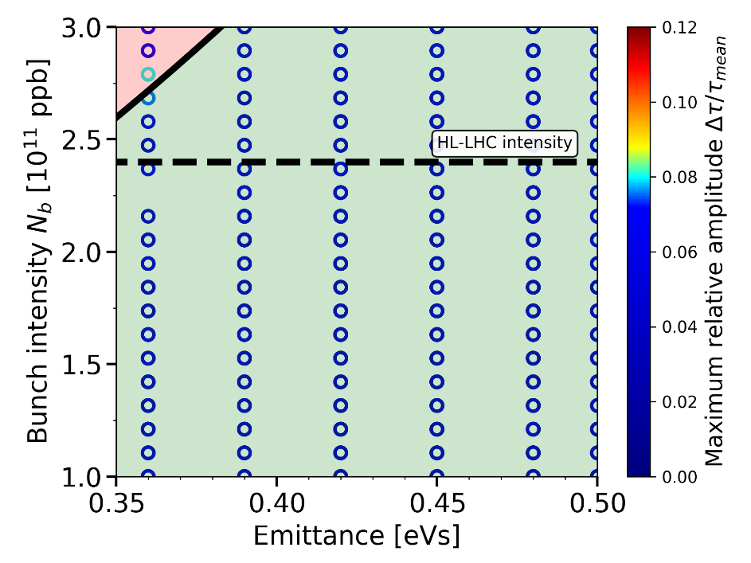
Beam stability with corrected $V_{ind}$
The 80 MHz voltage is the one minimising the uncontrolled emittance blow-up at HL-LHC intensity
Intensity threshold in a single 80 MHz RF system
Train of 48 bunches with ditributions extracted from PS
Intensity threshold in a double 80+200 MHz RF system (BSM)
Train of 48 bunches with ditributions extracted from PS
No stability for 0.35 eVs emittance beam → problem for other non-LHC beams
Impedance of the 80 MHz RF system can reduce the threshold and decrease margins for 0.5 eVs
With 200 MHz in bunch-shortening mode → sufficient margins for all beams

Slide 8
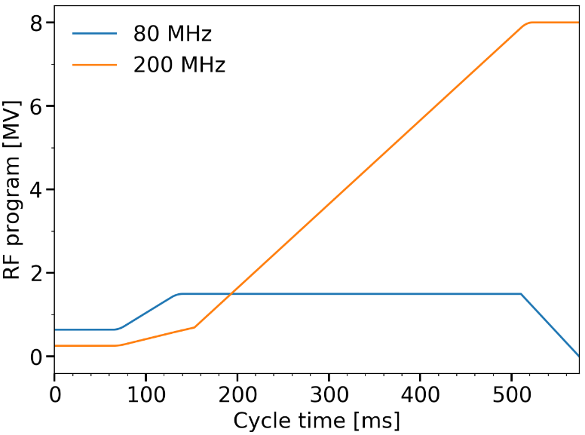
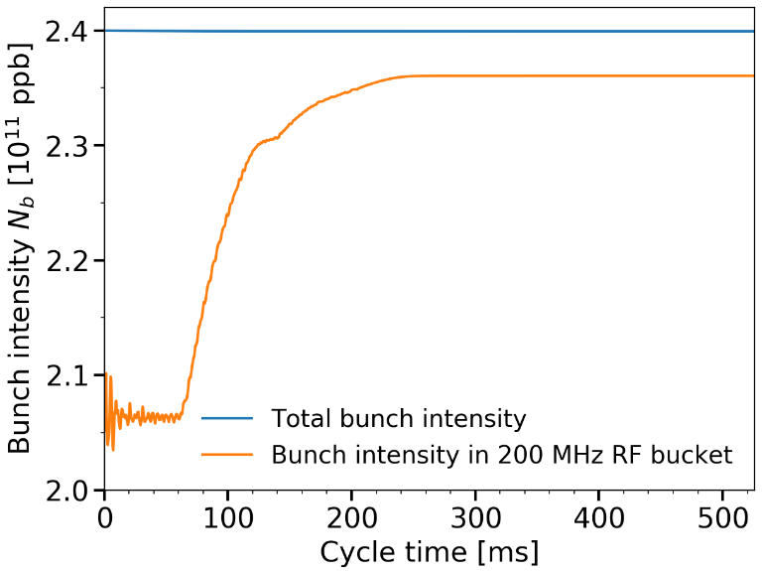
Transfer from 80 MHz to 200 MHz RF bucket in the SPS – RF program and losses
Bunches must be transferred to the main 200 MHz RF bucket for acceleration and transfer of short enough bunches to the LHC
RF program for re-bucketing
Capture voltage chosen to minimise uncontrolled emittance blow-up
$V_{80}$ increased to a maximum value (scan next slide) to shorten the bunches
$V_{200}$ increased afterwards and 80 MHz switched off
The losses are computed with the number of particles inside the main 200 MHz RF bucket
Evolution of # particles inside the main 200 MHz RF bucket
One example for a large bunch distribution
Re-bucketing voltage program

Slide 9
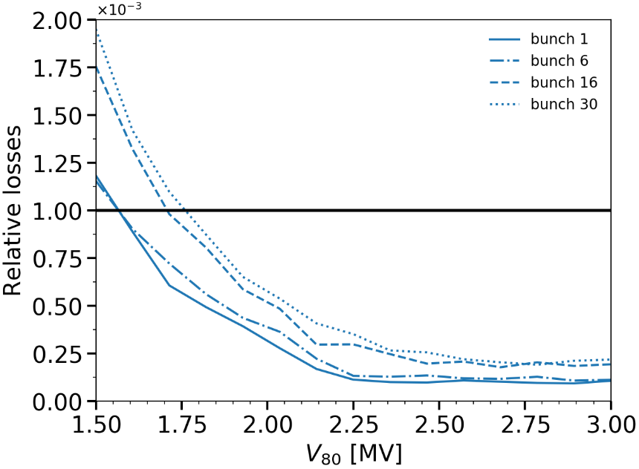
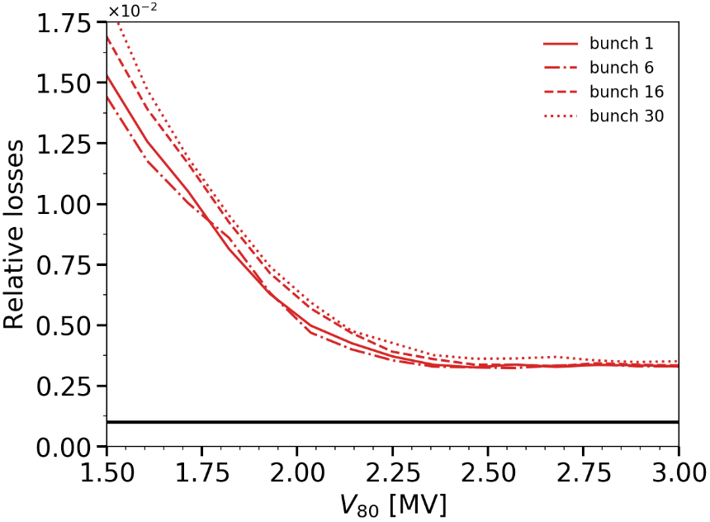
Re-bucketing and maximum $V_{80}$ – $N_{b}=2.4×{10}^{11}$ ppb
Lost particles are captured in neighbouring buckets (satellite bunches)
Satellite bunches are harmful for LHC already at an intensity ratio of ${10}^{−3}$
For larger maximum $V_{80}$ → smaller bunches, less losses but in which limit?
Losses for bunches with 0.36 eVs emittance, large tails,
in function of maximum 80 MHz voltage
Losses for bunches with 0.5 eVs emittance, large tails,
in function of maximum 80 MHz voltage
Threshold for satellite bunches in LHC
Threshold for satellite bunches in LHC
The losses increase along the batch (beam-loading)
Losses for large bunches with large tails can exceed the threshold independent of $V_{80}$
$V_{80}=2.5$ MV to minimise creation of satellite bunches

Slide 10
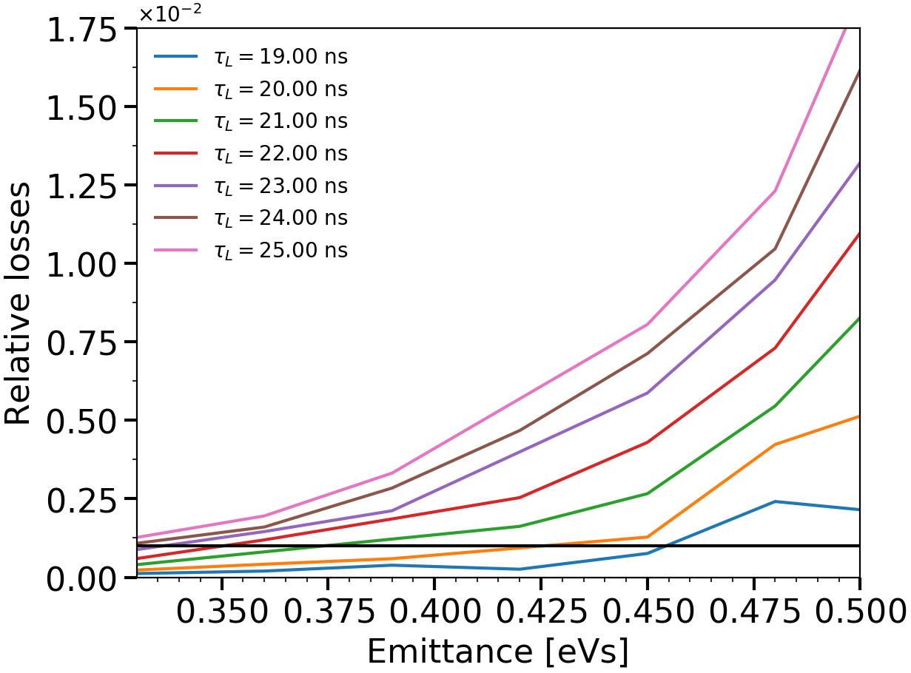
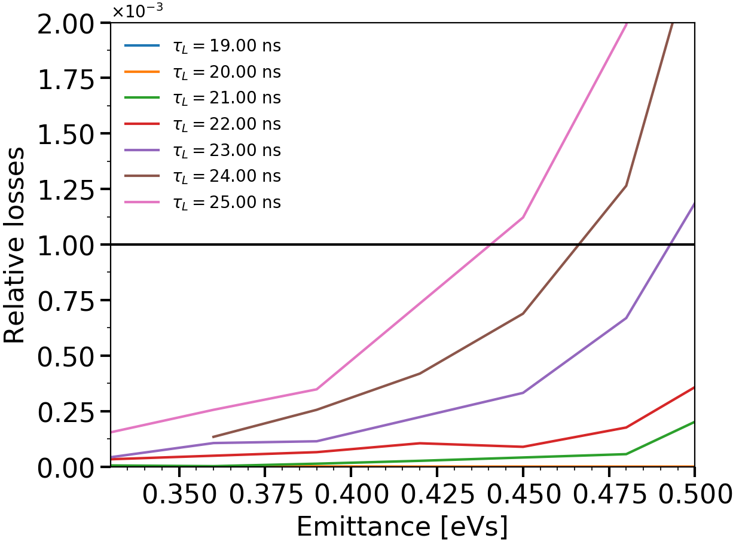
Losses versus emittance extracted from PS
The extensions of the tails of the bunch distribution are crucial in the creation of satellite bunches
Losses in function of PS emittance
Different assumptions on tails ($τ_{L}$)
$V_{80}=1.5$ MV
Losses in function of PS emittance
Different assumptions on tails ($τ_{L}$)
$V_{80}=2.5$ MV
A 80 MHz voltage of 2.5 MV is necessary
Bunches with large tails exceed the threshold for satellite bunches
Feasibility of the scenario depends on bunch quality from the PS, shaving in the PS may be needed

Slide 11
Conclusion
Stability in double RF (200 MHz in bunch-shortening mode) gives sufficient margins
The 80 MHz voltage at capture is ~0.8 MV to minimise uncontrolled emittance blow-up along the batch
A maximum 80 MHz voltage of 2.5 MV is needed for the re-bucketing to minimise the creation of satellite bunches
The losses for large bunches with large tails can however exceed the threshold of satellite bunches
The feasibility of the scenario depends on the bunch quality from the PS

Slide 12
THANK YOU FOR YOUR ATTENTION!

