Slide 1
Slip–stacking simulations with intensity effects
D. Quartullo
Acknowledgements: T. Argyropoulos, A. Lasheen,
E. Shaposhnikova, the BLonD team

Slide 2
Contents
Introduction
Slip-stacking fundamentals
Slip-stacking in SPS
Results for Q20 optics
Parameter optimizations
Suggested solution
Results for Q22 and Q26 optics
Conclusions and next steps

Slide 3
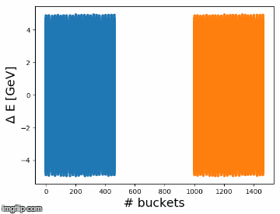
Introduction (1/2)
HL-LHC requirement: to double peak luminosity after LS2
Increase the number of bunches in the LHC
LIU baseline to achieve that is to decrease bunch spacing from 100 ns to 50 ns in SPS through slip-stacking
Basic idea: let two batches move in longitudinal phase space and interleave -> bunch spacing divided by two!
Slip-stacking used at Fermilab to double beam intensity

Slide 4
Introduction (2/2)
Potential slip-stacking feasibility is based on large bandwidth of the 200 MHz RF system
Slip-stacking can be tested only after LS2
LLRF of 200 MHz RF system has to be upgraded
Simulations are the only means to check slip-stacking feasibility
In case of bad outcome alternative scenarios have to be found [1]
Some preliminary simulations done in 2014 [2]
Simulations were without intensity effects
Limited consideration of measured beam parameters
The goal of the present study is to test slip-stacking feasibility with
Full SPS impedance model
Measured beam parameters
Optimization with respect to the most significant parameters involved
[1] A. Saa Hernandez ‘Results from ion studies in PS & SPS from 2016/2017 and planning for 2018’, Injector MD day, 2018
[2] T. Argyropoulos et al. ‘Slip stacking in the SPS’, LIU Day, 2014

Slide 5
Contents
Introduction
Slip-stacking fundamentals
Slip-stacking in SPS
Results for Q20 optics
Parameter optimizations
Suggested solution
Results for Q22 and Q26 optics
Conclusions and next steps

Slide 6
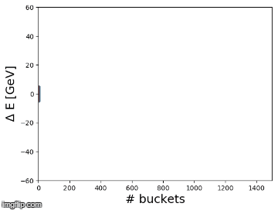
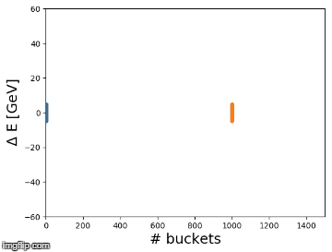
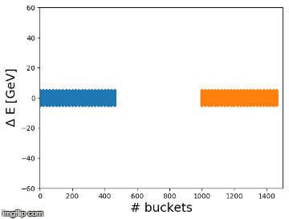
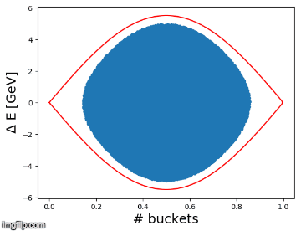
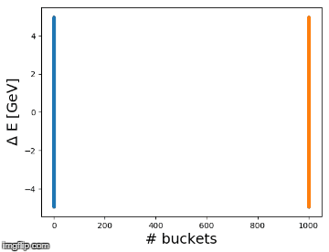
Equations behind slip-stacking
$$\frac{{∆f}_{rf}}{f_{rf,0}}=−η_{0}\frac{∆p}{p_{0}}$$
$$\frac{∆p}{p_{0}}=γ_{tr}^{2}\frac{∆R}{R_{0}}$$
$${∆φ}_{rf}=\frac{2 π h{ ∆f}_{rf}}{f_{rf,0}}$$
Examples above transition ($η_{0}$>0)
$${∆f}_{rf}<0$$
$$∆p>0$$
$$∆R>0$$
$${∆φ}_{rf}<0$$
$${∆f}_{rf}>0$$
$$∆p<0$$
$$∆R<0$$
$${∆φ}_{rf}>0$$
1 bunch
2 bunches
48 bunches

Slide 7
RF perturbation
Unfortunately each RF system, while accelerates one batch, perturbs the other batch.
The perturbation is zero when the batch distance is greater than the time needed to switch alternatively the two RF systems on and off depending on which batch passes by.
The perturbation has less damaging effects when ${Δf}_{rf}^{b}$ is large relative to $f_{s0}$
the perturbation averages within a synchrotron oscillation period (no coherent effects)
It has been proven (F. E. Mills) that a lower limit for stable motion is defined by
$α$is called slip-stacking parameter and two different cases with the same $α$ show in first approximation the same beam dynamics
$α$ >> 4 -> small perturbation effect but large needed recapture voltage and large emittance after filamentation
$α$ $≈$ 4 -> smaller recapture voltage needed (and small emittance growth after recapture ) but the perturbation has more effect
Difference in RF frequency between the 2 RF systems
Core synchrotron frequency
separatrices of the buckets of the two batches are tangent to each other
Half-bucket height
$$α≐\frac{{Δf}_{rf}^{b}}{f_{s0}}=2\frac{{ΔE}^{b}}{H_{b}}=4$$
$${ΔE}^{b}=2H_{b}$$
Difference in absolute energy
between the two batches

Slide 8
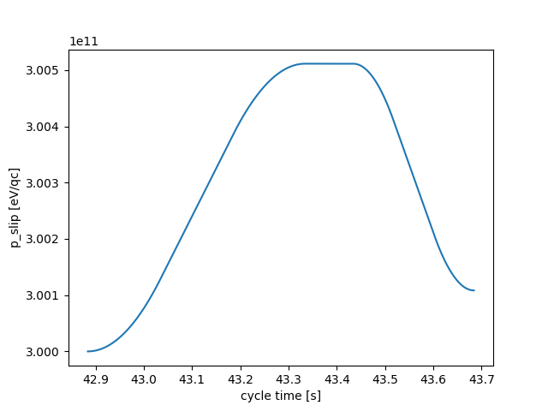
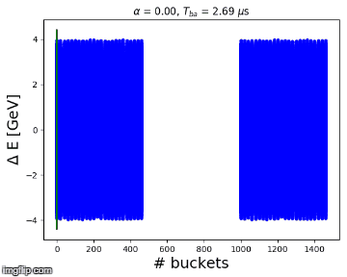
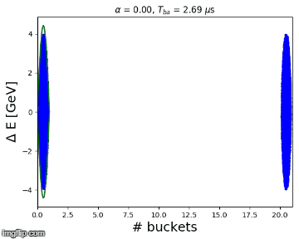
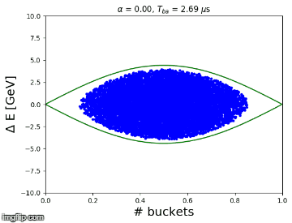
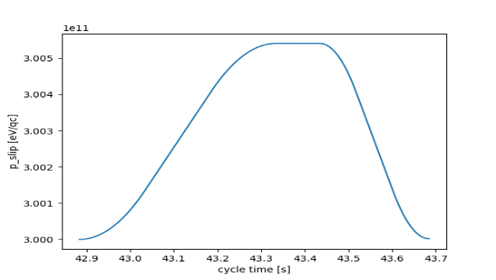
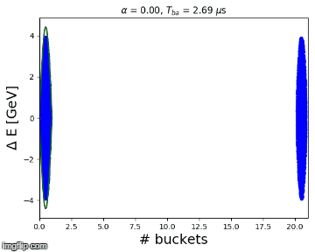
Examples with RF perturbation
Bunches become red when perturbation starts
Example 1: $α_{end}=8$ -> perturbation practically not visible
$$p_{slip}$$
$$p_{0}$$
Example 2: $α_{end}=4$ -> perturbation is visible but bunch still inside bucket
$$p_{slip}$$
$$p_{0}$$
Example 3: $α_{end}=0$ -> bunch is lost
$$p_{slip}$$
$$p_{0}$$

Slide 9
Contents
Introduction
Slip-stacking fundamentals
Slip-stacking in SPS
Results for Q20 optics
Parameter optimizations
Suggested solution
Results for Q22 and Q26 optics
Conclusions and next steps

Slide 10
Slip-stacking procedure in SPS
Two SPS batches, each batch contains 24 bunches spaced by 100 ns
Before slip-stacking the two batches are separated by $T_{b}$= 2.7 $μs$
$T_{b}$ is defined by the LLRF specifications: it has to be so large that when $T_{b}$= $T_{b}^{th}$ then $α≫4$ to avoid perturbation from the other RF
In SPS $T_{b}^{th}$= 1.3 $μs$ ($T_{b}^{th}$ is the time needed to switch the RF system off)
Each batch is controlled by a different subset of the 200 MHz TWCs
Slip-stacking to make the two batches interleave
Bunch spacing reduced from 100 ns to 50 ns
After slip-stacking:
A common recapture voltage is needed
Recapture done at the average (design) RF frequency

Slide 11
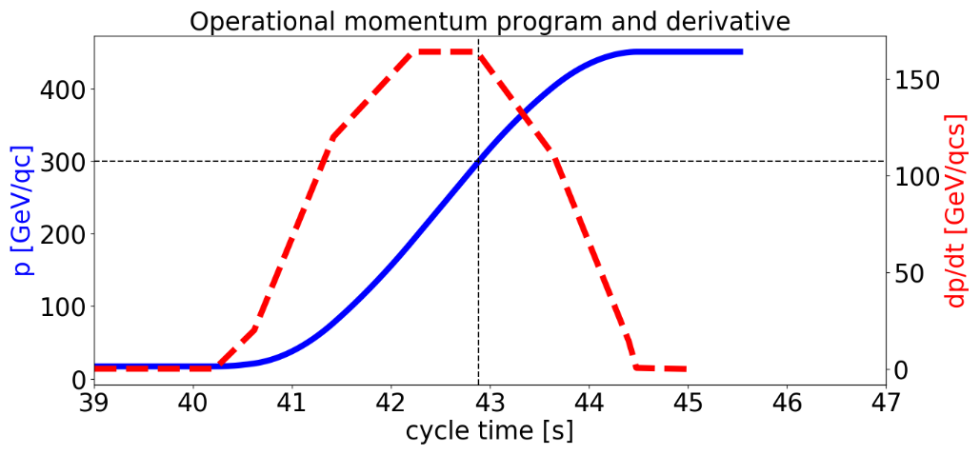
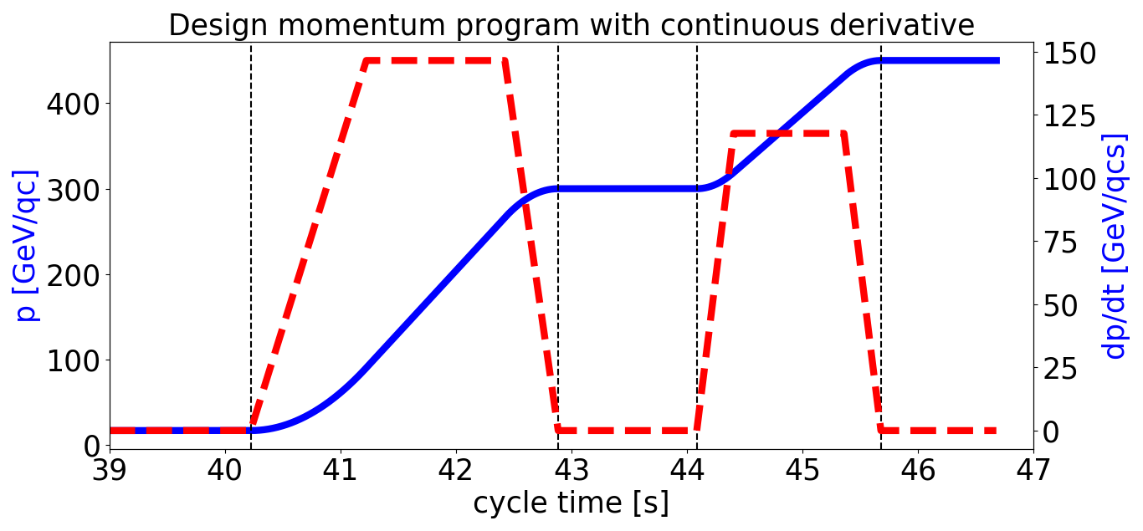
Momentum program design
$${TX}_{0}$$
$${TX}_{2}$$
$${TX}_{4}$$
$${TX}_{1}$$
$${TX}_{3}$$
At which energy should slip-stacking be performed?
Flat bottom: strong space charge effects, IBS and RF noise (observed during operation)
Flat top: extra time for filamentation is needed and uncaptured beam is transfered to the LHC
Intermediate energy plateau: weak space charge (but instability threshold ~ 1/E), presence of time for filamentation and cleaner beam for LHC
The energy 300 GeV/qc is chosen for the following simulations
Multiples of 1.2 s (PSB cycle) can be added to the SPS cycle for slip-stacking
1.2 s are added at 300 GeV/c

Slide 12
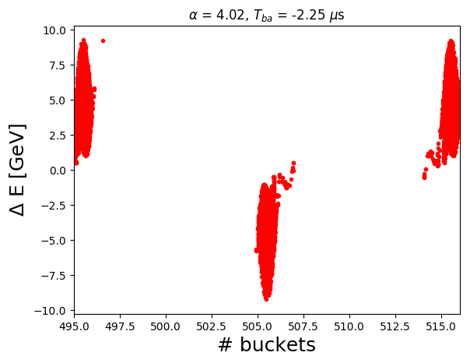
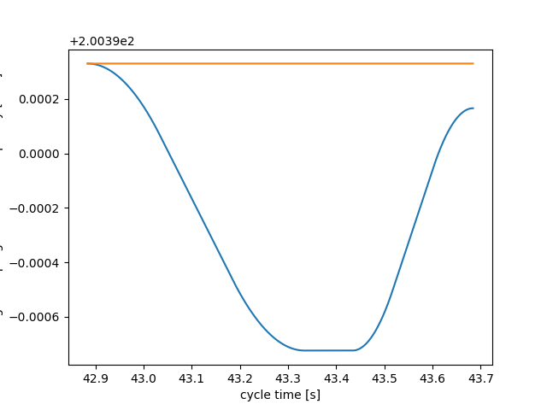
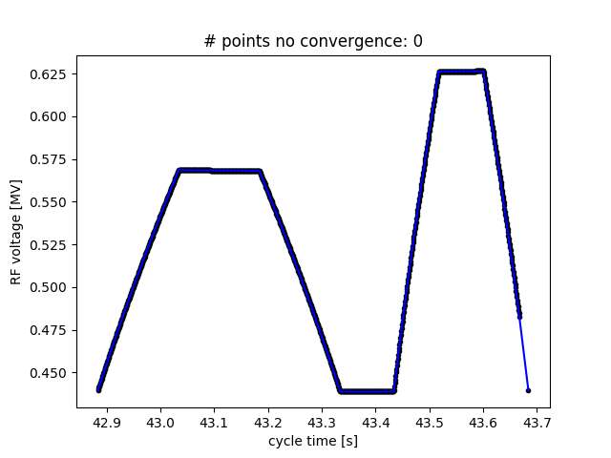
Slip-stacking programs
The momentum (or frequency) program is designed in such a way that the two batches are perfectly interleaved at ${TX}_{2}$
Alignment has to be precise to avoid
additional filamentation after recapture
The voltage program is calculated from the momentum program for constant filling factor in energy $q_{e}^{mss}$
The batches move in opposite directions relative to $∆E=0$, $f_{rf}^{1}=−f_{rf}^{2}$, $V_{rf}^{1}=V_{rf}^{2}$
Example of programs used in simulations for one of the two batches:
at ${TX}_{2}$
$$p_{max}$$
$$f_{rf,0}$$
$$V_{rf}^{1}$$
$$p$$
$$f_{rf}^{1}$$
$$p_{min}$$
$$p_{0}$$

Slide 13
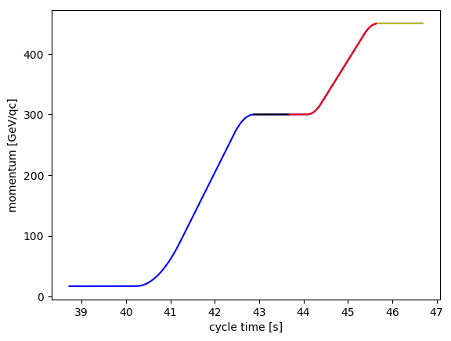
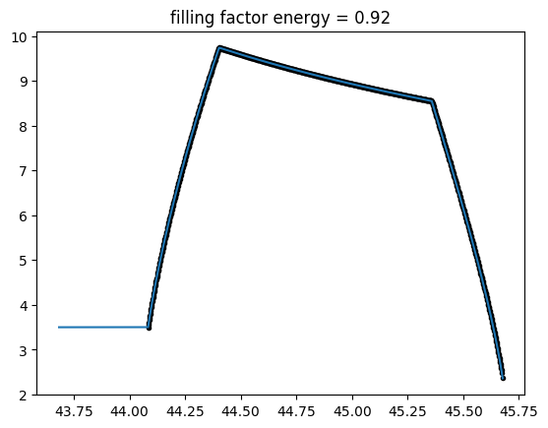
Programs after slip-stacking
Start slip-stacking
$${TX}_{1}$$
$${TX}_{4}$$
$${TX}_{3}$$
$${TX}_{2}$$
End slip-stacking
$${TX}_{0}$$
The capture voltage $V_{rf}^{rc}$ chosen at ${TX}_{2}$ is used in [${TX}_{2}$,${TX}_{3}$], then the code computes the filling factor in energy at ${TX}_{3}$ and uses it to calculate the voltage program in [${TX}_{3}$,${TX}_{4}$]
Example of $V_{rf}$ in [${TX}_{2}$,${TX}_{4}$] encountered in simulations
Here filling factor is computed
$${TX}_{2}$$
$${TX}_{3}$$
$${TX}_{4}$$
$V_{rf}$ with filling factor = 0.92
Capture voltage
At flat top two options are considered
$V_{rf}$ is increased linearly to 15 MV in 0.5 s (flat top length $≈$ 1 s) (bunch compression)
$V_{rf}$ is constant for 0.8 s and then is increased non-adiabatically to 15 MV (bunch rotation)
We assume that the maximum available RF voltage is 15 MV

Slide 14
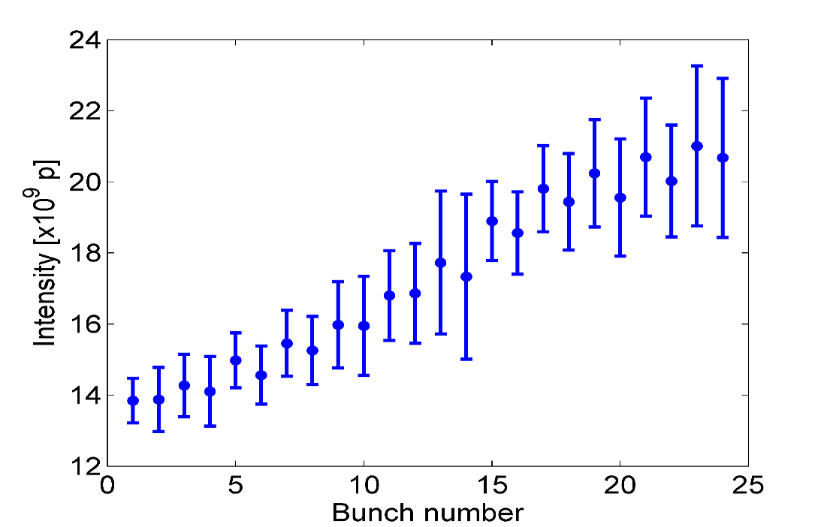
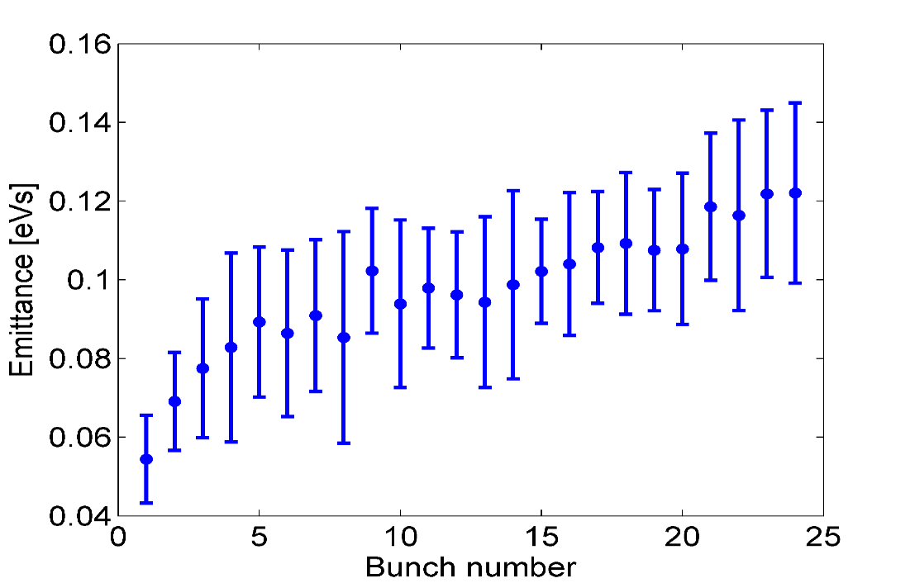
Initial beam parameters
Measurements done in December 2015 (courtesy A. Lasheen) show significant bunch to bunch variation in intensity and emittance along the batch at various point along the ramp
At 300 GeV/c
At 300 GeV/c
Intensity increases by a factor of 1.5
Emittance increases by a factor of 2
These beam parameters are exactly reproduced in simulations as starting point for the simulations

Slide 15
Contents
Introduction
Slip-stacking fundamentals
Slip-stacking in SPS
Results for Q20 optics
Parameter optimizations
Suggested solution
Results for Q22 and Q26 optics
Conclusions and next steps

Slide 16
Optimization of slip-stacking parameters
We define the total losses as $L_{tot}=L_{SPS}+S_{LHC}$
Constraints on
$L_{tot}<5$ %
$τ_{max}<$ 1.65 ns (maximum bunch length along the batch at SPS extraction)
We want to find the optimal combinations of parameters $α_{TX2}$, $q_{e}^{mss}$and $V_{rf}^{rc}$
The dynamics are complex (many parameters involved, intensity effects, …)
We don’t want to choose sub-optimal combinations for our proposals
Large parameter scan made possible by several algorithms which compute automatically for each case the design SPS programs
$α_{TX2}$ scanned from 3.5 to 8, step 0.5
$q_{e}^{mss}$ scanned from 0.45 to 0.9, step 0.05
$V_{rf}^{rc}$ scanned from 1 MV to 9 MV, step 0.5
We want also to monitor the maximum emittance $ε_{max}$ along the batch at ${TX}_{3}$ (after recapture filamentation)
Losses in SPS
Satellites in LHC

Slide 17
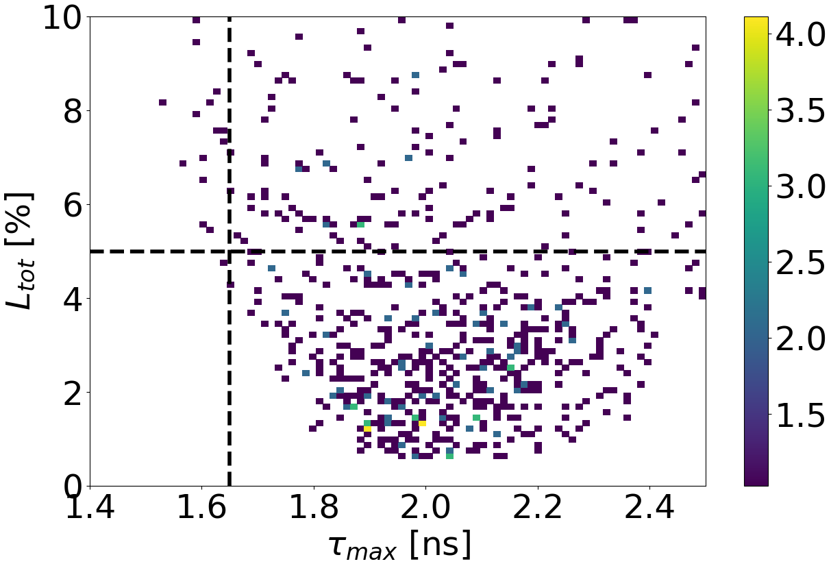
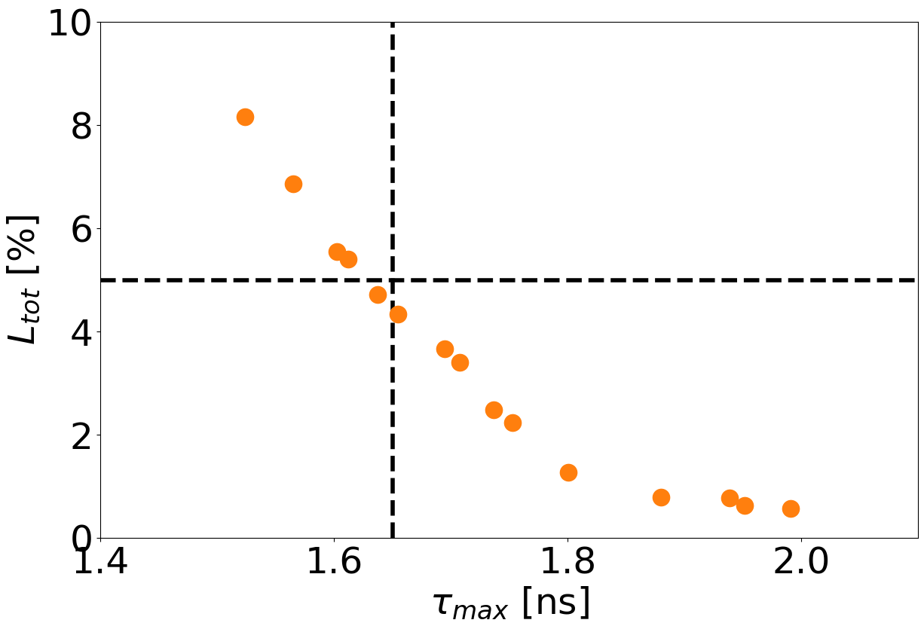
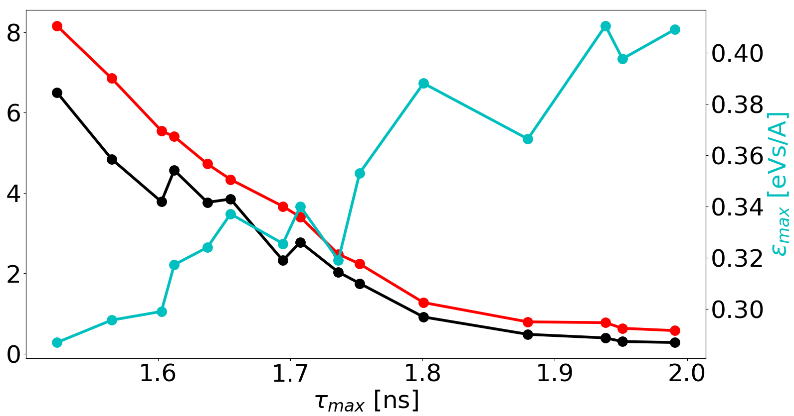
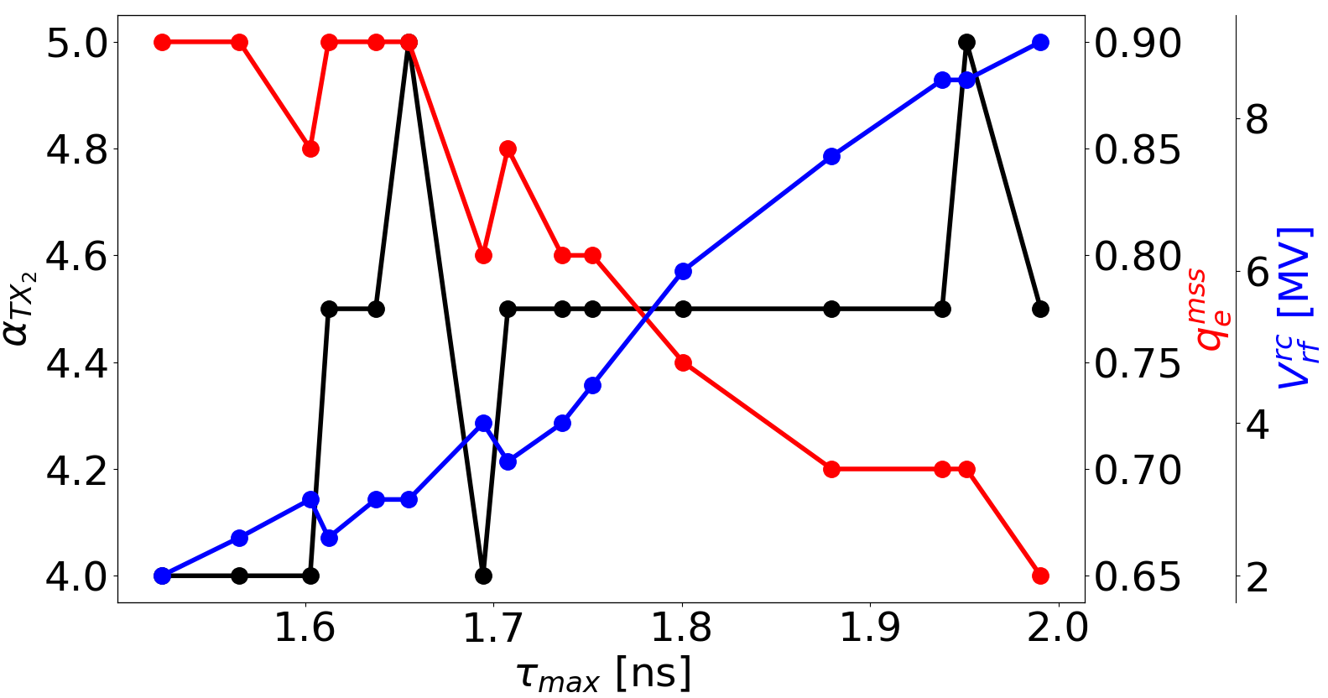
Q20: no intensity effects, compression
Scan result
Optimal solutions
Constraints are practically not satisfied
Behavior of main parameters for the optimal solutions
$$L_{tot}$$
$$S_{LHC}$$
$$L_{SPS}$$
$$ε_{max}$$
$$α_{TX2}≈4.5$$
$$q_{e}^{mss}$$
$$V_{rf}^{rc}$$
$L_{tot}$ and $S_{LHC}$ [%]

Slide 18
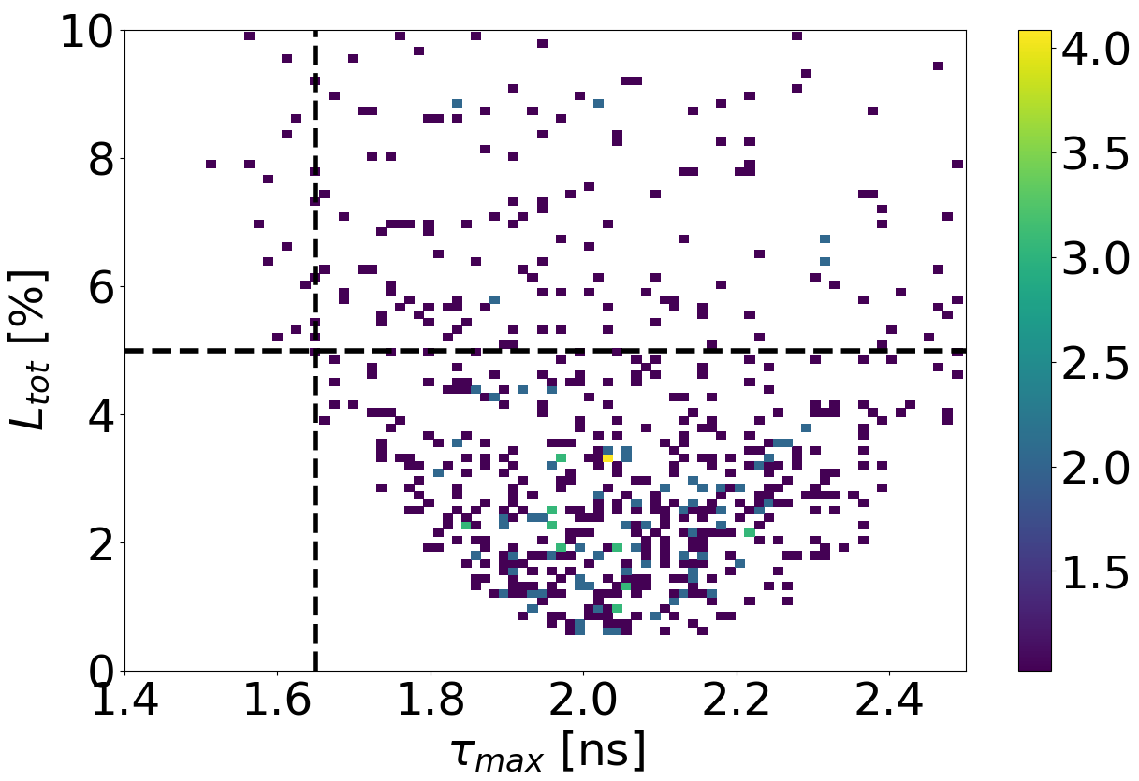
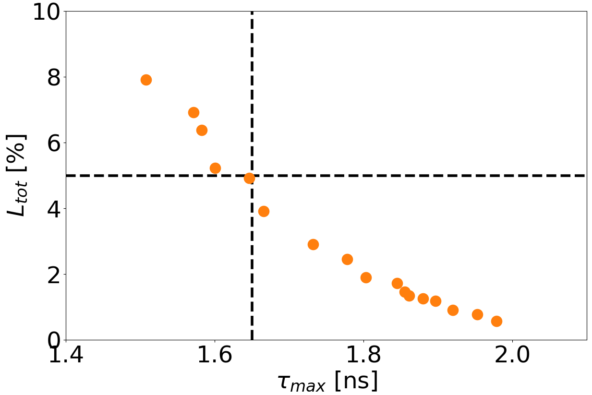
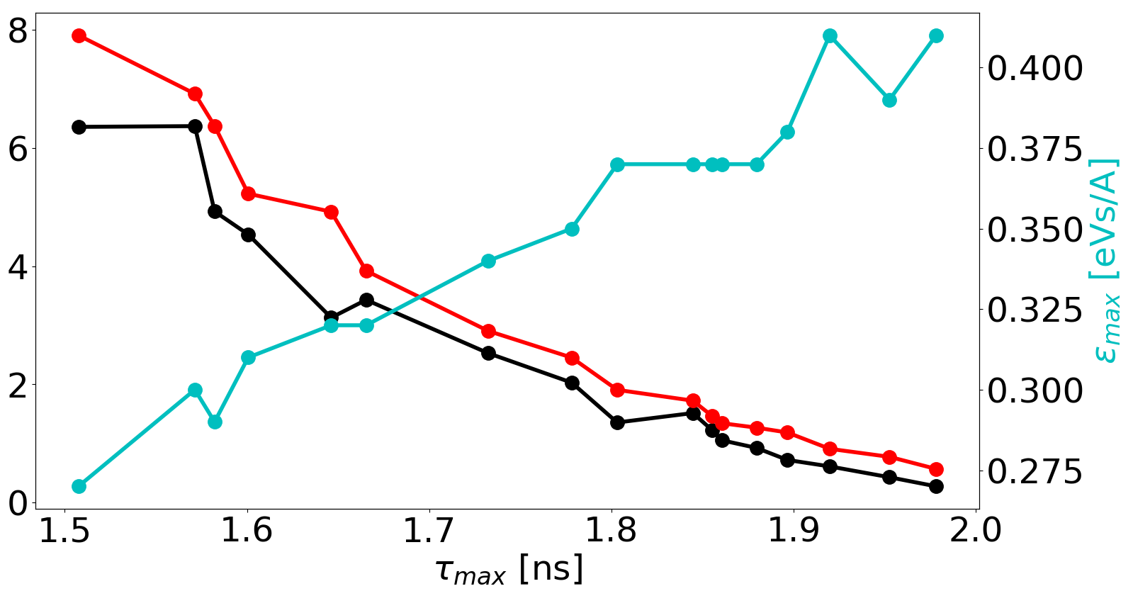
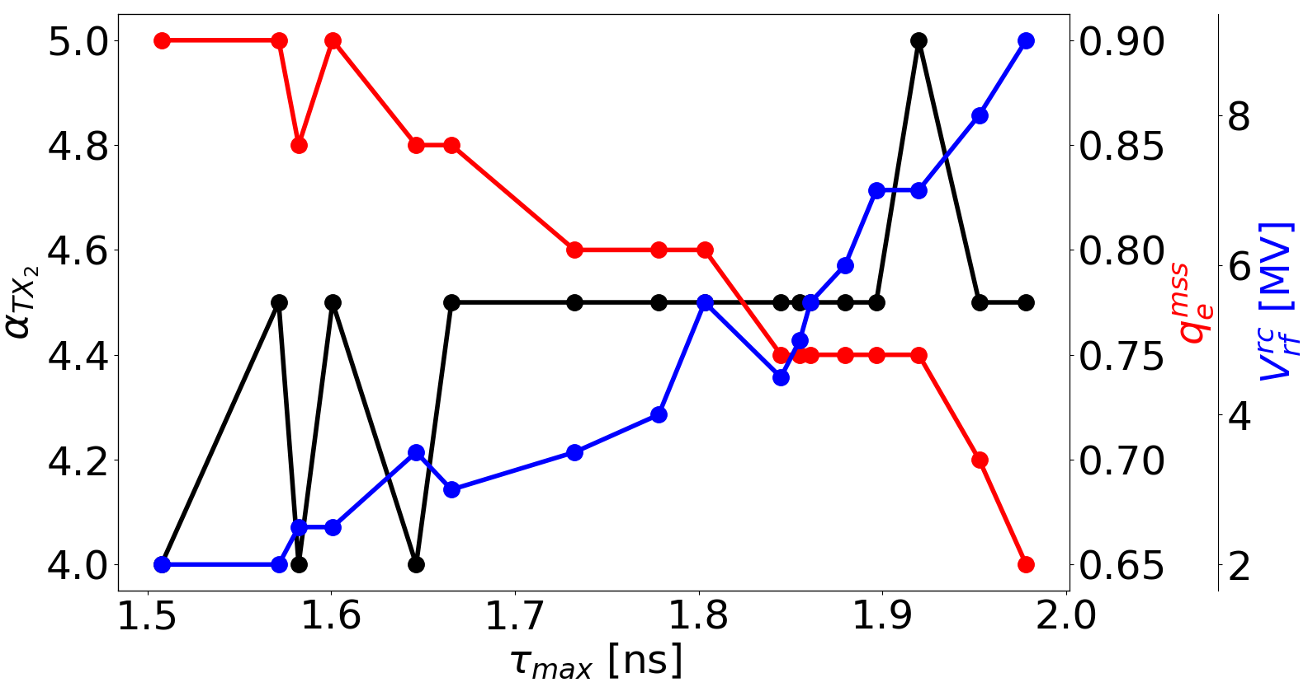
Q20: intensity effects, compression
Scan result
Optimal solutions
No significant difference if intensity effects are on
Behavior of main parameters for the optimal solutions
$$L_{tot}$$
$$S_{LHC}$$
$$L_{SPS}$$
$$ε_{max}$$
$$α_{TX2}≈4.5$$
$$q_{e}^{mss}$$
$$V_{rf}^{rc}$$
$L_{tot}$ and $S_{LHC}$ [%]

Slide 19
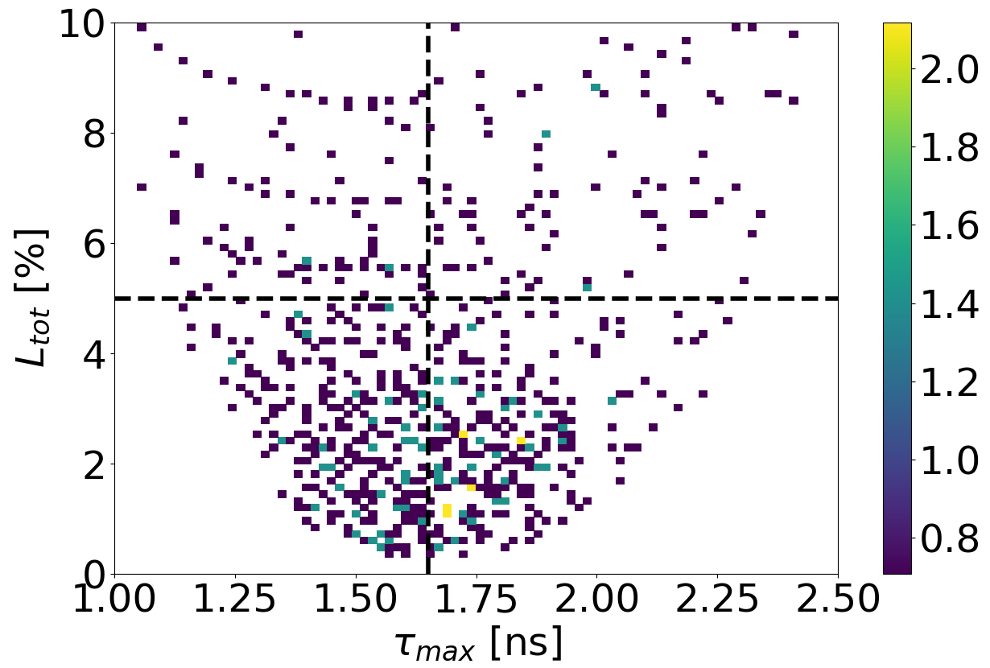
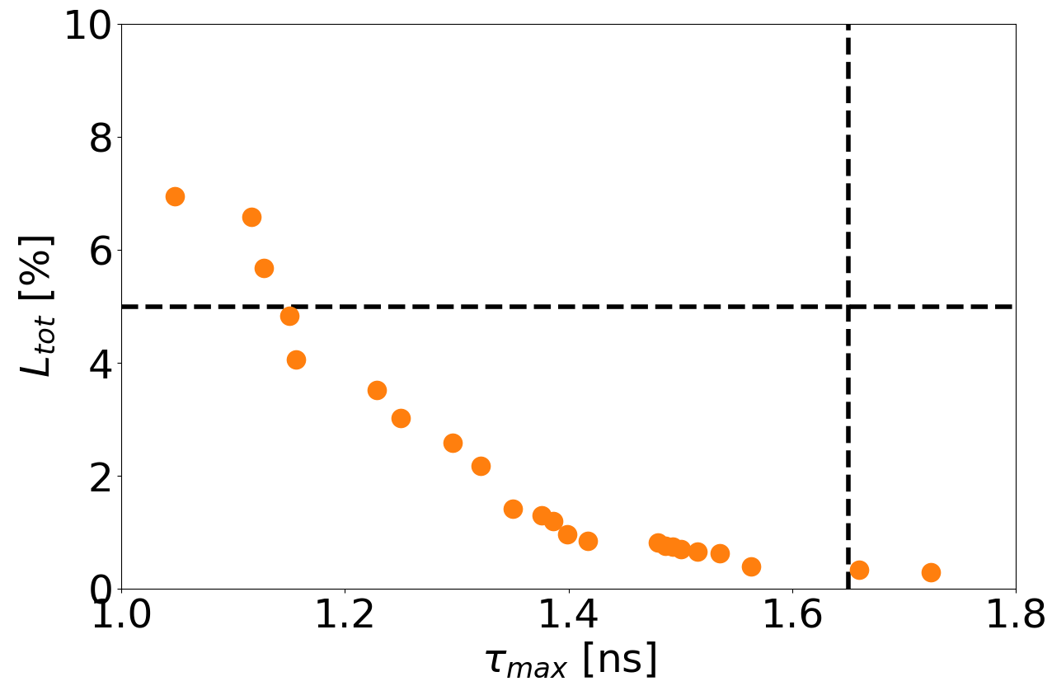
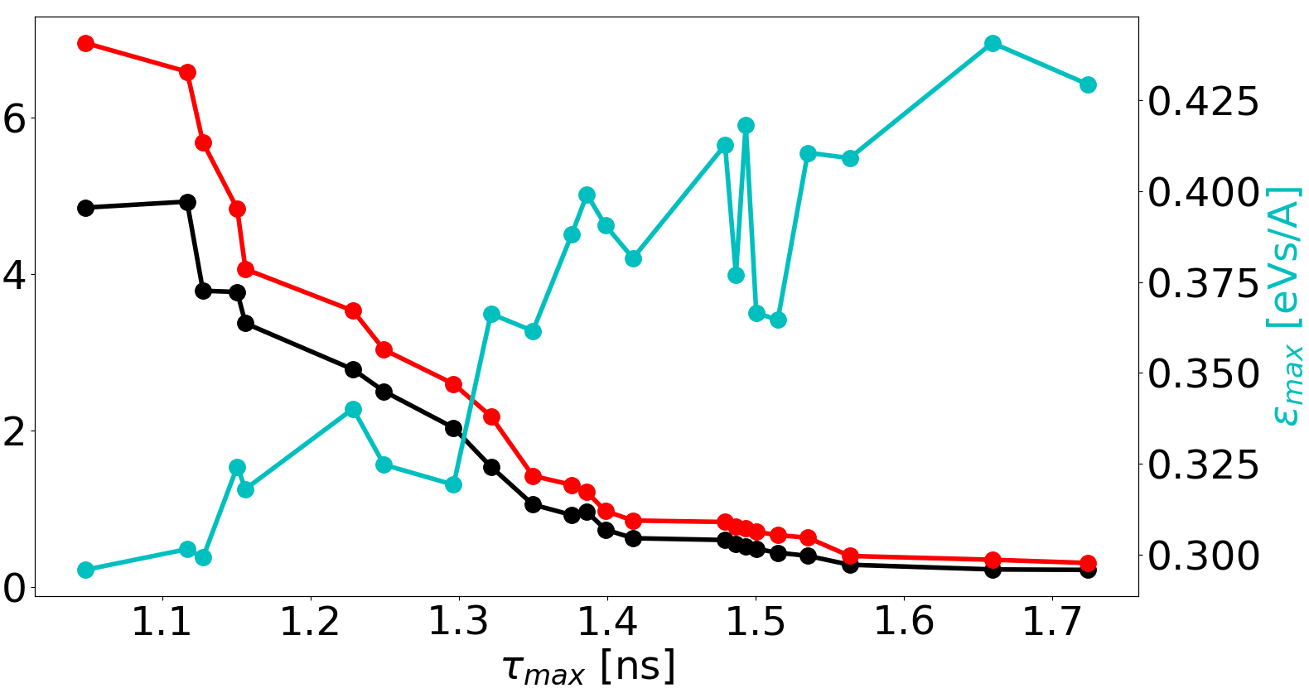
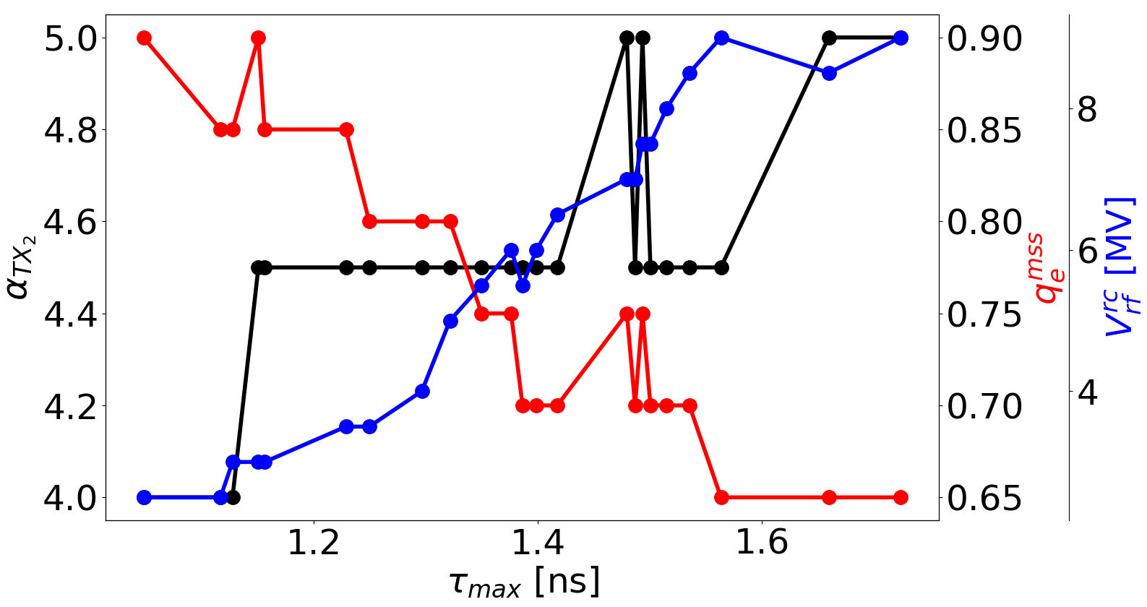
Q20: no intensity effects, rotation
Scan result
Optimal solutions
Constraints are largely satisfied
Behavior of main parameters for the optimal solutions
$$L_{tot}$$
$$S_{LHC}$$
$$L_{SPS}$$
$$ε_{max}$$
$$α_{TX2}≈4.5$$
$$q_{e}^{mss}$$
$$V_{rf}^{rc}$$
$L_{tot}$ and $S_{LHC}$ [%]

Slide 20
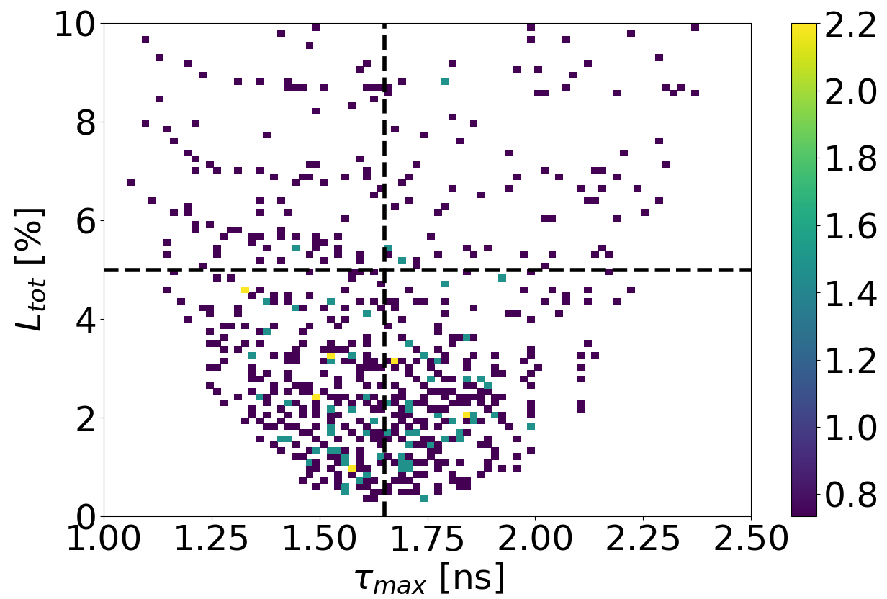
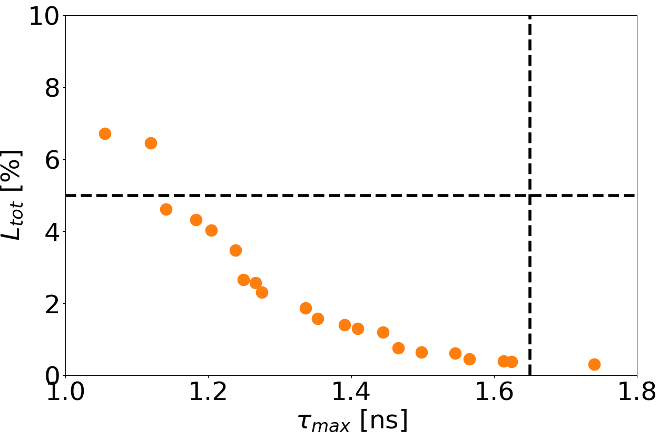
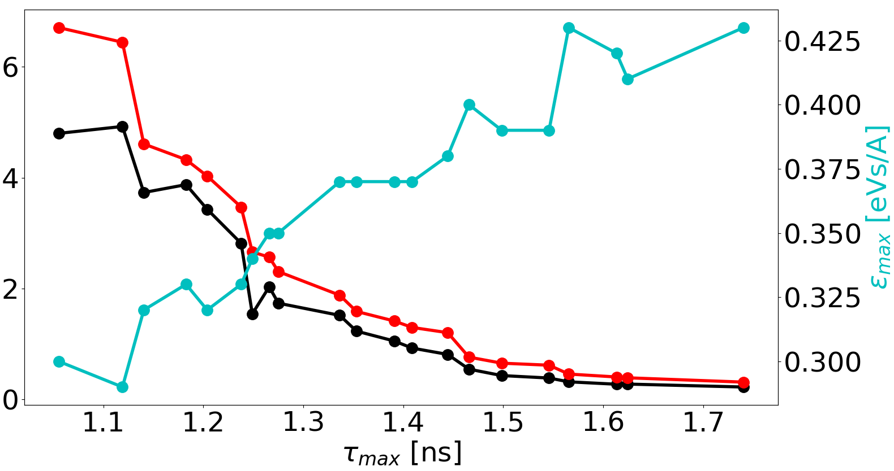
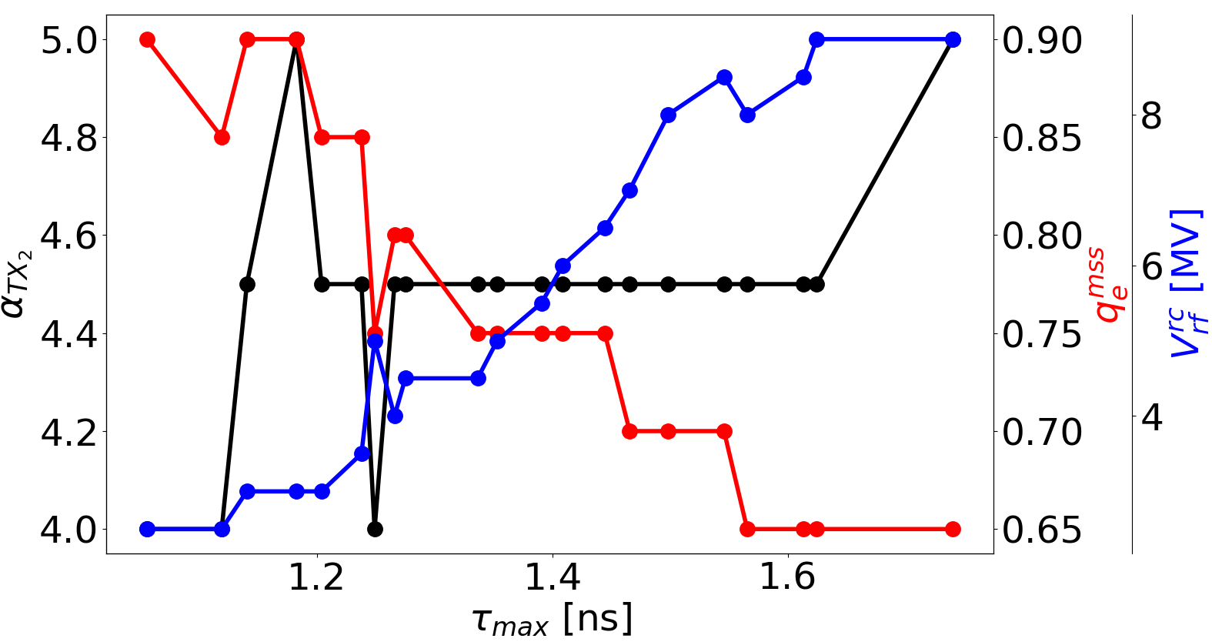
Q20: intensity effects, rotation
Scan result
Optimal solutions
No significant difference if intensity effects are on
Behavior of main parameters for the optimal solutions
$$L_{tot}$$
$$S_{LHC}$$
$$L_{SPS}$$
$$ε_{max}$$
$$α_{TX2}≈4.5$$
$$q_{e}^{mss}$$
$$V_{rf}^{rc}$$
$L_{tot}$ and $S_{LHC}$ [%]

Slide 21
Parameters of the optimal solutions
$$L_{tot}$$
$$S_{LHC}$$
$$L_{SPS}$$
$$ε_{max}$$
$$α_{TX2}≈4.5$$
$$q_{e}^{mss}$$
$$V_{rf}^{rc}$$
All optimal solutions have roughly the same $α_{TX2}$ as expected
Different configurations with same $α_{TX2}$ are similar from a slip-stacking perspective
$α_{TX2}≈4$, because 4 is the lower limit for stability and the solutions are optimal
The results show that on average $α_{TX2}=4.5$ is preferable (some margin is due to the tails of the larger emittance bunches which approach the separatrix)
If we want for example lower $τ_{max}$, qualitatively it follows that
$ε_{max}$ decreases (lower bunch length for lower emittance bunch)
$V_{rf}^{rc}$decreases (filamentation after recapture fills the entire bucket, bucket area has to decrease)
${∆E}_{b}$decreases (otherwise particles outside the recapture bucket will be lost)
$V_{rf}^{1}$ decreases ($α_{TX2}$ is constant)
$q_{e}^{mss}={∆E}_{peak}^{bunch}/H_{b}$ increases (${∆E}_{peak}^{bunch}∝{V_{rf}^{1}}^{1/4}$, $H_{b}∝{V_{rf}^{1}}^{1/2}$)
$S_{LHC}$ increases (bunch centroid closer to axis $∆E=0$, stronger perturbations)
$L_{SPS}$ increases (higher filling factor increases losses of particles close to separatrix)

Slide 22
Q20: proposed solution S
The results of the optimization shows that
Intensity effects do not influence how the constraints are satisfied
Bunch compression at flat-top cannot fullfill the requirements
Bunch rotation at flat-top largely fullfils the requirements
Giving priority to loss reduction
we propose the combination with
$L_{tot}=0.45$ %
$τ_{max}=1.57$ ns
$S_{LHC}=0.14$ %
$L_{SPS}=0.31$ %
$ε_{max}=0.43$ eVs/A
$α_{TX2}=4.5$
$q_{e}^{mss}=0.65$
$V_{rf}^{rc}=8$ MV
Low $q_{e}^{mss}$ helps limiting considerably the losses in SPS during slip-stacking
Low $q_{e}^{mss}$ and $α_{TX2}>4$ helps limiting influence of chaotic motion in $∆E=0$ making $S_{LHC}$ very low
$L_{tot}$ and $S_{LHC}$ [%]

Slide 23
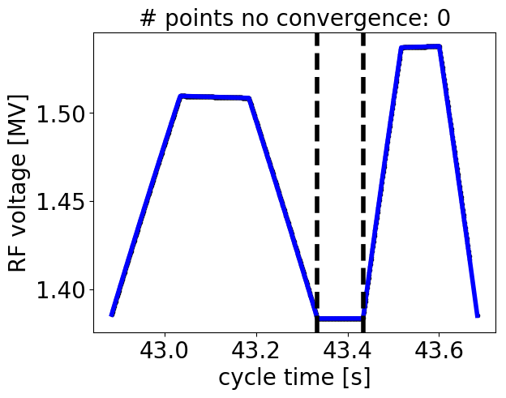
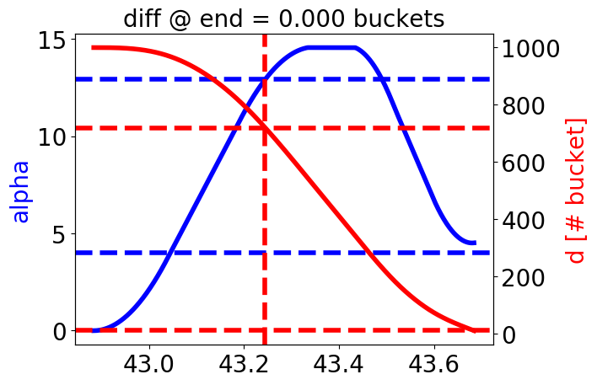
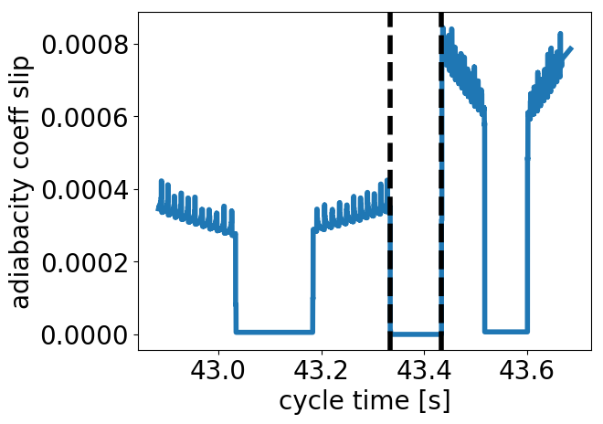
Q20: solution S, slip-stacking
Parameters for one batch
RF voltage for one batch
acceleration
deceleration
flat
Symbol | Units | Value
$$f_{s0}^{{TX}_{1}}$$ | Hz | 139.3
$$η_{}^{{TX}_{1}}$$ |  | 3x10⁻³
$$V_{rf}^{max}$$ | MV | 1.54
${Δp}_{}^{max}$/$p_{0}$ | - | 1.66x10⁻³
$${ΔR}_{}^{max}$$ | mm | 5.67
$${Δf}_{rf}^{max}$$ | Hz | 1013
$α$ for one batch and distance between batches (from head to head)
Adiabaticity coefficient for one batch
$$α_{d}=\frac{1}{ω_{s0}^{2}}\left|\frac{dω_{s0}}{dt}\right|$$
$d$=720
$$α_{d}<0.01$$
$$α$$
$α$=4.5
$α_{d}$ [1/rad]
$α$=4
$d$=10
bunch distance after slip-stacking
RF perturbation starts here, $α≫4$

Slide 24
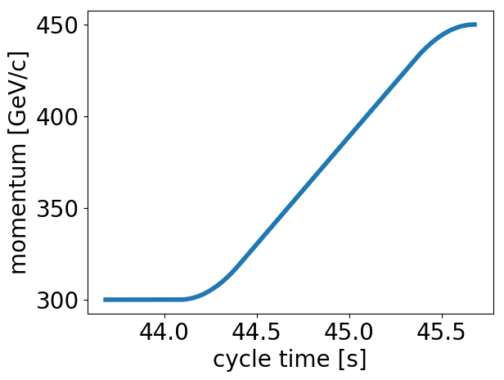
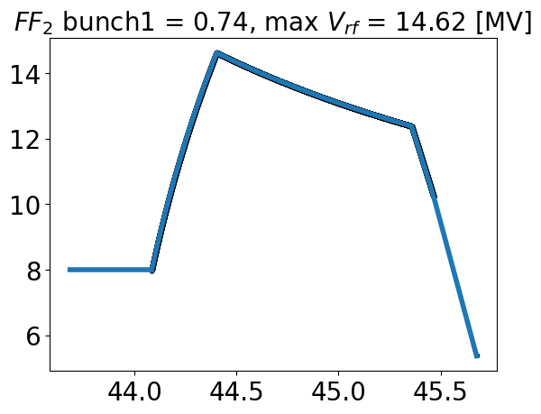
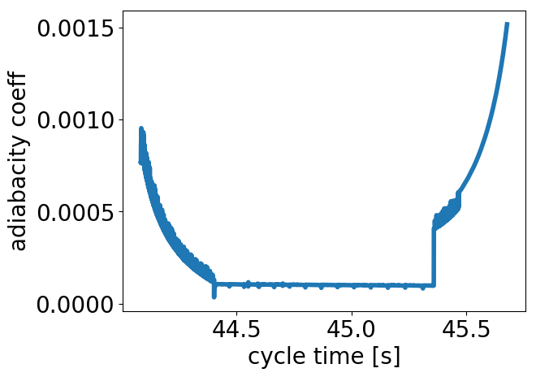
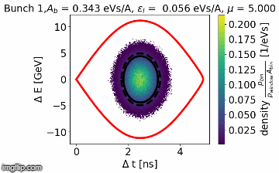
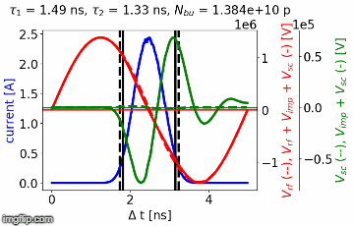
Q20: solution S, after slip-stacking
Momentum program
RF program
Adiabaticity coefficient
$$α_{d}<0.01$$
$p$ [GeV/qc]
RF voltage [MV]
$α_{d}$ [1/rad]
Max RF voltage 14.62 MV
cycle time [s]
At flat top, constant RF voltage for 0.8 s and then bunch rotation
MOVIES for solution S: Initial bunch distributions for one batch
$A_{b}$: bucket area, $τ_{1,2}:$ bunch length conventions, $N_{bu}$: # protons per bunch
$V_{imp, sc}$: voltage induced by impedances and space charge

Slide 25
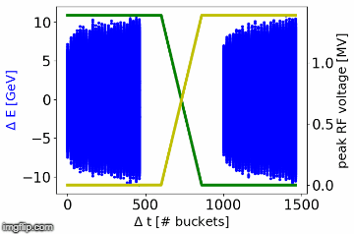
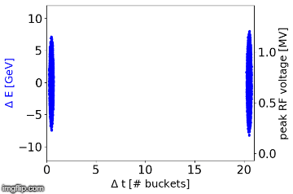
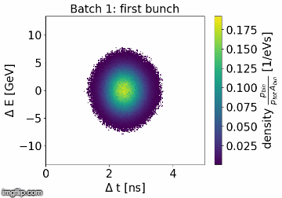
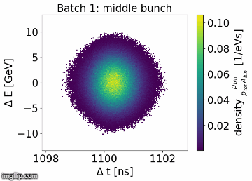
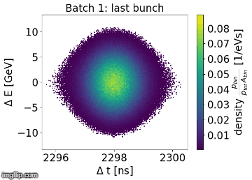
MOVIES for solution S: slip-stacking
General frame, $V_{rf}^{1}$, $V_{rf}^{2}$
Zoom on first two bunches
Bunches become red when RF perturbation starts
As expected only few particle lost during slip-stacking
At the end of slip-stacking low impact of chaotic motion in $∆E=0$
Resonances visible at the end of slip-stacking and core which performes dipole oscillations

Slide 26
MOVIES for solution S: capture and ramp
General frame
Bunches become yellow when the ramp starts
Few losses due to recapture and acceleration of higher emittance bunches
Small but very dense area in phase space never filaments (stronger for first bunch)
First bunch
Middle bunch
Last bunch

Slide 27
MOVIES for solution S: flat top
General frame
The dense area never filaments
Loss of Landau damping due to collective effects
Without intensity effects immediate filamentation
First bunch
Middle bunch
Last bunch

Slide 28
Loss of Landau damping
Loss of Landau damping when the second RF system perturbs the batch during slip-stacking
Dipole oscillations stronger for shorter bunches inside the batch
Solution S without intensity effects, dipole oscillations damp
Slip-stacking
Recapture and ramp
Flat top
RF perturbation starts here
Solution S with intensity effects, large dipole oscillations never dump
Slip-stacking
Recapture and ramp
Flat top
Max mean position and rms of the first bunch at flat top along the optimal solutions (S is marked by green line)
Dipole oscillations stronger for small $τ_{max}$
Quadrupole oscillations smaller for small $τ_{max}$ since the rotating island is very dense
First tests to damp these oscillations with the 800 MHz RF cavity gave negative results

Slide 29
Contents
Introduction
Slip-stacking fundamentals
Slip-stacking in SPS
Results for Q20 optics
Parameter optimizations
Suggested solution
Results for Q22 and Q26 optics
Conclusions and next steps

Slide 30
Q22: intensity effects, compression
Scan result
Optimal solutions
Acceptable margin for constraint fulfillment
Behavior of main parameters for the optimal solutions
$$L_{tot}$$
$$S_{LHC}$$
$$L_{SPS}$$
$$ε_{max}$$
$$α_{TX2}≈4.25$$
$$q_{e}^{mss}$$
$$V_{rf}^{rc}$$
$L_{tot}$ and $S_{LHC}$ [%]
Fixed $V_{rf}^{rc}$, lower $η_{0}$ lower $q_{e}^{mss}$ lower $L_{SPS}$ more acceptable solutions

Slide 31
Q22: intensity effects, rotation
Scan result
Optimal solutions
Constraints are largely satisfied, even better than Q20
Behavior of main parameters for the optimal solutions
$$L_{tot}$$
$$S_{LHC}$$
$$L_{SPS}$$
$$ε_{max}$$
$$α_{TX2}≈4.25$$
$$q_{e}^{mss}$$
$$V_{rf}^{rc}$$
$L_{tot}$ and $S_{LHC}$ [%]
Fixed $V_{rf}^{rc}$, lower $η_{0}$ implies lower $q_{e}^{mss}$ lower $L_{SPS}$ more acceptable solutions

Slide 32
Q26: intensity effects
Bunch compression
Scan result
Optimal solutions
Constraints are largely satisfied, even better than Q22 (lower $η_{0}$)
Bunch rotation
Scan result
Optimal solutions
Constraints are largely satisfied, even better than Q22 (lower $η_{0}$)

Slide 33
Contents
Introduction
Slip-stacking fundamentals
Slip-stacking in SPS
Results for Q20 optics
Parameter optimizations
Suggested solution
Results for Q22 and Q26 optics
Conclusions and next steps

Slide 34
Conclusions and next steps
The principle behind slip-stacking has been illustrated through different examples
The slip-stacking procedure has been simulated for the SPS-ion beams to verify its feasibility after LS2
Many ring parameters were designed (voltage and RF programs during and outside the slip-stacking time, duration of the different cycle phases)
Effort spent to use measured bunch distributions
Realistic losses count mechanisms and machine parameters used
The three different optics have been tested
Full SPS impedance model included in simulations
Simulation results:
Q20: bunch compression cannot satisfy constraints with enough margin, bunch rotation is needed
Q22 and Q26: bunch compression can be used, even if bunch rotation gives always better results
Next step:
Try counteracting loss of Landau damping through beam-based loops and the 800 MHz RF system

