Slide 1
Longitudinal stability of 12 bunches s 31st of July 2018
LIU-SPS Beam Dynamics Working Group
J. Repond, E. Shaposhnikova
Acknowledgements: G. Papotti, T. Bohl, H. Bartosik, SPS OP crew

Slide 2
MD 12 high intensity bunches, double RF operation Study of effects of the voltage ratio $V_{800}/V_{200}$ on beam stability
LHC nominal momentum and RF cycles
12 bunches with nominal longitudinal emittance (0.35 eVs)
LLRF activated: Feedback, Feedforward, Longitudinal Damper, Phase and Synchro-loops (no controlled emittance blow-up)
Injected bunch intensities between $1.4×{10}^{11}$ ppb and $2.45×{10}^{11}$ ppb
Double RF operation with a constant ratio during cycle, $V_{800}=r×V_{200}$
The ramp starts at 11.1 s and finishes at 19.53 s
$$r=0.1$$

Slide 3
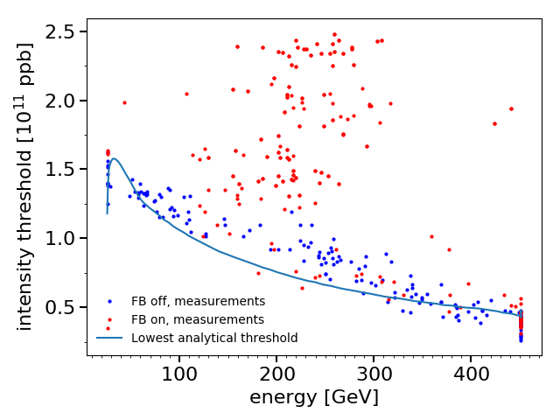
Stability threshold during ramp, 12 bunches Energy dependence in a single RF system
Presented last year
Instabilities at flat bottom were observed not reproduced in simulation
What is the effect of the 800 MHz RF system?

Slide 4
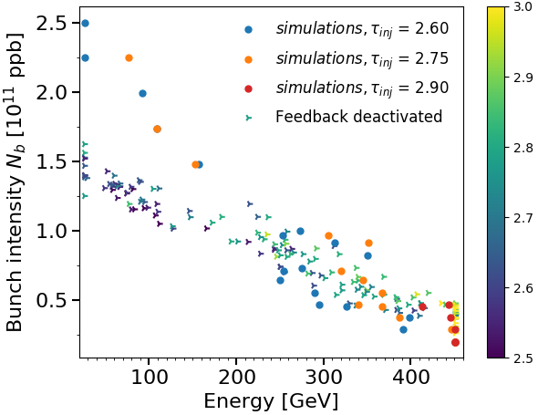
Intensity treshold during ramp, feedback off 12 bunches SRF: simulations vs measurements
Presented last year
Intensity threshold with feedback off, single RF system
Matched bunches in simulations
End of ramp and flat top well reproduced in simulations with correct bunch length
Difficulties to reproduce flat bottom instability
Short flat bottom in simulation (1s)
Bunch rotation in PS before extraction (s-shape)
Missing impedance?

Slide 5
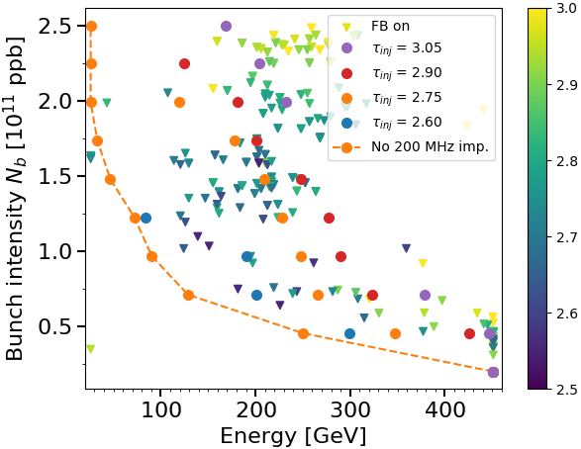
Stability treshold during ramp 12 bunches: simulations vs measurements
Presented last year
Steady-state formula of impedance reduction from feedback gives reasonable agreement
→ Increasing bunch length with intensity removes the energy dependence

Slide 6
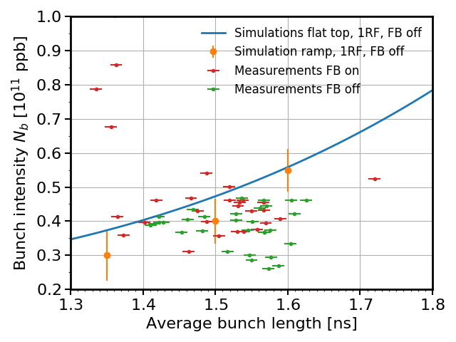
Stability threshold at flat top Comparison between ramp simulations and measurements
Presented last year
7 MV, single 200 MHz RF system, 12 bunches, feedback off
Measurements of unstable beam during ramp cannot be compared here
no information about bunch length at flat top
Stable beam
Bunch distribution in simulation is matched at flat top
→ Bunch distribution after ramp can differ from matched at flat top
Measured threshold at flat top is compared with simulations
→ Measurements of stable beams and simulations (FT and ramp) are in good agreement with feedback off

Slide 7
Instability at flat bottom
Presented last year
12 unstable bunches at flat bottom, single RF, $N_{b}=1.4×{10}^{11}$ ppb
Injected bunch length 3.3 ns
Bunch length after filamentation: 2.7 ns
Instability at flat bottom after 4 s
Bunch length [ns]
Instability observed but not reproduced yet in simulation
Problem of accuracy in the induced voltage calculation
Bunch distribution, long flat bottom
LLRF (phase-loop)
Missing impedance?
Can the 800 MHz RF system cure the instability at flat bottom?

Slide 8
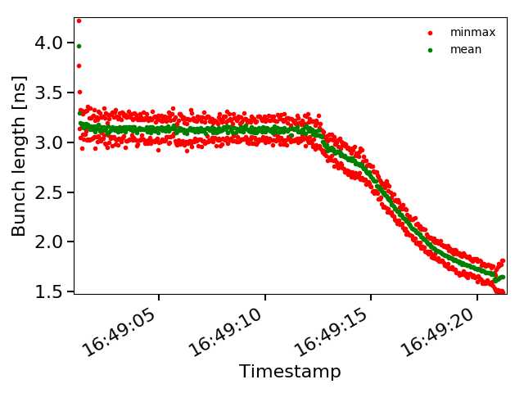
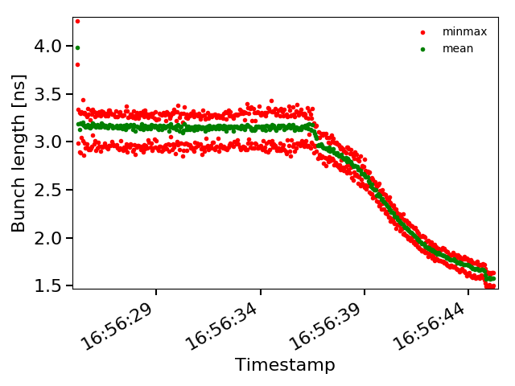
Beam stability with 12 highest intensity bunches as a function of the voltage ratio between the two RF systems
Intensity at injection: $2.45×{10}^{11}$ ppb, decreases to $∼2.3×{10}^{11}$ ppb during the flat bottom,
nominal 200 MHz voltage program ($V_{200}=4.5$ MV at injection, $V_{200}=7$ MV at flat top), $V_{800}=r×V_{200}$
Bunch length evolution, $V_{800}=0.15×V_{200}$
Bunch length evolution$, V_{800}=0.2×V_{200}$
High intensity beams unstable at flat top with low voltage ratio ($≤0.15$)
Can be stabilized by increasing the voltage ratio
→ Bunch length oscillations with larger amplitude at flat bottom for a larger voltage ratio (similar observations with lower intensities)

Slide 9
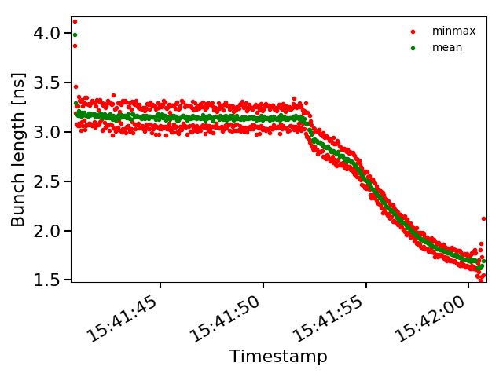
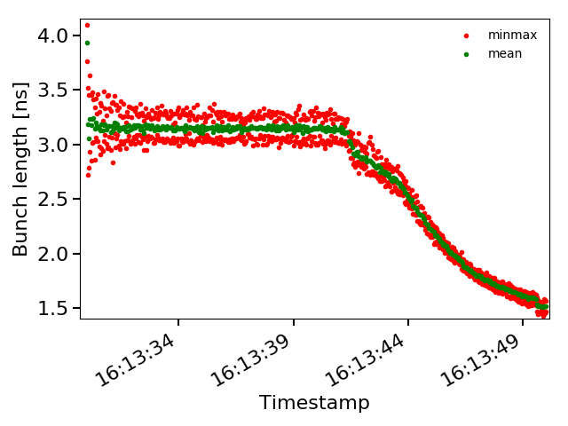
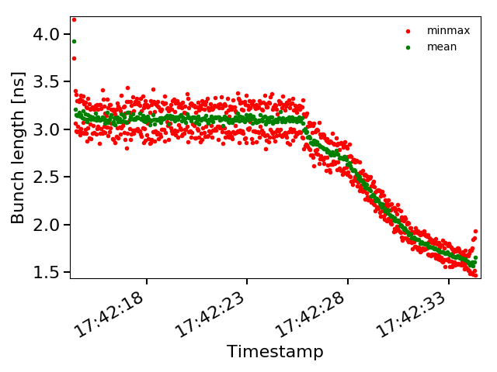
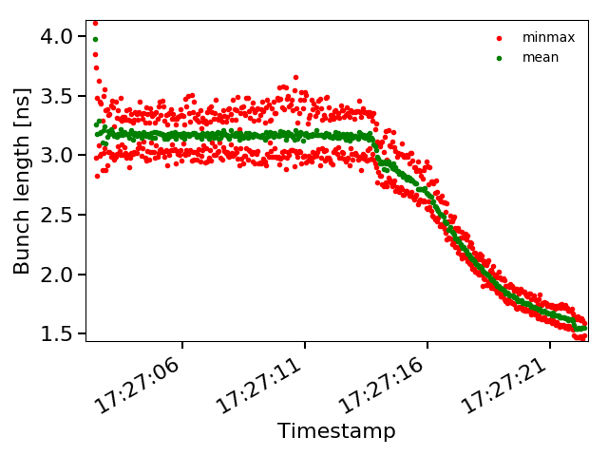
Beam stability with 12 lower intensity bunches as a function of the voltage ratio between the two RF systems
$$V_{800}=0.05×V_{200}$$
$$V_{800}=0.25×V_{200}$$
Bunch intensity injected
$1.95×{10}^{11}$ ppb
$$V_{800}=0.10×V_{200}$$
$$V_{800}=0.25×V_{200}$$
Bunch intensity injected
$2.0×{10}^{11}$ ppb
→ Improved stability at flat top with large ratio $V_{800}/V_{200}$ but larger oscillations at flat bottom observed

Slide 10
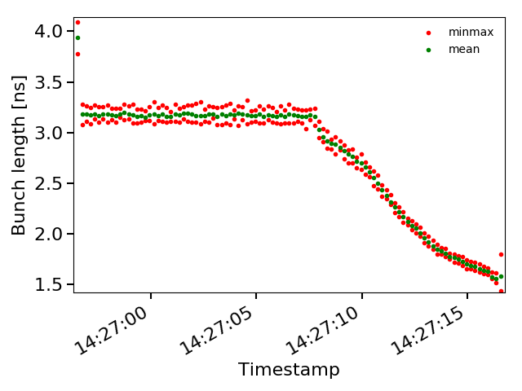
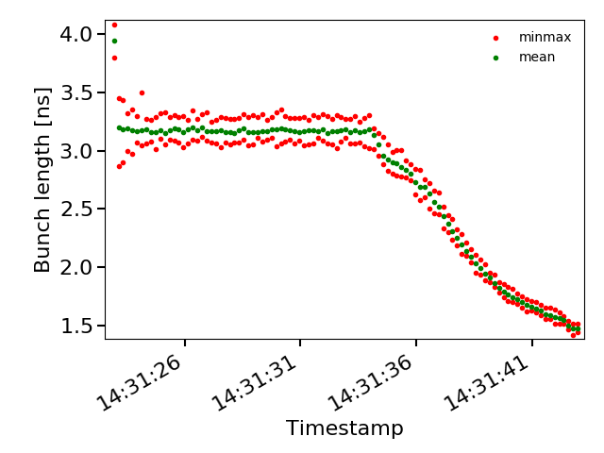
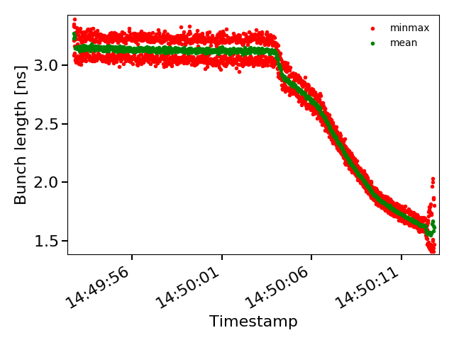
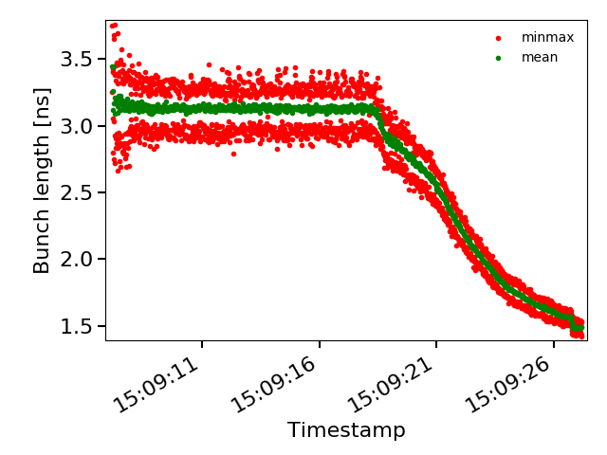
Beam stability with 12 lower intensity bunches as a function of the voltage ratio between the two RF systems
$$V_{800}=0.05×V_{200}$$
$$V_{800}=0.25×V_{200}$$
Bunch intensity injected
$1.4×{10}^{11}$ ppb
$$V_{800}=0.05×V_{200}$$
$$V_{800}=0.25×V_{200}$$
Bunch intensity injected
$1.65×{10}^{11}$ ppb
→ Same observations with lower intensities: improved flat top stability with a larger voltage ratio $V_{800}/V_{200}$ but larger oscillations at flat bottom

Slide 11
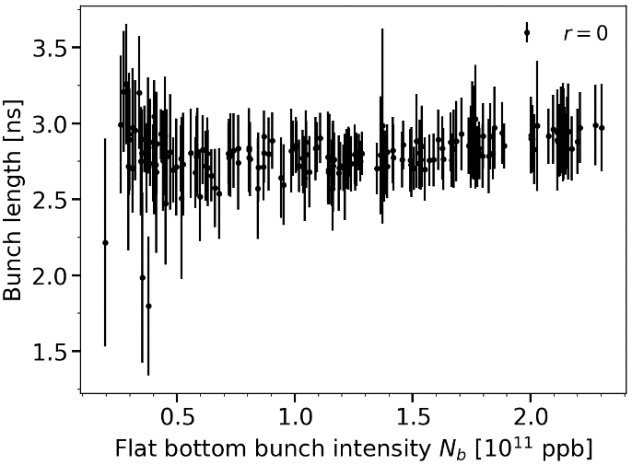
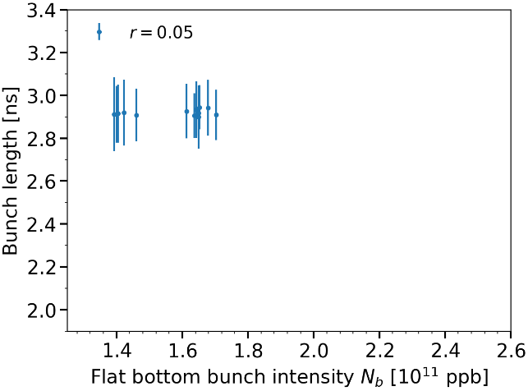
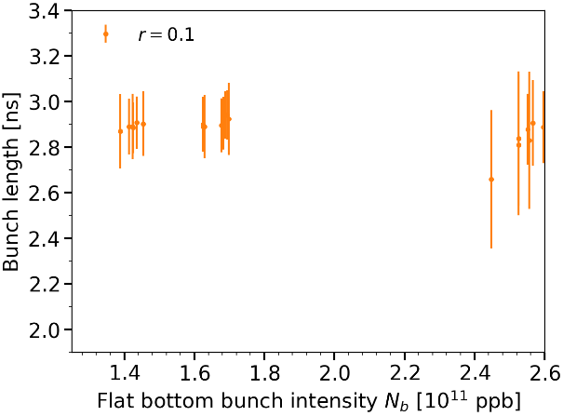
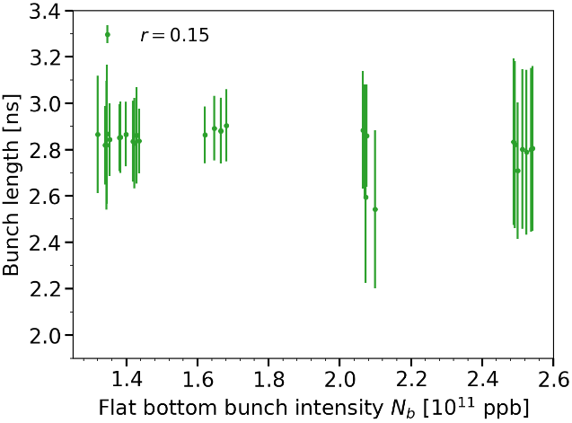
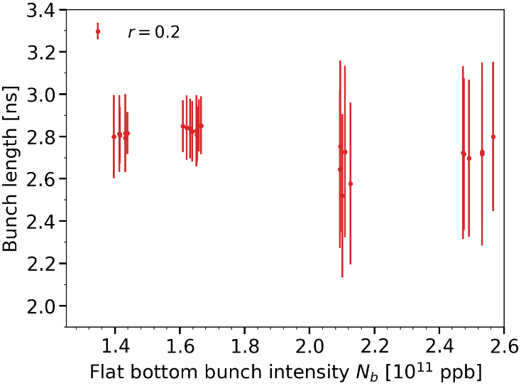
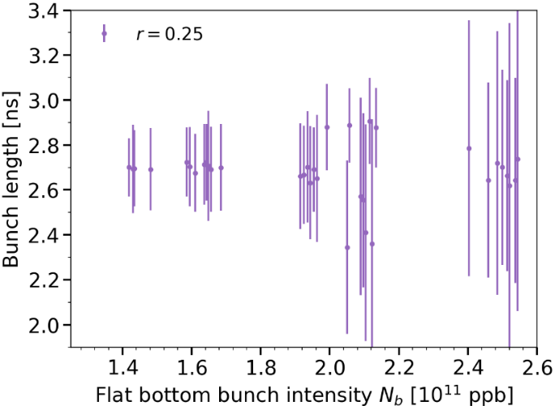
Bunch length (FB) versus bunch intensity for different $V_{800}/V_{200}$ voltage ratios
FB on, FF on
Batch of 12 bunches, nominal LHC voltage program. Bad beam quality last year compared to 2018.
The error bars represent the maximum amplitude of the bunch length oscillations
Data from last year
$$V_{800}=0$$
Different scales!
$$V_{800}=0$$
$$V_{800}=0.05×V_{200}$$
$$V_{800}=0.1×V_{200}$$
$$V_{800}=0.15×V_{200}$$
$$V_{800}=0.2×V_{200}$$
$$V_{800}=0.25×V_{200}$$
A small voltage ratio improves the stability at flat bottom (compared to r=0)
Larger oscillations with increasing $V_{800}/V_{200}$ ratio, why?

Slide 12
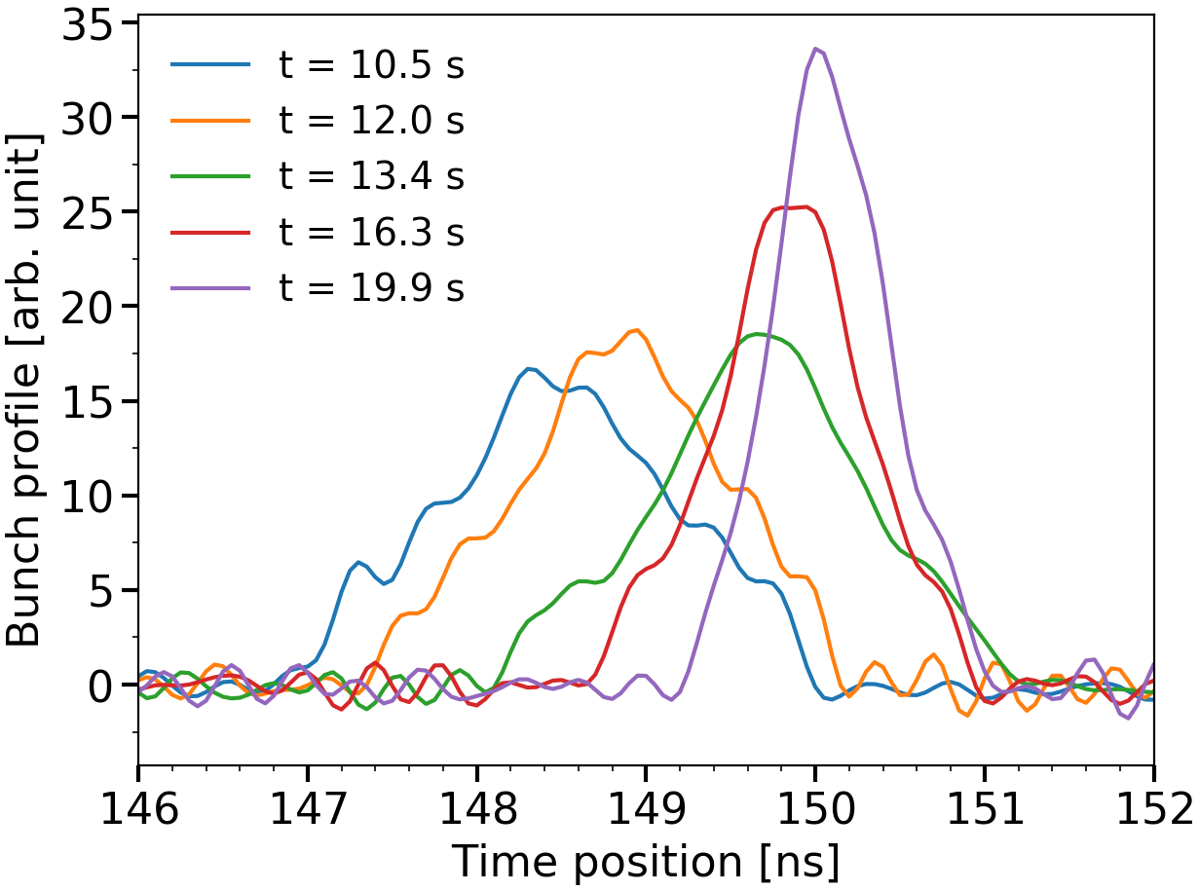
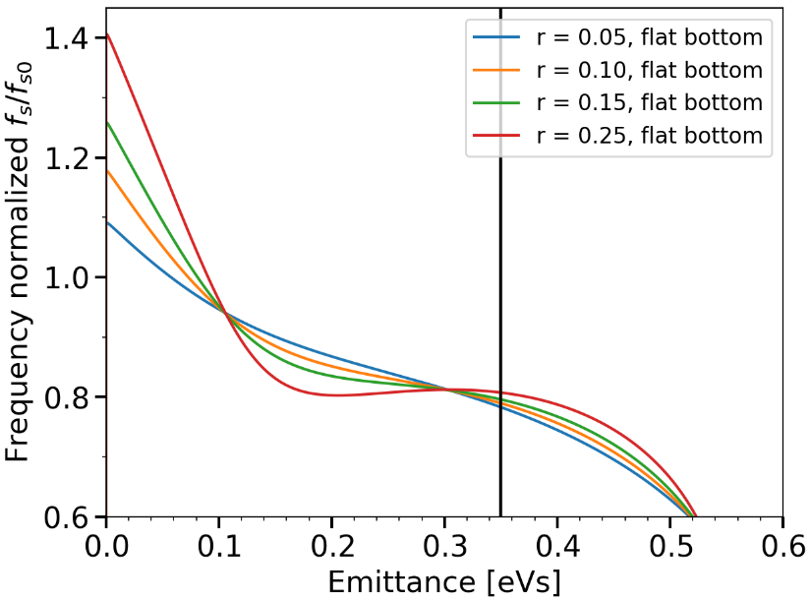
Bunch profile evolution during cycle, large tails at FB with a large voltage ratio (0.25)
Bunch line density measured during cycle
Synchrotron frequency at FB
for different voltage ratios (BSM)
For voltage ratios $V_{800}/V_{200}$ > 0.1
the bunch has a flat portion in the synchrotron frequency distribution

Slide 13
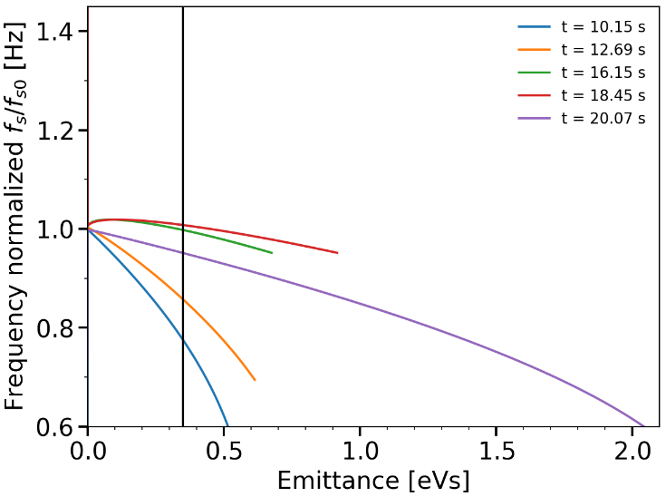
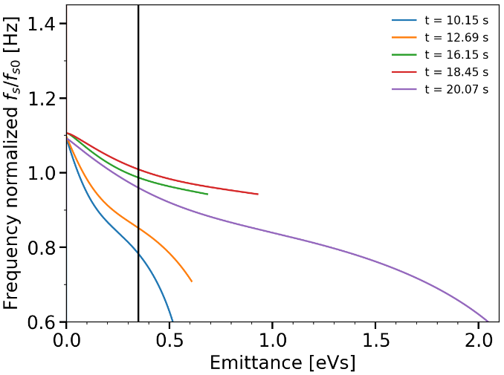
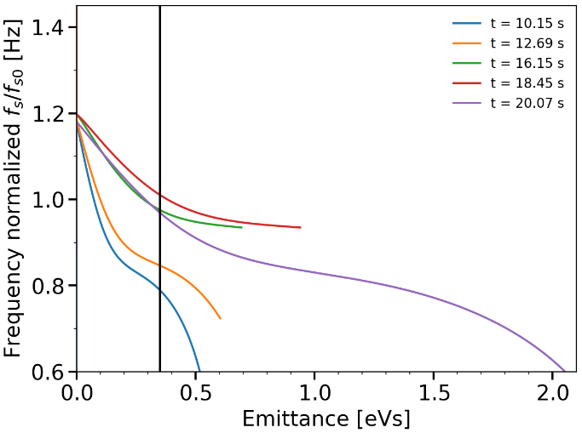
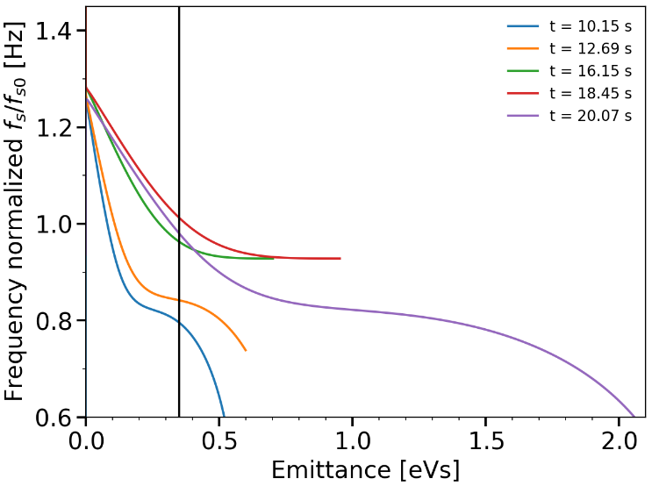
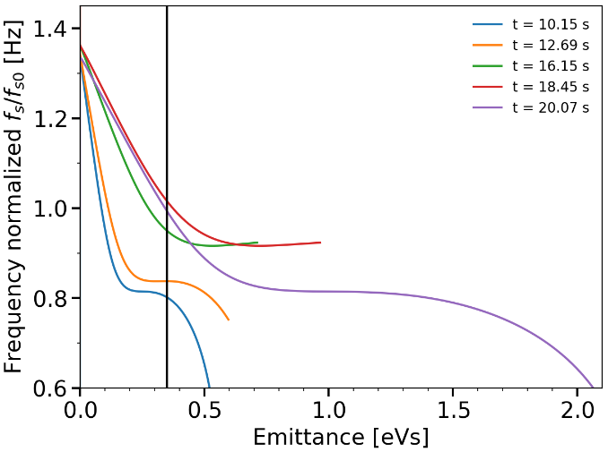
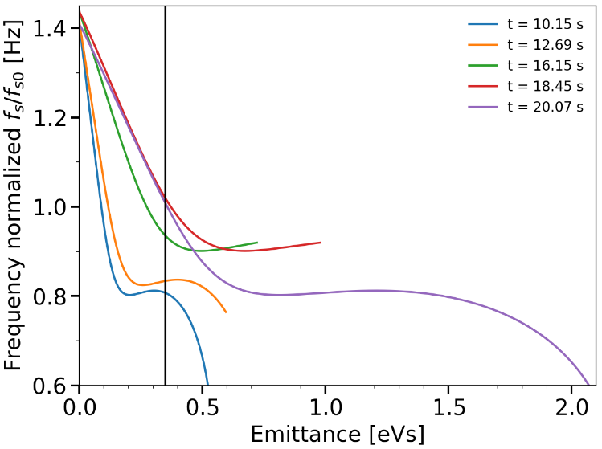
Synchrotron frequency distribution during cycle for different voltage ratios with ${φ_{800}−φ}_{200}=π$ (BSM)
− Flat top
− Flat bottom
$$V_{800}=0.05×V_{200}$$
$$V_{800}=0.1×V_{200}$$
$$V_{800}=0$$
$$V_{800}=0.15×V_{200}$$
$$V_{800}=0.2×V_{200}$$
$$V_{800}=0.25×V_{200}$$
The plateau in the synchrotron frequency distribution at flat bottom (r > 0.1) gives a large coherent response explaining the oscillations observed
Large spread at flat top for every ratio $0<r≤0.25$ → Improved stability
Impossible to increase the synchrotron frequency spread at flat bottom?

Slide 14
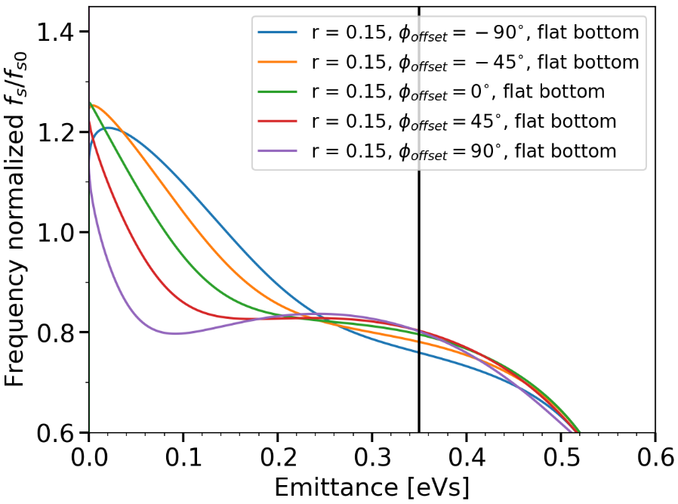
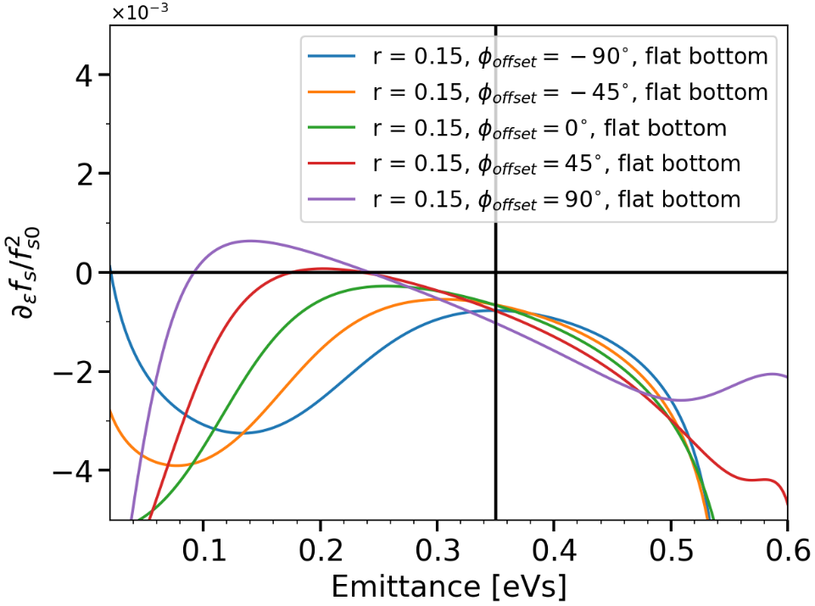
Synchrotron frequency distribution, $V_{800}/V_{200}=0.15$ Effect of phase shift between the two RF systems
$$V_{800}\left(t\right)=V_{800}sin⁡(4ω_{rf}t+π+φ_{offset})$$
Synchrotron frequency distribution
$V_{800}=0.15×V_{200}$, different $φ_{offset}$
Derivative of the synchrotron frequency
$V_{800}=0.15×V_{200}$, different $φ_{offset}$
A negative phase shift from the bunch-shortening mode reduces the plateau in the synchrotron frequency distribution
The same behaviour observed for other voltage ratios $V_{800}/V_{200}$
/!\ The acceptance is reduced with a phase shift (to be checked!)

Slide 15
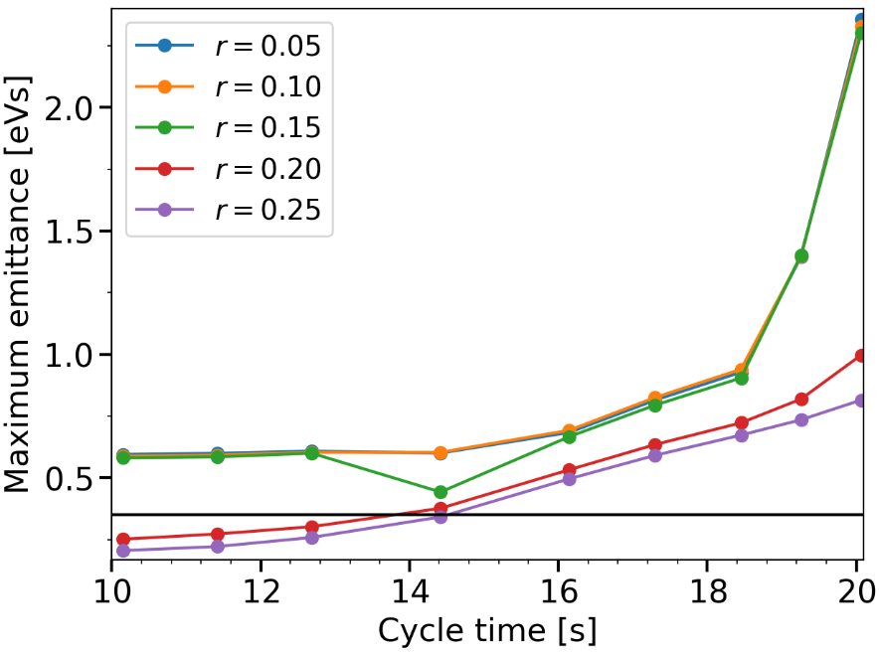
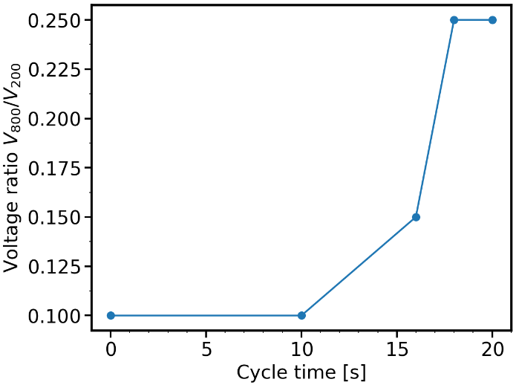
Maximum emittance during cycle for different voltage ratios $V_{800}/V_{200}$ with ${φ_{800}−φ}_{200}=π$ (BSM)
Critical emittance is defined by the emittance of the first zero crossing of $∂_{ε}f_{s}$ or the one closest to zero
Maximum emittance is the critical one if $∂_{ε}f_{s}$ crosses zero or the acceptance if no plateau
Momentum cycle (LHC nominal)
Voltage ratio during cycle, first approximation
$ε=0.6$ eVs
$ε=0.35$ eVs
Taking into account controlled emittance blow-up the voltage ratio $V_{800}/V_{200}$ can be increased to 0.15 after ~16 s and to >0.2 after ~18 s

Slide 16
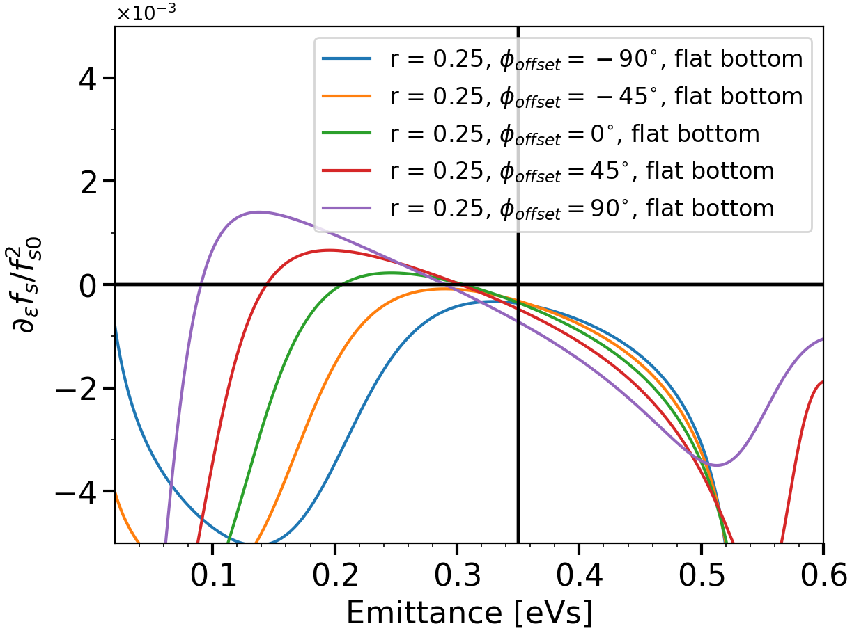
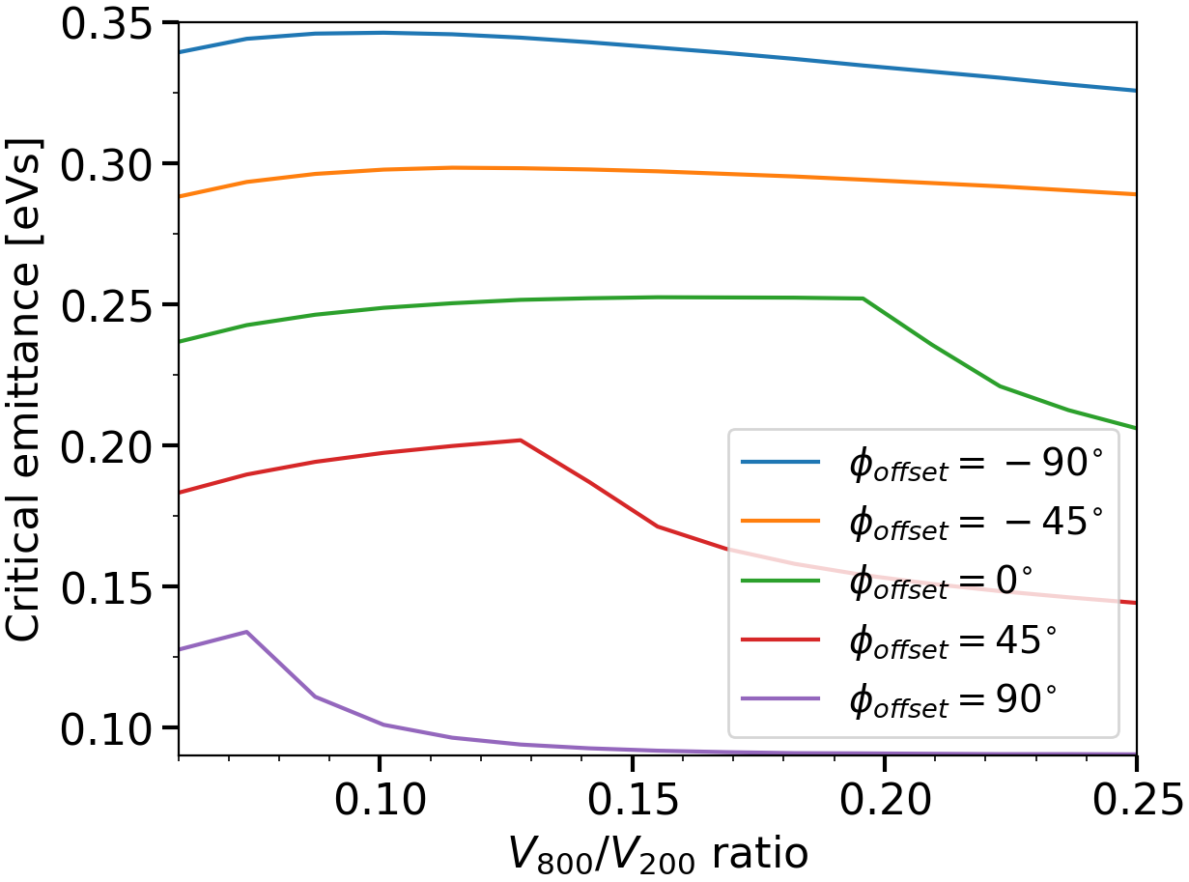
Critical emittance at flat bottom Effect of phase shift between both RF systems
* Critical emittance is defined by the emittance of the first zero crossing of $∂_{ε}f_{s}$ or the one closest to zero
Derivative of the synchrotron frequency
$V_{800}=0.25×V_{200}$, different $φ_{offset}$
Critical emittance as a function of $V_{800}/V_{200}$
for different $φ_{offset}$ (shaded area = no zero crossing)
*
*
*
A negative phase shift from the bunch-shortening mode increases the bunch emittance without flat portion in the synchrotron frequency distribution
The stability is not necessarily ensured but lower coherent response expected
The acceptance is reduced with a phase shift (to be checked!)

Slide 17
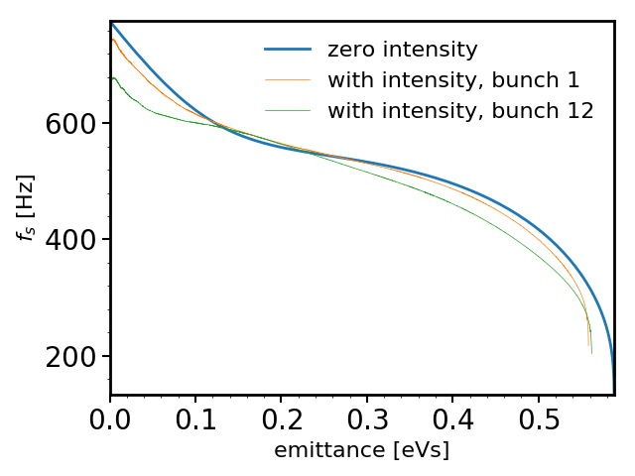
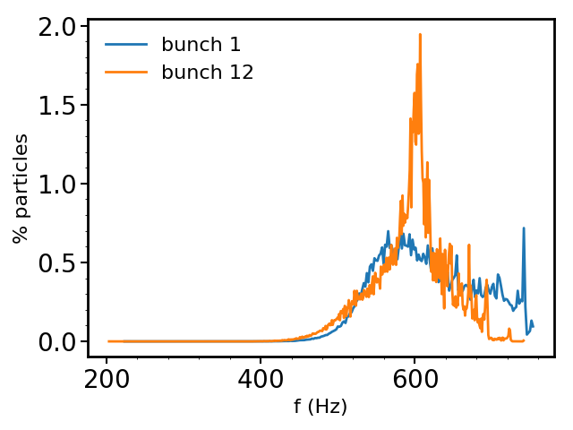
Synchrotron frequency distribution and intensity effects An example from simulations at flat bottom, 2 RF, $V_{800}=0.1×V_{200}$
Beam of 12 bunches, 3 ns long with $N_{b}=2.3×{10}^{11}$ ppb
Synchrotron frequency distribution
with and without intensity effects (bunch 1 and 12)
Distribution of particles in synchrotron frequency,
bunch 1 and 12
Single RF: peak at ~4%, ~650 Hz
Frequency shift from intensity effects → changes the plateau
Due to beam loading, each bunch sees a different synchrotron frequency shift and a different phase of the 800 MHz
To be checked in simulations!

Slide 18
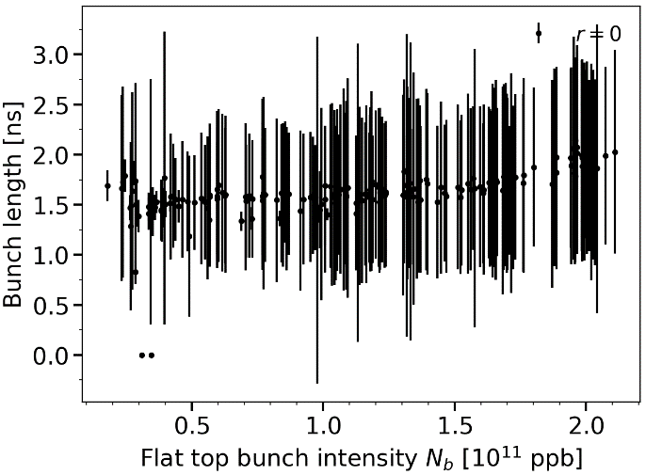
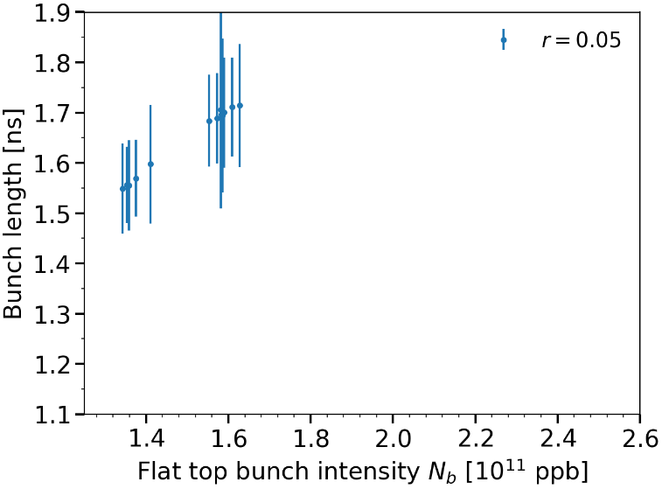
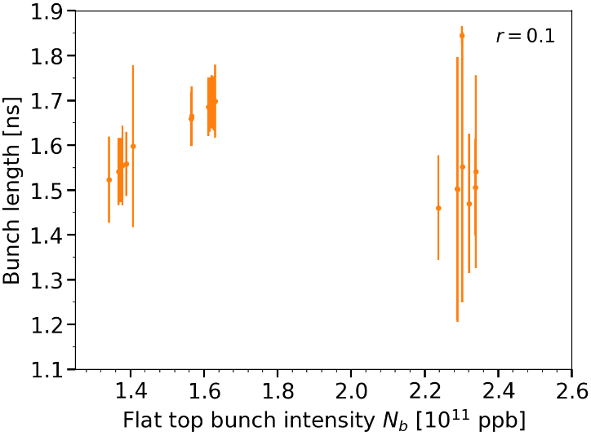
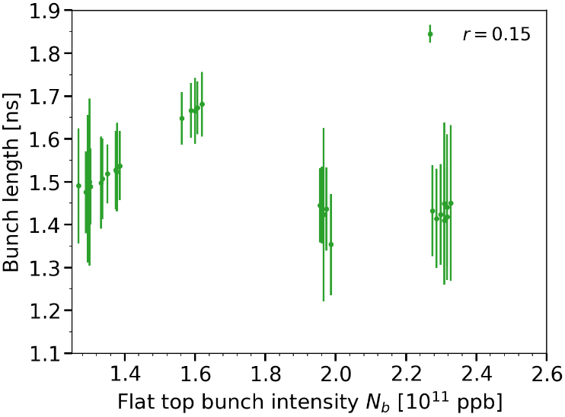
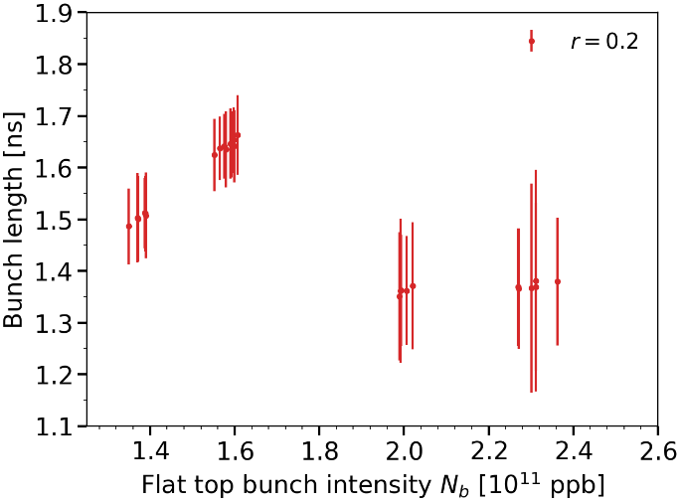
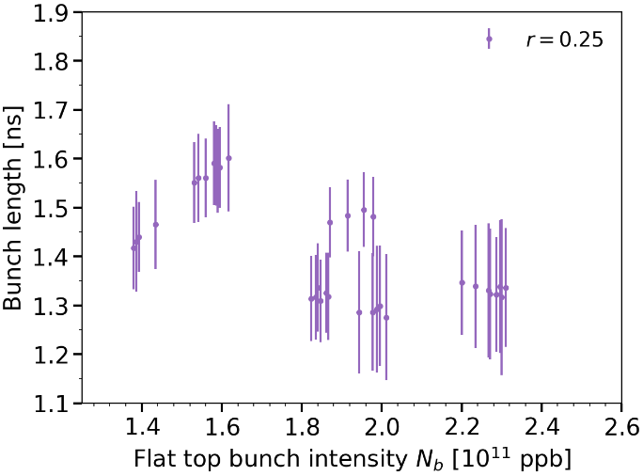
Bunch length (FT) versus bunch intensity for different $V_{800}/V_{200}$ voltage ratios
Data from last year
$$V_{800}=0$$
$$V_{800}=0.05×V_{200}$$
$$V_{800}=0.1×V_{200}$$
$$V_{800}=0.15×V_{200}$$
$$V_{800}=0.2×V_{200}$$
$$V_{800}=0.25×V_{200}$$
Improved stability at flat top with increasing voltage ratio $V_{800}/V_{200}$

Slide 19
Conclusion
The high intensity beam with 12 bunches ($2.45×{10}^{11}$ ppb injected) can be stabilized by increasing the voltage ratio $V_{800}/V_{200}$
For voltage ratios $V_{800}/V_{200}>0.1$ at flat bottom, large bunch oscillations are observed
→This is the effect of the flat portion in the synchrotron frequency distribution which induces a large coherent response.
To increase further the synchrotron frequency spread at flat bottom the phase difference between both RF systems can be adjusted
A negative frequency shift from the bunch-shortening mode can remove the plateau
At flat top the voltage ratio $V_{800}/V_{200}$ can be increased to 0.25 (maximum before creation of smaller buckets) to increase the synchrotron frequency spread

Slide 20
THANK YOU FOR YOUR ATTENTION!

Slide 21
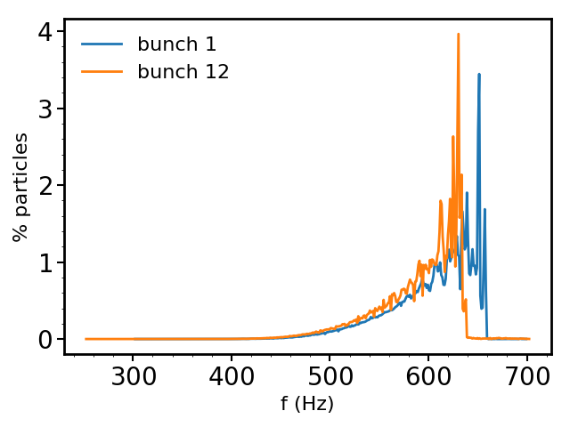
Synchrotron frequency distribution and intensity effects An example from simulations at flat bottom, 1RF vs 2 RF (10%)
1RF
2RF

Slide 22
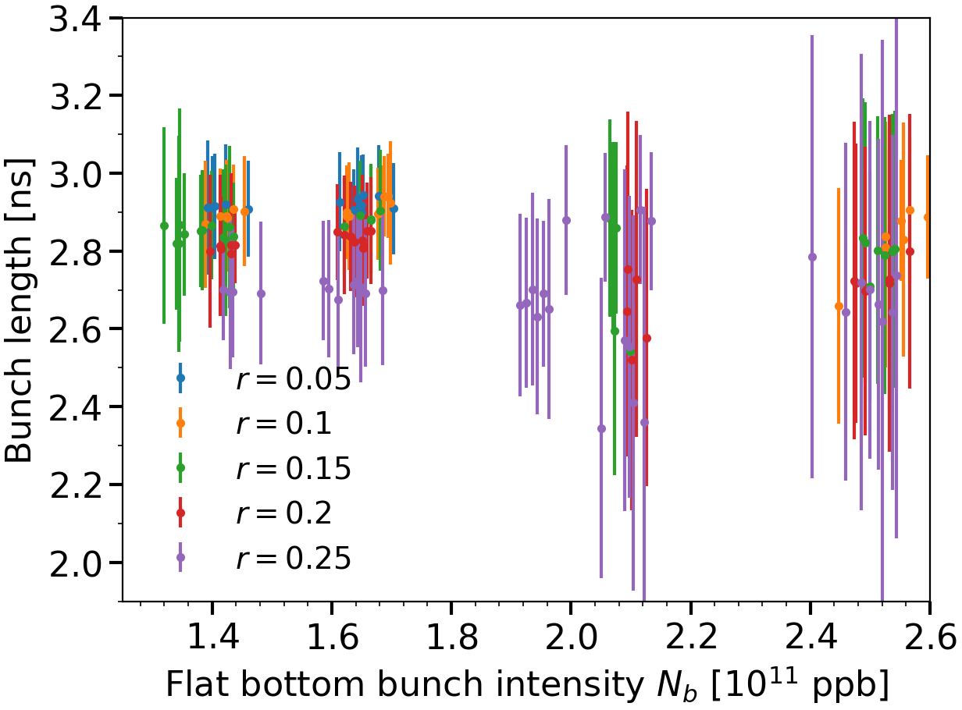
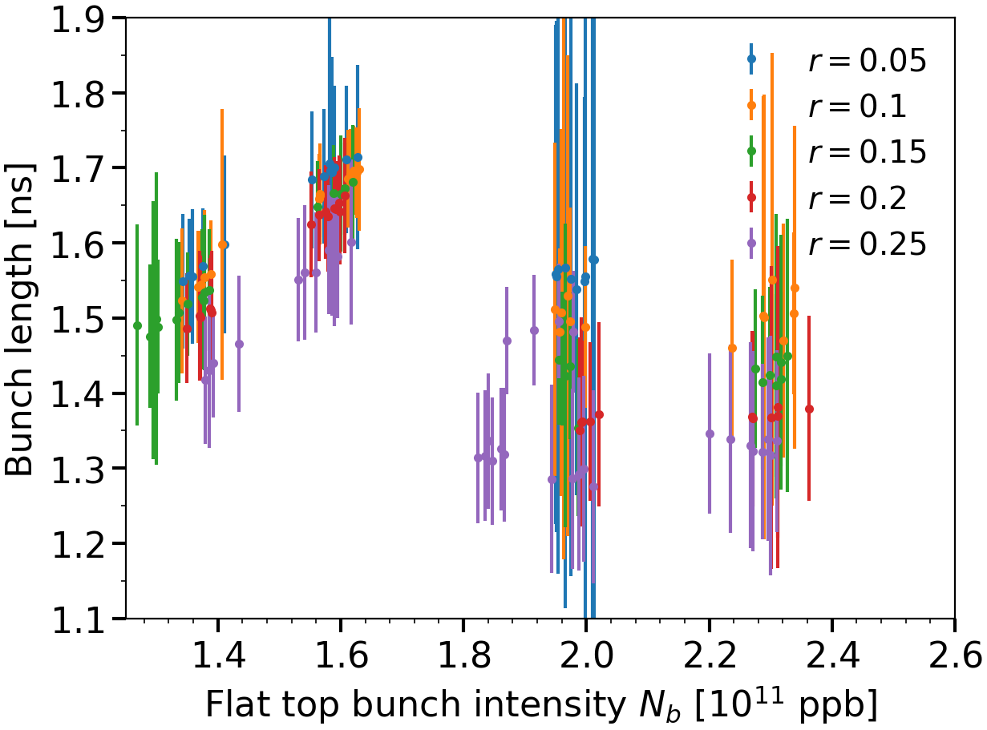
Bunch length comparison with different voltage ratio (>0)
Flat bottom
Flat top

Slide 23
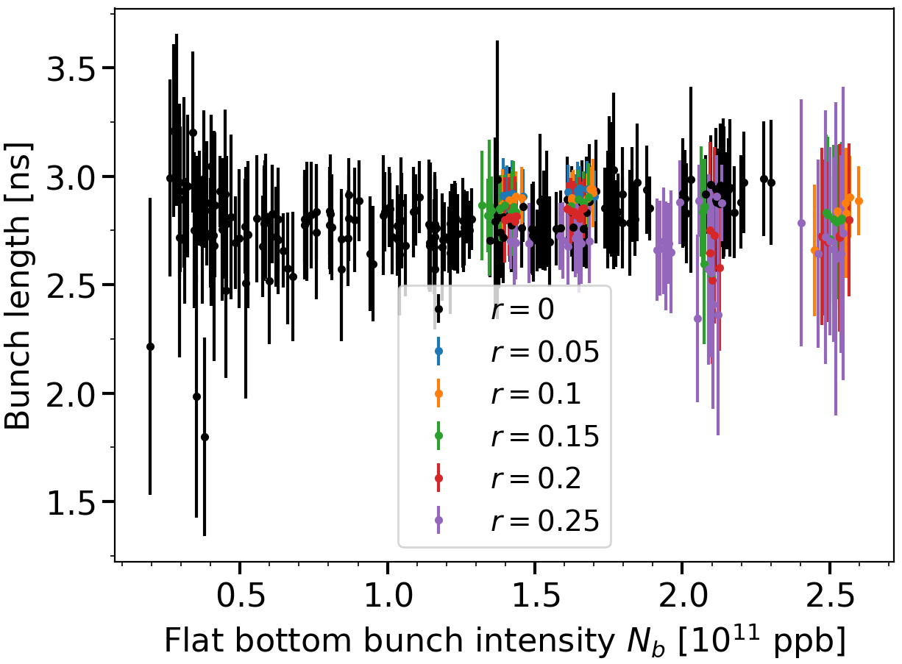
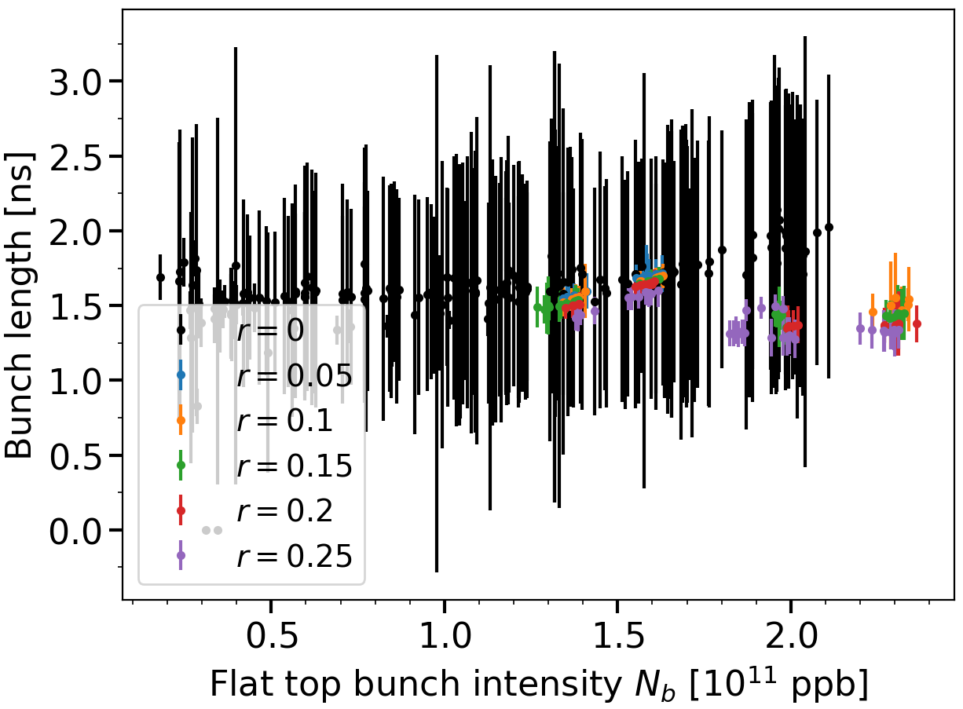
Bunch length comparison with different voltage ratio
Flat bottom
Flat top

Slide 24
$N_{b}=1.4×{10}^{11}$ ppb
$$V_{800}=0.05{×V}_{200}$$
$N_{b}=1.4×{10}^{11}$ ppb
$$V_{800}=0.1{×V}_{200}$$
$N_{b}=1.4×{10}^{11}$ ppb
$$V_{800}=0.15{×V}_{200}$$
$N_{b}=1.4×{10}^{11}$ ppb
$$V_{800}=0.2{×V}_{200}$$
$N_{b}=1.4×{10}^{11}$ ppb
$$V_{800}=0.25{×V}_{200}$$

Slide 25
$N_{b}=1.65×{10}^{11}$ ppb
$$V_{800}=0.05{×V}_{200}$$
$N_{b}=1.65×{10}^{11}$ ppb
$$V_{800}=0.1{×V}_{200}$$
$N_{b}=1.65×{10}^{11}$ ppb
$$V_{800}=0.15{×V}_{200}$$
$N_{b}=1.65×{10}^{11}$ ppb
$$V_{800}=0.2{×V}_{200}$$
$N_{b}=1.65×{10}^{11}$ ppb
$$V_{800}=0.25{×V}_{200}$$

Slide 26
$N_{b}=1.95×{10}^{11}$ ppb
$$V_{800}=0.05{×V}_{200}$$
$N_{b}=1.95×{10}^{11}$ ppb
$$V_{800}=0.1{×V}_{200}$$
$N_{b}=1.95×{10}^{11}$ ppb
$$V_{800}=0.15{×V}_{200}$$
$N_{b}=1.95×{10}^{11}$ ppb
$$V_{800}=0.2{×V}_{200}$$
$N_{b}=1.95×{10}^{11}$ ppb
$$V_{800}=0.25{×V}_{200}$$

Slide 27
$N_{b}=2.0×{10}^{11}$ ppb
$$V_{800}=0.05{×V}_{200}$$
$N_{b}=2.0×{10}^{11}$ ppb
$$V_{800}=0.1{×V}_{200}$$
$N_{b}=2.0×{10}^{11}$ ppb
$$V_{800}=0.15{×V}_{200}$$
$N_{b}=2.0×{10}^{11}$ ppb
$$V_{800}=0.2{×V}_{200}$$
$N_{b}=2.0×{10}^{11}$ ppb
$$V_{800}=0.25{×V}_{200}$$

Slide 28
$N_{b}=2.45×{10}^{11}$ ppb
$$V_{800}=0.1{×V}_{200}$$
$N_{b}=2.45×{10}^{11}$ ppb
$$V_{800}=0.15{×V}_{200}$$
$N_{b}=2.45×{10}^{11}$ ppb
$$V_{800}=0.2{×V}_{200}$$
$N_{b}=2.45×{10}^{11}$ ppb
$$V_{800}=0.25{×V}_{200}$$

