Slide 1
Update on the BPV Impedance Aaron Farricker Contributions from: B. Salvant & J. Varela

Slide 2
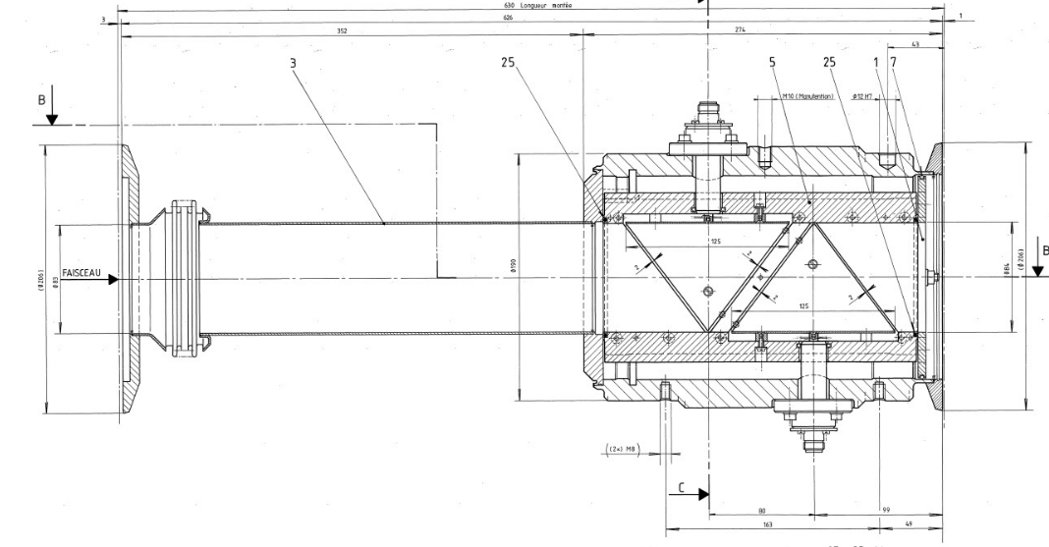
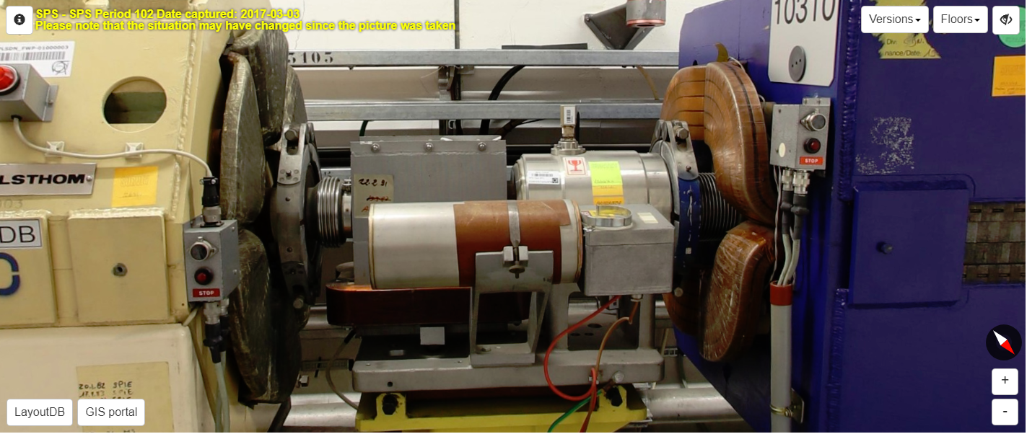
What is the BPV?
The BPV is vertical BPM usually found upstream of every QD
They form an important part of the systems which measure the orbit of the beam
The are a type of BPM known as a shoebox

Slide 3
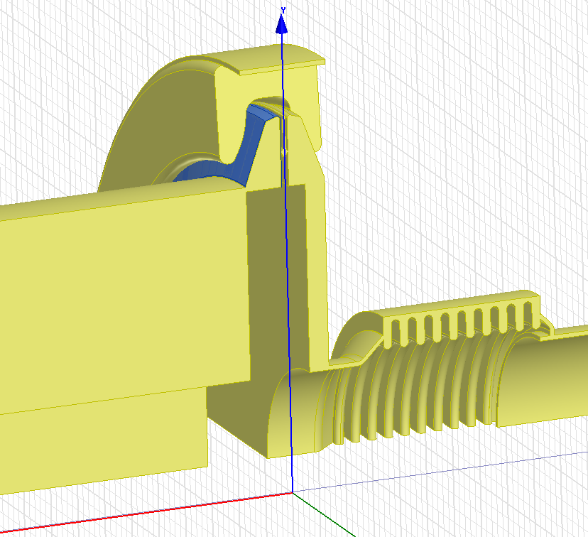
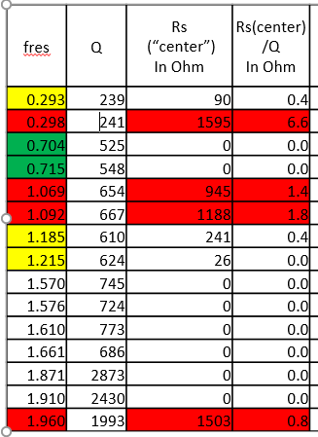
Current Model
B.Salvant LIU-SPS-BDWG
J. Varela LIU-SPS-BDWG 04/09/2014
Resonant Mode:
Rsh = 7 kΩ
Q = 315
F = 1.210 GHz
The BPV and its flange have been treated separately
The model of the device itself is accurate and in agreement with the designs
The model of the flange is no longer available
In the Longitudinal model the lowest frequency peaks are not present

Slide 4
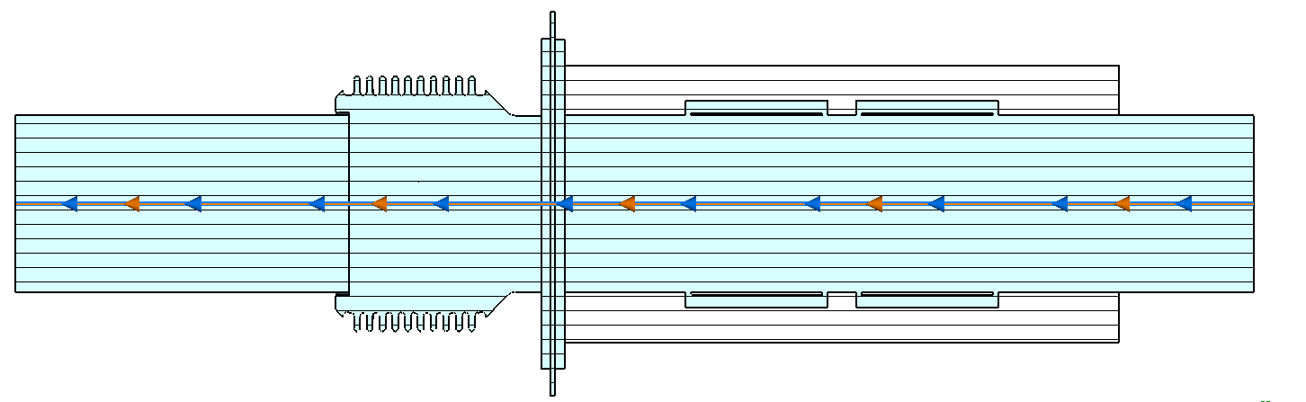
Remodeling
The BPV and flange were modelled together
As the geometry of the BPV constructed by Benoit was accurate that was used as one of the pieces
The bellow and flange were reconstructed from the original drawings
As the Flange is enameled the enamel was simulated as porcelain in using CST default settings

Slide 5
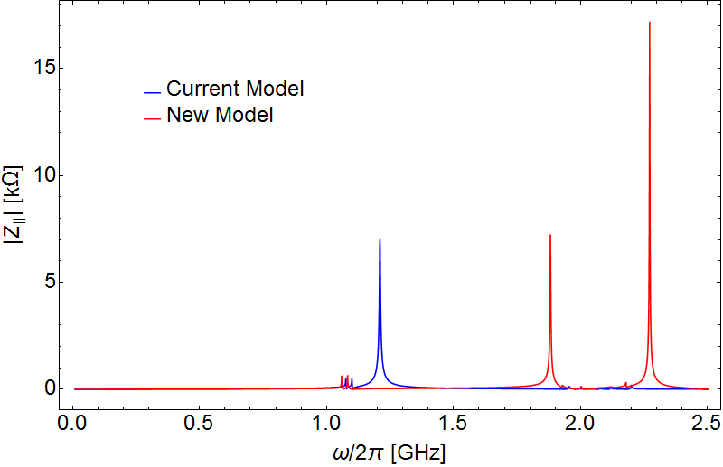
Impedance
Not Simulated Originally
This moves

Slide 6
Impedance--Comments
The BPV
In the resonances which originate in the BPV itself the frequencies have shifted downwards a little
This is due to the increased volume of the bellow and flange pulling the frequency down
The Flange
The frequency is significantly higher than in the original model up to 1.21→1.85 GHz
There is the extra peak at 2.3 GHz which was not simulated originally
Not Simulated Originally
This moves

Slide 7
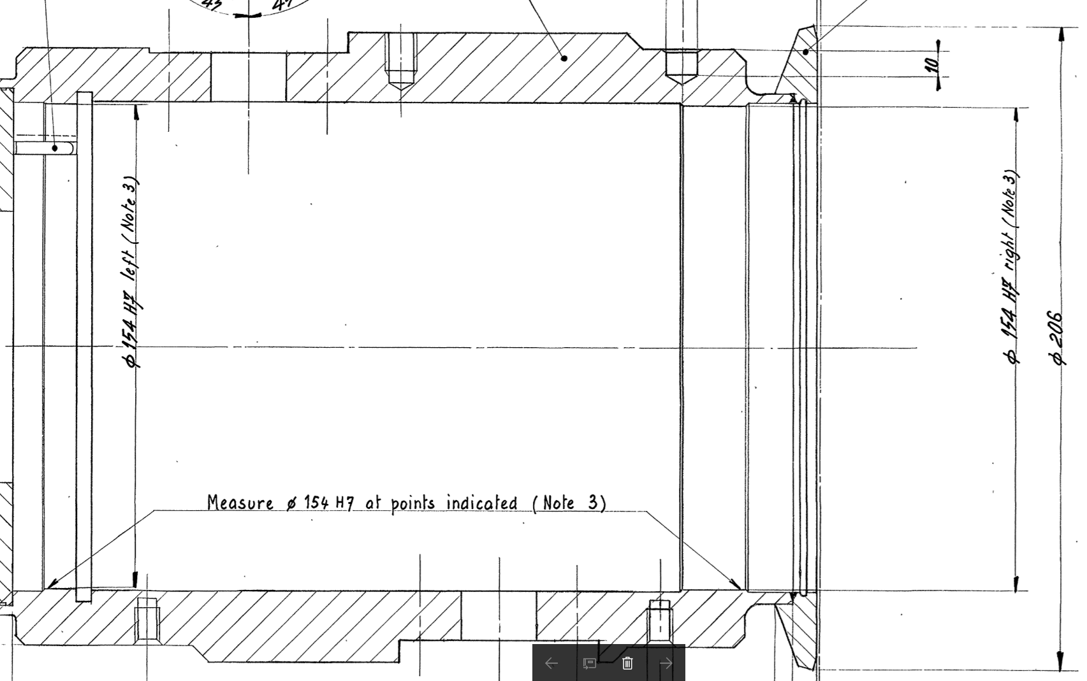
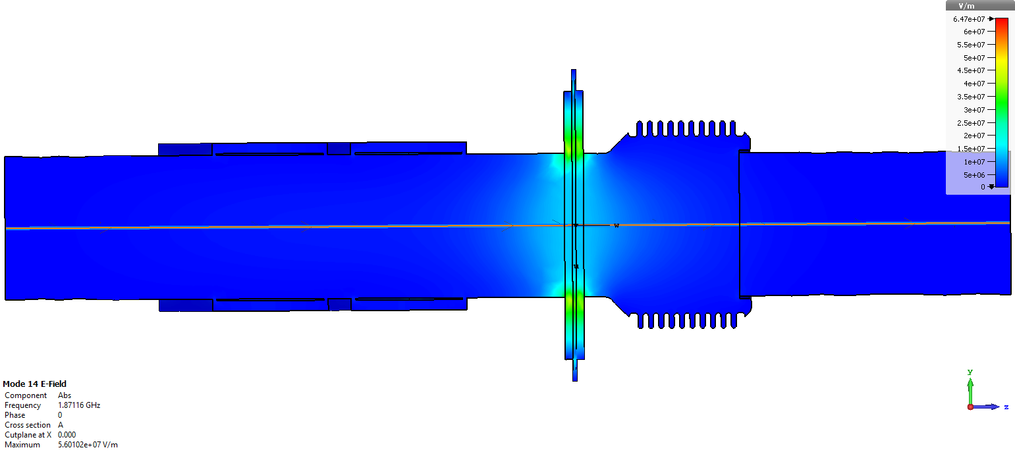
Does the Change Make Sense
The original frequency suggests a ‘cavity’ with a diameter of at least 189 mm
Clearly from the drawing shows this is not possible and suggests the maximum possible diameter is 154 mm
This give a frequency of at least 1.5 GHz
This is a strong indication that the frequency is indeed higher than in the model
Even with the enamel on the flange the frequency could not be pulled down this much
154 mm

Slide 8
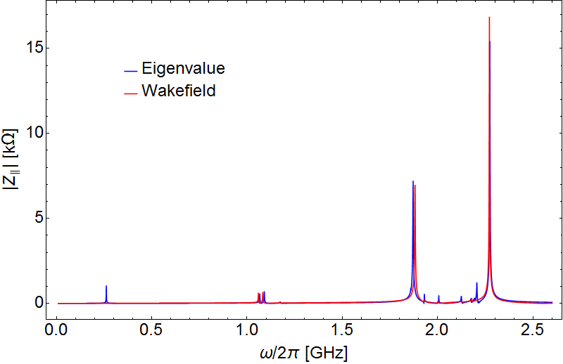
One Remaining Question
The eigenvalue simulations both with and without the flange suggest there are two low frequency modes at approximately 300 MHz
These are not in the impedance model but the same model was used for the BPV so why?
When I simulate the model in Eigenmode the modes are present however in Wakefield they disappear
This is unusual for low frequency modes as they are well within the bunch frequency spectra
I can only suppose there is a meshing issue in the Wakefield solver which makes it vanish

Slide 9
Summary
The original model of the BPV done by Benoit is an accurate model of the geometry
However the impedance attributed to the flange appears to be incorrect
Rebuilding the model to include both the flange and BPV showed small frequency changes in the BPV modes
More significantly it showed a huge frequency discrepancy in the flange mode of around 500 MHz
Some investigation needs to be done into why the low frequency mode does not appear in the wakefield

Slide 10
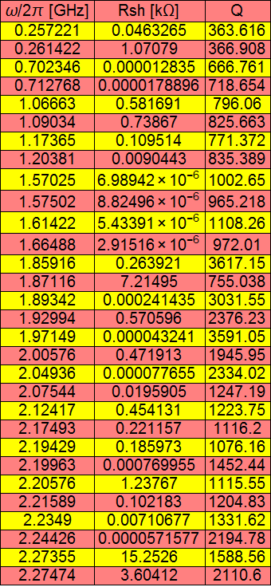
Eigenmode Summary
New Model
Old Model
Flange Mode:
Rsh = 7 kΩ
Q = 315
F = 1.210 GHz

