Slide 1
Longitudinal instability of 12 bunches on the SPS flat bottom - Measurements
Participants:
A. Lasheen, J. Repond, M. Schwarz, E. Shaposhnikova Acknowledgements:
H. Bartosik, T. Bohl, G. Papotti, SPS&PS operator team

Slide 2
Flat bottom instability for different machine and beam parameters
Setup:
MD 9 August 2018: 12 bunches, 25ns spacing, Q20
Intensity variable: 0.8e11 to 2.2e11 protons per bunch (ppb)
longitudinal emittance variable:
FeedForward: off, Phase loop: on, long. damper: on/off
FeedBack on/off and ‘at 50%’ by switching off FB in cavity 1 and 3
V₂₀₀ = 4.5 MV, V₈₀₀ off
Consider data at flat bottom up to 19.2 s; then ramp
NOTE: only one 40 MHz cavity was used in the PS for bunch rotation;
this might be the cause of high losses (10% to 20%)
negative losses after injection (-2%) as uncaptured halo moves above/below bunch
Outline:
Instability threshold
‘Mode analysis’
Instability and losses

Slide 3
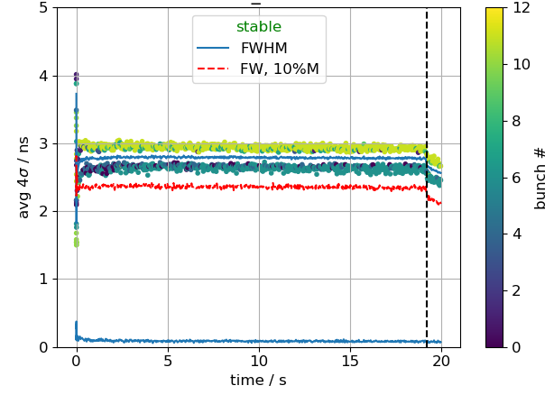
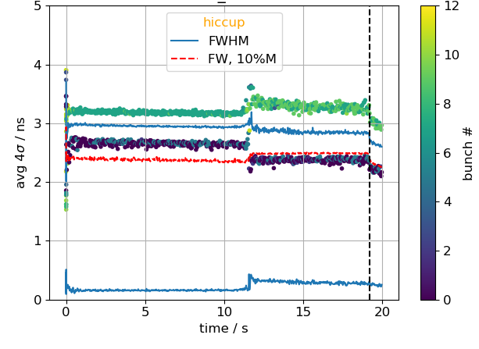
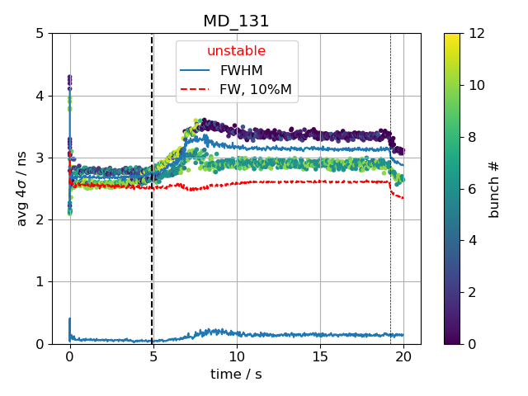
Flat bottom bunch length
Beam:
is stable along entire flat bottom
develops an instability sometime between 2s and 19s
has a ‘hiccup’ for high intensity with only cavity 2&4 feedback on
rise time and onset of instability similar for all bunches
instability occurs between 2s and 19s
hiccup occurs
instability starts

Slide 4
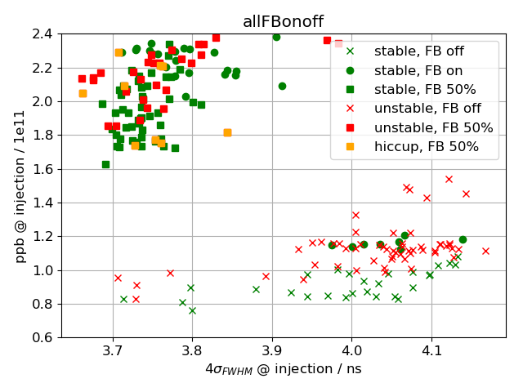
Injected bunch length vs intensity
Bunch length, ppb at injection (i.e. first turn in SPS)
Started MD with nominal intensity and bunch length
Increased intensity to 2.2e11 ppb and decreased emittance
Studies with different FB settings at high intensity
Decreased intensity back 1.0e11 ppb and increased emittance
Decreased emittance
Whether bunches are stable/unstable is independent on injected bunch length
For high intensity, no clear threshold observed
Without FB and low intensity, threshold around 1.0e11 ppb
For nominal intensity, bunches that are stable when FB is on have same initial conditions as unstable bunches

Slide 5
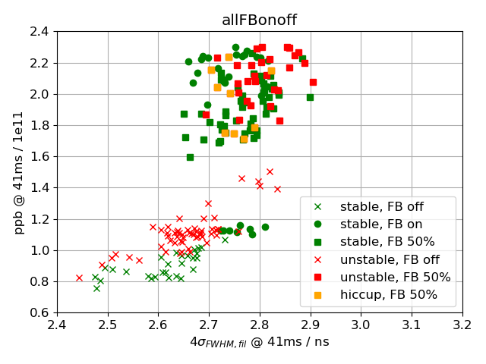
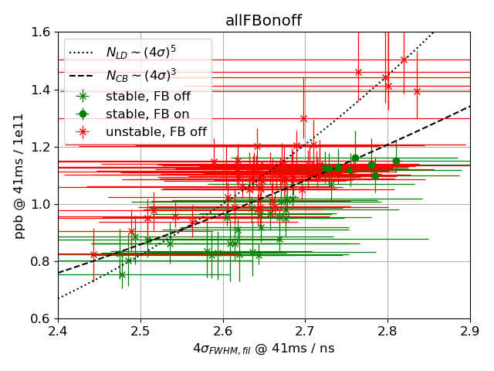
Filamented bunch length vs intensity
Bunch length, ppb after filamentation (~41 ms)
No clear pattern for high intensities
For nominal and low intensities, instability threshold seems to follow coupled bunch instability threshold (N_{CB}), instead the one for loss of Landau damping (N_{LD}). (*)
Errorbars show min/max value
(*) threshold curves multiplied by arbitrary constant to roughly follow data (i.e. no fit)

Slide 6
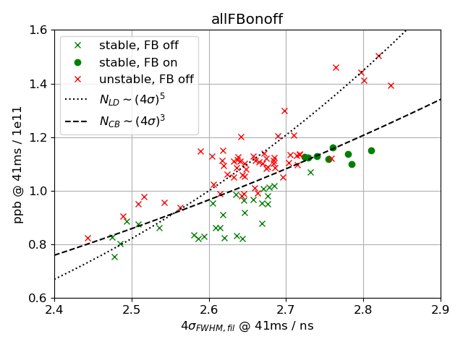
Filamented bunch length vs intensity
Bunch length, ppb after filamentation (~41 ms)
No clear pattern for high intensities
For nominal and low intensities, instability threshold seems to follow coupled bunch instability threshold (N_{CB}), instead the one for loss of Landau damping (N_{LD}). (*)
(*) threshold curves multiplied by arbitrary constant to roughly follow data (i.e. no fit)

Slide 7
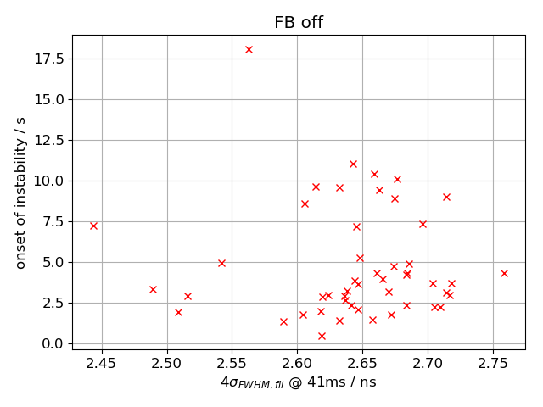
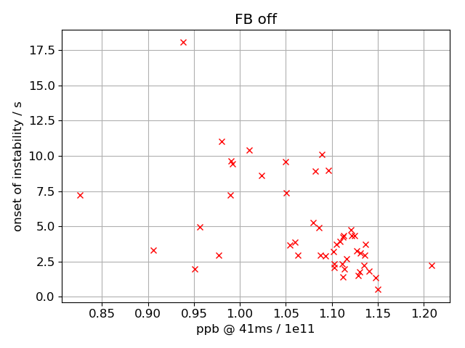
Time when instability starts
Data for nominal intensities and below (FB off)
Onset time of instability: time when bunch-averaged bunch length exceeds maximum bunch length, averaged between 10 and 500ms: ${\left\langle 4σ_{FWHM}\left(t_{onset}\right)\right\rangle }_{bunch}>{\left\langle \max\left(4σ_{FWHM}\right)\right\rangle }_{10…500ms}$
no clear pattern when comparing to bunch length
Anti-correlation with intensity: lower intensity -> later start of instability

Slide 8
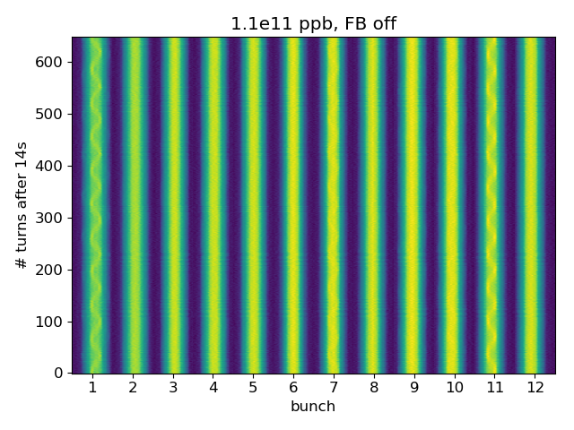
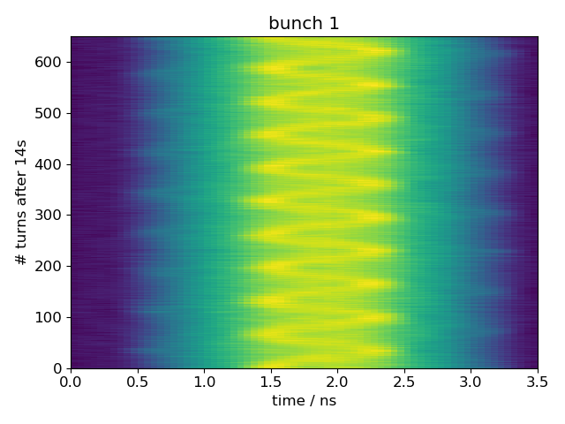
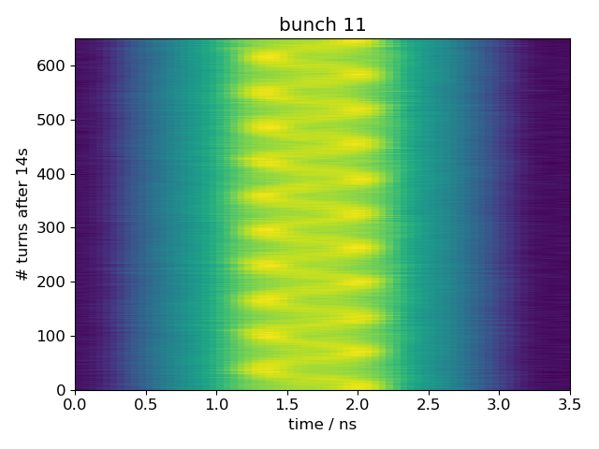
Turn-by-turn profiles at flat bottom, after instability
Bunch 1 and 11 have oscillating substructures:
Period 65 turns (synchrotron period ~66 turns)
180⁰ out of phase (could be due to phase loop)

Slide 9
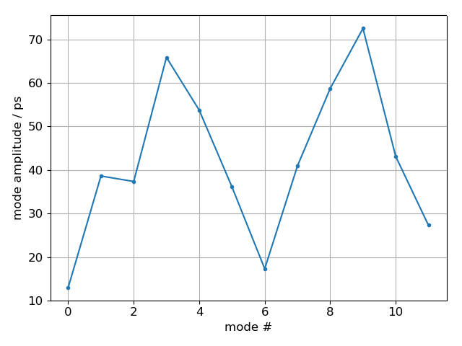
‘Mode analysis’ of turn-by-turn profiles
Coupled bunch analysis usually assumes full ring (but only 12 bunches for h=4620)
Last bunch coupled to first bunch due to LLRF
Fit sine-curve to maximum for each bunch $a_{b}\sin\left(ω_{b}t+φ_{b}\right), b=0…11$
Construct ‘modes’ $m=0…11$ by $\sum_{b=0}^{N−1}{a_{b}sin⁡(ω_{b}t+φ_{b}−m \frac{2π b}{M}) }$
Fit sine-curve to each ‘mode’ $A_{m}sin⁡(ω_{m}t+φ_{m})$
No single, dominant mode observed

Slide 10
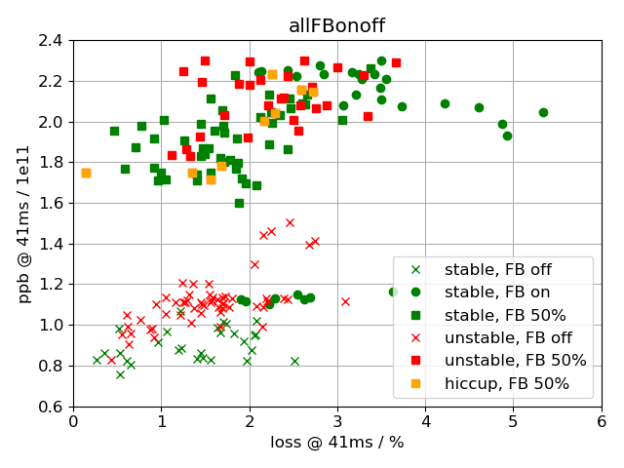
Losses and instability
Losses higher with FB on, because
injection phase error < -40⁰, for high intensity
reference phase error < -15⁰, for low intensity

Slide 11
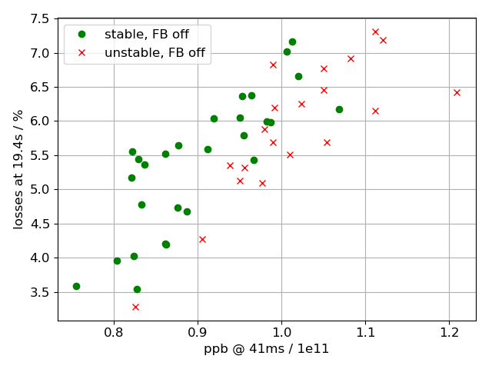
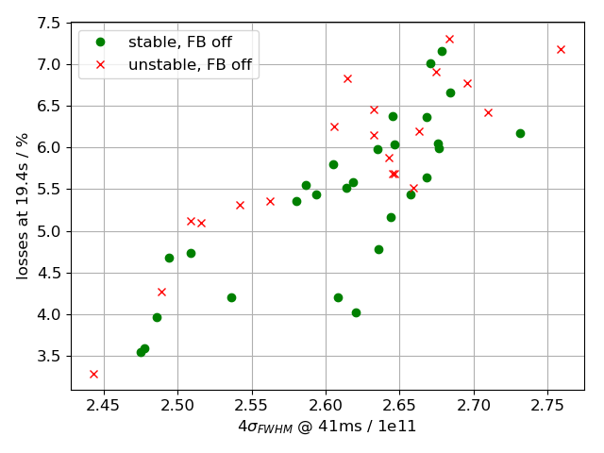
Losses and instability
Losses for data taken at same machine condition (transverse adjustment, reference & injection phase, time of day)
For similar intensity, stable beams have more losses
For similar bunch length, stable beams have less losses
For similar bunch length, stable beams have less losses

Slide 12
Flat bottom instability for different machine and beam parameters
Summary:
Data for intensity 1.1e11 ppb show (coupled bunch?) instability threshold
Instability occurs earlier with increasing intensity
‘Mode analysis’ does not show single mode
Next steps:
Need more data for 12 bunches and nominal intensity and below for better statistics (unfortunately no MD last week)
Study instability without influence of FB and phase loop after filamentation (1st bunch should not be unstable)
Measurements for 24, 48, 72 bunches
Thank you for your attention!

Slide 13
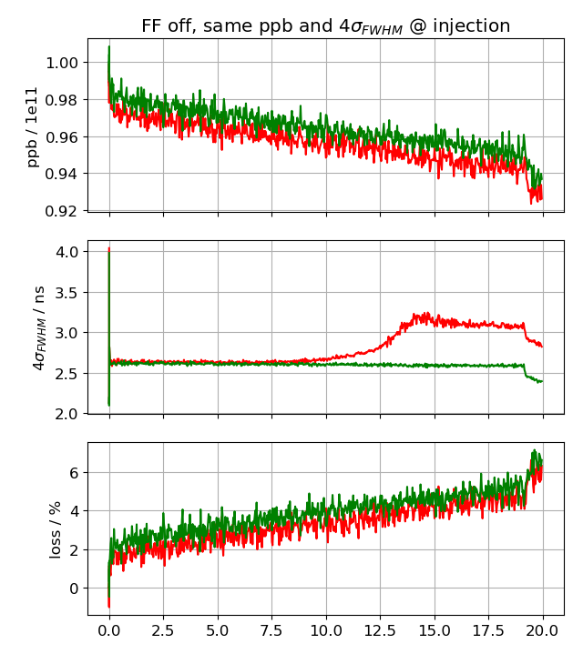
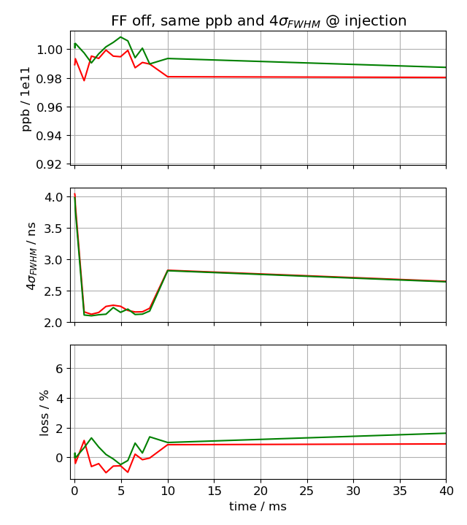
Similar after filamentation
time / s

