Slide 1
Longitudinal instability of 12 bunches on the SPS flat bottom – Simulations s 28st of August 2018
LIU-SPS Beam Dynamics Working Group
J. Repond, E. Shaposhnikova
Acknowledgements: M. Schwarz, A. Lasheen, G. Papotti, T. Bohl, H. Bartosik, SPS OP crew

Slide 2
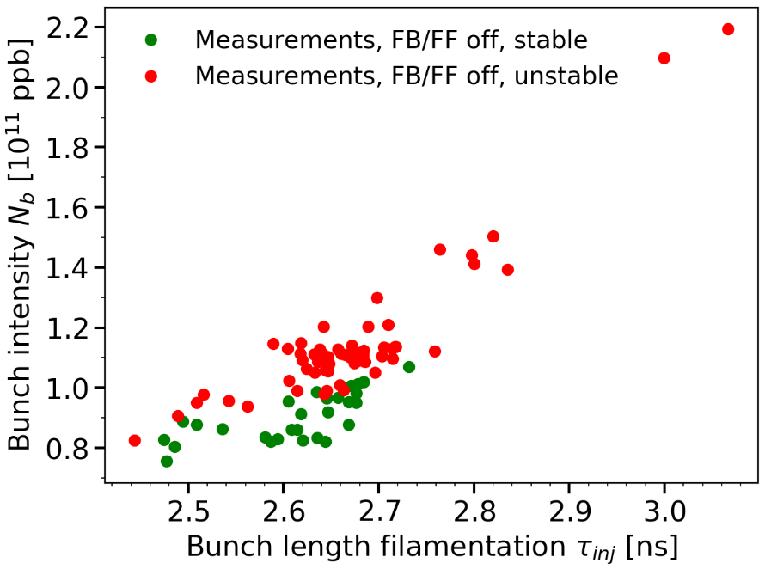
Stability threshold at SPS flat bottom with 12 bunches Measurements in single RF without feedback and feedforward
Flat bottom cycle (26 GeV), single RF with $V_{200}=4.5$ MV
One 40 MHz cavity was not available in the PS → Injected bunch length larger than nominal
Batch of 12 bunches with nominal emittances and smaller
The bunch length $τ_{inj}$ and the intensity $N_{b}$ are measured after filamentation at ~50 ms
The measurements analyzed here were done without feedback, feedforward and longitudinal damper
Instability threshold of 12 bunches, 1RF,
in function of the bunch length after filamentation
→ The measurements show a clear instability threshold, can we reproduce it in simulation?

Slide 3
Stability threshold at SPS flat bottom with 12 bunches Simulations with bunches matched to the RF bucket with intensity effects
Intensity limit of 12 matched bunches at flat bottom (10 s), 1 RF (4.5 MV),
latest SPS longitudinal impedance model without FB/FF
The simulations with 12 matched bunches are much more stable than the measurements.
Already observed in the past, is it an effect of the bunch distribution?

Slide 4
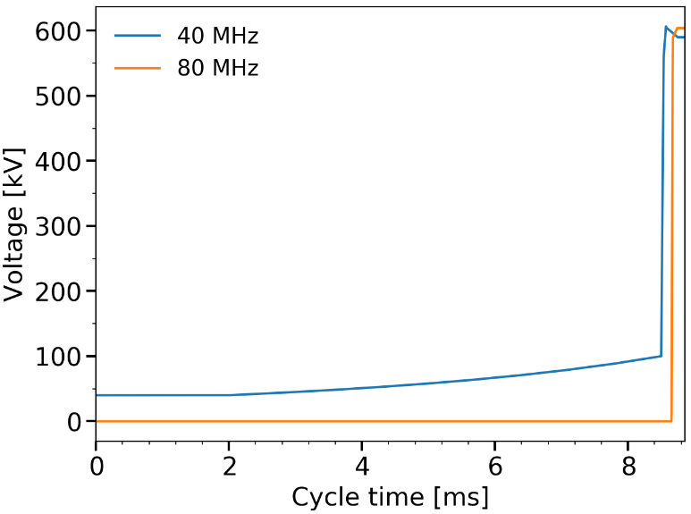
Generation of the bunch distribution in the PS Simulation of the bunch rotation
Bunch distribution generated at PS flat top
In the 40 MHz RF bucket with $V_{40}=50$ kV
With a binomial distribution with $μ=1$ and different emittances (controlled by $H_{0}$)
The nominal PS RF program is used to simulate the bunch rotation (two 40 MHz cavities and two 80 MHz cavities for a total of 600 kV in both)
The bunch is extracted after ¼ of synchrotron period (shortest bunch length)
1. Binomial phase-space distribution
$$F\left(H\right)=F_{0}{\left(1−\frac{H}{H_{0}}\right)}^{μ}, H∈[0,H_{0}]$$
2. PS RF program for bunch rotation
80 MHz phase jumps to bunch-shortening mode
3. Example of a bunch distribution at extraction of the PS

Slide 5
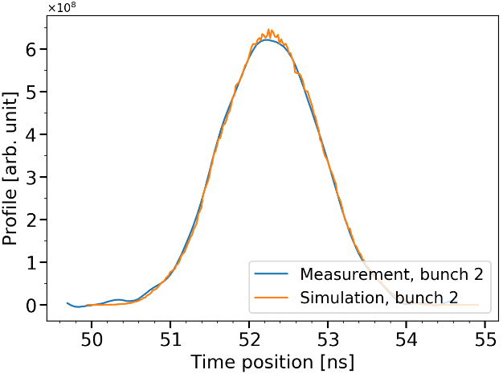
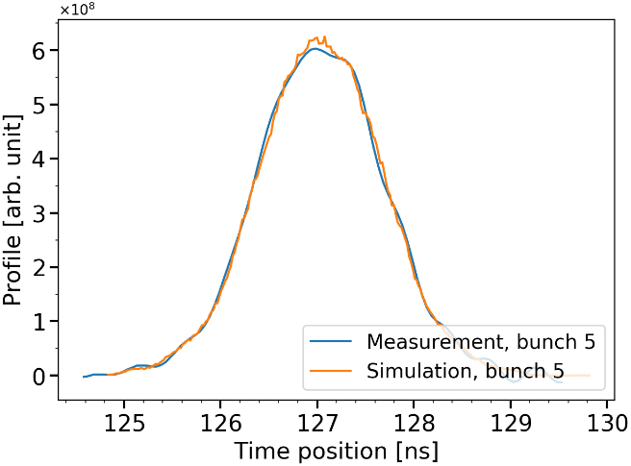
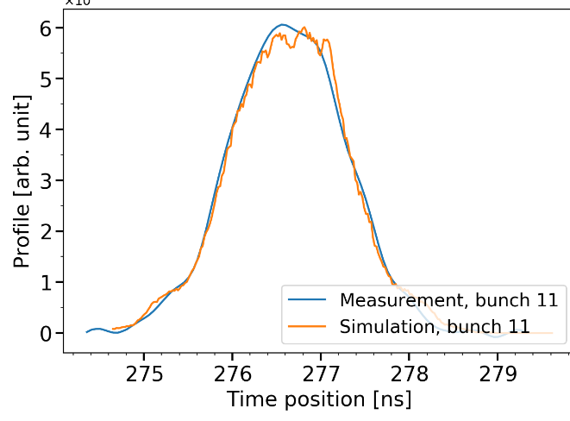
Injection of 12 rotated bunches in the SPS Bunch profiles after filamentation, measurements vs simulations (stable)
12 similar bunch distributions are injected, spaced by 25 ns, centered in the RF bucket according to the average synchronous-phase shift along the batch (effect of phase-loop)
The bunch distribution in simulation is similar for all intensities
Here we compare one measurement and one simulation with the same bunch intensity
Bunch profiles comparison, simulations/measurements after filamentation (~50 ms) , $N_{b}=1.0×{10}^{11}$ ppb (stable)
Bunch profiles after filamentation (~50 ms) well reproduced in simulation
when compared to a measurement with the same intensity

Slide 6
Stability threshold of 12 rotated bunches in the SPS Scan of the bunch emittance, single RF
Comparison of the instability threshold between simulations and measurements,
single RF ($V_{200}=4.5$ MV), latest impedance model without FB, FF and LD
Agreement between measurements and simulations (no missing impedance)

Slide 7
Effect of the exponent $μ$ and the parameter $max⁡(\frac{Δτ}{\overline{τ}})$ Single RF (4.5 MV), latest SPS longitudinal impedance model
Stability threshold of 12 bunches, comparison with different $μ$ of the binomial distribution
$$μ=1$$
$$μ=2$$
Parameter $max(Δτ/\overline{τ)}$ used to distinguish stable from unstable beam
$$μ=2$$
$$μ=1$$
With $μ∈[1,2]$, the agreement between simulations and measurements is satisfying
The threshold is sensitive to the parameter used to distinguish stable from unstable beam

Slide 8
Stability threshold of 12 rotated bunches in the SPS Scan of the bunch emittance, effect of the second RF
Instability threshold, simulations in double RF ($V_{200}=4.5$ MV, $V_{800}=0.45$ MV (BSM)),
latest impedance model without FB, FF and LD
Single RF threshold
The operation in double RF ($V_{800}=0.1×V_{200}$) does not cure the instability !

Slide 9
Conclusion
The intensity threshold for 12 rotated bunches in simulation is in good agreement with the measurements.
There is no main contribution to the impedance missing.
However, the first bunch is not unstable in simulation whereas in measurements all the bunches become unstable (effect of phase-loop?).
The instability is not cured by the 800 MHz system ($V_{200}={0.1×V}_{800})$ in bunch-shortening mode.
Next step: measurements with different emittances (larger and smaller) to confirm further the intensity threshold obtained in simulation.

Slide 10
THANK YOU FOR YOUR ATTENTION!

Slide 11
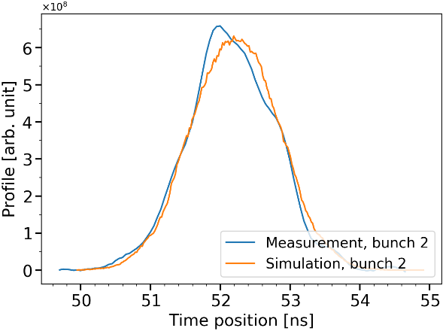
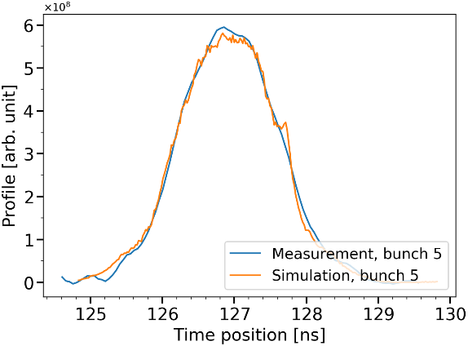
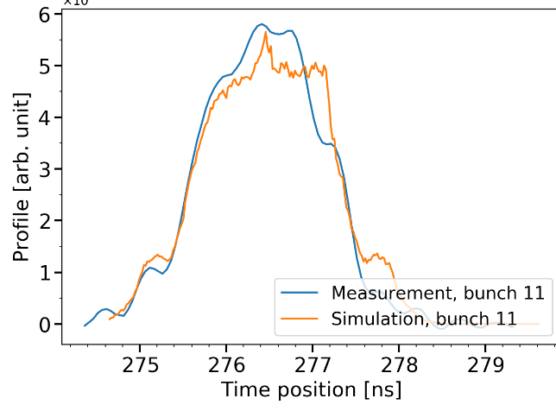
Injection of 12 rotated bunches in the SPS Bunch profile after filamentation, measurements vs simulations (unstable)
12 similar bunch distribution are injected, spaced by 25 ns, centered in the RF bucket according to the average synchronous-phase deviation (effect of phase-loop)
Bunch profiles comparison simulations/measurements after filamentation (~50 ms) , $N_{b}=1.5×{10}^{11}$ ppb (unstable)

Slide 12
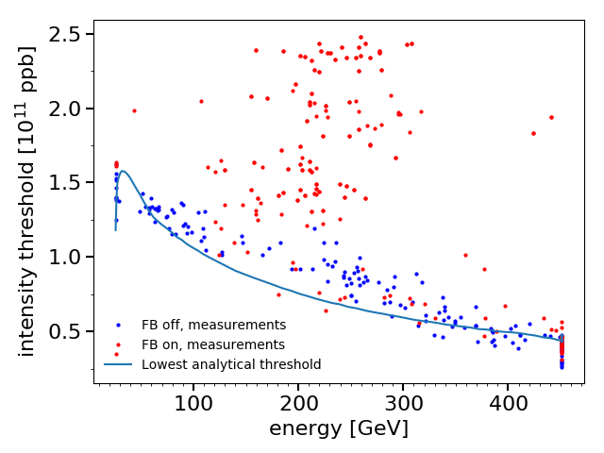
Stability threshold during ramp, 12 bunches Energy dependence in a single RF system
Presented last year
Instabilities at flat bottom were observed not reproduced in simulation
What is the effect of the 800 MHz RF system?

Slide 13
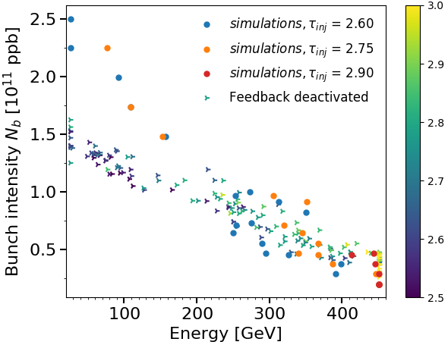
Intensity treshold during ramp, feedback off 12 bunches SRF: simulations vs measurements
Presented last year
Intensity threshold with feedback off, single RF system
Matched bunches in simulations
End of ramp and flat top well reproduced in simulations with correct bunch length
Difficulties to reproduce flat bottom instability
Short flat bottom in simulation (1s)
Bunch rotation in PS before extraction (s-shape)
Missing impedance?

Slide 14
Instability at flat bottom
Presented last year
12 unstable bunches at flat bottom, single RF, $N_{b}=1.4×{10}^{11}$ ppb
Injected bunch length 3.3 ns
Bunch length after filamentation: 2.7 ns
Instability at flat bottom after 4 s
Bunch length [ns]
Instability observed but not reproduced yet in simulation
Problem of accuracy in the induced voltage calculation
Bunch distribution, long flat bottom
LLRF (phase-loop)
Missing impedance?
Can the 800 MHz RF system cure the instability at flat bottom?

Slide 15
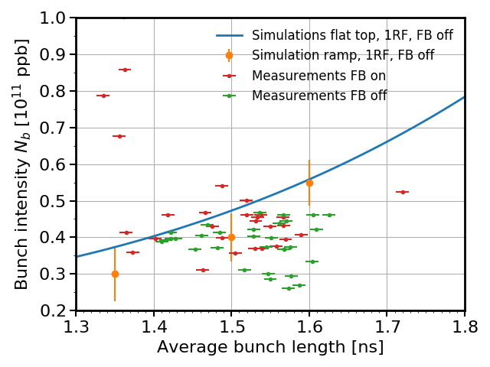
Stability threshold at flat top Comparison between ramp simulations and measurements
Presented last year
7 MV, single 200 MHz RF system, 12 bunches, feedback off
Measurements of unstable beam during ramp cannot be compared here
no information about bunch length at flat top
Stable beam
Bunch distribution in simulation is matched at flat top
→ Bunch distribution after ramp can differ from matched at flat top
Measured threshold at flat top is compared with simulations
→ Measurements of stable beams and simulations (FT and ramp) are in good agreement with feedback off

Slide 16
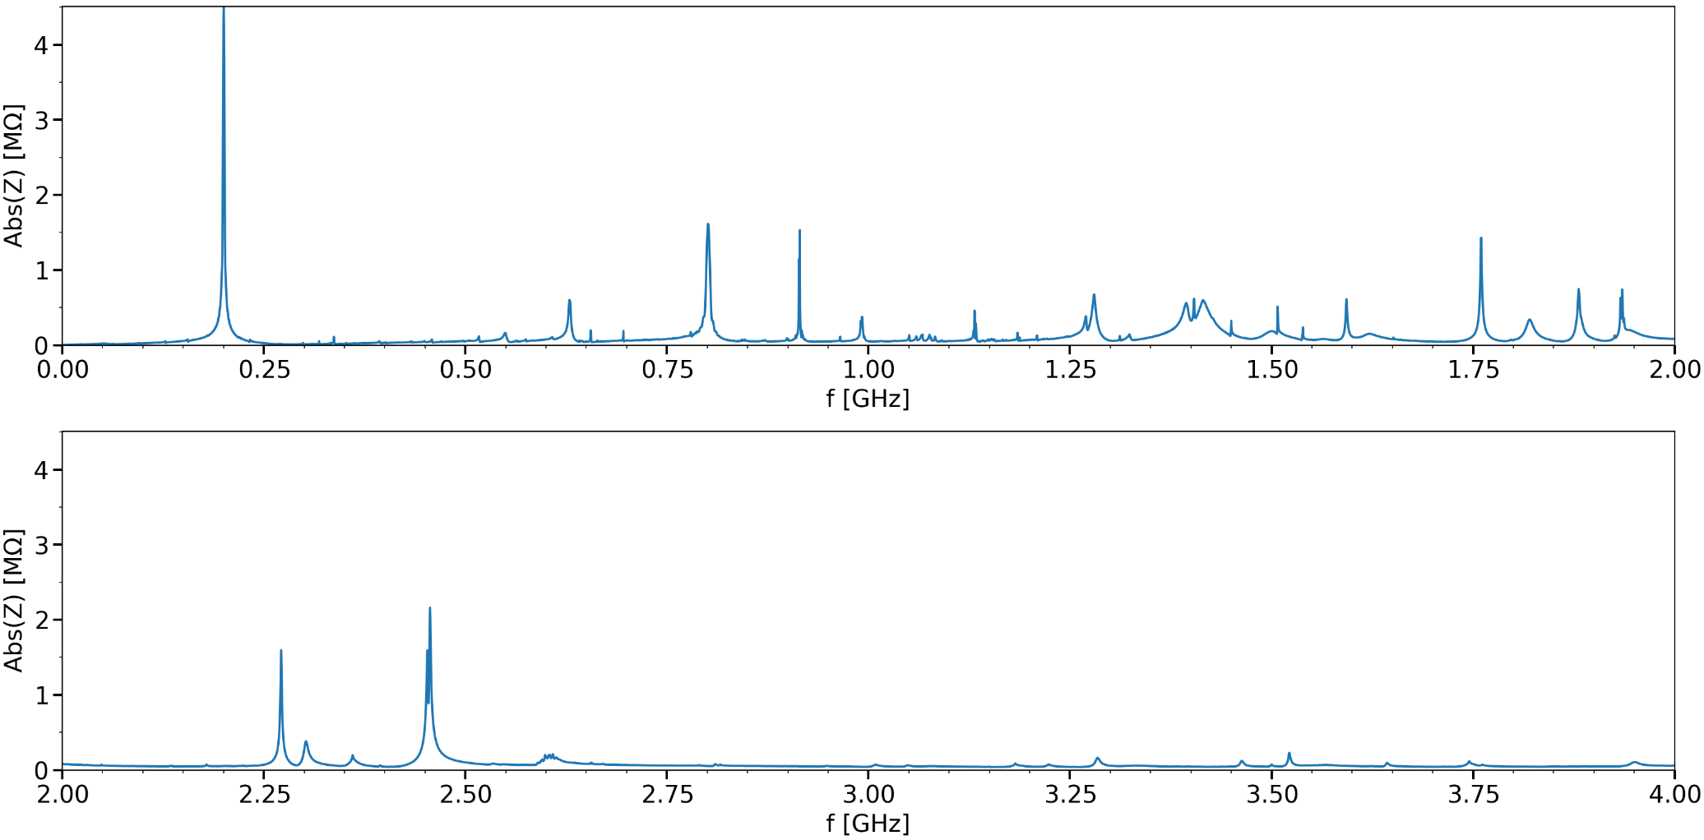
Longitudinal impedance model (August 2018) Present configuration of the SPS

