Slide 1
Sorting of Machine Elements in the LSS for Mitigation of Beam Impedance Aaron Farricker, Christine Vollinger

Slide 2
General Remarks
Within the ongoing studies on beam impedance mitigation, the LSS upstream of some QFAs were identified as locations with large variations of the vacuum pipe cross-section.
At each cross-sectional change, all modes are excited.
Impedance-wise, best performance obtained from a smooth beam pipe.
Four straight sections were targeted for sorting their machine elements without compromising the functionality of the area or modifying the machine elements:
upstream QFA.21610, QFA.21810, QFA.41810, and QFA.61810.
These areas mainly contain BI equipment which can be shifted within limits.
Wakefields were calculated for these areas before/after layout improvement.
4 ECRs are drafted and will be circulated within the next days – the work shall be carried out during LS2.

Slide 3
Area upstream QFA.21610
Current situation (pic from layout db).
ZS diffuser
VBCA bellow
BPCE
MDHA
1. Swap the positions of the horizontal correction dipole MDHA and the beam position monitor BPCE;
VEDX
bellow
2. Replace the existing vacuum bellow VBCA with a race-track shaped bellow;
3. Replace the vacuum bellow VEDX with a bellow of smaller diameter (i.e. closer to the inner diameter of e.g. the diffuser or the crystal goniometer);
4. Shield the pumping port attached to MBA with a simple lid.
+
MDHA
side view
MDHA
Draft ECR is circulated!

Slide 4
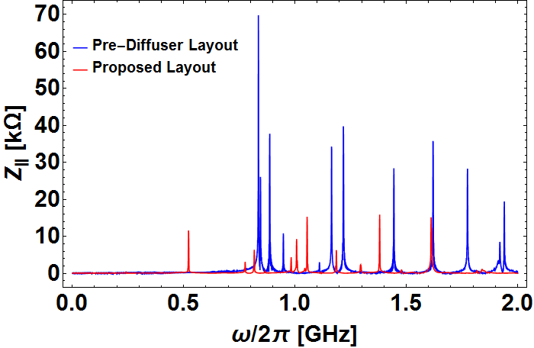
Area upstream QFA.21610
Current situation (pic from layout db).
ZS diffuser
VBCA bellow
BPCE
MDHA
VEDX
bellow
Remarks:
It is not possible to calculate the area as the sum of its individual machine element contributions. The entire area has to be simulated instead.
The diffuser will soon be replaced by the crystal goniometer (also a test object, only).
The peak just above 500 MHz is from the diffuser tank.
Simulated longitudinal impedance

Slide 5
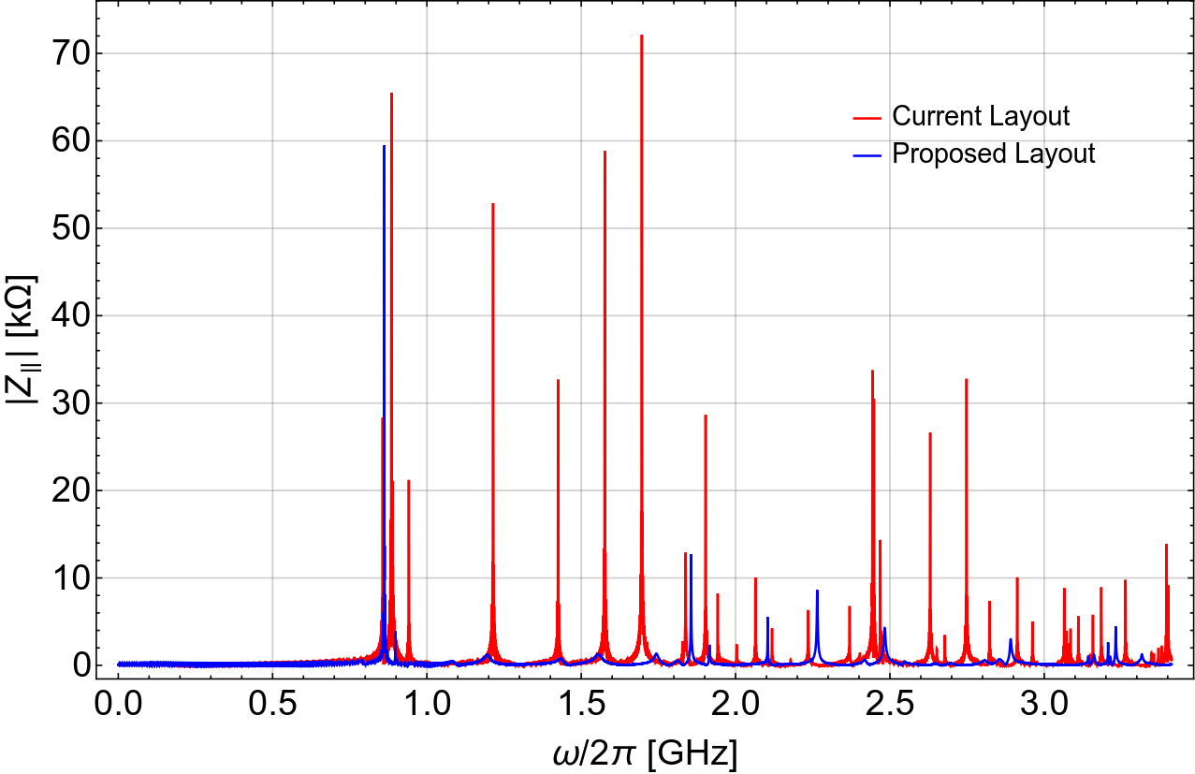
Area upstream QFA.21810
Vacuum assembly: bellow with pp
Current situation (pic from layout db).
BPCE
MDHA
Remarks:
One race-track shaped bellow is to be added next to the QFA.
Slight frequency shift for the peak at ~850 MHz.
Draft ECR is circulated!
Simulated longitudinal impedance

Slide 6
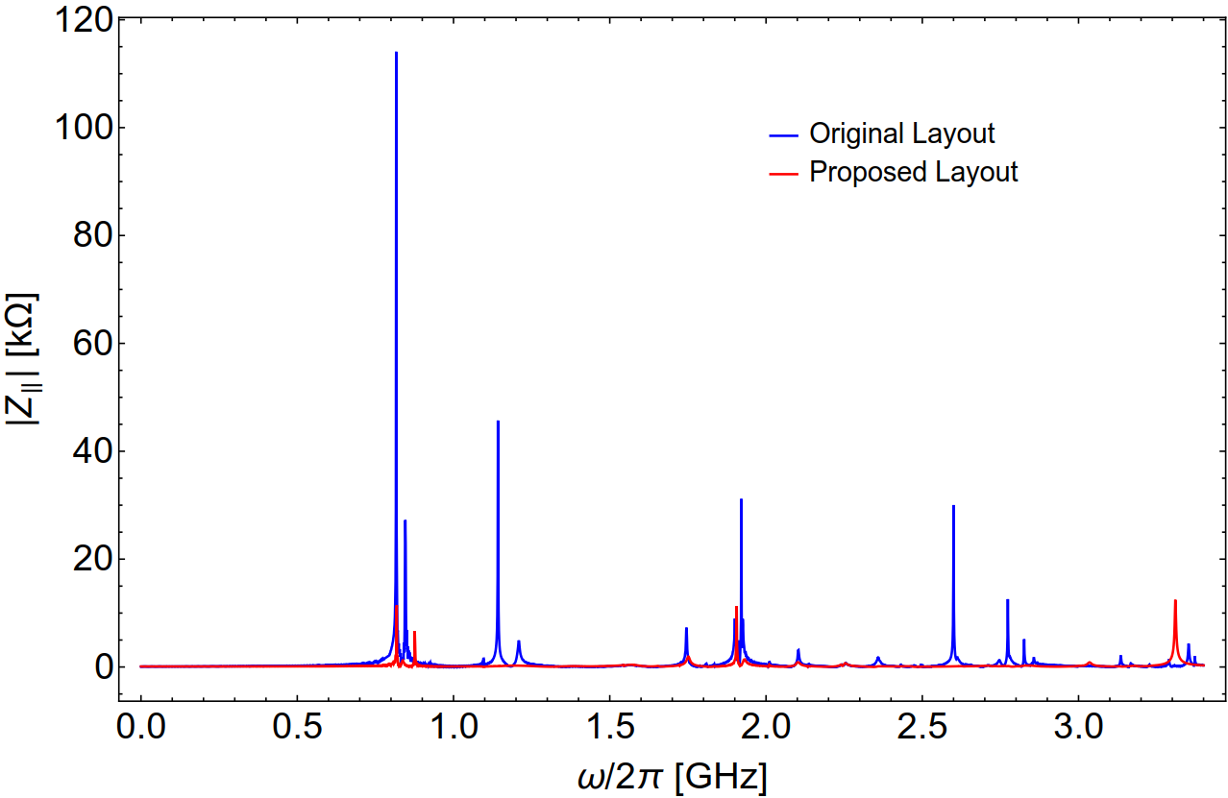
Area upstream QFA.41810
VBCA bellow
VBCA bellow
Current situation (pic from layout db).
MDHA
Remarks:
QFA has a diamond-shaped beam pipe, but the standard flat beam pipe appears to be possible without aperture restriction (to be confirmed).
VBCA bellow is replaced by race-track shaped bellow.
Draft ECR is circulated!
Simulated longitudinal impedance

Slide 7
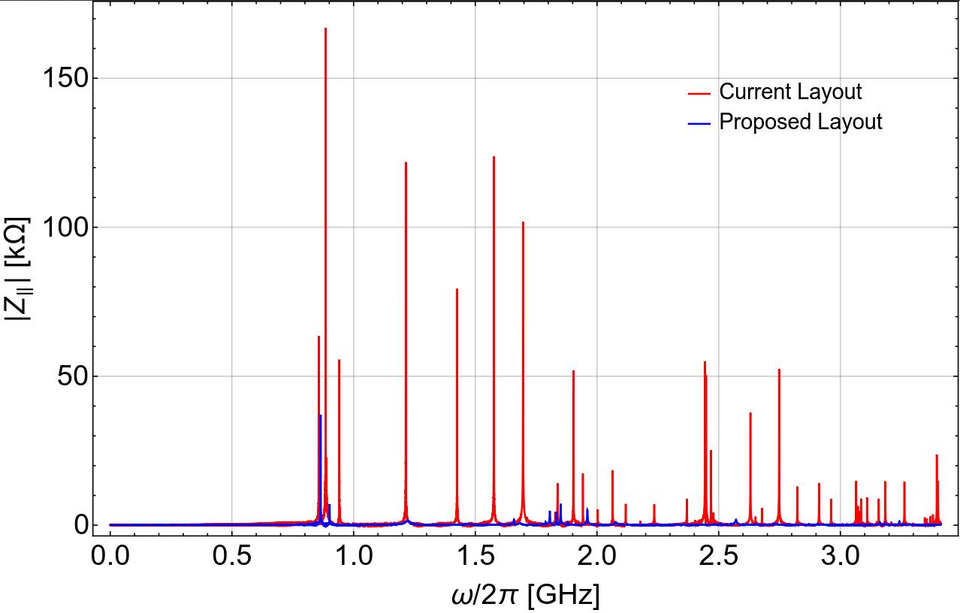
Area upstream QFA.61810
MDHB
VBCA bellow
Current situation (pic from layout db).
BPCE
VEDX
bellow
Remarks:
Swap BPCE with VBCA bellow with the MDHB. VBCA bellow can stay, if it is attached to the BPCE, however,
VEDX bellow is replaced by race-track shaped bellow.
Draft ECR is circulated!
Simulated longitudinal impedance

Slide 8
Conclusion
Optimisation of the layout is targeted for four areas in the LSS’s, upstream of
QFA.216, QFA.218, QFA.418, and QFA.618.
In all cases, considerable reduction of the longitudinal beam impedance is possible without compromising the functionality of the area and without modifying the individual machine elements.
The suggested use of race-track shaped bellows next to the QFAs is possible at acceptable costs, since identical bellows as are used for the ZS will be installed (machining costs are covered already).
This proposals are supported by LIU, have to be circulated as ECRs and will require IEFC approval.
Work shall be carried out during LS2.
Thanks to TE-VSC, TE-ABT, BE-BI, TE-MSC, BE-OP,… for valuable discussions & for supporting this idea!

