Slide 1
Status of HOM-damping - Improvements of 630 MHz HOM-coupler
P. Kramer
28th August 2018

Slide 2
Content
Improvement of 630 MHz HOM-coupler
Critical coupling
Complex conjugate output matching
Overview & status of HOM-damping on 3-sections
First results on 3-section measurements
Measurement setup and travelling wave matching
Tuning of the three sections

Slide 3
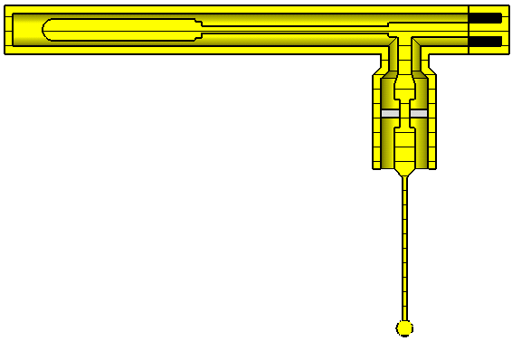
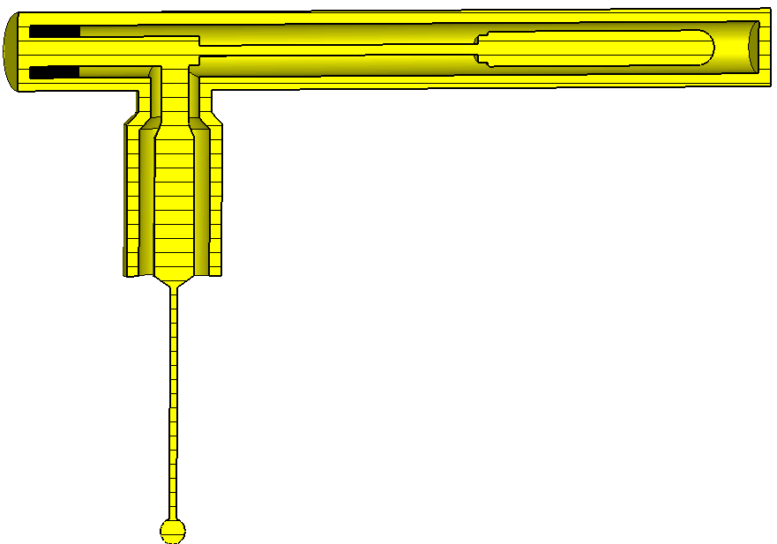
Improvement by (close-to) critical coupling
Highest damping is achieved at point of critical coupling
Existing 50Ω-coupler not optimal
A 23Ω-coupler is close to the optimal critical coupling
No deteriorating influence of FPB π/2-mode ✓
With this method alone damping is increased by factor >2!

Slide 4
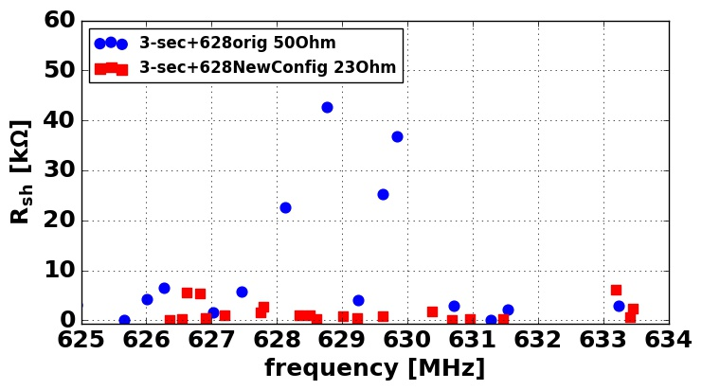
Overall impedance reduction around 630MHz
New damping scheme for 3-sections consisting of…
Improved HOM-couplers @630MHz
Seven additional HOM-couplers on top
New mitigation technique via perturbations in bottom
Deployment of a complex load on couplers avoids fabrication of new coupler-parts
Overall impedance reduction by a factor 7 p-p in Eigenmode simulation

Slide 5
Conclusion & Outlook
Two general methods to improve HOM-couplers were employed
Application to 630MHz-coupler shows already factor >2 improvements
Better results are expected by more careful implementation
Methods can be applied to any HOM-coupler on both 3- and 4-section cavities
Overall impedance reduction by a factor 7 is achieved for the 3-section structures in Eigenmode simulations

Slide 6
Measurements on 3-sections
P. Kramer, C. Vollinger
28th August 2018

Slide 7
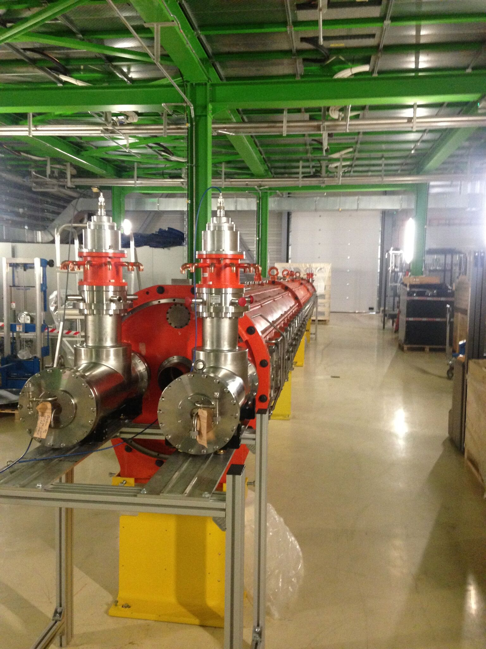
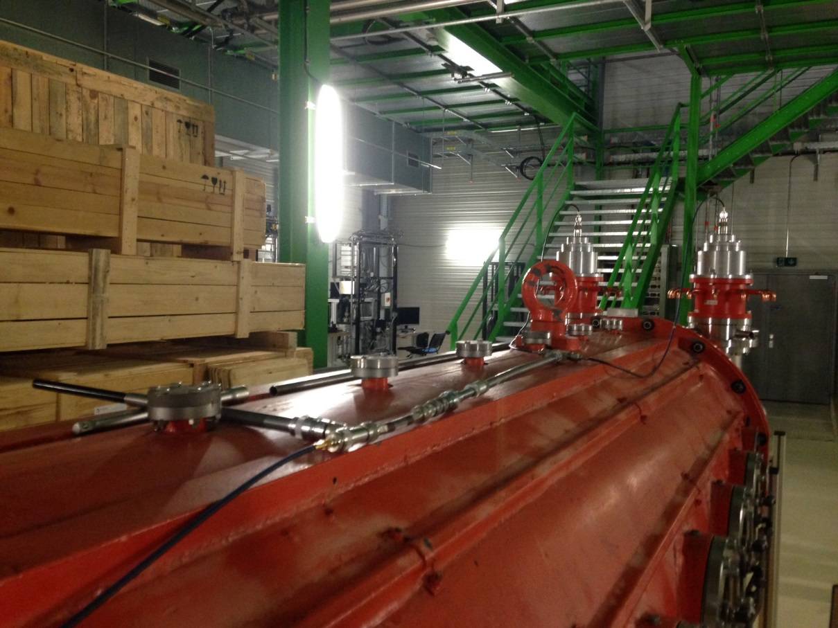
Measurement setup & goals
Setup
3 sections
No HOM-couplers
Present FPCs
Custom matching networks
Goal
Determine frequency of π/2-mode for all cells (cavity tuning)

Slide 8
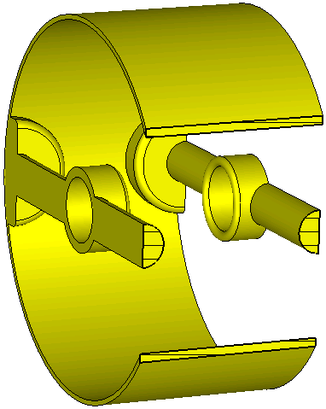
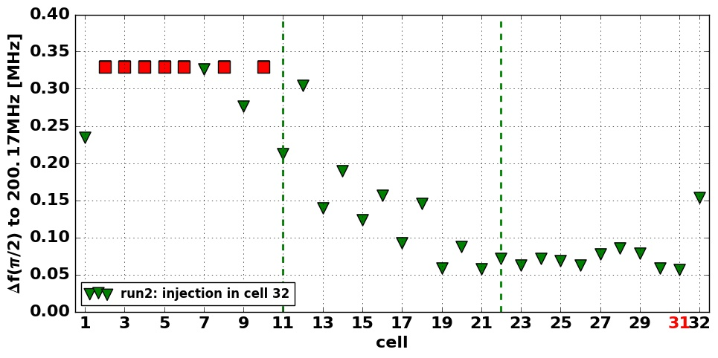
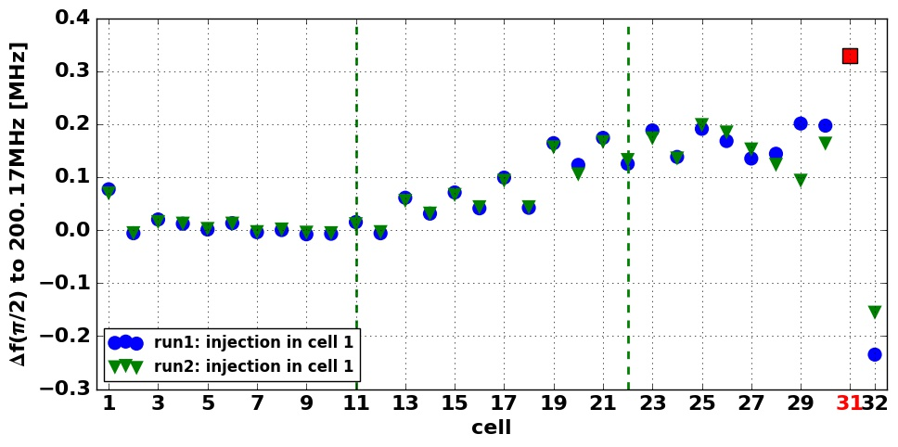
Cell tuning measurements
Absolute frequency values to be taken with care as influenced by many variables!
FPC drift-tube assemblies detuned
Spare sections 1&3 tuned well
Spare section 2 detuned
24.3⁰C, 46.7-46.9%rH
Out of measurement range

Slide 9
Conclusions
Full understanding of matching for travelling condition was demonstrated in measurement
A method to measure the cell tuning of the 200MHz TWS was developed and tested
Detune of spare section 2 was demonstrated
In progress: Tuning of spare 2 by solving Eigenvalue problem and reshuffling the drift-tubes

Slide 10
Backup

Slide 11
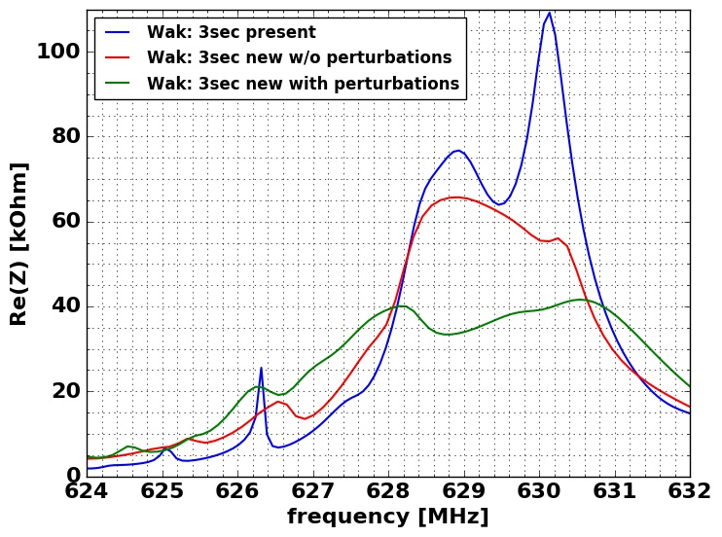
Present status on 3-section HOM-mitigation

