Slide 1
Longitudinal instabilities on SPS flat bottom
H. Bartosik, T. Bohl, A. Lasheen, G. Papotti, J. Repond, M. Schwarz, E. Shaposhnikova SPS & PS operators
LIU-SPS BD WG meeting 18/09/25

Slide 2
Outline
Measurement of instability threshold
Instability for different LLRF system settings
First simulation results

Slide 3
Flat bottom instability
Setup:
MD 11 September 2018: 12 bunches, 25ns spacing, Q20
Intensity variable: protons per bunch 0.8e11 to 1.3e11
Bunch length ($4σ_{FWHM}$ at filamentation): 2.5ns to 2.85ns
FeedBack: off, FeedForward: off, Phase loop: on, long. damper: off
V₂₀₀ =4.5 MV, V₈₀₀ off
Consider data at flat bottom up to 19.2 s; then ramp
LIU-SPS BD WG meeting

Slide 4
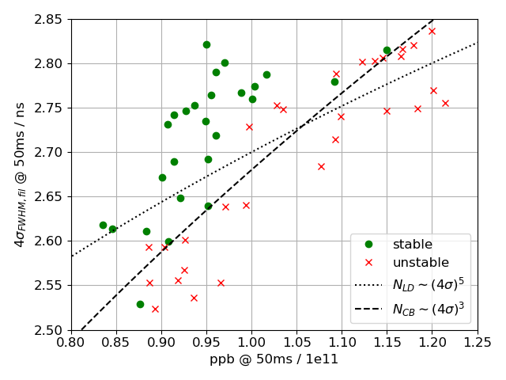
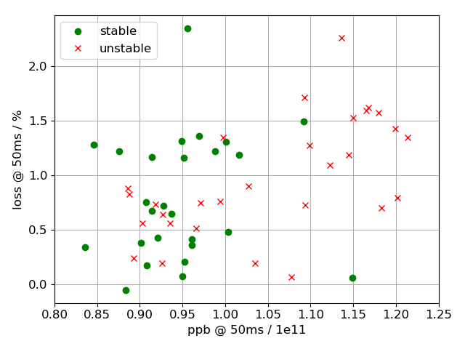
Flat bottom instability: threshold
Threshold scales as coupled bunch instability threshold (no fit)

Slide 5
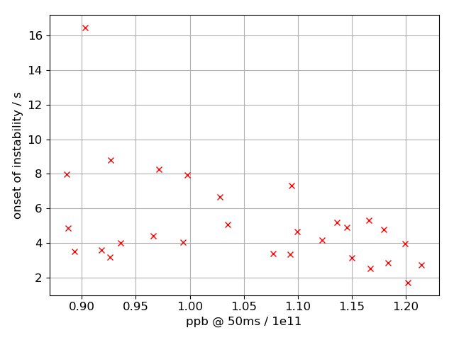
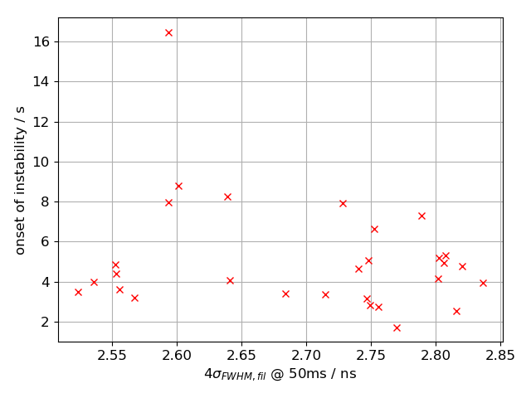
Flat bottom instability: start of instability
Mild anti-correlation between start of instability and bunch intensity

Slide 6
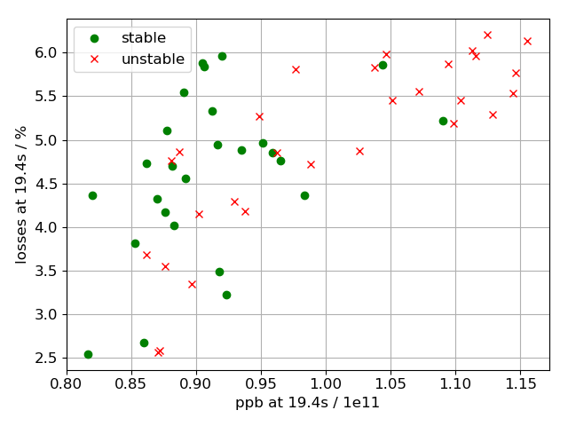
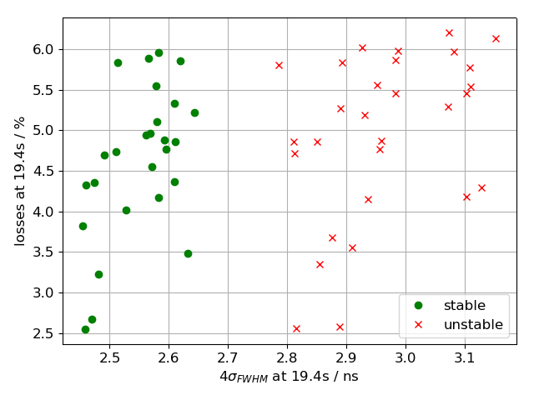
Flat bottom instability: loss after ramp
No difference in losses between stable and unstable beams

Slide 7
High intensity
Setup:
MD 04 September 2018: 2 batches,12 bunches, 25ns spacing, Q20
Intensity: 2.5e11 protons per bunch
FeedBack: on/off, FeedForward: on/off, Phase Loop: on/off, long. damper: on/off
V₂₀₀ =4.5 MV, V₈₀₀ off
Consider data at flat bottom up to 11.2 s
LLRF becomes power limited after injection of 2nd batch
Bunch length plots have been smoothed for clarity by moving average (n=20)
LIU-SPS BD WG meeting

Slide 8
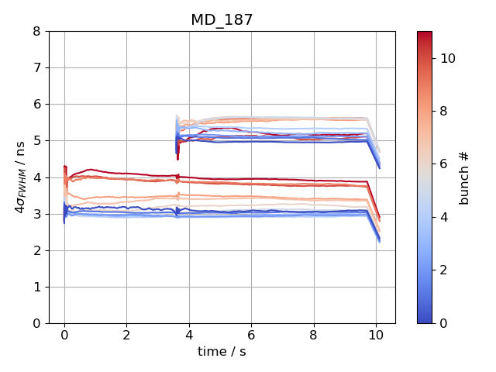
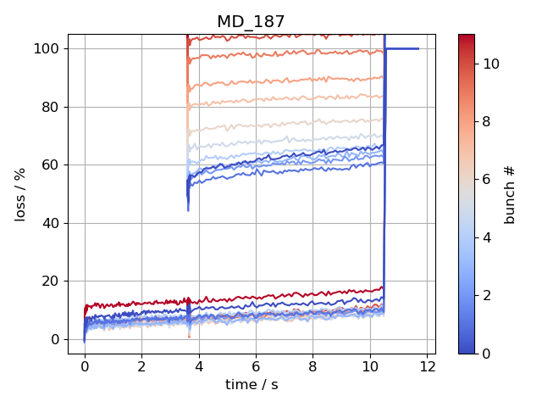
High intensity: FB off, FF off, LD off, PL off
offset by 2ns
offset by 50%
1st batch: last bunches ‘blow up’ after injection, others may become unstable at flat bottom (see next slide)
2nd batch: stable but last bunches have large losses (~50%)
Bunch lengths of 2nd batch shifted by 2ns, and losses by 50% for clarity

Slide 9
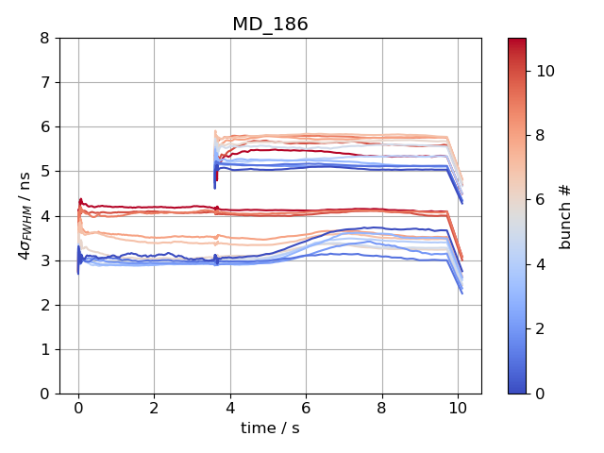
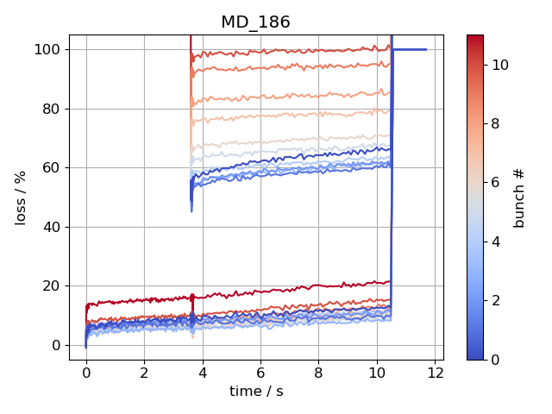
High intensity: FB off, FF off, LD off, PL off
offset by 2ns
offset by 50%
first bunches become unstable
1st batch: last bunches ‘blow up’ after injection, first bunches become unstable at flat bottom
2nd batch: stable but last bunches large losses (~50%)

Slide 10
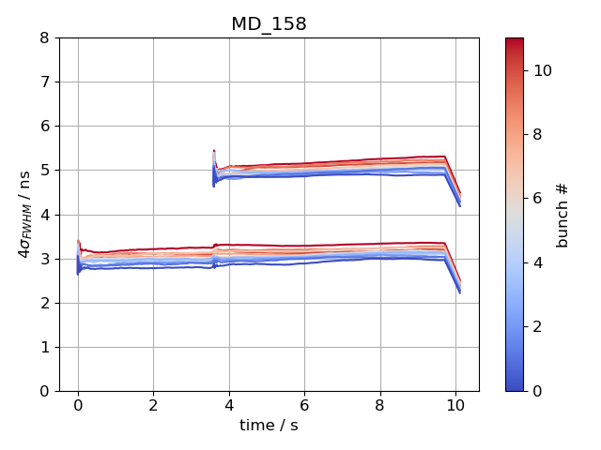
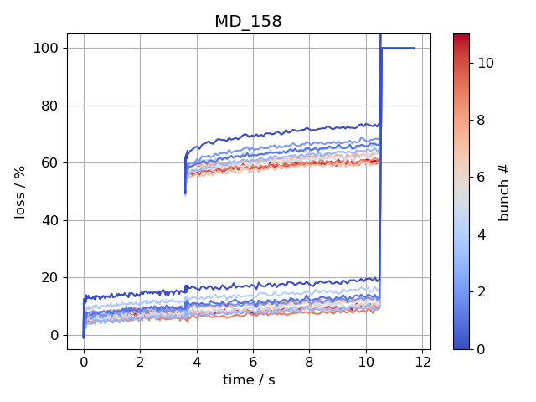
High intensity: FB on, FF off, LD off, PL off
offset by 2ns
offset by 50%
Both batches filament and are stable
Biggest contribution to losses at capture (10%)

Slide 11
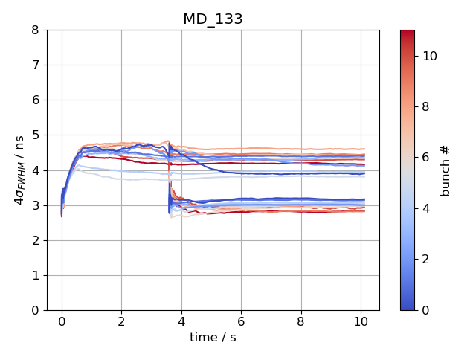
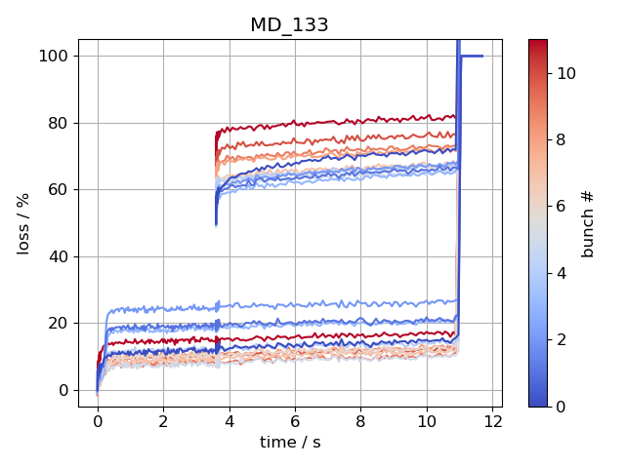
High intensity: FB off, FF off, LD off, PL on
offset by 50%
1st batch: bunch lengths of all bunches begins to grow 100ms after injection
2nd batch: filaments and stable

Slide 12
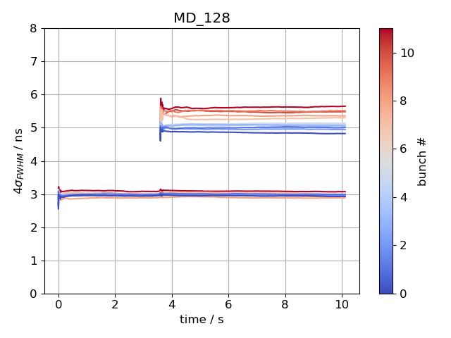
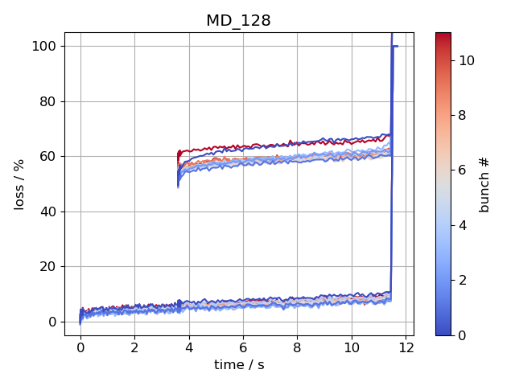
High intensity: FB on, FF off, LD off, PL on
offset by 2ns
offset by 50%
1st batch is stable and capture losses are ~ 5%
2nd batch stable, but larger bunch length and losses for last bunches

Slide 13
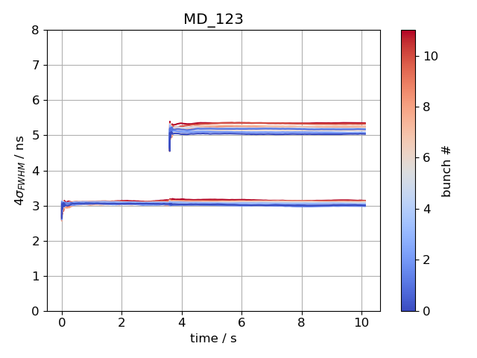
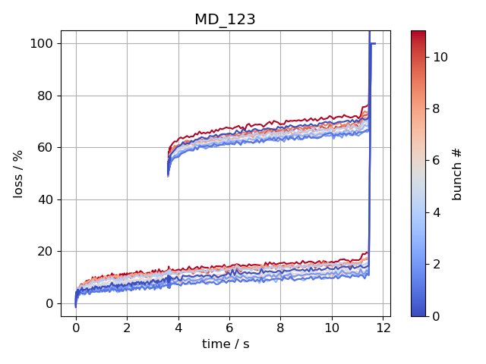
High intensity: FB on, FF on, LD off, PL on
offset by 2ns
offset by 50%
with FF on, both batches are stable, but higher flat-bottom losses

Slide 14
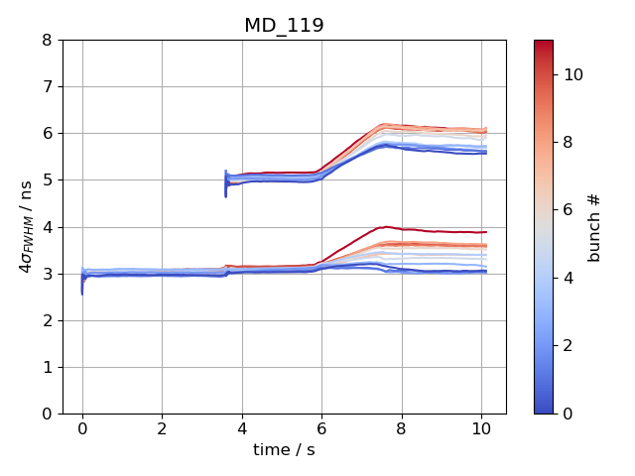
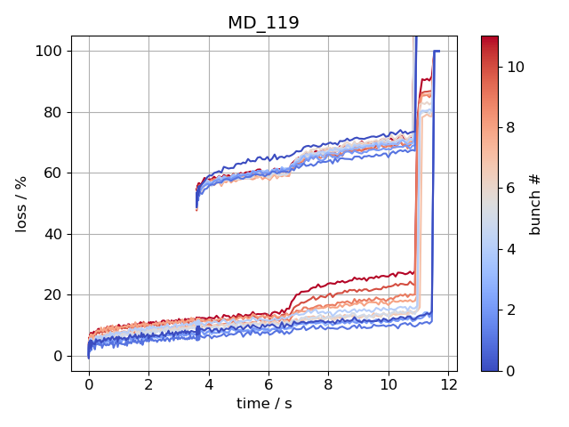
High intensity: FB on, FF on, LD on, PL on
offset by 2ns
offset by 50%
With LD on, all bunches become unstable at the same time

Slide 15
First simulation results
Setup:
12 bunches, 25ns spacing, Q20
Intensity: 2.2e11, 2.4e11, 2.5e11 protons per bunch
FeedBack: off, FeedForward: off, Phase loop: on, long. damper: off
V₂₀₀ =4.5 MV, V₈₀₀ off
With these settings, measured bunch length increases within 1s -> simulate 1s (43k turns)
Use full SPS impedance model
Use different bunch distributions simulated in the PS (courtesy of A. Lasheen)
$4σ_{FWHM}$: 3.5ns, 3.8ns
Out of the 4M macro-particles, randomly select 2M (3M) macro-particles for tracking in the SPS for each of the 12 bunches; ‘seed’ parameter determines which macro-particles are used for tracking
Place bunches at center of bare RF-bucket
Same data analysis routines as used to analyze measured bunch profiles

Slide 16
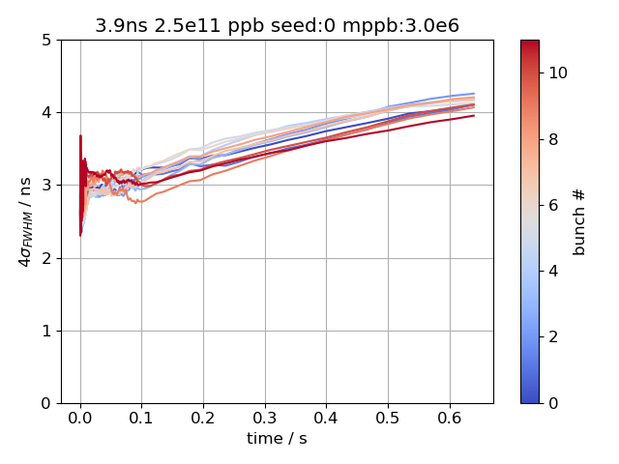
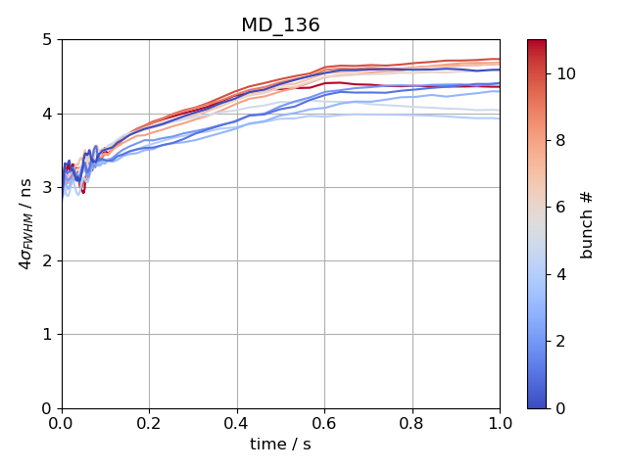
Simulation vs Measurement: bunch length
simulation
measurement
similar bunch lengths, but simulated bunch length first filaments during first 100ms

Slide 17
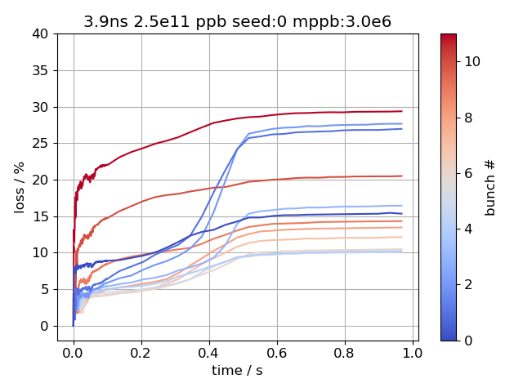
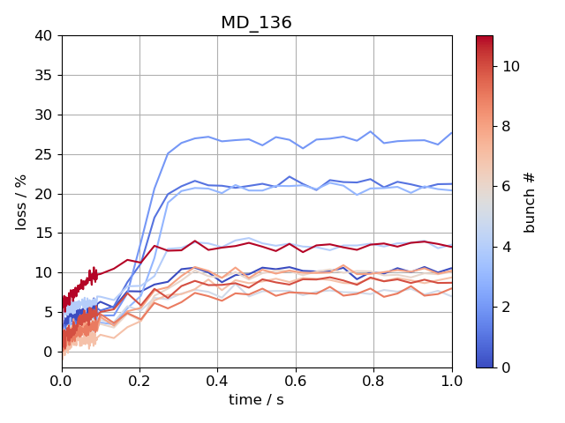
Simulation vs Measurement: losses
simulation
measurement
First bunches have same losses in simulation and measurement, but simulated bunch lengths increase at later time
Simulated losses too large for last bunches

Slide 18
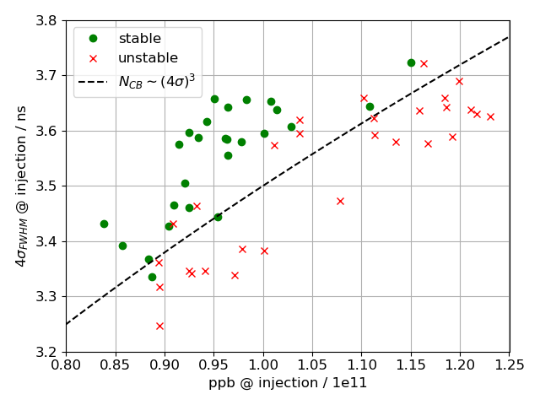
Summary 12 bunches measurements
FB off, FF off, LD of, PL on, V₈₀₀: off
High intensity (2.5e11 ppb, V800 off)
FB on: stable
+ PL on: stable
+ FF on: stable
+ LD on & 2nd batch: unstable
FB off:
+ PL on: unstable
+ PL off: last bunches unstable
Next steps:
Scan V₈₀₀ voltage and FB off
Measure instability threshold for 1x24 bunches

Slide 19
Summary Simulation
Simulations:
First simulations show agreement between measurement and simulation (but not perfect)
Next steps simulation
Systematic study with different initial PS bunch distributions
Fix phase loop gain problem (gain threshold to low in simulation)
Simulations of entire flat bottom (19s ~ 800k turns) for nominal intensity and different long. emittance, to compare simulated threshold to measurements
Thank you for your attention!

Slide 20
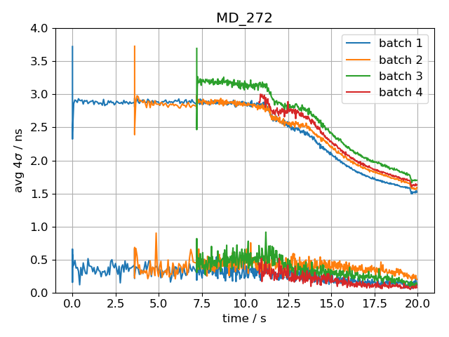
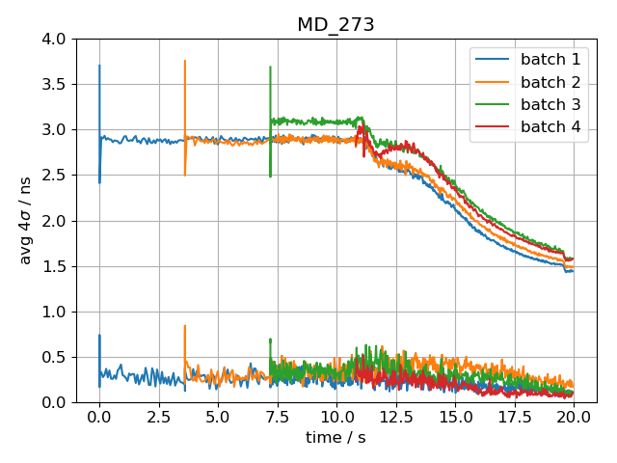
4x12 bunches, 2e11 ppb at flat top
800 MHz cavity at constant 10%
800 MHz cavity optimized during ramp
Smaller bunch length at flat top with Joel’s ‘optimized’ momentum program of 800 MHz cavity

Slide 21
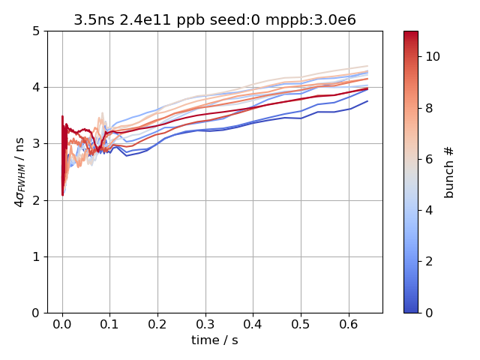
Simulation vs Measurement: bunch length
simulation
measurement
Similar bunch length

Slide 22
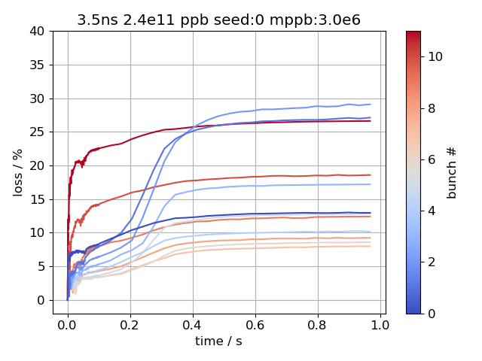
Simulation vs Measurement: losses
simulation
measurement
First bunches have same losses in simulation and measurement
Simulated losses too large for last bunches

Slide 23
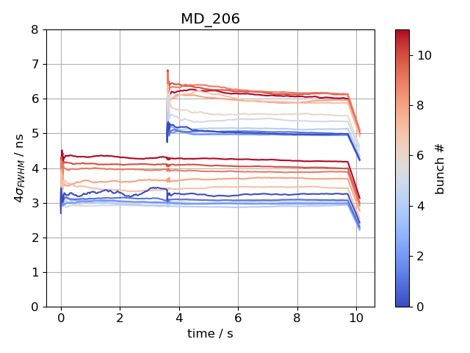
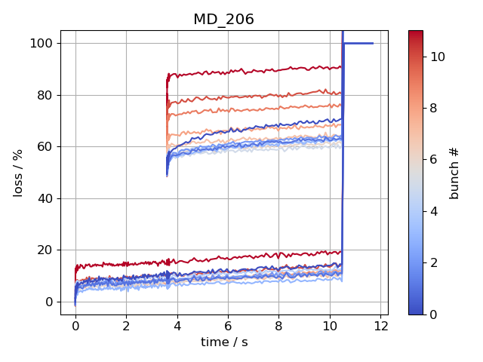
High intensity: FB off, FF off, LD off, PL off
Batch spacing: 2000ns
offset by 2ns
offset by 50%
…

Slide 24
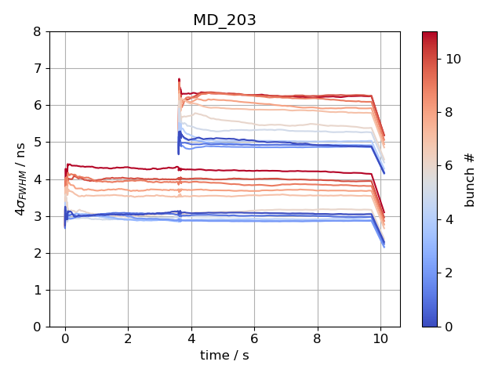
High intensity: FB off, FF off, LD off, PL off
Batch spacing: 1200ns
offset by 2ns
offset by 50%
…

Slide 25
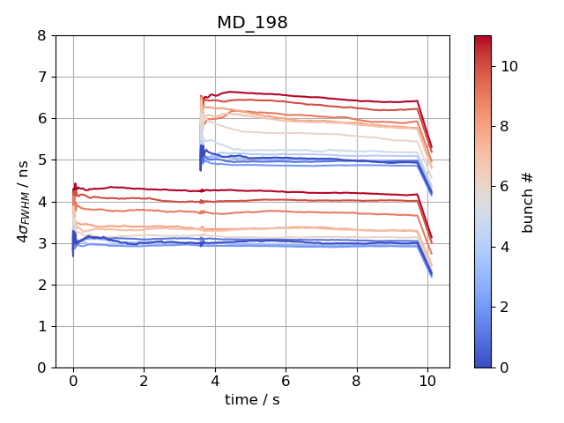
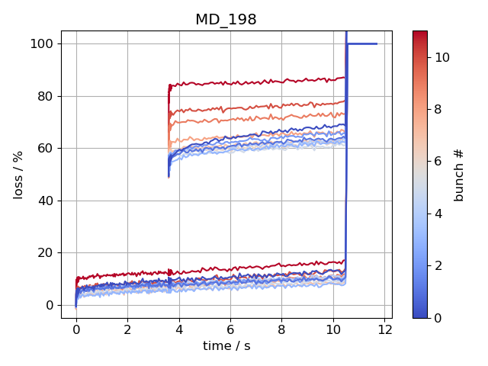
High intensity: FB off, FF off, LD off, PL off
Batch spacing: 600ns
offset by 2ns
offset by 50%
…

Slide 26
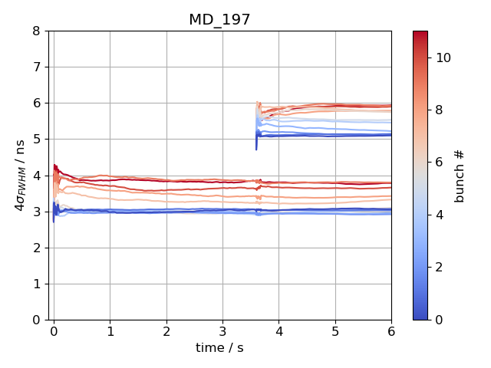
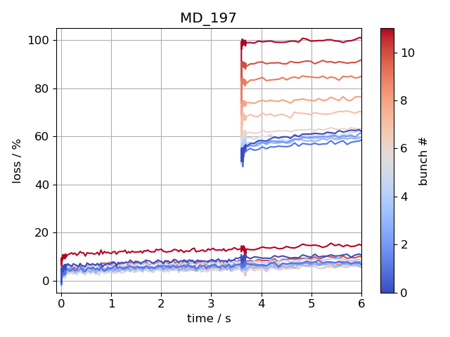
High intensity: FB off, FF off, LD off, PL off
Batch spacing: 300ns
offset by 2ns
offset by 50%
…

Slide 27
High intensity: FB off, FF off, LD off, PL off
Batch spacing: 250ns
offset by 2ns
offset by 50%
…

Slide 28
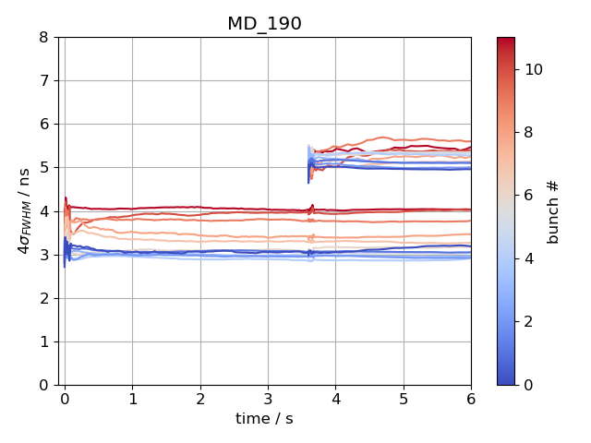
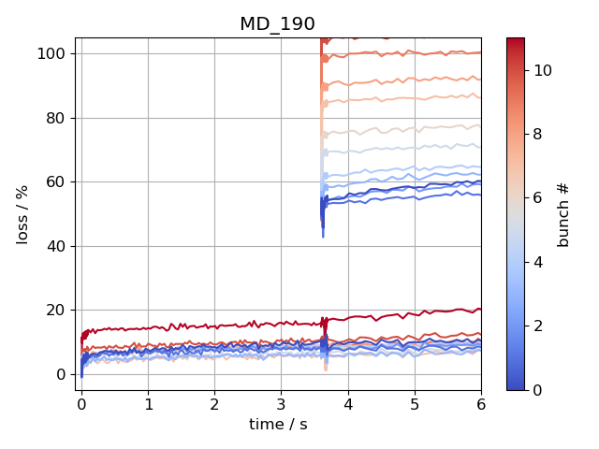
High intensity: FB off, FF off, LD off, PL off
Batch spacing: 200ns
offset by 2ns
offset by 50%
…

