Slide 1
Measurements of the Synchronous Phase Shift Aaron Farricker Participants: A.Lasheen, J. Repond & M.Schwarz Acknowledgements: H. Bartosik, T. Bohl, G. Papotti, SPS operator team

Slide 2
Synchronous Phase Shift
In a storage ring parasitic energy loss is inevitable
This is caused by the resistive impedances and results in a shift in the synchronous phase
The phase shift is related directly to the energy loss and hence impedance
The synchronous phase shift can be used to test the SPS impedance model
Measurements of the synchronous phase were last carried out in 2003 (E.Shaposnikova et al.)
The data collected was found to be consistent with the Impedance model of the time
Synchronous Phase
Energy Loss
Modal Loss Factor (Gaussian Bunch)

Slide 3
Synchronous Phase Shift – Measurement Technique
In order to measure the synchronous phase shift a reference phase must be identified
In this measurement two bunches of equal bunch length will be used
The reference with low intensity and the test bunch with a higher variable intensity
By sampling the bunch profiles on a 40 GS/s oscilloscope simultaneously the relative phase is trivial to calculate.

Slide 4
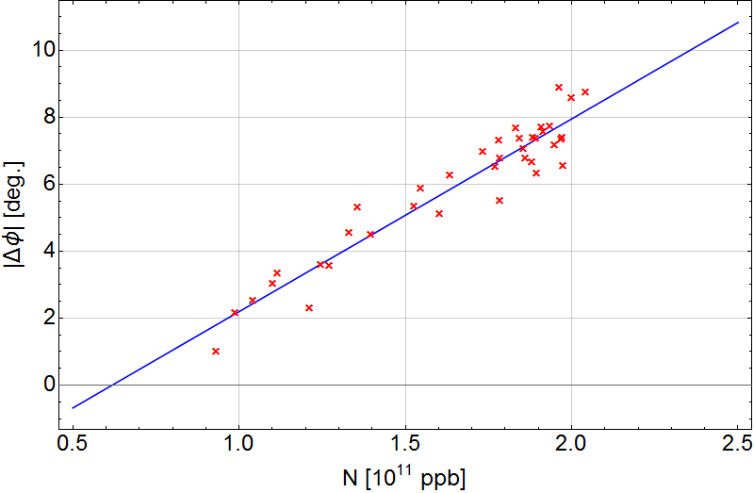
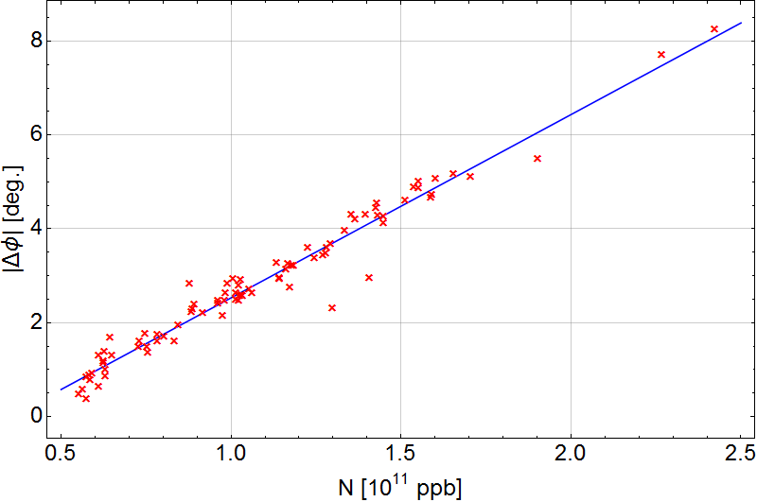
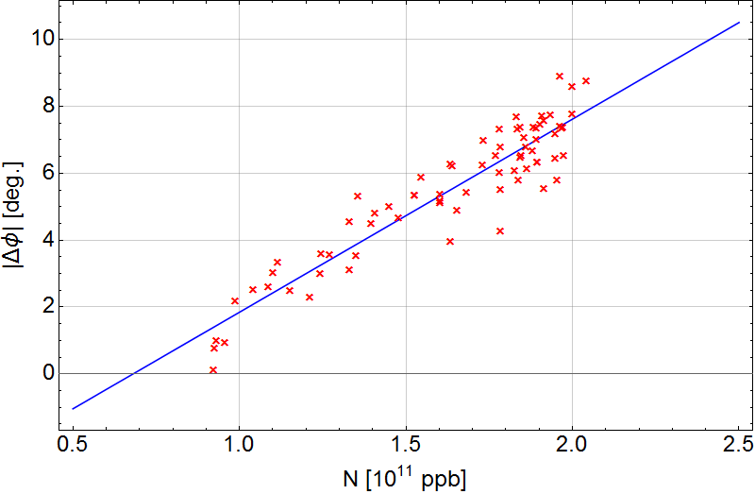
Measurement Data
Q20 optics
Single RF
Feedback OFF
Feedfoward OFF
Longitudinal damper OFF
V200 = 2.5 MV (4.5 MV capture)
3.2 ns
3.5 ns
3.6 ns

Slide 5
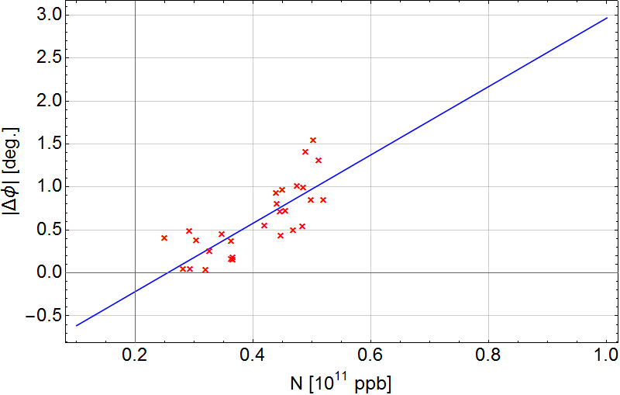
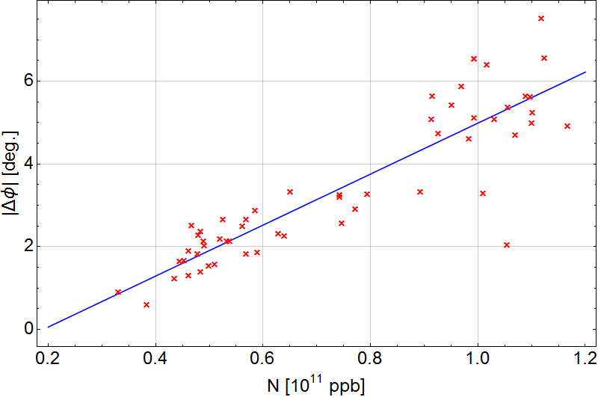
Measurement Data
2.0 ns
2.5 ns
Q20 optics
Single RF
Feedback OFF
Feedfoward OFF
Longitudinal damper OFF
V200 = 4.5 MV (4.5 MV capture)
Q20 optics
Single RF
Feedback OFF
Feedfoward OFF
Longitudinal damper OFF
V200 = 2.5 MV (4.5 MV capture)

Slide 6
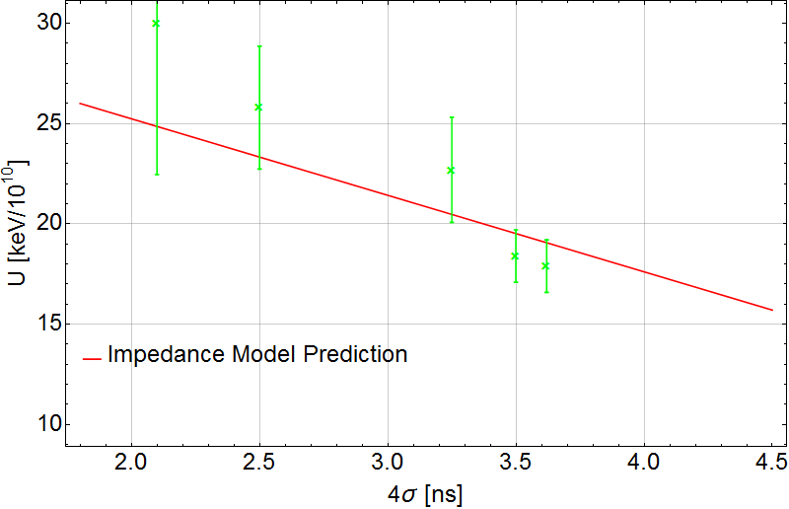
Comparison to the Model
The data so far is consistent with the Impedance model predictions that can be readily calculated
The two shorter bunch lengths have significant error bars due to the increased variation in the data
To complete the picture a couple more data points would be good to have in the region between 2.5 and 3.0 ns

