Slide 1
First results of horizontal aperture measurements after modification of QD apertures in YETS
V. Kain, H. Bartosik, S. Cettour Cave, K. Li, C. Pasquino, F. Velotti

Slide 2
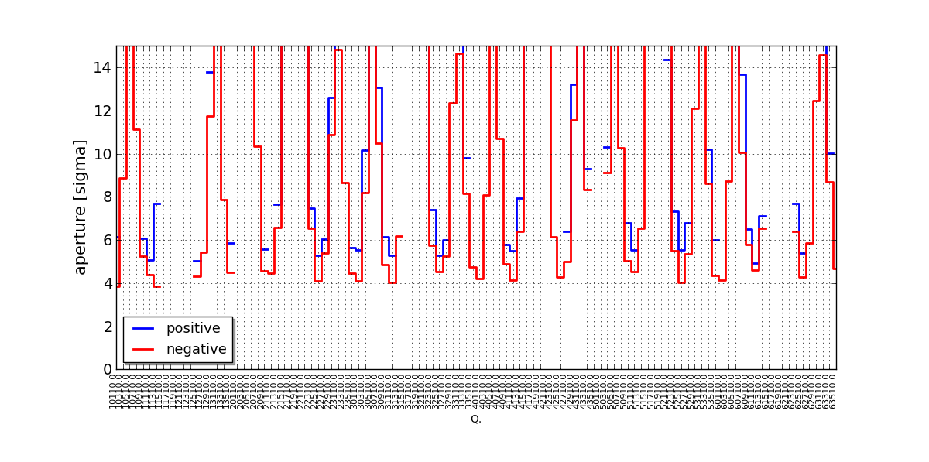
Reminder: 2017 measurements
Due to flange with eccentric bellow at MBB to QD–SSS transition, asymmetric bottleneck at QDs with large dispersion
Assume 2 um emittance, 2 mm orbit, 1.5e-3 dp/p
Aperture: +4.9 σ/-3.8 σ

Slide 3
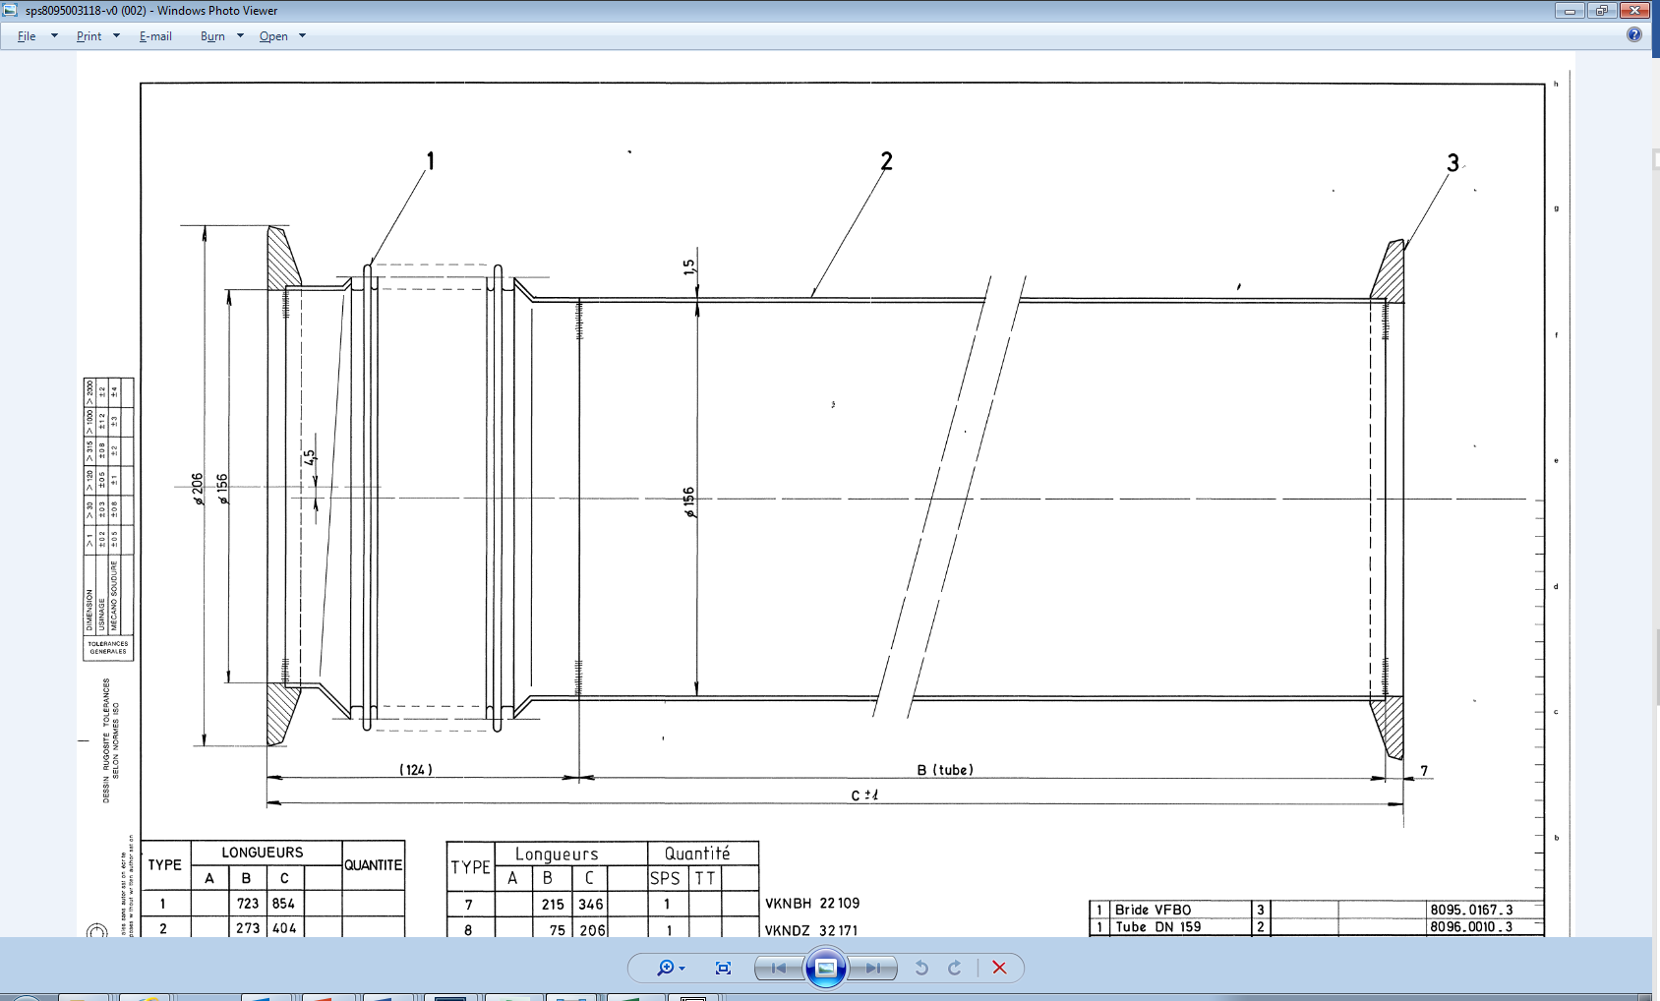
Reminder: YETS proposal
Exchange problematic flange at 3 locations and repair location 113
3 locations: 101, 401, 521 (only changed orientation)
Magnet axis
Beam axis
Idea was to exchange this…
…by this

Slide 4
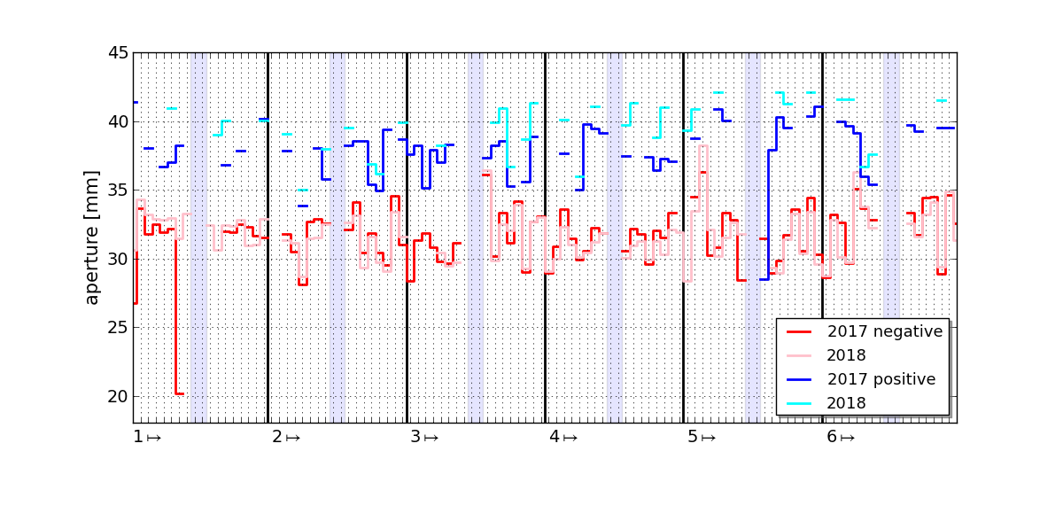
Results: horizontal plane
Basically: no change. Aperture 2018: -3.9 σ / 5 σ
101 and especially 113 were repaired, but asymmetry remains
Reason: RF fingers were installed inside 156 mm flange
Side remark: horizontal plane more difficult to measure: reliable orbit measurement required

Slide 5
Summary and Outlook
Confirmed measurements of 2016: asymmetric aperture
Possible cure in three test locations did not help. RF fingers
Might tackle one location during TS1 or TS2 (probably 113)

