Slide 1
Losses at flat-bottom
M. Schwarz
Acknowledgements:
A. Lasheen, J. Repond, E. Shaposhnikova, H. Bartosik, V. Kain, T. Bohl, H. Timko,G. Papotti,
P. Baudrenghien, P. Kramer, I. Karpov
SPS & PS operator team, BLonD dev team

Slide 2
Content
Motivation
Instability of simulated losses with radial loop
Comparison between measurements and simulation with frequency loop
Simulations for 2.6e11 particles per bunch

Slide 3
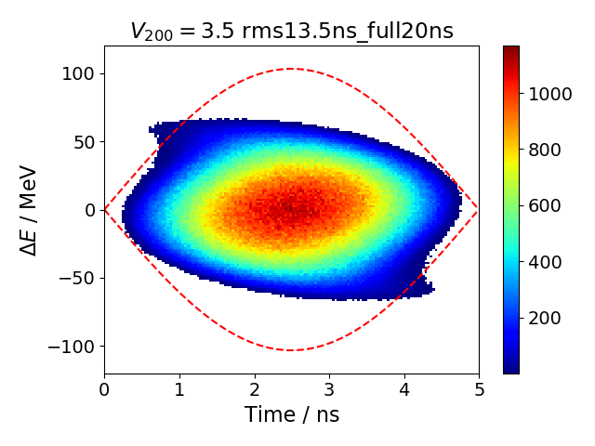
Sources of losses in the SPS
Losses at injection, possible sources:
Longitudinal effects (bunch shape from PS, uncaptured PS beam,…)
SPS LLRF system
Losses at SPS flat-bottom, possible sources:
Momentum aperture and transverse emittance
Full bucket (intensity effects, noise from LLRF)
Simulated PS bunch in SPS RF-bucket (courtesy of A. Lasheen)

Slide 4
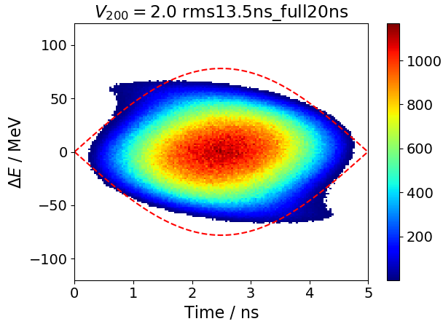
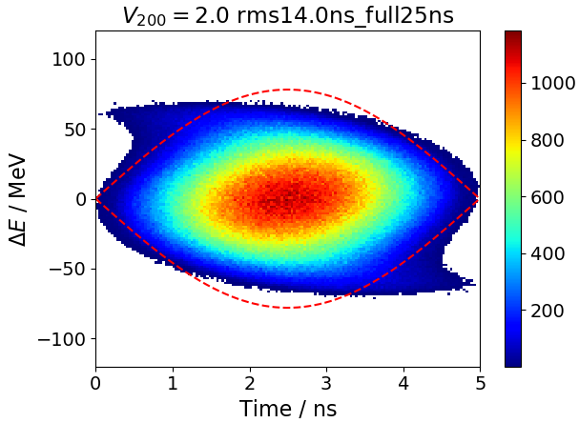
Simulation parameters
Use different bunch distributions simulated in the PS (courtesy of A. Lasheen)
Out of the 4M macro-particles, randomly select 1M macro-particles for tracking in the SPS for each of the 72 bunches; ‘seed’ parameter determines which macro-particles are used for tracking; average simulation results for different seeds
Place bunches at center of bare RF-bucket
Use ‘impedance reduction’ to model one-turn delay feedback of 200 MHz TWC
V₈₀₀ = 0 MV
Phase loop gain: 5e3 1/s; PL averages over 12 bunches (hard edge)
Radial loop gain: 5e9
Frequency loop gain: 0.09
Either with full SPS impedance or with just 200 MHz TWC impedance
Initial intensity per bunch: 1.7e11 (both measurement and simulation)
Simulation parameters
number of bins / RF-bucket (64, 128, or 256)
Frequency resolution (df= 4 f_rev)
Six different seeds for initial distribution
Number of macro-particles: 1M
Distribution 2
Distribution 3
Calculate intensity of bunches after 1s (~43k turns) and calculate loss relative to initial intensity

Slide 5
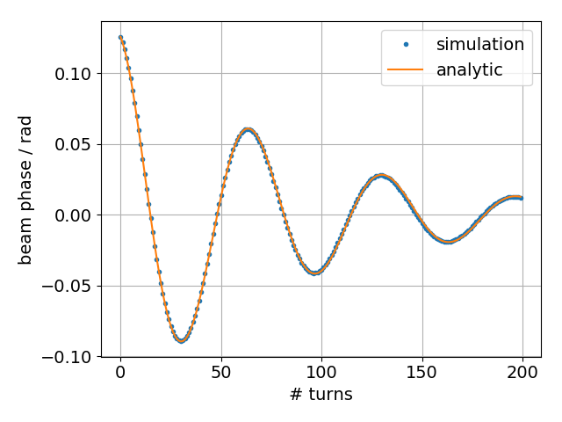
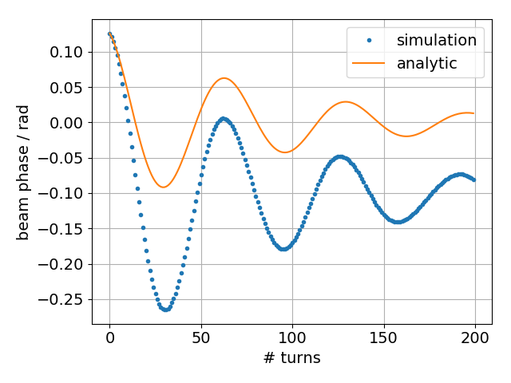
LLRF loops
Phase loop: displaces RF, such that beam phase equals synchronous phase; damps dipole oscillations
$$δω_{RF}(t)=−g_{PL} \left\langle φ_{beam}(t)\right\rangle$$
$$δφ_{RF}(t)=\int_{0}^{t}{δω_{RF}\left(\tilde{t}\right)d\tilde{t}}$$
no beam loading
beam loading
Radial loop: adjust RF to keep beam orbit centered
$$δω_{RF}\left(t\right)=−g_{PL} \left\langle φ_{beam}\left(t\right)\right\rangle −g_{RL}\left\langle R\right\rangle$$
$$\left\langle R\right\rangle =\frac{α_{0}R_{ring}}{β^{2}E_{0}}\left\langle ΔE\right\rangle$$
~# macroparticles -> numerically expensive
Frequency loop: adjust RF to design frequency
$$δω_{RF}\left(t\right)=−g_{PL} \left\langle φ_{beam}\left(t\right)\right\rangle −g_{FL}(ω_{RF}\left(t\right)−ω_{RF,d})$$

Slide 6
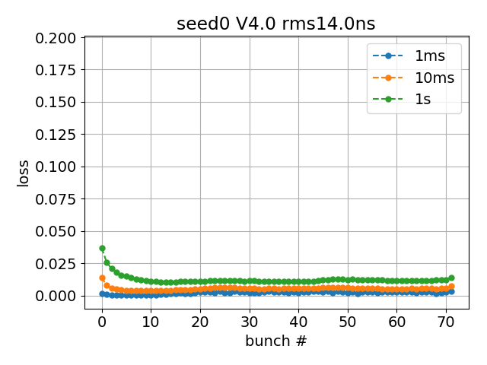
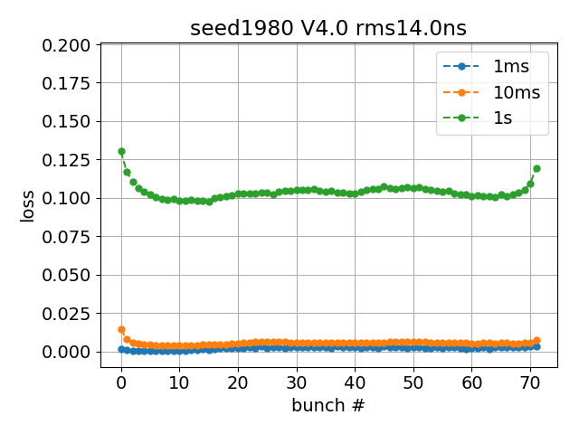
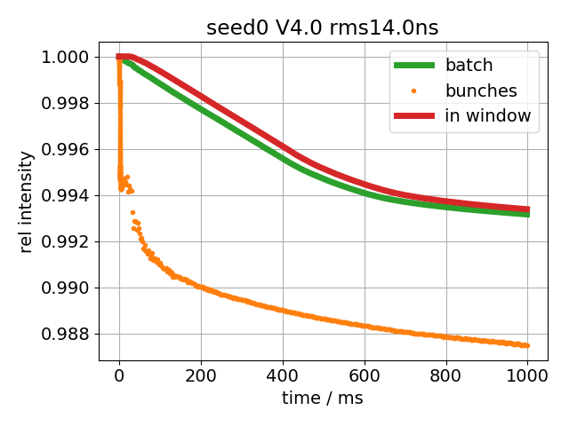
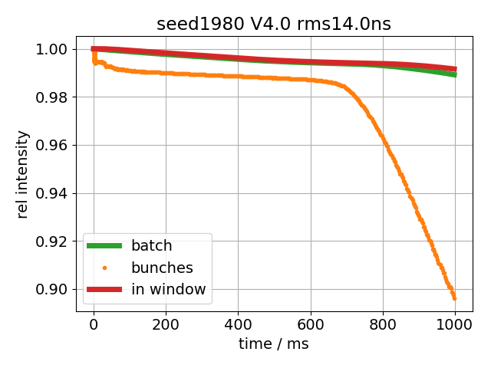
Instability with radial loop
Seed 0
Seed 1980
Notice different
intensity scales!
Seed 0
Seed 1980
Tiny variation in initial distribution leads to five times more losses

Slide 7
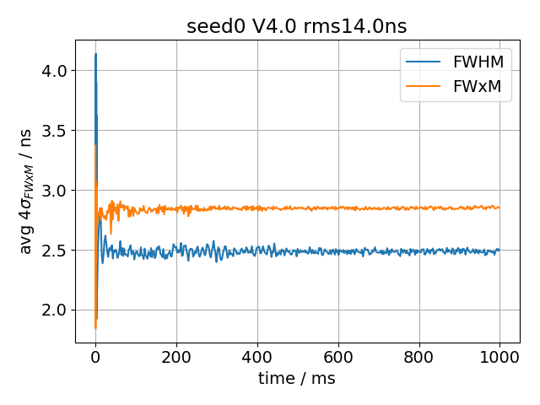
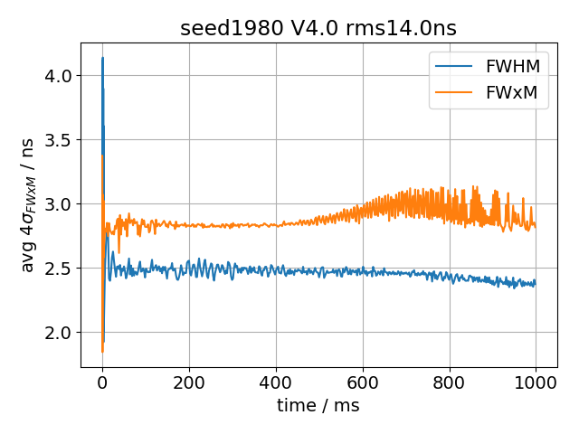
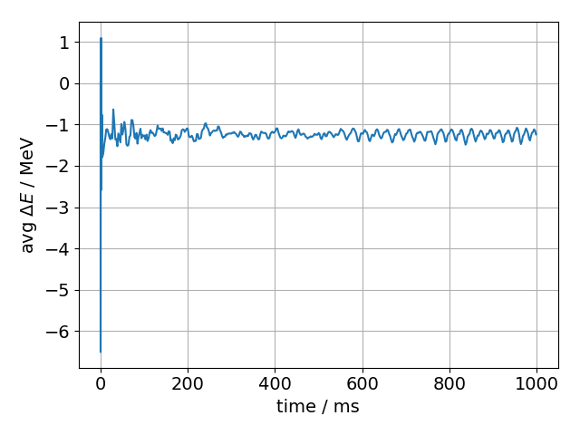
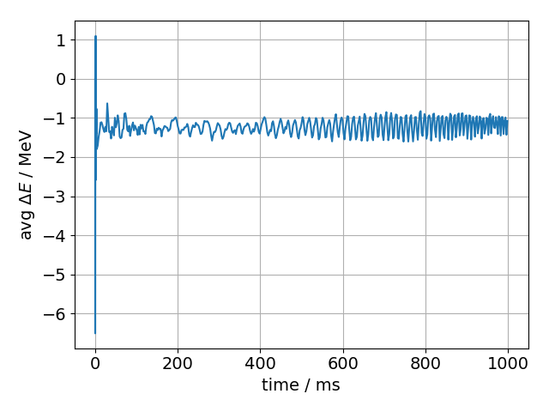
Average bunch length and beam energy
Seed 0
Seed 1980
Seed 0
Seed 1980
Up to ~400ms nearly identical behavior;

Slide 8
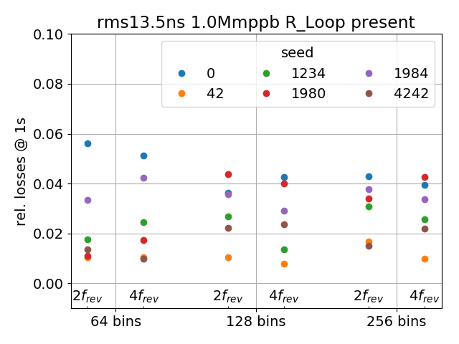
Instability with radial loop: phase space animation of 1st bunch
Seed 0
Seed 1980
For seed ‘1980’, bunch center starts to oscillate at ~400ms
For seed ‘1980’, ‘sub-bunch’ develops into a ‘ring’ around main core
Changing numerical simulation parameters (# bins, frequency resolution) does not improve stability

Slide 9
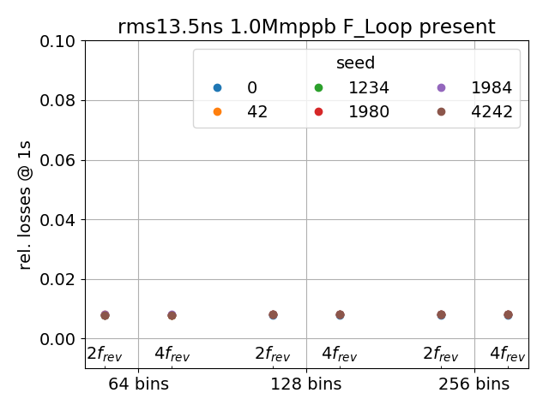
Using frequency loop
Results independent of:
numerical simulation parameters
initial seed
Simulation factor 2 faster than with radial loop
-> use frequency loop in the following
SPS uses synchro-loop for protons instead of radial loop
Sensitivity of simulations with radial loop not completely understood
Possible reason: both phase and radial loop depend directly on beam parameters (phase and energy); frequency loop only looks for changes in RF-frequency

Slide 10
Simulation parameters
Use different bunch distributions simulated in the PS (courtesy of A. Lasheen)
Out of the 4M macro-particles, randomly select 1M macro-particles for tracking in the SPS for each of the 72 bunches; ‘seed’ parameter determines which macro-particles are used for tracking; average simulation results for different seeds
Place bunches at center of bare RF-bucket
Use ‘impedance reduction’ to model one-turn delay feedback of 200 MHz TWC
V₈₀₀ = 0 MV
Phase loop gain: 5e3 1/s; PL averages over 12 bunches (hard edge)
Frequency loop gain: 0.09
Either with full SPS impedance or with just 200 MHz TWC impedance
Initial intensity per bunch: 1.7e11 (both measurement and simulation)
Simulation parameters
64 number of bins / RF-bucket
Frequency resolution: df= 4 f_rev
Six different seeds for initial distribution
Number of macro-particles: 1.5M
Distribution 2
Distribution 3
72 bunches, 1.7e11 ppb, 25ns bunch spacing
Q22 optics
V₈₀₀ = 0 MV
Measurement setup

Slide 11
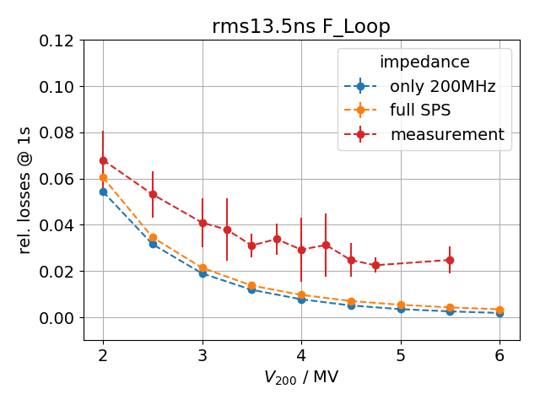
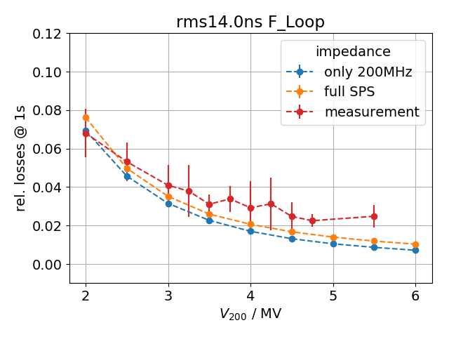
Simulation vs measurement: V₂₀₀ scan
distribution 2 frequency loop
distribution 3 frequency loop
Smaller simulated losses for distribution with less tails
Slightly more losses when including full SPS impedance in simulations
Agreement between measurement and simulation for small V₂₀₀, where beam loading is more prominent
For large tails, simulated losses still below measured losses
due to on-set off flat-bottom losses (like momentum aperture limitation), which are not present in simulation?

Slide 12
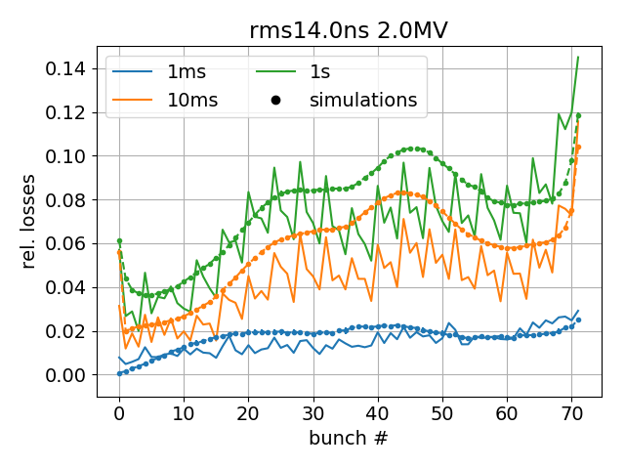
Simulation vs measurement: bunch-by-bunch loss pattern
V₂₀₀ = 2.0 MV
Distribution 3
Over all, good qualitative and quantitative agreement, but
Measured 10 MHz modulation (every 4th bunch) not reproduced here, because no initial bunch modulation (see presentation https://indico.cern.ch/event/705636/)
‘bump’ for bunches 40 to 50 not as pronounced in measurement
Up to 10ms, simulated losses larger by about 1%

Slide 13
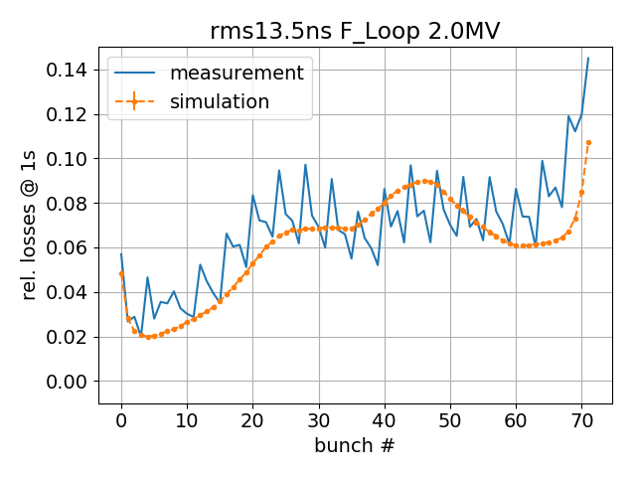
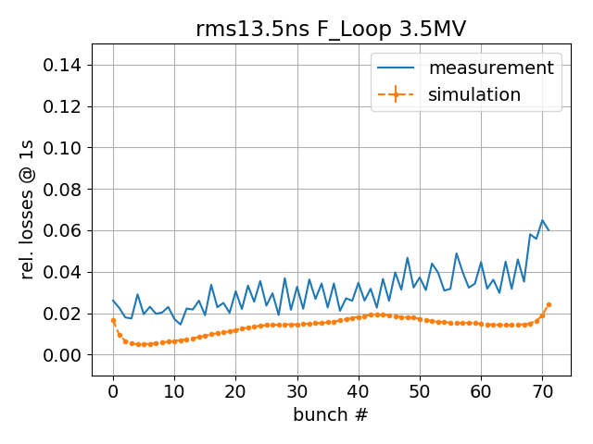
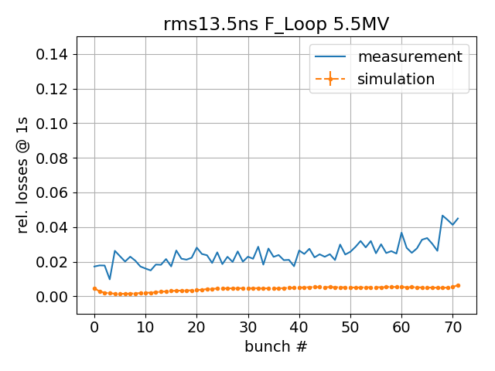
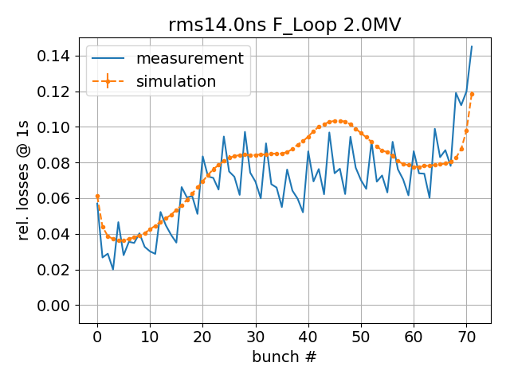
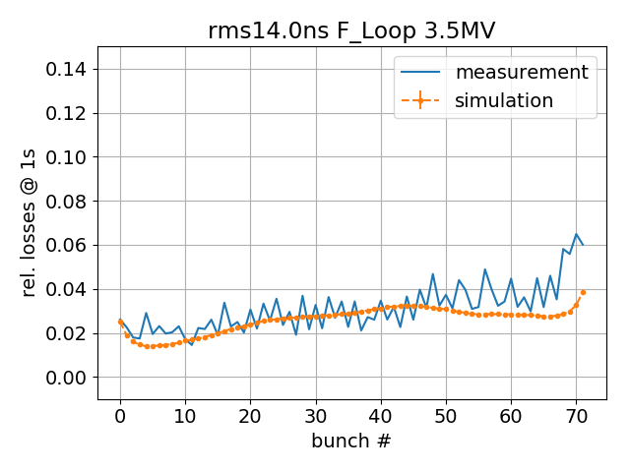
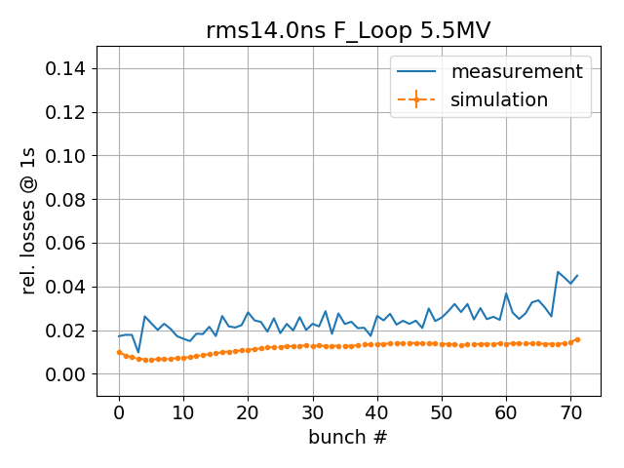
Simulation vs measurement: bunch-by-bunch loss pattern
distribution 2 3.5 MV
distribution 2 5.5 MV
distribution 2 2.0 MV
distribution 3 3.5 MV
distribution 3 5.5 MV
distribution 3 2.0 MV
For high V₂₀₀, measured and simulated loss patterns become more ‘flat’
less influence of beam loading for higher V₂₀₀
For high V₂₀₀, simulated losses below measured ones
Mechanism of flat-bottom losses not implemented in simulation

Slide 14
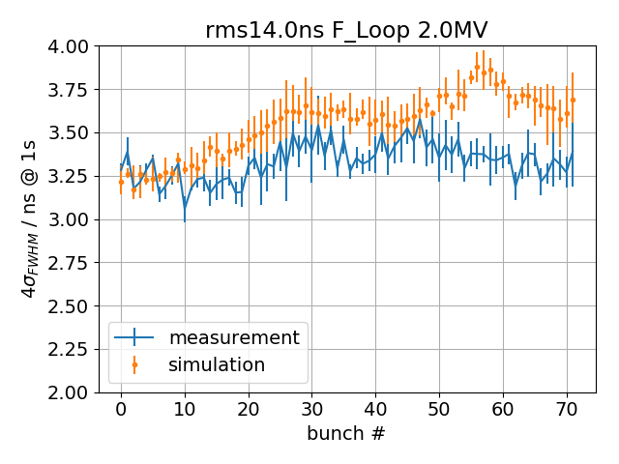
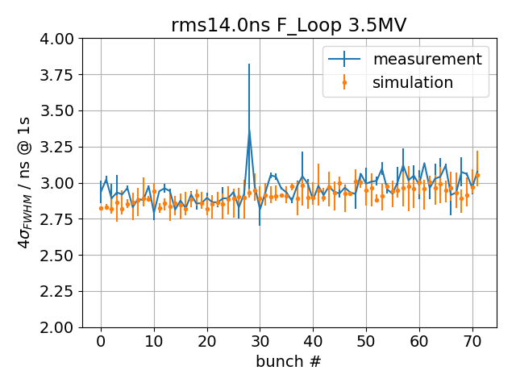
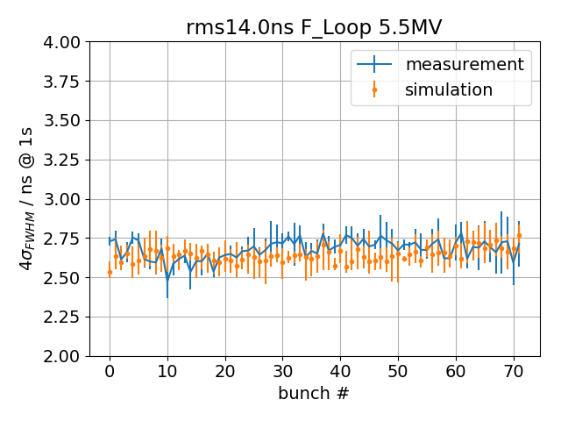
Bunch length, distribution 3, frequency loop, V200 scan
V₂₀₀ = 2.0 MV
Nice agreement for higher voltages and simulations
For V₂₀₀=2.0, simulated bunch lengths larger at end of batch

Slide 15
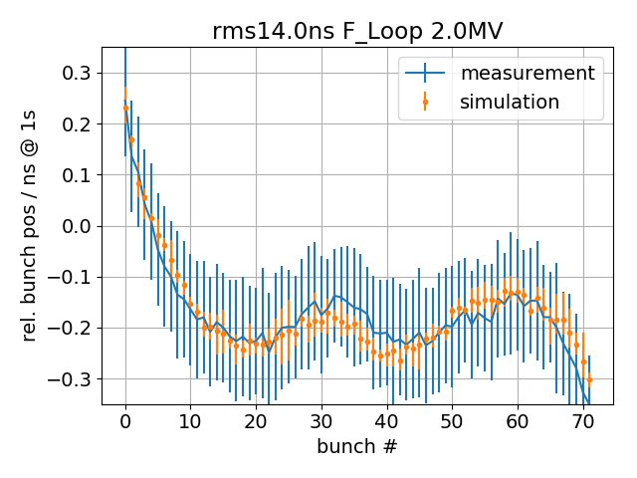
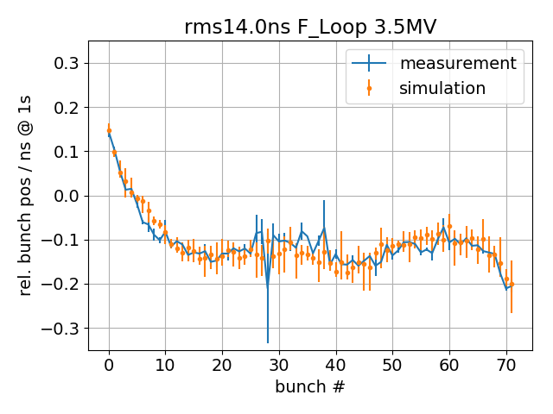
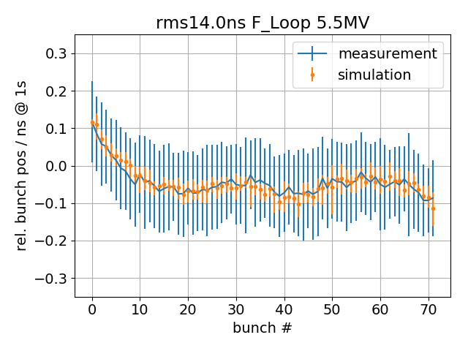
Bunch position, distribution 3, frequency loop, V200 scan
V₂₀₀ = 2.0 MV
Bunch position relative to ideal RF-bucket
Adjust mean of simulated bunch position to mean of measured bunch position
Within errors, perfect agreement ☺

Slide 16
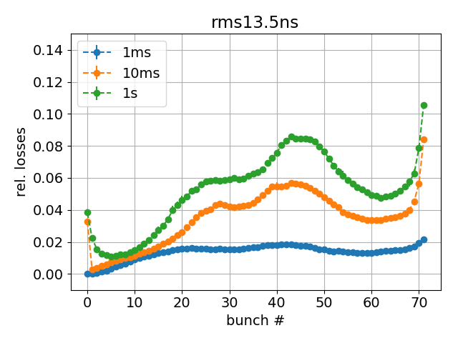
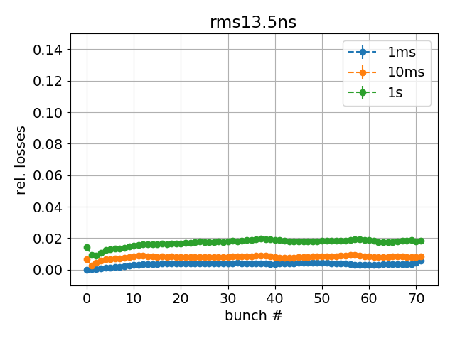
Simulated losses for high intensity, 2.6e11 ppb
Simulation parameters present:
72 bunches, 2.6e11 ppb
V₂₀₀ = 3.5 MV
Feedback strength at -15 dB reduction
Phase loop averages over 12 bunches
Two 5-section and two 4-section cavities
Present SPS impedance model
Simulation parameters future:
72 bunches, 2.6e11 ppb
V₂₀₀ = 3.5 MV
Feedback strength at -26 dB reduction
Phase loop averages over all bunches
Two 4-section and four 3-section cavities
Future SPS impedance model
present
future
Losses ~2%

Slide 17
Summary
Simulations with radial loop up to 1s can very sensitive to tiny variations of initial parameters
Simulations with frequency loop more robust (and faster by factor 2)
Comparing measurements with simulations with frequency loop yield
good agreement for low V₂₀₀ where beam loading is more prominent
systematically lower simulated losses for high V₂₀₀; either initial distribution not correct, or mechanism for flat-bottom losses (such as momentum aperture) not included in simulations
Thank you for your attention!

Slide 18
Appendix

Slide 19
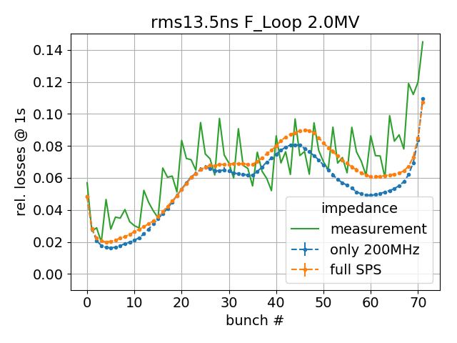
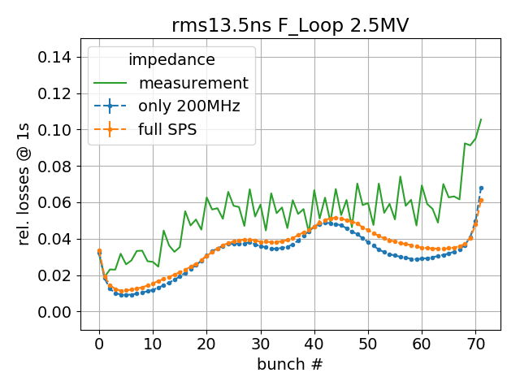
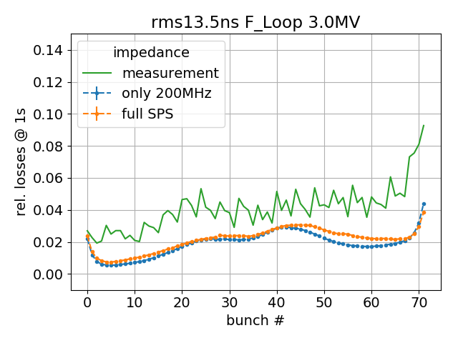
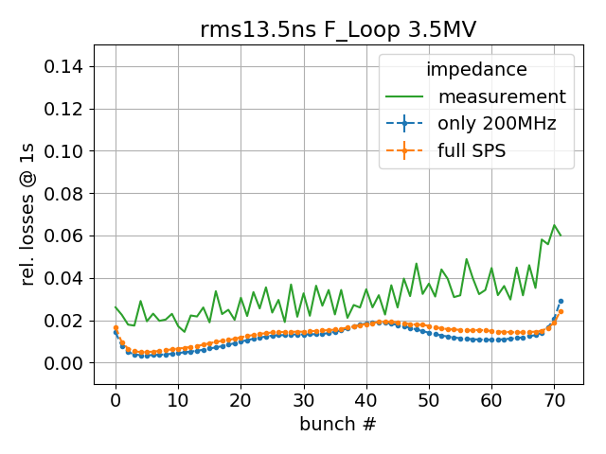
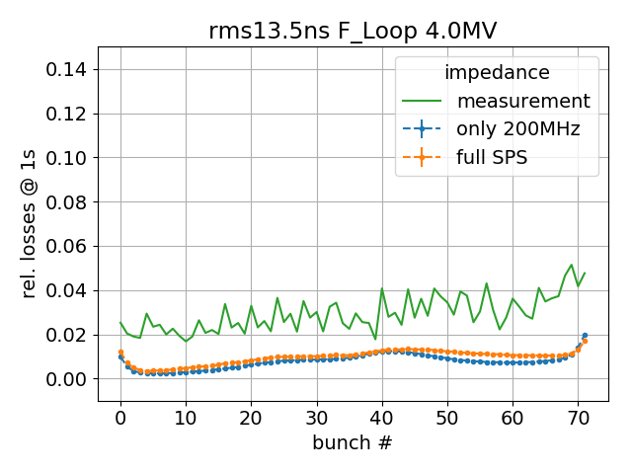
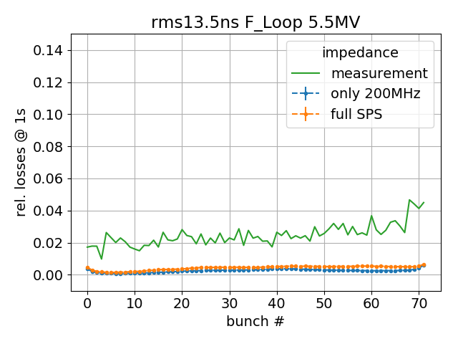
bbb loss pattern, distribution 2, frequency loop, V200 scan
Good qualitative and quantitative agreement for low V200
For high V200, measured and simulated loss patterns become more ‘flat’
For high V200, practically no simulated losses -> all tails captured

Slide 20
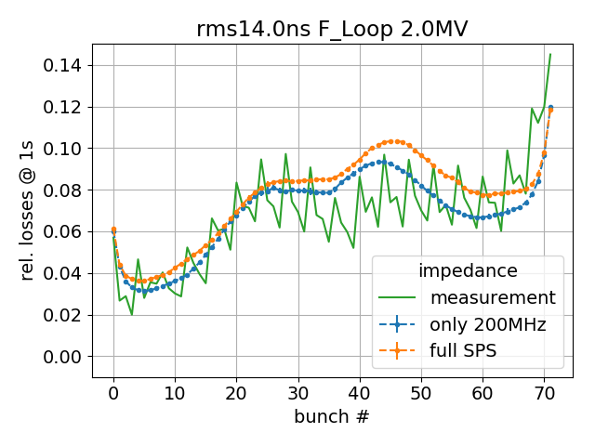
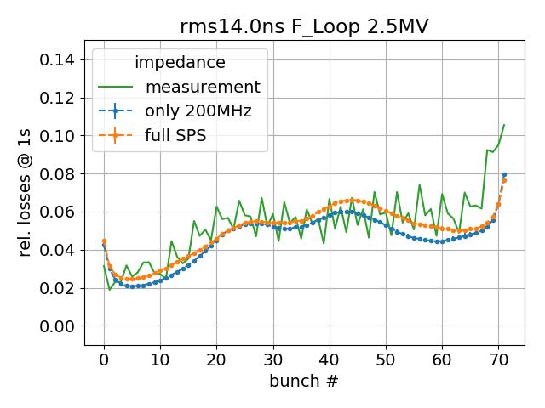
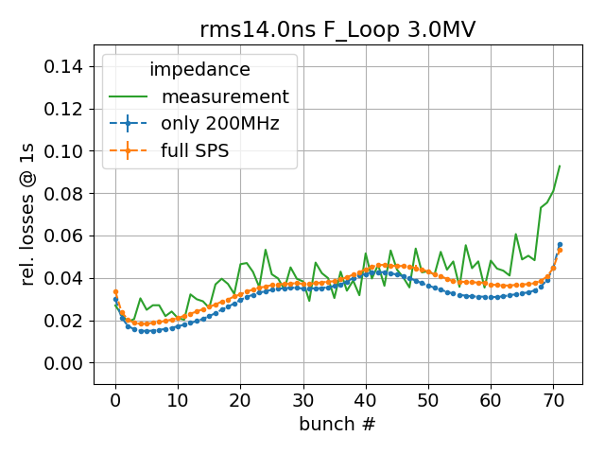
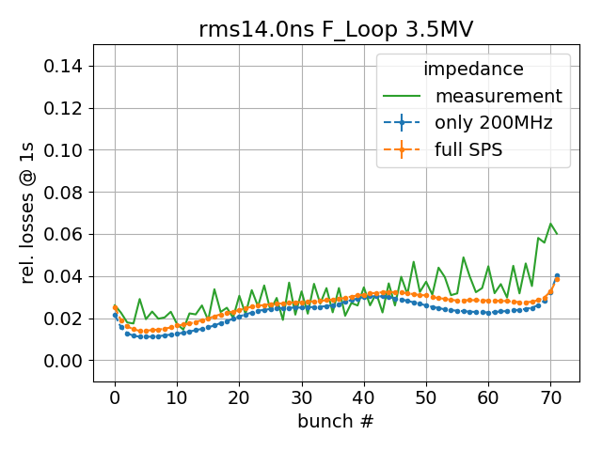
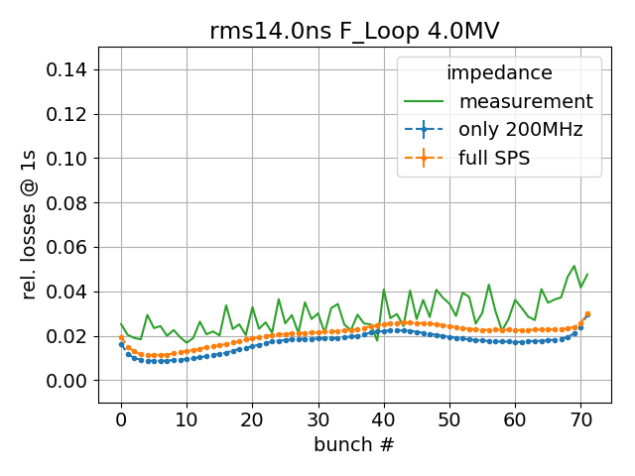
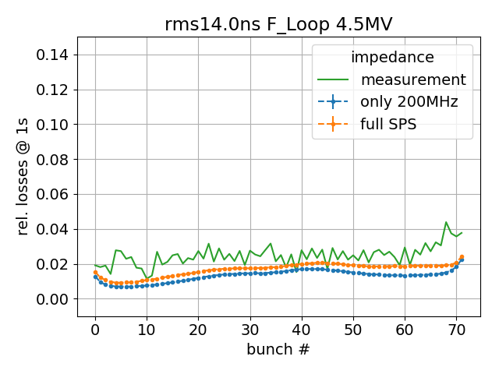
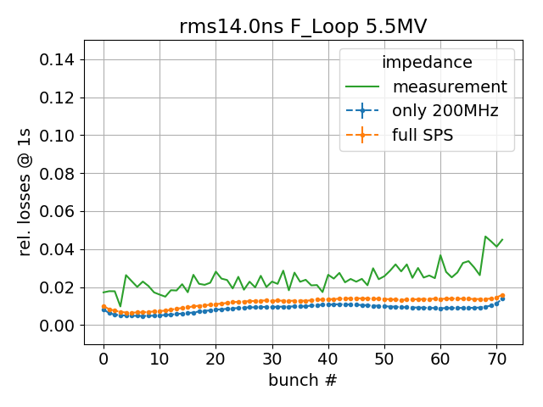
bbb loss pattern, distribution 3, frequency loop, V200 scan
Good qualitative and quantitative agreement for low V200
For high V200, measured and simulated loss patterns become more ‘flat’
For high V200, simulated losses smaller than measured losses -> not enough tails in simulated distribution

Slide 21
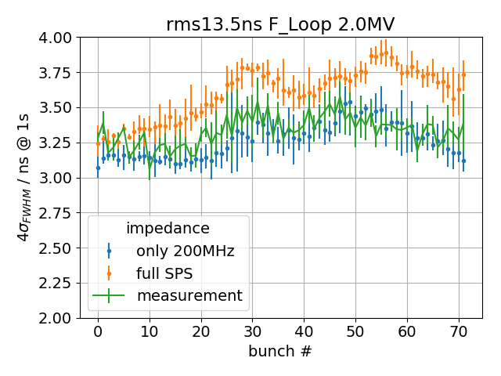
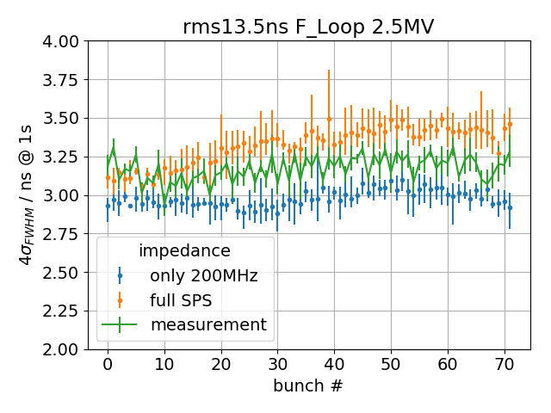
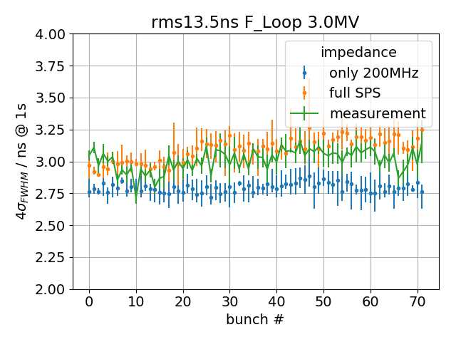
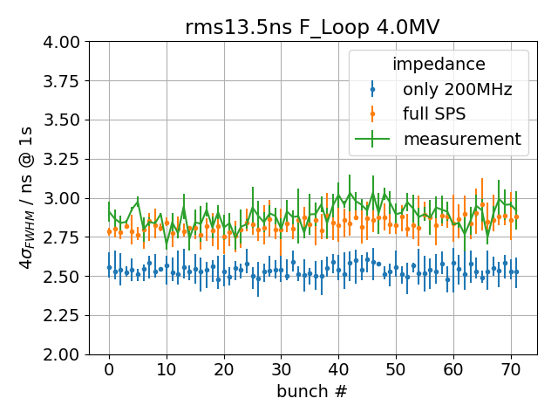
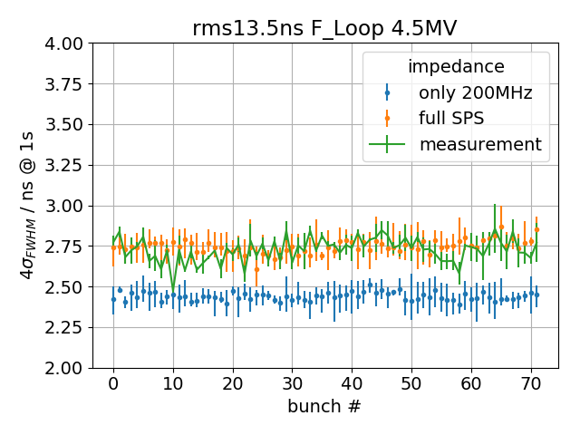
Bunch length, distribution 2, frequency loop, V200 scan
Nice agreement for higher voltages and simulations with full SPS impedance model
For V200=2.0, model with only 200MHz TWC impedance gives better agreement

Slide 22
Bunch length, distribution 3, frequency loop, V200 scan
Nice agreement for higher voltages and simulations with full SPS impedance model

Slide 23
Bunch position, distribution 2, frequency loop, V200 scan
Bunch position relative to ideal RF-bucket
Adjust mean of simulated bunch position to mean of measured bunch position
Within errors, perfect agreement ☺

Slide 24
Bunch position, distribution 3, frequency loop, V200 scan
Bunch position relative to ideal RF-bucket
Adjust mean of simulated bunch position to mean of measured bunch position
Within errors, perfect agreement ☺

