Slide 1
Parameters of the low-frequency capture RF system in the SPS s 24th of April 2018
LIU-SPS Beam Dynamics Working Group
J. Repond, E. Shaposhnikova
Acknowledgements: A. Lasheen, H. Damerau, P. Baudrenghien, E. Montesinos, G. Papotti, BLonD dev. team.

Slide 2
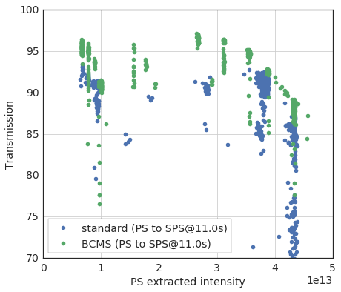
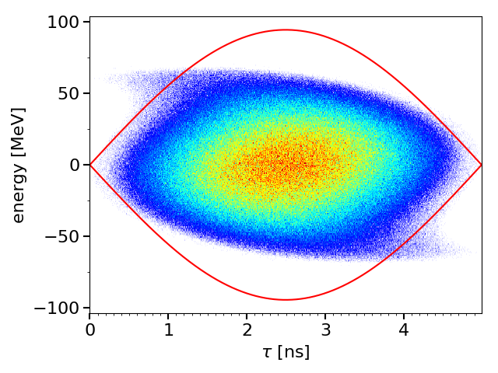
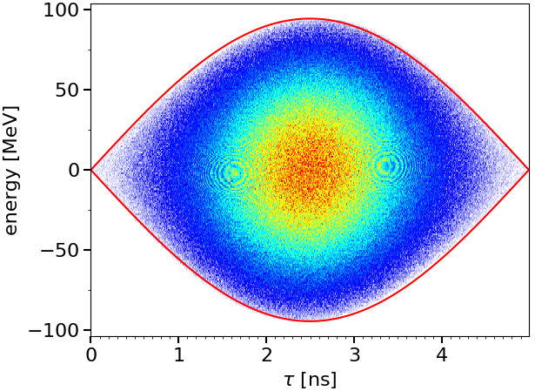
Why consider a lower-harmonic RF system in the SPS?
Full bucket in the SPS
Losses increasing with intensity
PS bunch:
Rotated using 40 & 80 MHz RF
Larger emittance than nominal may be needed for beam stability
SPS:
No bunch-to bucket matching
Particles injected close to the separatrix
Transmission measured during the high-intensity run (november 2017)
→ Losses increase with intensity
Flat bottom transmission 4 batch (BCMS vs. standard beam)
1st turn in SPS 200 MHz bucket
after filamentation
Loss budget
Courtesy H. Bartosik
→ Full bucket, independent of capture RF voltage at 200 MHz
→ Bottleneck for the HL-LHC proton beams
→ Lower-harmonic RF allows larger acceptance and less particle close to the separatrix

Slide 3
PS-SPS beam transfer – some history
R. Garoby, Requirements to the PS RF system for filling the LHC with 25 ns spacing between bunches, CERN PS/RF/Note 93-04
D. Boussard, RF scenarios at 26 GeV in the SPS as LHC injector, CERN SL/Note 93-12
R. Garoby, A non-adiabatic procedure in the PS to supply the nominal proton bunches for LHC into 200 MHz RF buckets in SPS, CERN PS/RF/Note 93-17
The 80 MHz RF system in the SPS was proposed and eliminated after consideration of the coupled bunch instability and bunch rotation on the SPS flat bottom: “Scenario where the 9 ns long bunches are held all along 4.8 s flat bottom is unrealistic.” (D. Boussard, reduction of 200 MHz impedance by factor 10)
→ Bunch compression in the PS is much better and needs less hardware

Slide 4
What is different today?
LIU-SPS 200 MHz RF upgrade
Increase of available power
Better control of beam-loading
Impedance reduction
Larger longitudinal emittance needed in PS for beam stability
Experience in beam stabilisation using a higher harmonic RF system (800 MHz in bunch-shortening mode)
→ use 200 MHz as a Landau system

Slide 5
A need in the SPS 200 MHz RF system
As Landau cavity: for given emittance and optics we lose in stability in all cases
For acceleration: due to large bandwidth (TW) it works for ions and FT protons from 14 GeV/c
For beam transfer to LHC: otherwise one needs the 200 MHz RF in LHC and even then the situation will be worse with transfer from the 80 MHz RF system in the SPS
→ Keep also the 800 MHz RF system, used for beam stabilisation in the 200 MHz RF system

Slide 6
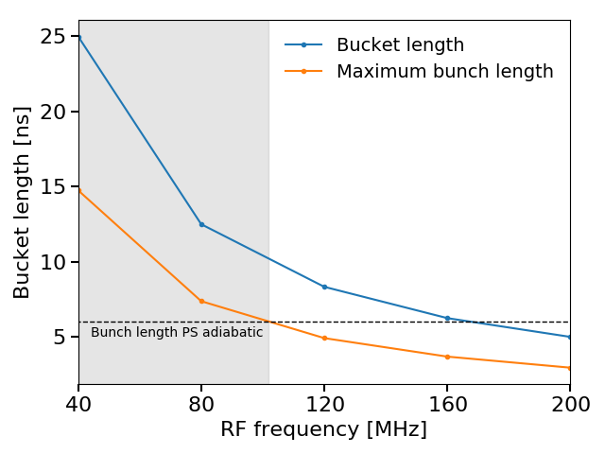
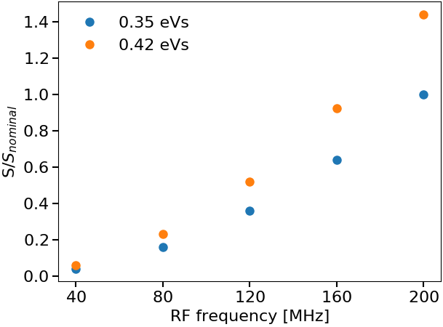
Lower-harmonic RF system in the SPS, choice of RF frequency
Bucket and bunch length
Stability in lower-harmonic RF
$f_{rf}=k×40$ MHz due to 25 ns spacing
PS can produce adiabatically 6 ns bunches (to be confirmed for multi-bunch in 2018) [*]
Longer bunches require control of 200 MHz voltage to a very low level
Beam stability decreases with $h$ with scaling
CBI threshold $∼η\frac{ε^{2}h^{2}}{Eτ}$
LLD threshold $∼η\frac{ε^{2}h^{2}τ }{E}$
Q22 worst, $\frac{η_{22}}{η_{20}}≈0.7$ at flat bottom
Bucket length and maximum bunch length for $q_{p}=0.8$
Stability scaling, $S=ηε^{2}h^{2}$
nominal
→Only 80 MHz RF system suitable on SPS flat bottom with 200 MHz as a Landau system
[*] H. Damerau, A. Lasheen, private communications

Slide 7
Potential issues with the 80 MHz
Acceleration of larger emittance bunches in 200 MHz (needed for beam stability in PS if no Landau system installed in PS)
SPS acceptance limited by available power and beam-loading
Lower beam stability due to lower harmonic number
→ 200 MHz as a Landau cavity, but
Residual $V_{200}$ difficult to control to a low level → 6 ns bunch length from the PS but not guaranteed
Instabilities recently observed on flat bottom not fully understood and the 800 MHz RF was not very helpful
Re-bucketing in the 200 MHz RF system
Potential reduction of losses only if related to bunch shape due to PS bunch rotation
Large 80 MHz voltage for re-bucketing in 200 MHz
Creation of satellite bunches if PS bunch has large tails → harmful for LHC
Impedance and beam-loading in the new RF system
Effect on beam stability during the rest of the cycle
Not treated here, requires a dedicated study

Slide 8
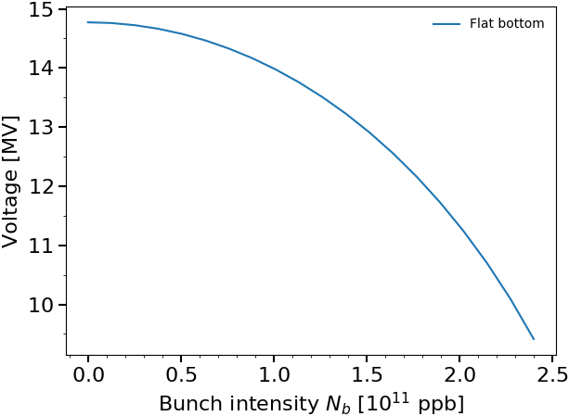
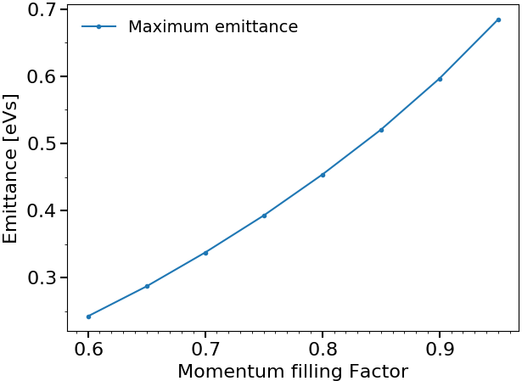
Emittance limitation during acceleration after RF upgrade
Particles too close to separatrix lost when acceleration starts
Maximum available power ($P_{4}^{max}=1.6$ MW, $P_{3}^{max}=1.05$ MW) and beam-loading limit the acceptance in the SPS
→ Maximum voltage/bucket area depending on intensity
RF voltage program usually designed to keep a constant momentum ﬁlling factor $q_{p}$
Maximum voltage versus bunch intensity
Flat bottom / flat top (lower during accel.)
Maximum emittance
due to power limitation and beam-loading
for a given $q_{p}$
Filling factor $q_{p}=0.8$ based on present operation → $ε∼0.45$ eVs

Slide 9
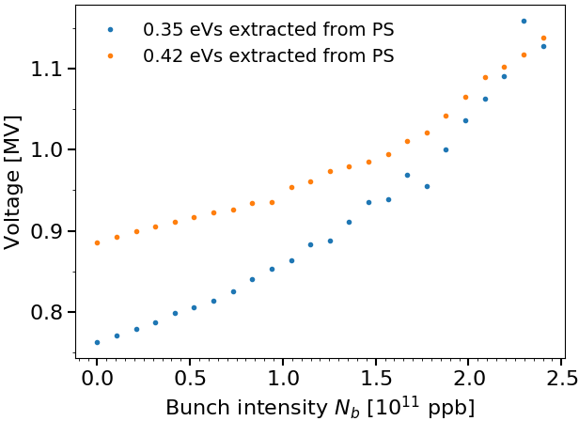
Voltage at capture with intensity effects HL-LHC intensity ($2.4×{10}^{11}$ ppb)
Filamentation at capture should be kept as small as possible to
avoid particle loss during re-bucketing
avoid full bucket in 200 MHz
0.35 eVs and 0.42 eVs emittance beam simulated in PS without rotation and intensity effect
→ Matched 80 MHz voltages in SPS are respectively 0.76 MV and 0.89 MV
Higher voltage needed due to intensity eﬀects
→ Simulations with full SPS impedance model after LIU upgrade
Bunches centred in RF bucket with intensity effects
→ Minimum value compared to what will be needed in operation
Voltage needed at capture to compensate intensity effects
and conserve bunch length injected from PS
200 MHz as a Landau system, $V_{200}=\frac{h_{80}}{h_{200}}V_{80}$
→ $V_{80}=1.15$ MV
minimum value to compensate intensity effects and conserve bunch length from PS

Slide 10
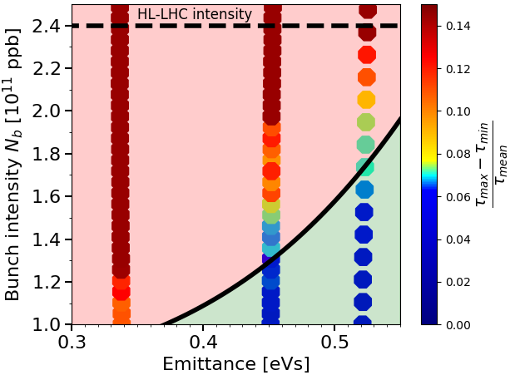
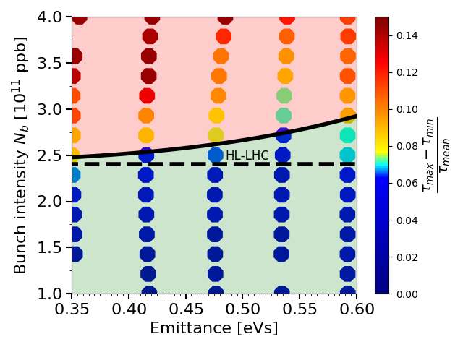
Beam stability in the 80 MHz RF system
Stability in single 80 MHz RF system
Stability in double 80+200 MHz RF system
SPS impedance model after LIU upgrade
48 bunches matched with intensity effects
10 seconds flat bottom
$V_{80}=1.1$ MV for all intensities.
200 MHz as Landau system in BS mode
$V_{80}=1.1$ MV, $V_{200}=0.44$ MV
Threshold above HL-LHC intensity but no margin left for nominal intensity
Stability treshold in a single 80 MHz RF system
Stability treshold in a double RF 80 MHz + 200 MHz system
→ Threshold above $N_{b}$(HL-LHC) by using 200 MHz as a Landau system but no margin left

Slide 11
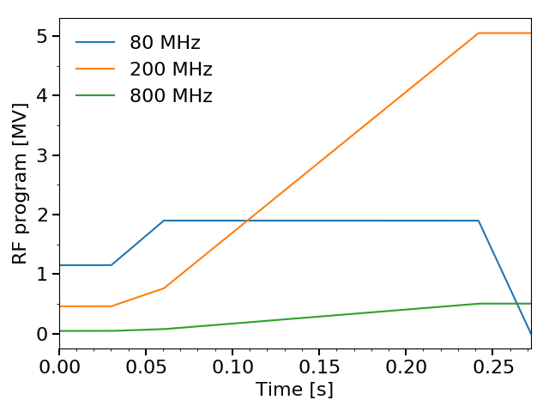
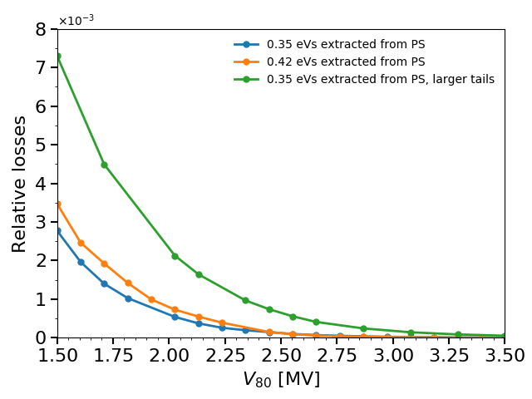
Transfer to the 200 MHz RF system with intensity effects
Typical voltage program for re-bucketing in 200 MHz
Particles not captured in main 200 MHz RF bucket create satellite bunches, harmful for LHC already at an intensity ratio of ${10}^{−3}$
Larger losses observed for voltages above the matched value of 1.15 MV at capture (filament.)
Assumptions on the tails of the PS bunch distribution are crucial
→ Can change losses by an order of magnitude
Bunches centred in RF bucket with intensity effects → Lowest value of losses
Preliminary analysis, study of PS bunch tails necessary to determine the gain of such a system
$$V_{80}^{max}$$
Emittance [eVs] | $$q_{p}$$ | $τ$ in 200 MHz [ns] | $V_{80}^{max}$ [MV]
0.35 | 0.8 | 2.9 | 1.9
0.42 | 0.8 | 2.9 | 2.7
$$V_{80}^{inj}$$
Losses from main 200 MHz RF bucket
$V_{80}^{inj}=1.3$ MV, $N_{b}=2.4×10^{11}$ ppb
Factor 4 increase with larger tails !
Harmful for LHC
→$V_{80}$ might reach 3 MV, additional study of effects of the tails/mismatch on losses needed

Slide 12
Conclusion and future work
Only a 80 MHz RF system is suitable on SPS flat bottom
Stability with 200 MHz as Landau system sufficient but no margin left for nominal emittance
The 80 MHz voltage might reach a voltage above 3 MV to limit the population of satellite bunches
More satellites expected in realistic capture conditions (mismatch, PS bunch tails)
Future studies
Effect of bunch tails during transfer to the main 200 MHz RF bucket
Study larger emittance bunches (0.5 eVs wanted in PS)
Effect of voltage ratio and phase on stability

Slide 13
THANK YOU FOR YOUR ATTENTION!

