Slide 1
Possible SPS octupole reconfiguration to minimize 2nd order chromaticity
H. Bartosik
LIU-SPS Beam Dynamics working group meeting, 24 April 2018

Slide 2
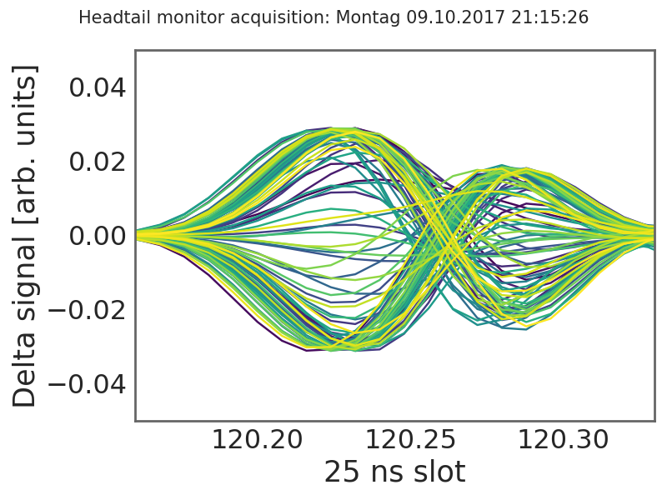
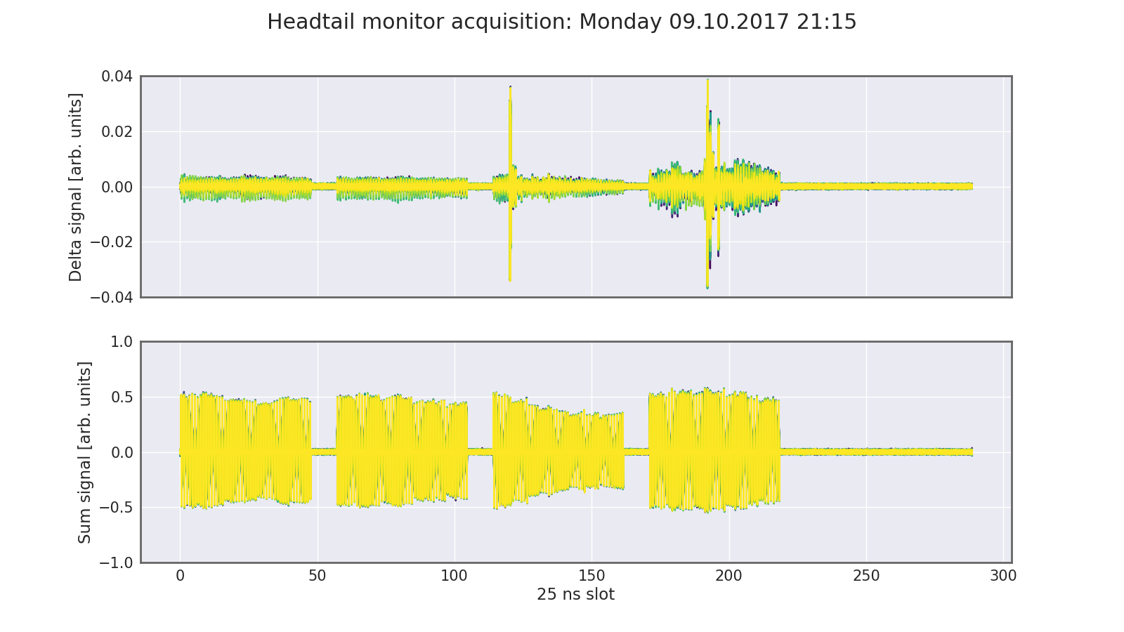
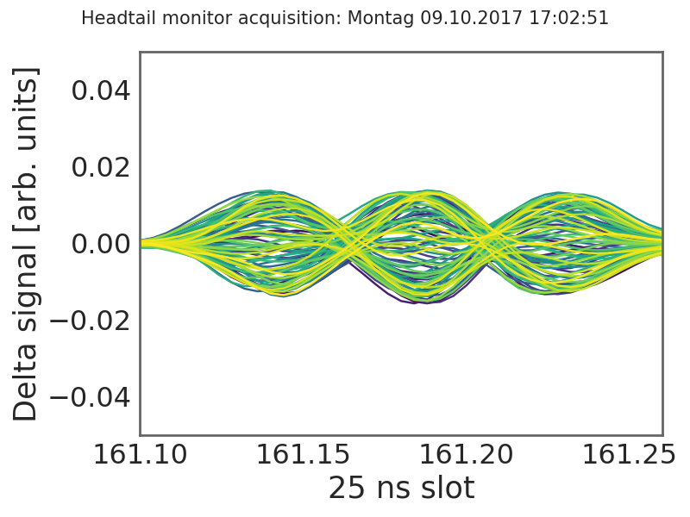
Introduction
Transverse instabilities encountered in high intensity multi-bunch regime (Q20)
  The 20 MHz coupled bunch instability from 2015 was not observed in 2017 (now higher gain at 20 MHz in the transverse damper, but also only 4 x 48 bunches …)
  With transverse damper, 4 x 48 bunches exhibit single bunch instabilities in the later batches
Single bunch instabilities can be cured with chromaticity
  ξ_{H} ~ 0.1 – 0.2 → mode 1
  ξ_{H} ~ 0.3 – 0.5 → mode 2
  ξ_{H} > 0.5 → instability mostly suppressed but enhanced losses
  (maybe due to large chromatic detuning of uncaptured beam?)
ξ_{H} ~ 0.1 – 0.2
ξ_{H} ~ 0.3 – 0.5

Slide 3
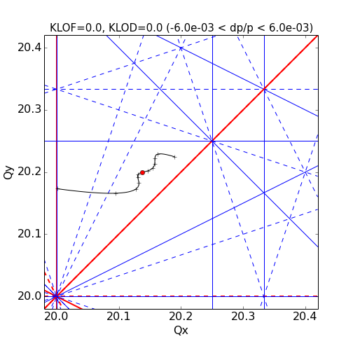
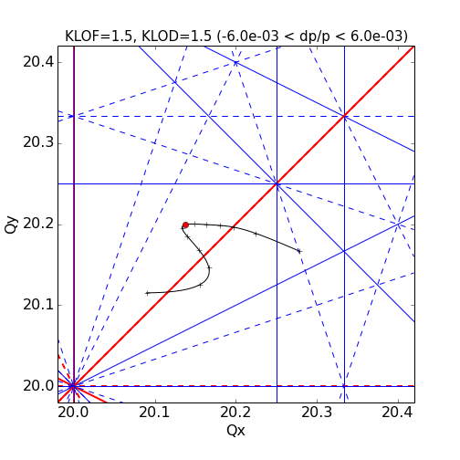
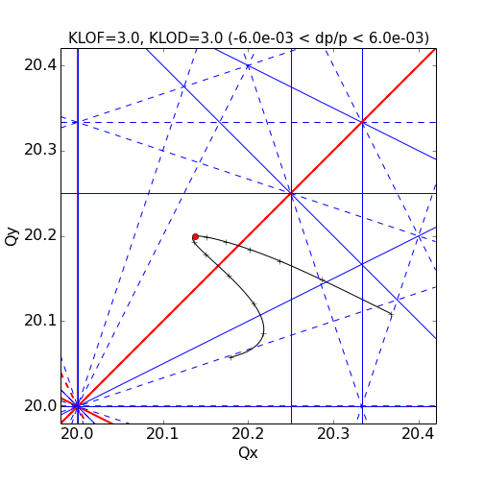
Motivation
Stabilization of single bunch horizontal instability with octupoles?
  KLOF > 1.5 mostly suppressed these instabilities but incoherent losses similar as with high ξ_{H}
  Incoherent losses most likely due to 2nd order chromaticity Q’’ induced by large dispersion in Q20:
  Q’’ depends on D²k₃ (i.e. dispersion squared times octupole strength)
Tune spread from octupoles can be an efficient way of suppressing (unexpected) instabilities at LIU intensities (if Q’’ can be avoided)
  Successfully used in SPS for stabilization of fixed target beam, critical for LHC operation, …
  Could hope for better transmission compared to stabilization by linear chromaticity

Slide 4
SPS octupoles and dispersion (Q26 optics)
Octupole positions chosen
to minimize Q’’ in Q26
Not all octupoles connected
Two LOFs in irregular positions
s [m]

Slide 5
SPS octupoles and dispersion (Q20 optics)
High dispersion in octupole positions
Might reconfigure octupole circuits to minimize Q’’ …
s [m]

Slide 6
Proposed octupole reconfiguration
Aim is to minimize Q’’ induced by octupoles in Q20 without compromising Q26
  Exploit the already installed octupoles and change powering scheme
  Optimize powering to minimize Q’’ on all optics
Proposal
  Octupoles at positions with largest dispersion inverted to ~ cancel Q’’
  No major hardware change! (just some interventions on patch panels ...)
  Need 1.5 times higher K for same amplitude detuning (effectively 2 octupoles / arc generate amplitude detuning in new scheme compared to 3 / arc in original scheme)
  Enough margin for operational use on FT beam
  Could (or should!) envisage re-establishing symmetry of octupole layout
  (i.e. moving LOF204 to position 208 and LOF530 to 522)
LOF position | x08 (04) | x22 (30) | x26 | x28
present polarity | +1 | 0 | +1 | +1
proposed polarity | +1 | +1 | -1 | +1
LOD position | x03 | x07 | x27 | x33 | x35
present polarity | 0 | +1 | +1 | 0 | +1
proposed polarity | 0 | +1 | +1 | +1 | -1

Slide 7
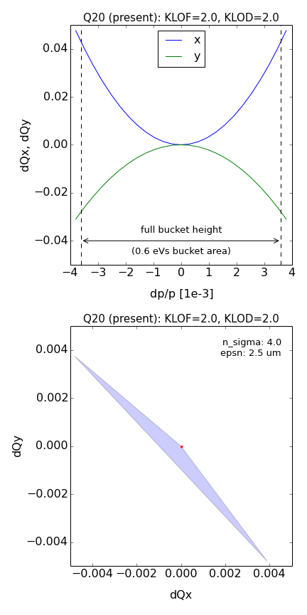
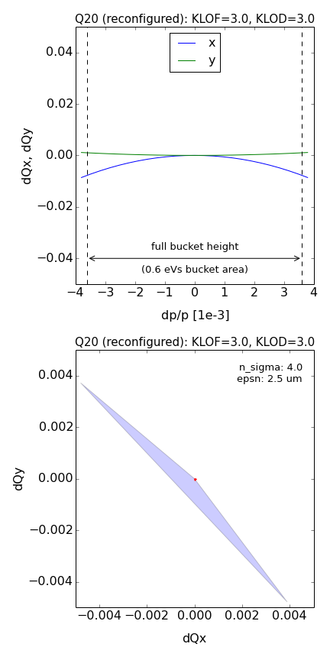
Present vs. proposed octupole scheme (Q20)
reconfiguration

Slide 8
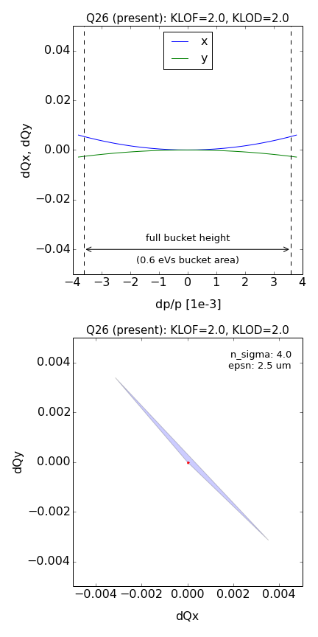
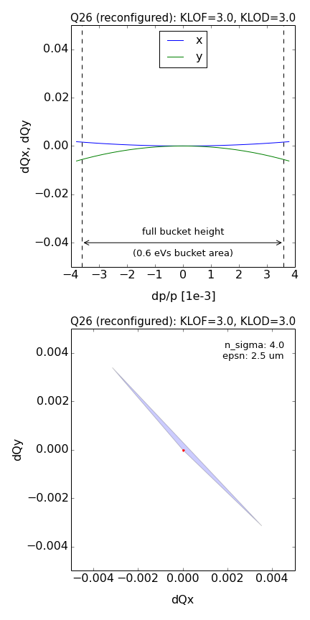
Present vs. proposed octupole scheme (Q26)
reconfiguration

Slide 9
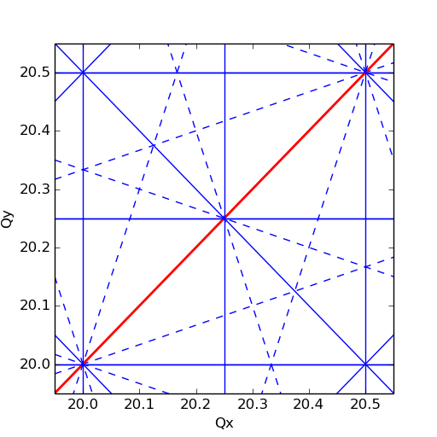

Impact on resonances?
Most of the 4th order resonances suppressed by super periodicity
  Assuming 6 fold symmetry of octupole arrangement which is presently not the case due to LOF204 and LOF530, but might be fixed (e.g. during LS2)
  Only the diagonal (2Qx-Qy=0) is systematic
  Expect no big impact on resonances as beta-beating in SPS relatively small (to be checked in more detail, in particular in dedicated MD where octupole reconfiguration could be tested)
4th order resonances
4th order resonances
– systematic
– non-systematic
– normal
-- skew

Slide 10
Summary & Conclusions
Amplitude detuning from octupoles is a powerful knob for controlling instabilities
  Should be prepared in case of unexpected instabilities with LIU intensities
SPS Landau octupoles induce large Q’’ in Q20 optics due to high dispersion
  The chromatic tune shift is at least one order of magnitude higher than amplitude detuning (for present 25 ns standard beam parameters)
  Incoherent losses limit the accessible parameter range to KLOF/D ~ ±2
Proposal for octupole reconfiguration
  Using only already installed octupoles (some of them presently not connected)
  The proposed scheme implies inverting polarity on strategic octupoles, which allows cancelling most of induced Q’’ for all SPS optics, i.e. Q20, Q26 and even Q22 (not shown here)
  For same amplitude detuning 1.5 times higher K in new scheme compared to present scheme
  Expect no big impact on resonances
  Can be tested in a dedicated MD by intervention on the respective octupole patch panels in the tunnel
  Load should be OK for power converter (to be verified)
  In any case, symmetry of octupole positions should be re-established during LS2

