Slide 1
Longitudinal instabilities in the SPS: effect of 800 MHz cavity
M. Schwarz
Acknowledgements:
H. Bartosik, T. Bohl, A. Lasheen, G. Papotti, J. Repond, E. Shaposhnikova SPS & PS operators
LIU-SPS BD WG meeting 18/10/23

Slide 2
Motivation:
Simulations (by J. Repond) predict that 800 MHz cavity (in bunch shortening mode with feedback off) does not cure instability at flat bottom (J. Repond, LIU-SPS BD WG meeting, 28 August 2018)
Setup:
MD 15 October 2018: 12 bunches, 25ns spacing, Q20
Intensity variable: protons per bunch 1.2e11 to 2.0e11
Bunch length ($4σ_{FWHM}$ at filamentation): 2.5ns to 3.0ns
FeedBack: off, FeedForward: off, Phase loop: on, long. damper: off
V₂₀₀ =4.5 MV, V₈₀₀ variable
Flat bottom up to 3.2s; Q-kick at 3.0s
LIU-SPS BD WG meeting

Slide 3
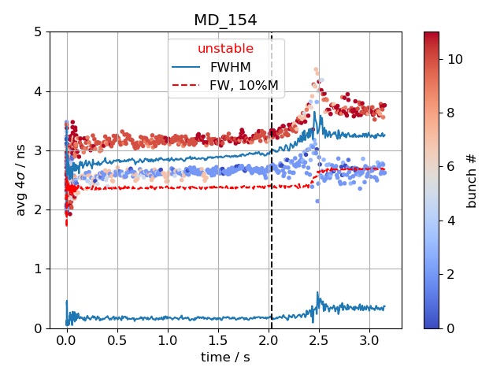
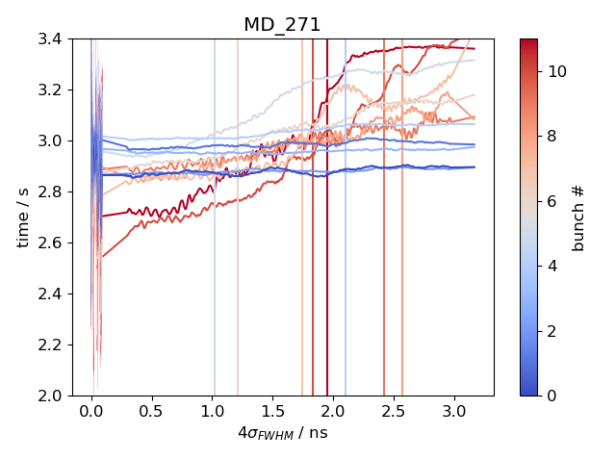
Criteria for instability
Beam unstable: Average bunch length exceeds mean of maximum bunch length between 50ms and 100ms
Bunch unstable: Bunch length exceeds average + standard deviation of bunch length between 50ms and 100ms; smoothing with Savitzky-Golay filter

Slide 4
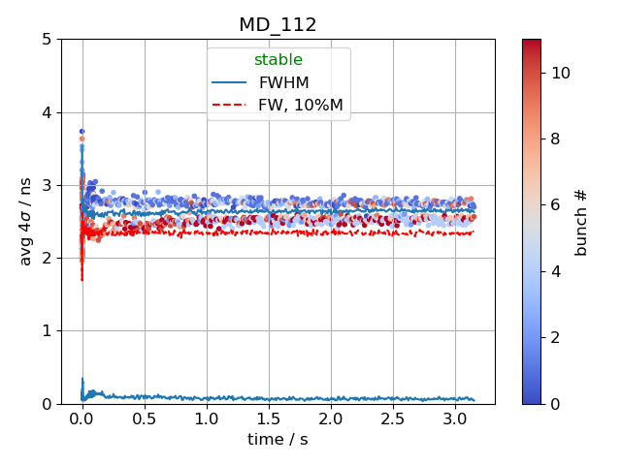
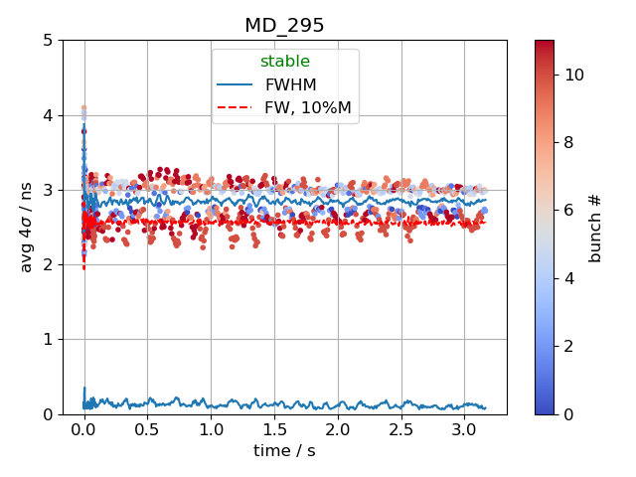
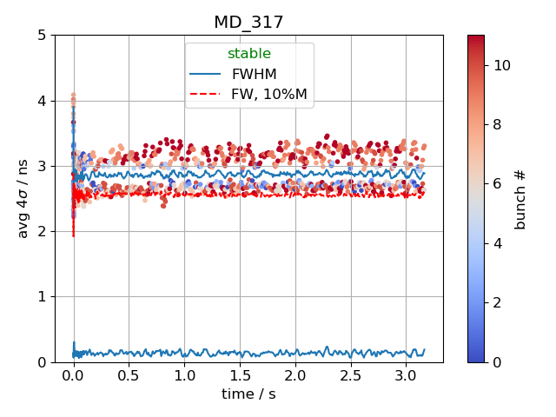
‘Noise’ introduced by 800 MHz
800MHz off
800MHz at 10%
800MHz at 15%
When 800 MHz cavity is on, ‘stable’ bunch length is more noisy

Slide 5
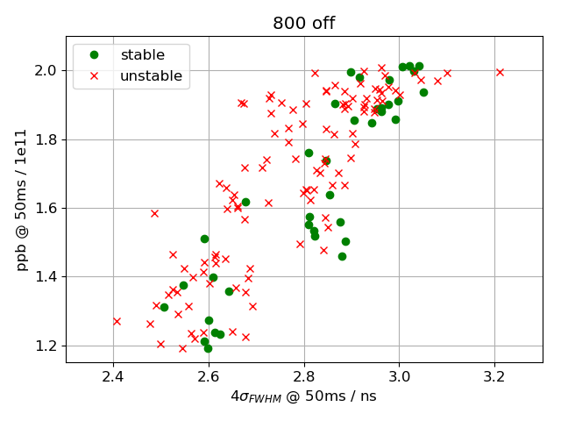
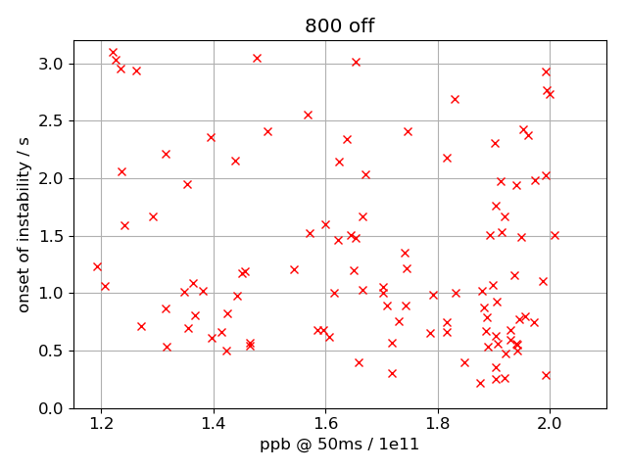
Beam stability: 800 MHz off
Threshold not as clearly observed as with previous measurements at lower intensity
No trend in start of instability with bunch intensity

Slide 6
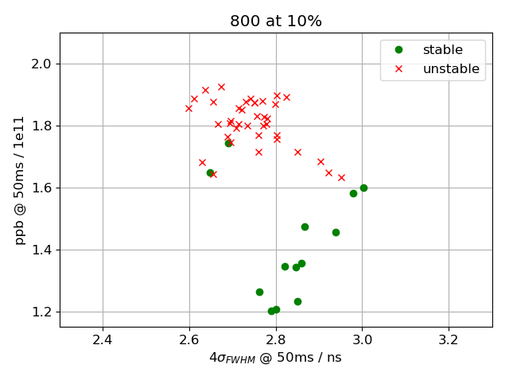
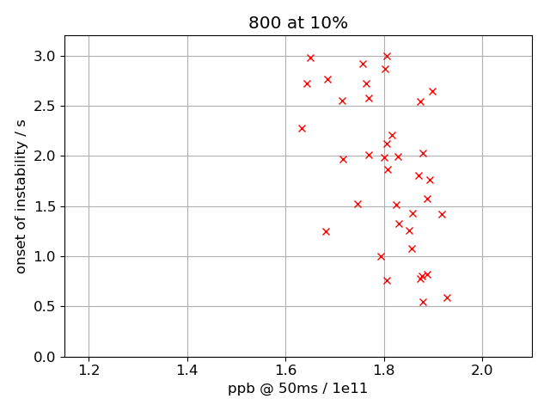
Beam stability: 800 MHz at 10%
Threshold at around 1.6e11 ppb
No trend in start of instability with bunch intensity

Slide 7
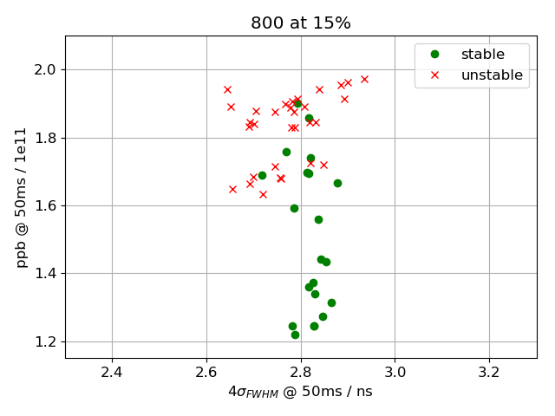
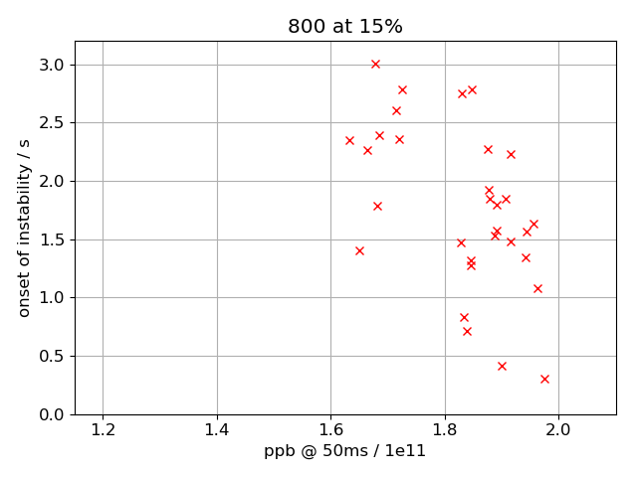
Beam stability: 800 MHz at 15%
Threshold at around 1.6e11 ppb
No trend in start of instability with bunch intensity

Slide 8
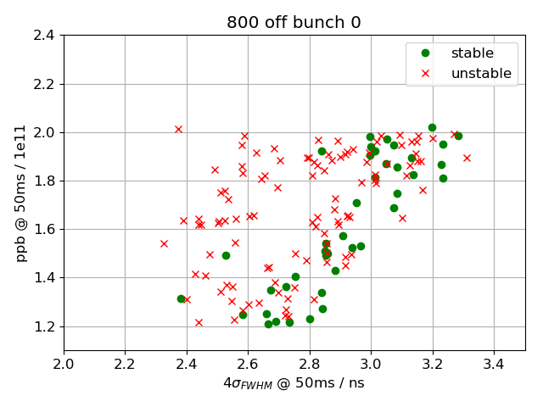
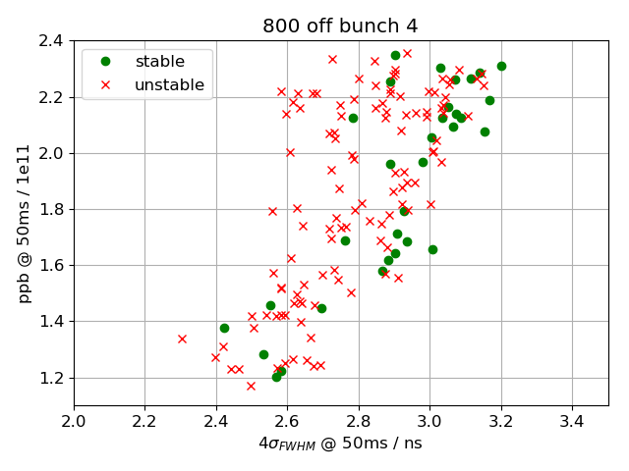
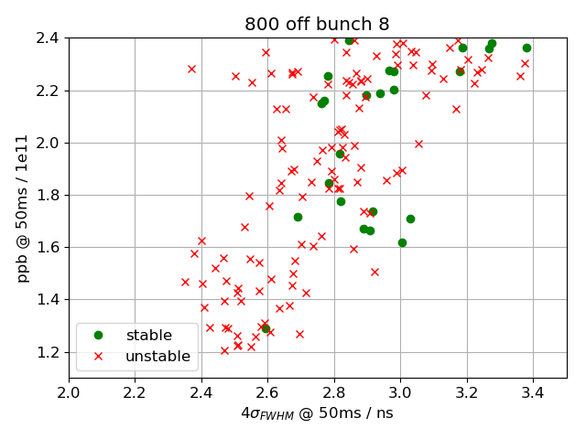
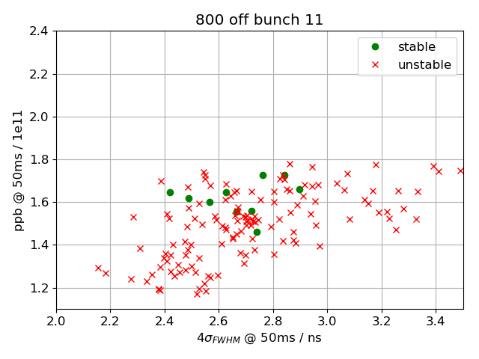
Bunch-by-bunch stability: 800 MHz off
All bunches become unstable

Slide 9
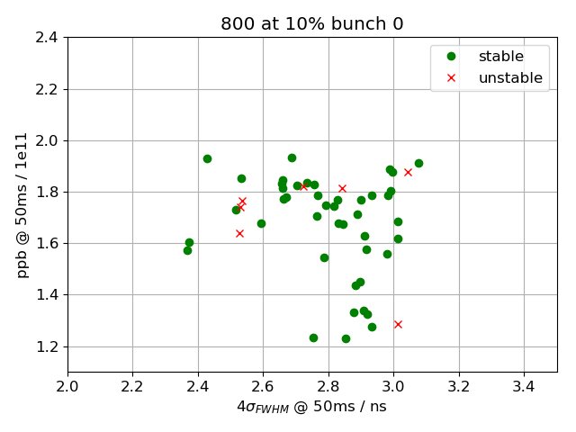
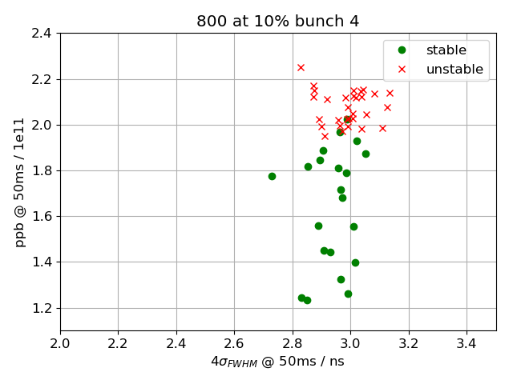
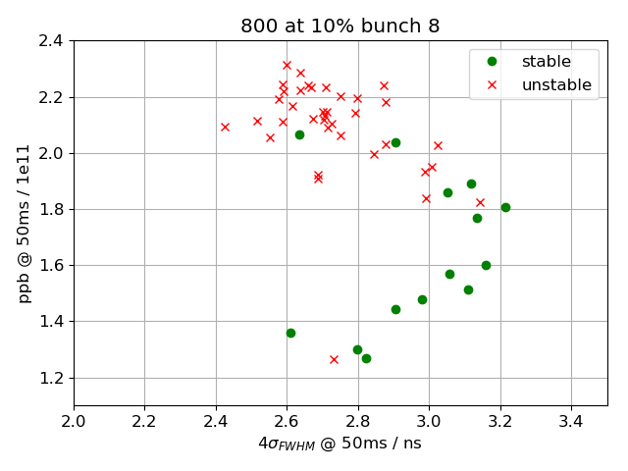
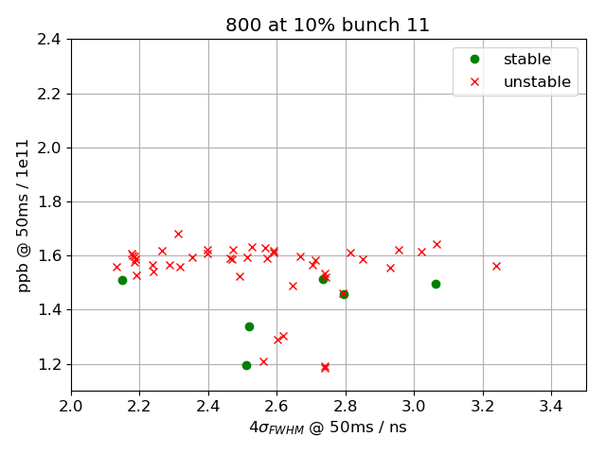
Bunch-by-bunch stability: 800 MHz at 10 %
first bunches are stable
last bunches are unstable

Slide 10
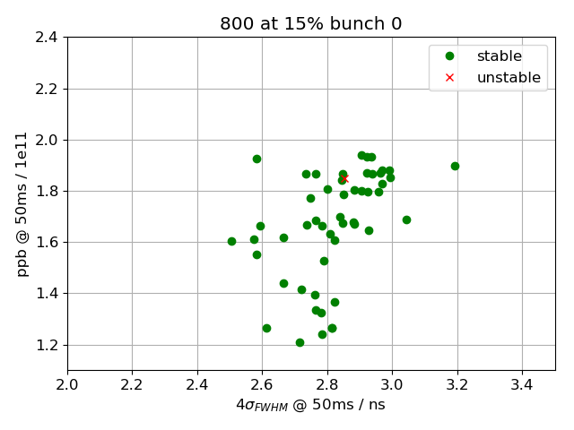
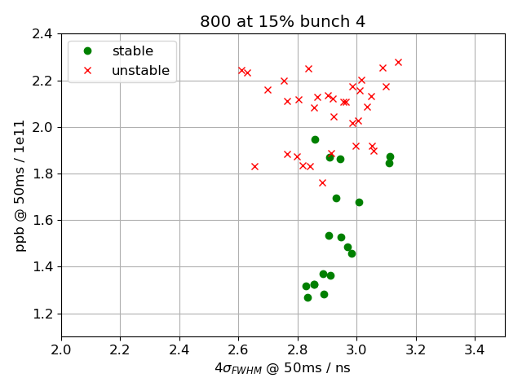
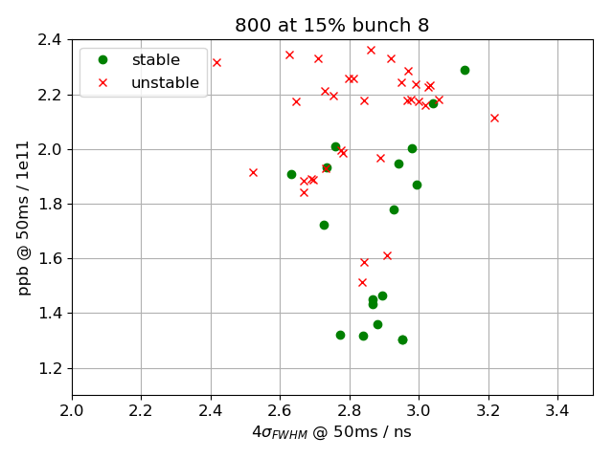
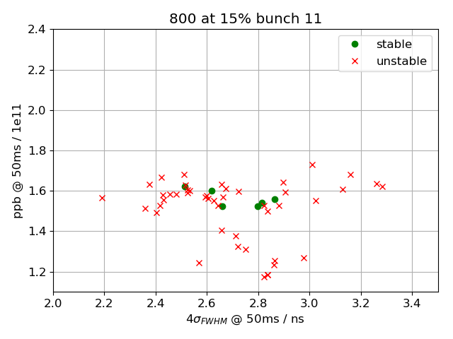
Bunch-by-bunch stability: 800 MHz at 15 %
first bunches are stable
last bunches are unstable

Slide 11
Simulation:
800 MHz cavity (in bunch shortening mode with FB off) does not cure instability at flat bottom (J. Repond, LIU-SPS BD WG meeting, 28 August 2018)
Measurements:
800 MHz cavity does not change average beam threshold
800 MHz cavity does change threshold on a bunch-by-bunch basis
Conclusion:
Simulations agree with measurements of average beam threshold
Further studies of simulation data required for bunch-by-bunch threshold
Thank you for your attention!
LIU-SPS BD WG meeting

