Slide 1
Possible quality control of the VF impedance shielding
A. Farricker, C. Vollinger
LIU-SPS BD WG meeting
23-Oct-18

Slide 2
SPS Flange Impedance Reduction Targets
First impedance reduction programme was targeting the vacuum pipe interconnects between main ring magnets, where shields were installed (1999);
The impedance reduction that is targeted now concerns the interconnects in the 108 SSSs adjacent to the QF magnets. (These were not covered in the first campaign).
The actual shield installations will be carried out by TE-VSC in parallel with the aC coating activity.
In addition, some interconnections upstream and downstream of these SSSs in the arc and dispersion suppressor regions were not shielded in the 1999 campaign and will be included now.
New shield designs were developed by TE-VSC for this purpose, and BE-RF shall carry out RF-measurements as a QA measure to ensure maximum shielding effect in the SSSs.

Slide 3
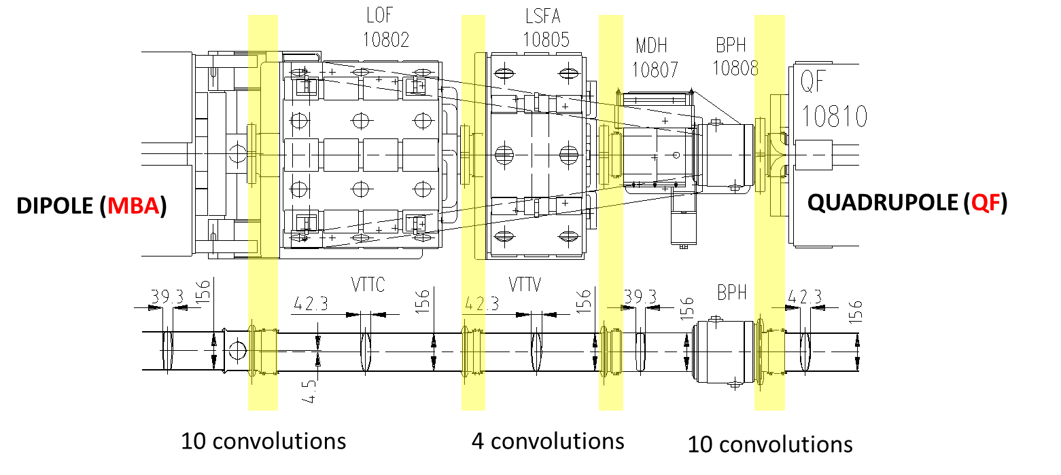
Representative Version of a SSS in the SPS
Picture from ECR #1709280
(J. Perez Espinos)
SSS consists of three different functional positions which may not all be occupied, for example: not all SSSs are equipped with a “LOF” (focussing octupole lens).
However, there are always 4 different interconnects to be shielded: 2x 10 convolution bellows, and 2x 4 convolution bellows.

Slide 4
Shielding types in the SSS
Picture from ECR #1709280
(J. Perez Espinos)
The installation of the shields concerns many teams and as such is logistically complex: for the SSS example shown above, work flow is as follows:
LOF is removed and brought to surface (TE-MSC);
LSFA is removed and brought to surface (TE-MSC);
BPH together with the MDH is removed and stored under the adjacent QF (BE-BI);
In parallel with the aC activities, TE-VSC is installing shield parts in situ (e.g. MBA), OR on the surface (e.g. LOF and LSFA) AND on the stored BPHs and MDHs in the tunnel.

Slide 5
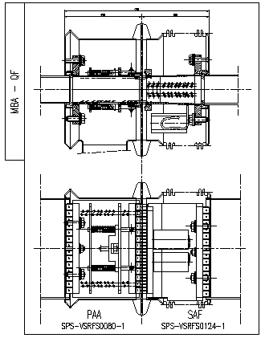
Shielding types in the SSS, example PP shield
Picture from ECR #1709280
(J. Perez Espinos)
Left part of the shield is installed in the vacuum chamber with PP pipe attached (in situ);
Right part of the shield is installed in the 10-convolution bellow of the LOF on the surface;
Full shielding only if the parts are connected after re-installation of the LOF.
BE-RF suggests measuring after re-connection via the PP access (before the vacuum pump is re-installed) → time critical in work planning!
SPSVSRF0086

Slide 6
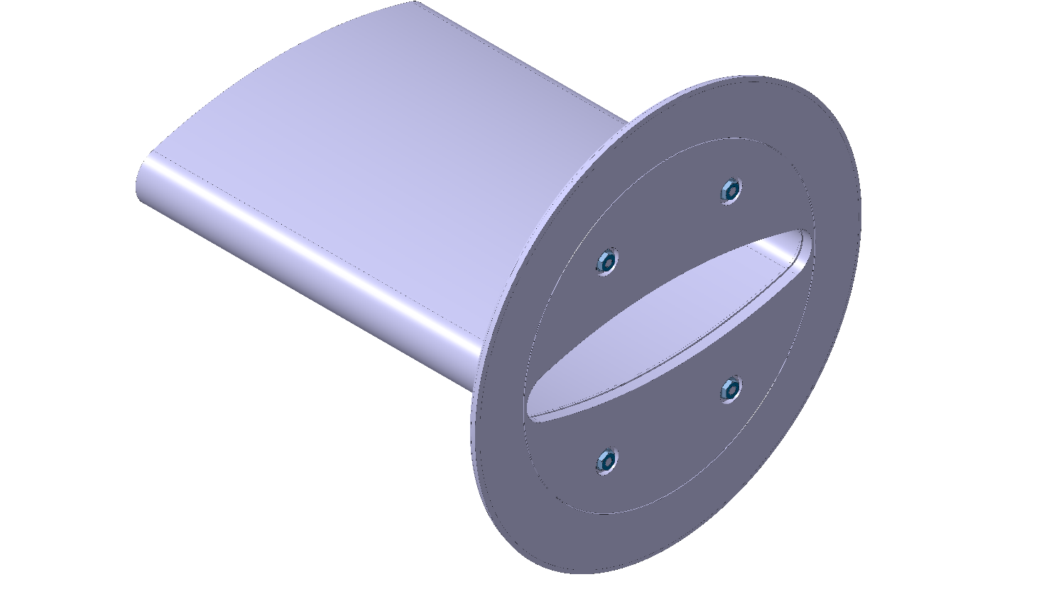
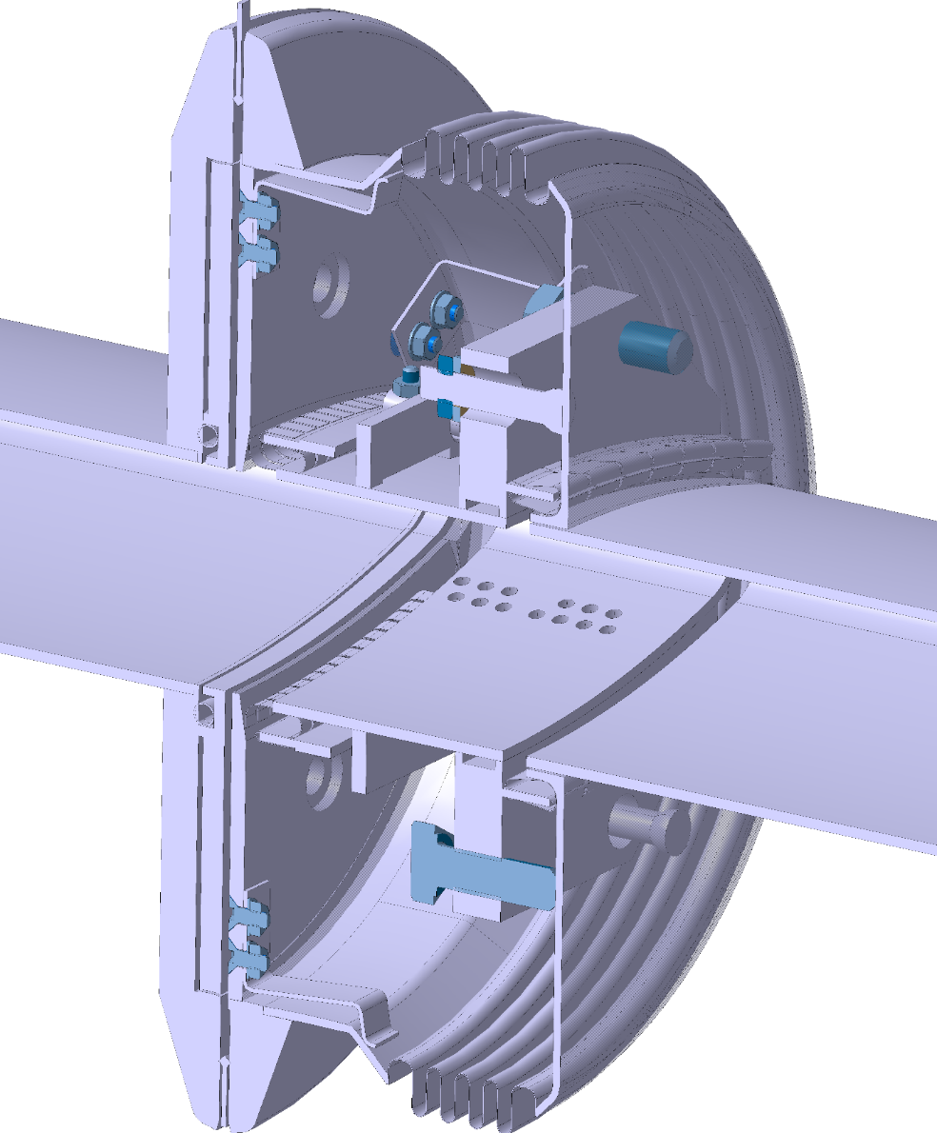
Shielding types in the SSS, example 4-convolution ‘left side’
Picture from ECR #1709280
(J. Perez Espinos)
New shield design from TE-VSC consisting of flange filler on LOF side and RF-finger shields on the 4-convolution bellow;
Both parts are installed on the surface;
Again: full shielding only if the parts are connected after re-installation of the two elements, but will be inaccessible then!
BE-RF suggests measuring the 4-convolution shield after installation on the surface with probes via vacuum pipe access
→ time critical in work planning, with little more margin!
We will need a “training object” beforehand…
J. Perez Espinos, ECR 1709280

Slide 7
Shielding types in the SSS, example 4-convolution ‘right side’
Picture from ECR #1709280
(J. Perez Espinos)
New shield design from TE-VSC consisting of flange filler on LOF side (installed on the surface) and RF-finger shields on the 4-convolution bellow (installed on the BPH in the tunnel, but not in-situ).
Again: full shielding for the 4-convolution bellow only if the parts are connected after re-installation, but will be inaccessible then!
BE-RF suggests measuring the 4-convolution shield after installation with probes via vacuum pipe access
→ time critical in work planning!
We will need a “training object” beforehand…
J. Perez Espinos, ECR 1709280

Slide 8
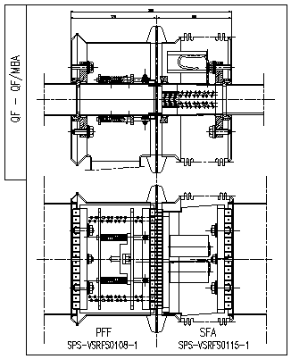
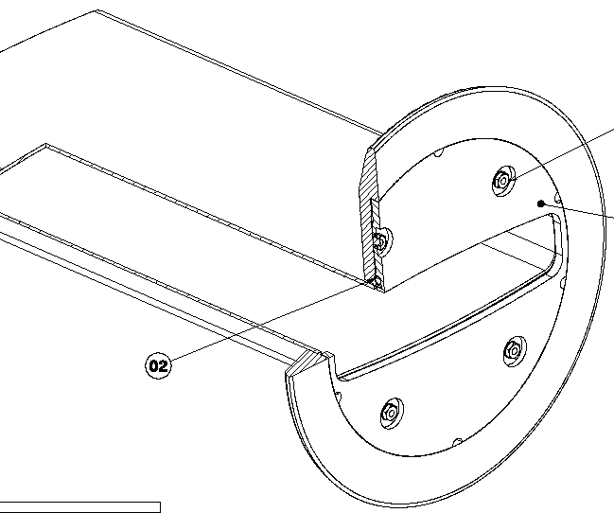
Shielding types in the SSS, example QF-BPH
Picture from ECR #1709280
(J. Perez Espinos)
New shield design from TE-VSC consisting of flange filler on BPH side and existing shield on the 10-convolution bellow;
Both parts are installed in the tunnel, but not in-situ on the BPH.
In this case: The QF-BPH shield can be measured later.
BE-RF suggests measuring the 4-convolution shield after installation on the BPH with probes via vacuum pipe, and the 10-convolution shield via the BPH-connectors after full re-installation.
→ not time critical in the work planning, if shields are conform!
J. Perez Espinos, ECR #1852554

Slide 9
Summary - Conclusions
Installation of the shields for impedance reduction in the SSSs will be carried out by TE-VSC, as described in ECRs #1709280 and #1852554 as well as WPA #2007543.
This is a crucial and challenging task which will lead to a significant improvement in the reduction of beam impedances in the SPS.
The task is demanding in the coordination due to the number of machine elements touched and the number of interlocutors (e.g. TE-VSC, BE-BI) involved and due to the shield installations itself.
BE-RF suggests to carry out a QA of the newly installed shields wherever feasible during the installation work flow of the different machine elements.
The shield installation is no simple task and the goal is to identify imperfections in the shield installations at the earliest possible stage so that corrections can be carried out – if needed.
Close collaboration between TE-VSC and BE-RF is mandatory in this effort! Big thanks to TE-VSC for the support & discussions so far!

