Slide 1
SPS horizontal instability studies
H. Bartosik, M. Beck, T. Bohl, M. Carla’, L. Carver, H. Damerau, V. Kain, G. Kotzian, K. Li, G. Papotti, M. Schwarz, E. Shaposhnikova, C. Zannini
SPS & PS operators
LIU SPS-BD working group meeting, 23 October 2018

Slide 2
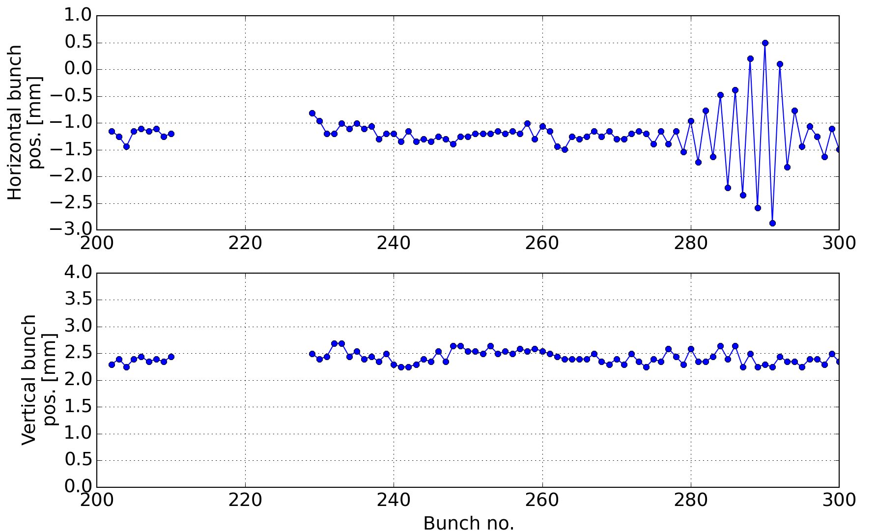
Introduction
Horizontal instability at SPS flat bottom observed since 2015
In 2015 signs of a coupled bunch instability at 20 MHz (highest coupled bunch mode) for intensities higher than 1.8e11 p/b

Slide 3
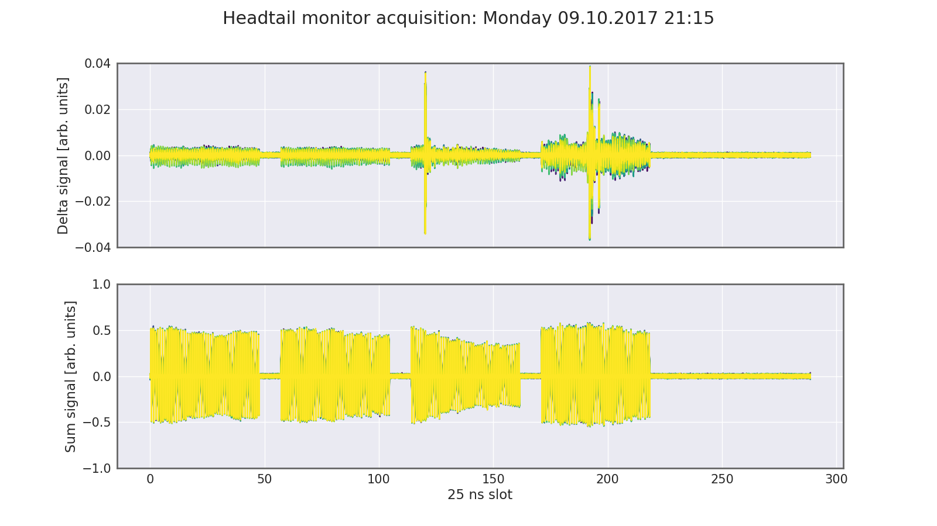
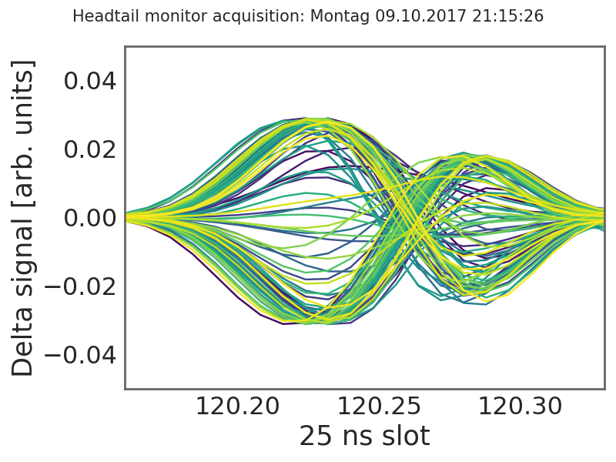
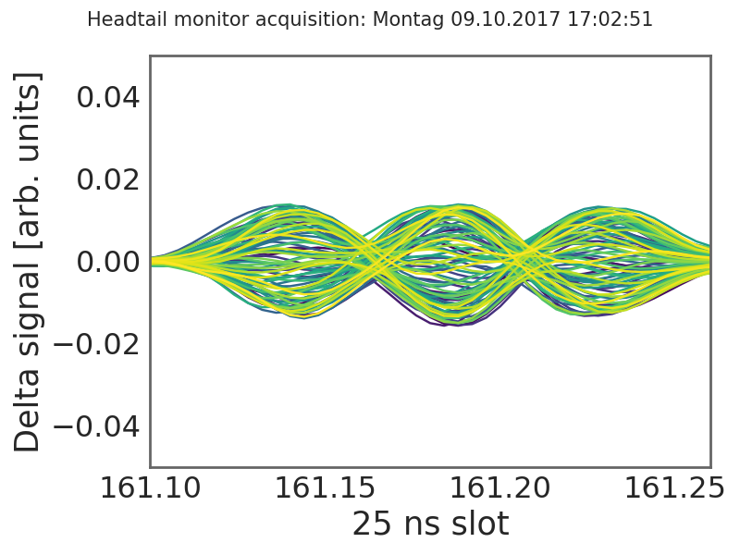
Introduction
Horizontal instability at SPS flat bottom observed since 2015
In 2015 signs of a coupled bunch instability at 20 MHz (highest coupled bunch mode) for intensities higher than 1.8e11 p/b
In 2017 the gain of the damper at high frequency was improved but headtail instability remained (unstable mode depending on chromaticity, as expected)
ξ_{H} ~ 0.1 – 0.2
ξ_{H} ~ 0.3 – 0.5

Slide 4
Introduction
Horizontal instability at SPS flat bottom observed since 2015
In 2015 signs of a coupled bunch instability at 20 MHz (highest coupled bunch mode) for intensities higher than 1.8e11 p/b
In 2017 the gain of the damper at high frequency was improved but headtail instability remained (unstable mode depending on chromaticity, as expected)
Detailed studies performed in 2018
Instability clearly observed in second half of 2018 run
Used BCMS beam with 4x48 bunches and the nominal longitudinal longitudinal emittance (0.35 eVs – thanks to PS)
In the following a summary of the observations so far will be given (detailed analysis is ongoing)

Slide 5
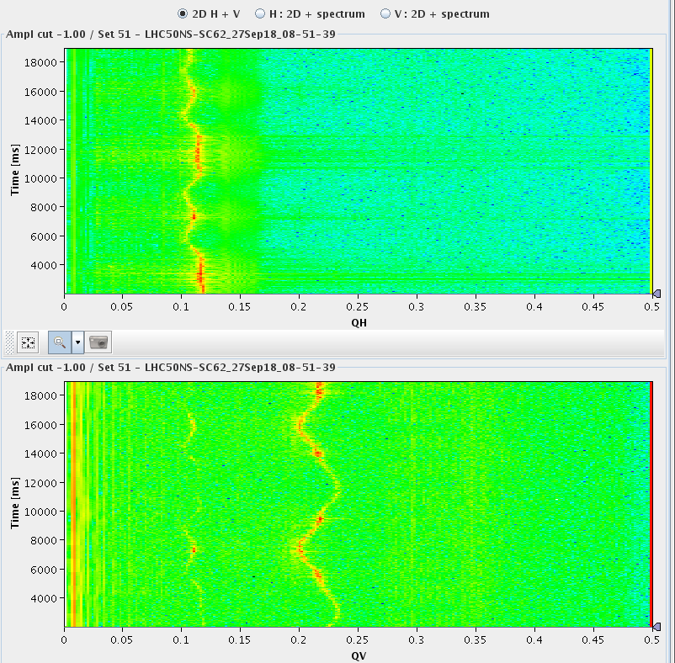
Preparation of flat bottom cycle
Corrected amplitude detuning
KLOF = -0.2 gives roughly zero horizontal amplitude detuning
Measurement of chromaticity
Sinusoidal trim of radial steering allows chromaticity measurement within a cycle
Calibration of chroma knobs shows QPH = 0.05 corresponds roughly to zero chromaticity

Slide 6
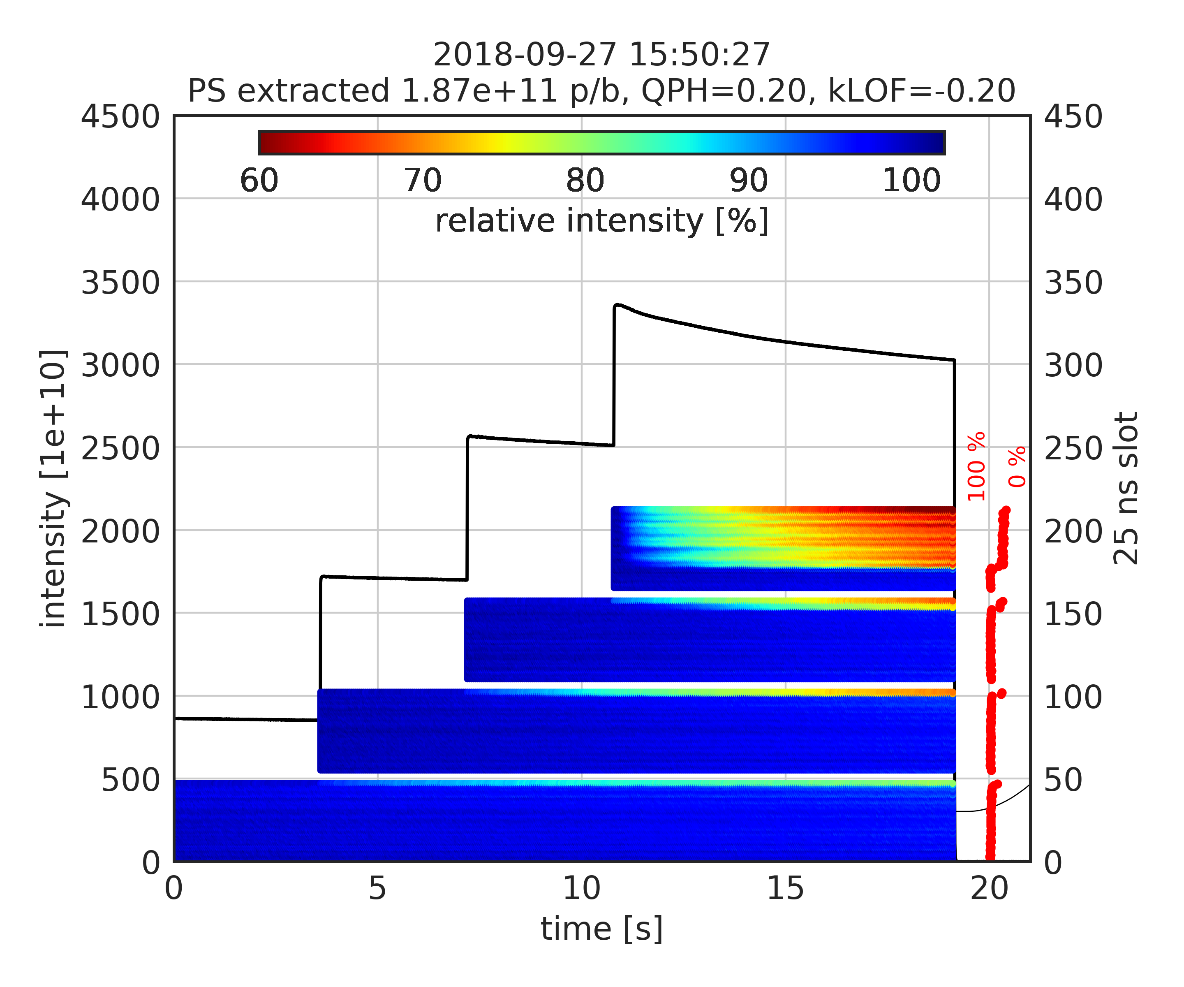
Instability depending on chromaticity
QPH=0.2 and no amplitude detuning
Mode 1 instability on last bunches of the batch for intensity >1.8e11 p/b
Last bunches of last circulating batch excited by injection kicker (MKP delay not optimal)
Losses correlated with instability
FF OFF

Slide 7
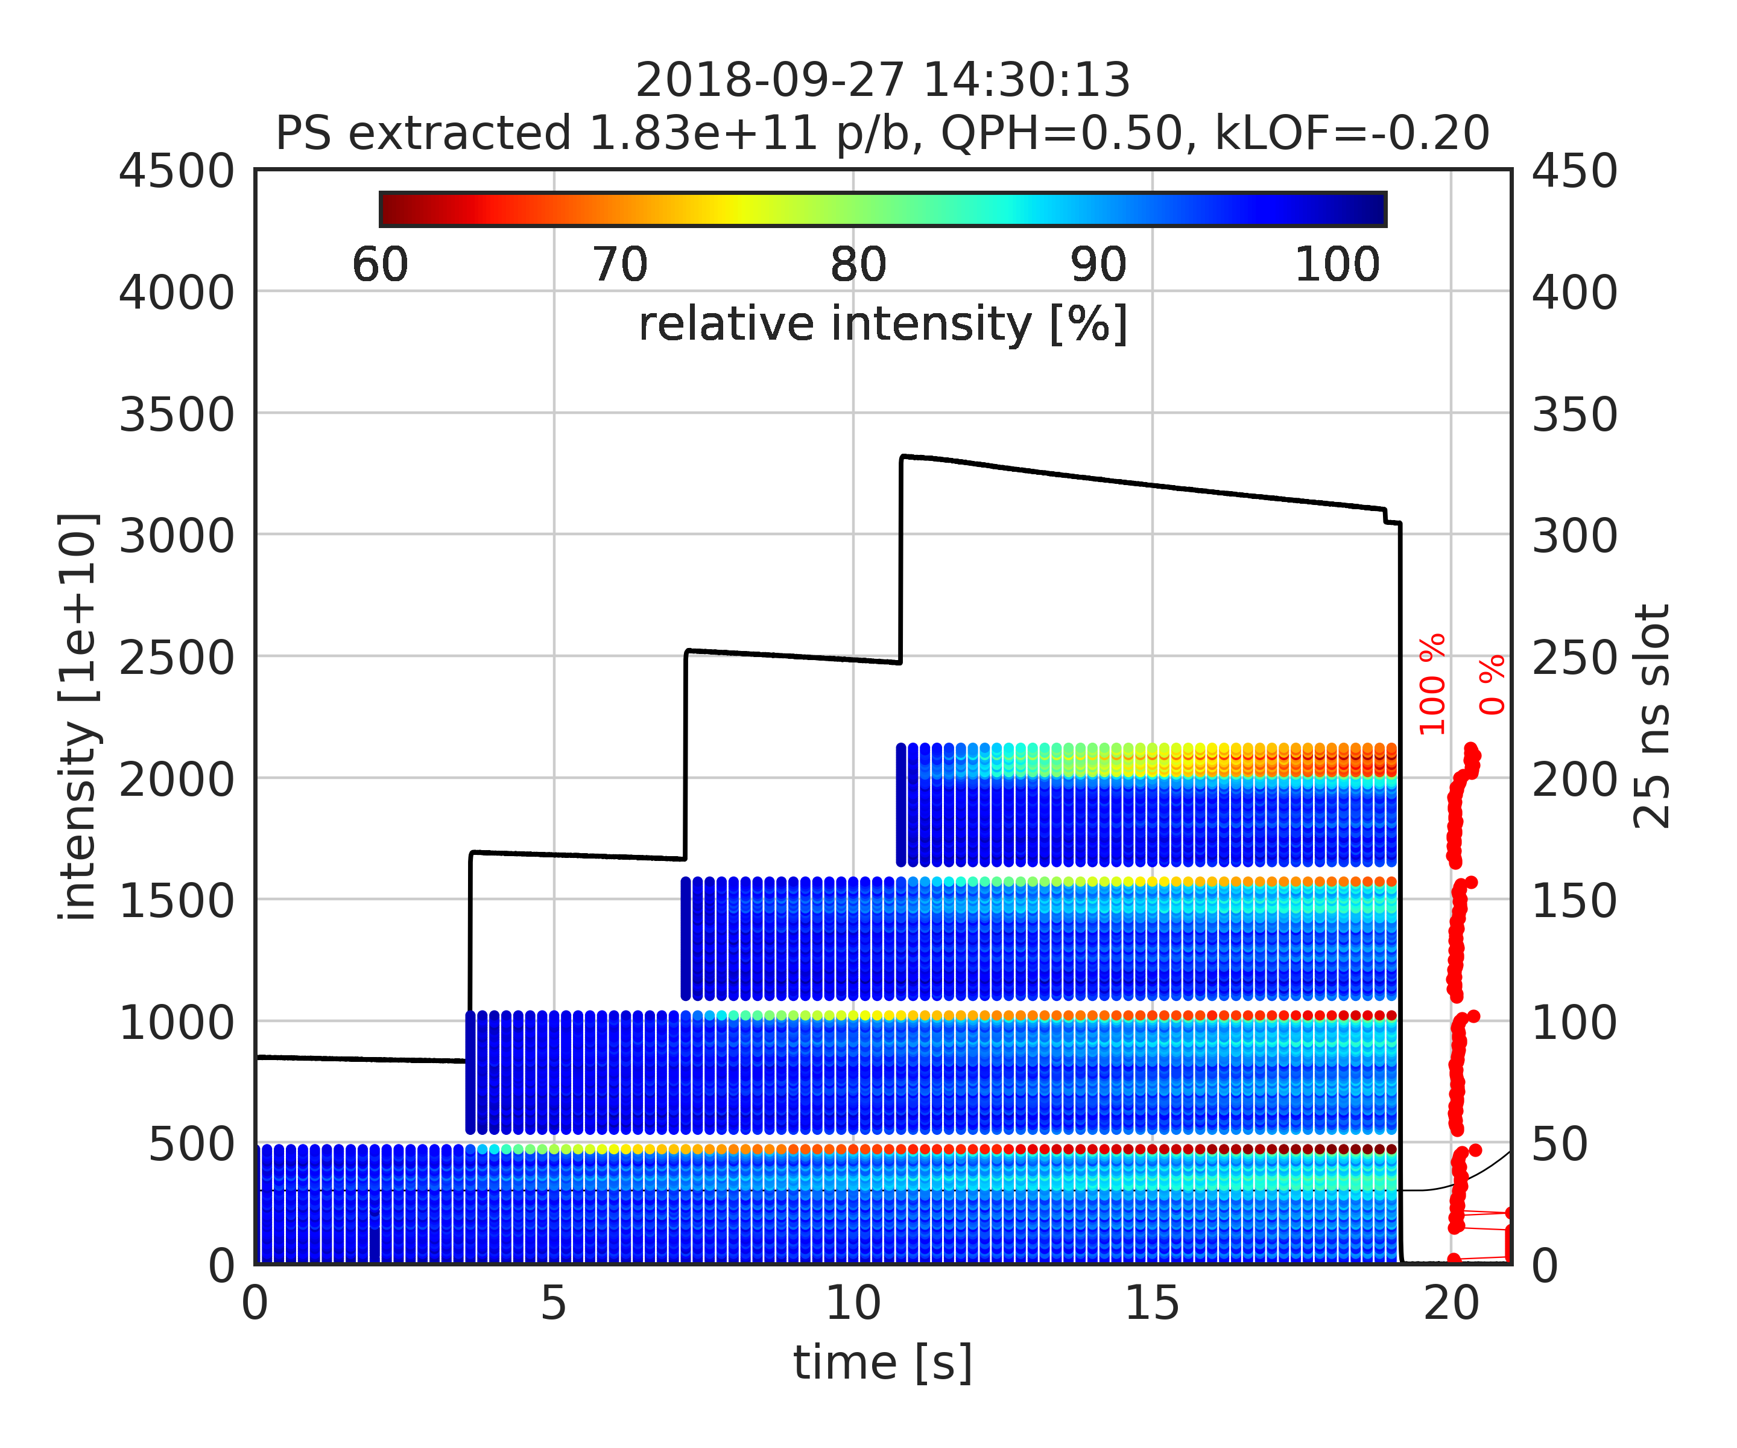
Instability depending on chromaticity
QPH=0.2 and no amplitude detuning
Mode 1 instability on last bunches of the batch for intensity >1.8e11 p/b
Last bunches of last circulating batch excited by injection kicker (MKP delay not optimal)
QPH=0.5 and no amplitude detuning
Mode 2 instability on last bunches of the batch for intensity >1.8e11 p/b
Note: losses on first batch enhanced with feed-forward ON – see later
FF ON

Slide 8
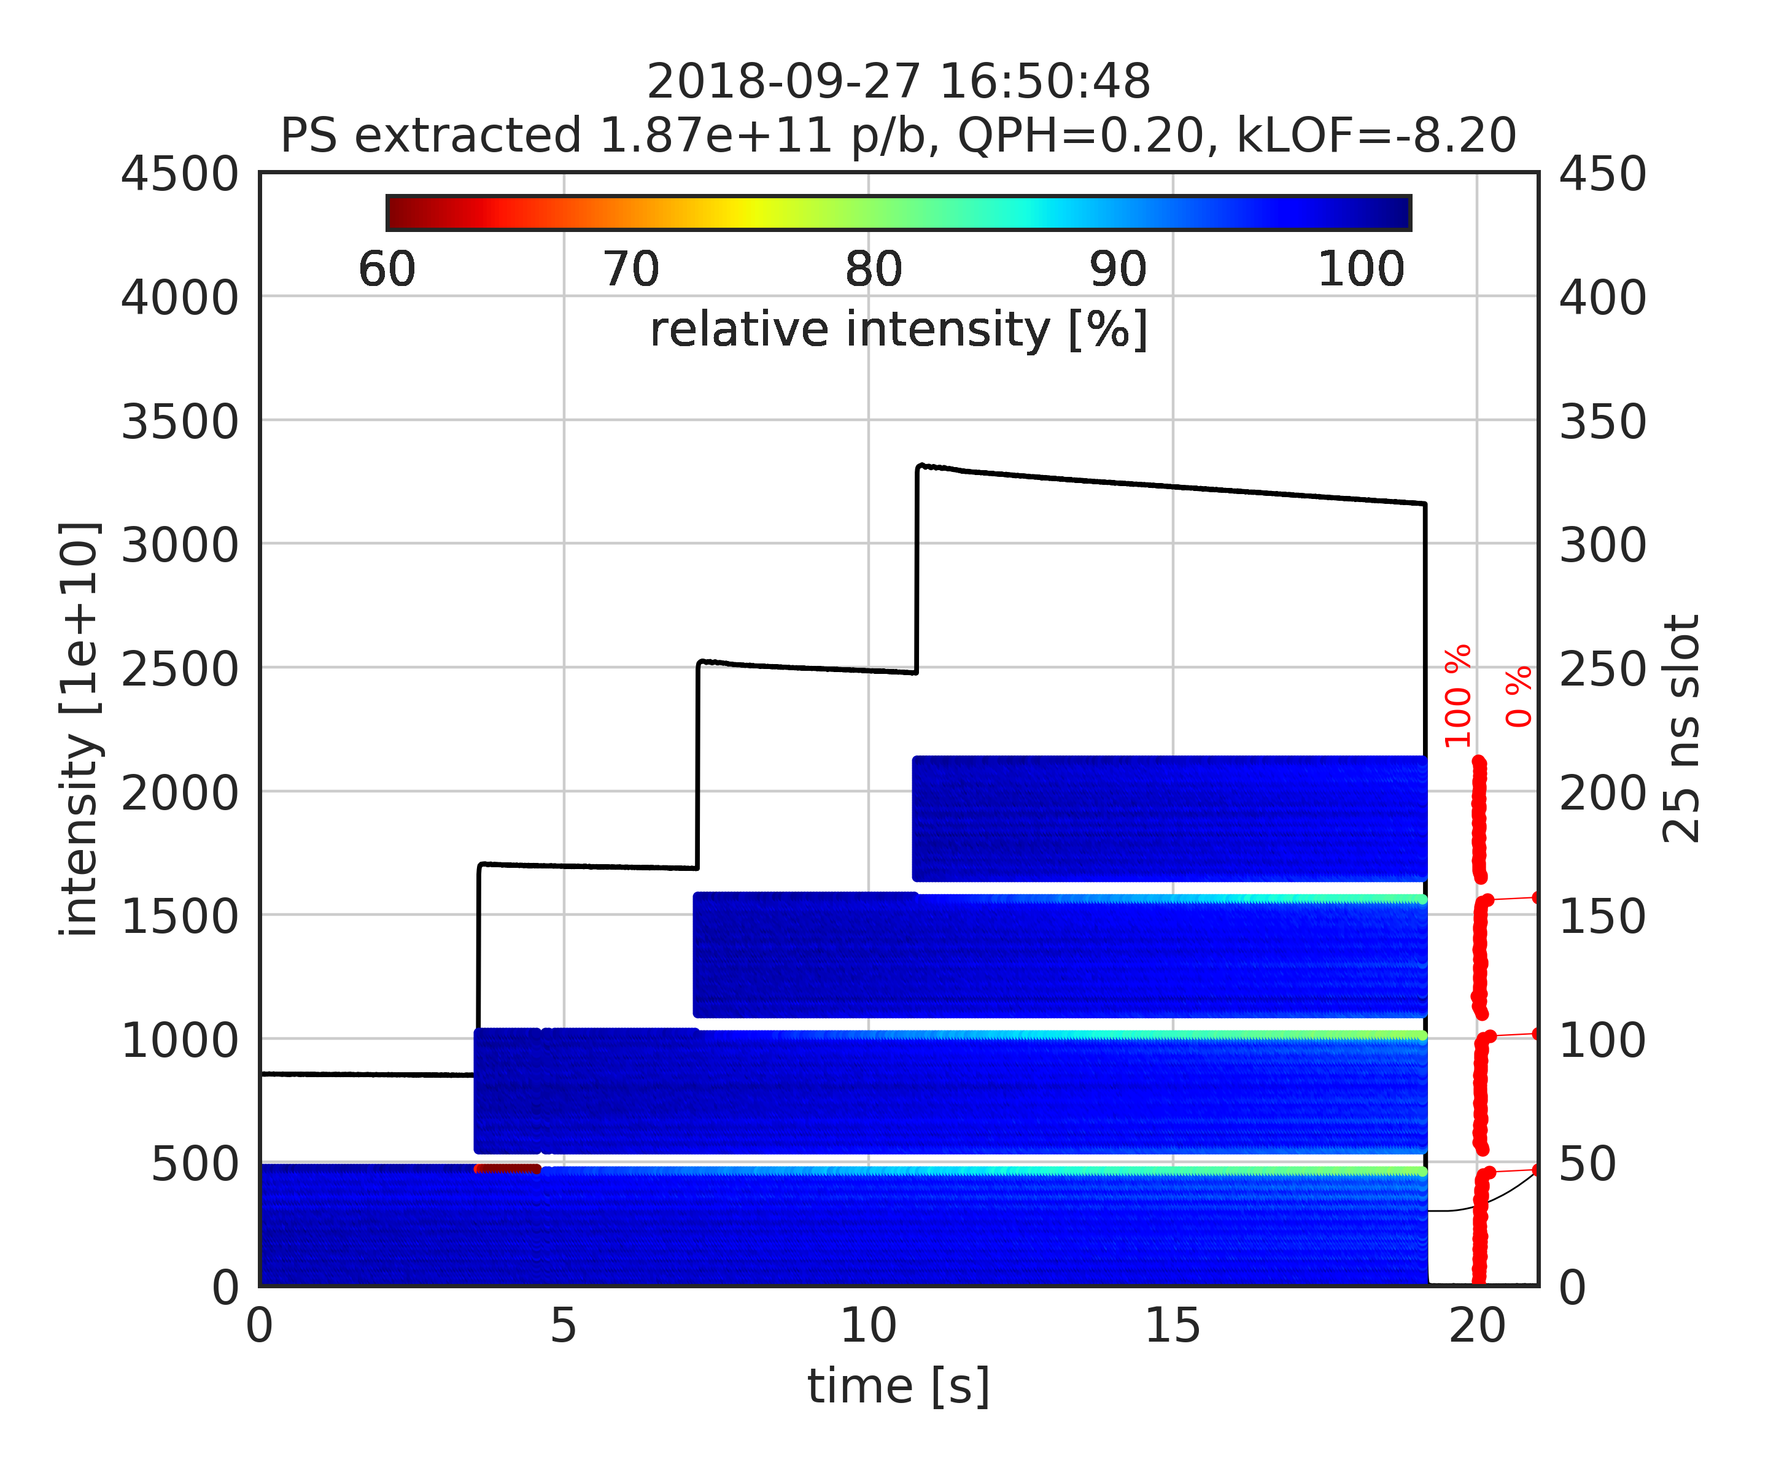
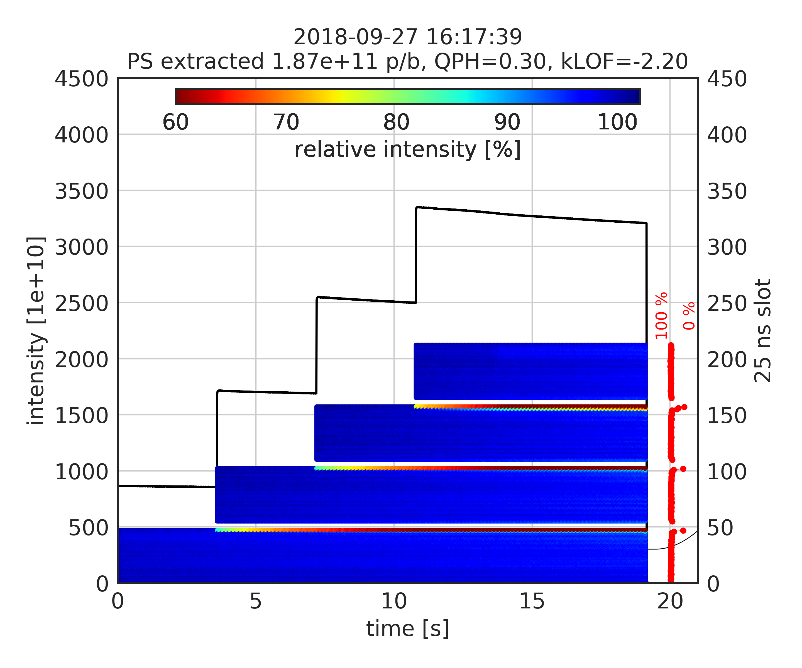
Instability depending on chromaticity
Tested stabilization with octupoles (after reconfiguration to minimize Q’’)
Took data in various configurations of octupole and chroma settings
Only negative KLOF settings observed to help stabilizing
Still the last bunches of the last circulating batches were affected (MKP delay not optimal)
QPH=0.2 / KLOF=-8.2
3 out of 3 shots stable
QPH=0.3 / KLOF=-2.2
6 out of 6 shots stable

Slide 9
Feed forward and flat bottom losses
Flat bottom losses strongly enhanced when 200 MHz FeedForward in ON
Thanks to Elena for proposing to test impact of FF!
FF ON
FF OFF

Slide 10
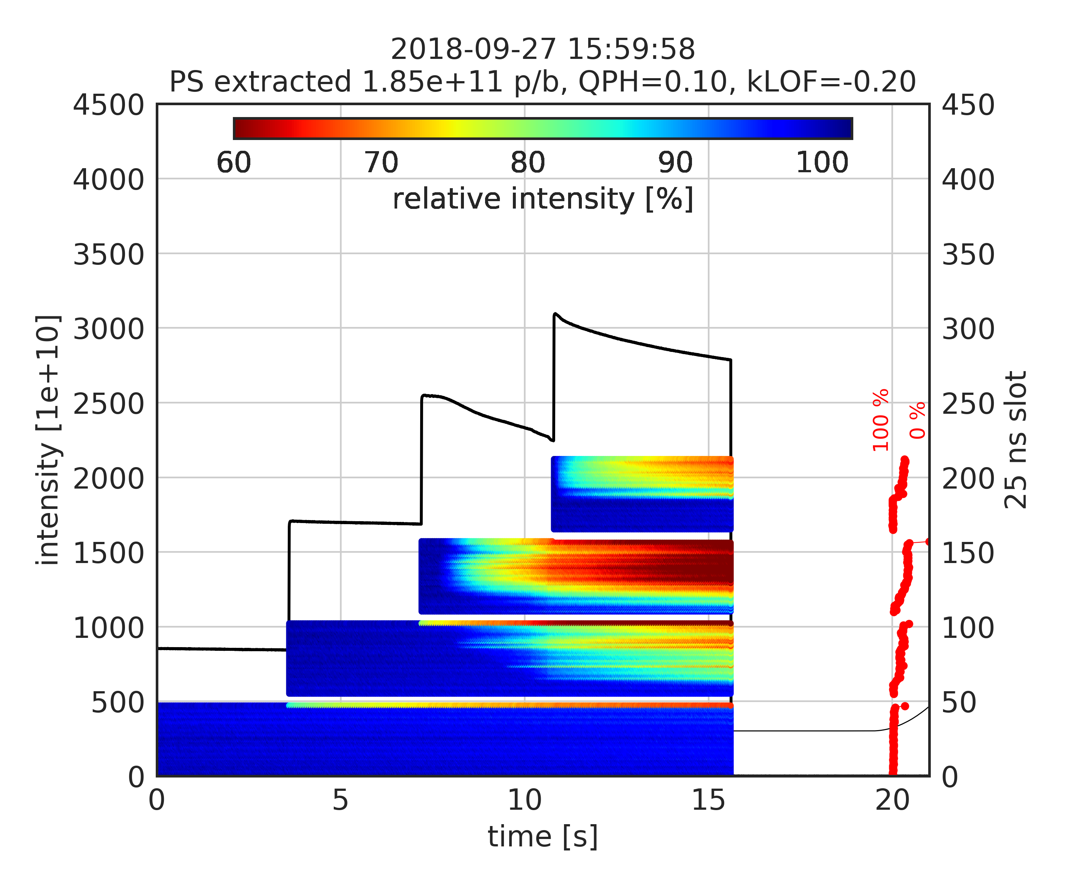
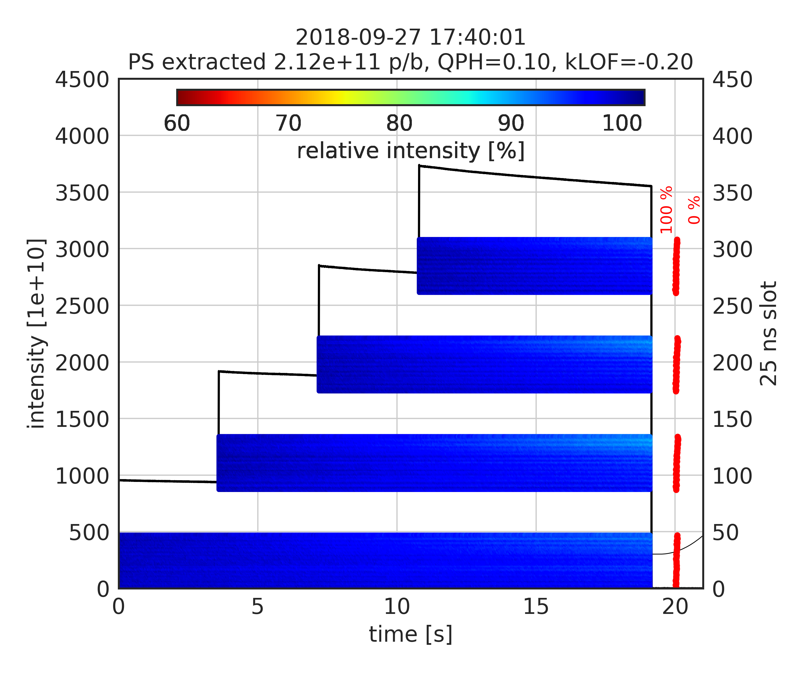
Impact of batch spacing
Instability not observed for large batch spacing
Even for low chromaticity and higher intensity
200 ns batch spacing
1000 ns batch spacing

Slide 11
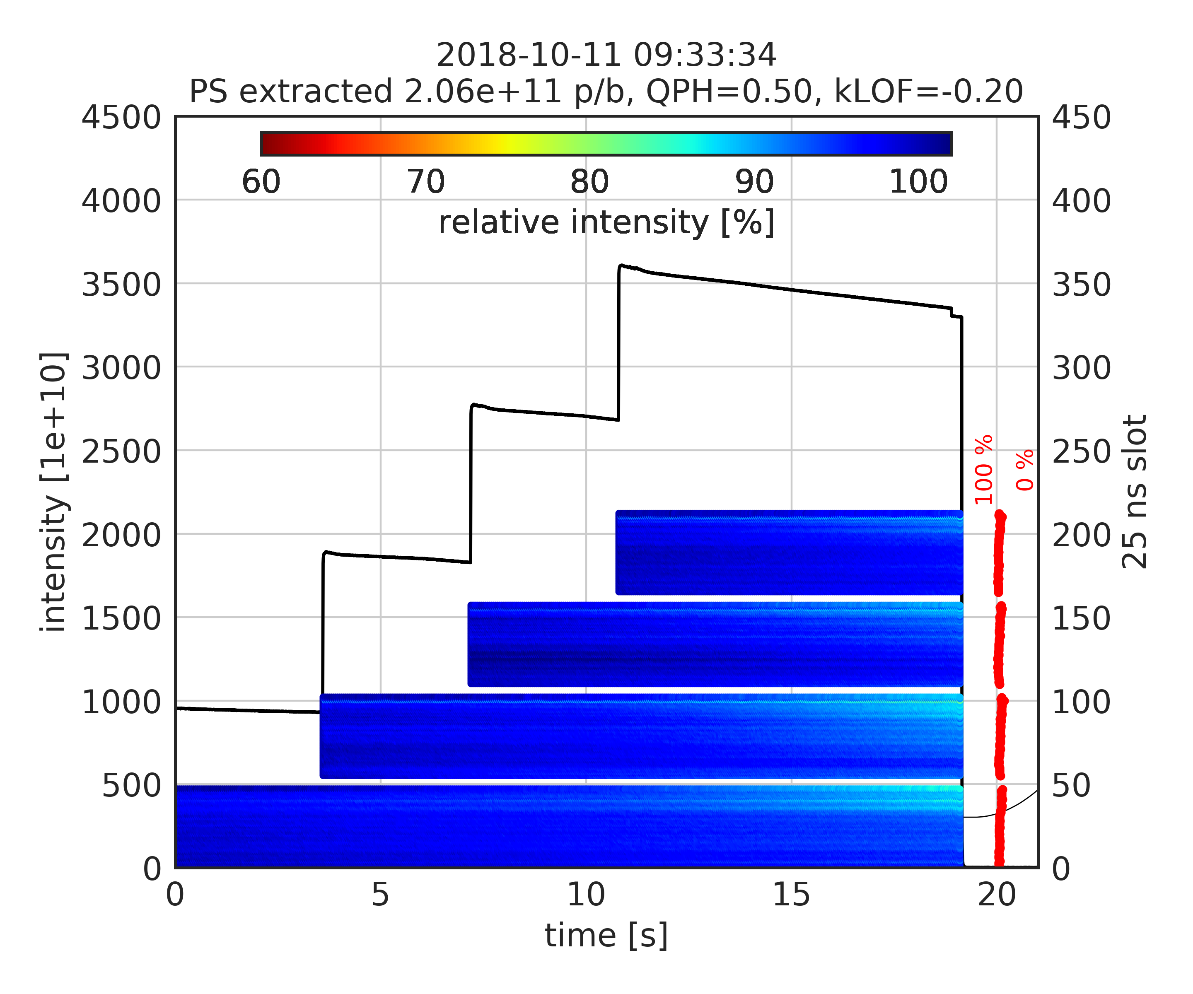
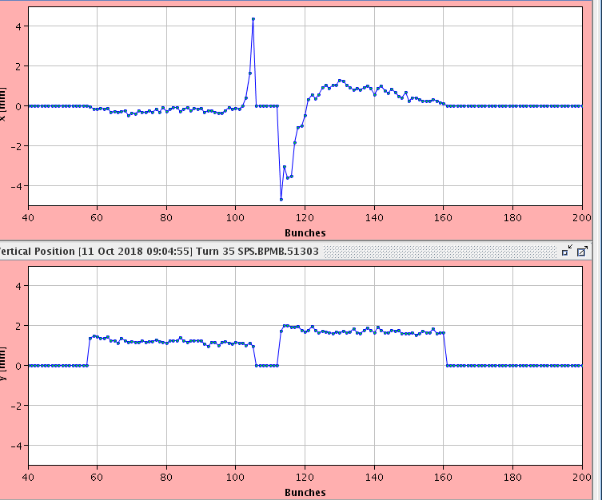
Optimization of MKP delay
Optimum delay settings
Still the last bunch of circulating batch is kicked by about 4 mm …
But clear improvement on transmission of last bunches

Slide 12
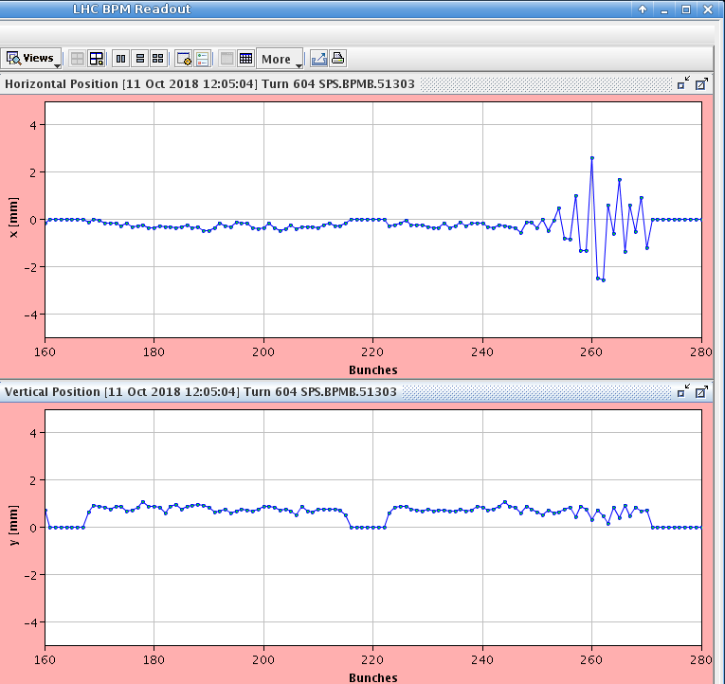
Studies with chromaticity step
Lots of data taken to characterize instability – to be analyzed in detail
First 3 batches with high chromaticity to maintain stability, then reduced just before last injection
Clear observation of instability with LHC BPMs, headtail monitor, wirescanners
Optimized damper settings (tune acceptance, delay at 20 MHz)
Managed to stabilize up to about 2e11 p/b, above this also coupled bunch patter visible
Chroma step
LHC BPM
ADT
3rd batch
4th batch
rise time of a few hundred turns

Slide 13
Summary
Horizontal instability is encountered at SPS flat bottom
With multiple closely spaced batches of 25 ns beam above 1.8e11 p/b
“Mild” losses observed on BCT, but unstable bunches have important losses and huge emittance
Optimization of MKP delay critical to avoid exciting last circulating bunches
Stabilization by chromaticity alone results in too high (incoherent) losses
Octupoles (with negative KLOF) help to stabilize the beam up to about 2e11 p/b
Still a big step to 2.6e11 p/b
Next steps
Refine data analysis
Gerd will try to commision the horizontal wideband feedback (exponential pickup used as kicker)
Will try to perform measurements with horizontal WBFB in one of upcoming MD slots

